Slide 1
Analysis and design of HW/SW electronic systems for Mu2e data acquisition
Supervisors:
Ryan Rivera, Antonio Gioiosa, Micol Rigatti
Marco Ferrini
Midterm Presentation
08/29/2022

Slide 2
Mu2e – explained by an engineer
Mu2e has been designed and is currently being constructed at Fermilab to search for the neutrino-less muon conversion to an electron in the field of an aluminum nucleus

Slide 3
TDAQ – Trigger and Data Acquisition
ROCs – Readout Controllers: digitize and zero suppress data at the detectors and transmit them over optical links to TDAQ servers.
DTCs – Data Transfer controllers: provide an interface between the Mu2e ROC modules and the TDAQ servers.
CFO – Command Fan Out: provides an interface between the Run Control Host and the DTCs spreading the clock signal.

Slide 4
TDAQ – Beam structure
Supercycle: the temporal window between two proton beams. Beam is delivered to the detector during the first 467ms of each supercycle
Spills: proton pulses delivered to the target in the Production Solenoid. Each spill contains approximatively 32000 µBunches
µBunches: the temporal windows between two proton poulses (1695ns)

Slide 5
TDAQ – Timing
The Run Control Host receives the
RF-cavity 0-crossing Marker from the Accelerator which is synchronous with the arrival of protons pulses every 1695ns
The Run Control Host generates a continuous System Clock with the frequency of 40MHz.
The System Clock is encoded indicating the start of the Mu2e event window

Slide 6
TDAQ – Clock distribution
The clock is distributed sequentially from the CFO to the DTCs.
Distribution is through a loop that allows the CFO to control phase and frequency of the return signal.
Each DTC forwards the clock signal to each attached ROC ring link.
The system clock is not guaranteed to arrive to all detector ROCs phase aligned. Phase alignment at individual ROCs is accomplished by an adjustable delay at the ROC clock input.

Slide 7
DTCs loss of lock
There are troubles in the synchronization of the DTCs:
Along the distribution loop the DTCs were accumulating too much jitter so the signal back to the CFO was not in phase
  An RTF has been added to have parallel distribution of the clock to the DTCs
The DTCs can’t lock on the clock signal
  Updating the firmware of the RTF and DTCs to improve the clock signal quality.
In the last test the DTCs stayed locked for 3 days

Slide 8
Artdaq
Artdaq is a toolkit of C++ 2011 libraries and programs for use in the constructions of TDAQ systems.
Basically, it provides scalable, low-cost data acquisition architecture as a service.
It provides functionality that includes the following:
Configuration of the TDAQ HW
DAQ control and monitoring
Event analysis and filtering using the art event-processing framework.
Encapsulation of the data and support for experiment-specific raw data formats to provide type-safe data access

Slide 9
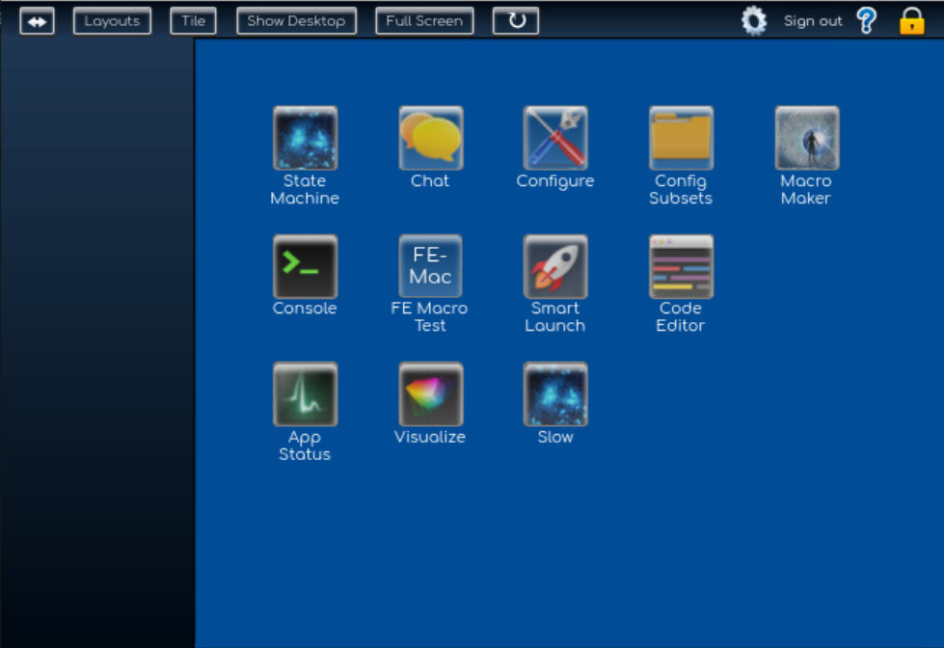
Otsdaq – Off-The-Shelf data acquisition
Otsdaq is the online DAQ software framework that Mu2e has chosen.
Otsdaq uses the artdaq framework providing a web interface to configure, control and monitor the online DAQ software entities.

Slide 10
Configuring otsdaq
Configuring the electronics from otsdaq takes a lot of time.
In order to speed the process up, the following procedure was necessary:
Printing out every writing access to the DTC’s registers
Understanding the configuration process step by step
Deleting what is not necessary

Slide 11
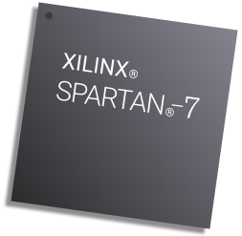
Firmware Porting from Spartan-6 to Spartan-7
The CRV front end electronics are in production phase.
Since the FPGAs the firmware were developed on are out of production, the porting to the newer model is necessary

