Slide 1
Short Baseline Focus Group
22 May 2012

Slide 2
TOWARDS CONCLUSIONS & RECOMMENDATIONS
Over the last year the community interest in searching for sterile neutrinos has greatly increased. This is largely because, in addition to the LSND/MiniBooNE effects, there are also the reactor and source anomalies, and they are all associated with the same range of L/E. In addition there are the cosmological hints.
Although all of the anomalies may be due to statistical and/or systematic effects, there is a chance that we are seeing an emerging discovery, and there is competition with reactor- and source-experiments to see if this is the case.
The reason to do more SBL experiments at FNAL is because there is a chance of discovery. If Fermilab is to enter the competition to see if the tensions with 3 flavor mixing are due to new physics, it should do so seriously, and support experiment(s) that maximize the chance of discovery in the face of the competition.

Slide 3
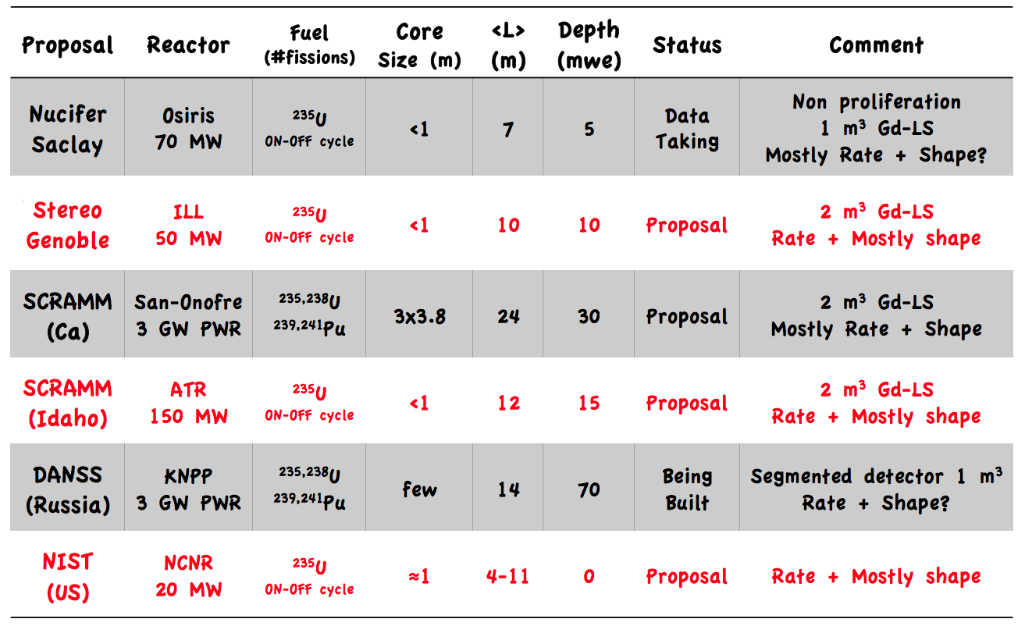
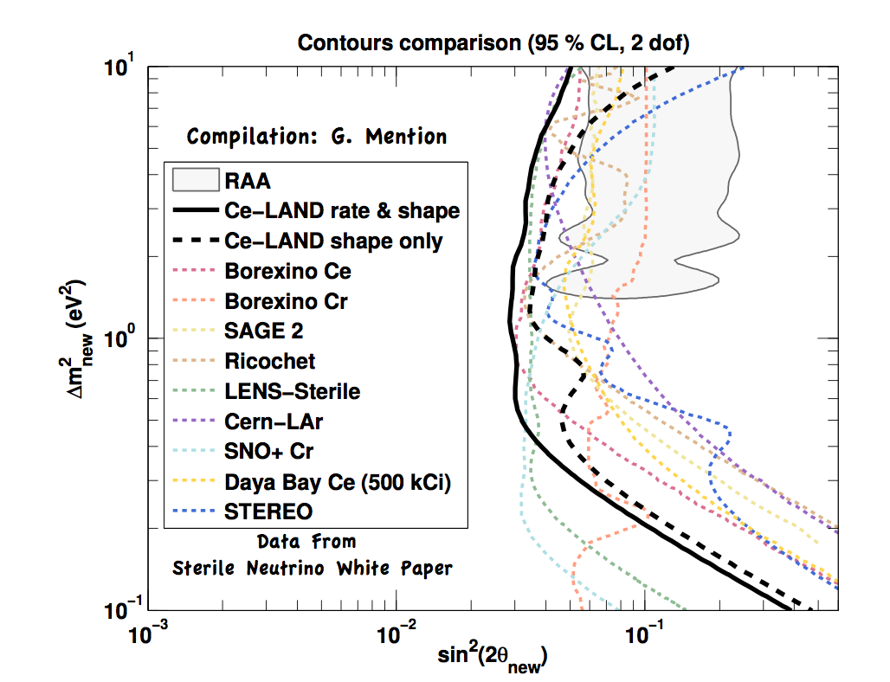
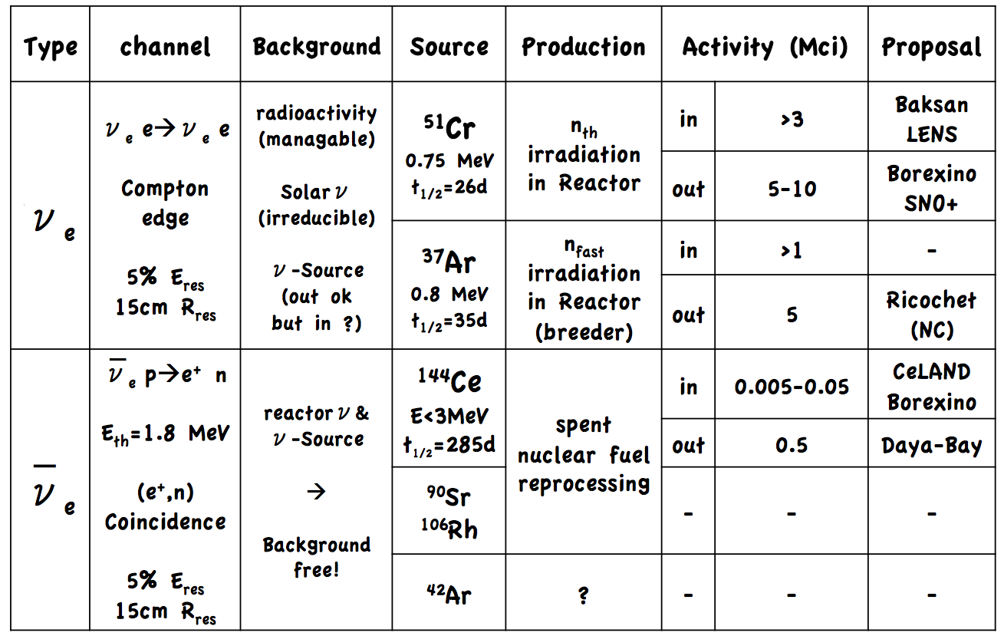
THERE IS COMPETITION

Slide 4
FAST vs COMPREHENSIVE
EMERGING
DISCOVERY
NO NEW
PHYSICS
AGGRESSIVE FNAL PROGRAM TO BE FIRST
WITH A CONVINCING 5σ DISCOVERY
TIMELY & DEFINITIVE FNAL PROGRAM TO
LAY THE LSND &
MINIBOONE ANOMALIES TO REST
FAST
cover as much parameter space as you can on a competitive timescale
COMPEHENSIVE
cover all of the parameter
space definitively
We don’t know which of these worlds we are in, so perhaps we need a dual strategy that has BOTH a fast experiment and a comprehensive experiment.

Slide 5
HOW FAST CAN WE GO?
 | FNAL Stage I | FNAL Stage II | Begin Data taking
MINERvA | April 2005 | July 2007 | March 2010
MicroBooNE | July 2010 | May 2012 | 2014
HENCE, ASSUME 5 YEARS FROM STAGE I APPROVAL TO
DATA TAKING

Slide 6
STRAWPERSON TIMELINE
05 | 06 | 07 | 08 | 09 | 10 | 11 | 12 | 13 | 14 | 15 | 16 | 17 | 18 | 19 | 20 | 21 | 22 | 23 | 24 | 25 | 26 | 27
5 years
Run
Run
MINERvA
4 years
Run
6 x 10²⁰ POT
MicroBooNE
Experiment using PIP
Approval &
Construction
Run
Experiment using PX Stage 1
Approval & Construction
Run
RESULTS
MiniBooNE
+ SciBooNE
Final
Planck
MicroBooNE
MINOS+

Slide 7
CALL FOR PROPOSALS ?
Several promising experimental ideas have been proposed to explore the LSND/MiniBooNE preferred region of sterile neutrino parameter space. These ideas are in various states of development.
Possible recommendations:
A call for proposals so that all the proposed ideas can be evaluated by the PAC at one time, and recommendations made.
The criteria for evaluating the proposals should include the region of sterile neutrino parameter space for which a discovery at 5σ can be made for a given running period.
The criteria should also include (i) the expected background rates and the uncertainty on these rates, (ii) the expected systematic uncertainties, and the uncertainty on these uncertainties, (iii) the possible upgrade path that could be pursued if there is a discovery.
If no single proposal enables a FAST + COMPREHENSIVE result, then a dual strategy should be followed in which both a fast experiment and a slower more definitive experiment are pursued in parallel.

Slide 8
THE PROPOSAL LIST IS NOT EMPTY
FNAL-relevant proposals / ideas presented to the group, in random order:
LArLAr
Muon Ring (nuSTORM)
RICOCHET
nu-tau appearance
2 dets * 2 beams
?????
We could also list anything that might help each of the proponents in preparing to make the best case they can (Example: engineering study to understand cost and performance of the muon ring).

