Slide 1
Computing Consortium Organization
H Schellman
August 2022

Slide 2
Now 2 - ½ day workshops
https://indico.fnal.gov/event/55942/
Talks by early career collaborators
See where we are on multiple projects
We need to report to DOE on what we are doing
  Annual reports are due in early January
Further in the future
  actual meeting (in Oregon? At the actual dunes? )

Slide 3
US Consortium – (why we are here today)
In March 2020 US collaborators submitted a proposal to DOE
  “Essential computing and software development for the DUNE experiment”
Originally 10 institutions, 3 were working on advanced pattern recognition and were not funded.
Now have 7 – funding arrived at OSU 9/29/2021 – got through the paperwork 2 months later. But fiscal year starts on 5/1/2022….
Argonne, Brookhaven, Colorado State, Fermilab, Minnesota, Oregon State and Wichita State
Already done a lot – report here
We need to complete what we said we would do and apply for longer term funding over the next year.

Slide 4
DOE guidance
Priority should be given to Task 1 (Data bases), within Task II (Frameworks and data structures) to data modeling, data discovery, and signal processing, and within Task III (Common Software, Training, Standards and Infrastructure) to build systems and code standards.

Slide 5
Task I - Databases
BNL – Paul Laycock, Lino Gerlach, conditions database
CSU = Norm Buchanan, Ana Paula Vizcaya Hernandez
Minnesota – Hajime Muramatsu, Marvin Marshak + Alex Wagner
FNAL - Brandon White, Steve White, Igor Mandrichenko, Vladimir Podstavkov

Slide 6
Task II - Data model (large and small scale)
Large Scale (FNAL and BNL)
  MetaCat (Igor Mandrichenko)
  Data Dispatcher (Igor M. , Steve Timm)
  Hardware/production systems (Kirby, Ken Herner)
  Rucio (Doug Benjamin, Steve Timm, Robert Illingworth, FNAL team)
Small Scale (ANL, BNL, CSU, FNAL, OSU)
  HDF5 and decoding -- Barnali Chowdhury, Amit Bashyal, Peter Van Gemmeren, Tom Junk, Kurt Biery, Saba, CSU postdocs, Jake Calcutt, David Adams, Brett Viren, Doug Benjamin

Slide 7
Frameworks
This is intertwined with event model and with ND integration
  FNAL ( Kyle Knoepfel, Chris Jones, Andrew Norman and Tom Junk)
  BNL (Paul Laycock, Brett Viren)
  Argonne (Barnali Chowdhury and Amit Bashyal)
  OSU (Jake Calcutt)
  CSU
  WSU ( ND integration)
  Wirecell people

Slide 8
Task III Code management/build systems/standards
Code management and documentation
  Tom Junk, Jake Calcutt, David Adams
ND integration
  Michael Muether, Palash Roy
Ongoing training and documentation work
  Ken Herner, Claire David, Mike Kirby, Tom Junk … and Dave DeMuth
  HMS is now part of a second DOE graduate training grant!

Slide 9
Overall organization of DUNE offline
Consortium
Sites
Collaboration
Project management
Core software development
Core operations
Interfaces to DUNE consortia
Interfaces to other projects
Training
User support
Storage
CPU
Networking
Algorithms
Operations help
User support
Production group
Validation
Calibrations
New ideas

Slide 10
What problems are we trying to solve
LAr TPC’s have very large trigger records (200 MB for protoDUNE vs. < 10 MB for ATLAS/CMS). Need to be able to access small chunks of data efficiently.
possible SuperNova -> 460 TB of data
New detector technologies
Many subsystems in ND
We’re supposed to use 75% non-FNAL computing
Keep up with general chaos due to OS/Authentication/architecture/HPC evolution and people being people.

Slide 11
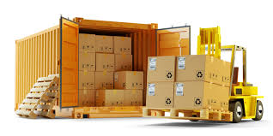
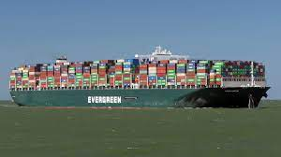
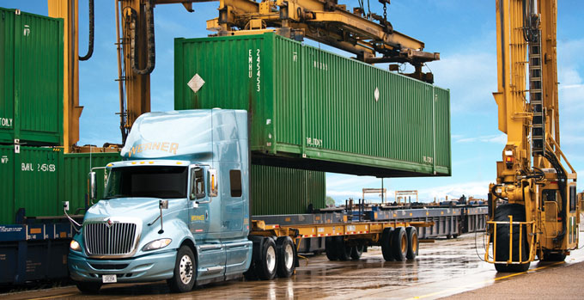
DUNE FD-Data for Supernova
Pack 150 5 ms APA readouts
into a 6 GB file
Ship 20,000 time slices (x 4 modules)
This is ½ module
11
8/29/22

Slide 12
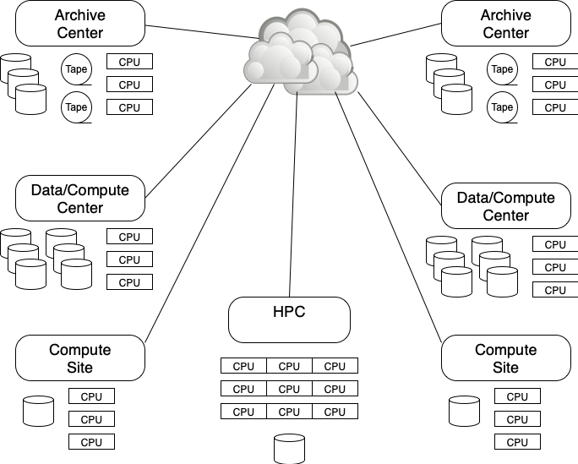
Distributed computing model
Less “tiered” than current WLCG model → DOMA
Collaborating institutions (or groups of institutions) provide significant disk resources (~1PB chunks)
Rucio places multiple copies of datasets
We likely can use common tools:
  But need our own contribution system
  And may have different requirements for dataset definition and tracking

Slide 13
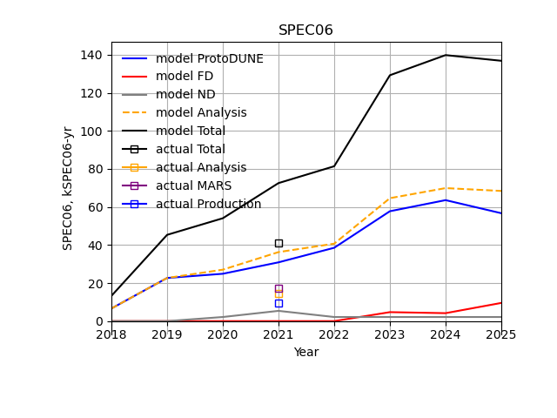
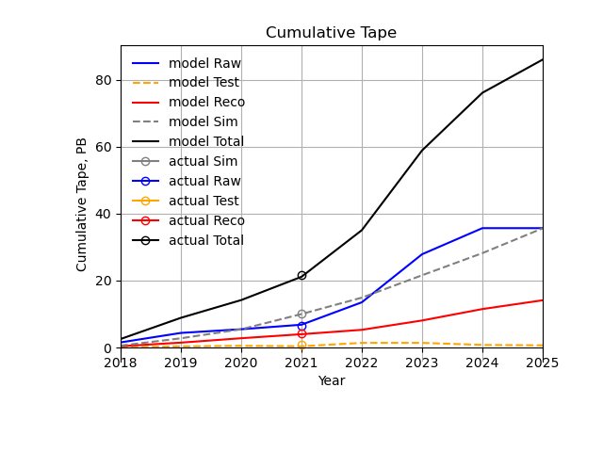
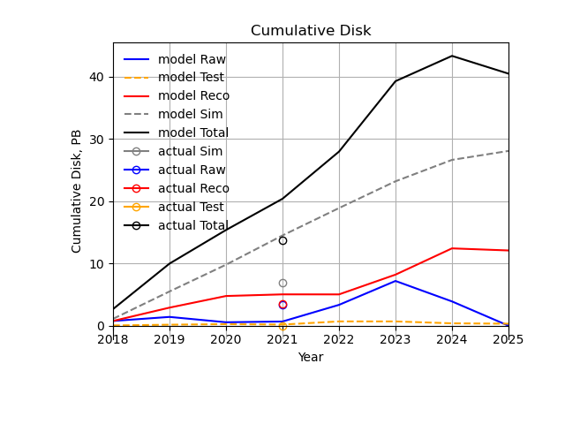
CDR - Resource estimates to 2025
2 copies of raw data on tape (6 months on disk)
1 copy of “test” data stored for 6 months
1 copy of reco/sim on tape
  Currently assume 1 reco pass over all data and 1 sim pass/year
  Assume reco/sim resident on disk for 2 years
Assume 2 disk copies of reco and sim
  impose shorter lifetimes on tests and intermediate sim steps.

Slide 14
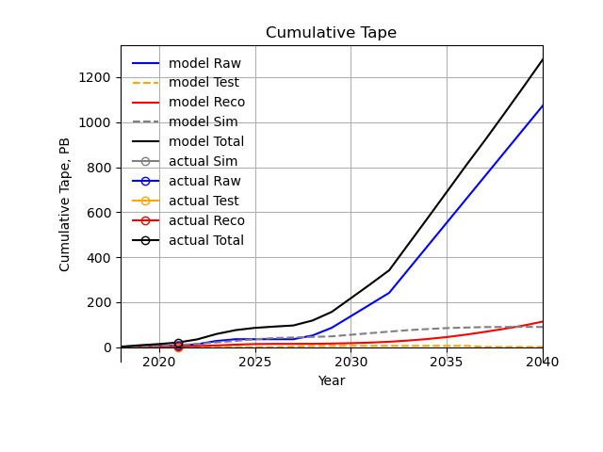
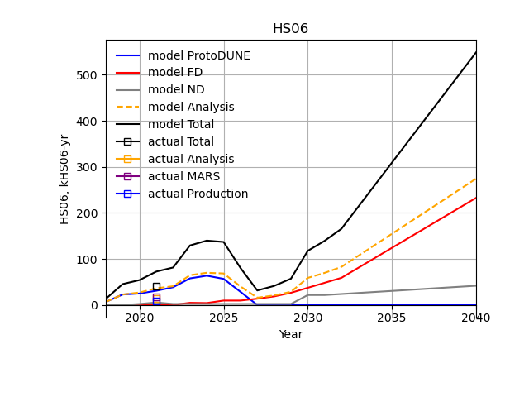
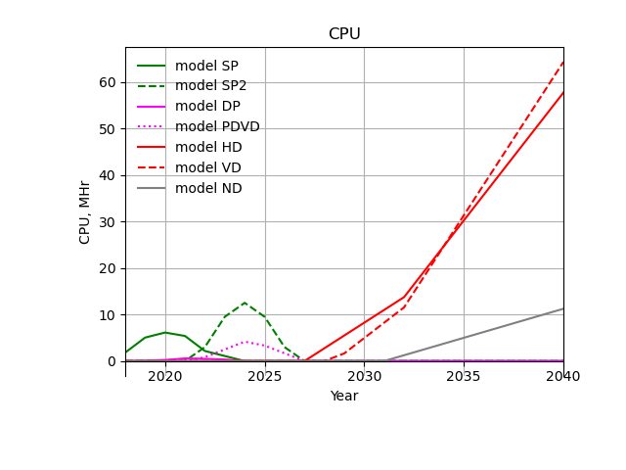
Longer term projections
VD assumed to be similar to HD, raw data may be larger due to longer drift.
2 copies of raw data on tape (6 months on disk)
1 copy of “test” data stored for 6 months
1 copy of reco/sim on tape
  Currently assume 1 reco pass over all data and 1 sim pass/year
  Assume reco/sim resident on disk for 2 years
Assume 2 disk copies of reco and sim

Slide 15
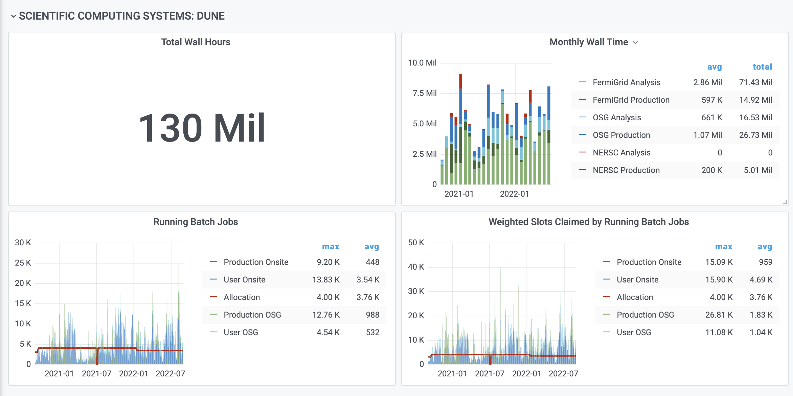

Slide 16
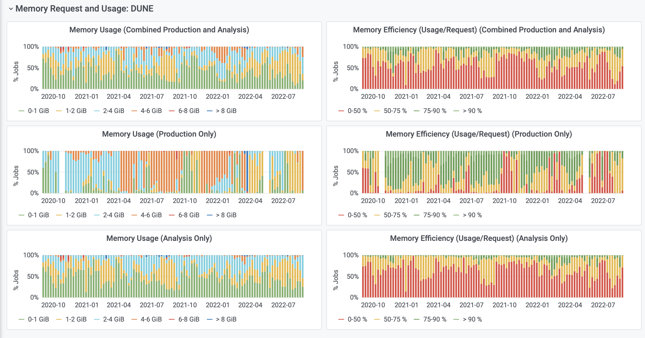
Last 2 years Memory use

Slide 17
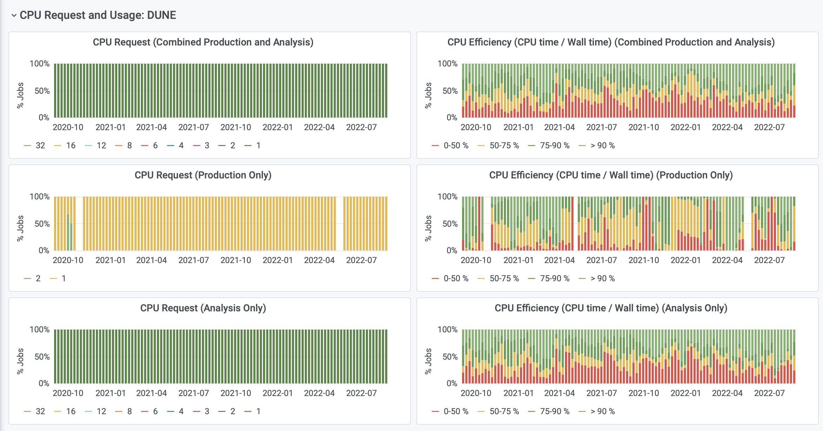
Last 2 years, CPU request use

Slide 18
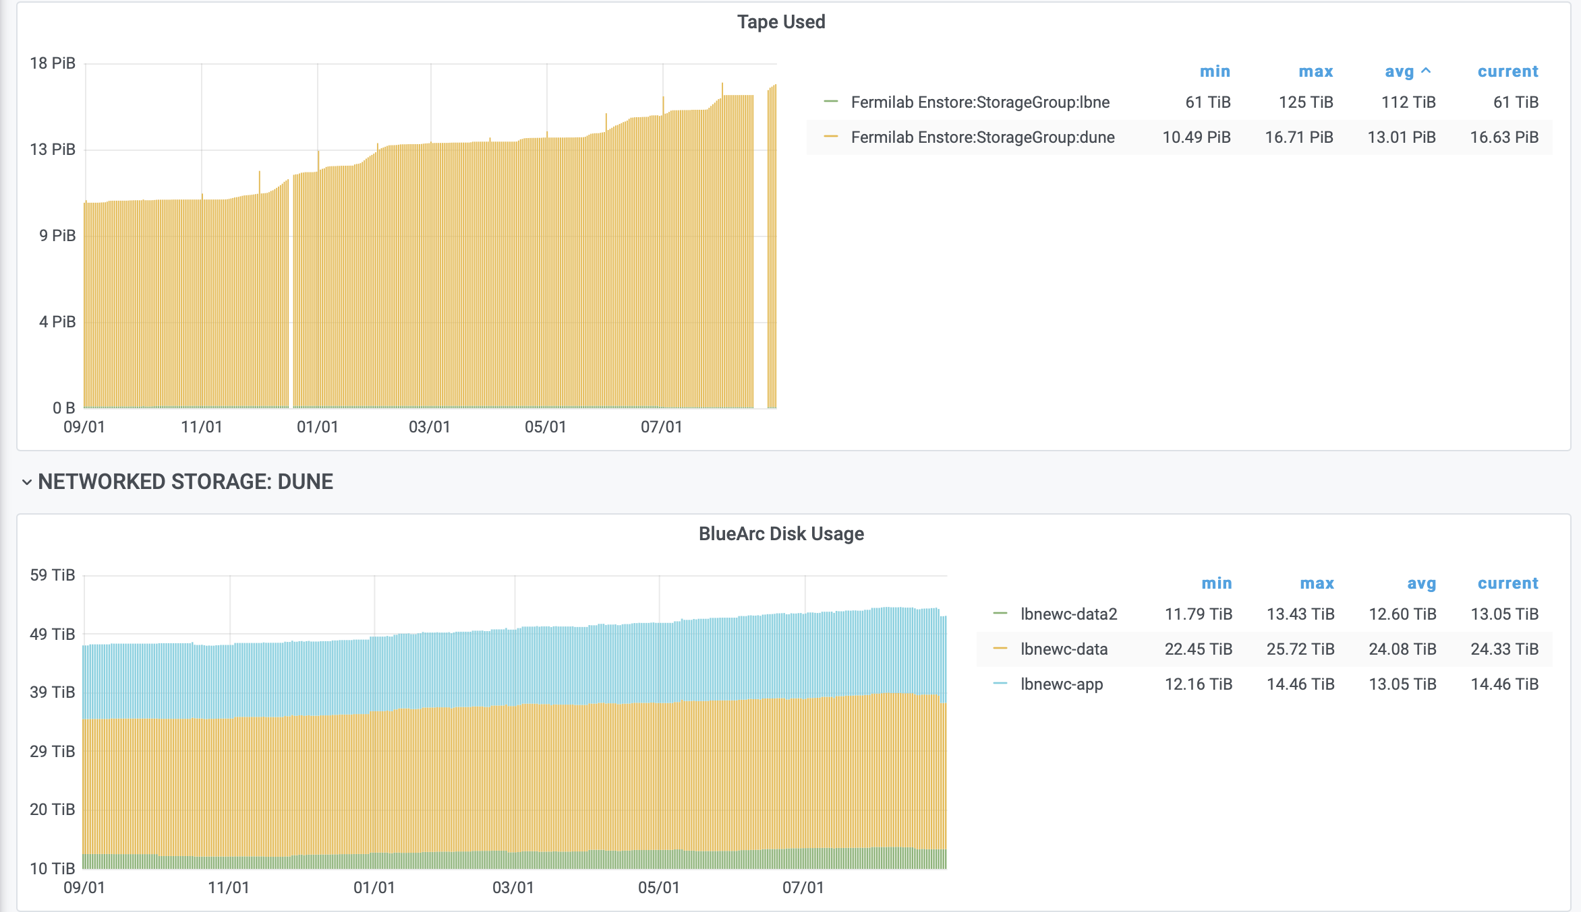
Storage at FNAL

Slide 19
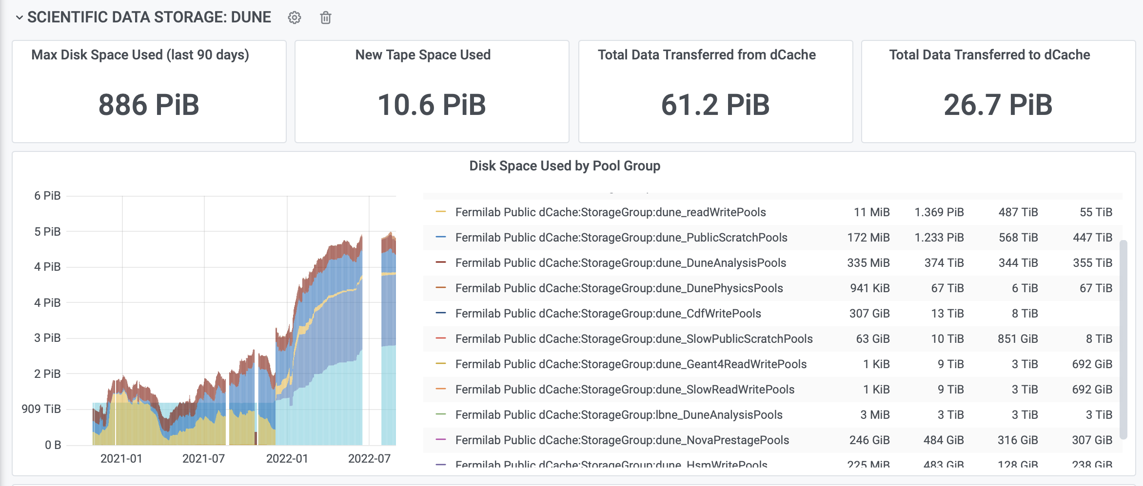
Storage at FNAL

Slide 20
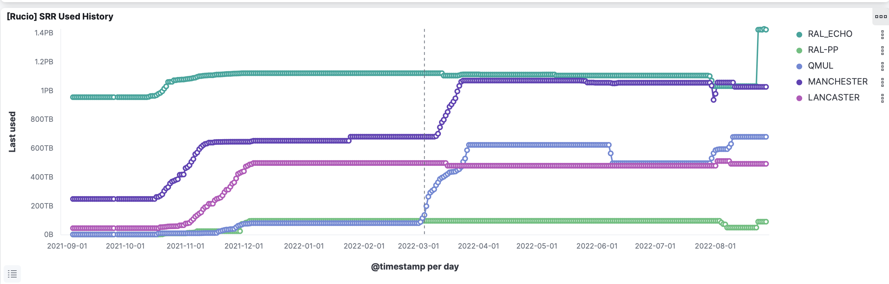
Moving Data to Europe
FNAL, BNL, Edinburg + OSU testing

Slide 21
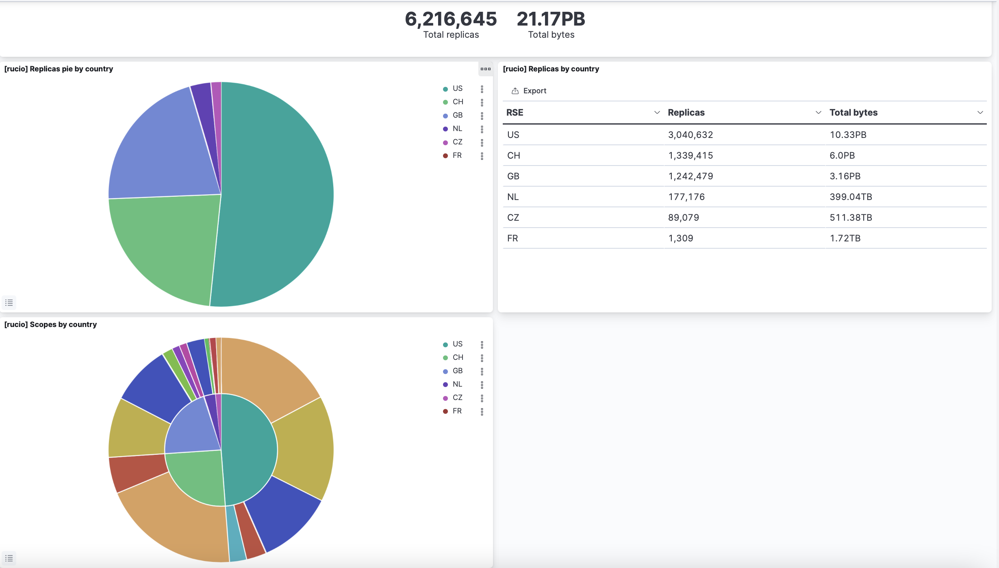

Slide 22
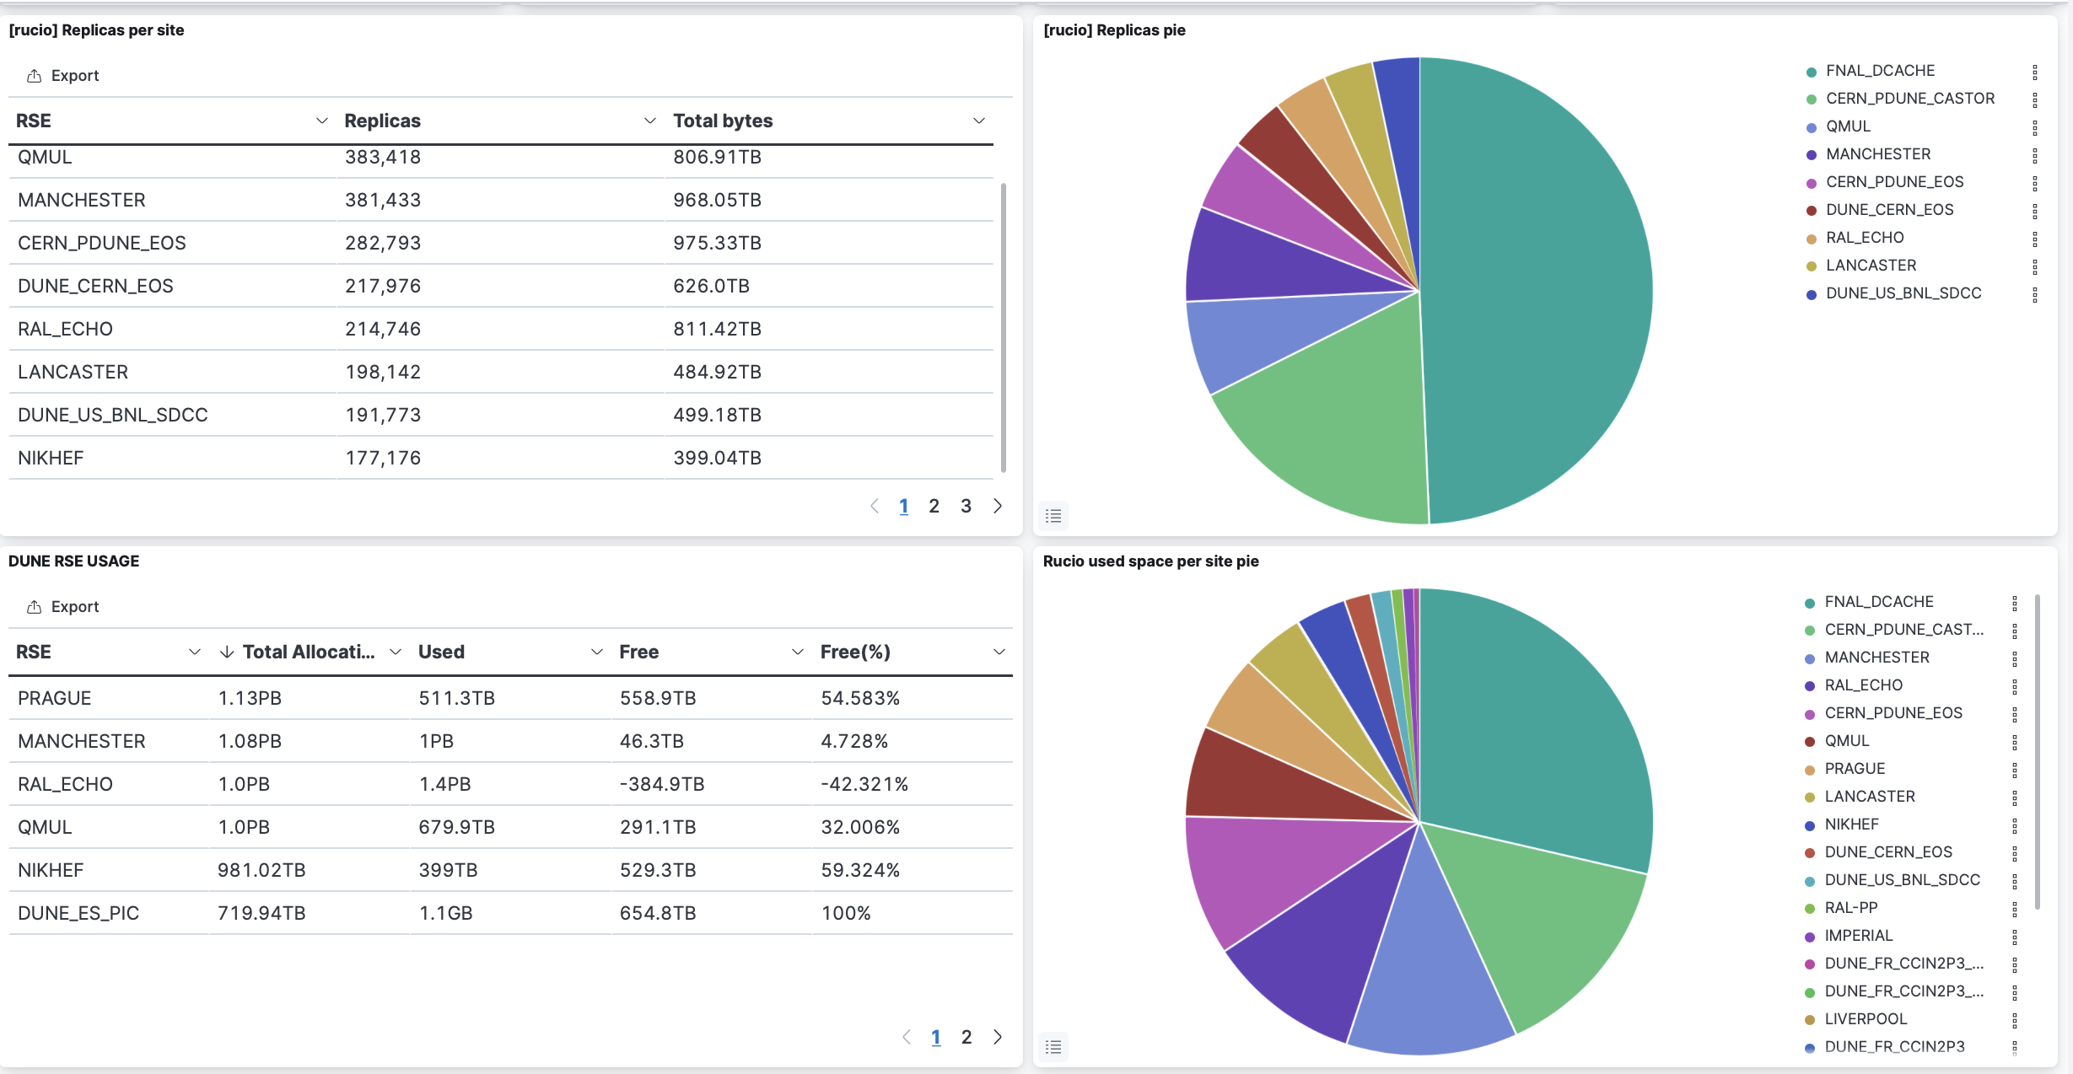

Slide 23
Short term efforts
Test Rucio/Metacat/DataDispatcher for ProtoDUNE data taking
Process data from coldboxes using new production interfacedto Rucio/Metacat/DataDispatcher
Work on HDF5 read/write/sim
  UK groups will test the Workload Manager
Improve monitoring
Configuration and slow controls → Conditions DB
Integrate offline calibrations
Support ProtoDUNE II running and analysis
Long term efforts
HPC integration
Framework improvements
Continue to integrate hardware databases
Stay on top of OS/authentication/Spack evolution
Work with DOE/NSF for multi-decade operations program

Slide 24
FTE estimate. Does not include shared facility (storage etc.) costs
Some effort (mainly operations – pastels at top) can be trained collaboration physicists.
Rest requires experts
Currently have around 14 FTE experts (FNAL + collab), all in-kind contributions except UK DUNE funded personnel and DOE.
Expert need is greatest for ProtoDUNE 2 and pre-operations in 2024-2028.
DOE and UK funding

