Slide 1
Lab 6 Polystyrene Polymer Tests (cont.)
Brian Leung

Slide 2
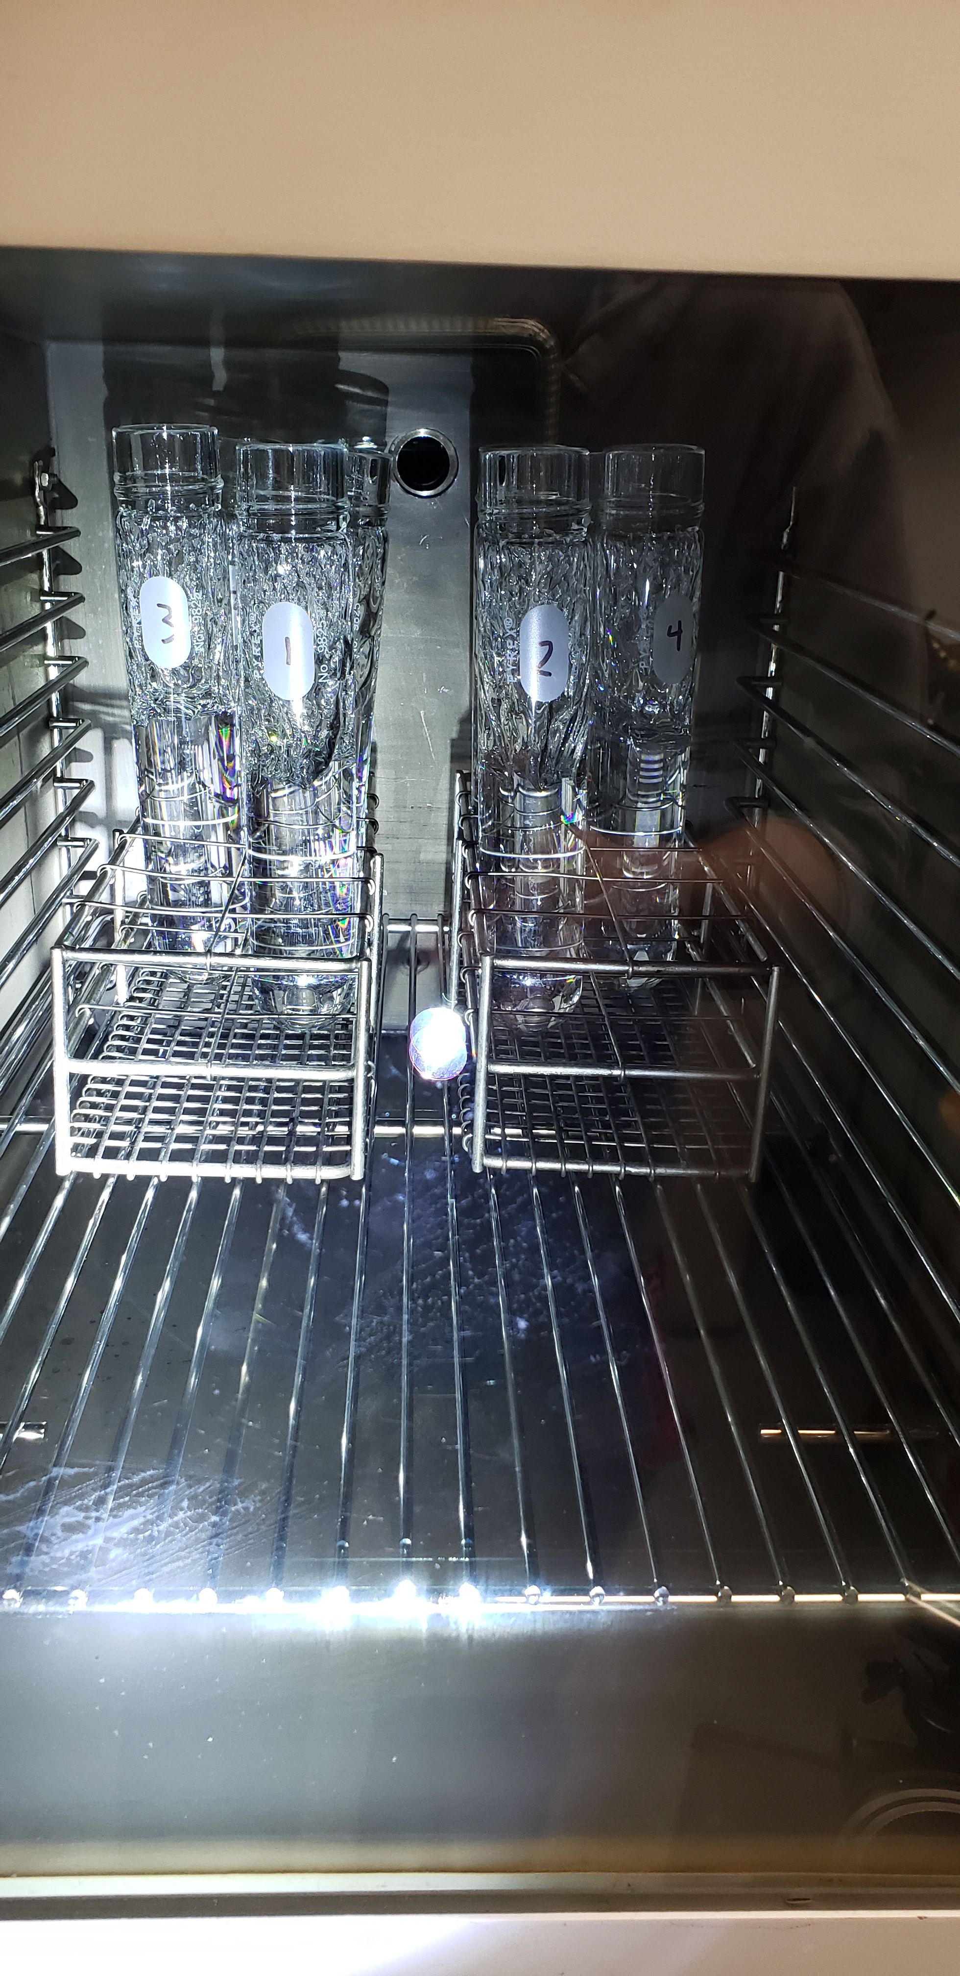
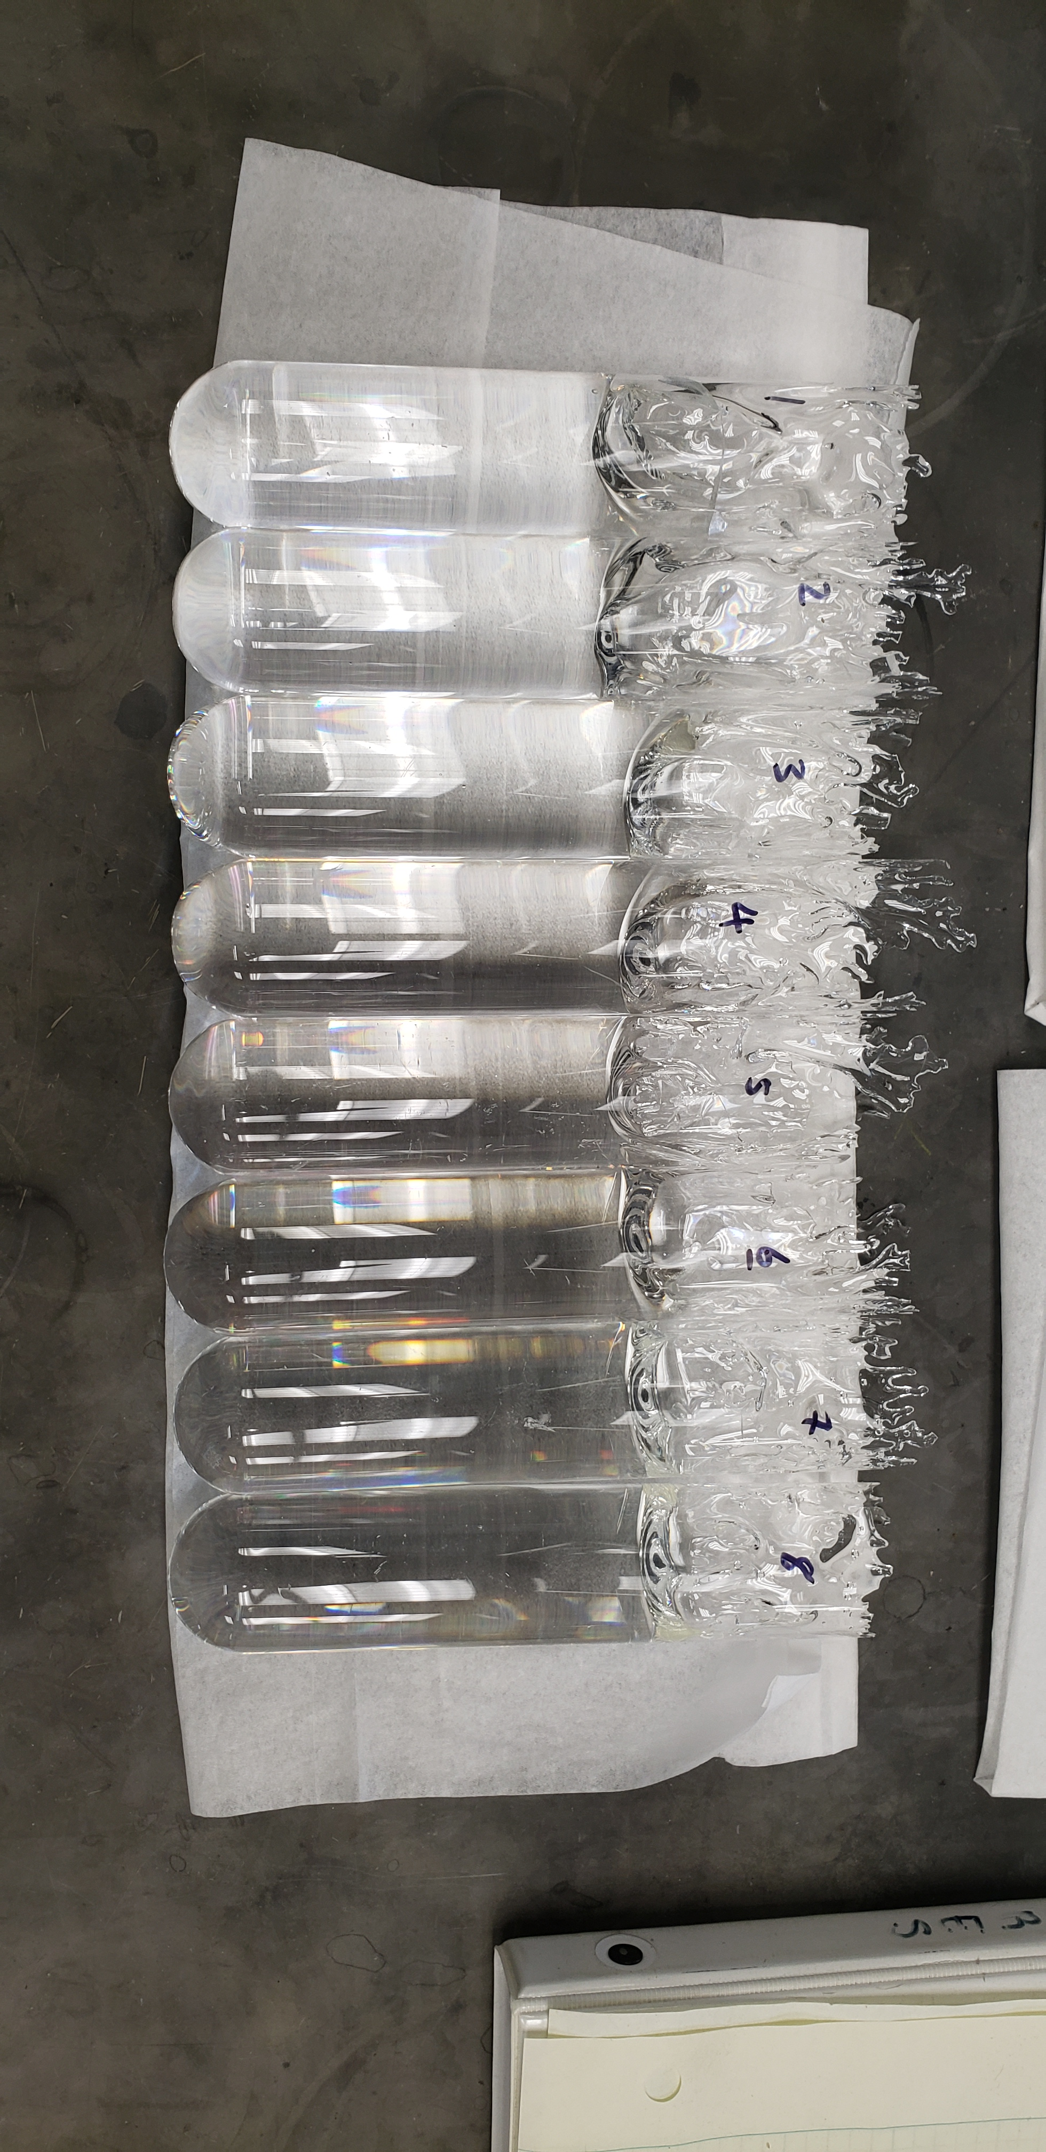
Oven Run PS Pellet Casting

Slide 3
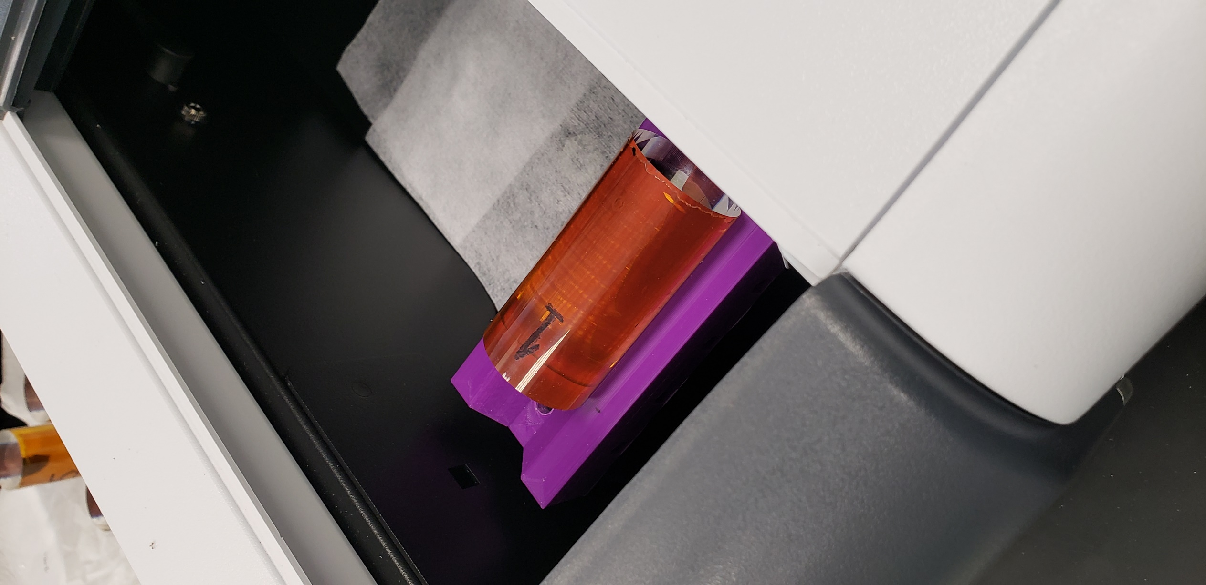
Oven Run Sample Measurements
Measurements performed using: Agilent Cary 60 UV-Vis Spectrophotometer

Slide 4
Oven Run Samples
AmSty 665
INEOS 1200
INEOS 153F - Germany
Hyundai G144 - Korea
LG Chemical 25SPI - Korea
Kumho GP125 – Korea

Slide 5
Oven Run Samples:
Oven Run 4/22
AmSty 665
INEOS 1200
INEOS 153F – Germany
LG Chemicals 25SPI – Korea*
*Sample pellets half the size of other pellets, overflowed during Melt Cycle, only able to cut/polish into 5cm lengths
Oven Run 5/22
AmSty 665
Hyundai G144 - Korea
Kumho GP125 - Korea
**Unless noted, samples made of pure PS pellets (no dopants) and cut/polished into 7cm lengths

Slide 6
LG Chemicals 25SPI vs. AmSty 665

Slide 7
Previous Oven Runs 1/22 & 2/22 – AmSty 665
Older AmSty 665
Newer AmSty 665
*All samples cut to 7cm

Slide 8
Oven Run 4/22 – AmSty 665, INEOS, LG Chemicals
INEOS 153F
AmSty 665
LG Chem 25SPI
*Compared to Newer AmSty 665, all samples cut to 7cm, except LG Chem 25SPI

Slide 9
Oven Run 5/22 – AmSty 665, Hyundai, Kumho
AmSty 665
Kumho GP125
*Compared to Newer AmSty 665, all samples cut to 7cm

Slide 10
Oven Run 5/22 – AmSty 665, Hyundai, Kumho
*Compared to Newer AmSty 665, all samples cut to 7cm

Slide 11
AmSty 665 2021 & 2022 across Oven Runs
*Comparing Newer AmSty 665, all samples cut to 7cm

Slide 12
Various Polystyrene Pellet Brands across Oven Runs
*Compared to Newer AmSty 665, all samples cut to 7cm, except LG Chem 25SPI

Slide 13
Various Polystyrene Pellet Brands across Oven Runs
*Compared to Newer AmSty 665, all samples cut to 7cm, except LG Chem 25SPI

Slide 14
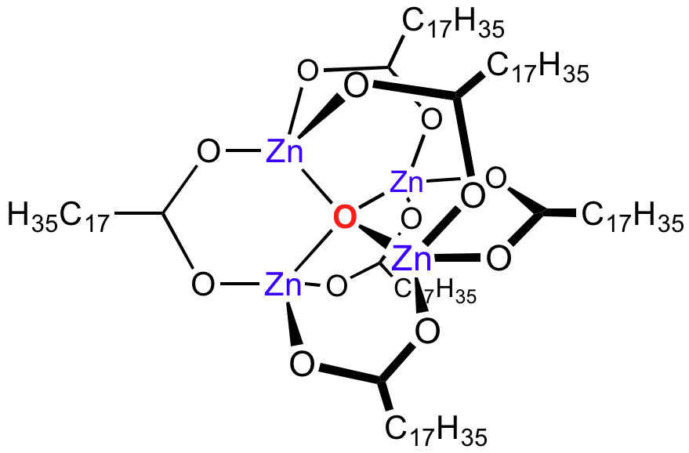
Absorption around 500-600nm
Releasing Agents and Lubricants
Antistatics
Antioxidants
Flame Retardants
UV Absorbers
Zinc Stearate – a common releasing agent in Polystyrene

Slide 15
Upcoming Testing
Additive Testing
Polystyrene Reference from Monomer (Polymerization Run)
Further LG Chemical 25SPI Testing
FTIR Pellet Testing
Additional TiO2 Pellet Casting

