Slide 1
SSR Status Update at Fermilab
SSRs team at Fermilab
August 25, 2022
ALL Partners Coordination Meeting

Slide 2
Contributions from PIP-II/SSR to Linac2022

Slide 3
EPDM for PIP-II/SSRs scope
Engineering Process Documentation Management (EPDM) | Teamcenter No.
Prototype SSR1 | ED0001256
Production SSR1 | ED0011856
Pre-production SSR2 | ED0001257
Production SSR2 | ED0011912
The EPDMs listed contain all the references for the Design, Procurement, Fabrication, Assembly and Testing for all components and subassemblies for the cryomodule.

Slide 4
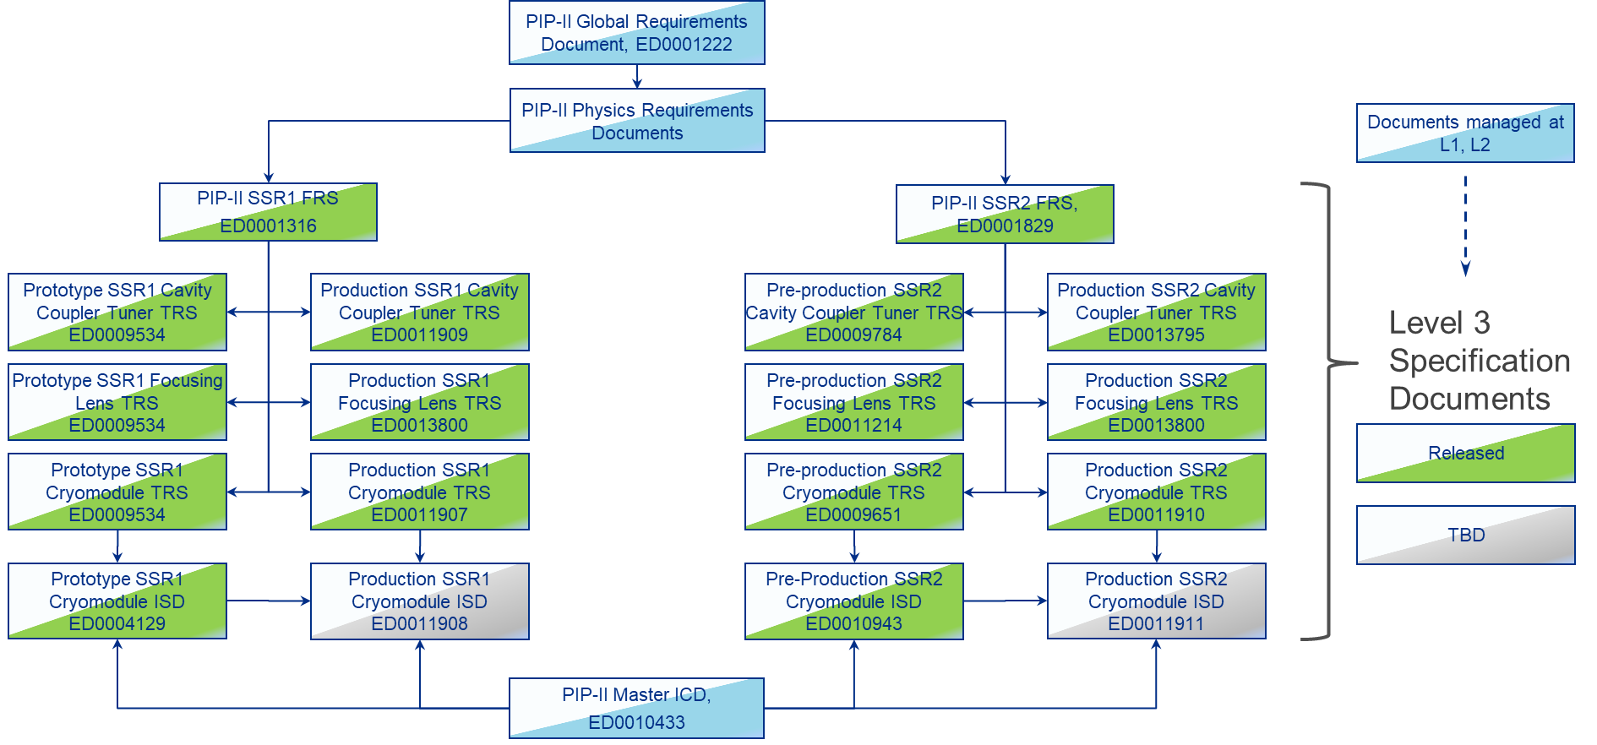
Flow-down of Requirement and Interface Specifications

Slide 5
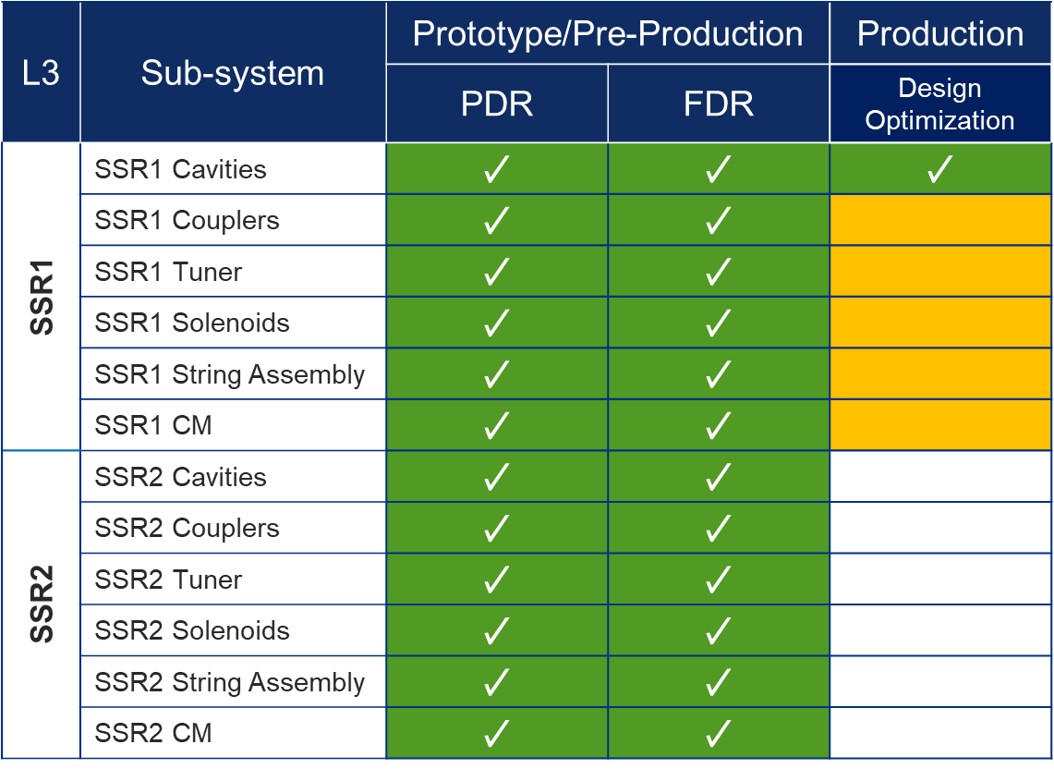
Status of Design Reviews

Slide 6
SSRs Niobium and Cavities
SPM: P. Berrutti
Presenter: M. Parise

Slide 7
Niobium
Production SSR1 Niobium​
- ATI is fabricating the niobium for the 1st production SSR1 CM (1-9 cavities). Coupons arrived at FNAL and tensile testing are performed.
Discussing results with vendor.
Additional Niobium for ppSSR2 (3 more cavities) procurement in ongoing.​

Slide 8
Cavities
ppSSR2 Cavities fabrication​
Fabrication at Zanon is proceeding.
1st cavity is receiving the final light BCP. Next: cleanroom assembly and shipping to IJCLab is planned on Sept. 12
2nd will be back at Zanon for jacketing this month
3rd is ready to be jacketed
- Fabrication of additional 3 cavities has started.
- RI has completed welding qualification

Slide 9
SSRs Solenoids
SPM: M. Turenne/Dino Karas
Presenter: TBD

Slide 10
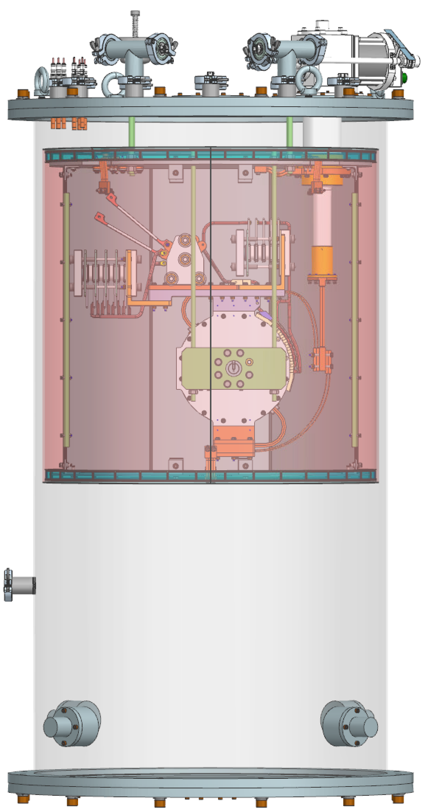
SSR solenoid status update – FNAL activities
New SPM identified: welcome Dino Karas!
Preparation of CoCoLoCo underway
Conduction-Cooled Low-Cost test stand
Current leads, thermal shield, MLI in house and dry fit
Final instrumentation and documentation/safety in progress
First cooldown and zero magnet commissioning is next
OPEN: cryogenic magnetic sensors from Lakeshore delayed; procurement from second vendor in progress
As-built 3D model from BARC received, integration into cryomodule in progress

Slide 11
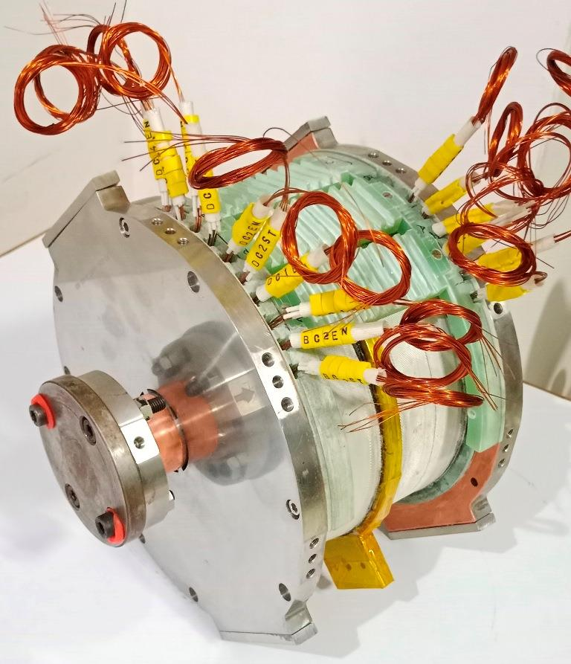
SSR solenoid status update – BARC activities
Parallel testing of prototype 3 and first pre-series magnet underway in 2 separate test stands
Transfer function:
Prototype magnet: ~0.177 T/A
Pre-series magnet: ~0.165 T/A
Difference attributed to different packing factor
New load line calculation in progress
Ramp rate:
Slower than anticipated @ ~0.5-1 A/min
Likely a limitation of the test stand and not the magnet design
To be confirmed/tested at FNAL
Cold DC coil mapping completed
Shipping of first pre-series magnet initiated

Slide 12
SSRs Couplers
SPM: N. Solyak
Presenter: N. Solyak

Slide 13
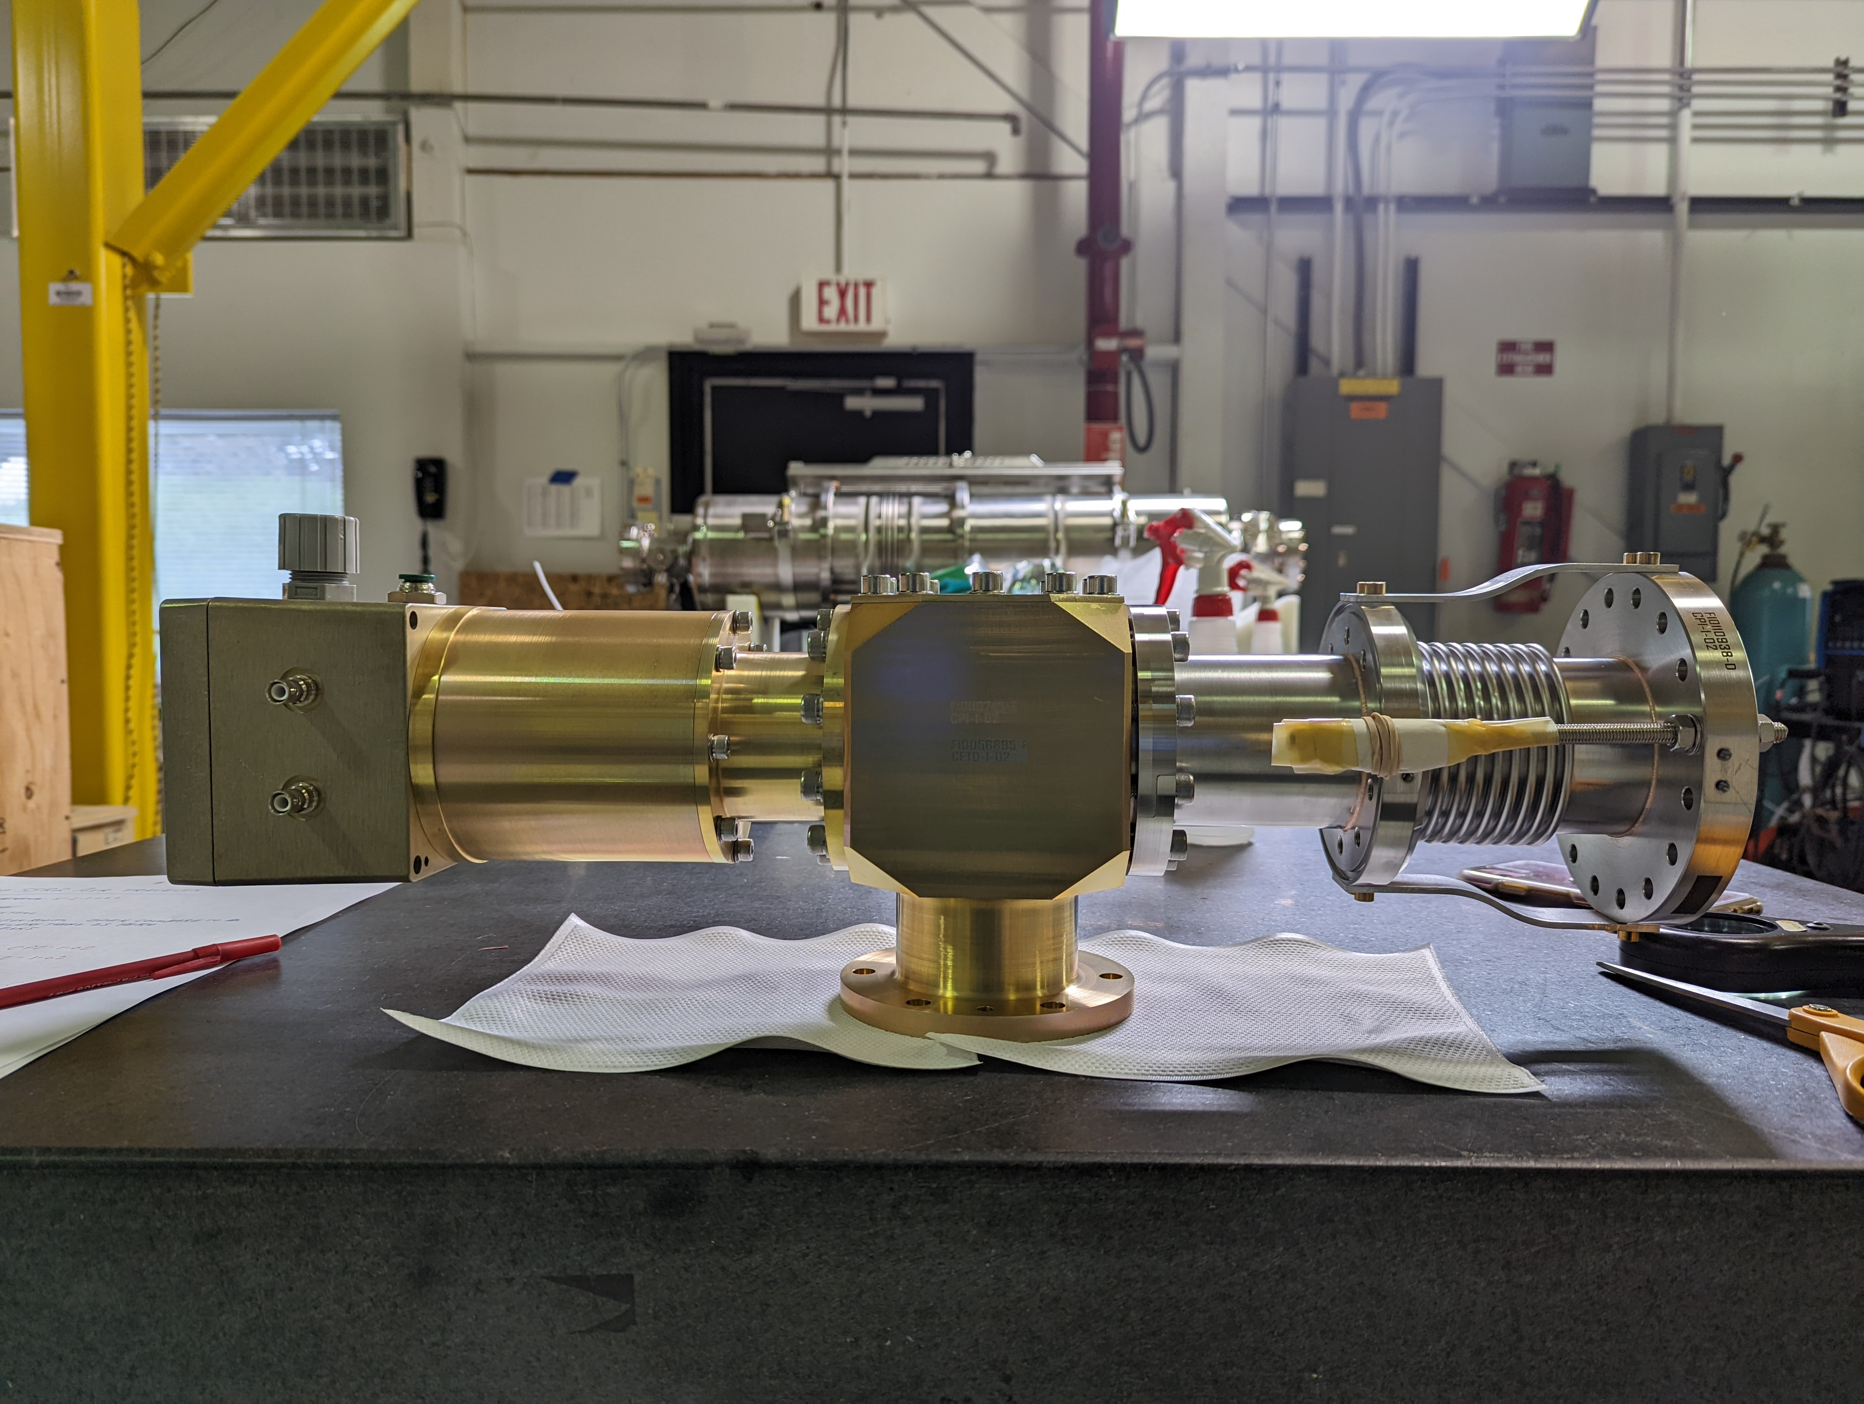
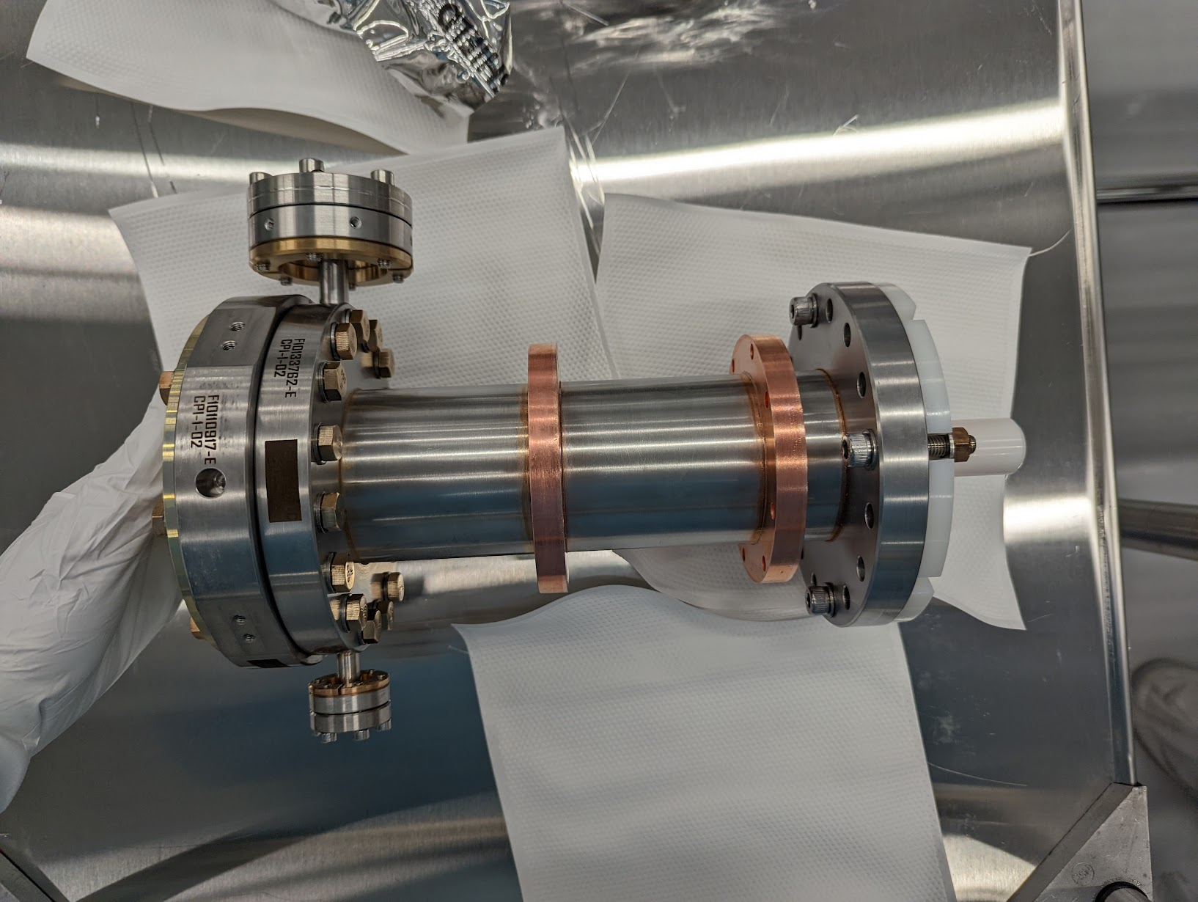
SSR2 Coupler status
ppSSR2 Coupler
3 out of 5 vacuum-end couplers received
5 out of 5 air side coupler accepted and stored at FNAL
Preparing the RF testing of the first 2 couplers

Slide 14
SSRs CM design
SPM: M. Parise Presenter: M. Parise

Slide 15
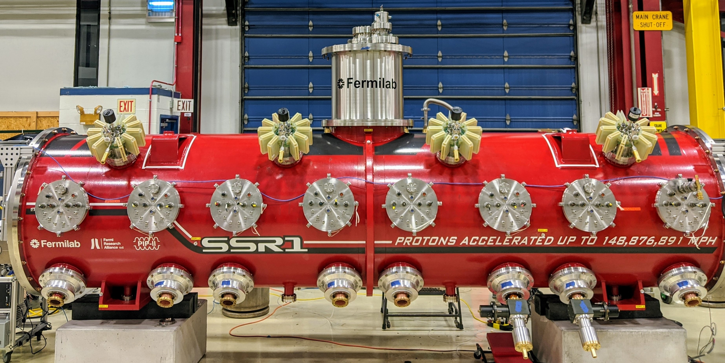
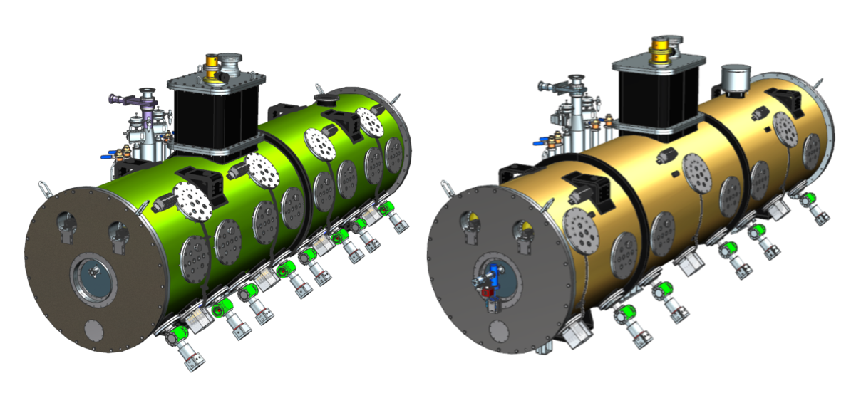
Pre-productionSSR2 CM: F10138829
Production SSR1 CM: F10142933

Slide 16
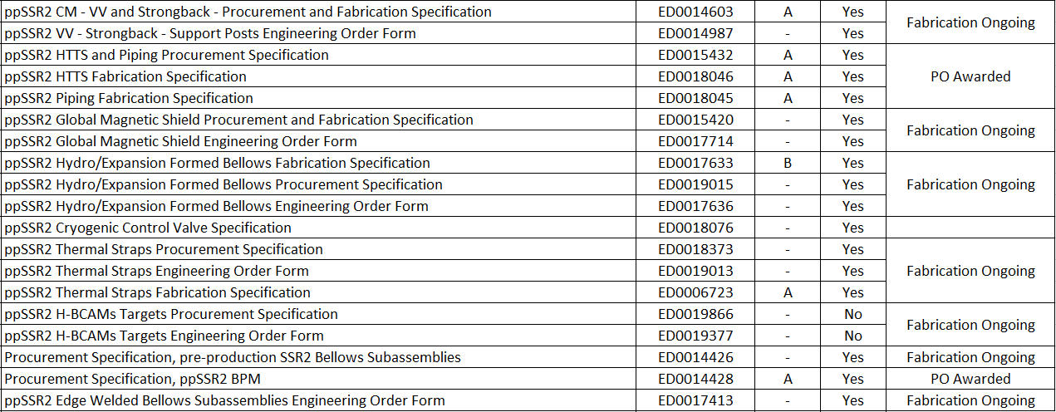
pp SSR2 CM
90+% of the procurement for the ppSSR2 CM was initiated.
Most of procurement and fabrication specification are completed and used to initiate the procurements. Check EPDM, Tab "Cryomodule"
Pre-production SSR2​ | ED0001257​

Slide 17
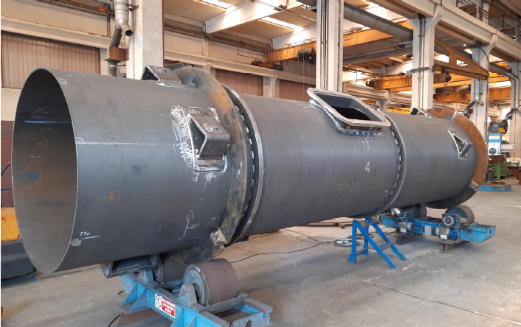
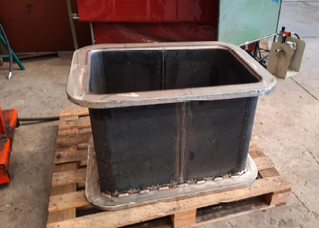
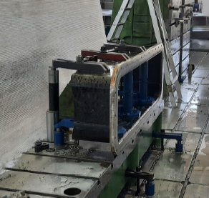
pp SSR2 CM: Vacuum Vessel
Fabrication of vacuum vessel is ongoing
Strongback and support posts’ material are in procurement phase

Slide 18
Action items from previous meetings
BARC: cavities tooling Technical discussion ongoing
BARC: Plan tuner Manufacturing Readiness Review Discussion in progress
Release TRS/ISD for the SSR2 cryomodule Released!!!

Slide 19
Action Items

