Slide 1
IJCLAB status/updates on SSR2 activities
Patricia Duchesne, Sandry Wallon, Nicolas Gandolfo, Longuevergne David
On behalf of PIP-II team at IJCLab

Slide 2
OUTLINE
Progress on SSR2 cavity
Progress on Coupler
Progress on Tuner
Other points

Slide 3
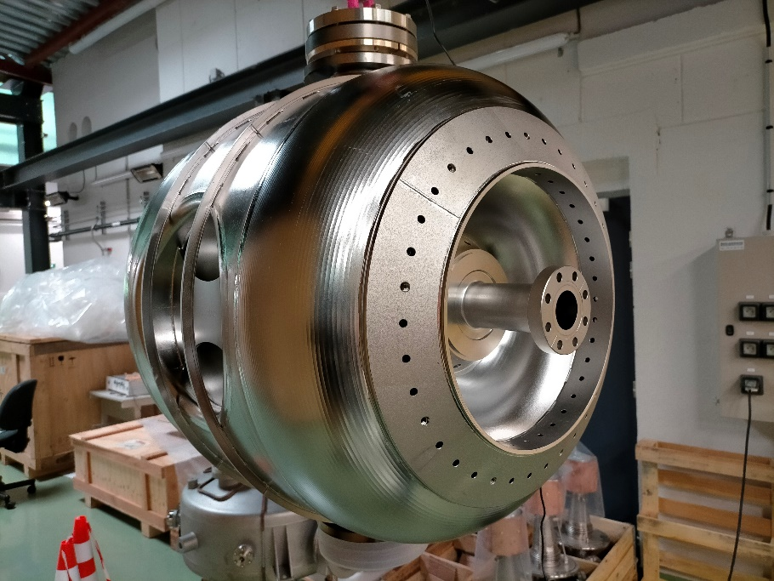
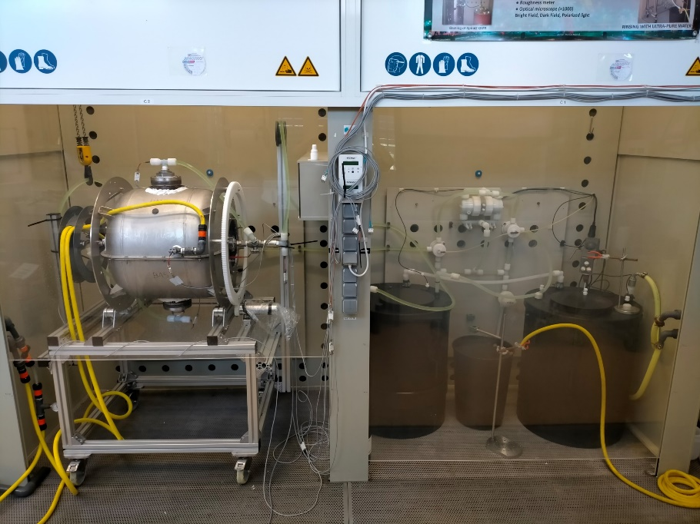
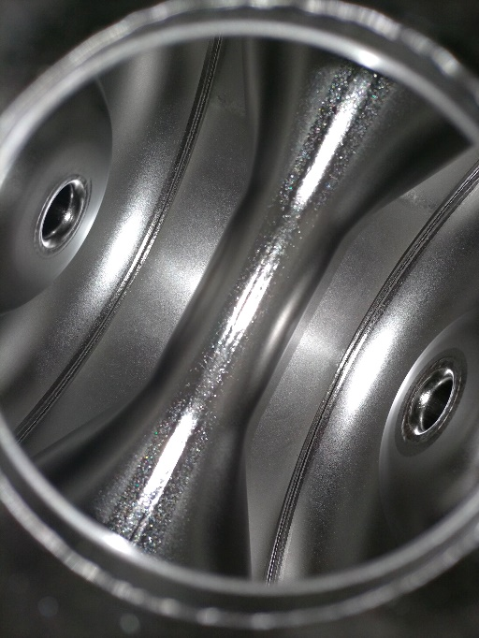
Progresses on cavity prototypes
3 bare cavities fully built @Zanon.
First Prototype has been processed @ Zanon and helium tank has been integrated. Will be delivered @IJCLab ready for vertical test mid of September 2022 after final treatment (BCP, HPR, assembly for VT).
Second prototype delivered @IJCLab in May, BCP treated (rotational BCP commissionning) and shipped back @Zanon for HPR, heat treatment and tank integration the 22nd of August.
Third prototype ready for tank integration. To be delivered for vertical testing in October.
3 additional prototypes being built to be delivered ready for test in 2023.

Slide 4
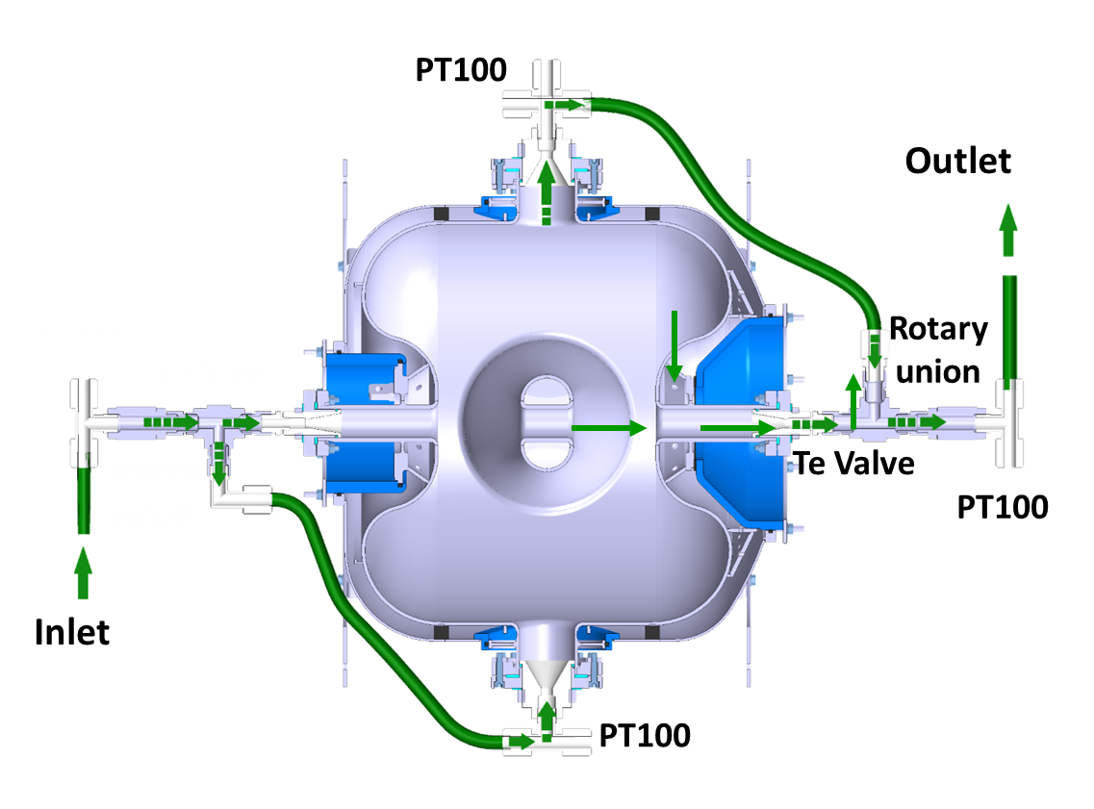
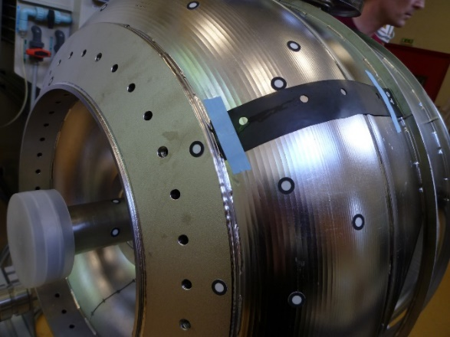
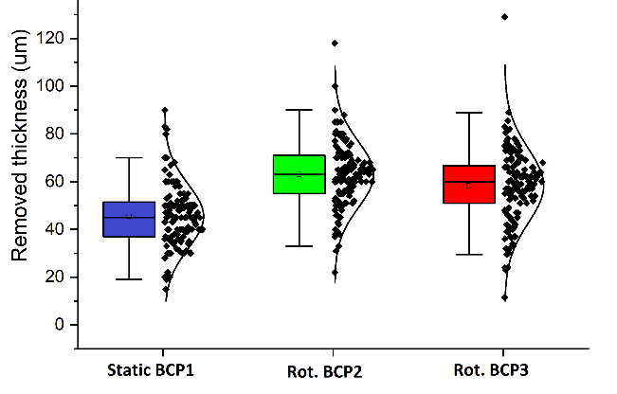
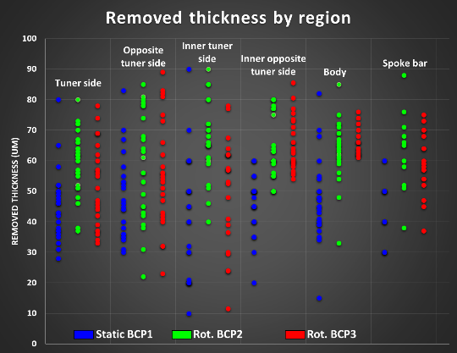
Progresses on cavity prototypes
Analysis of BCP runs (presented at linac2022) :
Parameters | Unity | BCP1 | BCP2 | BCP3
Duration | min | 75+75 | 150 | 150
Rotation speed | rpm | - | 0.5 | 0.5
Niobium concentration | g/l | 11.5 | 2.37 | 6.48
Acid flow rate | l/min | 14.4 | 14.4 | 14.4
Cavity filling | % | 100 | 100 | 100
T° acid set point | °C | 12 | 12 | 8
T° water set point | °C | 9 | 9 | 9
Thickness measurements (~100 data points)
Results | Unity | BCP1 | BCP2 | BCP3
Max acid T° at outlet | °C | 22 | 14 | 15
Weight difference | kg | 0.6 | 0.78 | 0.815
Average removal | µm | 48.4 | 62.9 | 65.7
Etching rate | µm/min | 0.32 | 0.42 | 0.43
Frequency shift | kHz | -1.75 | -17.1 | -13.5
Etching sensitivity | kHz/µm | -0.04 | -0.275 | -0.208

Slide 5
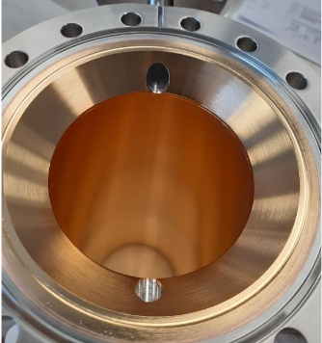
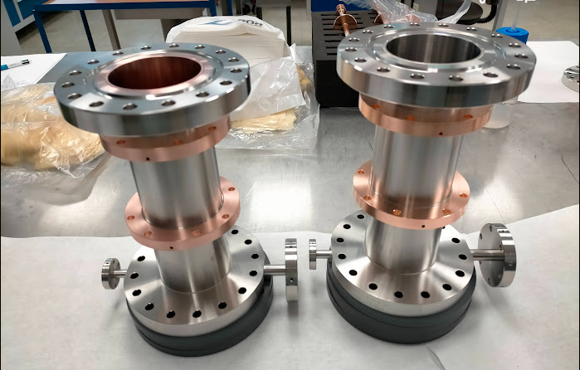
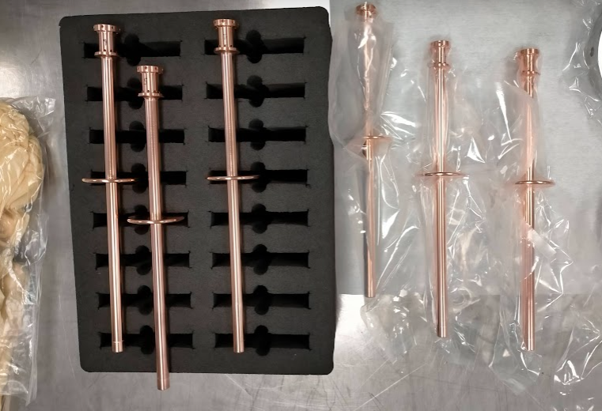
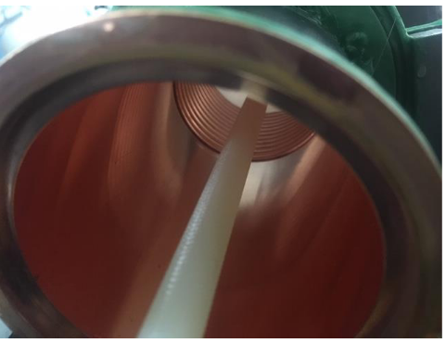
Status of proto couplers fabrication at PMB Cie
T0 : 17 Nov. 2020 (kick off meeting with PMB).
Production is slow as facing several problems (crisis, new project manager, many sub-contractors, …).
PMB is willing to deliver « high quality » parts despite the complex situation.
To be finalized : copper coating of warm end, EB welding, part cleaning + baking
Visit of PMB facilities in August.
Final parts are now being finalized for a delivery in September/October.

Slide 6
Other points
Schedule
Finalized. Milestones validated in PPD part2
PPD
PPD part2 finalized
PPD part1 pending
Documentation
Acceptance plan : to be drafted by Fermilab
Acceptance criteria list : preliminary list edited. To be continued

