Slide 1


Magnets 302.2.02 - Strand Procurement and Testing
Lance Cooley – Florida State / NHMFL (L3)
Vito Lombardo – Fermilab (L3 Deputy and CAM)
HL-LHC AUP Rebaseline Dir. Rev. – Sep. 27th–29th 2020

Slide 2
Outline
Scope and Interfaces
Procurement Status and Progress
QA/QC
Cost and Schedule Performance
Risks
ES&H
COVID-19 impact
Summary

Slide 3
Scope
Approved under CD-3a plus BCR#111 and BCR#227
Procure Nb₃Sn strand for 104 cables (plus 12 cables from LARP inventory)
  UL = 500 m
  500 m x 40 strands X 104 UL = 2080 km
  Vendor’s QC is included
Approved under CD-3b
Verify vendor’s QC tests of round strands
  Critical current I_{c}, RRR, other spot checks
Perform cable extracted strand tests
  I_{c} only under 302.2.02; RRR is in 302.2.03
Prepare and test coil witness samples
  I_{c} and RRR both under 302.2.02
Work Authorization Document: US-HiLumi-doc-1208
WBS dictionary: US-HiLumi-doc-39

Slide 4
WBS 302.2.02: Organization
US HL-LHC Accelerator Upgrade Project: 302.2 MQXFA Magnets Fabrication
Control Account
MQXFA Magnets
Fabrication
302.2
L2: G. Ambrosio
(M. Baldini)
US-HiLumi Document 104
Magnet Design, Integration and Coordination
302.2.01
L3/CAM: G. Ambrosio
(M. Baldini)
Strand Procurement and Testing
302.2.02
L3: L. Cooley
(V. Lombardo)
CAM: V. Lombardo
Cable Fabrication
302.2.03
Cable Fabrication
L3: I. Pong (M. Naus)
CAM: I. Pong (E. Lee)
Coil Parts, Materials, and
Tooling Procurement
302.2.04
L3/CAM: M. Yu
(A. Nobrega)
Coil Fabrication at FNAL
302.2.05
L3/CAM: A. Nobrega
(M. Yu)
Coil Fabrication at BNL
302.2.06
L3/CAM: J. Schmalzle
(M. Anerella)
Structure Fabrication and
Magnets Assembly
302.2.07
L3/CAM: S. Prestemon
(D. Cheng)
Lance Cooley (NHMFL / ASC) – L3 manager
Vito Lombardo (Fermilab) – L3 deputy manager and CAM
Dan Turrioni (Fermilab) – extracted and witness strand testing
Jun Lu, Jeremy Levitan (NHMFL) – verification (round) strand testing

Slide 5
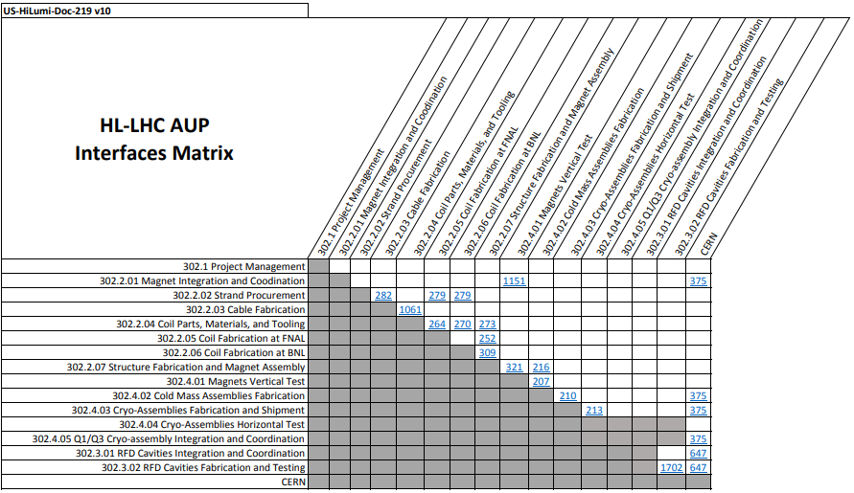
WBS 302.2.02: Interfaces
US-HiLumi-doc-219

Slide 6
Interfaces
Reviewed and approved under strand PRR
Interfaces controlled globally by US-HiLumi-doc-219
US-HiLumi-doc-282: Strand to Cable (302.2.02-03)
  Deliver strand spools to cable team with QC reports certifying compliance with specification
    Full traceability of raw materials and QC (vector #464341, 464219, 464269); trace to cable QC (vector #464342) and cable MIP
  Receive extracted strands for I_{c} testing & report back data
    Controlled under cable production traveler (vector #464342)
US-HiLumi-doc-279: Strand to Coil (302.2.02-05, 02-06)
  Deliver coil reaction heat treatment schedule to coil teams
    Reaction schedule is controlled by US-HiLumi-doc-109
  Deliver witness samples to coil teams, receive test samples back, perform I_{c} and RRR tests.
    Test report certifies proper reaction and coil margin
    Report is entered into coil reaction traveler (vector #464312)

Slide 7
WBS 302.2.02: Technical Status and Progress
 | TOTAL (km) | RECEIVED (km) | UPCOMING (km)
FY18 LBNL | 100 | 100 | 0
FY18 FNAL | 300 | 300 | 0
FY19 FNAL - base | 580 | 580 | 0
FY19 FNAL - option | 400 | 256 | 0
FY20 FNAL | 540 | 540 | 0
FY22 FNAL - spare | 160 | 60 | 100
TOTAL | 2080 | 1980 | 100
TOTAL % |  | 95% | 5%
CDR, PDR, FDR, ICDR, PRR all completed
No outstanding actions (Doc 1322)
100% of production strand received from vendor.
FY22 spare order (final 160km) partially received.
Last 100km scheduled to be delivered by mid 2023

Slide 8
Nb₃Sn RRP 108/127 strand
This design was the winning bid for both LARP open procurements
Bruker - OST

Slide 9
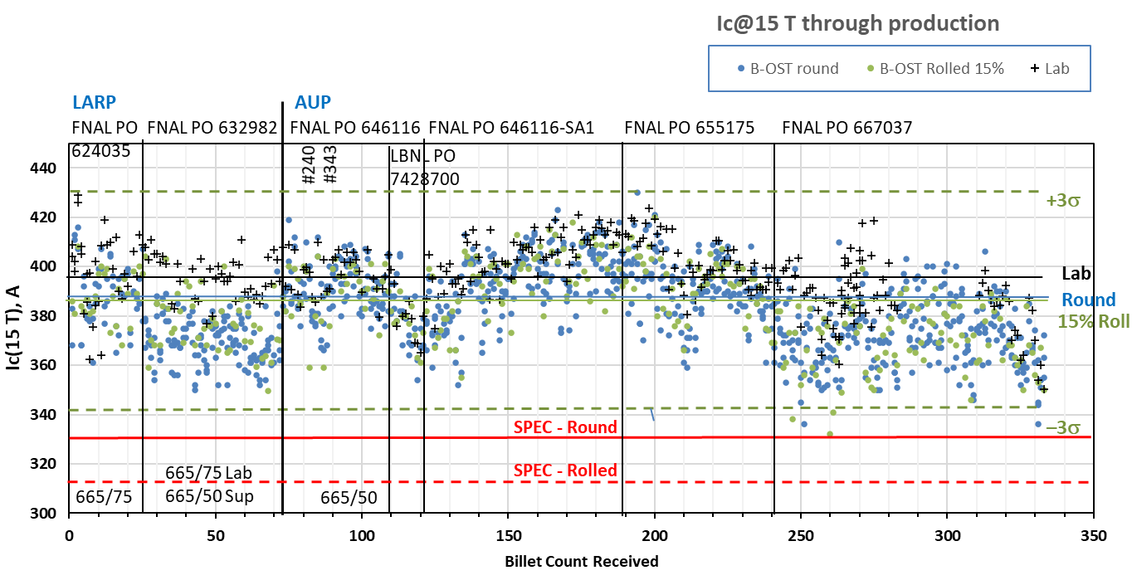
Ic(15T) vs. billet receipt sequence
Includes data from the LARP pre-production
Billets were not received in sequence of production.
Causes of process shifts: 1) raw material changes; 2) COVID;
3) personnel changes; 4) equipment changes
Supplier is conservative by 1.5%

Slide 10
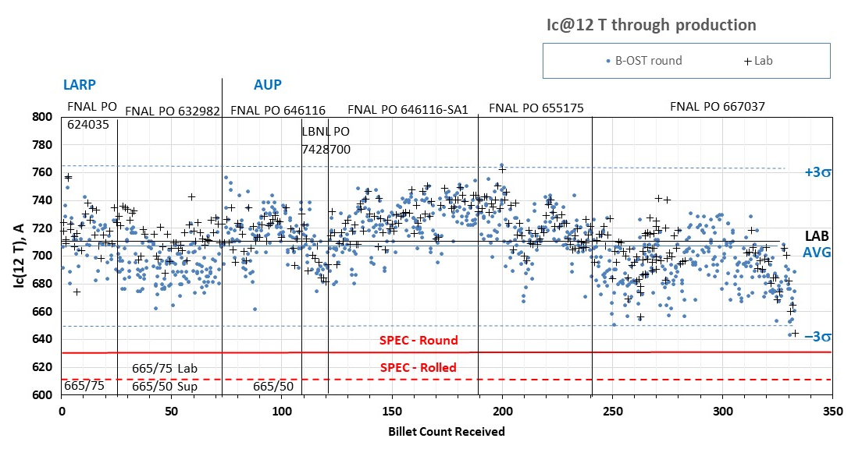
Ic(12T) vs. billet receipt sequence
Billets were not received in sequence of production

Slide 11
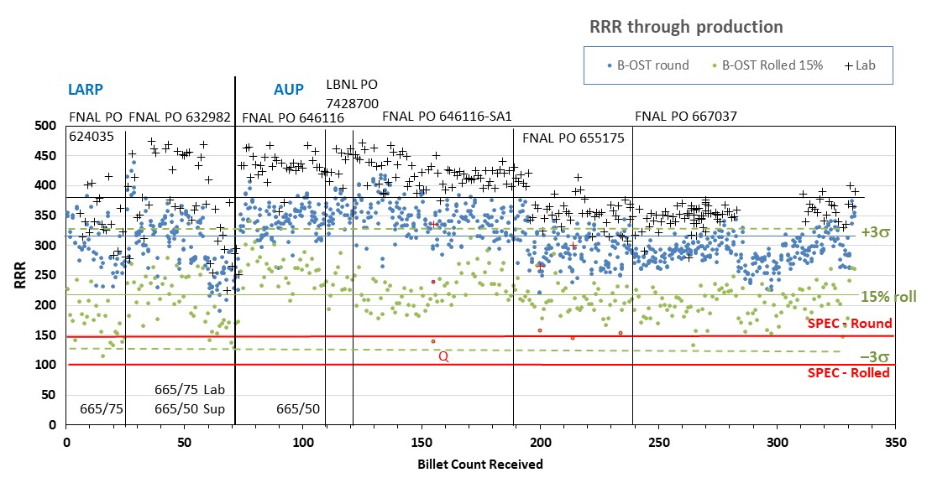
RRR vs. billet receipt sequence
Billets were not received in sequence of production
RRR_{IEC} – RRR_{20K}
Quarantined outliers.

Slide 12
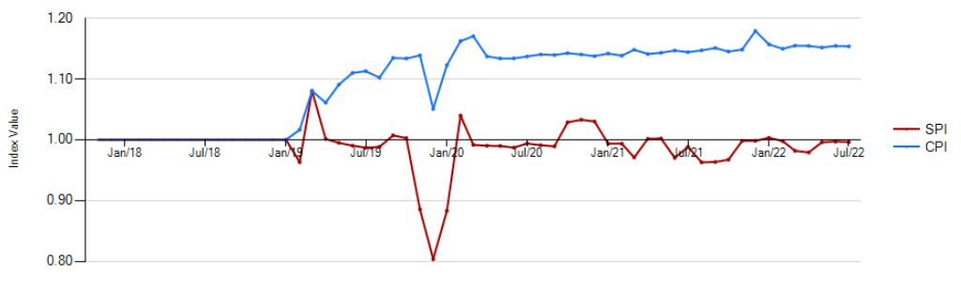
302.2.02 – Cost and Schedule
Performance Report
Account is on schedule with an SPI of 1.00 and under budget with a CPI of 1.15, partially due to cost savings identified in strand QC and partially because of incorrect overhead charges credited back to the account from strand M&S costs incurred before CD2 (under CD3a scope).
Cost and schedule are well understood. CPI and SPI essentially unchanged over the last year. Projected overall savings ~3M$.
Actuals from vendor’s milestones hit the books in Dec19, value earned in Jan20. No real consequences to cumulative costs.
Driven by a mismatch in invoice timing by the vendor.
Driven by actual vendor delays toward the end of CY19

Slide 13
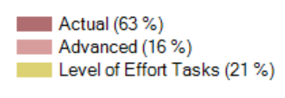
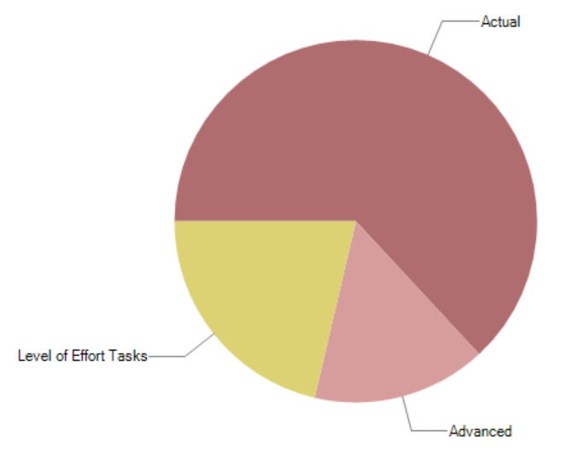
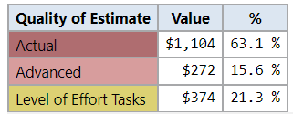
302.2.03 Estimate Quality
$ amounts in pie chart are from 8/1/22 to completion
“Actual” refer to $ allocated for strand which is already under fixed price contract
“Advanced” include estimate for remaining strand and coil witness testing activities
The remaining covers LOE tasks

Slide 14
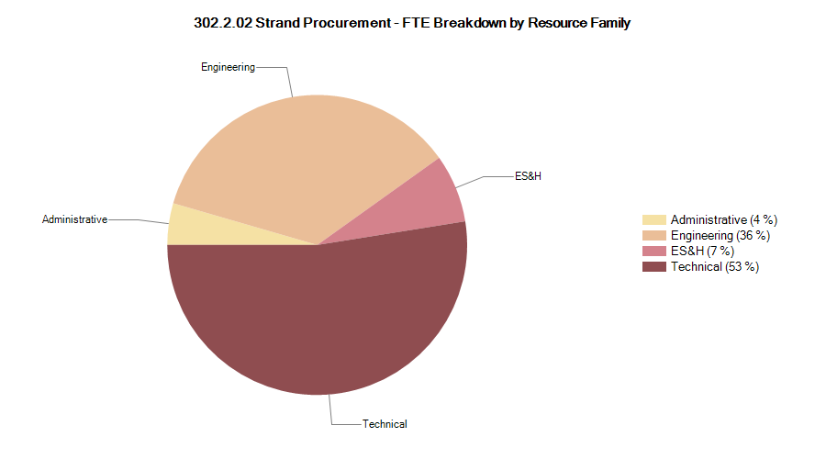
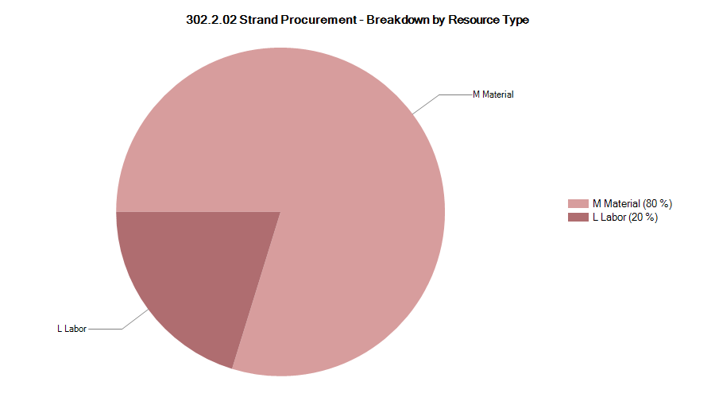

302.2.03 Resource Type Breakdown
Pie chart includes only work to go, 8/1/22 to completion
CA still dominated by M&S expenditure for strand procurements

Slide 15
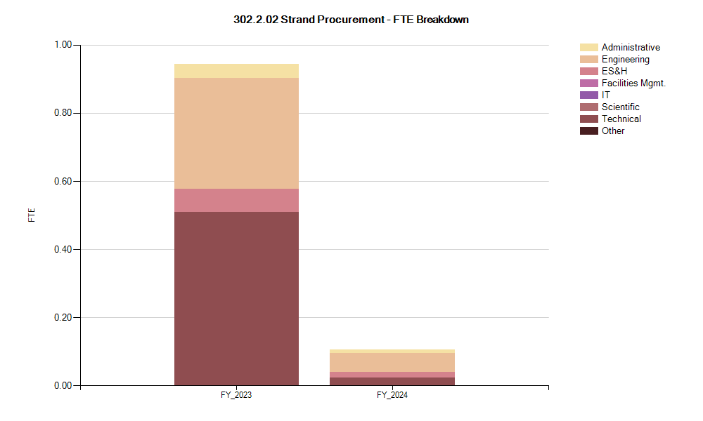
302.2.03 FTE Breakdown

Slide 16
302.2.03 Risks
Risk-ID | Title | Risk Rank
RT-302-2-02-004 | Variation in manufacturing rate affects strand delivery schedule. (still OPEN, but impact negligible since outstanding orders are spare quantities) | Medium
RT-302-2-02-002 | Theft or disaster causes loss of entire strand inventory (REVISED to reflect only yet to be cabled lengths) | Medium
RT-302-2-02-001 | Problems in supply chain cause major disruption of strand delivery. (RETIRED as all raw materials have been acquired by the strand vendor). | Medium
RT-302-2-02-005 | Additional QC requested by CERN (RETIRED after strand and cable PRR recommendations were implemented into baseline, BCR#70) | High
RT-302-2-02-003 | Strand price is much higher than estimated (RETIRED after last order was placed) | Medium
Opportunity-ID
RO-302-2-02-001 | Accept multiple unit lengths for delivery to reduce strand price (RETIRED after final order was placed) | High

Slide 17
ES&H & QA
ES&H
  AUP Hazard Analysis Report (HAR) in US-HiLumi-doc-303
  Electrical and cryogenic hazards apply to strand testing
    Test methods are covered by existing approved test procedures:
      FNAL 464129 - General Procedures for Testing Critical Current of Superconducting Strands
      FNAL 464130 - Cryogenic High-Magnetic-Field High-Current Testing Operations in IB3-A
      FNAL 464132 - Teslatron Cryogen and Probe Procedures in IB3-A
QA
  AUP Quality Assessment Plan in US-HiLumi-doc-80
  AUP Superconductor Quality Plan US-HiLumi-doc-903
    Supplier QC, Verification QC, and Acceptance documents delivered to CERN
    Strand is a component delivered to the 302.2.03 Cable MIP

Slide 18
WBS 302.2.02: past, present and future COVID impact
Summary of COVID shut down impacts to 302.2.02
  Strand procurement: Vendor deemed essential. All strand ordered under fixed price contract. No $ or schedule impact.
  Strand verification tests at FSU: testing activities temporarily stopped during shelter in place, but quickly resumed with minimal to no impact to schedule.
  Cable verification and coil witness tests at Fermilab: testing activities resumed after lab shutdown, high priority personnel back at the lab quickly leading to minimal impact to cost and schedule.
“COVID-restricted” restart
  At Fermilab: selected personnel was identified to return to work under COVID-restricted phase to minimize impact to AUP critical path. (302.2.02 team back to Fermilab on 28 May 2020). Preparation, heat treatment and test of cable verification and coil witness samples has been performed with no interruptions since.
  At FSU: Tests approved under phase 1 prioritized re-opened 5 Jun 2020; testing completed with minimal to no impact to schedule
COVID impact to future activities
  Key personnel is currently allowed on site both at Fermilab and FSU. No substantial future delays or projected inefficiencies to completion of scope.

Slide 19
302.2.03 Schedule
  Strand is not on the critical path of the project

Slide 20
Summary
Well defined WBS and interfaces
CD-3a procurement: 100% of strand under CD3a scope has been received from the vendor.
Small contract placed for spare conductor, expected by mid 2023.
Extracted strand testing proceeds through cable production.
Witness strand testing proceeds through coil production.
COVID-19 did not impact strand supply and extremely limited impact on QA/QC activities at FNAL and FSU.
Cost and schedule are under control; CA is on schedule and projecting substantial savings to the project.
Major reviews all completed
ESH&Q and Risks well managed

