Slide 1


Magnets 302.2.05
Coil Fabrication at FNAL
Fred Nobrega - Fermilab
HL-LHC AUP Rebaseline Dir. Rev. – Sep. 27th–29th 2020

Slide 2
Outline
Scope, Interfaces, Dependencies & Team
Achievements since CD-3
COVID impacts & COVID BCRs affecting L3s
Other BCRs/Manual Adjustments since CD-3
Procurement Status
Schedule
Cost and Schedule Performance & VAR Reports
Estimate at Completion
QA/QC
Risks
ES&H
Summary

Slide 3
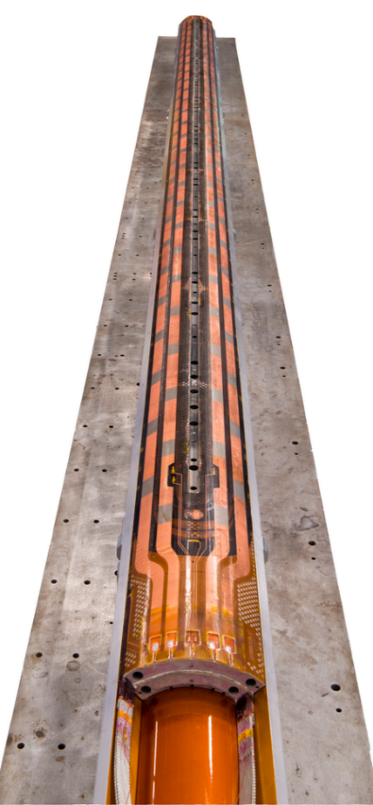
WBS 302.2.05 Scope
Charge #7
WBS Code | WBS Name | Control Account
302.2.05 | Coil Fabrication at FNAL | Yes
WBS Description
Scope of Work Fabricate 52 QXFA coils and 1 QXFP coil at Fermilab. Fabrication steps include Winding and Curing, Reaction, and Impregnation. Includes shipping of accepted coil to LBNL for magnet assembly. Detailed description of QXF coil fabrication process provided by US-HiLumi-doc-95. Scope Assumptions/Exclusions One set of coil fabrication tooling is available from LARP, installed and fully functional in Fermilab Industrial Building 3 (IB3). This includes a winding machine with one mandrel, a curing press, a reaction oven, reaction fixtures, an impregnation station (in IB2) and impregnation fixtures. Coil witness sample testing is covered under the scope of WBS 302.2.02 Strand Procurement. Coil production yield is assumed to be 82.4%. WBS Deliverables A minimum of 43 accepted QXFA coils with their corresponding QC reports.
Pre-series coils (complete)
  Fabricate coils (15)
CD-3b Scope (complete)
  Fabricate coils (7)
CD-3 Scope (in progress)
  Fabricate coils (30)
  3 coils added to scope to meet coil production yield observation.

Slide 4
WBS 302.2.05 Interfaces
Charge #8
Interface control documents (ICDs) detail the flow of materials and data from one WBS to another.
No external dependencies.
  Receive witness samples for reaction from WBS: Strand Procurement (send them back after reaction).
    WBS 302.2.02 → WBS 302.205 - Strand Procurement to Coil Fab (ICD: US-HiLumi-doc-279).
  Receive insulated cable, coil parts, and additional reaction impregnation fixtures from WBS: Coil Parts, Materials, and Tooling.
    WBS 302.2.04 → WBS: 302.2.05 - Coil Parts, Materials, and Tooling to Coil Fabrication (ICD: US-HiLumi-doc-264).
  Send completed coils to WBS: Structure Fabrication and Magnet Assembly at LBL.
    WBS 302.2.05 → WBS: 302.2.07 - Coil Fabrication to Structure Fabrication and Magnet Assembly (ICD: US-HiLumi-doc-252).
US-HiLumi-doc-219

Slide 5
Organization Chart
Charge #7
Control Account
MQXFA Magnets
Fabrication
302.2
L2: G. Ambrosio
(M. Baldini, P Ferracin)
Magnet Design, Integration and Coordination
302.2.01
L3/CAM: G. Ambrosio
(M. Baldini)
Strand Procurement and Testing
302.2.02
L3: L. Cooley
(V. Lombardo)
CAM: V. Lombardo
Cable Fabrication
302.2.03
L3: I. Pong (E. Lee)
CAM: I.Pong (M. Naus)
Coil Parts, Materials, and
Tooling Procurement
302.2.04
L3/CAM: M. Yu
(A. Nobrega)
Coil Fabrication at FNAL
302.2.05
L3/CAM:
A. Nobrega
(M. Yu)
Coil Fabrication at BNL
302.2.06
L3/CAM: J. Schmalzle
(M. Anerella)
Structure Fabrication and
Magnets Assembly
302.2.07
L3/CAM: S. Prestemon
(D. Cheng)
Technical Support
Supervisor: M. Walls
A. Coons
C. Korleski
P. Fox
L. Flores
C. Cuautle
S. Ransom (C)
M. Cook (C)
K. Kaufman (C)*
M. Vallejo (C)
* Recent hire, fully staffed.

Slide 6
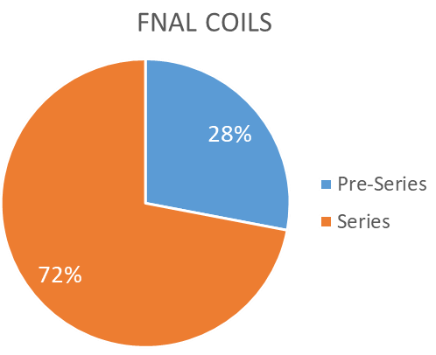
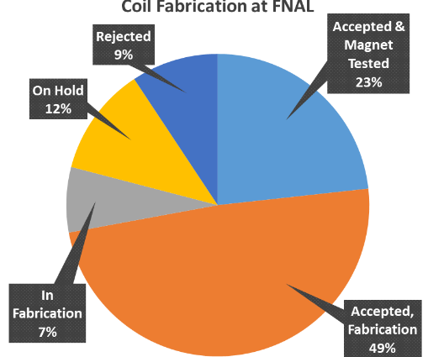
WBS 302.2.05: Achievements since CD-3
Charge #8
Pre-series coil fabrication is complete.
Series Coil Production Readiness Review, April 2020.
Coil Acceptance Reviews for all magnets.
Coil Fabrication Status as of 7/22/22
  Accepted & Magnet Tested 10
  Accepted, Fabrication 20
  In Fabrication 1.05*
  On Hold 5
  Rejected 4
  Total: 40.05
  Yield: 83.8%**
  * Fractional portion complete of 3 coils in fabrication.
  ** Assumes 50% on hold coils rejected.

Slide 7
WBS 302.2.05: COVID Impacts
Charge #1
COVID lockdown
  Illinois stay at home order 3/21/2020
  Production stop 3/23 - 5/14 2020
  Essential workers phased return beginning (5/14/20) with 4 techs increasing to 6 techs two weeks later (5/28/2020).
  Contract techs (4) not considered essential → tech crew at 60%.
Determination of inefficiencies
  15 min in the AM and 15 min in the PM each day for workplace and tooling disinfecting → 4% measured.
  PPE use, 5 min break per hour of mask use → 5% measured.
  6ft separation and/or barriers, ~5 min per hour → 8% at the beginning and later tapered to zero.
  Quarantine ~3%.
  Contract technicians (4) return July 8, 2020, full tech crew.
  See backup slides for more information.
COVID mitigation measures
  Disinfecting of workplace, tools, and tooling each day AM/PM.
  PPE → masks, gloves.
  Social distancing.
  Physical barriers, eventually abandoned.
  Quarantine.

Slide 8
WBS 302.2.05: COVID BCRs
Charge #1
BCR # | BCR Description | Cost $k
279 | COVID-19 Attribution portion of Addition of 5 Cables and 2 Coils Due to Present Cable and Coil Yield | $131.7
216 | COVID-19 Inefficiency Planning for future work for Apr-Jun 2021 | $82.2
199 | COVID-19 Inefficiency Planning for future work for Jan-Mar 21 | $81.7
160 | COVID-19 LOE Adjustments July 2020 | $72.8
188 | COVID-19 Inefficiency Planning for future work for Nov-Dec 20 | $63.7
144 | COVID-19 Schedule Delay March 2020 | $47.9
168 | COVID-19 Inefficiency Planning for future work for Aug-Oct 20 | $26.8
154 | COVID-19 Schedule Adjustments May 2020 | $10.5
262 | COVID-19 Attribution portion of Magnets Rework and Test Replan Following MQXFA07/08 Performance Issues | $3.6
258 | COVID-19 Attribution portion of Delay to Coil and Magnet Work due to MQXFA08 preliminary test results | $3.6
 |  | $524.5

Slide 9
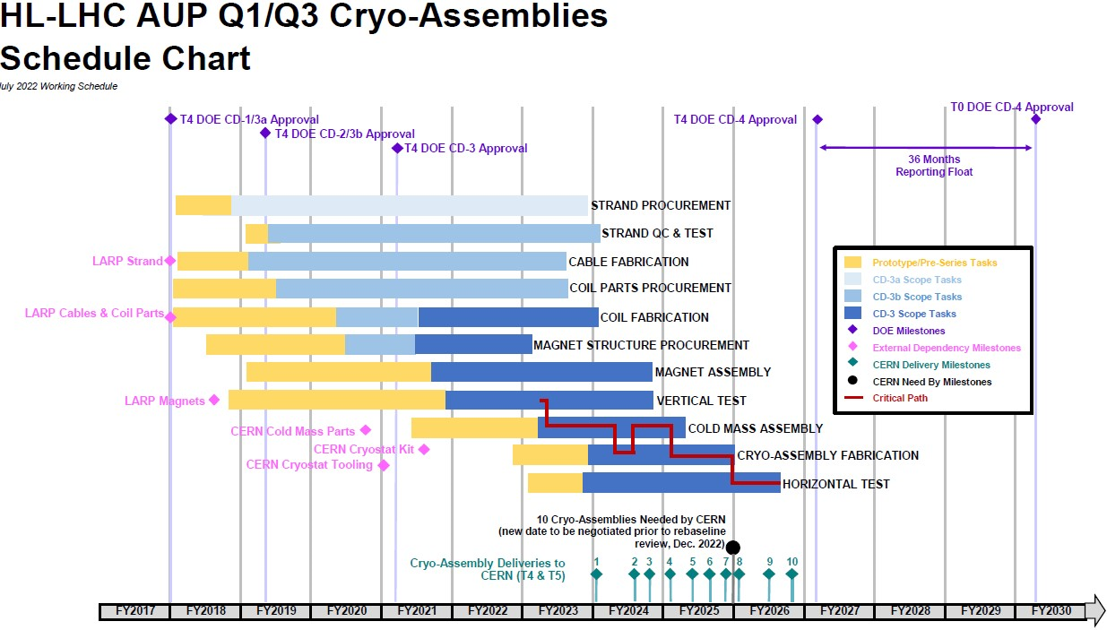
WBS 302.2.05: Schedule
Charge #4

Slide 10

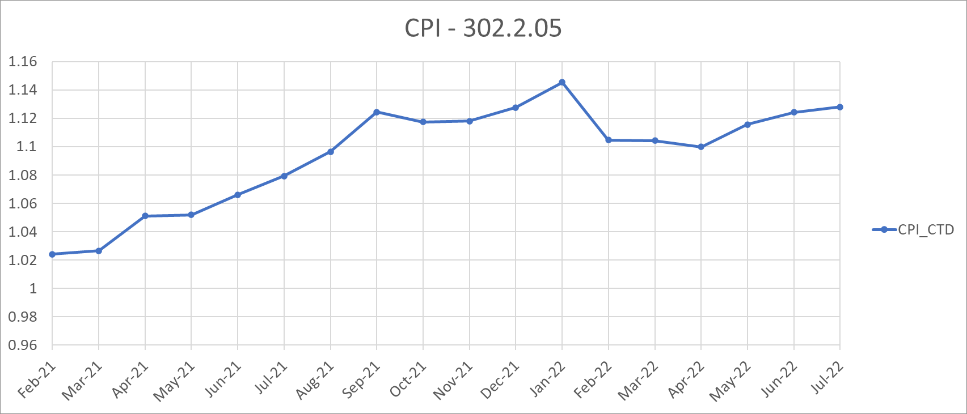
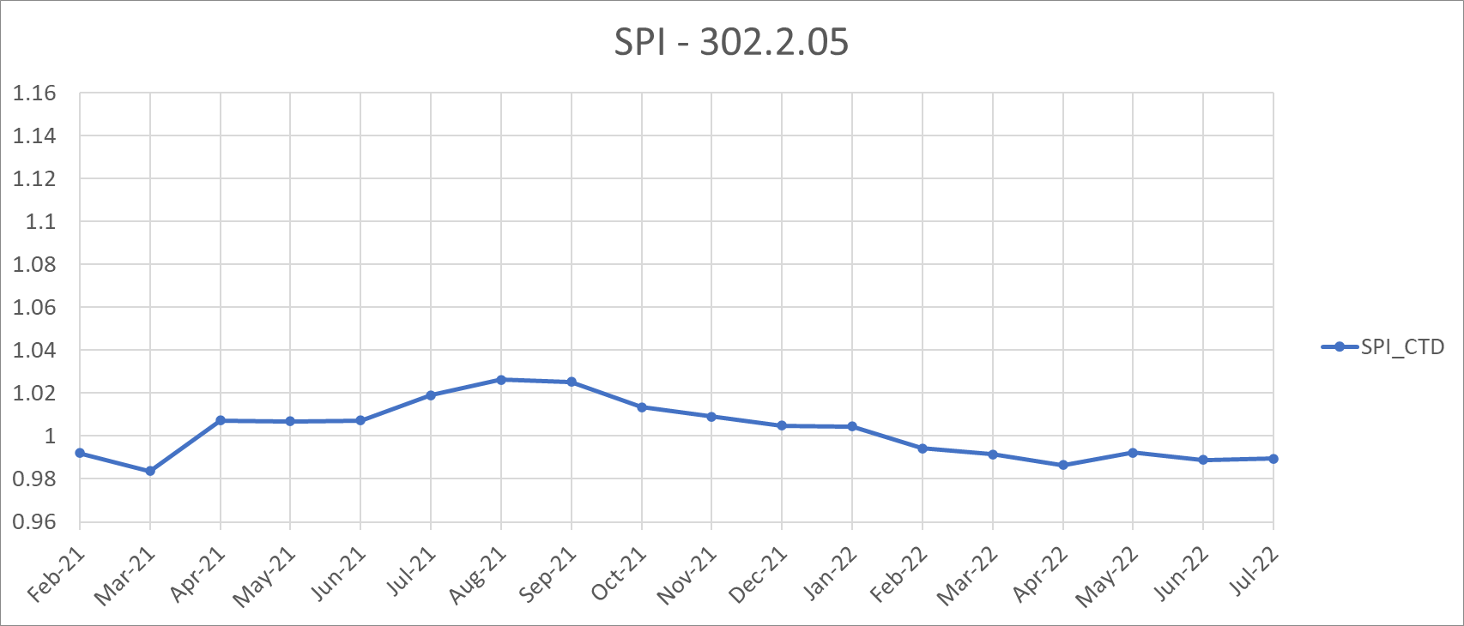
WBS 302.2.05: Cost and Schedule Performance
Charge #4 & #8
CPI
  Technician labor cost, 40% contract labor.
  Core technician crew learning curve.
  BoE change in tech labor approved with BCR 285.
  Temporary coil production ramp down.
SPI
  Understaffed from technician turnover.
  Tight labor market.
  Recent hire brings tech crew to full staff.

Slide 11
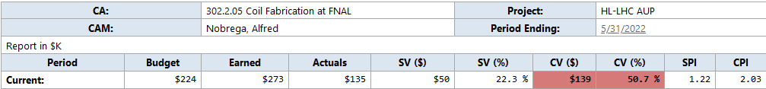
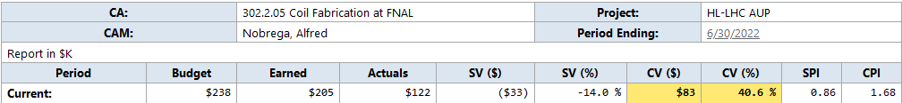
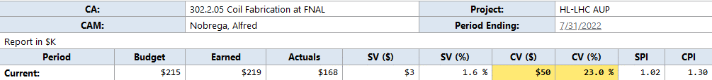
WBS 302.2.05: May-July Variance
Charge #4
Cost Variance:
  About 50% of techs are contract labor technicians with lower cost than FNAL techs. The AUP baseline assumed only FNAL techs. Higher technician efficiently coupled with staff shortage contributed to lower labor costs. The technician hiring process for a full-time position continues.
Corrective action:
  Analyze coil fabrication labor data to revise BoE's and submit BCR. (BCR285 approved 8/22)
May 2022
June 2022
July 2022

Slide 12

WBS 302.2.05: Estimate at Completion
Charge #4
Estimate at completion is $10.5M
Variance at completion driven by:
  Low contract technician labor costs.
  Coil fabrication learning curve.
Manual EAC adjustments:
  Cost to characterize the possible power lead degradation of coil QXFA121 (on hold).
  Additional LOE to account for the difference in completion of work between the working schedule and the PMB schedule.

Slide 13
WBS 302.2.05: QA/QC
Charge #4
AUP Quality Assurance Plan, US-HiLumi-doc-80
  Manufacturing & Inspection Plan (MIP) submitted to CERN.
  The coil QA plan is described in the Series Coil Production Specification, US-HiLumi-doc-2986
  Travelers (work plan) with in-process electrical checks.
    Coil Interface Traveler (coil fab at FNAL→ magnet assy at LBNL)
  Coil electrical QA/QC plan, US-HiLumi-doc-521
  CMM - Coil size measurements.
  Data is saved to CERN Manufacturing & Test Folders (MTFs).

Slide 14
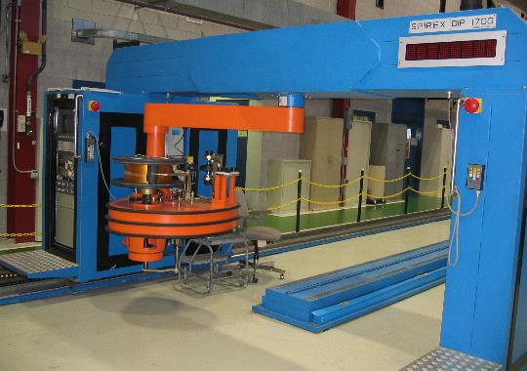
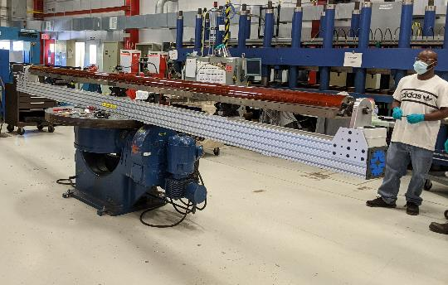
WBS 302.2.05: QA/QC
Charge #2
Rejected Coils:
  Coil 108 – electrical issue found after reaction.
    Cause: Possible cause is excess CTD-101 binder that pyrolyze and became conductive.
    Corrective action: revise application process of CTD-101 binder – Apply binder from the midplane up to the 3 turn from the pole.
    Coil was epoxy impregnated and used for coil various studies.
  Coil 118 – cable damaged during coil winding.
    Cause: Selva winding machine boom height was in wrong position.
    Corrective action: revised process – added steps in traveler to inspect location of boom prior to each layer of coil winding.
    Coil dismantled; coil parts recovered.
  Coil 120 – unexpected high cable tension during winding setup.
    Cause: Selva cable tensioner program and control parameter settings were coarse.
    Corrective action: program and controls fine tuned and updated. Use the cable assigned to coil 120b to recommission the Selva coil winder. Later developed a tensioner issue that permanently damaged the cable.
    Final disposition: Selva winder removed from project. Elevated rotating table from backup winder to primary coil winder.
  Coil 138 – incomplete epoxy impregnation.
    Cause: Excess RTV formed a seal between the LE plate port and the mandrel effectively sealing the tooling closed.
    Corrective action: Machine 0.5"W x .13"D vertical slot in the mandrel to prevent excess RTV from forming a seal between the LE plate and mandrel.
    Final disposition: Processes coil to include CMM and final electrical measurements and tests. Storage.
Selva Spirex winding machine.
Backup winding table with new coil mandrel support system.

Slide 15
WBS 302.2.05: QA/QC
Coils On Hold
Charge #4
QXFA # | Description | Repaired (Y/N) | Passed Electrical | Passed CMM
109 | Coil to saddle short discovered at LBNL. Repaired at FNAL. | Y
121* | Deflected leads after reaction. | n/a
125 | Midplane damage using file after VPI. | Y
127 | QH to coil short caused by S2 bead. | Y
133* | Pinched lead cable strand, splice moved inboard 50 mm. | Y
140 | QH to coil short caused by S2 bead. | Y
* Coils more likely to be rejected.

Slide 16
WBS 302.2.05: Risks
Charge #3
Risk-ID | Title | Probability | Cost Impact | Schedule Impact | Risk Rank
RT-302-2-05-002 | FNAL Curing Press Failure | 39.0% | 0.5--1--50 k$ | 0.05 -- 0.1 -- 1 months | 2 (Medium)
RT-302-2-05-006 | FNAL Winding Machine Failure | 50.0% | 10 k$ | 0.2 -- 0.5 -- 1 months | 2 (Medium)
RT-302-2-05-003 | FNAL Reaction Oven Failure | 81.0% | 0.5--2--4 k$ | 0.05 -- 0.1 -- 0.25 months | 2 (Medium)
RT-302-2-05-004 | FNAL Impregnation Station Failure | 39.0% | 0 k$ | 0.033 -- 0.067 -- 0.25 months | 2 (Medium)
RT-302-2-05-005 | FNAL Impregnation Station Availability | 5.0% | 0 k$ | 0.05 -- 0.1 -- 0.15 months | 1 (Low)
RT-302-2-05-007 | Coil fabrication at FNAL is delayed due to lack of approved cables | 25.0% | 0 k$ | 0 -- 2 -- 3 months | 1 (Low)
Coil fab risks included in risk register, US-HiLumi-doc-79.
Risks are actively managed via monthly Risk Management Board meetings.
  Equipment used have critical spare components in house.
  Risk of higher coil failure than in baseline is addressed in WBS 302.2.01 (RT-302-2-01-004).
  Risk of higher coil failure due to COVID is addressed in WBS 302.2.01 (RT-302-2-01-004-C).
  Risk of lower efficiencies to the end of the project due to COVID is addressed in WBS 302.2.01 (RT-302-1-097C).

Slide 17
WBS 302.2.05: ES&H
Charge #5
All tasks are planned and performed to minimize the risk of injury to personnel and damage to equipment.
  Regular walkthroughs of fabrication area
  Engineers & tech’s attend required ES&H training courses
  Identify hazards and use appropriate PPE.
Hazards include:
  Electrical
  Chemicals (Boron Nitride, Mold release, Epoxy, Soldering flux).
  Hot surfaces from ovens, curing press, and soldering irons.
  Use of overhead cranes and lifting fixtures.
  Use of liquid argon
Hazard analysis
  Hazard Analysis Form integrated into Fermilab’s IMPACT program.
  AUP Hazard Analysis Report: US-HiLumi-doc-303
COVID-19 Work Requirements (Added to all travelers on multiple pages)
  Wear a face mask when community spread is at level HIGH.
ORC: mandrel support for rotating winding machine.
Safety incident: hammered finger. Corrective action: modify tooling. Human Performance Improvement #290 (fnal.gov)

Slide 18
WBS 302.2.05: Summary
FNAL coil fabrication is proceeding according to the baseline plan.
  Pre-series coils are complete.
SPI & CPI are ≥ 1.
Risks are identified and mitigated.
Coil production yield is lower than assumed and is being addressed through BCR’s and implementing lessons learned.
All aspects of WBS 302.2.05, Coil Fabrication at Fermilab, including ESH&Q, are actively managed.

Slide 19
Backup Slides

Slide 20
Impacts from COVID-19
15 min in the AM and 15 min in the PM each day for workplace and tooling disinfecting → 6.7% max.
PPE use, 5 min break per hour of mask use → 8% max.
6ft separation, impact tbd based on tech labor task sheets
Quality during COVID-19
Additional hourly breaks from wearing masks. (mask fatigue)
Additional PPE use, face shields if working less than 6 feet from another worker
Disinfecting tools and tooling at the beginning and at the end of the day.
Collectively, all of the above lead to peace of mind & lower anxiety, thereby maintaining quality & mental health.
Error Precursors (risks) during COVID-19
Changes / Departure from routine – no engineering support
Anxiety
Tunnel vision
Assumptions
Mitigation: external periodic checks, group chats,

Slide 21
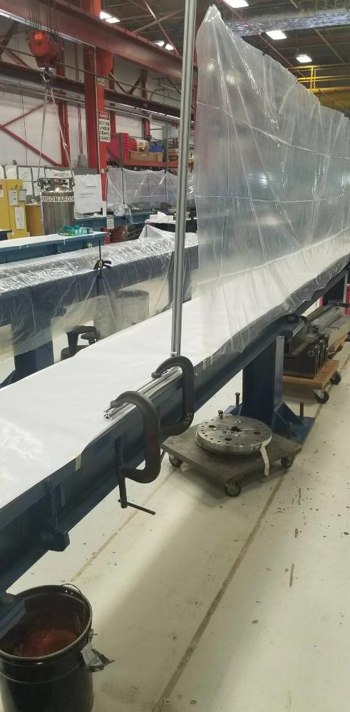
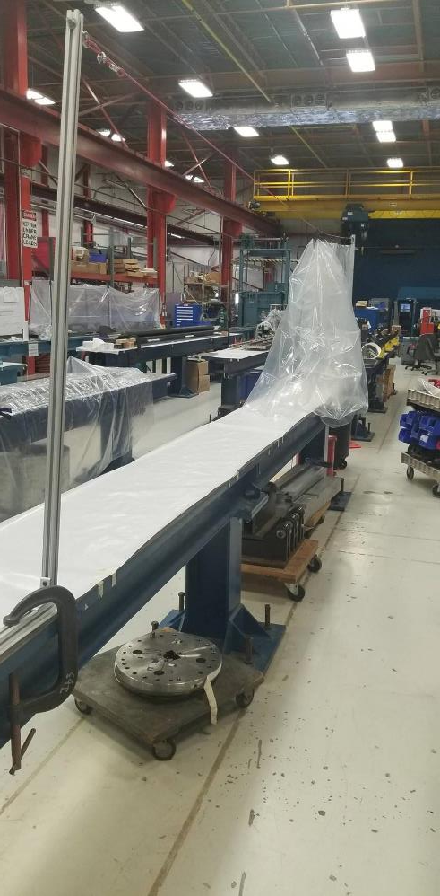
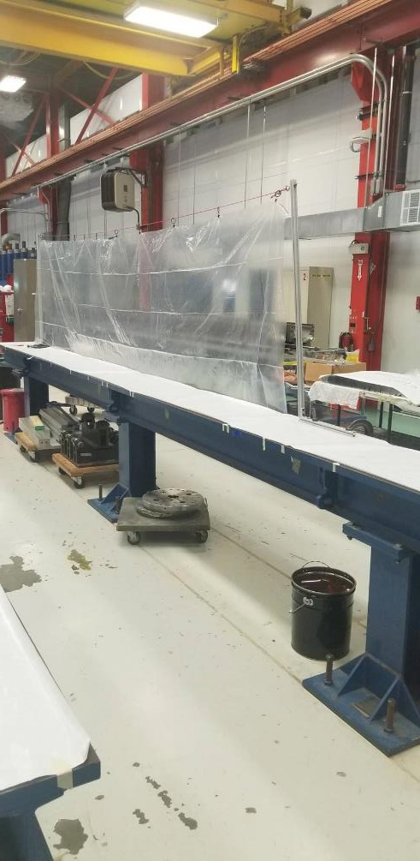

Slide 22
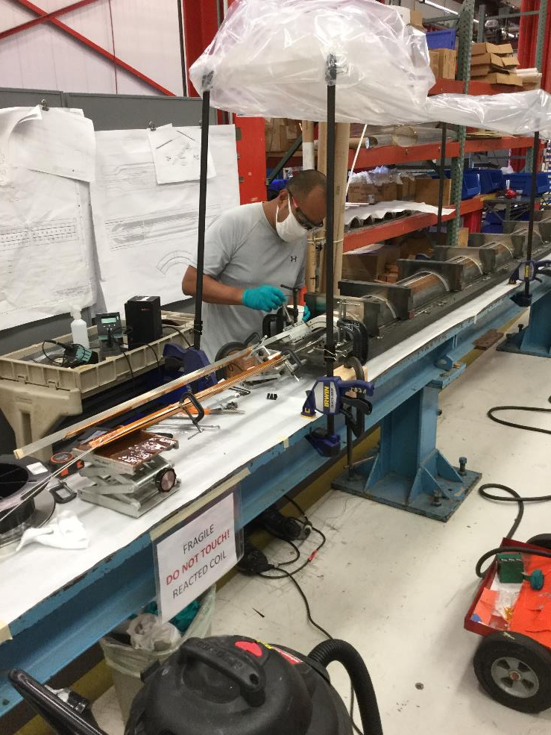
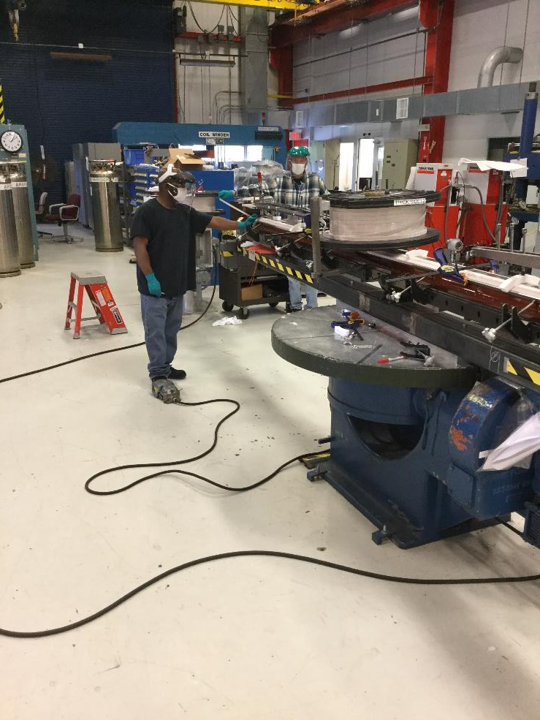

Slide 23
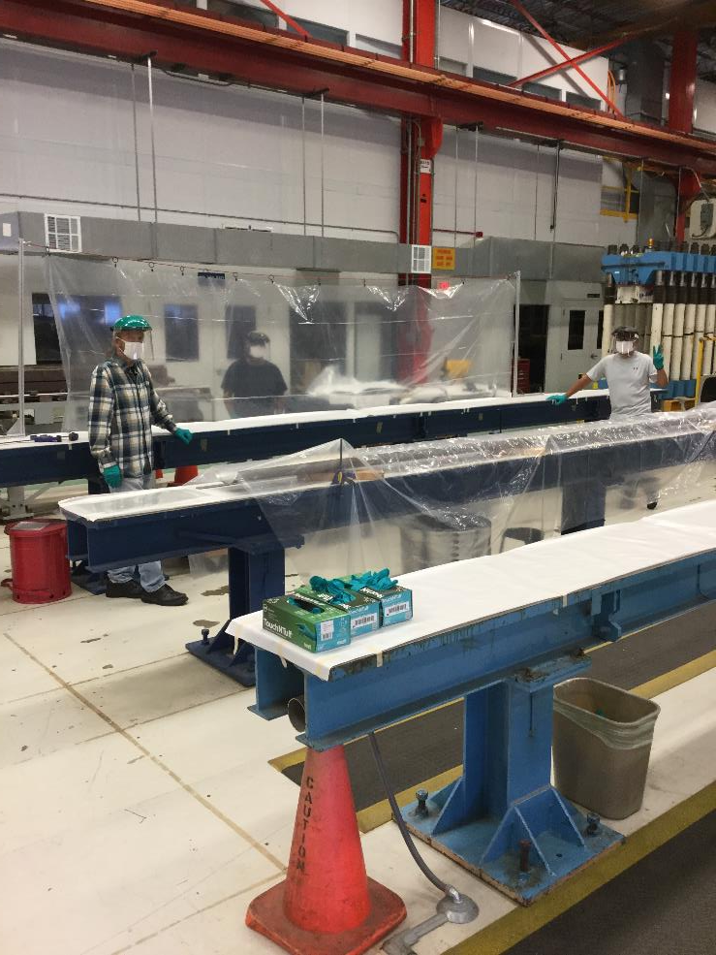
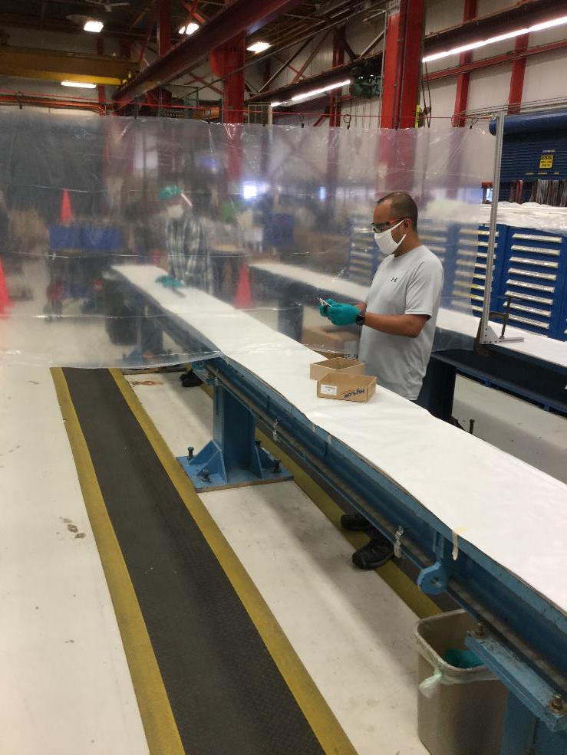

Slide 24
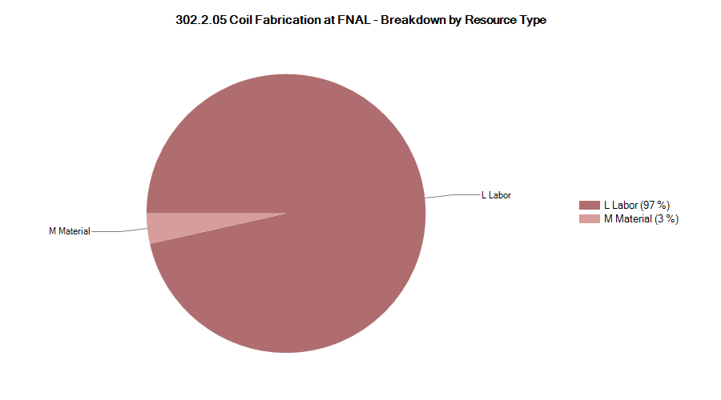
302.2.005 Resource Type Breakdown

Slide 25
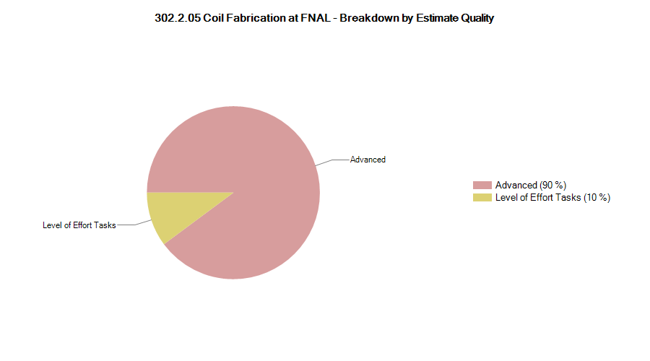
302.2.05 Estimate Quality

Slide 26
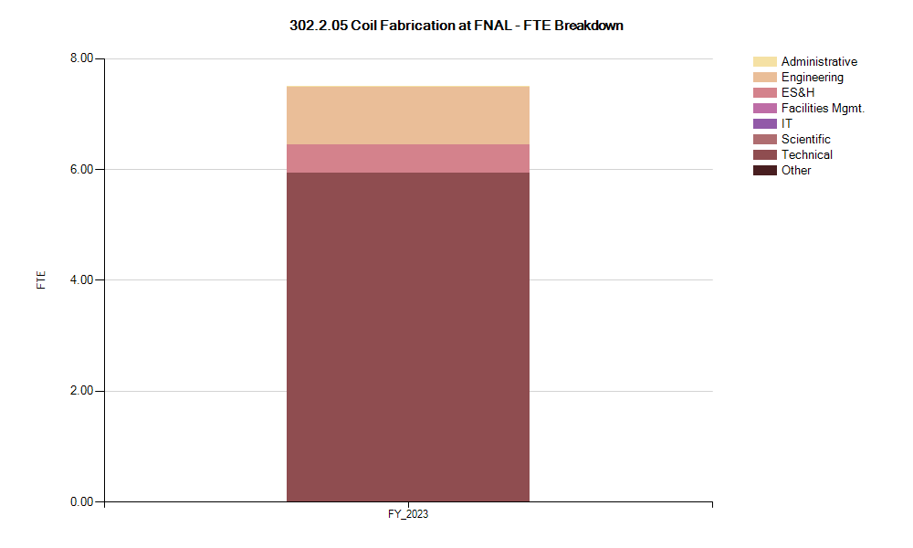
302.2.05 FTE Breakdown

Slide 27

302.2.05 Cost Performance Report
BAC = $10.5M
Current Period Cost threshold crossed (yellow).
Cumulative to Date threshold crossed (red).
Cumulative SPI = 0.99, CPI = 1.13

