Slide 1


Magnets 302.2.07 - Structure Fabrications and Magnet Assembly at LBNL
Soren Prestemon – LBNL (L3/CAM)
Dan Cheng– LBNL (Deputy L3/CAM)
HL-LHC AUP Rebaseline Dir. Rev. – Sep. 27th–29th 2020

Slide 2
Outline
Scope, Interfaces, Dependencies & Team
Achievements since CD-3
COVID impacts & COVID BCRs affecting L3s
Other BCRs/Manual Adjustments since CD-3
Procurement Status
Schedule
Cost and Schedule Performance & VAR Reports
Estimate at Completion
QA/QC
Risks
ES&H
Summary

Slide 3
WBS 302.2.07: Scope and Interfaces
Charge #8
Scope of Work
Re-assemble magnet prototype MQXFAP-1b, fabricate 5 pre-series magnets (from MQXFA-03 to MQXFA-07), and fabricate 20 MQXFA series production magnets. Scope includes:
  Parts procurement for 21 magnet structures (shell, Yoke, masters, pads, collars, axial support components, keys, strain gauges and wires)
  26 magnet assemblies (1 prototype re-assembly, 5 pre-series, 16 series production, and 4 re-assemblies).
    Assembly includes install strain gauges on shells, Fabricate Yoke/Shell subassemblies. Receive and check coils, perform CMM measurements and prepare coils for magnet assembly. Assemble collar packs and coil packs. Insert coil packs, setup bladders, and perform azimuthal and axial preload, and conduct electrical QC
  Prepare for shipment and ship the magnet assembly to BNL for vertical testing.

Slide 4
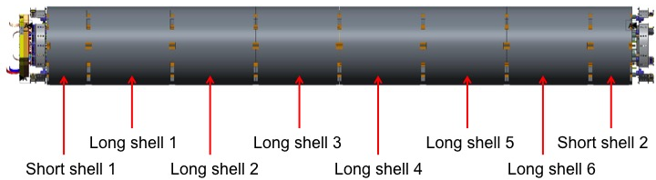
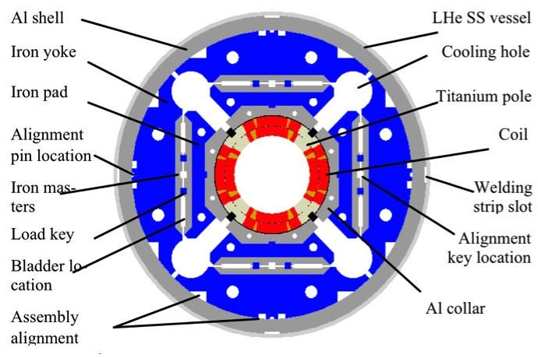
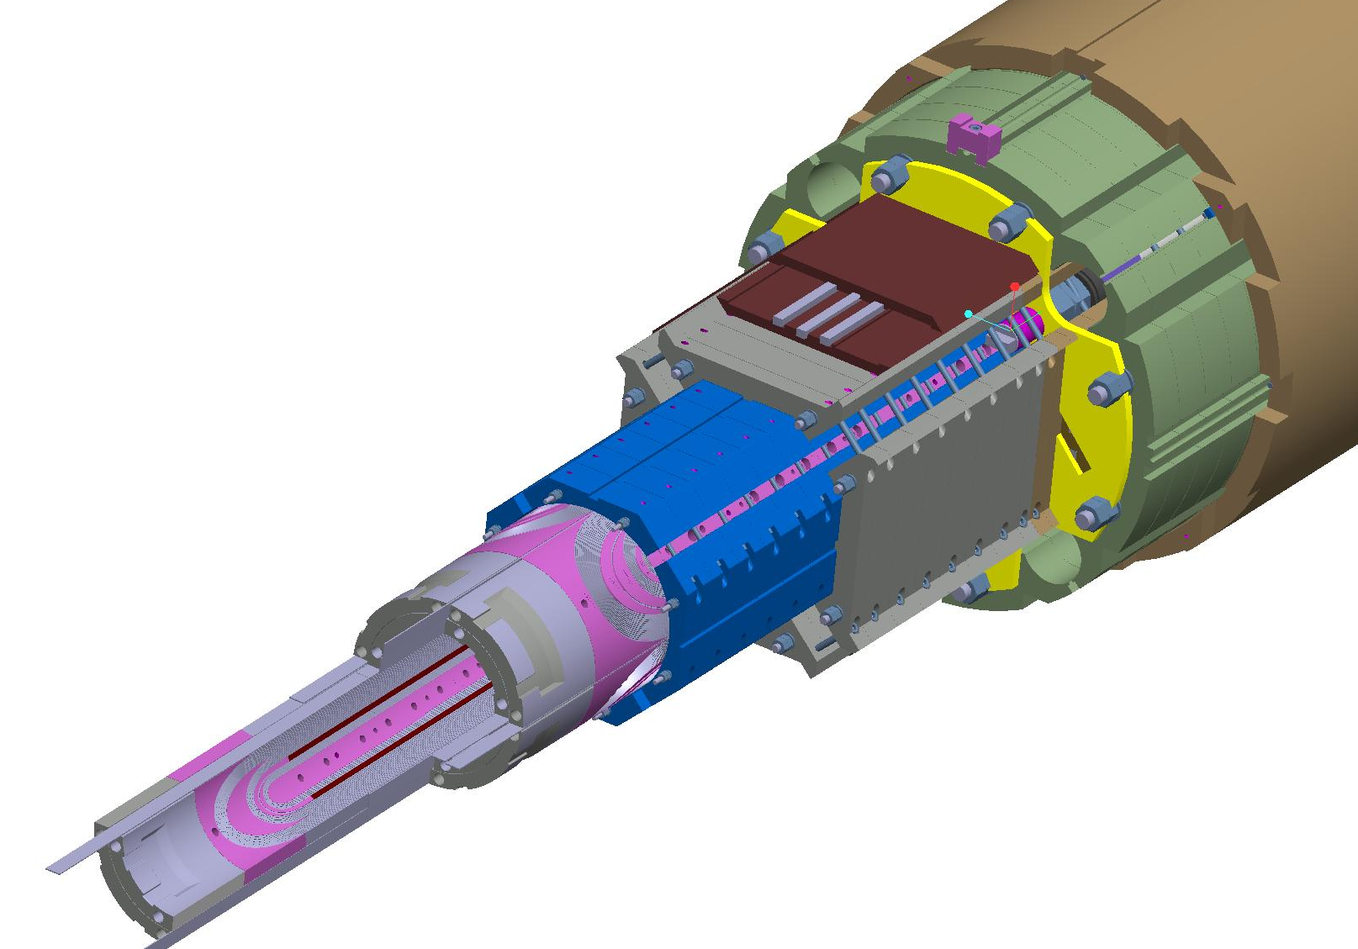
WBS 302.2.07: Overview of deliverables

Slide 5
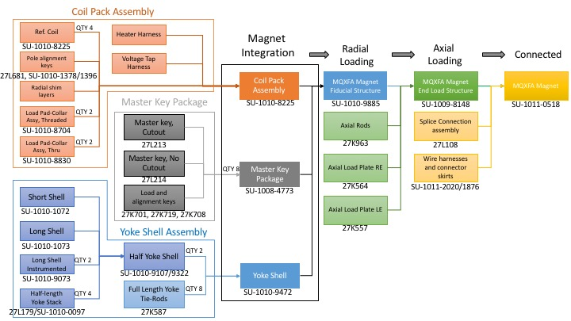
WBS 302.2.07: Work Flow and Interfaces
Coils from FNAL
302.2.05
Coils from BNL
302.2.06
Coil components
302.2.04
Magnet shipped to BNL
302.4.1
US-HiLumi-doc-252
US-HiLumi-doc-309
US-HiLumi-doc-273
US-HiLumi-doc-321
Fiducialization Data to FNAL
302.4.02
US-HiLumi-doc-216
HL-LHC AUP CD-3 IPR - Nov 17th -19th, 2020
5

Slide 6
WBS Deliverables & Yield Assumptions
WBS Deliverables
  Re-assembled prototype magnet MQXFA-1b, 4 accepted pre-series magnets, and a minimum of 17 accepted production MQXFA magnets with their corresponding QC reports.
Yield Assumptions:
  3 of the 16 series magnets and one of the 5 pre-series magnets are assumed to be re-worked before passing acceptance test. Parts are assumed to be re-used for this re-work.
  1 Magnet structure is assumed to be irreversibly damaged, due to shipping and handling, and therefore assumed lost.

Slide 7
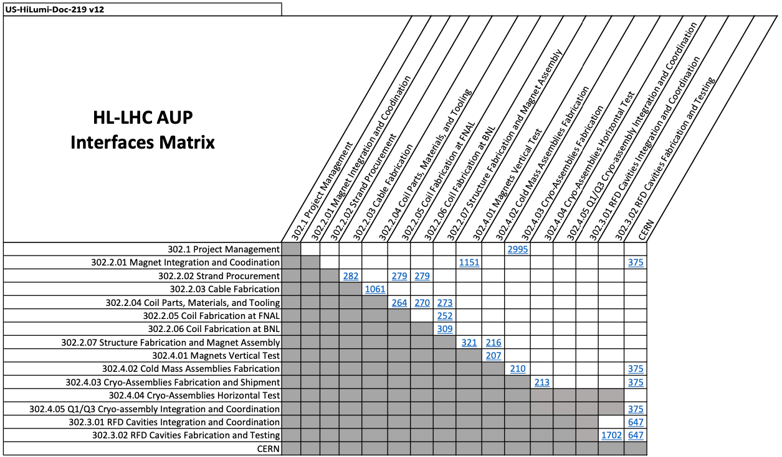
Interfaces with incoming coils and with magnet testing

Slide 8
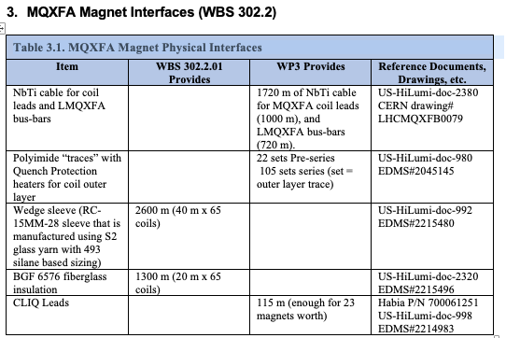
WBS 302.2.07: External Dependencies
Charge #8 & #6
Original CLIQ leads were provided by CERN (see interface control document US-HiLumi-doc-375); described in US-HiLumi-doc-998 (now obsolete)
Recently a modified procedure has been defined
  Described in US-HiLumi-doc-4328
  Update to ICD US-HiLumi-doc-998 is underway
All CLIQ lead material had been received from CERN in Feb 2020
New material will be needed per doc-4328

Slide 9
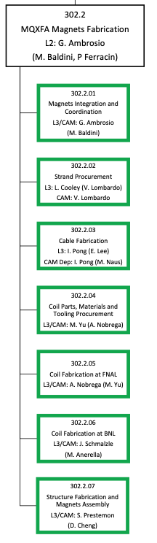
WBS 302.2.07: Team
Very established team
  Additional technicians planned
Target staffing & training level:
At least one additional technician to minimize disruption from vacation, illness, etc.
Cross-train to avoid potential bottlenecks or single-point failures
  Ex.: recent training of 2 junior techs on instrumentation
Soren Prestemon, L3 Manager
Dan Cheng, Deputy L3 Manager
Paolo Ferracin, Deputy L2 Manager
Laura Garcia Fajardo
QA:
Katherine Ray
Jennifer Doyle
Mike Solis (also procurements)
Technicians:
Joshua Herrera, lead
Juan Rodriguez
Jonathan Hekmat
Matt Reynolds
Bob Memmo (Electrical)

Slide 10
WBS 302.2.07: Achievements since CD-3
Charge #8
Facility improvements (lab-supplied):
- HVAC and roofing of assembly building
Completed tooling for full parallel assembly capability needed for production magnets
Completed assembly of all pre-series scope (MQXFA03-A07)
Assembled MQXFA08-11 and reassembled MQXFA08b
Key technical milestones since DOE CD-3 review
  PRR (4005 Feb. 2021)
  MQXFA Series Magnet Specifications updated (DocDb 4009-v6)
  Coil selection, Structure & Shim reviews; Handoff meeting for each magnet delivered to BNL

Slide 11
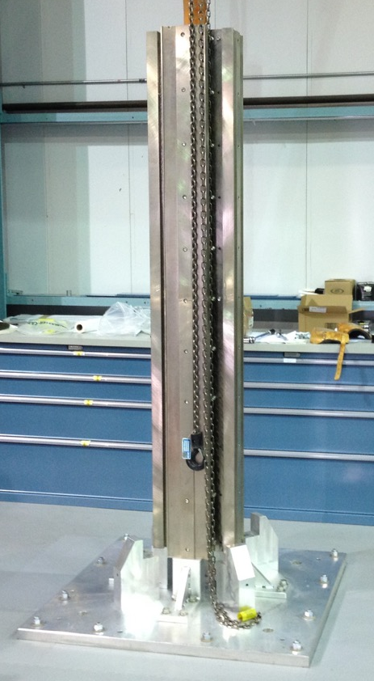
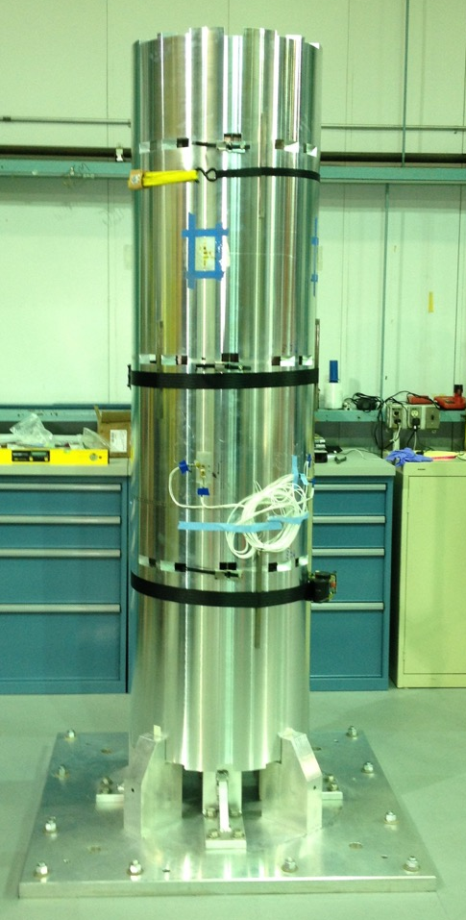
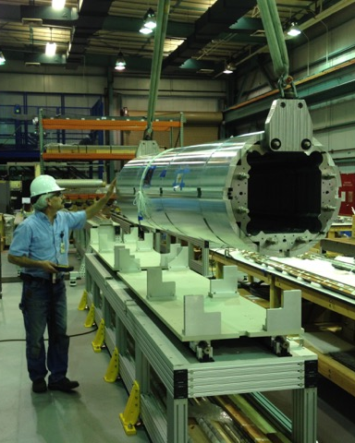
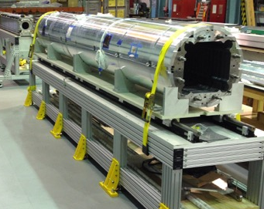
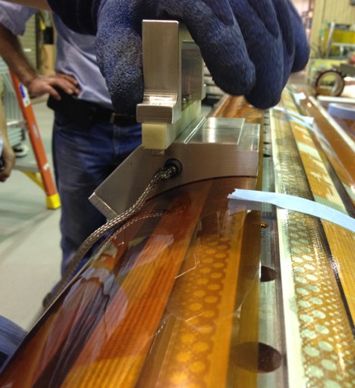
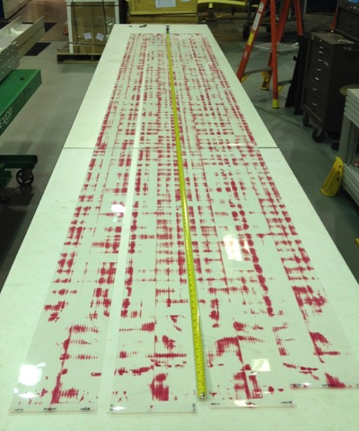
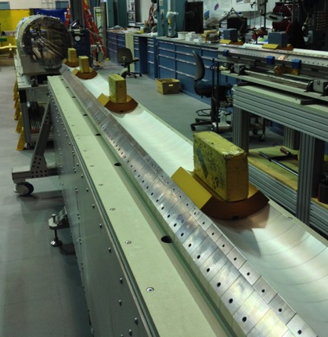
Magnet fabrication process – a pictorial view
Shell-Yoke Assembly
Coil Prep
Fuji Paper Exposure
Radial Shim Prep
11

Slide 12
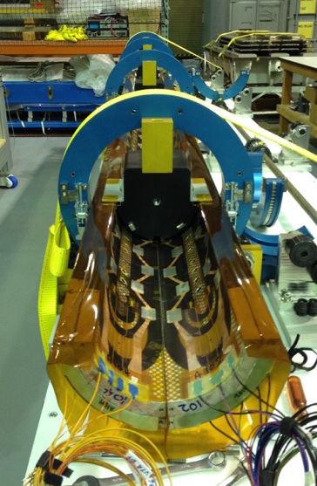
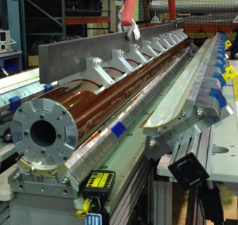
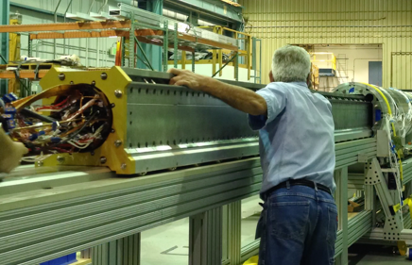
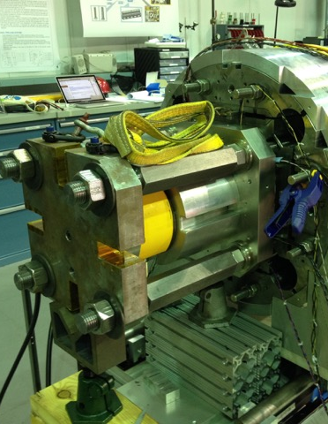
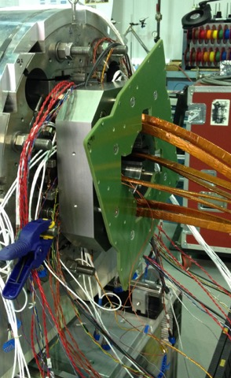
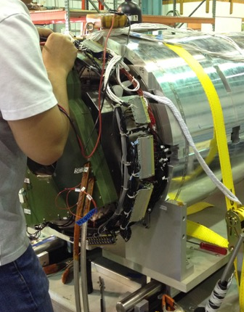
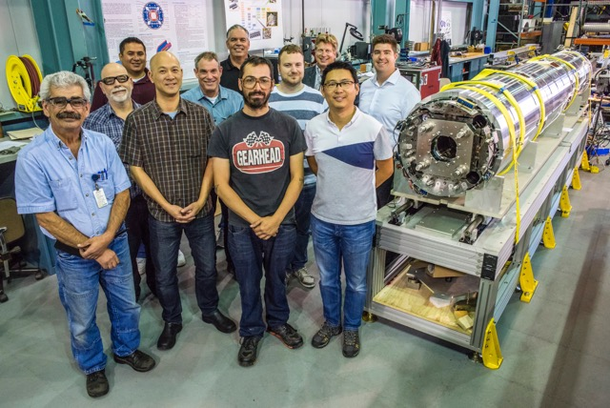
Magnet fabrication process – a pictorial view
Final Coil pack assembly
Coilpack Insertion
Preloading
Splicing and Connectorization
Fully assembled magnet

Slide 13
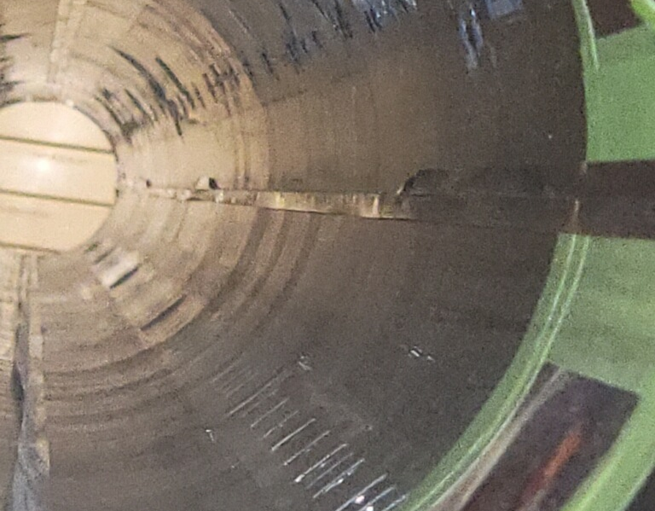
Examples of issues and resolutions
Cooling hole bore clearance – ECN-0233
GPI fold issue in MQXFA09 – NCR-0313 (critical)
Fiberoptics installed (upper coils only) – DCR-4190
Increase in pole-key gaps – DCR-4304

Slide 14
WBS 302.2.07: COVID Impacts and COVID BCRs
Charge #1
Major impact to magnet Structures:
  US-HiLumi-doc-4319: evaluated at $1,122,104
  Relevant BCRs:
    HL-LHC AUP_0248 “Magnet MQXFA07 Rework” (~67% due to COVID)
    HL-LHC AUP_0265 “Magnet Assembly and Vertical Testing Schedule Revisions” (~67% due to COVID)
    EAC-MA-15 “Additional magnet disassembly and reassembly”
    EAC-MA-16 “Additional magnet vertical test after 07/08”

Slide 15
WBS 302.2.07: COVID Impacts and COVID BCRs
Charge #1
Major impact to magnet Structures:
  Lockdown March 17- June 1 – no hands-on technical labor
  AUP deemed high-priority project upon restricted resumption of work
    First estimates of efficiency: ~75%
      driven primarily by slow-downs associated with training issues
      Potential for issues related to PPE and restrictions for certain operations
    Updated to 87.5% once some experience developed in restricted work mode
  Social distancing requirements made us modify some procedures
    #1: change in bolting procedure for increasing tech distance
    #2: the technician who had been leading the coil-pack assembly operations up to magnet MQXFA05 was removed from that task (starting from MQXFA06) because not vaccinated.
  Activities largely back to normal now, but lab guidance on COVID distancing and safety protocols remain linked to rate metrics => impacts some techs.
    Our processes are no longer impacted by design

Slide 16
Lesson’s learned resulted in improved process of assembly, demonstrated with MQXFA10
Identified during MQXFA07 disassembly
Lessons learned and preventive actions are being implemented on all magnets going forward

Slide 17
WBS 302.2.07: Procurement Status
Charge #4
All major components have been ordered
  ”Master Agreements” proved valuable
    Enabled timely PO placements
    Likely avoided additional costs due to inflation
Majority have been received and are in-use or in storage
Remaining procurements may include:
  Magnetic shims, and other consumables
Additional exposure to inflation is minimal for Structures

Slide 18
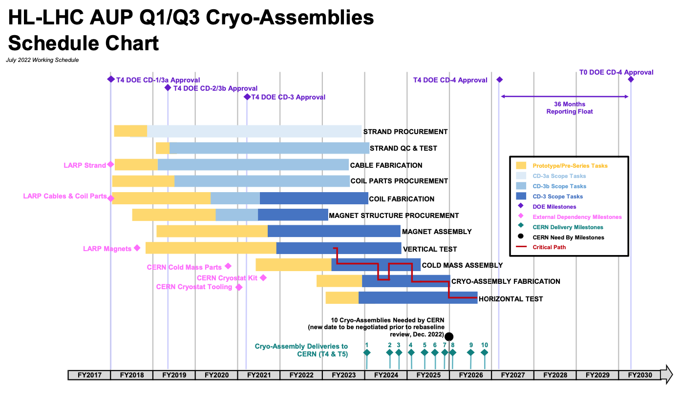
WBS 302.2.07: Schedule
Charge #4
Structures not on critical path, but…
  Need vigilance to meet P6 schedule
  Actions are being taken and remaining risks identified
Note: we have two fully functioning assembly lines to support meeting the schedule

Slide 19
WBS 302.2.07: Schedule considerations
Charge #4
Anticipated “full production” mode has been disrupted by:
  Disassembly of MQXFA07 for post-mortem
  Disassembly of MQXFA08 and re-use in MQXFA08b
  Disassembly of MQXFA09 and use of structure in MQXFA11
  Unloading and reloading of MQXFA10 to address “squareness” lessons-learned
Nevertheless:
  We are confident in our ability to deliver to the schedule
    Labor estimates and durations in BOEs demonstrated on each step of the Assembly Breakdown Structure
  Actions taken:
    Training staff for some level of redundancy
    Out-sourced some assembly steps to industry
  Remaining concern:
    Challenging market for tech expertise – hard to hire and to retain

Slide 20
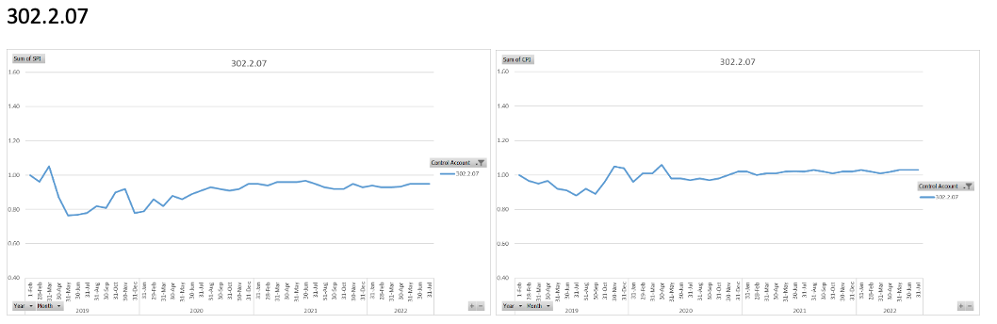
WBS 302.2.07: Cost and Schedule Performance & VAR Reports
Charge #4, #8
SPI
CPI
Major variances earlier in project stemmed from large procurements and various vendor issues in delivering on schedule
  Most significant example was ARMCO steel order
Recent variances typically associated with individual component delivery delays (e.g. due to vendor rework), mismatch of receipt and earning of article, and overruns/underruns on certain labor elements

Slide 21

WBS 302.2.07: Estimate at Completion
Charge #4
  Minor Variance at Completion (BAC- EAC) = $108K on $33.7M
    Balance between positive cumulative cost variance $693K and manual EAC adjustments ($554.6K)

Slide 22
WBS 302.2.07: QA/QC
Area | QC / Work Instructions | QA – MIP element
Coil Selection and Shimming Plan Review | Coil Acceptance WI SU-1011-5294; Coil CMM WI SU-1012-3958 | 1.1
Incoming Shells and Yokes & inspection |  | 2.2
Assemble Yoke Half-Stacks | Yoke Pre-Stack SU-1008-8072; Yoke Half Stack SU-1009-7829 | 2.2
Put strain gauges on shells | Shell Instrumentation SU-1009-3745 | 2.3
Complete Shell-Yoke Assembly | Shell-Yoke Assembly SU-1008-2169 | 2.4
Incoming coil pack assembly parts inspection | Load Pad Pre-Stack SU-1008-8075 | 3.1
Dressed Coil | Dressed Coil SU-1008-8073 | 3.2
Pad Collar Assembly | Pad-Collar Assembly SU-1010-1610 | 3.3
Coil Pack Assembly | Coil Pack Subassembly SU-1008-8074 | 3.4
Coil Pack Electrical Tests | MQXF Magnet Electrical QA at LBNL SU-1010-1903 | 3.5
Coil Pack Magnetic Measurements | Magnetic Meas. SU-1010-2018 | 3.6
Area | QC / Work Instructions | QA – MIP element
Incoming parts inspection (Master Keys, etc.) |  | 4.1
Strain Gauges on Axial Rods | Axial Rods Instrumented SU-1008-8069 | 4.4
Magnet Integration and Loading | MQXFA Loading and Integration WI SU-1011-5637 | 4.5
Post-preload Electrical QC | MQXF Magnet Electrical QA at LBNL SU-1010-1903 | 4.6
Finish Wiring | Connectors and Finishing WI SU-101205517 | 4.7
Assemble Splice Box and verify Bore ID Clearance | Splice Box WI SU-1008-8067 | 4.8
Magnetic Measurements, Fiducial Structure | Magnetic Measurements SU-1010-2018 | 4.10
Final Electrical QC | MQXF Magnet Electrical QA at LBNL SU-1010-1903 | 4.11
Strain Gauge Reading |  | 4.12
Prepare for Shipment |  | 4.13
MIP has been approved by all parties
QC data for each magnet is uploaded to Vector and to the CERN MTF – all magnet data is then available to subsequent WBS elements

Slide 23
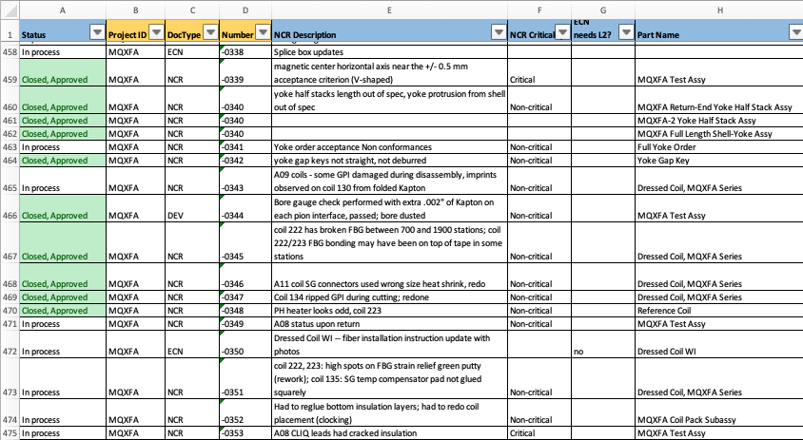
WBS 302.2.07 QA/QC process
Detailed tracking sheet is maintained
Monthly reports submitted to L2 and Project QA Manager, as well as regular meetings
  Clear process for informing L2 of an issue and for resolution
  Excellent relations within AUP and with CERN – strong team, very transparent

Slide 24
WBS 302.2.07: Risks
Charge #3
Risk ID | Title | Prob. (+COVID) | Realized
RT-302-2-07-007 | Magnet disassembly and reassembly needed to meet the requirements | 50% (+10%) | Yes
RT-302-2-07-001 | Magnet assembly matrixed or shared resources unavailable when needed | 65% | No
RT-302-2-07-006 | Production is stopped because more QC testing/discussions need to be carried out | 62% | No
RT-302-2-07-004 | Magnet structure vendor delivery delays | 33% (+25%) | No
RT-302-2-07-002 | Bladder pressurizing system failure | 25% | Yes
Risks are monitored and reviewed regularly
  RT-302-2-07-002: “Bladder pressurizing system failure” was realized; spare had been procured as part of mitigation, resulting in negligeable delay
  RT-302-2-07-007: “Magnet disassembly and reassembly needed to meet the requirements” has been realized with the disassembly and reassembly of magnet 10
    Updated entry reflect residual risk of having to disassemble and reassemble between 0 and 2 magnets between now and the end of the project.

Slide 25
WBS 302.2.07: ES&H
Charge #5
We have regular LBNL HL-LHC AUP EH&S meetings
Meeting agenda’s and notes are shared regularly with FNAL Project EH&S Manager Amy Pavnica
Magnet Survey and Alignment has a Work Planning and Control (WPC) Activity (laser tracker has Hazard Level 2); staff are trained accordingly
Crane failed in assembly area:
  Resulted in halt of use until inspected and operation recovered
  Spare parts have been procured, maintenance will be planned when all parts are in-house and when AUP schedule is minimally impacted

Slide 26
WBS 302.2.07: Summary
The Magnet Assembly WBS is in full production mode, deep into production magnet assembly
Strong team, now well-versed in all technical, QC/QA, and EVMS aspects of the project
COVID has had a significant impact on multiple fronts – these are now understood and addressed
We have procured all major components for the magnet assemblies, alleviating a major concern with inflation and supply-chain
Risks are being managed and addressed – plenty to worry about… but plenty to be proud about!

Slide 27
Backup Slides
You should keep the pie-charts and tables from the CAM e-Toolbox as backup slides in case someone asks questions

Slide 28
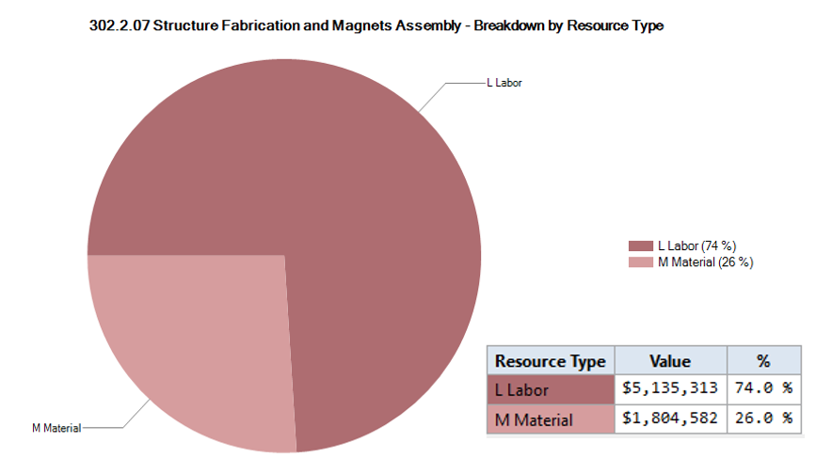
302.2.07 Resource Type Breakdown
Charge #4
74% Labor, 26% M&S
M&S dominated by Structure procurements; also includes shipment, etc.

Slide 29
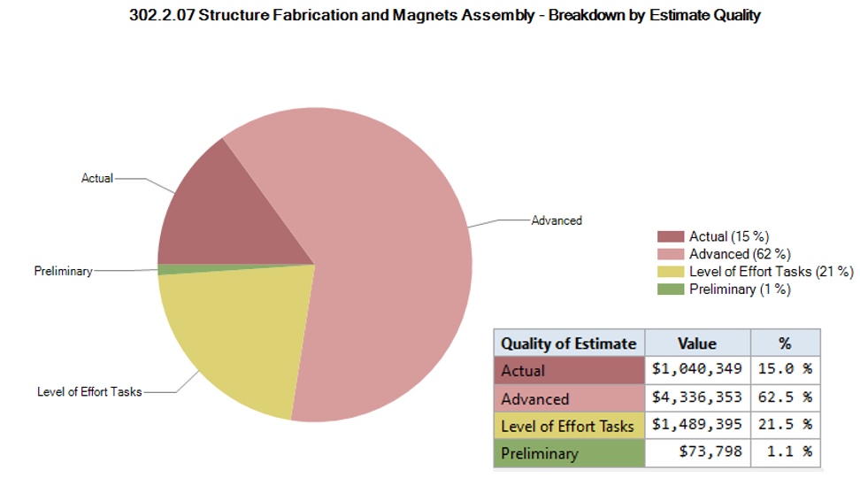
302.2.07 Estimate Quality
Charge #4

Slide 30
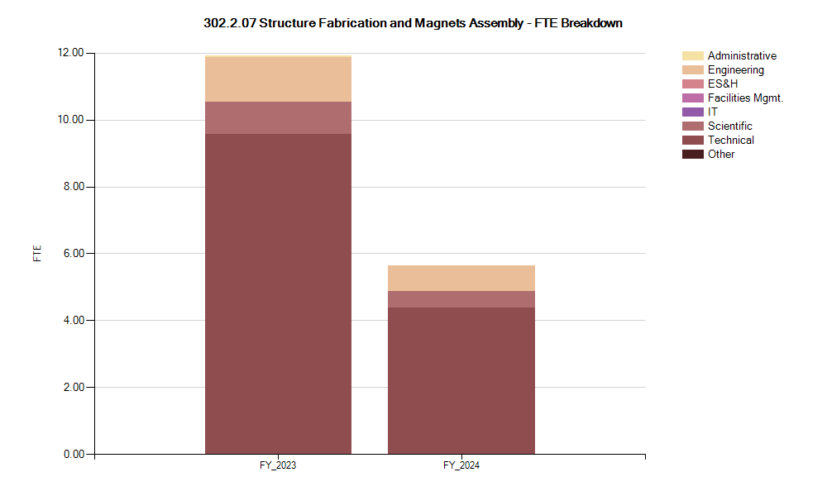
302.2.07 FTE Breakdown
Charge #4

Slide 31

302.2.03 Cost Performance Report
Charge #4
BAC = $33.802M
Yellow thresholds crossed in Current Period Cost
Yellow thresholds crossed in Cumulative to Date schedule
Cumulative SPI = 0.95, CPI = 1.03

Slide 32
WBS 302.2.07: Other BCRs/Manual Adjustments since CD-3
Additional significant BCRs:
  BCR#0278 Additional Bladders Required to Replace Unreliable Bladders;
    Impact: Cost $193,137; Sched Days 0
  BCR#0270 Rework of MQXFA-10 due to Pole-key Gap Asymmetry;
    Impact: Cost $102,556; Sched Days 0
  BCR#0249 Magnet Axial Rods PO and Additional Bladders Order;
    Impact: Cost $179,972; Sched Days 0
  BCR#0221 Tariffs to Move ARMCO Plates to PAMCo. and FY21 Structure Orders;
    Impact: Cost -$192,769; Sched Days 0

