Slide 1
QICK (Quantum Instrumentation Control Kit), Readout and control for qubits and detectors.
Gustavo Cancelo
Fermilab
June 1st, 2022

Slide 2
Readout and control for qubits and detectors.
Control and readout (classical)
Cold electronics (classical or quantum)
Several temperature-controlled stages
Qubit or detector
A large collection of detectors, in particular, many of them used for astrophysics, share commonality with qubits and elements used in QIS.
To minimize thermal noise, they operate at very low temperatures, typically below 1K and as low as 10mK.
The size of the cryostat, its cooling capacity, limit the amount and functionality of the cold electronics.
Complex control low temperature electronics is a field of research in its own.
We focus in warm electronics control and readout.
Performing most functions at room T increases the cabling outside and inside the fridge. However due to the amazing commercial electronics components to build room T control systems it is very hard to think of replicating that in low temperature.
Notes:
This is an optional third slide that provides additional information to facilitate presentation of this slide by and to various people not directly involved with the project.

Slide 3
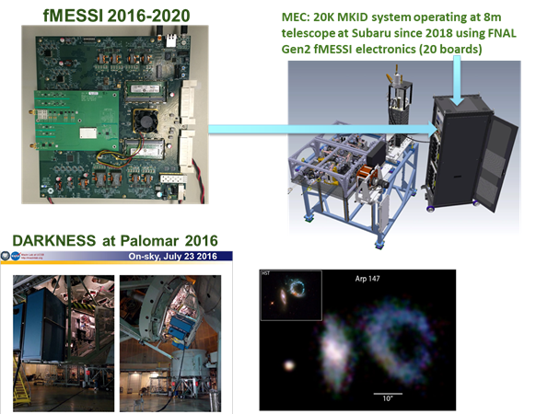
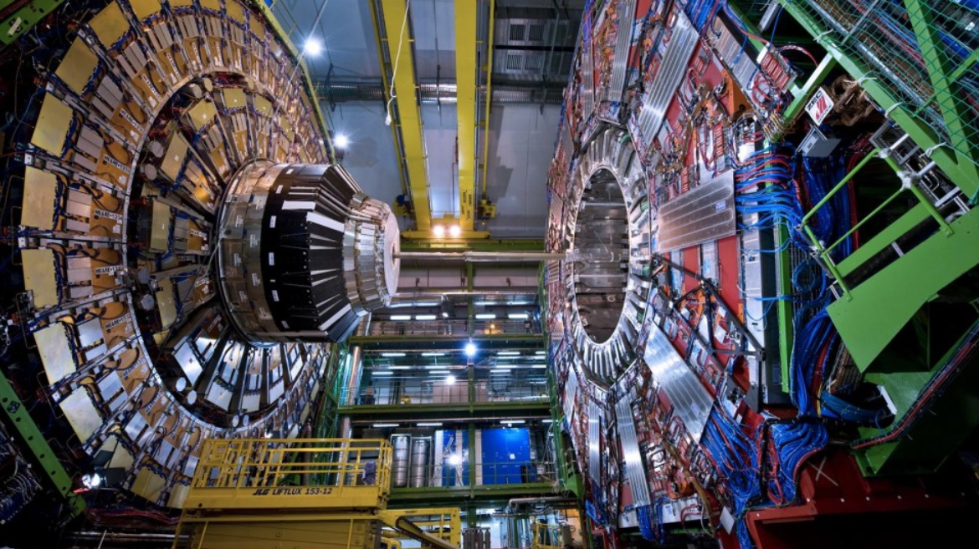
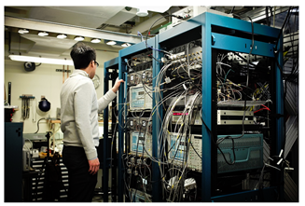
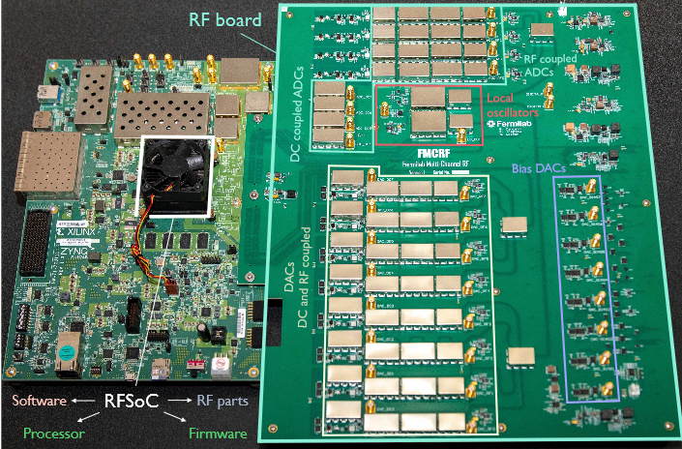
What is QICK?
In HEP we are used to design R&C electronics for millions of channels. DOE labs can make a strong contribution to QIS
Precursor of QICK. 20K MKID based camara.
UCSB-FNAL collaboration (B. Mazin, G. Cancelo)
In operation at 8m Subaru telescope (Hawaii)
CMS at CERN
with $20K, single pair of boards
Replaces ~$1M, full rack, off-the-shelf
QIS after ~2020
QIS before ~2020
RFSoc
FPGA
Notes:
This is an optional third slide that provides additional information to facilitate presentation of this slide by and to various people not directly involved with the project.

Slide 4
Control and readout (C&R): QIS vs. HEP
In particle physics (e.g. cosmology) detector specifications are (ideally) frozen before the R&C is designed. That typically includes:
Number of channels,
Signal to noise.
Frequency and time domain specifications: BW, timing, latency, triggers, etc.
Type of detector (e.g. MKID, TES, SNSPD, etc.). One or many but pre-established.
QIS is different to detectors.
The final goal is to build a quantum computer or a quantum network such that the internet.
An intermediate goal may be to build a fault tolerant qubit and a fault tolerant gate.
There are many avenues and technologies being pursued to achieve those goals.
For each QIS technology the components (e.g. qubits) are in constant evolution.
QIS experiments vary the number of elements from 1 to many.
Is there a common C&R system that can be used for all that?
Is the system scalable to achieve a NISQ or larger?
How can we take advantage of the existing technology to build C&R systems?
QIS is similar to detectors
In the characteristics of the signals to be processed: time, frequency and power domains.
They can use similar technology: hardware, firmware and software!
Notes:
This is an optional third slide that provides additional information to facilitate presentation of this slide by and to various people not directly involved with the project.

Slide 5
Control and readout (C&R): QIS vs. HEP
Control and readout (classical)
What are the signals from/to C&R and QIS/Det?
What are the functions to be performed?
Cold electronics (classical or quantum)
Radiofrequency signals in the ~2-20GHz: Short pulses (few ns up to CW).
RF signals are modulated by complex envelopes.
Fast control DC coupled and up to 1 or 2GHz signals.
Accurate, ultra low noise bias signals.
Read, decode and record information.
Run many times to lower statistical errors.
Variational parameters for characterization and calibration (e.g. amplitude, frequencies, powers, etc.).
Low latency for feedback control.
It is obvious that the best control and readout needs fast digital processing, fast A/D and D/A conversion.
Multiple control and readout outputs and inputs
Qubit or detector
Notes:
This is an optional third slide that provides additional information to facilitate presentation of this slide by and to various people not directly involved with the project.

Slide 6
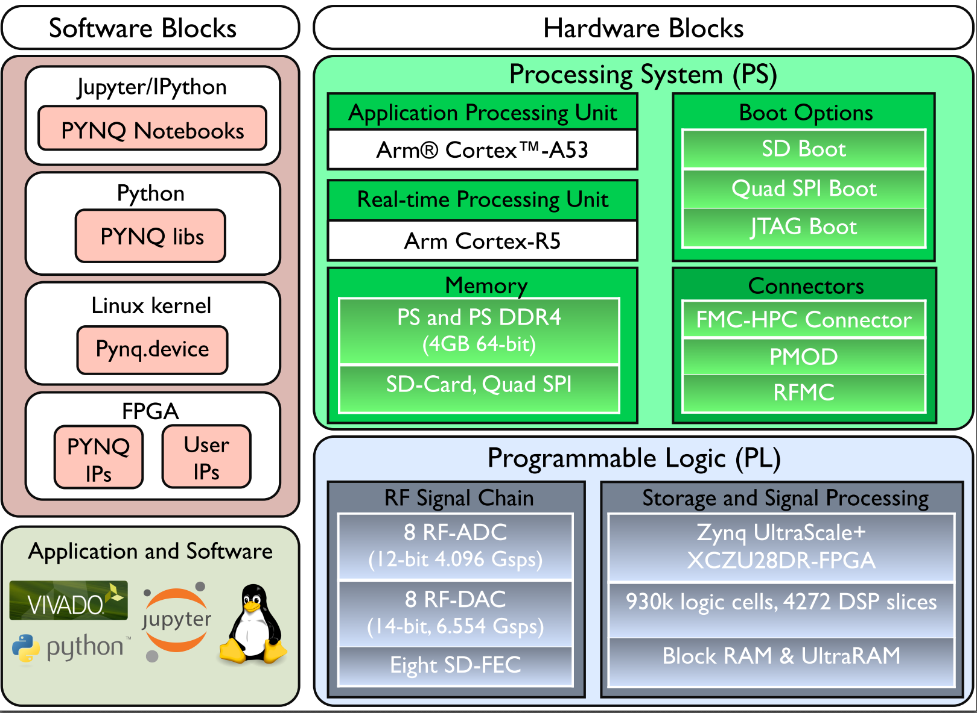
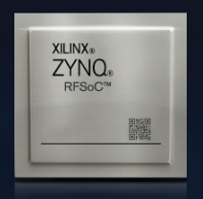
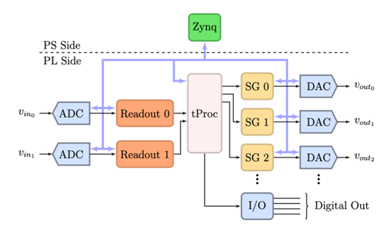
Supercomputer + 16 channel 10GHz RF in a chip
Xilinx RFSoC FPGAs are extremely powerful and used to build multi output/input complex control and readout functions.
10 GHz DACs and ADCs are built in.
4 core ARM processor running Linux based QIS software.
We only need to add RF amplifiers, attenuators and filters.
And we need electronics to support the FPGA (clocks, interfaces, etc.)
Notes:
This is an optional third slide that provides additional information to facilitate presentation of this slide by and to various people not directly involved with the project.

Slide 7
Quantum Instrumentation Control Kit v1: QICK1
A fully integrated readout and control system for QIS, quantum networks and superconducting detectors.
No extra room temperature hardware needed.
8 RF control/readout up to 8GHz. 14 bit DACs
8 DC coupled control up to 2GHz.
4 RF inputs, up to 80dB amplification, 125K noise.
4 DC-1.5GHz inputs. 1nV/Hz noise.
8 1ppm resolution in bias channels.
Frequency multiplexed control and readout up to 16 qubits per output/input.
Example: FPGA DAC output can be selected as a RF or DC coupled output on the RF board.
The RF output uses a DSB analog mixer and filter.
Output power controlled by step attenuators.
FPGA
Notes:
This is an optional third slide that provides additional information to facilitate presentation of this slide by and to various people not directly involved with the project.

Slide 8
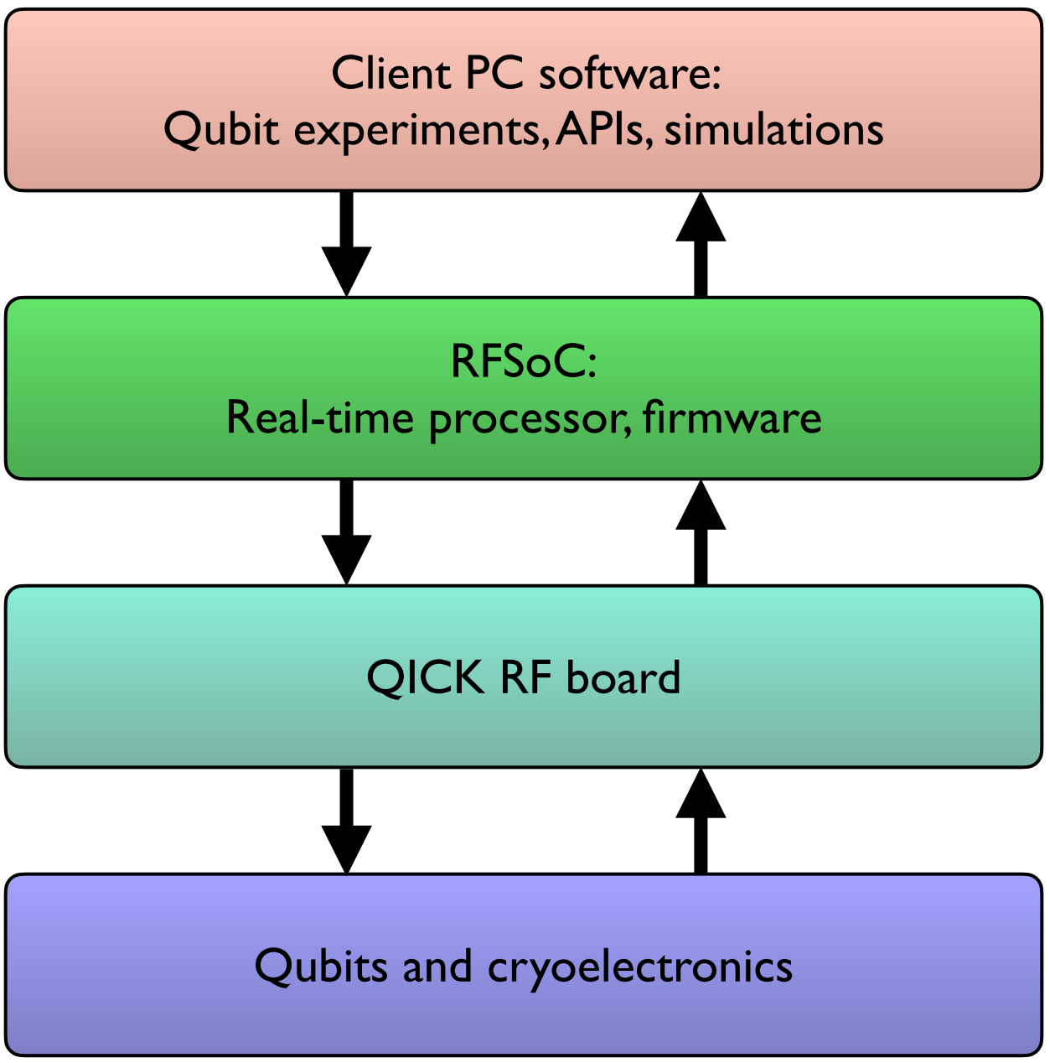
QICK Software
Quantum programs are developed in python using the PYNQ environment and Jupyter notebooks.
Quantum programs run on Linux in the RFSoC FPGA 4 core processor.
All critical functions are executed in the programmable logic.
In progress: Software layers to make QICK a backend for Qiskit and Braket. OpenQasm3

Slide 9
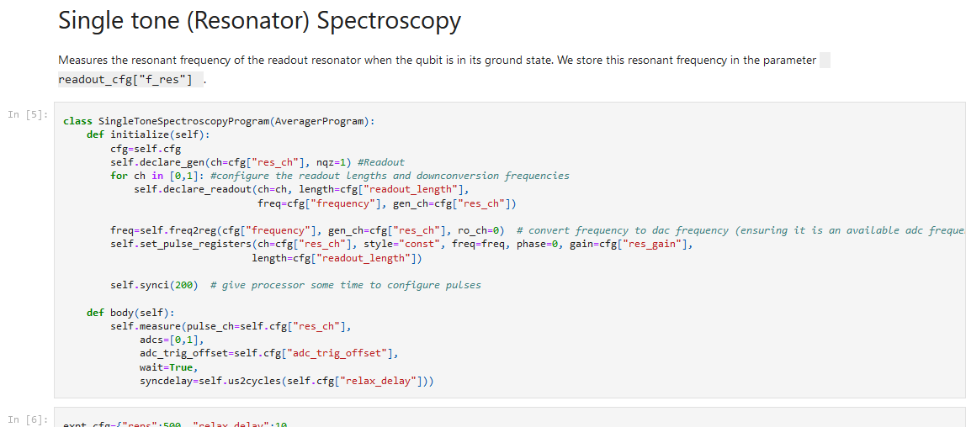
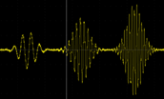
Quantum Instrumentation Control Kit
DAC-RF
t
DAC-flux
Ap
Tdelay
Tpulse
t
ADC Readout
Tpulse
Ap
t
Repeat for different Ap, Tdelay
The QICK user writes quantum programs in python using the PYNQ environment running on the FPGA processor.
The code is compiled into machine language and executed by the tProc on the FPGA.
The firmware generates waveforms and reads out data time synced to a master clock running on the FPGA board.
Multiple boards can be synced up to build larger systems.
Notes:
This is an optional third slide that provides additional information to facilitate presentation of this slide by and to various people not directly involved with the project.

Slide 10
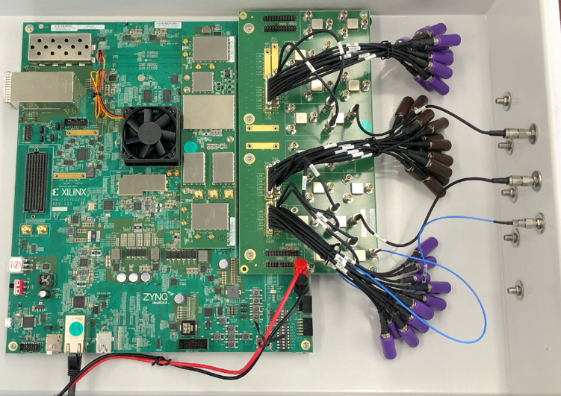
Quantum Instrumentation Control Kit 2: QICK2
QICK2 based on RFSoC ZCU216. RFSoC Gen3 FPGA
Custom RF board being designed.
16 RF or fast DC-1.5GHz outputs.
RF digital synthesis up to 10GHz (no analog mixers needed).
60 dB of programmable attenuation, LP and BP filtering.
4 RF inputs, 4 DC-1.5GHz inputs.
Direct ADC sampling of RF input, no analog mixers needed
LNA noiseT=125K, 90 dB programmable gain.
8 20-bit DACs for biasing.
The RF companion board is under development. For now users need to use discrete RF amplifiers and filters.
The RF chain is much simplified because the outputs go up to 10 GHz in the digital domain.
Al RF mixing is done in the digital domain inside the FPGA.
Notes:
This is an optional third slide that provides additional information to facilitate presentation of this slide by and to various people not directly involved with the project.

Slide 11
More QICK features
Very low latency for feedback-based quantum algorithms (e.g. active reset and error correction).
High frequency digital up/down conversion make RF spectra spur free (see QICK paper plot)
Sophisticated quantum programs with multiple loops and parameter sweeps run on FPGA without software latencies.
Automated calibration.
AI and optimal control algorithms are easily integrated.
Open source: posted at QICK github. (https://github.com/openquantumhardware/quick)
An educational version with 2 control/readout channels is available for $2.5K (small universities can do QIS)
QICK simulator in progress.
100 qubit system by end of 2022. (NOTE: Multiplexing can increase this number).
DC control example: 1.3ns pulse

Slide 12
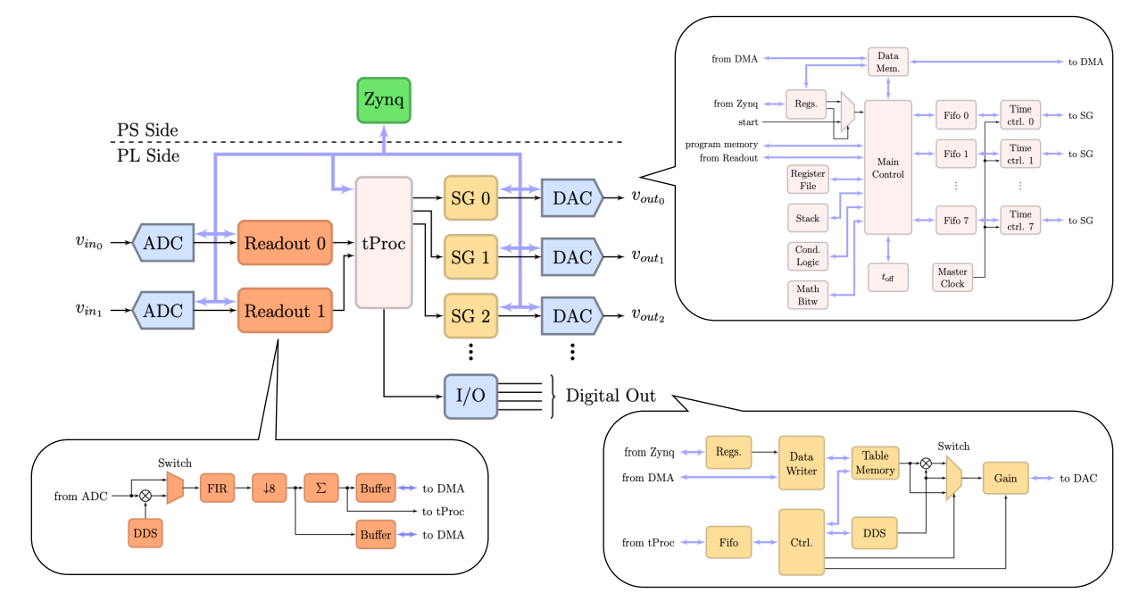
The QICK firmware
Highly configurable to accommodate qubit types and number of channels
Frequency and time multiplexing available on every DAC (and ADC)
DAC1
. . .
f
f₁
f₂
f₃
f_{N}
∆f=200MHz
∆f=200MHz

Slide 13
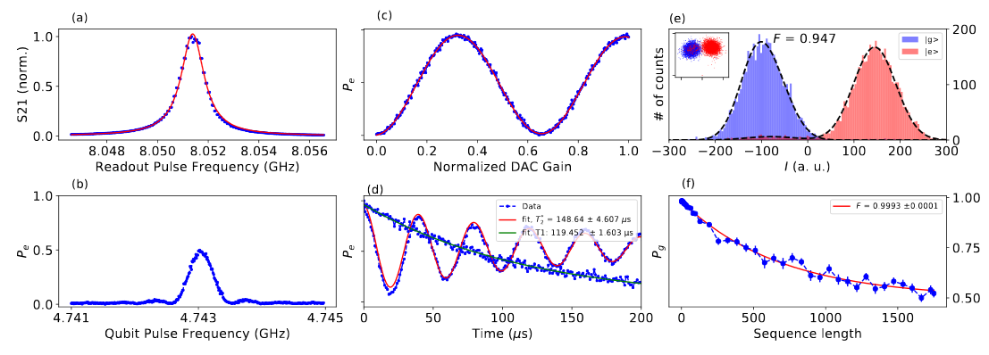
QICK: single qubit measurement at David Schuster’s lab, U.C (prepared by Ankur Agrawal).
Single qubit measurement
State of the art single shot fidelity F=94.7% (without parametric amplification)
Randomized benchmarking fidelity of F_{avg}=99.93±0.01%, close to the estimated coherence-limited gate fidelity of F_{lim}=99.96%.
QICK performance measurements using a transmon qubit dispersively coupled to a readout cavity.
(a) and(b) Qubit spectroscopy measurements.(c) Qubit Rabi oscillations. (d) T1 and T2measurements (of 119μs and 148μs, respectively). (e) Single shot measurements of a qubit prepared in ground and excited states showing 94.7% fidelity.(f) Randomized benchmarking protocol. Average gate fidelity is Favg=99.93%±0.01% which approaches the estimated coherence-limited gate fidelity of Flim=99.96%.
Notes:
This example is from a single-investigator award. Please use the NQISRC template.

Slide 14
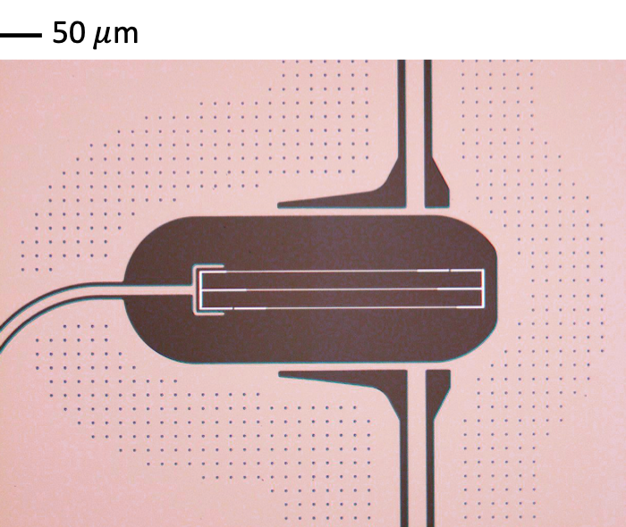
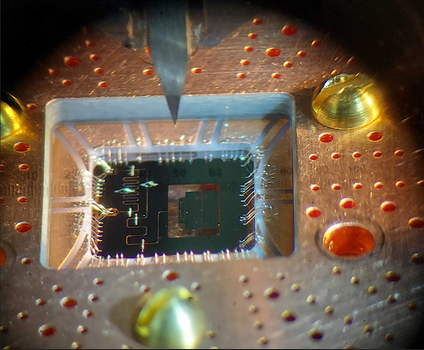
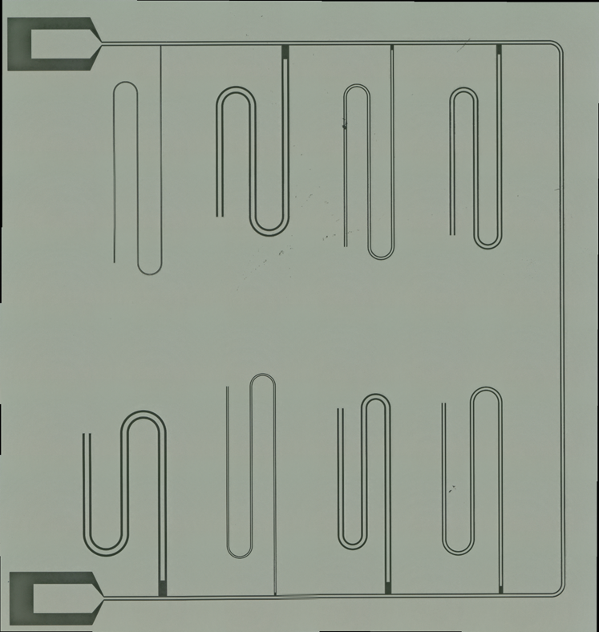
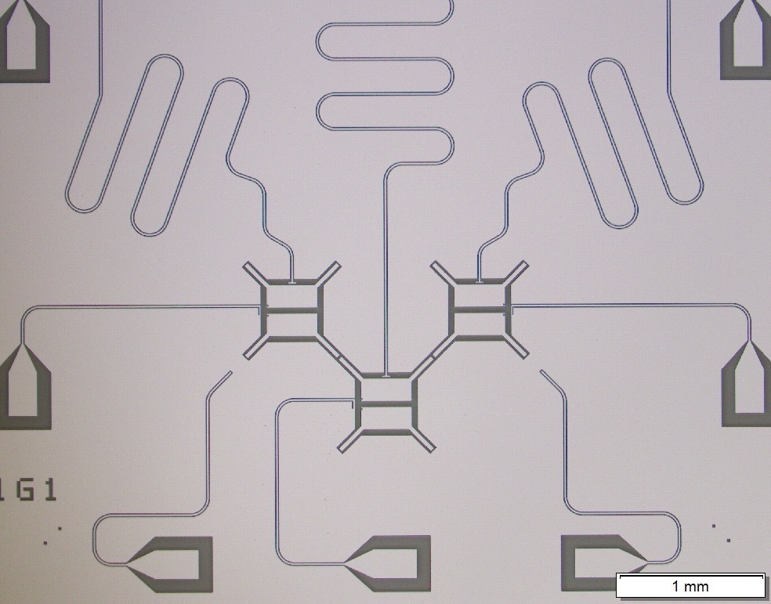
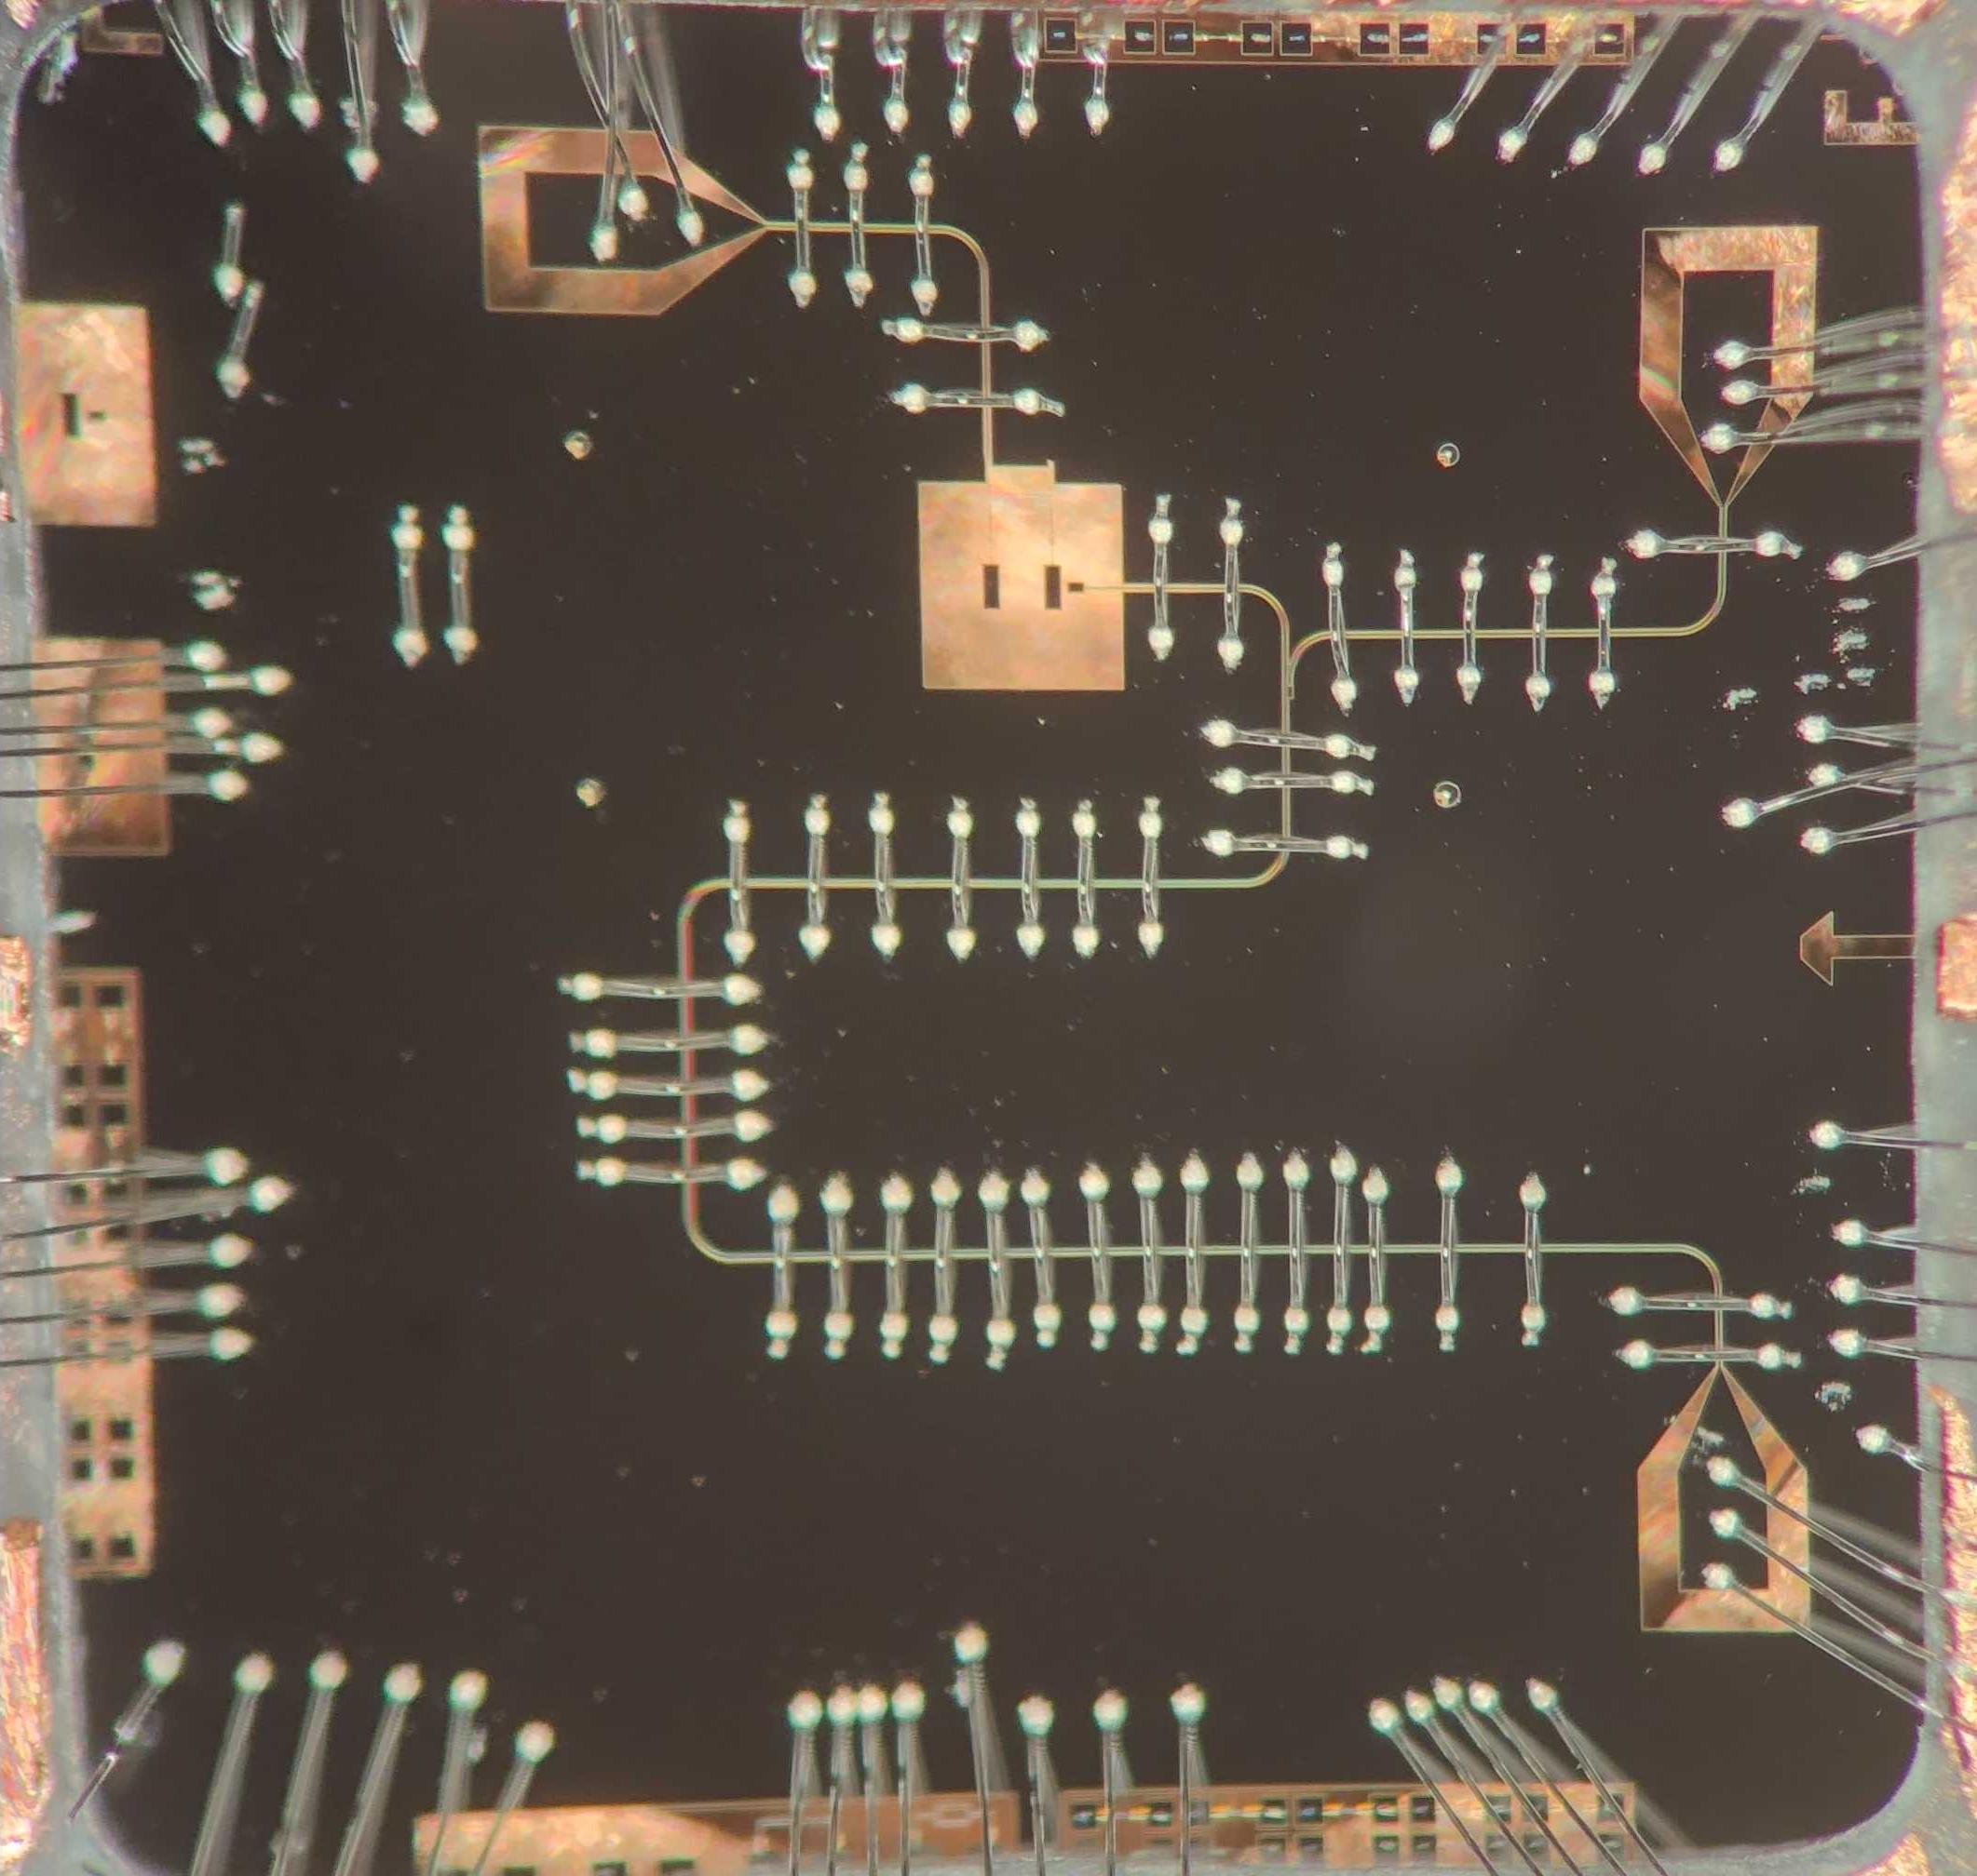
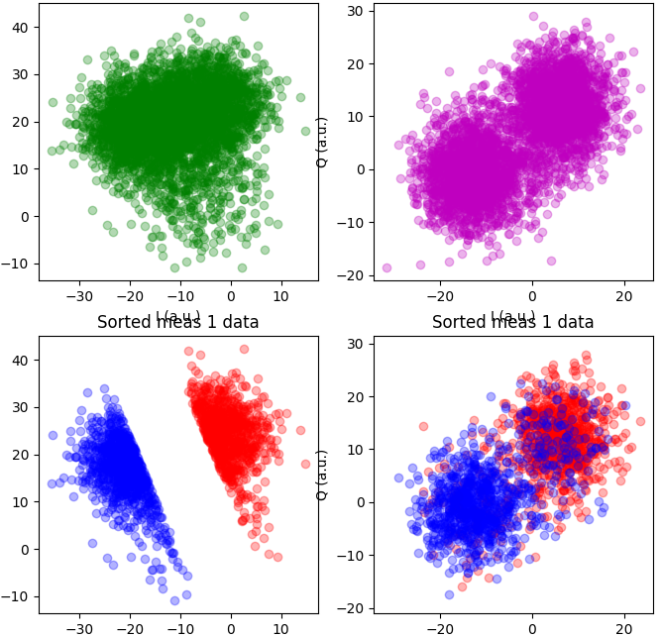
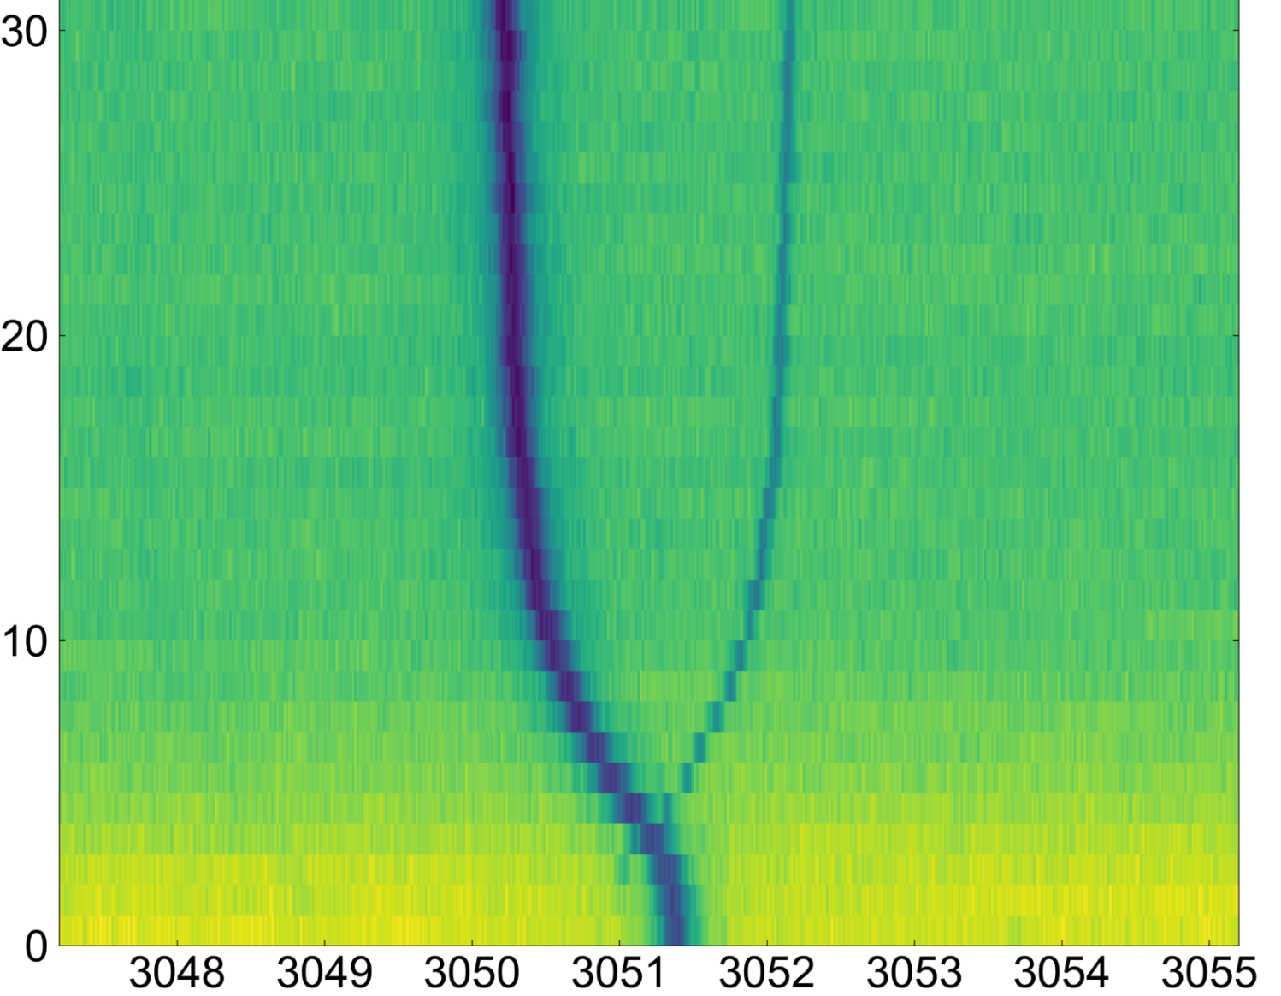
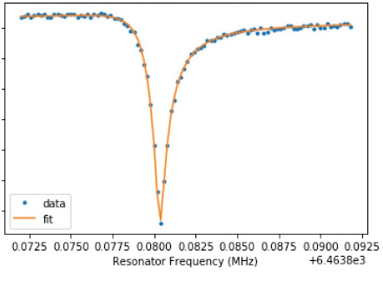
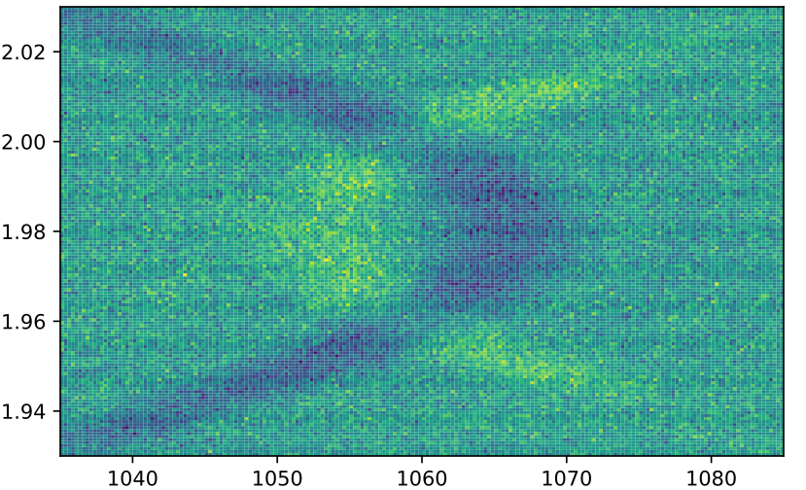
(prepared by Sara Sussman)
High-Q tantalum
resonators
2D tantalum
Kerr-Cat qubit
Tunable transmon lattice
for quantum simulation
Fluxonium
molecule
Active control of
fluxonium
Squeezing power (a.u.)
Transmission (a.u.)
Flux pulse strength (a.u.)
Common mode voltage (V)
Q (a.u.) Q (a.u.)
Spec frequency (MHz)
Resonator frequency (MHz)
Spec frequency (GHz)
Spec frequency (MHz)
I (a.u.) I (a.u.)
Phase-coherent
squeezing drive for
noise-biased cat states
MUX’d readout
Fitted Qs > 15 million
Fast flux pulses to simulate
flat band state dynamics
Sensitivity to qubit levels
that are protected from noise
Optimal readout
Post-selection
Active reset
Notes:
Fluxonium molecule
-The blue transition is designed to be protected from noise

Slide 15
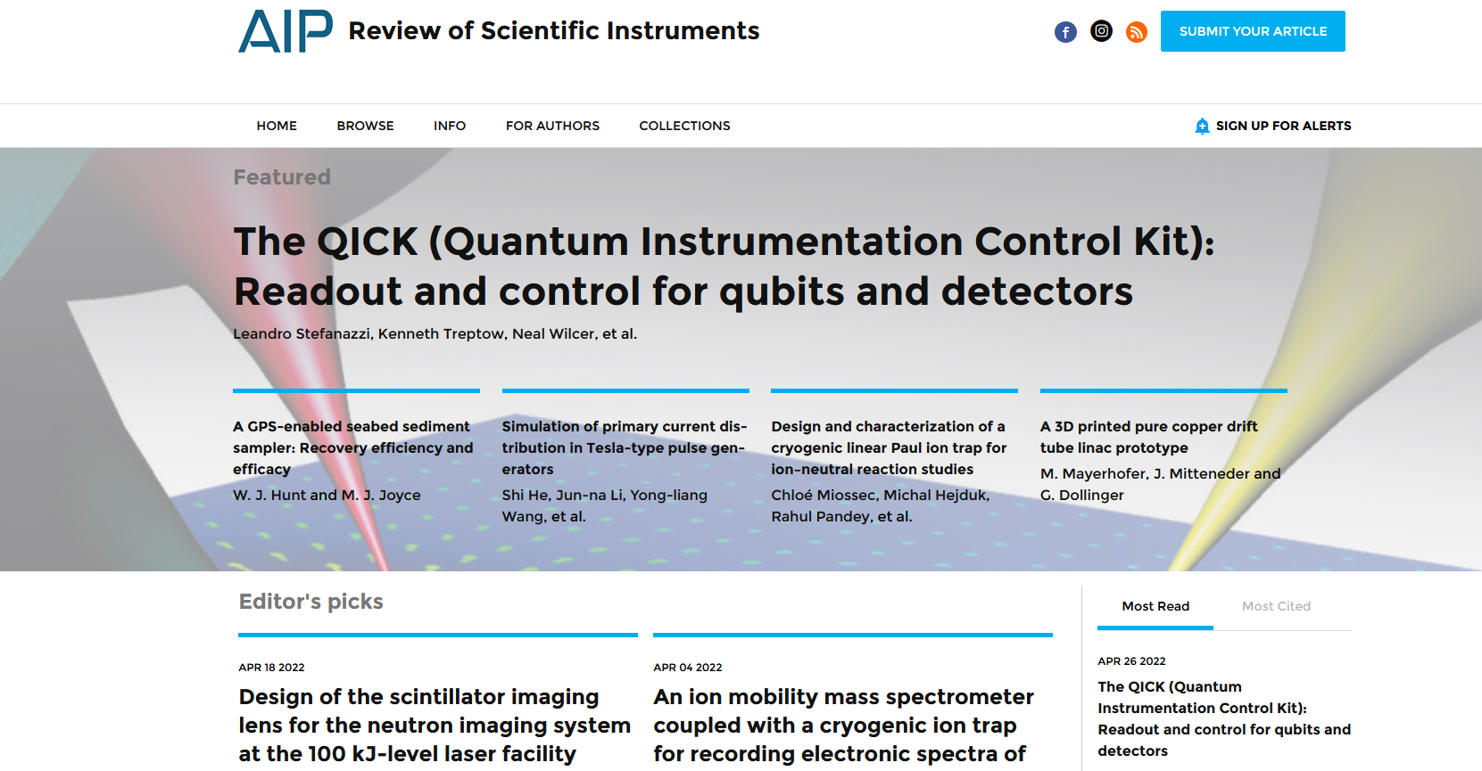
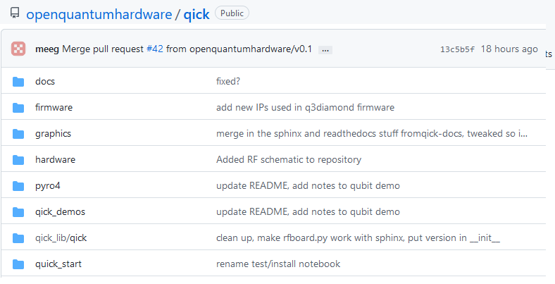
QICK paper made the cover of AIP RSI
Research Details
We outline state of the art methods in the paper The QICK (Quantum Instrumentation Control Kit): Readout and control for qubits and detectors. arXiv:2110.00557. Published in Research of Scientific Instruments. https://doi.org/10.1063/5.0076249
We opened our work to the scientific community.
https://github.com/openquantumhardware/qick

Slide 16
Experiments using QICK. Talks at the APS march meeting
(not including 2 talks about the QICK system itself)
Monday
B36.00001 : Controlling Qubit Relaxation in 1-3 Dimensions
Wednesday
M36.00003 : A Josephson junction-based maser using three-wave mixing
N34.00006 : Fast flux control of a high-Q 3D multimode cavity
N41.00007 Towards Disorder-Induced Dynamics of Flatband States in Superconducting Circuits
Q41.00002 Study of Two-Level-System losses in Tantalum Superconducting Microwave Coplanar
Waveguide Resonators
Q41.00005 Characterizing Loss Channels in Tantalum Transmons using Lumped Element Resonators
Thursday
T41.00001 : Improved Readout with Active Reset in a Heavy Fluxonium Circuit
T41.00003 Progress Towards a Protected Qubit Subspace within a Fluxonium Molecule
T41.00004 : Fast control of low-frequency fluxonium qubits
T41.00007 Towards a 2D tantalum Kerr-cat qubit
An experiment with 16 qubits is being prepared to run at Schuster’s lab (UC) in April.

Slide 17
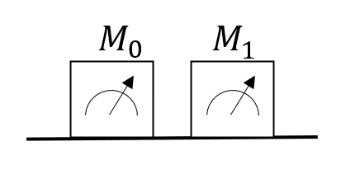
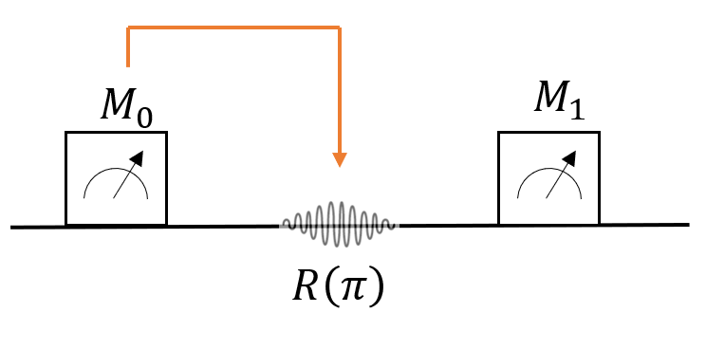
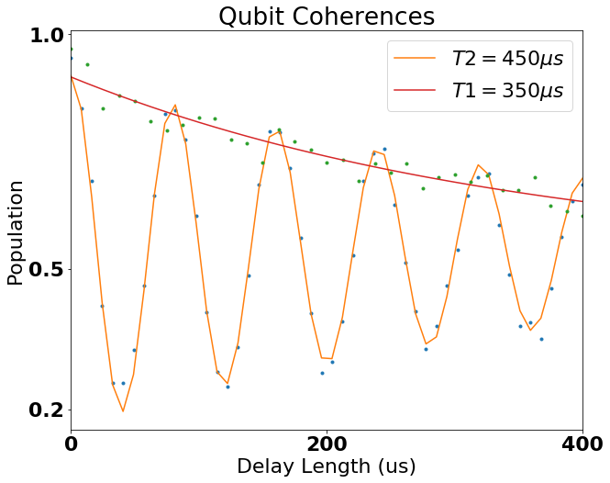
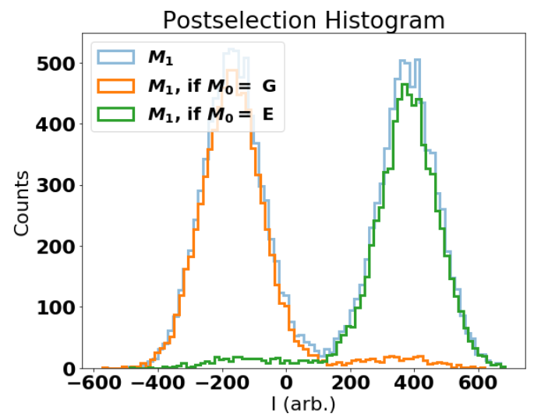
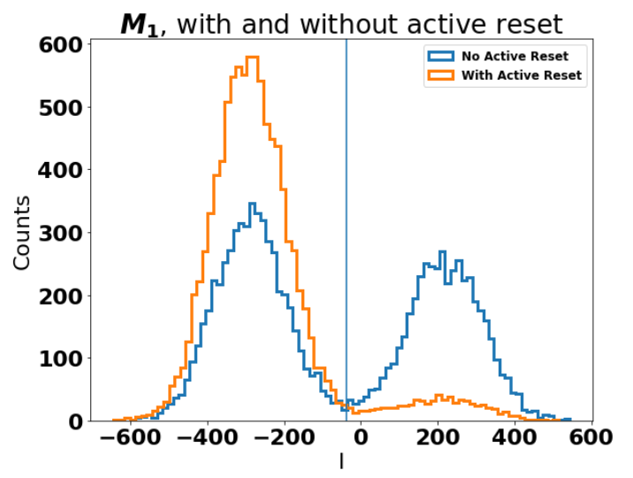
Fluxonium sample measured with RfSoc. (prepared by David Schuster)
Readout length: 16$μ$s
Readout fidelity: 96.3%
Feedback delay: ~200ns
Qubit Coherence:
T₁=450$μs$, T₂=350$μ$s

Slide 18
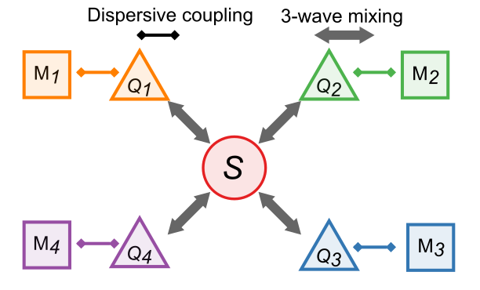
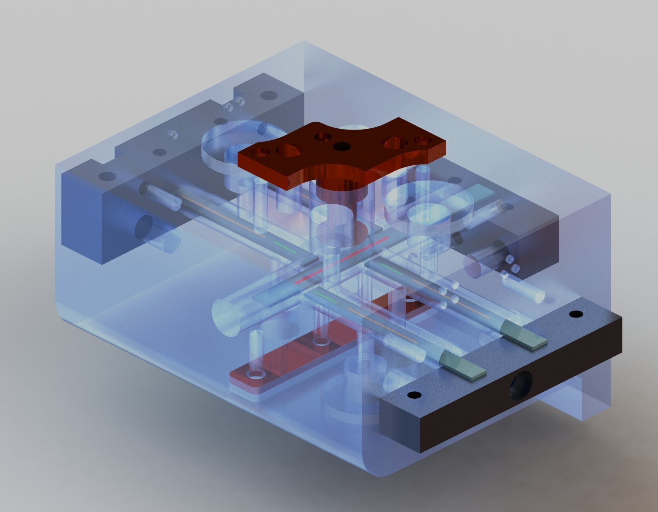
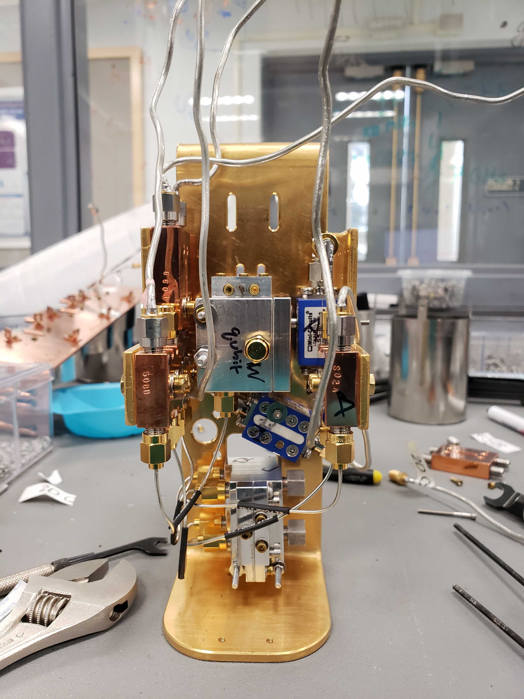
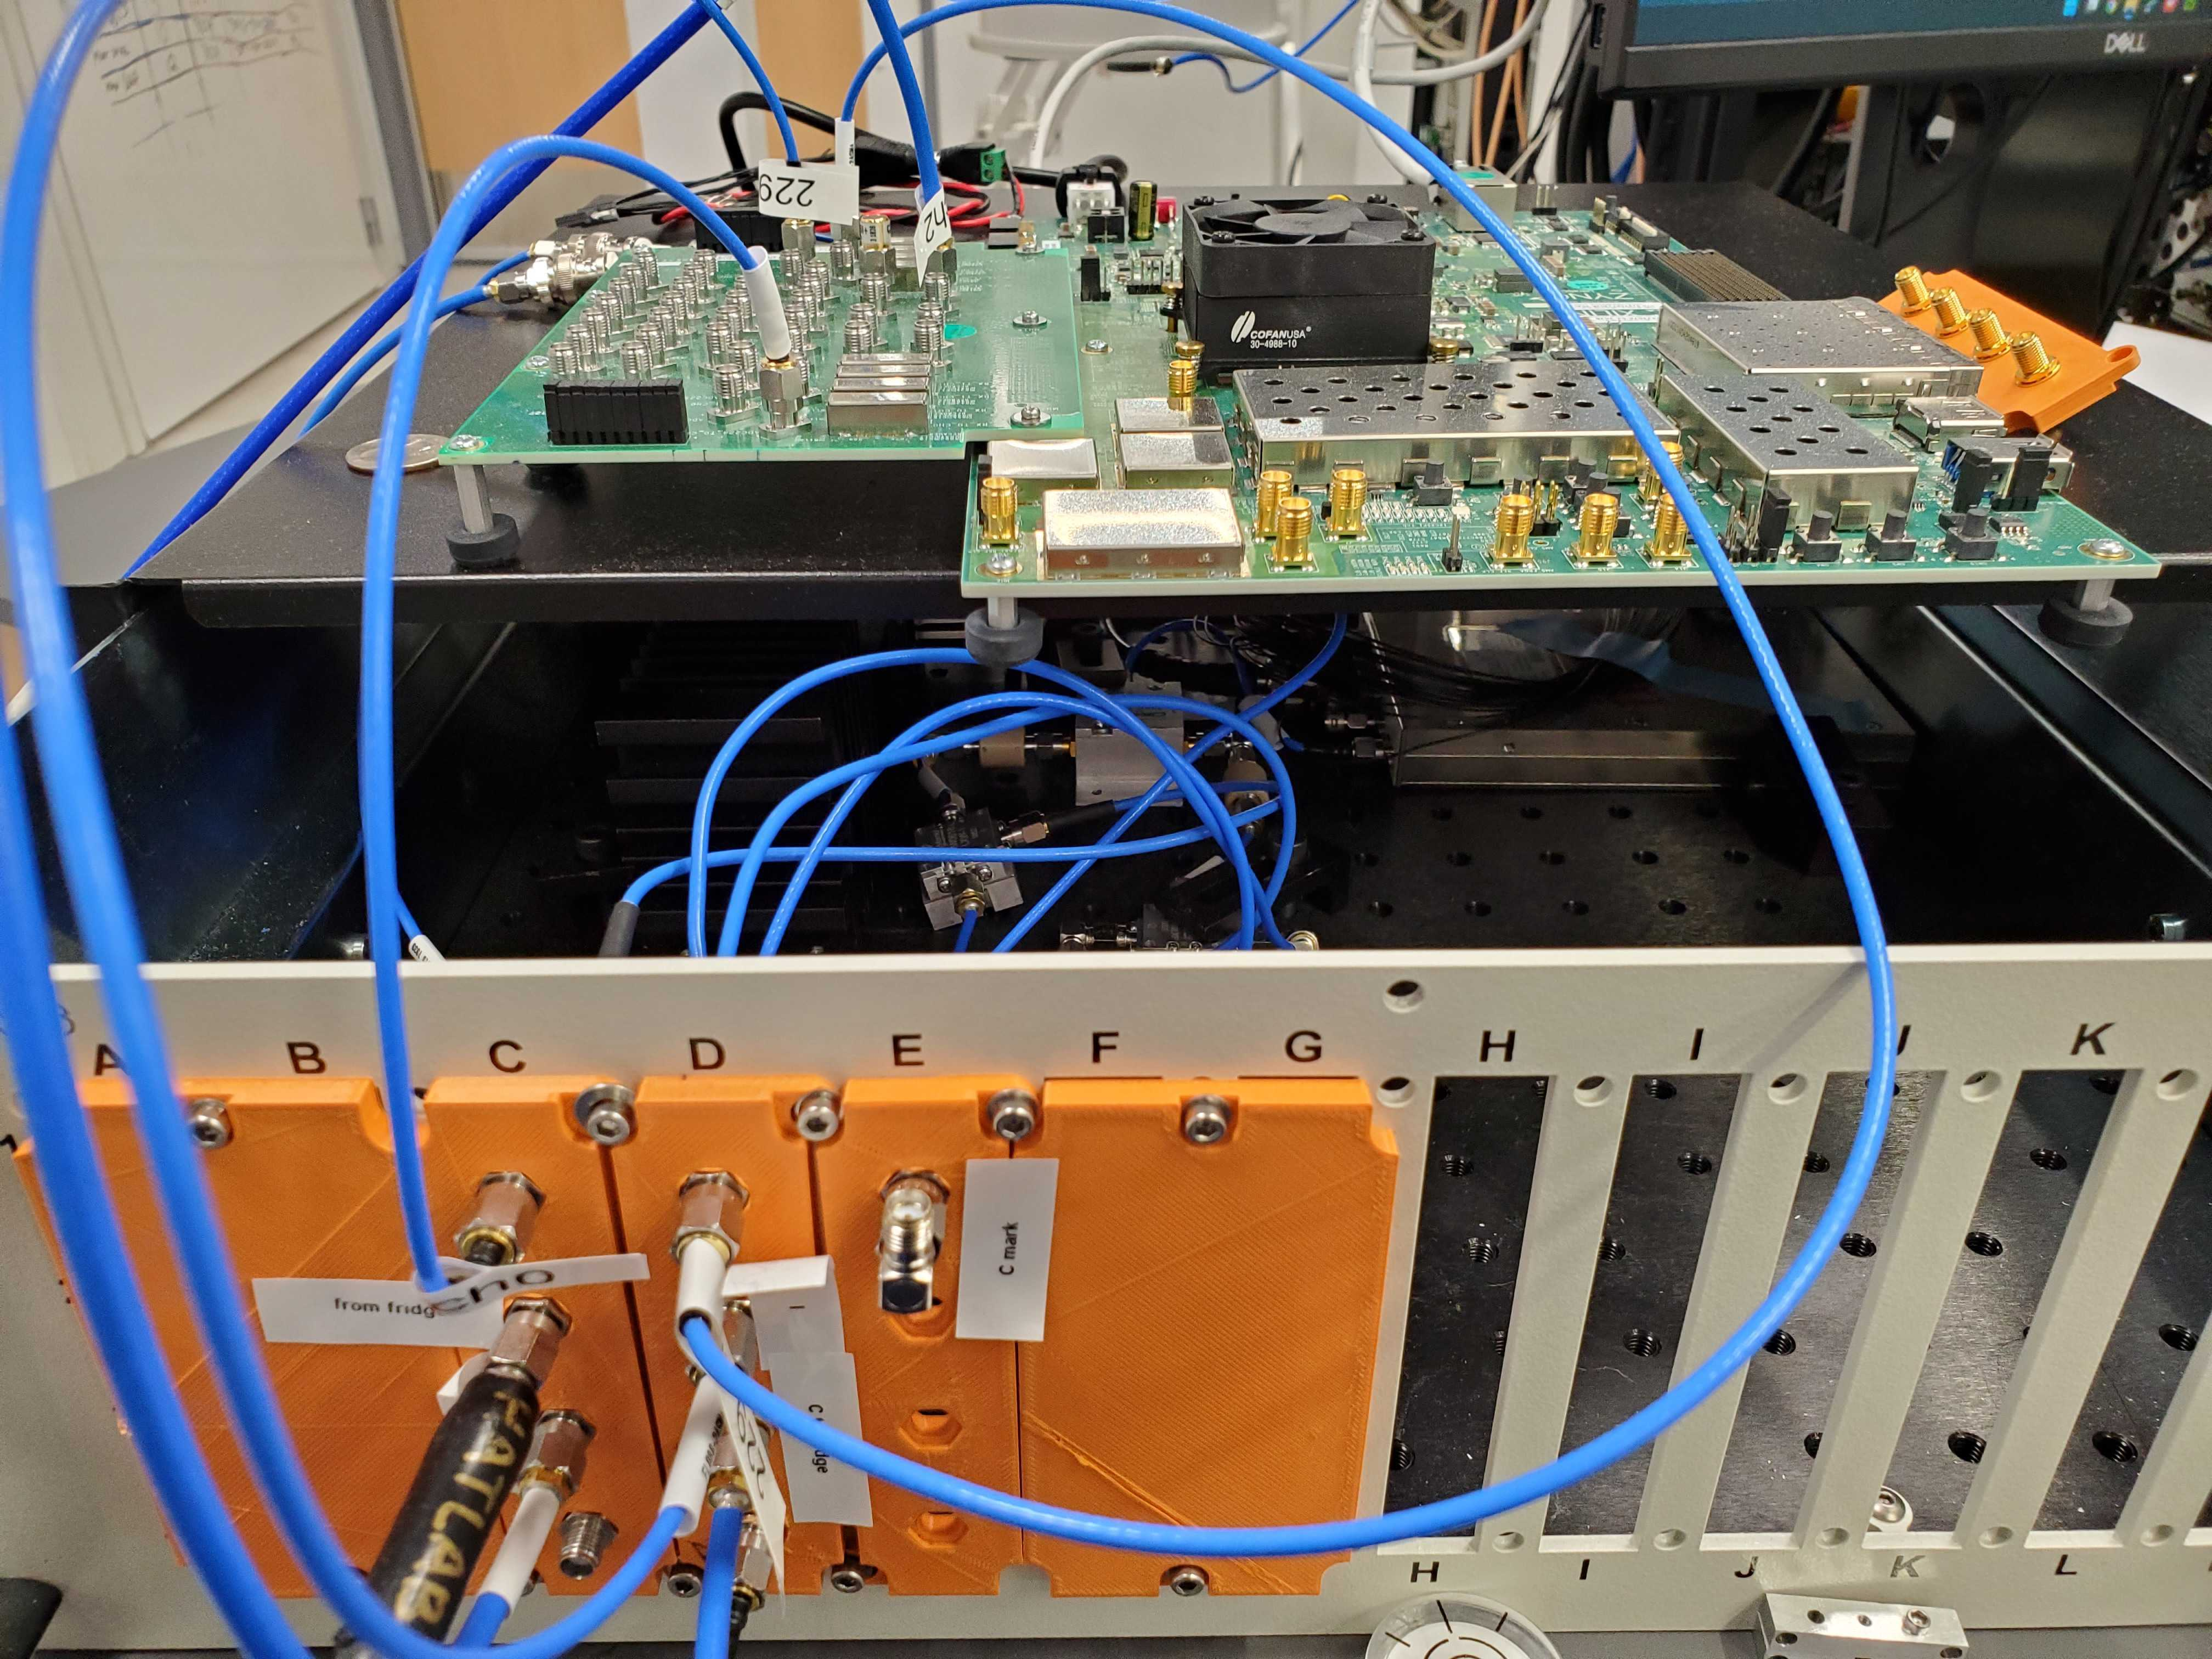
A quantum module with all-to-all gates via parametric control (prepared by Chao Zhou, U. Pittsburg)
Parametric two-qubit gate
Subharmonic single-qubit gate
Magnet
Low pass filter (2.8 GHz)
Frequency
SNAIL
Pump port
Q+C
QICK
1cm
Currently at Hatlab, the RFSOC board is set up for single qubit characterization.
We have used this setup to measure tens of qubits over many cool downs, above is a typical result.
We got similar results as we have gotten before with Keysight cards, and the high freq DDS has greatly simplified our qubit control circuit.
More complicated multi-qubit experiments with ZCU216 are working in progress.

Slide 19
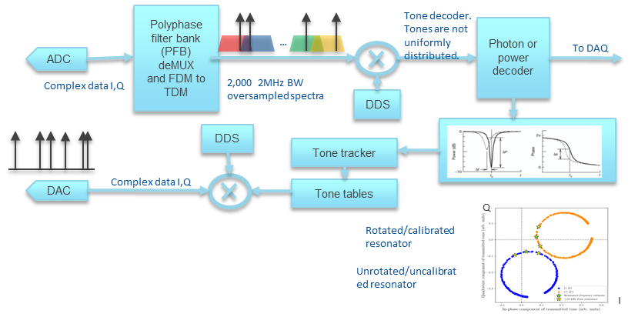
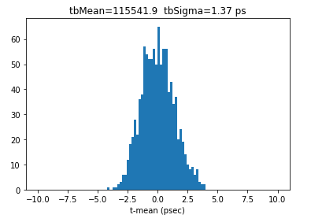
QICK for detectors
QICK is being used for CMB, dark matter, dark energy, quantum network, gravitational wave detectors.
MKIDS for CMB, dark energy and dark matter: 1000 pixels/Rf channel
1000 channels/RF
8K channels/board
QICK fast timing measurements for quantum networks: < 2ps resolution
Already triggering and reading photon entanglement experiments (Cristian Peña, et al)
JPL (Matt Shaw’s group will use QICK).
QICK to read single SNSPDs and SNSPD arrays for DM and gravitational waves (FNAL, Caltech, JPL).
Axion BREAD experiment: 500K bin FFT every 60usec 1 day averaging on FPGA, zero dead time.
Physics run this summer.
Quantum capacitor detectors: QICK already installed at Sidet Lab B. Caltech group requested a system.
Other potential fast timing measurements: colored centers timing measurements.

Slide 20
QICK team and collaborations (partial list)
Collaborations in Readout and controls for QIS and HEP.
Prof. David Schuster lab at U Chicago and at Stanford.
Prof. David Awschalom lab at U. Chicago, QNext.
Prof. Andrew Cleland lab at U. Chicago, QNext.
Prof. Hatridge lab at U. Pittsburgh.
Prof. Robert McDermott lab at U. Wisconsin, QNext.
Prof. Maria Spiropulu lab at Caltech.
Dr. Matt Shaw lab at JPL.
Prof. Enectali Figueroa-Feliciano U. Northwestern, QSC.
Dr. Kasra Nowrouzi, Lawrence Berkeley National Lab (AQT, QSA).
Dr. Anna Grassellino, SQMS, Fermilab.
Dr. Travis Humble, QSC, Oak Ridge.
Prof. Andrew Houck, Princeton, C2QA.
Prof Jeffrey Thompson lab at Princeton.
Prof. John Martinis, UCSB.
Prof. Rakshya Khatiwada lab at IIT.
Dr. Noah Kurimski, SLAC.
Prof. Alex Ma lab Perdue.
Companies: Amazon AWS (Sebastian Hassinger group). Rigetti (Josh Mutus group).
Quantum Networks: INQnet, scientists: Panagiotis Spentzouris, Cristian Peña (FNAL).
Other Fermilab scientists in QSC: Daniel Bowring, Aaron Chou, Lauren Szu,
QICK has feedback a lot of framework for HEP experiments in Astrophysics including CMB SPT3 upgrade, Brad Benson, Adam Anderson (lead).
Dark Matter for AXIONS using qubits, MKIDs, quantum capacitor detectors: Andrew Sonnenschein, Aaron Chou, Lauren Szu, Rakshya Khatiwada, Dan Baxter,
GQuest: Chris Stoughton, Rana Adhikari Caltech, Lee McCuller Caltech.

Slide 21
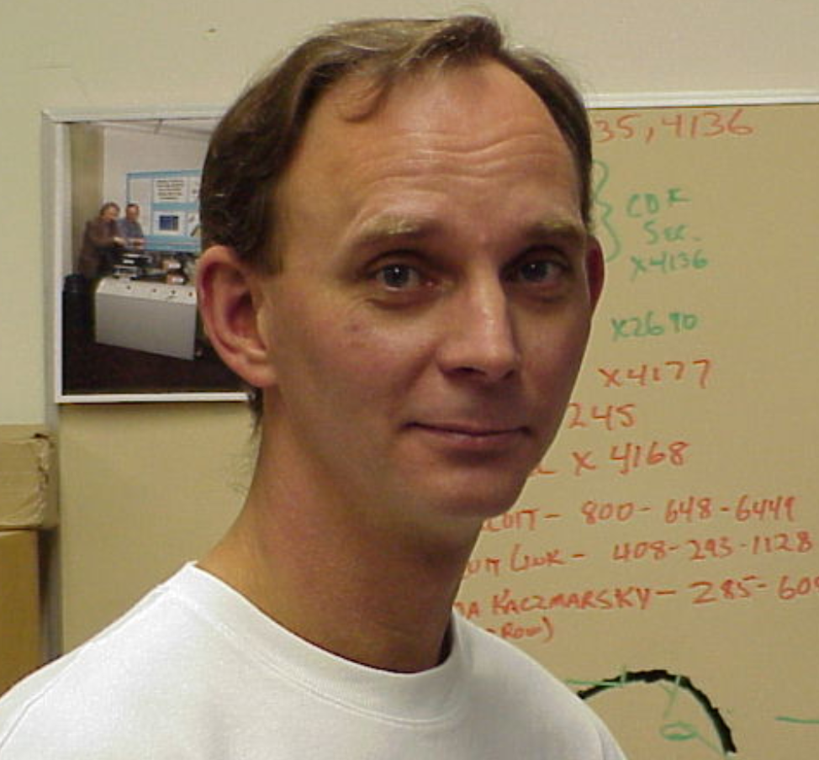
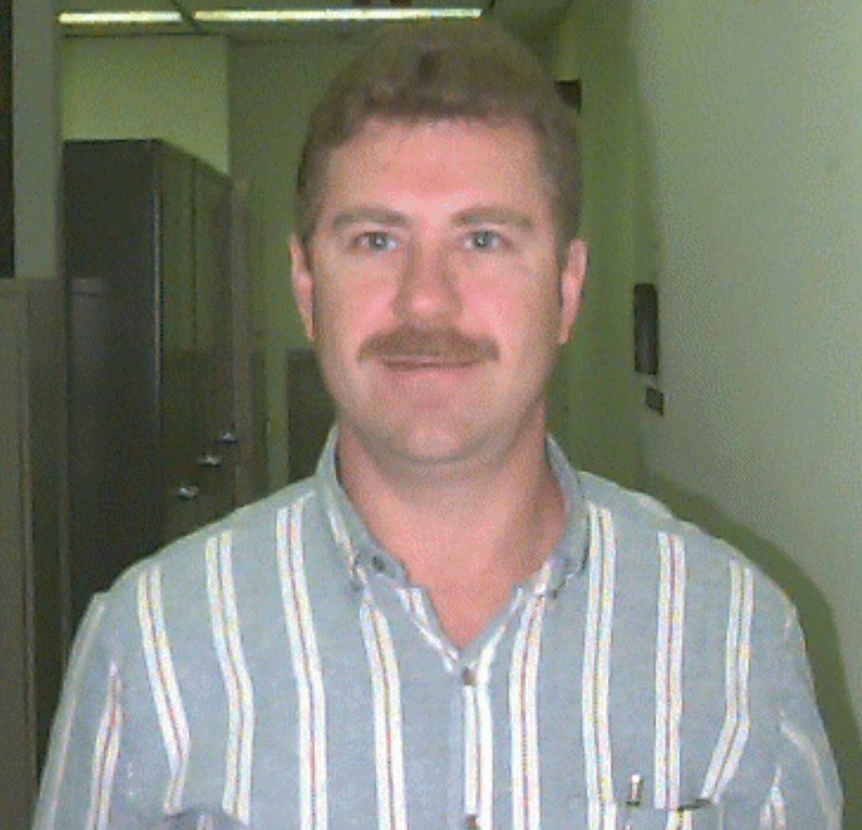
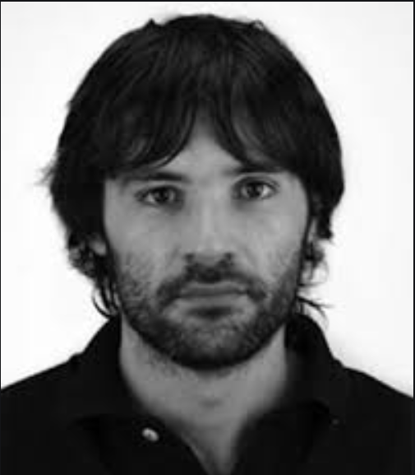
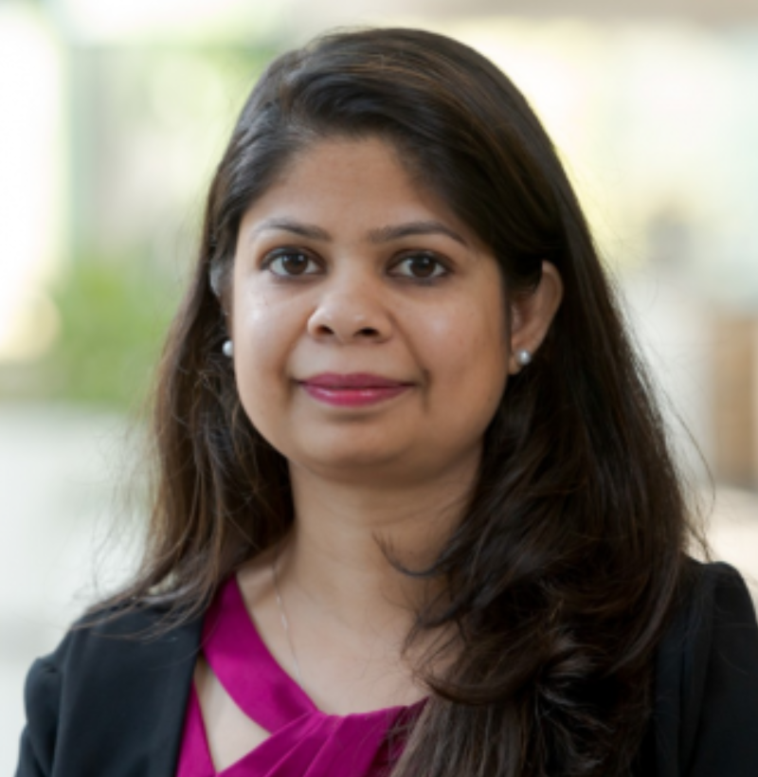
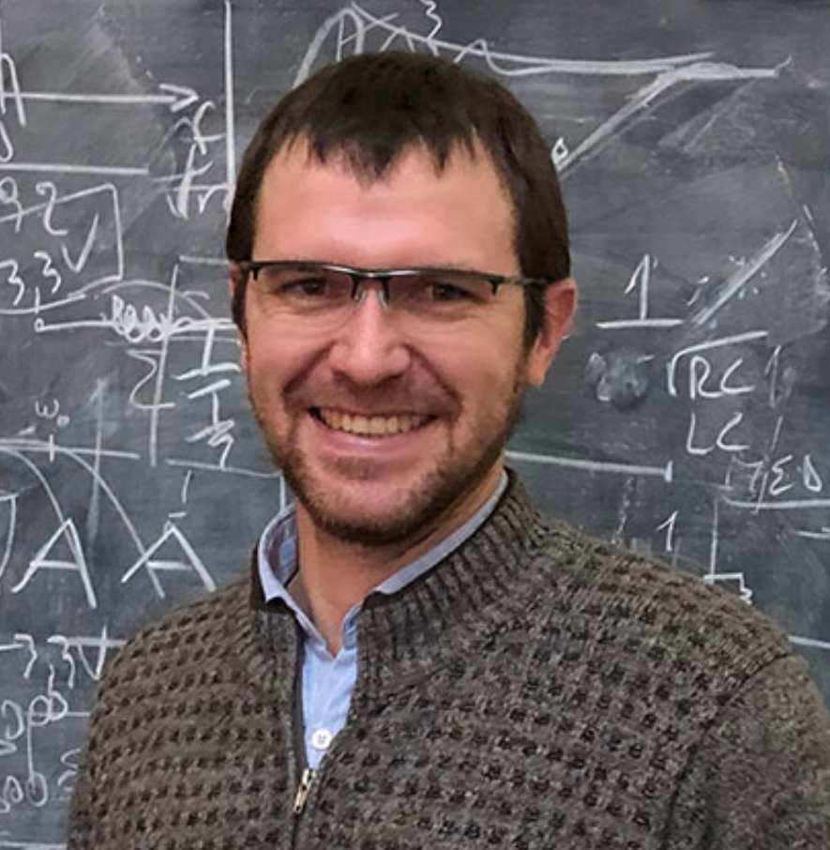
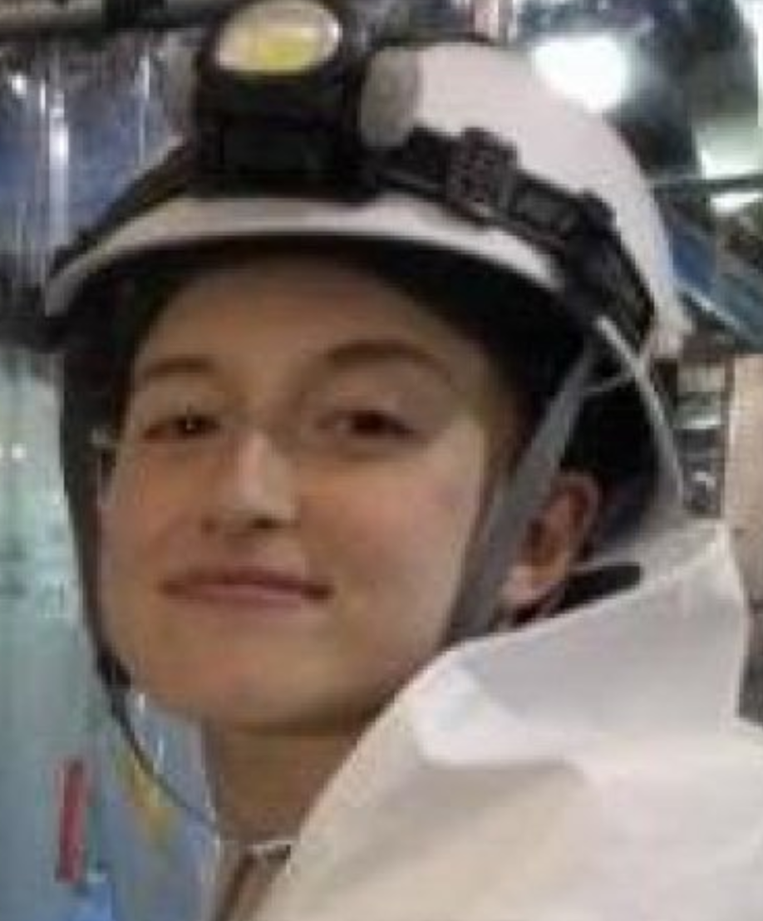
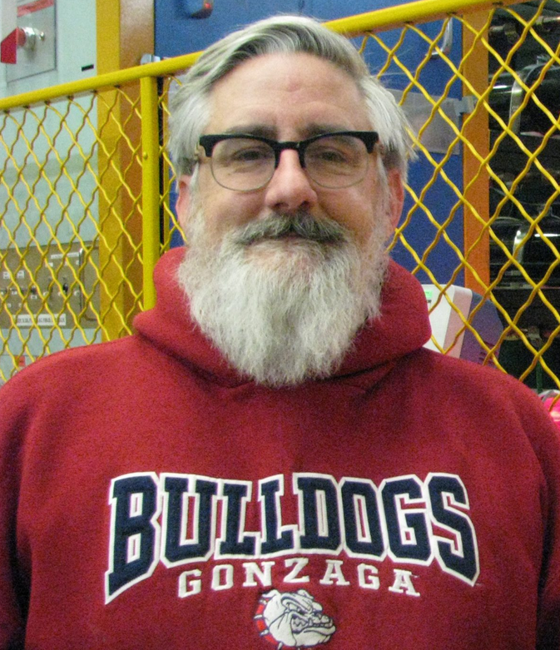
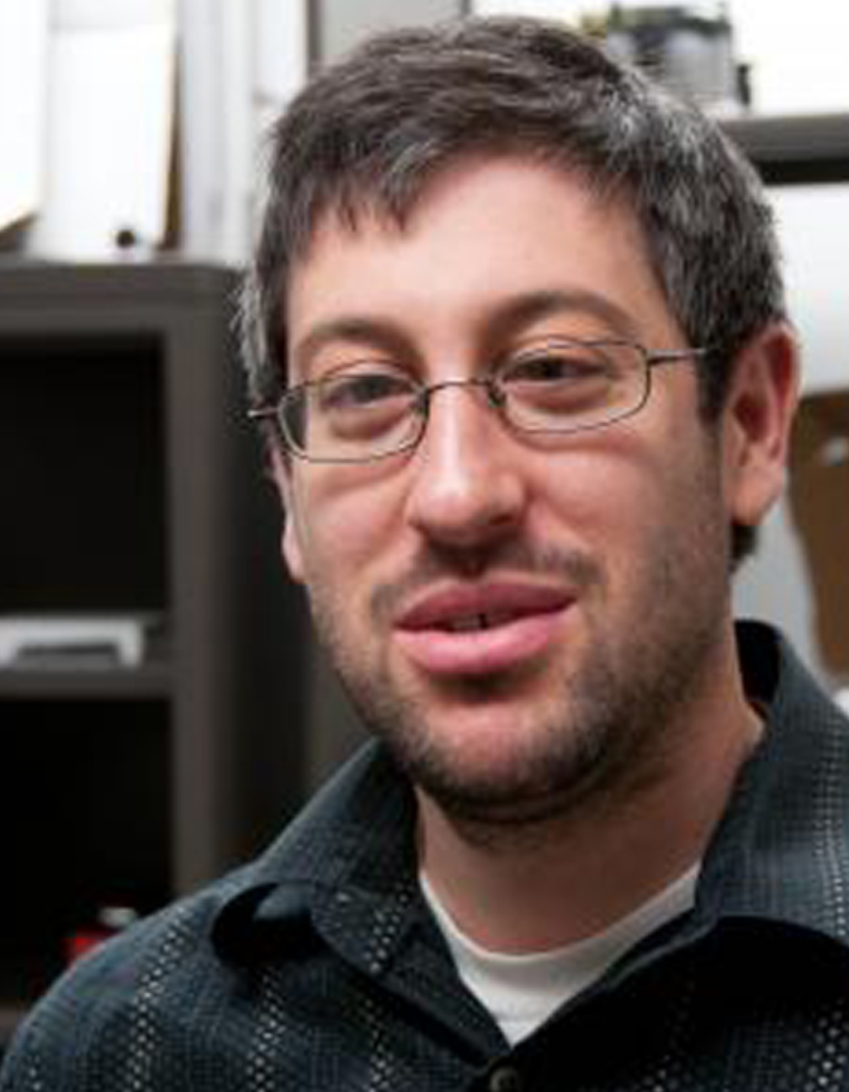
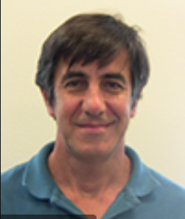
QICK team (partial list)
Neal Wilcer (FNAL)
Ken Treptow (FNAL)
Leo Stefanazzi (FNAL)
Shefali Saxena (ANL)
Horacio Arnaldi (CNEA, Argentina)
Sara Sussman (U. Princeton)
Chris Stoughton (FNAL)
David Schuster (U.Chicago)
Gustavo Cancelo(FNAL)
Not pictured: Salvatore Montella, Collin Bradford, (FNAL), Ankur Agrawal, Helin Zhang, Chunyang Ding (UC), Andrew Houck (Princeton)

Slide 22
Spare slides

Slide 23
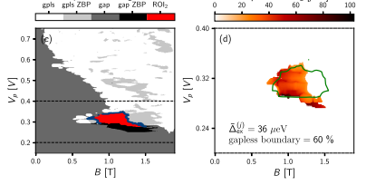
QICK for nanowire control and characterization (REF: Protocol to identify a topological superconducting phase in a three-terminal device, Dmitry I. Pikulin et al, (Microsoft Q), 2021, arXiv 2103:12217)
Two well-separated MZMs (Majorana zero-energy) form a single non-local fermionic state.
Look for signature: zero bias peak (ZBP) and detection of topological phase => precise measurement of conductance matrix.
Microsoft Q experimental protocol TGP (Topological Gap Protocol): minimize false positives and negatives .
local conductances dI_{R}/dV_{R} and dI_{L}/dV_{L} to identify regions in parameter space where ZBPs.
Non-local conductances dI_{L}/dV_{R} and dI_{R}/dV_{L /dV R} are then used to search for bulk phase transitions.
Required measurements:
RF reflectometry below 1 or 2GHz
Near DC measurements
Large phase space search varying parameters such as
Integration time 50 µs per pixel, 200 points for each bias voltage, 500 points in plunger gate, 20 cutter gate values, and 200 points in magnetic ﬁeld.
QICK can integrate the entire characterization search in one program with minimum latency.
QICK minimizes or completely replaces the need of any off the shelf equipment.
Accelerates experiment time. We tailor QICK to experiment requirements.

