Slide 1
Firmware features
Leandro Stefanazzi
September 15, 2022

Slide 2
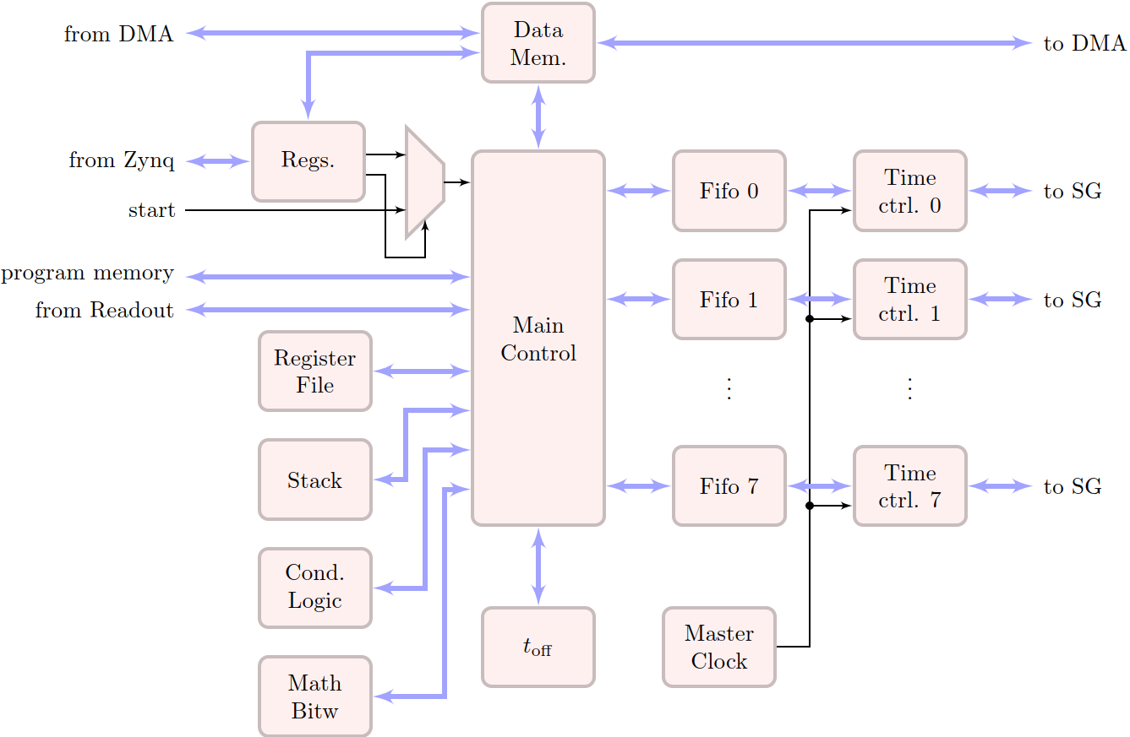
tProcessor: algorithm and time control

Slide 3
Signal Generator Blocks
Combined with DAC features (DUC, interpolation).
Different options: bandwidth, real/imaginary envelope, length.
Phase coherency, frequency hopping, gain control.
Combined with tProc.

Slide 4
Signal Generator: muxed output
Used mostly for readout pulses.
Allows to use a single RF feed line to read 4 resonators.
Pulse length configurable from tProc.
Mask to enable/disable individual outputs.
Can cover different bandwidth options.

Slide 5
Readout blocks
Digital-down conversion and x8 decimation.
Fast/accumulated sample output for readout.
Single accumulation output allows feedback using tProc.
Start of window capture triggered by tProc to ensure sync.

Slide 6
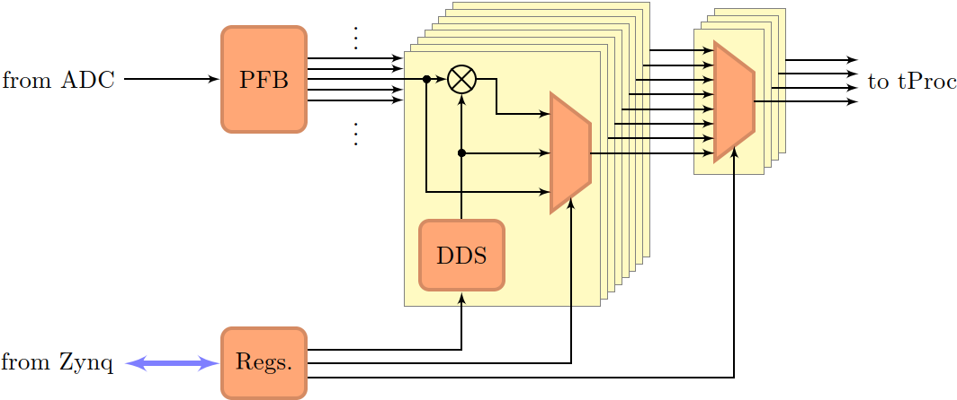
Readout block: muxed input
Muxed signal generator companion.
Polyphase filter bank to slice the input in 8 channels.
Individual DDC. All-to-4 output mux to create 4 outputs.

Slide 7
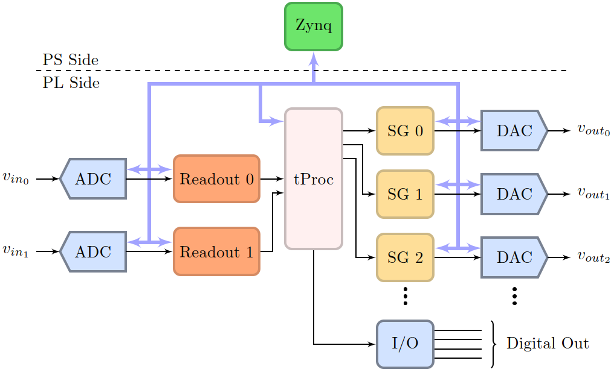
System 1

Slide 8
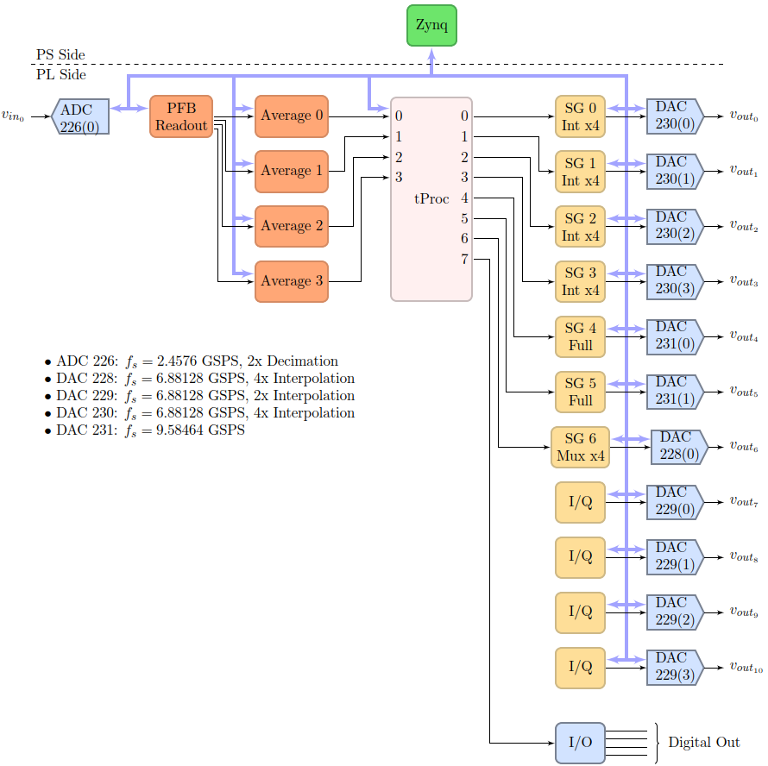
System 2

Slide 9
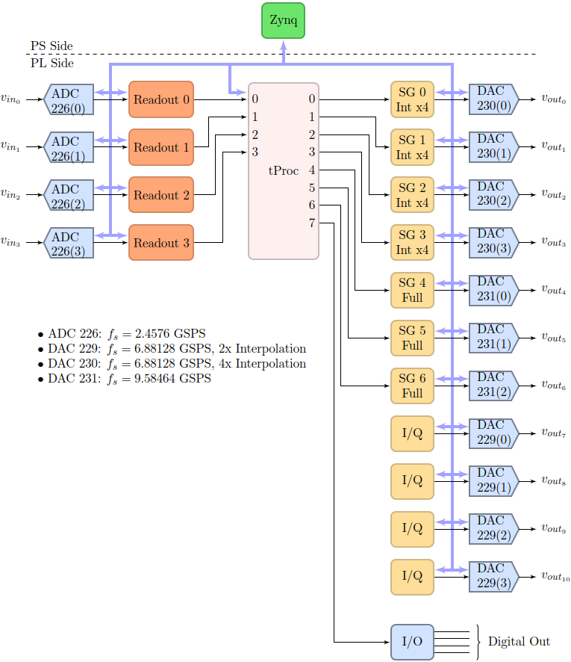
System 3

Slide 10
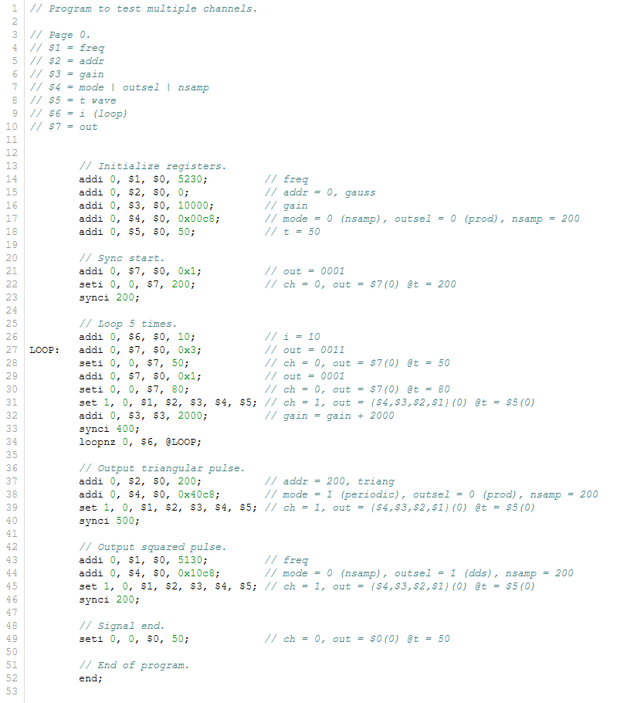
Assembly language

Slide 11
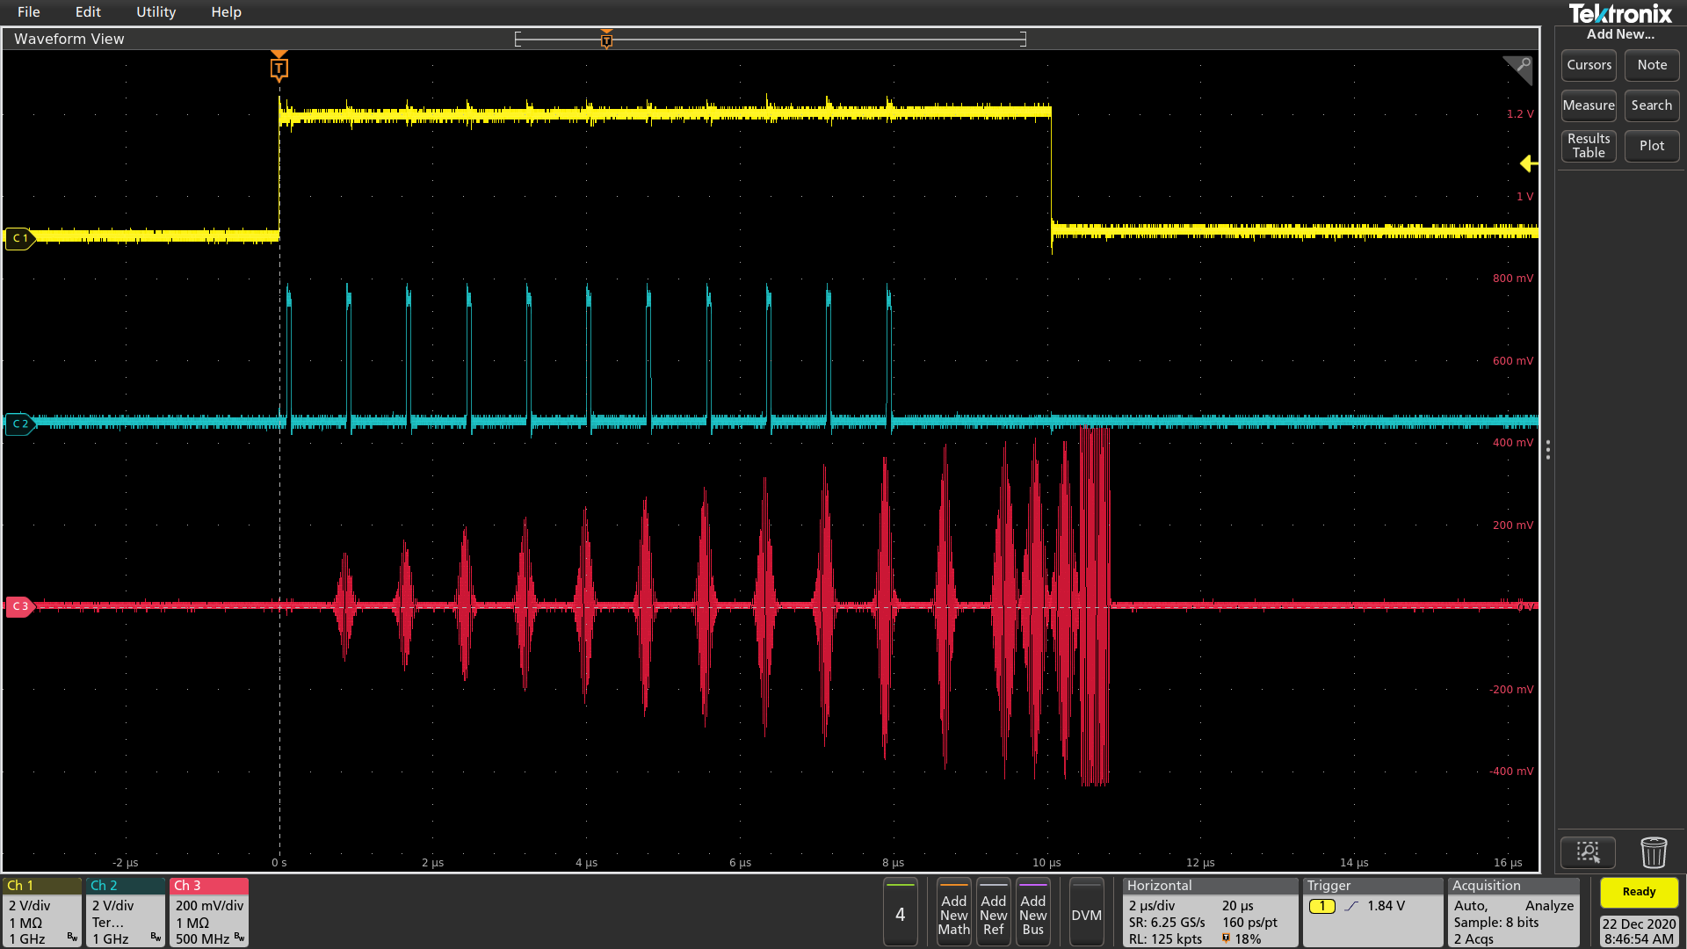
Example of signal output 1

Slide 12
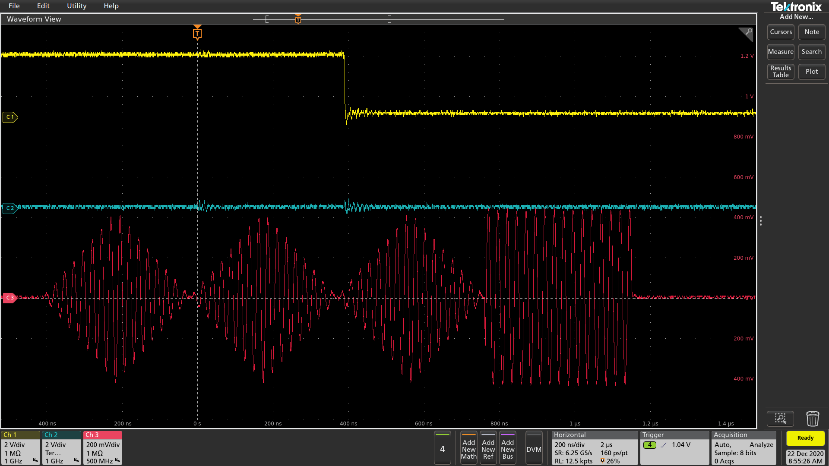
Example of signal output 2

Slide 13
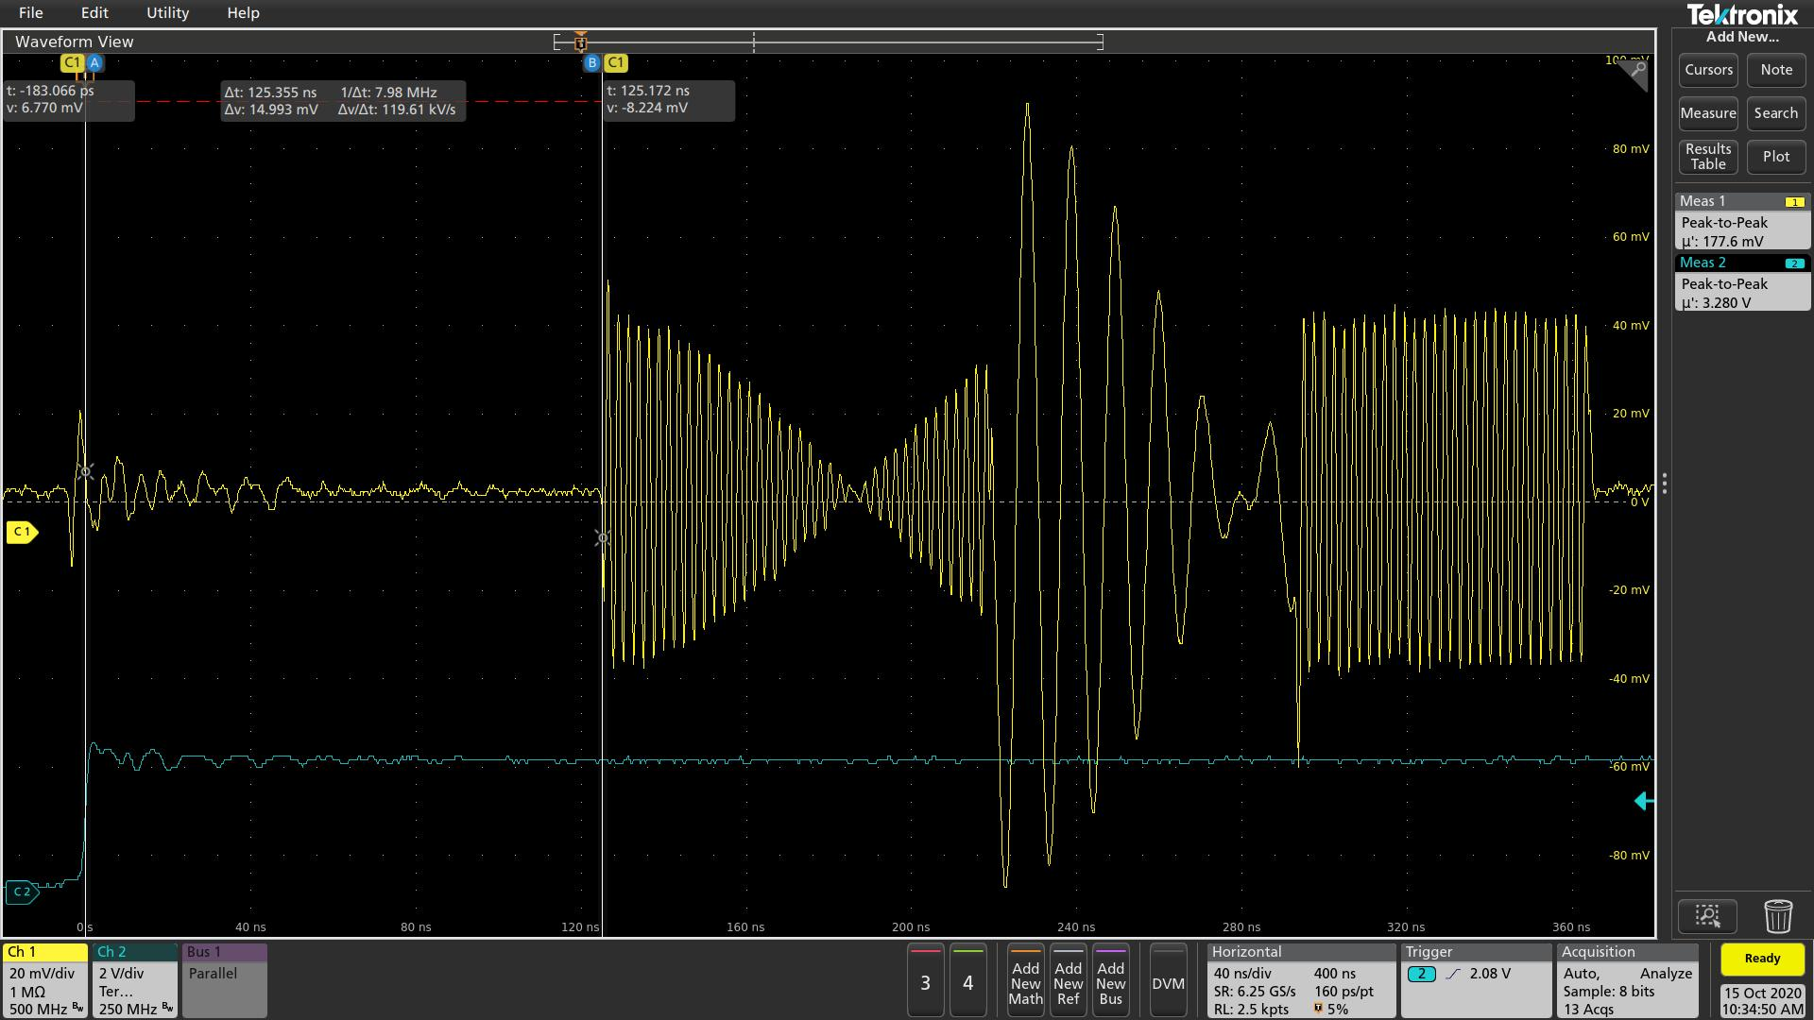
Example of signal output 3

Slide 14
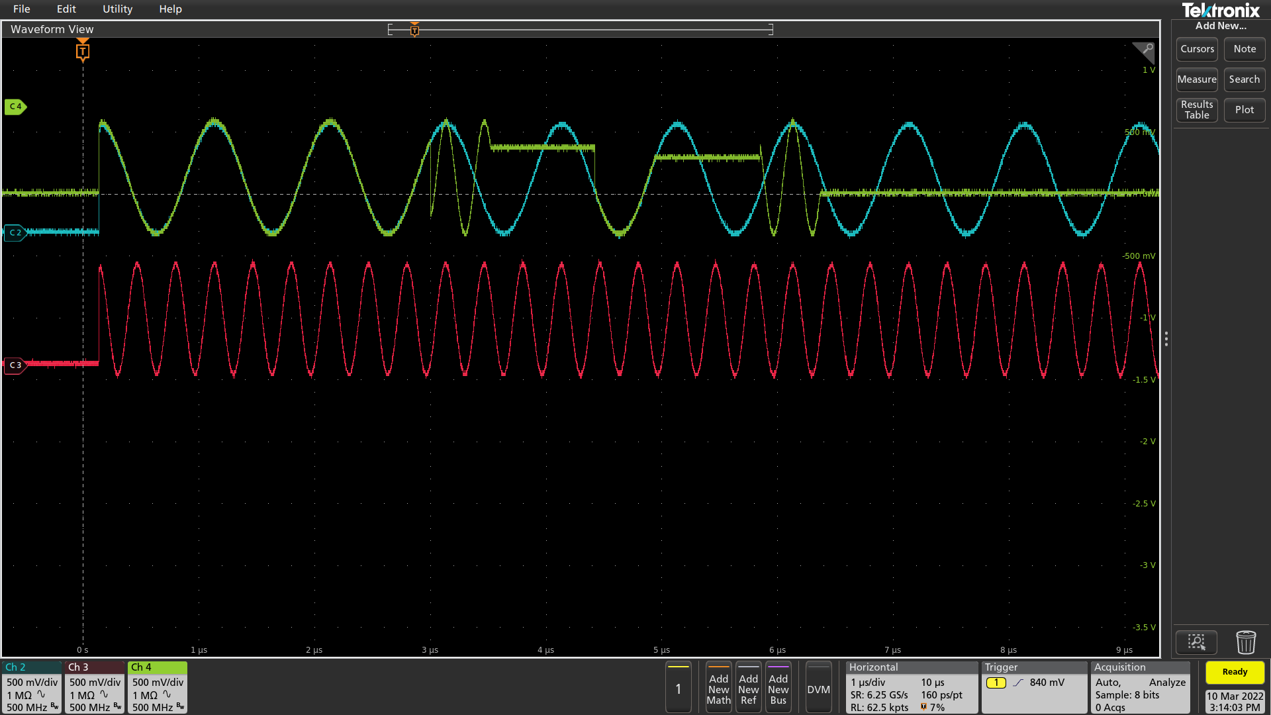
Phase control 1

Slide 15
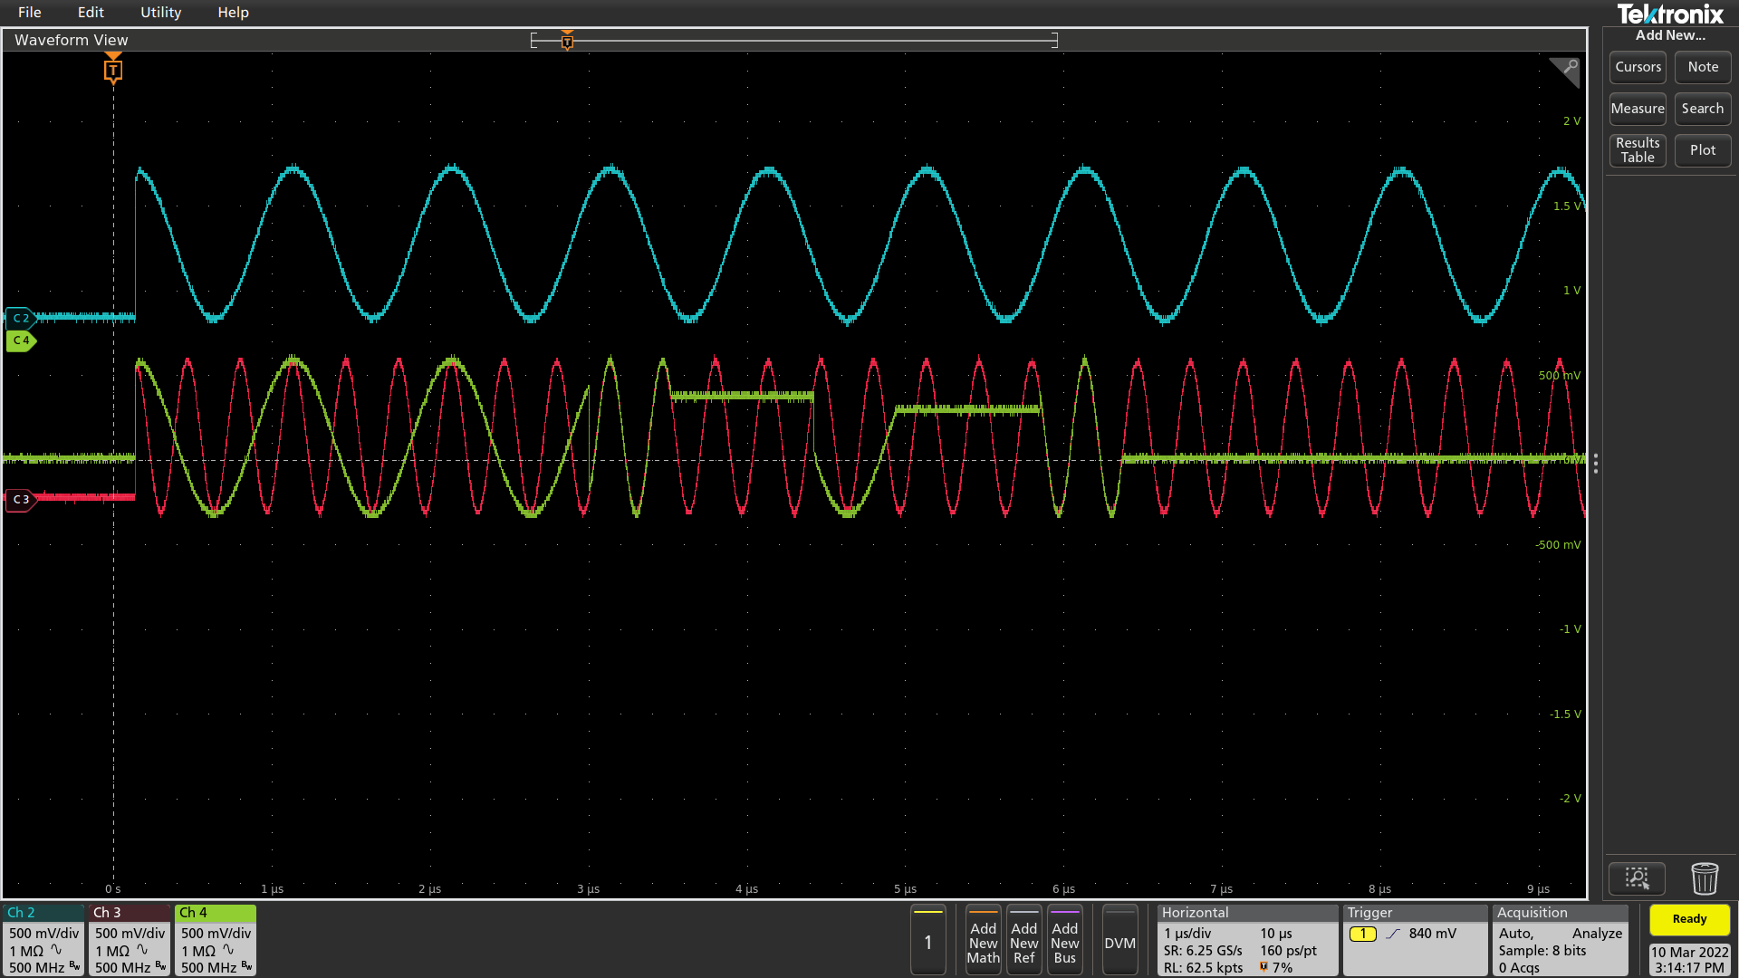
Phase control 2

