Slide 1
Site IPv6 Planning (2014)
Summer 2012 ESCC meeting
July 18, 2012

Slide 2
Site IPv6 Planning Survey (7/18/2012)
Site IPv6 WAN connectivity: 7/12 2/12
Not looking to 2014 yet; focusing tightly 1 7 6
on 2012 milestones
Investigating impact(s) of 2014 5 7 2
milestones on site
Actively planning for 2014 4 3 1
milestones already
Other 4 2 2
Questions:
Scope of IT involvement in 2014 investigation and/or planning?

Slide 3
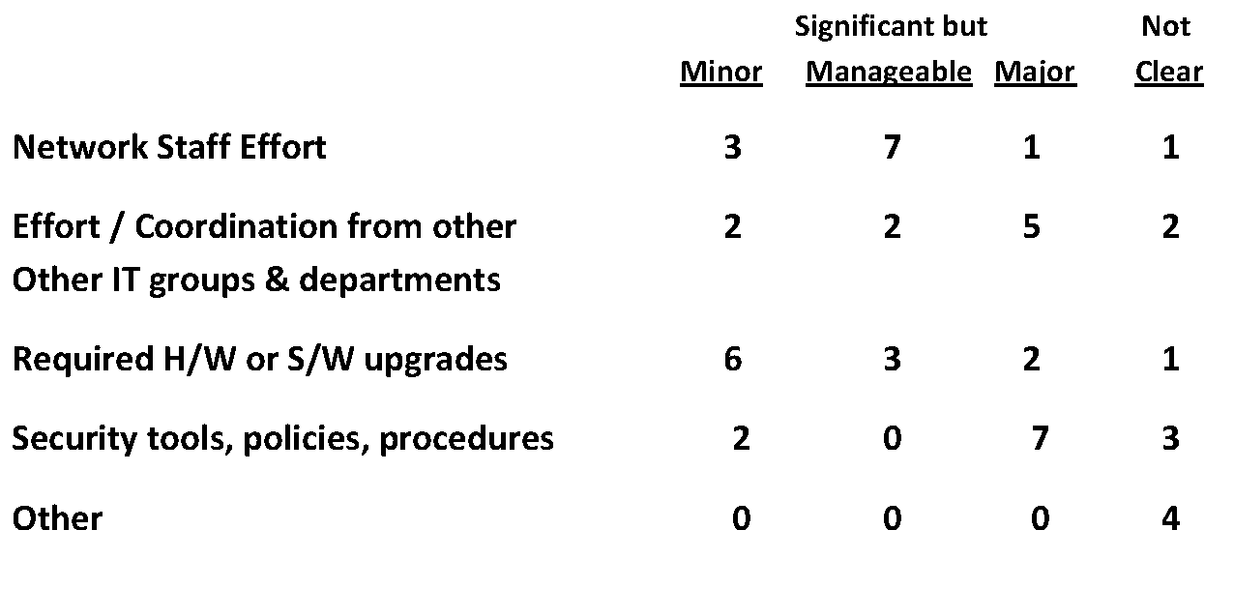
Impediments to 2014 Milestones

Slide 4
Comments on 2014 milestones impediments
Staffing turn-over, inadequate staff for current competing projects, and spotty support for IPv6 in major commercial security products.
Disruptive factor of dual stack operation not really understood yet. This could be a significant impediment is IPv6 becomes considered possibly disruptive
Currently see this as only impacting desktops and business systems, not the experimental program.
We will need an IPAM / DDNS / DHCP solution which we can integrate into our environment to support an internal IPv6 deployment
IPv6 is currently not on the list of our projects that have been proposed for the coming year. This is since there does not appear to be a compelling business case that it provides extra capabilities to our customers.

Slide 5
Questions of Site Impediments (2014)
What are the IPv6 computer security impediments your site is encountering?
Does Computer Security & Network Support fall under the same management umbrella (department, whatever…)
What coordination framework(s) is your site using to involve the “right” people
Expectation on achievability by 9/30/2014?
Expectation on continued effort commitment from management?

Slide 6
Addressing Plans
7/12 2/12
Well-developed addressing plan that’s 7 3 4
being implemented
Reasonably well-developed plan that’s 2 5 3
being worked on
In process of developing a plan 1 2 1
No plan, planning to develop one 2 6 4
No plan, not planning to develop one 2 1 1
Comments:
Limited deployment scope of 2012 milestones limits our evaluation of how well or poorly the current plan is working.
We have a plan but it is unclear how meaningful such a plan is

Slide 7
What Addressing Plans are based on…
7/12 2/12
Administrative/department boundaries 1 3 2
Topology (hierarchical) 2 1 1
Physical geography (buildings, etc) 1 3 2
IPv4 numbering plan 2 4 2
Vlan assignments 6 4 2
Multiple or other schemes 3 7 4

Slide 8
What are the important issues to discuss?
Rating scale :
Questions:
Which issues need to be addressed earliest in your 2014 planning?
Which issues or areas of concern are least understood?
What’s not on the list above that should be?

Slide 9
ESCC Role in 2012/2014 IPv6 Compliance
Awareness/education/mandate on the CIO level of the criticality of funding and committing IT resources on this initiative.
Forum for experiences & lessons-learned, as well as sharing of outreach tools & documentation
Sharing of implementation lessons learned; more in-depth discussion of cyber-security related to v6 deployment.
Keep topic alive and as sites progress solicit talks on lessons learned/best practices, particularly for:
Auto-configuration, DHCP, address management and any unexpected network management/security issues sites discovered along the way.
Get clear statement from DoE whether this is mandatory or voluntary
Continue to host discussions on interpretation and share experiences

