Slide 1
View from Washington and Germantown
Vincent Dattoria
ESnet Program Manager, Facilities Division, Office of Advanced Scientific Computing Research
July 18th, 2012

Slide 2
Talk Outline
SC Organization
ASCR Organization
2013 ASCR Budget Request
Explanation of Budget Changes
DOE Conference Reporting
Notable Activities

Slide 3
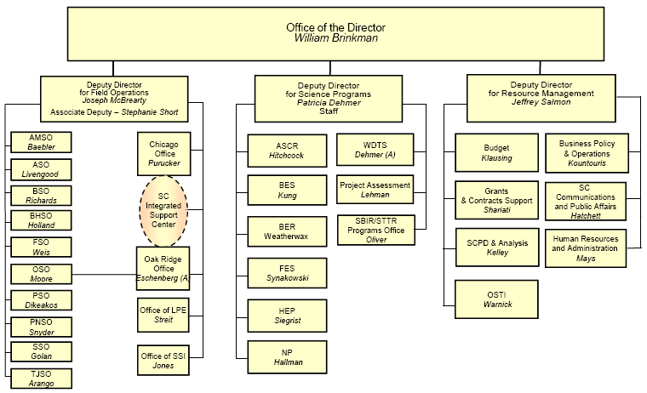
SC Organization

Slide 4
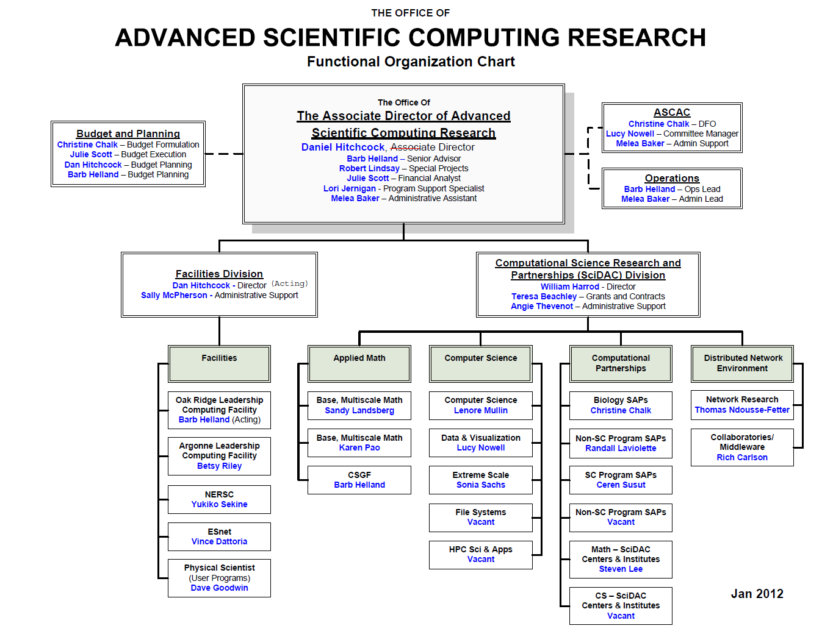
ASCR Org Chart

Slide 5
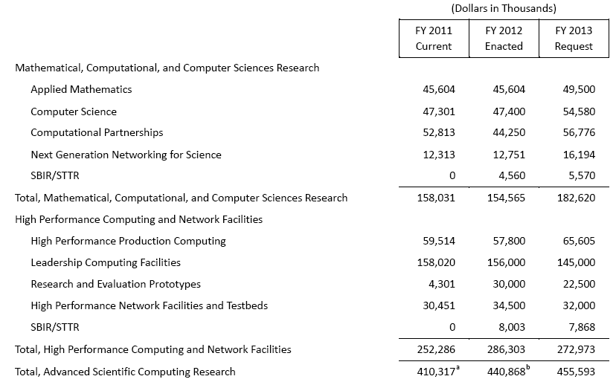
2013 ASCR Budget Request

Slide 6
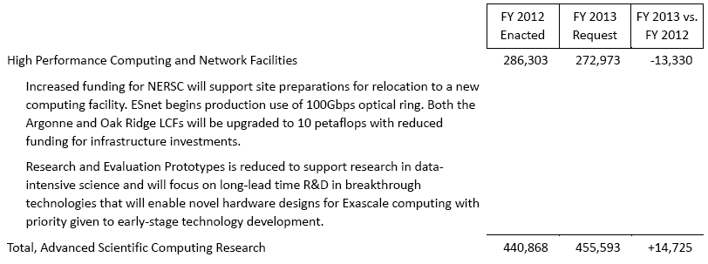
Explanation of Budget Changes

Slide 7
DOE Conference Reporting
New OMB policy for conference sponsorship, hosting, and attendance.
“Aggressively seek to curtail costs…including negotiating w/venues for meeting space, requiring attendees to carpool, bringing audiovisual equipment rather than renting it, etc.”
Data requested annually and updated quarterly (w/actuals).
Hosting a conference with 30 or more participants and at least half on official travel
Sending 15 or more participants from the organization
Conference expenditures >$100K (travel, fees, etc.)
Scope: Feds and DOE contractors
Different approval levels based on costs:
AD/SC-2 for <$100K or operational in nature
Dep Sec for $100K-$500K
Secretary waiver for >$500K “exceptional circumstances”
Notes:
7

Slide 8
Notable Activities
Upcoming-
ASCAC (Wash, AGU): Aug 14-15
ASCR/ESnet Program Requirements Review Workshop (GTN, MD): Week of 24 Sep
NERSC/BER Program Requirements Review Workshop (Rockville, MD): Sep 11-12
ESnet/BER Program Requirements Review Workshop (Wash DC metro): Week of Dec 8
ESnet On-site Operational Assessment (LBNL): Q2 FY13
ESnet customer satisfaction surveys due prior…

