Slide 1
Hayley Smith, Bryan Jones
ISIS Synchrotron Group
Fermilab Visit
29/05/12
H⁻ Stripping Foil Studies for 180 MeV ISIS Injection
ISIS MW Upgrade Project

Slide 2
Outline:
ISIS 70 MeV Injection Foil
180 MeV Injection Foil Studies
Stripping
Scattering
Heating
KEK / J-PARC Visit
Double Foil Studies
Future Work
Summary & Questions

Slide 3
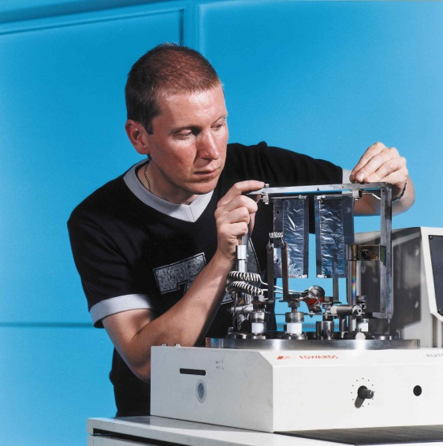
ISIS Foil:
Notes:
80000uA h lifetime. Mainly limited by mechanical factors (vacuum).

Slide 4
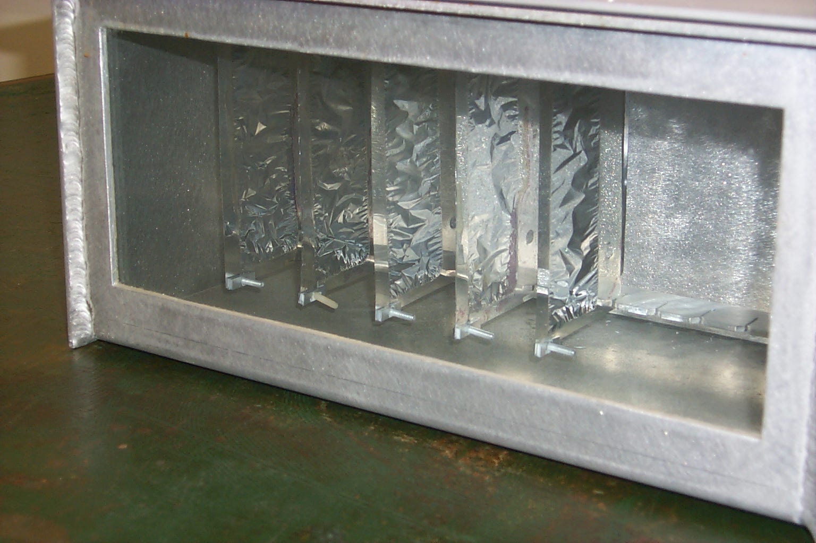
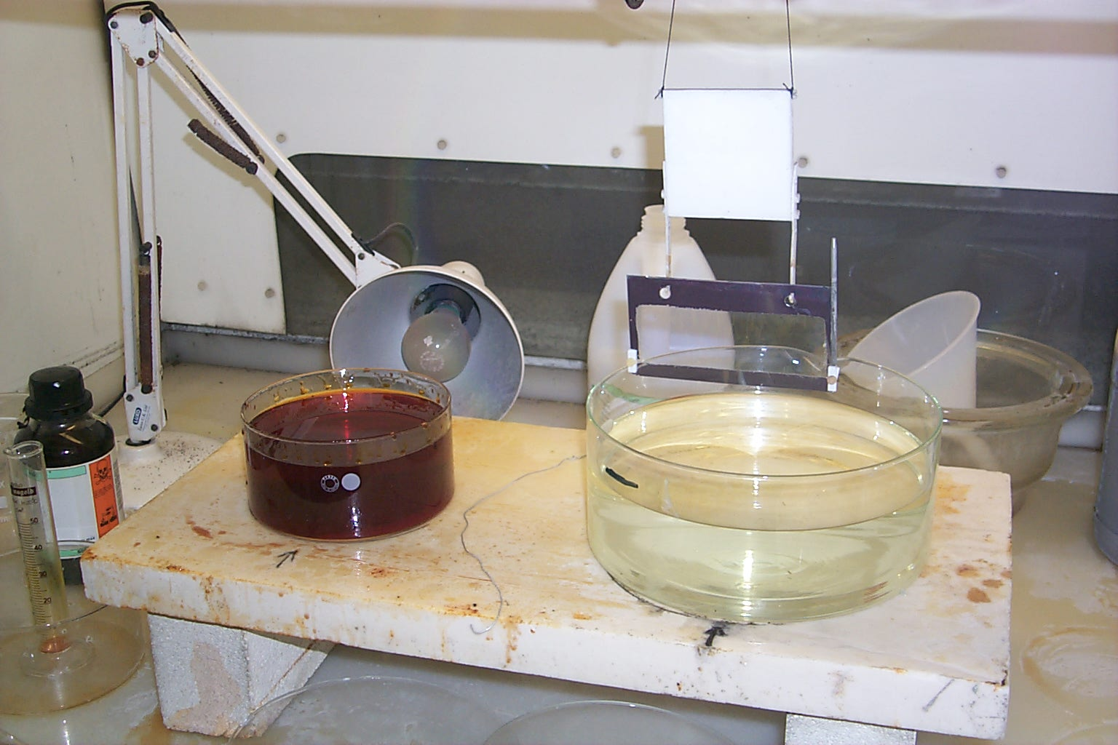
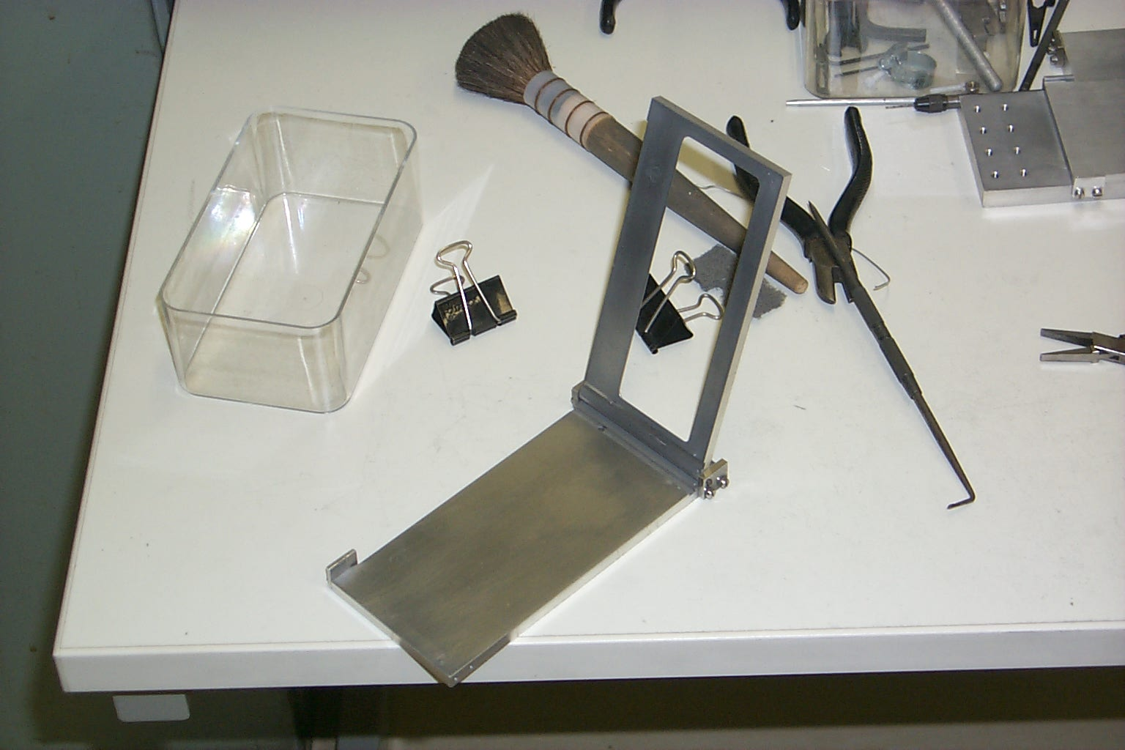
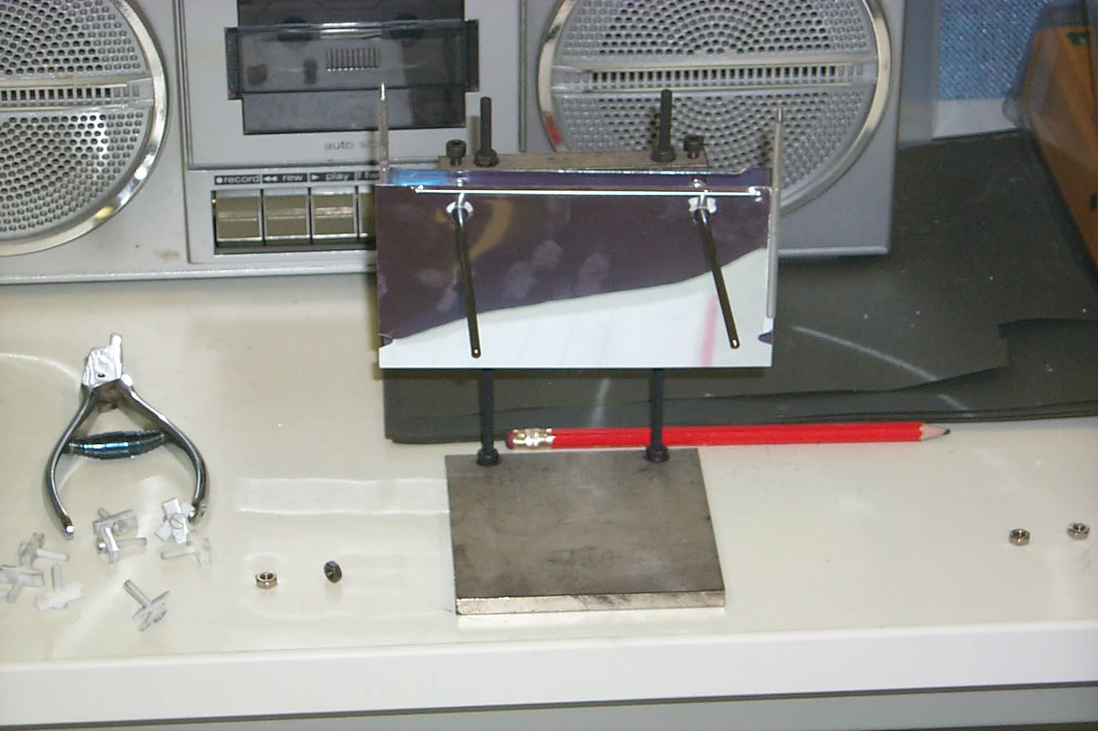
ISIS Foil:
Notes:
20 hours to produce a single foil
Foils are made in support frame by anodising aluminium in a weak electrolyte to the required thickness. Foil is then annealed (heated) to stretch the foil, to make it loose and wrinkled in the support frame to allow thermal expansion of frame / shrinking due to irradiation without stressing the foil. Any unwanted aluminium is then dissolved away. Foils coated with 0.01um Aluminium each side to prevent charge accumulation. Mounted on a rack driven in by a stepper motor.
Production method:
An Aluminium sheet, 0.15 mm thick, is cut on a standard paper guillotine to the approximate dimensions of the stripping foil (130 x 70 mm)
Mounting holes (used throughout the manufacturing process to support and position the foil) are punched into the Aluminium sheets using a standard paper hole punch.
Two wedges are clipped out of the sides of the Aluminium sheet to enable the final cutting procedure to be performed.
One edge of the Aluminium sheet is bent in a custom made jig to increase the second moment of area in one plane and strengthen the sheet.
A pin, used to mount the foil in position when it is installed in the synchrotron, is attached to the Aluminium by sliding the sheet into a slot in the pin. The pin is then crimped in place using pliers.
The Aluminium sheet is baked in a vacuum furnace for 8 hours.
The Aluminium is coated with an Aluminate layer, which is resistant to etching with bromine.
The sheet is baked in a vacuum furnace for 8 hours
An area of the Aluminate layer in the centre of one side of the sheet is rubbed off using wire wool. Lines are scored between the clipped out wedges and the area of exposed Aluminium to assist in the removal of the bottom edge of the frame in a later stage.
The Aluminium sheet is lowered into a Bromine and Methanol solution bath. The exposed area of Aluminium is etched away, leaving a thin transparent film of Aluminate surrounded by an Aluminium frame.
When a visual inspection shows that all of the required aluminium has been removed, the foil is taken out of the Bromine solution.
After the foil has been removed from the Bromine solution, it is washed in an acetone bath.
The now delicate foil is placed in a vacuum chamber and a layer of aluminium is electro-statically evaporated onto the foil, coating both sides of the sheet.
The bottom edge of the frame is cut away, using a scalpel, along the scored line between the two wedge shaped cuts in the frame.
The foil is then placed in a container to await installation in the ISIS synchrotron

Slide 5
Injection Upgrades:
~90 m
180 MeV
55 m
70 MeV
Notes:
Why it’s important for foils

Slide 6
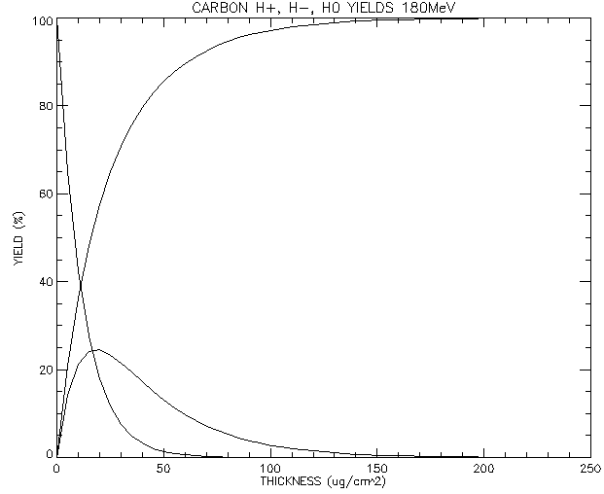
Stripping Efficiency:
Aluminium 70 MeV
Thickness (µg cm⁻²) | 50
H+ (%) | 97.1833
H0 (%) | 2.78181
H- (%) | 0.0349
Experimentally: 97-98 %
Carbon 180 MeV
> 160 µg cm⁻²
Stripping efficiency and lifetime of carbon foils, W. Chou (FNAL), M. Kostin (NSCL), Z. Tang (FNAL), Nuclear Instruments and Methods in Physics Research A 590 (2008) 1-12
Notes:
200 ug/cm2
Carbon
To account for alterations in manufacture.

Slide 7
Scattering:
Inelastic Fraction:
2.4×10⁻⁶
MCS Emmittance:
2.25×10⁻³ π mm mrad
Beam Loss:
0.27 W
Plural Scattering Algorithm
Benchmarked against Linac4:
Inelastic interactions
Coulomb Scattering Cross Sections for Accelerator Design, M.N Butler et al., Proc. PAC 1989
Notes:
2.4e-6 (prop of beam under go inelastic)
Multi coulomb scatter emittance growth 2.25e-3 pi mm mrad
0.27 W loss levels acceptable along ~5m inj straight
Mean squared theta:
linac4 = 3.92578 x 10⁻⁹ rad
Fssp x = 7.29730 x 10⁻⁹ rad
Fssp y = 7.7944 x 10⁻⁹ rad
Emmittance:
linac4 x= 7.22225 x 10⁻³ π.μ.m.rad
Linac4 y = 3.22806 x 10⁻³ π.μ.m.rad
Fssp x = 1.49 x 10⁻² π.μ.m.rad
Fssp y = 1.76 x 10⁻² π.μ.m.rad
Beta:
Linac4 x = 5.677764566
Linac4 y= 2.537733908
ISIS x = 6.32982
ISIS y = 6.95151

Slide 8
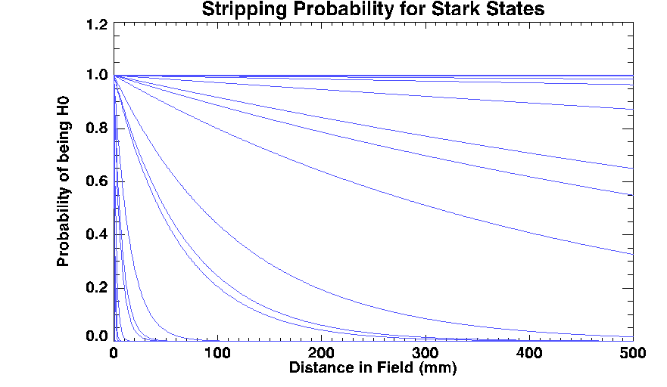
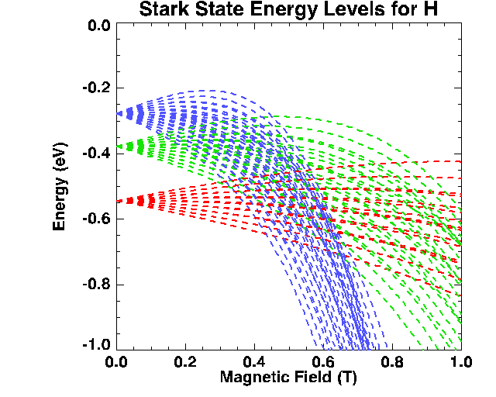
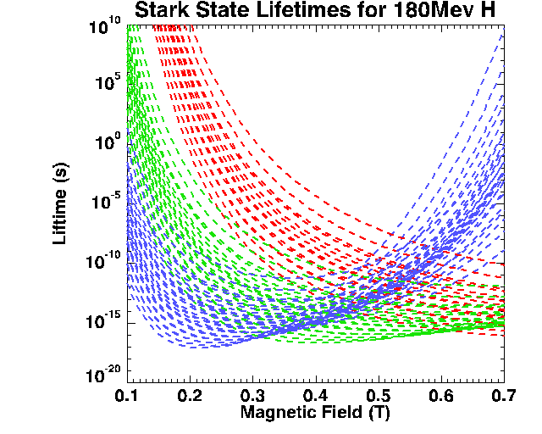
Stark States:
R. J. Damburg and V. V. Kolosov, “Rydberg States of Atoms and Molecules”, Cambridge University Press, England, 1983, p. 31
Notes:
180 MeV requires dipole fields of up to 0.18 T (c.f 0.11 T for 70 MeV).
Increase proportion of partially stripped H0 in 3rd inj dip from 3.1 – 29.2%
Corresponds to extra 4W beam loss in inj straight. (taking into account 70-180 MeV increase).

Slide 9
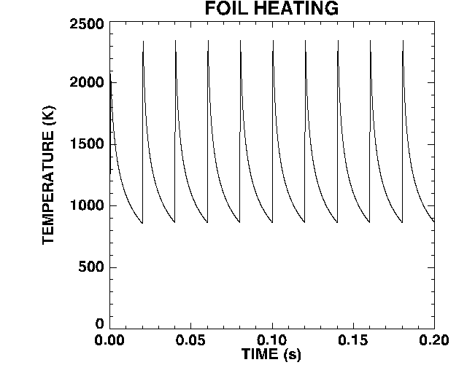
Foil Heating:
Injection Spot Size | 1 mm × 2.2 mm
Peak Current | 25.6 mA
Pulse Length | 500 μs
Repetition Rate | 50 Hz
Calculation of the lifetimes of thin stripper targets under bombardment of intense pulsed ions, S.G Lebedeve, A.S Lebedev, PRST-AB, 11, 020401 (2008)
Notes:
Simulate 30 days continuous operation – gives reduction 200 – 199.990 ug/cm2
Peak 2358 K cool to 866 K
Thickness non varying case – same result.
Equivalent ANSYS setup (with uniform beam spot, as in numerical method)
2304 K.
Also tried with Gaussian, 2521 K.

Slide 10
Injection Upgrades:
Notes:
Data from 3D ORBIT sims.
Inject beam only, peak 826 K
Adapted numerical solver – got peak 828 K
Inject + recirc. Dominated by proton recirculations (about 4)
Peak T 1657 K

Slide 12
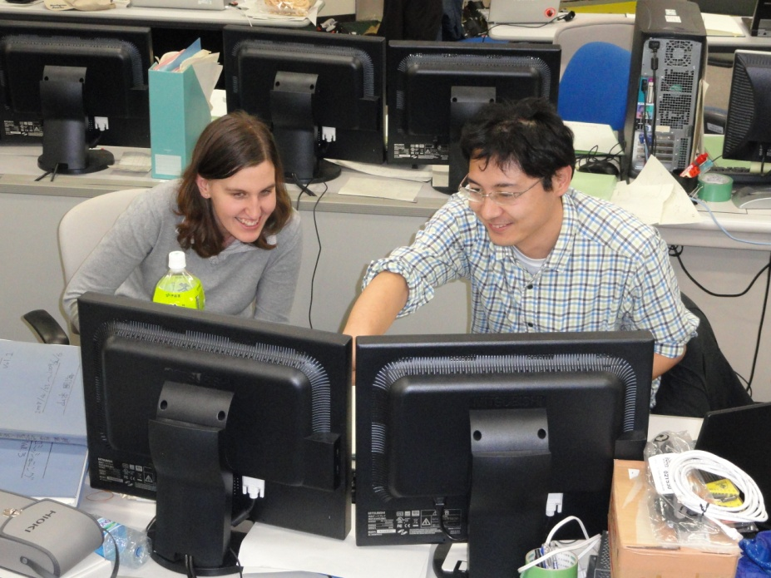
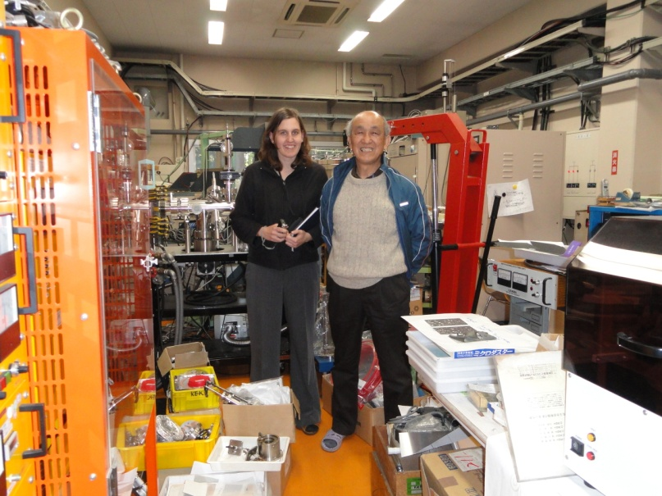
KEK/J-PARC:

Slide 13
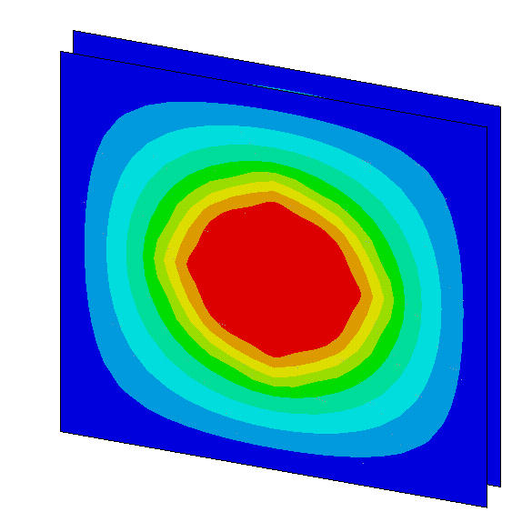
Double Foils:
Sample | Measured (K) | Simulated (K)
(202+202) µg cm⁻², 73.4 µA | 1673 | 1676, 1676
(320+103) µg cm⁻², 72.8 µA | 1837 | 1810, 1526
(226+223) µg cm⁻², 84.4 µA | 1769 | 1781, 1780
(188+185) µg cm⁻², 84.8 µA | 1694 | 1707, 1703
Temperature analysis of the multi layered HBC stripper foil by a high intensity H- beam irradiation, Y. Takeda et al., VASSCAA-4 (2008)
Notes:
KEK experimental results.
Benchmarking to these.

Slide 14
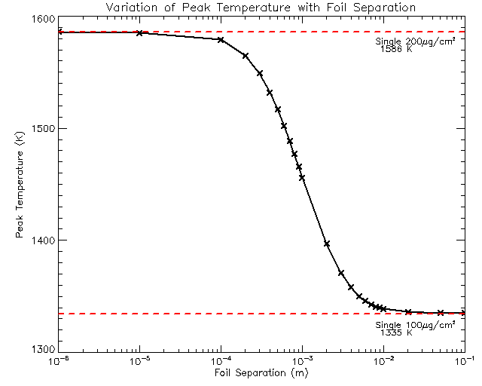
Double Foils:

Slide 15
Large Foils:
Notes:
Limitations I found in ANSYS.

Slide 16
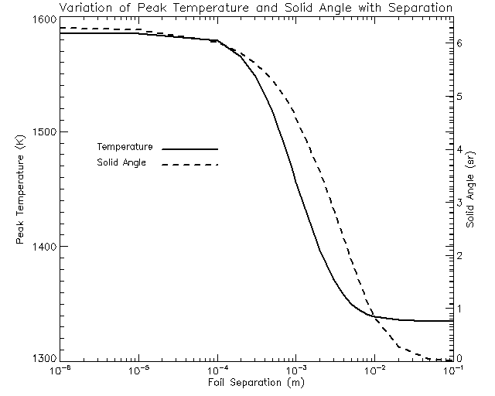
Large Foils:
Separation (m) | Simulated (K) | Calculated (K)
1x10⁻⁶ | 1586 | 1585
1x10⁻⁵ | 1585 | 1583
1x10⁻⁴ | 1579 | 1573
1x10⁻³ | 1456 | 1513
1x10⁻² | 1339 | 1363
1x10⁻¹ | 1335 | 1334
Notes:
Limitations I found in ANSYS.

Slide 17
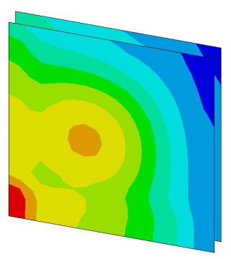
Double Foils:
Notes:
Moved on to try the ORBIT data for ISIS injection upgrades through the model.
Also looked at the effect of separation.

Slide 18
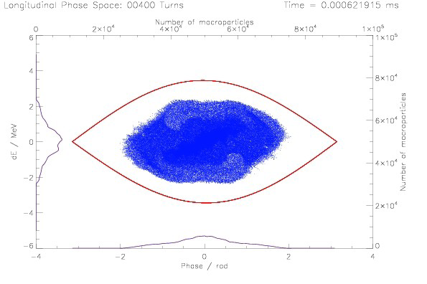
Future Work:
Set3Di:
2.5d tracking code
Injection Module
Foil Structure:
Structural analysis using ANSYS
Deformation and stresses
Notes:
Set3Di = in house 2.5d tracking code under development.
Include Injection module into full ISIS cycle simulation.
Include foil size, position, vertical and horizontal painting, foil re-circulation
Stability of single foil system? Curling? Bending? Where are the stresses?
Requirement for SiC fibres (as at J-PARC)?
Requirement for corrugated foil (as at SNS)?
Expansion of double foil system (as at KEK)?

Slide 19
Summary:
ISIS 70 MeV Injection Foil
180 MeV Injection Foil Studies
Stripping
Scattering
Heating
KEK / J-PARC Visit
Double Foil Studies
Future Work
Thank you, any questions?

