Slide 1
Rotating Foil and Stripping Station Studies
Dave Johnson (APC) and Zhijing Tang (PPD)
May 29, 2012

Slide 2
Motivation
Single pass Stripping station
Beam line (3 GeV H- transport)
At 3 MW, losses are an issue (Lorentz stripping, black body rad.)
Currently limited fields (restricted footprint) and Cold beam tube
Convert to protons w/stripping station eliminates these issues
1 GeV (1MW) to Nuclear facility
Potential ADS Technology Demonstration
Requires protons for vertical orientation
Multi-pass injection stripping foil
8 GeV injection into Recycler ( multiple short injections 1mA-4ms x6 inj @ 10 Hz or a single “long pulse” 1 mA-25ms injection)
1 GeV injection into Booster (CW linac, ≈ 1 ms inj. 15Hz rep)
Injection into high intensity storage rings
Why rotating foils
Spread energy deposition over larger area to reduce peak temperatures
Does not help with losses due to scattering
A preliminary estimation for a Project X “long pulse” injection scenario performed by A. Drozhdin, L. Vorobiev, S. Striganov, and I. Rakhno utilizing a moving strip foil indicates a reduction in temperature… to be discussed in next presentations

Slide 3
Typical H⁻ Stripping Foil Material
Carbon
Amorphous Carbon (such as Arizona carbon)
HBC (Hybrid Boron doped Carbon) KEK
DLC (diamond-like-carbon) Trumph
Aluminum-oxide
More recently polycrystalline (including nano- and ultranano- )diamond foils have been pioneered and utilized by SNS

Slide 4
UNCD Properties
General material properties
Young’s modulus: ~ 850 -1100 Gpa
Large fracture strength: ~ 4 GPa for UNCD
(free standing sheets are flexible and strong)
Density: ~3.3 g/cm³
Poisson ratio: ~0.057+/-0.38
Mohs hardness: 10
Dielectric constant: ~5.68
Electrical resistance ( depends on doping) 10⁻¹ to 10⁺⁴ Ω-cm
Breakdown voltage: ~10⁸ V/m
Thermal conductivity (depending on grain size) 12-1500 W/m-ºK
Coefficient of linear expansion ~10⁻⁶/ºC
Not a DLC (amorphous form of carbon) coating or film
Self supporting
Grown in wafers up to 300mm diameter (thickness 0.1 to ~2 μm)
Can be corrugated, etched, and diced for shaping of final foil geometry
Chemistry (atmosphere), multiple element deposition, grain control impact ultimate thermal, electrical, and mechanical properties

Slide 5
Approach (1)
Single Pass (want 100% neutralization)
MARS- for loss distributions/activation
ANSYS- thermal/mechanical simulations
Multi-turn Injection (typically 98 to 99%)
Utilize codes such as ORBIT and STRUCT for determination of parasitic hit distribution on foil as a function of
Ring and injection line lattice
Painting algorithm
Injection beam current, injection time, and rep rate
Losses due to scattering
Losses due to Stripping of excited states (Stark states)
ANSYS for thermal and mechanical simulations

Slide 6
Approach(2)
Develop ANSYS model of rotating foil to investigate thermal and mechanical properties
Utilize general UNCD properties for initial model (in consultation with CNM) as a starting point
Utilize existing energy deposition and foil temperature estimations based upon MNCPX and MARS simulations
Understand physical, thermal, and electrical characteristics requirements due to rotation and beam impact (structural, thermal, electrical, etc) What’s important & and how to specify material properties (strength, uniformity, thermal acoustic, and electrical properties)
Understand capabilities of CNM (Argonne)/Advanced Diamond Technologies
Understand the diamond-to-graphite conversion due to ion bombardment
Prototype disk
Design of rotational system
Design a disk which meets the physical and thermal requirements
Plan for temperature and foil dynamics measurement
Beam test (at FNAL) 400 MeV and/or 8 GeV or potentially SNS

Slide 7
First Example – single pass stripping
Assume 1 mA average linac current at 3 GeV in 162.5 MHz bunch structure → ~4E7 ions/bunch assuming all bunches are filled equally
Bunch length ~1 ns
Bunch repetition rate 6.15 ns
Assume Gaussian beam with σ=2mm
Assume foil thickness 2 μm and density 3 g/cm³ (600μg/cm²)
τ₁ bunch (pulse length),
τ₂ rep rate
τ₂
τ₁
2 micron UNCD film
(surface structure may be required
Si substrate
ω
Copper
82 mm
6 mm
20 mm
H- beam
τ = 30 ms
ω = 2,000 rpm

Slide 8
Thermal Model
ANSYS simulation developed by Zhijing Tang
τ₁ bunch (pulse length),
τ₂ rep rate
τ₂
h foil thickness
k thermal conductivity
τ₁
[J-kg/ºK]
Heat source term
1,
0,
* For now ignore delta electrons
N is the #ions/bunch

Slide 9
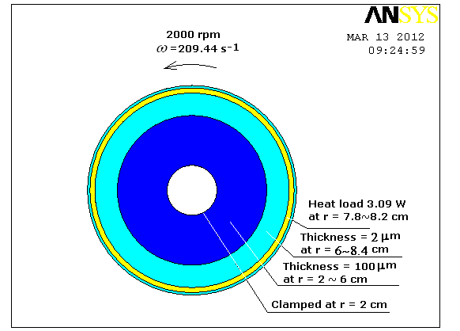
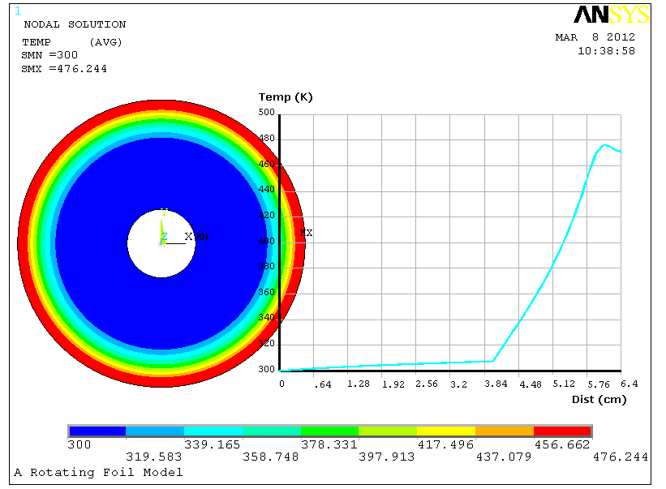
Preliminary ANSYS Simulations
ANSYS simulation developed by Zhijing Tang
Thermal Analysis
From NIST tables dE/dx through amorphous carbon (1p-2e) 4.95 MeV-cm²/g
Neglecting any reduction of energy deposition from delta electrons
For a bunch intensity of 4E7 ions the energy deposition for
single bunch (SI) u ~ 3.2x10⁻⁶ J-m²/kg
Instantaneous power (ρuh) into foil ~19W
average power τ₁/τ₂P₀ ~3W
Consider heat source continuous with time
Time scale for conduction
Time scale for radiation
Static solution

Slide 10
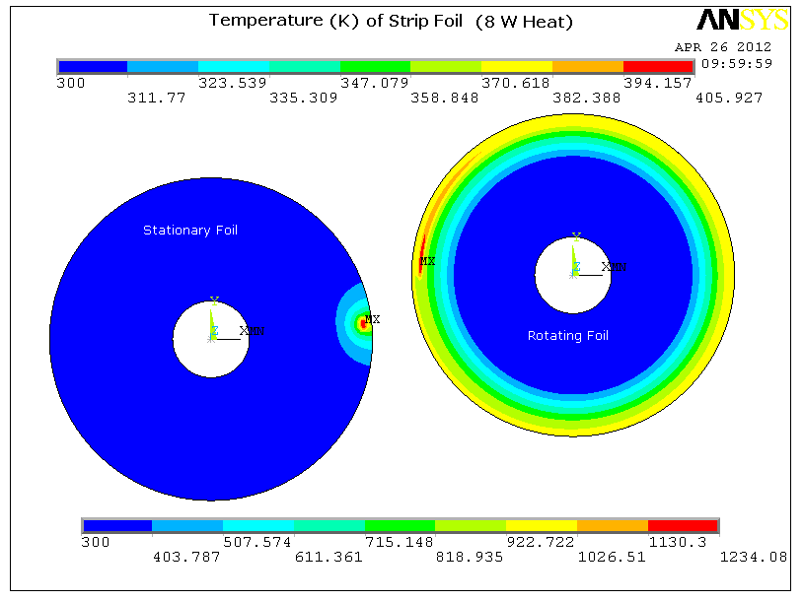
Increase Beam power
ANSYS simulation developed by Zhijing Tang
Assume hit rate of 5.15E14 proton/mm²
over 30 ms and constant hit rate
Outer radius = 8.4 cm, inner radius = 2 cm.
From r = 2 to r = 6 cm, thickness = 100 microns; from r = 6 to r = 8.4 cm, thickness = 2 microns.
Rotation speed = 2000 rpm.
Heating power = 8 W on a spot size = 1x2 mm² (r = 8 cm).
ρ = 3 g/cm³, k = 1370 W/m-K, ε = 0.5,
Bunch intensity ~1E8
Average heating ~8W
Boundary condition is the temperature at r = 2 cm and the enclosure temperature = 300 K.
Use a static solution as initial condition, following is the temperature distribution after 5.6 cycles.

Slide 11
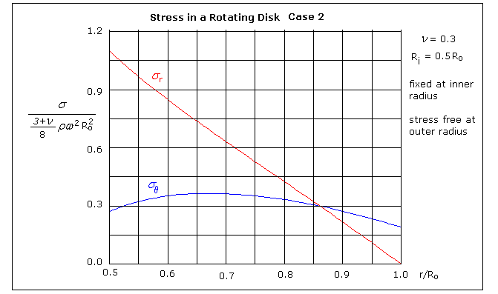
Mechanical Analysis
ANSYS simulation developed by Zhijing Tang
What are the design parameters for a foil to rotate at high speeds?
Interested in
stresses in the foil while rotating and with the addition of heat
natural frequencies of oscillation
buckling amplitudes
ANSYS Mechanical Model (stress for a rotating thin disk)
→Stress proportional to square of rotational speed and radius.
→All stresses are positive (under tension) when no thermal load
Stress due to centrifugal force
→ ~0.4 MPa for r=8cm and speed 2000rpm
Thermal stress proportional to temperature change
~.13 GPa for temp change of 150ºK

Slide 12
Summary/Next Steps
ANSYS simulations have just began
Start injection simulations
Move forward for beam test of UNCD foil

