Slide 1
OSGCAMPUS INFRASTRUCTURES
Rob Gardner
Computation and Enrico Fermi Institutes
University of Chicago
OSG Campus Infrastructures Workshop @ OSG All Hands, Indianapolis
March 12, 2013

Slide 2
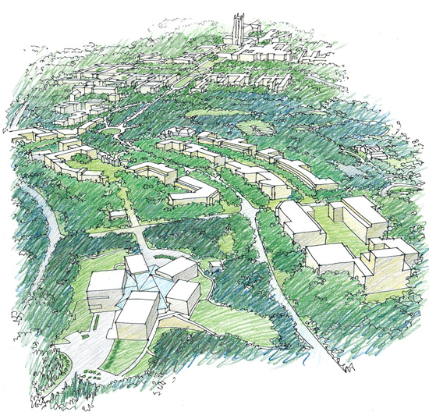
Science happens on campus

Slide 3
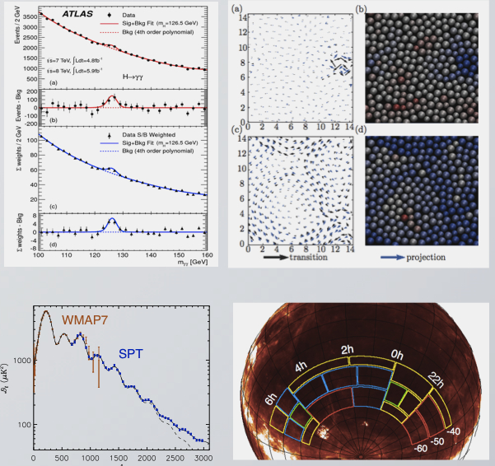
Campus + tools = Campus Grid → more science

Slide 4
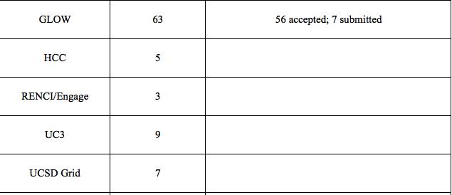
Clearly OSG Campus Grids accelerate things
Science publications (ref. 2012 OSG Annual Report)
More important than the numbers
are the new and diverse fields engaged

Slide 5
Campus Infrastructure in the OSG context
A Campus Infrastructure is a resource sharing capability that enables users to submit jobs and access data from diverse compute resources using only their campus identity management credentials.
A campus infrastructure is not limited to resources on a campus but incorporates the ability to access resources directly from other campuses and can also access resources from national cyberinfrastructures such as the Open Science Grid (OSG) or XSEDE.

Slide 6
Capabilities
Foundational
  Campus identity ( → federated, grid)
  Job management over diverse resources
  Ubiquitous software and data access
  Monitoring and accounting services
Practical
  Application best practices on d-HTC
  Advanced workflow services
  Advanced user interfaces

Slide 7
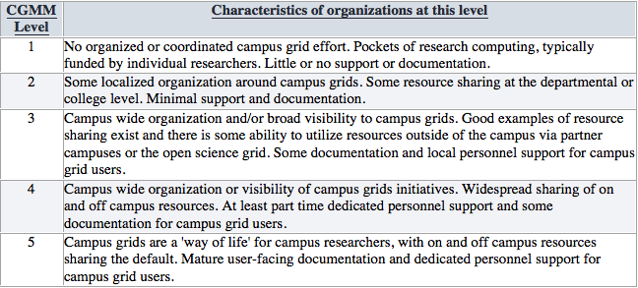
Campus Infrastructures Maturity Model
Brooklin Gore
https://twiki.grid.iu.edu/bin/view/CampusGrids/DeployedCampusInfrastructures

Slide 8
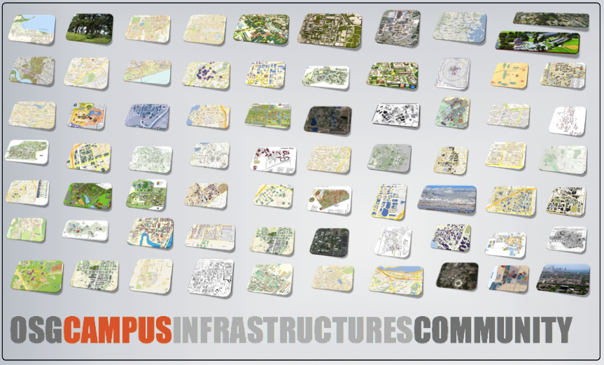
The US Campuses of OSG

Slide 9
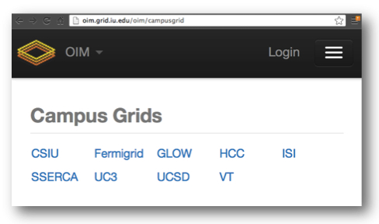
Currently registered Campus Grids
About 10% of sites have a registered activity

Slide 10
Campus Grids of OSG (today)

Slide 11
OSG CIC
What is the OSG Campus Infrastructures Community?
  A forum in OSG to share knowledge, expertise, tools and best practices for those creating campus distributed high throughput computing infrastructures and enabling applications and research communities which use them
Who are the members of the OSG CIC?
  You, most likely! Essentially anyone with an interest in bringing the advantages of d-HTC and other tools and services as efficiently as possible to domain end-users so as to optimize science
Reference
  https://osg-docdb.opensciencegrid.org:440/cgi-bin/ShowDocument?docid=1113

Slide 12
OSG CIC Committee
Lothar Bauerdick
Dan Fraser
Rob Gardner
Brooklin Gore
Thomas J Hacker
Shawn McKee
Mark Neubauer
Ruth Pordes
Mats Rynge
David Swanson

Slide 13
How does it work?
The forum will consist of monthly webinars and occasional face-to-face workshops.
Contributions can come from within or outside OSG and its affiliated communities.
Communications
  Subscribe to campusgrids@opensciencegrid.org for meeting announcements
  Suggest topics or volunteer at
  osg-cic-committee@opensciencegrid.org
  campusgrids.org for repository of talks and notices

