Slide 1
FermiCloud: Enabling Scientific Workflows with Federation and Interoperability
Steven C. Timm
FermiCloud Project Lead
Grid & Cloud Computing Department
Fermilab
Work supported by the U.S. Department of Energy under contract No. DE-AC02-07CH11359

Slide 2
FermiCloud Background
Infrastructure-as-a-service facility for Fermilab employees, users, and collaborators
Project started in 2010.
OpenNebula 2.0 cloud available to users since fall 2010.
Condensed 7 racks of junk machines to 1.5 racks of good machines
Provider of integration and test machines to the OSG Software team.
OpenNebula 3.2 cloud up since June 2012
This talk will focus mostly on current user experience and future directions
More technical details available on request

Slide 3
Who can use FermiCloud
Any employee, user, or contractor of Fermilab with a current ID.
Most OSG staff have been able to get Fermilab “Offsite Only” ID’s.
With Fermilab ID in hand, request FermiCloud login via Service Desk form.
Instructions on our new web page at http://fclweb.fnal.gov
Note new web UI at https://fermicloud.fnal.gov:8443/
Doesn’t work with Internet Explorer yet

Slide 4
Sunstone Web UI

Slide 5
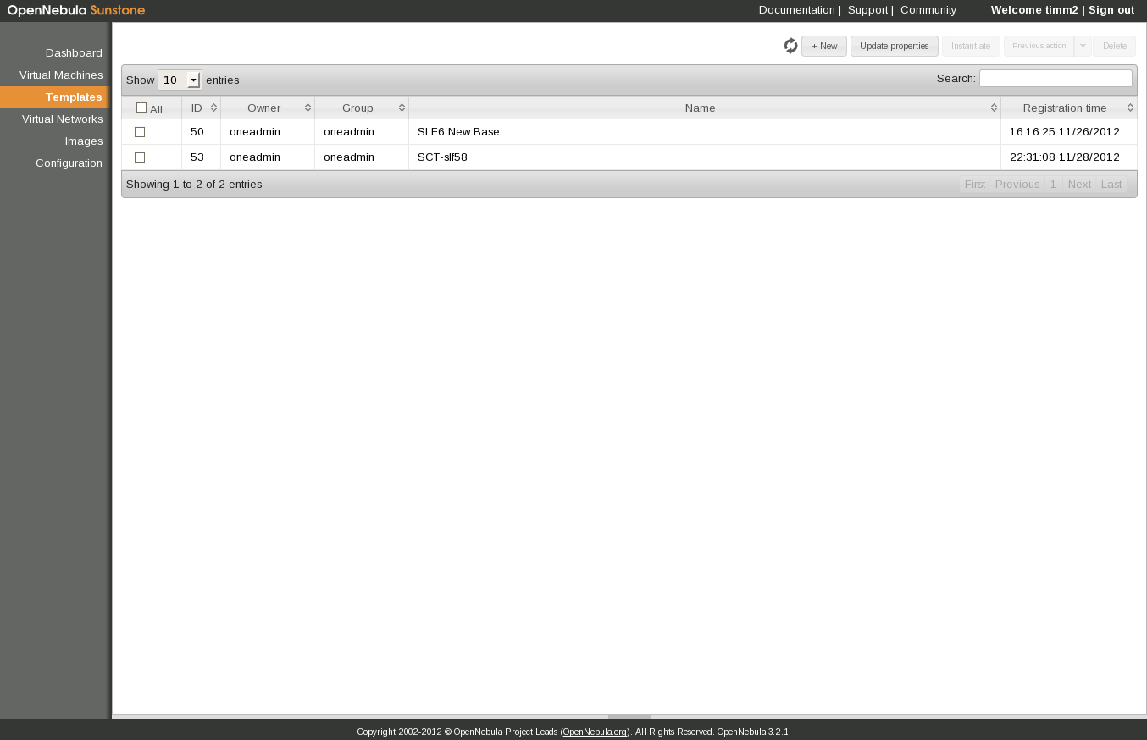
Selecting a template

Slide 6
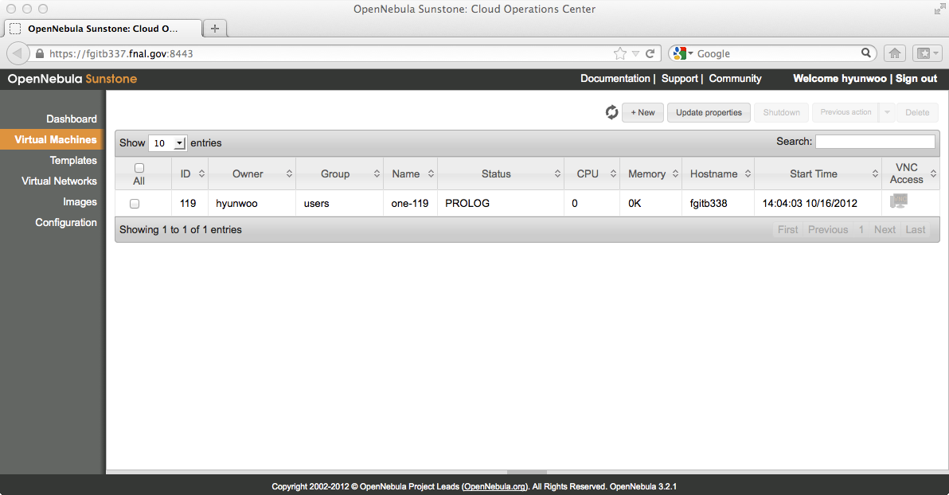
Launching the Virtual Machine

Slide 7
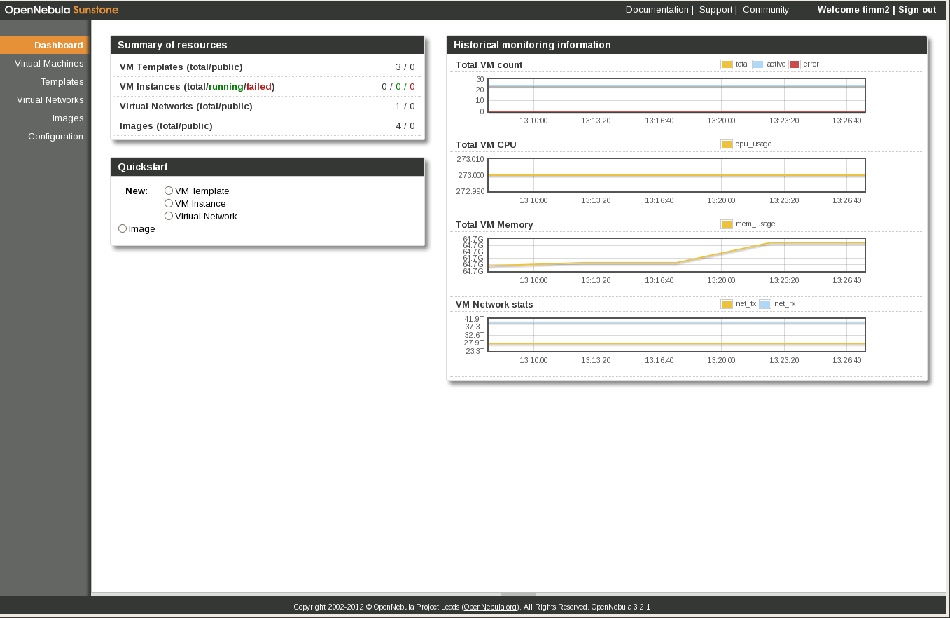
Monitoring VM’s

Slide 8
FermiCloud Development Goals
Goal: Make virtual machine-based workflows practical for scientific users:
Cloud bursting: Send virtual machines from private cloud to commercial cloud if needed
Grid bursting: Expand grid clusters to the cloud based on demand for batch jobs in the queue.
Federation: Let a set of users operate between different clouds
Portability: How to get virtual machines from desktop→FermiCloud→commercial cloud and back.
Fabric Studies: enable access to hardware capabilities via virtualization (100G, Infiniband, …)

Slide 9
Overlapping Phases
Phase 1:
“Build and Deploy the Infrastructure”
Today
Phase 2:
“Deploy Management Services, Extend the Infrastructure and Research Capabilities”
Phase 3:
“Establish Production Services and Evolve System Capabilities in Response to User Needs & Requests”
Phase 4:
“Expand the service capabilities to serve more of our user communities”
Time

Slide 10
Virtual Machines as Jobs
OpenNebula (and all other open-source IaaS stacks) provide an emulation of Amazon EC2.
Condor team has added code to their “Amazon EC2” universe to support the X.509-authenticated protocol.
Planned use case for GlideinWMS to run Monte Carlo on clouds public and private.
Feature already exists,
this is a testing/integration task only.

Slide 11
Grid Bursting
Seo-Young Noh, KISTI visitor @ FNAL, showed proof-of-principle of “vCluster” in summer 2011:
Look ahead at Condor batch queue,
Submit worker node virtual machines of various VO’s to FermiCloud or Amazon EC2 based on user demand,
Machines join grid cluster and run grid jobs from the matching VO.
Need to strengthen proof-of-principle, then make cloud slots available to FermiGrid.
Several other institutions have expressed interest in extending vCluster to other batch systems such as Grid Engine.
KISTI staff has a program of work for the development of vCluster.
GlideinWMS project has significant experience submitting worker node virtual machines to cloud. In discussions to collaborate.

Slide 12
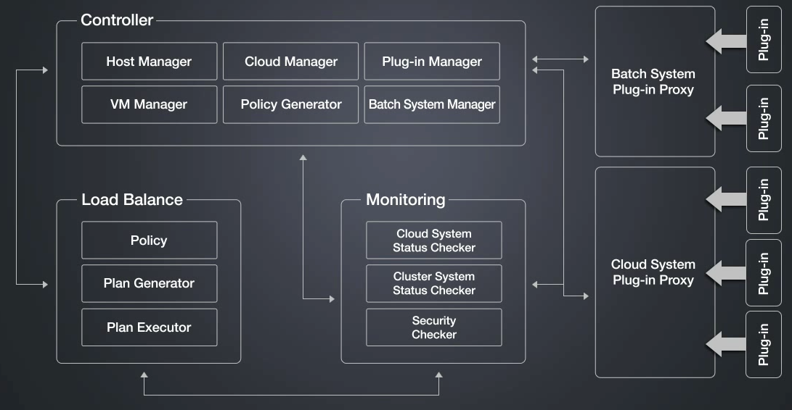
vCluster at SC2012

Slide 13
Cloud Bursting
OpenNebula already has built-in “Cloud Bursting” feature to send machines to Amazon EC2 if the OpenNebula private cloud is full.
Need to evaluate/test it, see if it meets our technical and business requirements, or if something else is necessary.
Need to test interoperability against other stacks.

Slide 14
FermiCloud Test Bed - Virtualized Server
FCL : 3 Data & 1 Name node
eth
ITB / FCL
Ext. Clients
(7 nodes -
21 VM)
2 TB
6 Disks
Dom0:
- 8 CPU
- 24 GB RAM
mount
(
)
Opt. Storage
Server VM
On Board
Client VM
CPU: dual, quad core Xeon X5355 @ 2.66GHz with 4 MB cache; 16 GB RAM.
3 Xen VM SL5 per machine; 2 cores / 2 GB RAM each.
BlueArc
7 x
mount
8 KVM VM per machine; 1 cores / 2 GB RAM each.

Slide 15
True Idle VM Detection
In times of resource need, we want the ability to suspend or “shelve” idle VMs in order to free up resources for higher priority usage.
This is especially important in the event of constrained resources (e.g. during building or network failure).
Shelving of “9x5” and “opportunistic” VMs allows us to use FermiCloud resources for Grid worker node VMs during nights and weekends
This is part of the draft economic model.
Giovanni Franzini (an Italian co-op student) has written (extensible) code for an “Idle VM Probe” that can be used to detect idle virtual machines based on CPU, disk I/O and network I/O.
This is the biggest pure coding task left in the FermiCloud project,
If KISTI joint project approved—good candidate for 3-month consultant.

Slide 16
Idle VM Information Flow
Idle VM Management Process
VM
VM
VM
VM
Raw VM
State DB
Idle VM
Collector
VM
VM
VM
VM
VM
VM
Idle VM Logic
Idle VM
Trigger
VM
VM
VM
VM
Idle VM
List
Idle VM Shutdown
VM
VM
VM
VM
VM
VM

Slide 17
Federation
Driver:
Global scientific collaborations such as LHC experiments will have to interoperate across facilities with heterogeneous cloud infrastructure.
European efforts:
EGI Cloud Federation Task Force – several institutional clouds (OpenNebula, OpenStack, StratusLab).
HelixNebula—Federation of commercial cloud providers
Our goals:
Show proof of principle—Federation including FermiCloud + KISTI “G Cloud” + one or more commercial cloud providers + other research institution community clouds if possible.
Participate in existing federations if possible.
Core Competency:
FermiCloud project can contribute to these cloud federations given our expertise in X.509 Authentication and Authorization, and our long experience in grid federation

Slide 18
Virtual Image Formats and Distribution
Clouds have different VM image formats:
FS, Partition table, LVM , Kernel
Identify differences, find conversion tools
Investigate image marketplaces (Hepix, UVic)
Do we need S3 or Gridftp image upload facility?
OpenNebula doesn’t have one now.
Develop auto security scan for VM images
Scan them like laptop coming onto site.

Slide 19
Interoperability/Compatibility of API’s
Amazon EC2 API is not open source, it is a moving target that changes frequently.
Open-source emulations have various feature levels and accuracy of implementation:
Compare and contrast OpenNebula, OpenStack, and commercial clouds,
Identify lowest common denominator(s) that work on all.
Contribute bug reports and fixes where possible.

Slide 20
High-Throughput Fabric Virtualization
Follow up earlier virtualized MPI work:
Use it in real scientific workflows
Example – simulation of data acquisition systems (the existing FermiCloud Infiniband fabric has already been used for such).
Will also use FermiCloud machines on 100Gbit Ethernet test bed
Evaluate / optimize virtualization of 10G NIC for the use case of HEP data management applications
Compare and contrast against Infiniband

Slide 21
FermiCloud X.509 Authentication
OpenNebula came with “pluggable” authentication, but few plugins initially available.
OpenNebula 2.0 Web services by default used “access key” / “secret key” mechanism similar to Amazon EC2. No https available.
Four ways to access OpenNebula:
Command line tools,
Sunstone Web GUI,
“ECONE” web service emulation of Amazon Restful (Query) API,
OCCI web service.
FermiCloud project wrote X.509-based authentication plugins:
Available in OpenNebula 3.2 and onward.
X.509 plugins available for command line and for web services authentication
.

Slide 22
FermiCloud X.509 Authorization
OpenNebula authorization plugins written in Ruby
As shipped: One DN -> one userid—no VO support
For now, must use Fermilab KCA short-lived cert.
Use existing Grid AuthZ routines:
Use Ruby-Java bridge to call Java-based routines from VO Privilege project
GUMS returns uid/gid, SAZ returns yes/no.
Works with OpenNebula command line and non-interactive web services
Almost impossible to send VOMS proxy through web browser
For OpenNebula’s Sunstone Web GUI develop VO selection pull-down (similar to Gratia Admin Web UI)
Get desired vo/role from user and poll GUMS/VOMS on server side

Slide 23
FermiCloud User Comments1:
Bothered by no-root-squash NFS (Mat)
FermiCloud stores all host/http certs in volatile RAM disk for just that reason.
Clock problem with pause/resume (Mat)
FC admins solve that by launching a process to restart ntpd on a loop just before we pause. Will try to make this available to users.
Way for user to intervene on down VM (several)
We as admins can get serial console or access via virt-viewer
Can't save VM snapshot (several)
Onevm saveas <vmid> 0 <name_of_image> ; onevm shutdown <vmid>
IP finding tool needed (several)
source /cloud/images/OpenNebula/scripts/one3.2/hostname.sh
Other OSG software team have written scripts too

Slide 24
FermiCloud User Comments 2
Change name of VM (several)
Have asked OpenNebula for this feature.
Community repo for users to share scripts(Marco)
OSG SW team already added
Better docs on best practices (shutdown) (Tim)
Next version of OpenNebula expected to beat a lot of race conditions
Until then—we will modify onevm delete so it will not delete a VM still in “shut” or “epil” state
And add an “are you sure?” prompt for VM in “run” state.
Make docs available as HTML pages, not word docs (Tim)
See http://fclweb.fnal.gov/fermicloud-dummies.html
And http://fclweb.fnal.gov/fermicloud-geeks.html

Slide 25
Acknowledgements
None of this work could have been accomplished without:
FermiCloud Project Team: Currently Steven Timm (lead), Keith Chadwick, Gerard Bernabeu, Karen Shepelak, Hyunwoo Kim, Parag Mhashilkar, Tanya Levshina, Gabriele Garzoglio
The excellent support from other departments of the Fermilab Computing Sector – including Computing Facilities, Site Networking, and Logistics.
The excellent collaboration with the open source communities – especially Scientific Linux and OpenNebula,
As well as the excellent collaboration and contributions from KISTI.

Slide 26
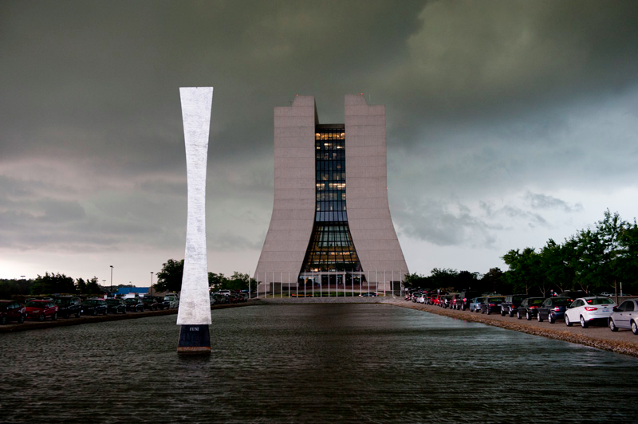
FermiCloud Summary
FermiCloud Development Collaboration:
Leveraging external work as much as possible,
Contribution of our work back to external collaborations.
Using (and if necessary extending) existing standards:
AuthZ, OGF UR, Gratia, etc.
FermiCloud Facility
Deploying 24by7 capabilities, redundancy and HA.
Delivering support for science collaborations at Fermilab
Making new types of computing work possible
The future is mostly cloudy.

