Slide 1
OSG PKI Transition
Impact on CMS

Slide 2
Impact on End User
After March 23 2013, DOEGrids CA will stop issuing or renewing certificates.
If a user is entitled to get certificates from the CERN CA, we strongly recommend that the user should get CERN certificate
Exceptions (get an OSG certificate):
  Users who cannot for some reason obtain a CERN certificate
  User who need to digitally sign their email (e.g. CMS Sponsors)
Must register new certificate with:
  CMS VOMRS (Required to get a VOMS proxy)
  SiteDB (Required to run CMS jobs)
May need to register new certificate with:
  CERN SSO (Only if you are getting a non-CERN certificate)
  REBUS
  GGUS
  OIM, MyOSG, OSG Ticketing System
  Site local storage
https://twiki.cern.ch/twiki/bin/view/CMSPublic/EndUsers

Slide 3
Impact on Sys Admins
If your proxy is used for PhEDEx, then make sure you update your mapping in GUMS for storage
After March 2013, you should obtain host/service certificates from the OSG CA
There is a web interface (through OIM) and a command line interface.
All Tier-2 sites should have at least one administrator registered as a grid-admin
  Much quicker turn around in receiving certificates
  Self approve certificate requests automatically
Tier-3 site admins can talk to Rob Snihur to determine if they want or need to become grid-admins
https://twiki.cern.ch/twiki/bin/view/CMSPublic/SysAdmins

Slide 4
CMS Site Specific Impact
No real impact on running a job
Number of dedicated CMS Pool accounts goes up (if using pool accounts)
However… Storage may be impacted
  CMS allows storage on a per user basis
  Need to ensure user is mapped to an account with rw privileges to their own files
  Not an issue with sites using gridmap files
  Not an issue with sites that do not use pool accounts
Sites using GUMS will need to do a little work

Slide 5
(Re)Map Users in GUMS
Unfortunately, there is no automated way to update user mappings
  Many users let their certs expire before requesting new certs
  Many users create new registrations in VOMRS rather than associate their new cert with their existing VOMRS registration
  As a consequence, we cannot automatically determine the DNs to associate with each other
  Additionally, sites have different procedures on how to handle cert changes

Slide 6
(Re)Map Users in GUMS
John Weigand wrote a tool that helps you analyze your current GUMS situation and take steps to fix problems and re-map users appropriately
http://home.fnal.gov/~tiradani/downloads/remap-user
Must be run as root
  Reads GUMS database info from the GUMS config
Very useful for GUMS “archaeology” as well as remapping users

Slide 7
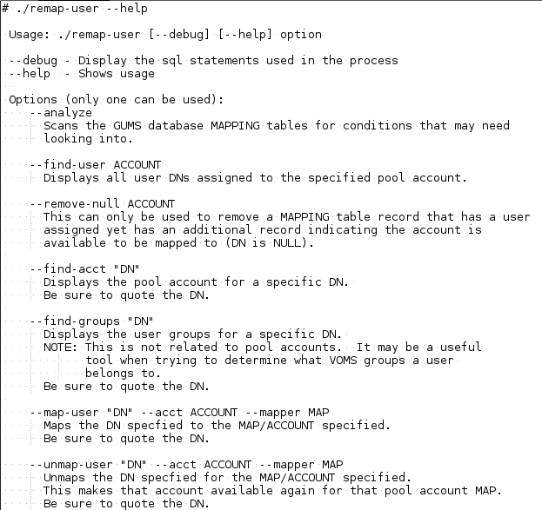
(Re)Map Tool
GUMS archaeology: --find-user, --find-groups, --find-acct, --analyze
GUMS Mod: --remove-null, --map-user, --unmap-user

Slide 8
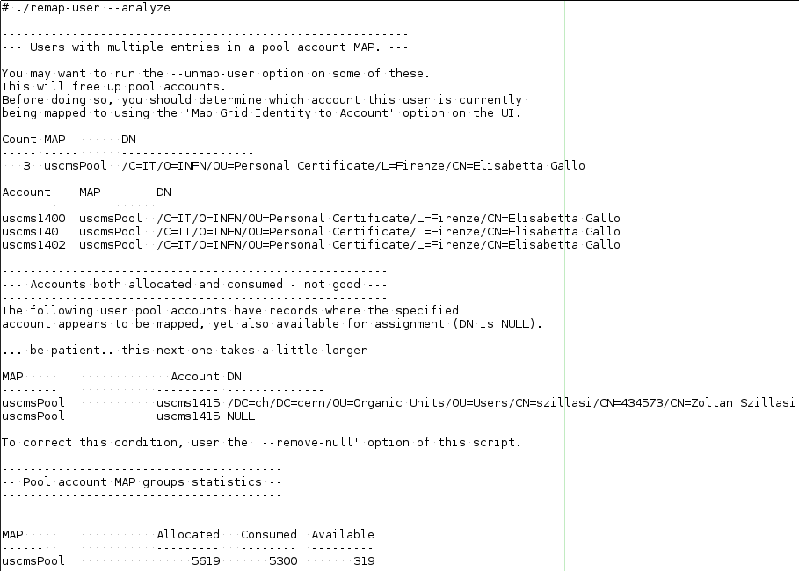
(Re)Map Tool
Analyze output: Shows potential problems in the database

Slide 9

(Re)Map Tool
In this context, user is the unix pool account
Shows all DNs associated with the pool account

Slide 10

(Re)Map Tool
Displays all pool accounts for a specific DN

Slide 11
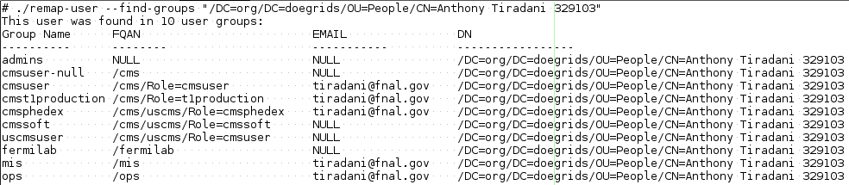
(Re)Map Tool
Occasionally, you may encounter a user user in the mapping table but have trouble finding the user in the GUMS user interface
The --find-groups option will display all the groups the DN has been assigned to
If no groups are returned, that means the user no longer has any valid certificates registered with the VOMS server
GUMS does not remove the user from the mapping table

Slide 12
OSG PKI Transition Questions
Questions?

