Slide 1
ATLAS Federated Xrootd Operations and OSG
ATLAS still a few steps away from declaring production ready, or setting requirements on sites
ATLAS Distributed Computing Operations has encouraged and endorsed “outsourcing” as many common operational components as possible: e.g. monitoring, availability, etc.
Would like OSG to assume responsibility for operation of “UCSD” collector for ATLAS (the EU zone will be hosted by CERN)
Encourage engagement of OSG Operations with WLCG federated xrootd deployment and operations taskforce led by Domenico Girodano

Slide 2
CMS status (from Brian)
  CMS has asked all sites to deploy Xrootd; USCMS believes all its T2s have complied.
  The US is has additional use cases planned for its sites above and beyond global CMS.
  Sites should have the *well-tested* capability to burst at up to 10Gbps.

Slide 3
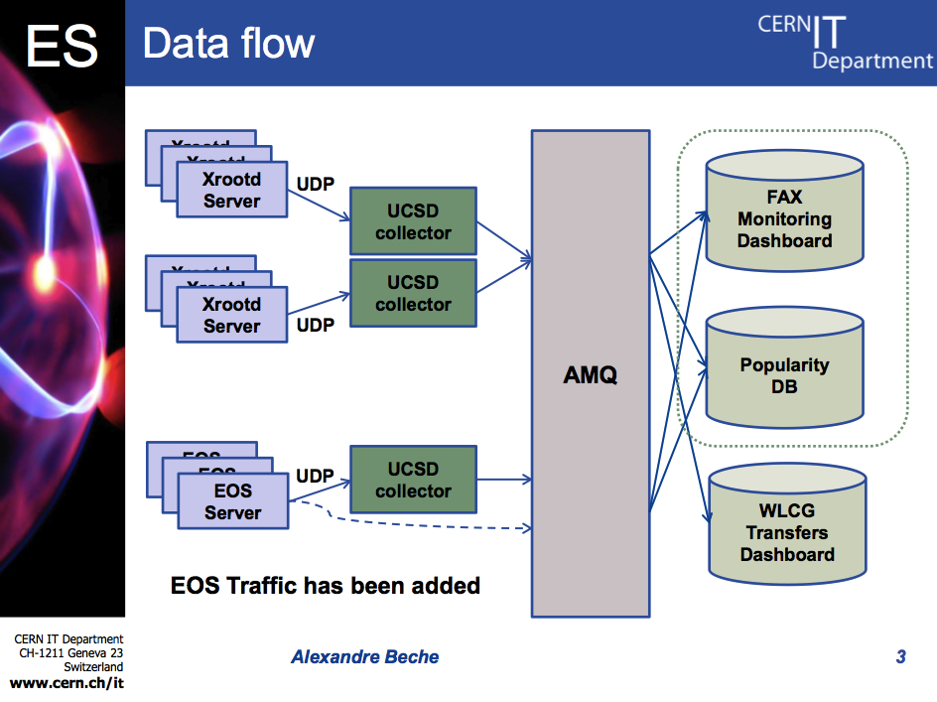
FAX monitoring by CERN IT-ES

Slide 4
For discussion
Aspects of a deployment include:
  Monitoring: besides the IO monitoring already gathered, what other things could be done in common?
  Software distribution: The "osg-contrib" repository already distributes CMS-specific configuration files and meta-RPMs. Is ATLAS interested in the same thing?
  Documentation: The OSG's documentation currently assumes you want to deploy an ATLAS T3 with Xrootd. Should it focus more on the federated case?

