Slide 1
What’s next for the US ATLAS Computing Facility?
Rob Gardner
Computation and Enrico Fermi Institutes
University of Chicago
US ATLAS Tier 1/Tier 2 Workshop
March 11, 2013

Slide 2
Lets review Facility Milestones
M. Ernst, NSF/DOE agency review last week

Slide 3
March FAX analysis milestone
Complete the FDR – new stress tests coming
Three access modes (at least)
From Panda/pathena
From a Tier 3 or cloud resource
Indirectly from the Slim Skim Service
Will need to work with US ATLAS analysis support team to generate good examples
Shuwei Yu has recent tests from the BNL tier3
Need to bring together examples and documentation
https://twiki.cern.ch/twiki/bin/view/Atlas/UsingFAXforEndUsers

Slide 4
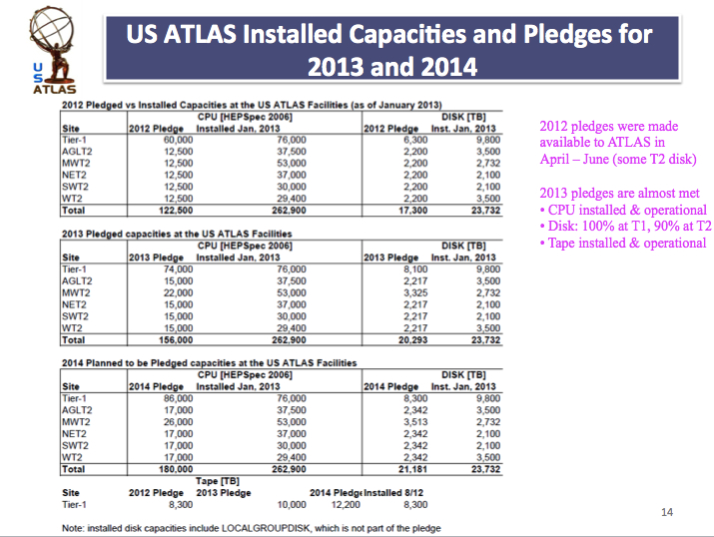
Complete deployment of FY13 resources
We are nearly there, but note April is upon us

Slide 5
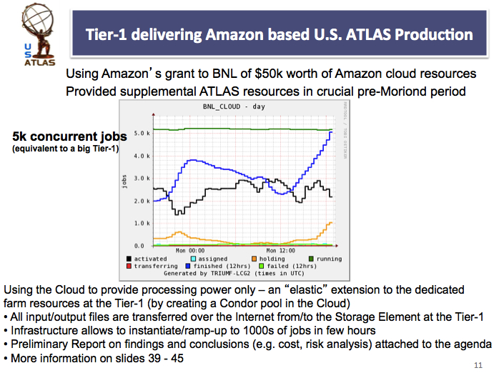
Making Cloudy Tier 2s
Follow BNL work on cloud activities, eg. Tier 1 elastic expansion into Amazon
Support expansion of Tier 3 clusters into Tier 2 (c.f. Lincoln’s presentation)

Slide 6
Exploiting Campus Grids

Slide 7
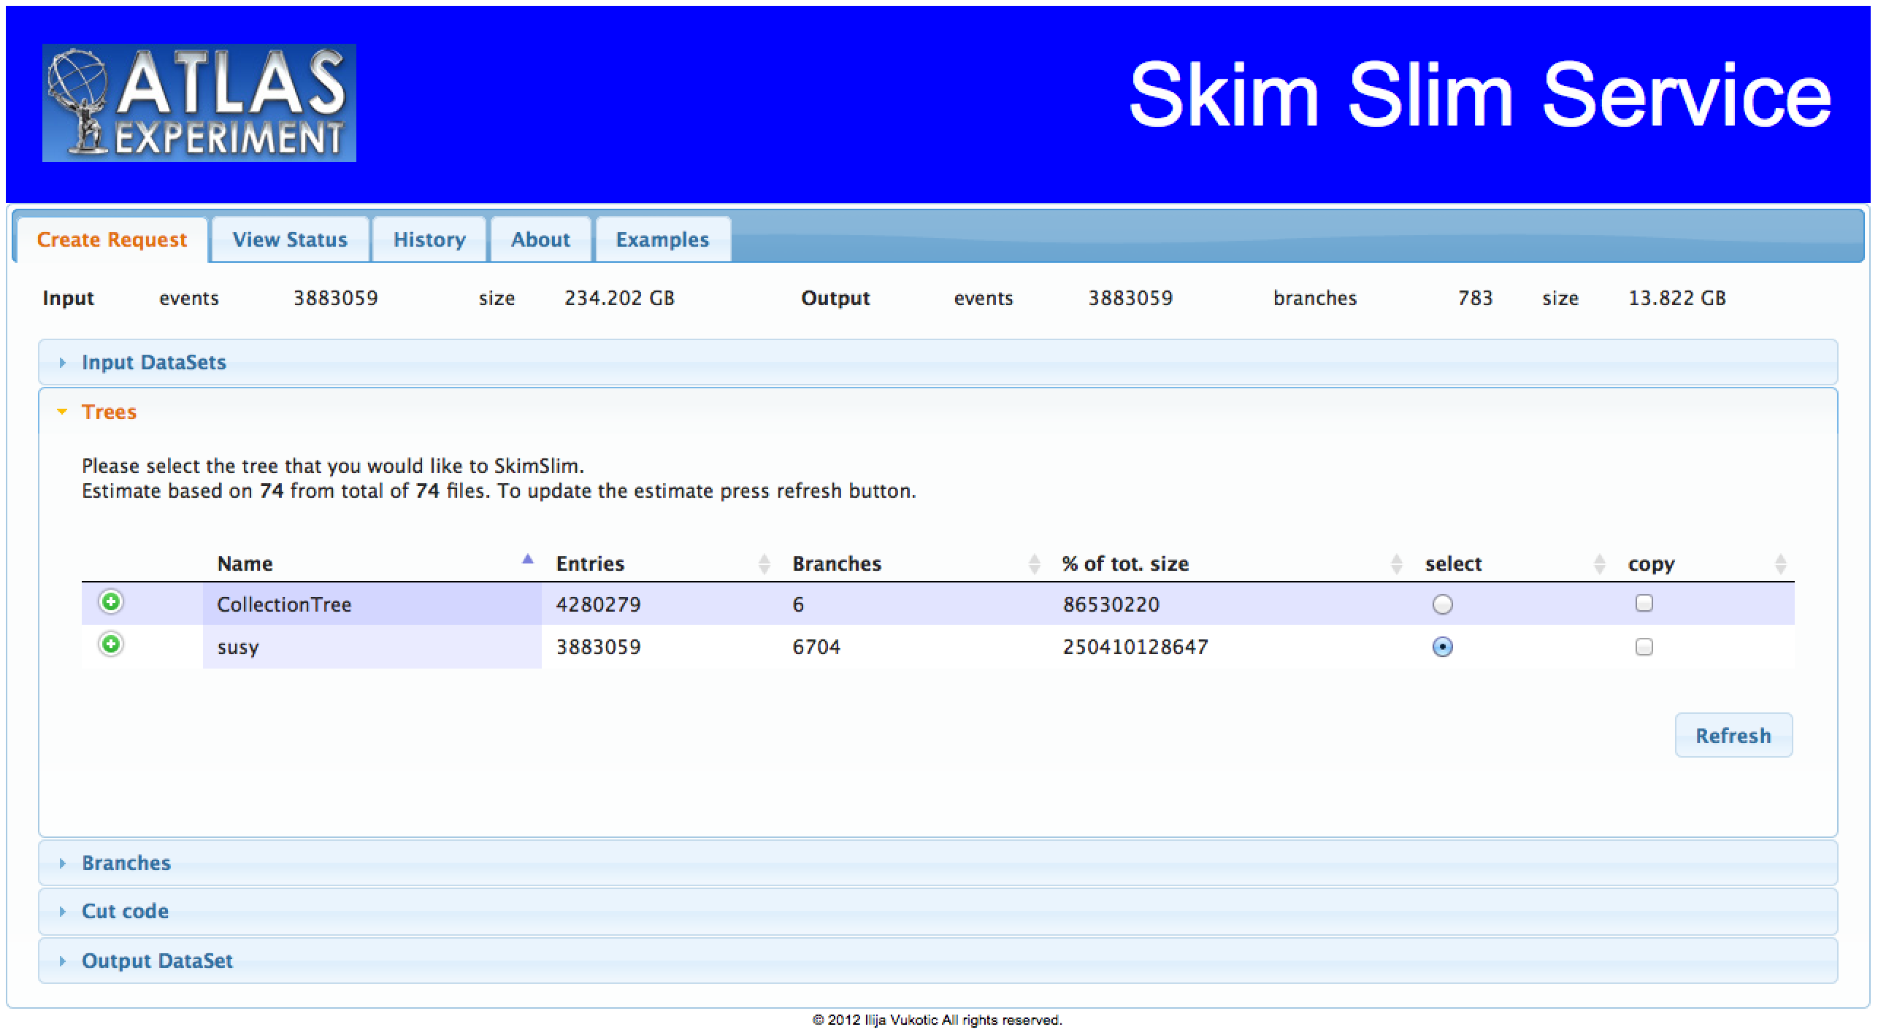
Skim Slim Service
In pre-production now, uses FAX & UC3
Will use part of beyond pledge resources
Many extensions possible – new mode of supporting analysis

Slide 8
Big Panda
Too early to tell what impacts on the Facility will be
Planning meeting in June

Slide 9
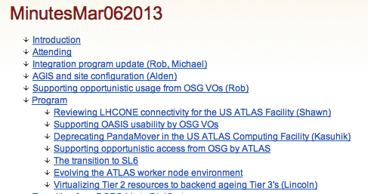
Odds-n-Ends in the Integration Program
As discussed at last Wednesday’s meeting

Slide 10
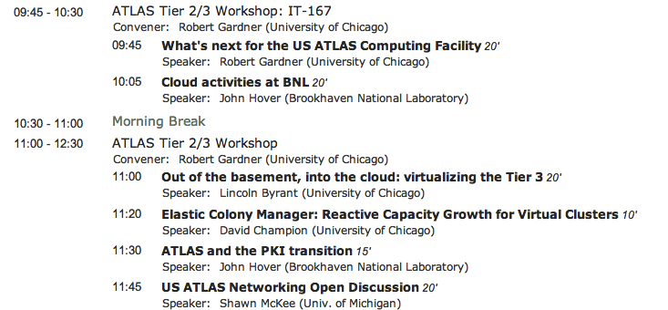
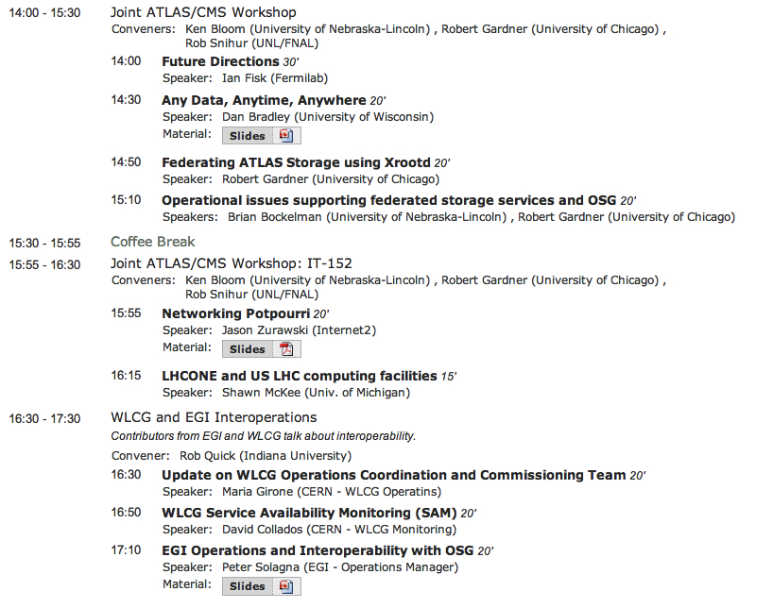
Today and this week
Tomorrow the OSG CIC meeting which I hope you all will attend

