Slide 1
Out of the basement, into the cloud: Extending the Tier 3
Lincoln Bryant
Computation and Enrico Fermi Institutes

Slide 2
Introduction

Slide 3
Motivations
UChicago has a large Tier 3 community, but a relatively small Tier 3.
There isn’t a lot of money to spend on new hardware.
Even if we did buy new hardware, our Tier 3 isn’t always 100% utilized.
There are existing, untapped resources available for opportunistic use.

Slide 4
Where to get resources?
There are a number of ways to expand capacity of a Tier 3 without investing in a lot of equipment.
A few examples:
Run opportunistically on a Tier 2
Utilize campus grid resources
Rent someone else’s resources on the cloud

Slide 5
Using a Tier 2
MWT2, for example, is over pledged on compute resources.
It would be nice if Tier 3 users could use a Tier 2 when it’s drained
We could have Tier 3 jobs in the mix with other opportunistic jobs.
MWT2 is also deploying a new virtual machine infrastructure.
Right now it’s just a KVM implementation, but eventually this will use OpenStack or a similar hybrid cloud technology.
We could send some Tier 3-based virtual machines over there opportunistically.

Slide 6
Using a campus grid
The University of Chicago Computing Cooperative (UC3) can support hundreds of jobs.
We can’t send them VMs (yet) – but if we’re lightweight and/or clever enough, we can send jobs via HTCondor’s flocking mechanism.
Plugging in to our campus grid infrastructure promotes mutual opportunity for researchers.

Slide 7
Using the cloud
Amazon is more than happy to take our money and run our VMs on their Elastic Compute Cloud (EC2).
We only need to provide them with an appliance definition
Since the Tier 3 is used in bursts, we can spin up VMs on an as-needed basis.
David Champion will talk more about this

Slide 8
Only a few tools needed
For virtual machines (i.e., the case of MWT2 and EC2), we use BoxGrinder.
Creates virtual machines and cloud appliances.
With one recipe, we can build VMs that run on any number of virtualization platforms.
Cloud environments like EC2, OpenStack, Nimbus
Directly on hypervisors like KVM and Xen
In the case of the campus grid, we use HTCondor flocking
We could have also done this to utilize MWT2
Notes:
VMs are a more generic solution vs flocking.

Slide 9
Setup

Slide 10
What’s our current setup?
UChicago’s Tier 3 has a little over 300 job slots.
Mix of old hardware and new
Mostly 2005-vintage machines with 4 job slots each
About ten machines with 24 job slots each
2GB RAM available per job slot.

Slide 11
A small snag
Our Tier 3 uses PBS Torque + Maui for job scheduling.
Unfortunately, there isn’t a good way to talk to HTCondor pools from PBS.
(you can, however, do the reverse with BOSCO)
At our campus, we need to use HTCondor in order to utilize our campus grid infrastructure.

Slide 12
Enter the HTCondor overlay!
Installed on our head nodes and worker nodes alongside of PBS
Currently configured to only run when CPUs are idle (i.e., not used by PBS jobs)
You could say this is “Phase One” of our transition to HTCondor.
Eventually we’ll turn off PBS.

Slide 13
A snapshot of the Tier 3
With the overlay, jobs that run via PBS are listed as being in “owner” state in HTCondor.
Due to inefficient jobs, there’s a small disparity between how many jobs each scheduler thinks are running
There may be some scalability issues lurking.
[lincolnb@uct3-s1 ~]$ qstat -B
Server Max Tot Que Run Hld Wat Trn Ext Status
---------------- --- --- --- --- --- --- --- --- ----------
uct3-pbs.mwt2.or 0 1760 1321 253 186 0 0 0 Active
[lincolnb@uct3-s1 ~]$ condor_status -total
Total Owner Claimed Unclaimed Matched Preempting Backfill
X86_64/LINUX 338 246 0 92 0 0 0
Total 338 246 0 92 0 0 0
Notes:
Small aside here: Should mention that we haven’t yet performed significant testing as scale. I think we are willing to live with a bit of inefficiency until we can turn PBS off.

Slide 14
Paradigm shifts

Slide 15
User expectations
Users typically rely on their home directory being accessible or NFS mounts being available.
Users also sometimes do undesirable things like reading/writing out of our xrootd FUSE mounts.
We decided to set up the UCT3 HTCondor such that users should have no such expectations right from the get-go.

Slide 16
Living without expectations
With HTCondor, users should not expect their home directories, NFS shares, or to even run jobs as their own user.
Instead, we encourage users to use FAX for data access, CVMFS for software, and the Tier 3 XrootD system or possibly MWT2_LOCALGROUPDISK for large job outputs.
Smaller outputs (on the order of 1GB) can be handled by HTCondor’s internal mechanisms.
Some level of PBS entrenchment is to be expected, so each worker advertises available resource as ClassAds

Slide 17
Condor ClassAds
Users don’t really care where their jobs go, as long as they run
We have all of our Tier 3 workers in a single Condor pool, but we need some way of directing job flow to machines that have what the users need.
To make this as transparent as possible to the user, they simply require one or more resources from the following table:
ClassAd | Description
HAS_CVMFS | Has /cvmfs/atlas-*.cern.ch mounted
HAS_TIER3_DATA | Has /share/t3data[1-3] mounted
HAS_TIER3_HOME | Has /share/home mounted

Slide 18
Tier 3 on Tier 2

Slide 19
Running VMs on a Tier 2
Boxgrinder generates KVM images for a hypervisor host.
The hypervisor host also runs Tier 2 VMs for the ANALY_MWT2_CLOUD PanDA queue.
There are still a number of manual steps.
Have to SSH to the hypervisor and start the VMs by hand
Need to set up the IP addresses of the VMs in Cobbler
Also need to provide ephemeral scratch space.
We hope this will become much more streamlined come OpenStack.

Slide 20
Available resources
We elected not to mount the various Tier 3 NFS shares.
This is also a bit of a carrot to get our Tier 3 folks to use FAX.
Again, we would like to push our users toward writing lightweight jobs.
As long as users don’t require HAS_TIER3_DATA or HAS_TIER3_HOME, their jobs run on the virtualized Tier 3 workers transparently.

Slide 21
Tier 3 on the cloud

Slide 22
EC2 Background
There have been a number of implementations for the “Tier 3 on the cloud” elsewhere.
We have tried to do the minimum to get jobs running in a cloud environment.
For our prototyping, we are using ‘small’ instances.
1 CPU / 1.7GB RAM
We’ll need to do a bit more legwork to figure out what kind of instance sizes/prices are ideal.

Slide 23
Implementation
Similar to running on a Tier 2, we use a Boxgrinder definition to run on EC2.
Little to no modification from the Tier-3-on-Tier-2 definition.
We simply configure Boxgrinder with our EC2 info and create an EC2 appliance instead of a KVM image.
EC2 worker nodes are sitting behind NAT
Solve this problem by using HTCondor’s connection brokering (CCB) mechanism.
Like the Tier-3-on-Tier-2 scenario, this should be transparent to the end user.

Slide 24
Some caveats
How do we mount our NFS shares?
We don’t.
There’s a potential security hole in exposing your NFS mounts to such a large IP block.
Just use FAX instead!
How do we export our users?
Again, we don’t.
You could add them to the image or use something like puppet, but those are kind of cumbersome solutions.
Our HTCondor configuration only relies on the ‘uct3’ user for job execution.
Interactive use, PROOF, etc?
Likely we’ll only want to use these resources for batch jobs.
Users can use their existing Tier 3 resources for that type of work.

Slide 25
Improving cloud-based Tier 3 resources
There are a number of other areas where we could probably improve our use of the cloud:
Proxying connections into Tier 3 NFS shares?
Setting up a Squid server in the cloud for CVMFS?
XrootD + File residency manager for caching data?
There is clearly more work to be done in this area.

Slide 26
Tier 3 on a campus grid

Slide 27
A very brief intro to UC3
University of Chicago Computing Cooperative
Framework for connecting campus resources
“Seeder” cluster with a little over 500 job slots
IT Services cluster with about 100 job slots (more on the way)
Can run opportunistically on MWT2 (almost 6000 job slots)
Access to the Research Computing Center’s “Midway” cluster (over 3500 job slots) via BOSCO
Registered VO with OSG
Jobs can also overflow onto the grid.

Slide 28
Maximizing resource usage with parrot
Since the vast majority of jobs will require CVMFS, our users will be stuck on nodes that have CVMFS mounted.
We can get around this limitation by using parrot to access CVMFS in user space.
There’s a bit of complexity that we would like to abstract away from the user.
Be sure to see Suchandra’s talk tomorrow!

Slide 29
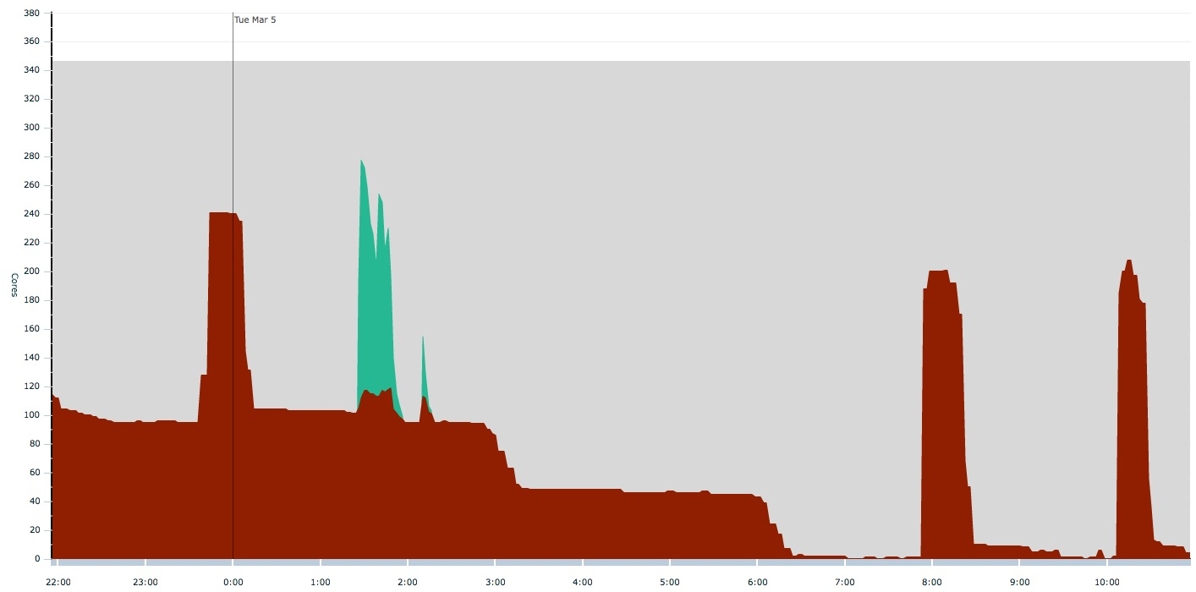
The other advantage
Lots of idle CPU that could be used by UC3!
Free slots!
Tier 3
HTCondor user
PBS users

Slide 30
Moving forward

Slide 31
How does this help you?
We would eventually like to help small Tier 3 sites run jobs on our Tier 2
Hopefully other Tier 2 sites will be able/willing to run jobs for smaller Tier 3 sites as well.
You can fork our Boxgrinder definition on github
The same appliance definition should work on most hypervisors.
You’ll need to make the appropriate changes for your site.
For EC2, there needs to be some discussion about how to get the most bang for your buck.

Slide 32
Thank you!

Slide 33
Bonus slides!

Slide 34
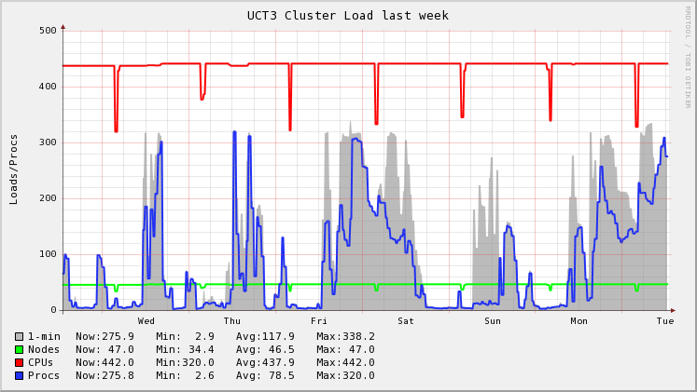
Tier 3 Usage

