Slide 1
Main Injector 2022 Shutdown Status
M. Murphy/D. Morris
9 o’clock Meeting
September 2nd, 2022

Slide 2
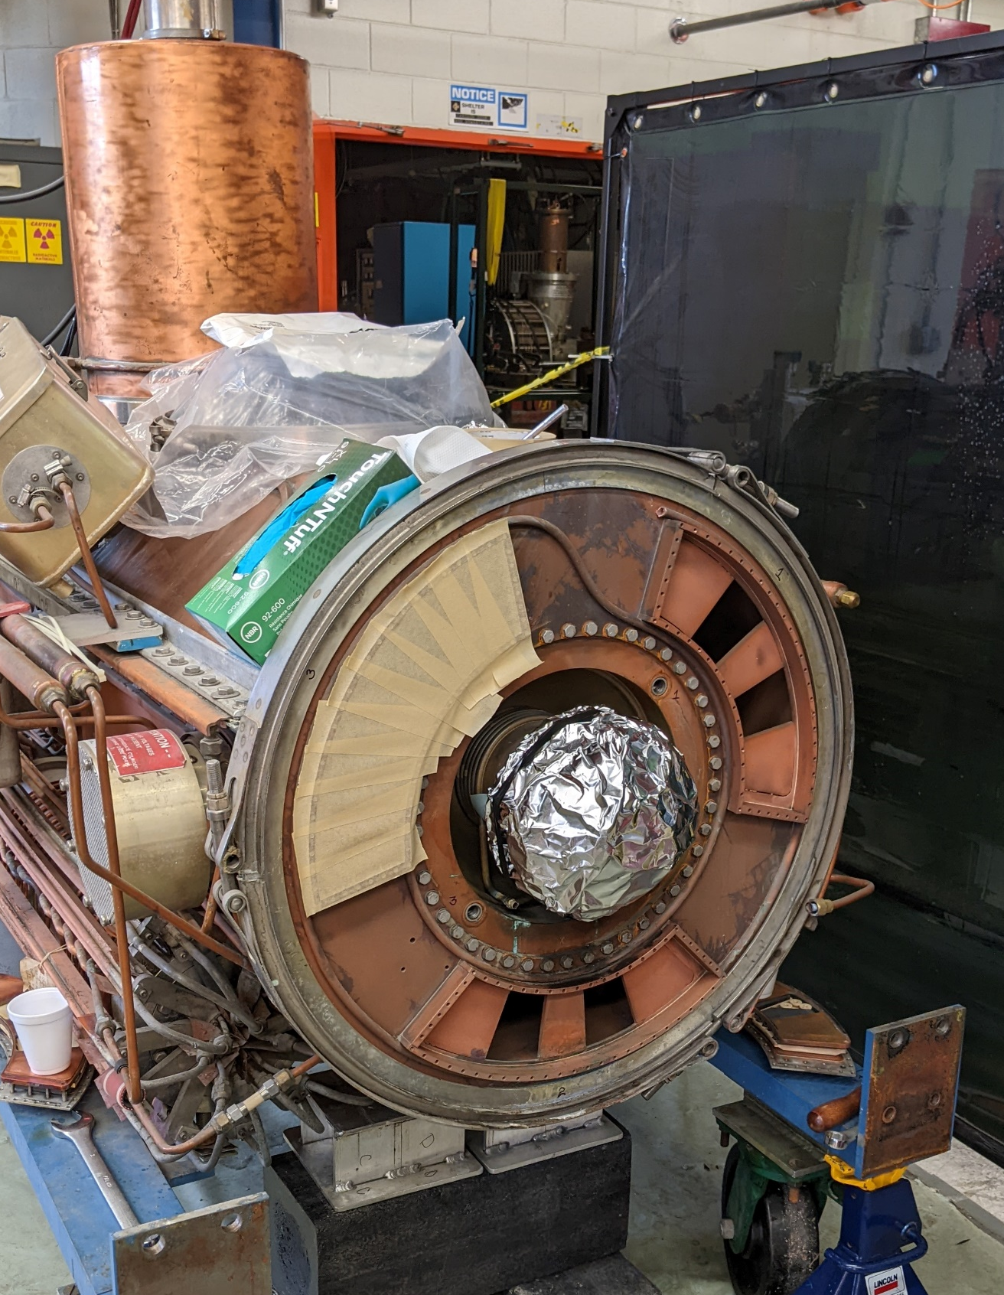
Tunnel Work
Main Injector jobs: 230
Recycler Jobs: 22
MI-8 Line: 20
RF maintenance continues
MI RF cavity #14 and #15 have been removed
from tunnel for water rework.
#14 should be ready for installation in two
weeks.
Cavity #15 will be reworked and become our
spare cavity.
2
MI Department Meeting | D. Morris
9/1/2022

Slide 3
Tunnel Work
Ops with AD/MSD: Worked on LCW white hose replacement for the remaining
2/3rds of the ring. Completed MI-30 (from 314 on) and MI40.
3
MI Department Meeting | D. Morris
9/1/2022

Slide 4
Tunnel Work
SEY sample change out.
Issue with sample retrieval system
Retrieval system required maintenance.
Samples have been changed out.
Retrieval system is fully functional.
SEY station is under vacuum.
Scheduled for another SEY data run prior to startup
4
MI Department Meeting | D. Morris
9/1/2022

Slide 5
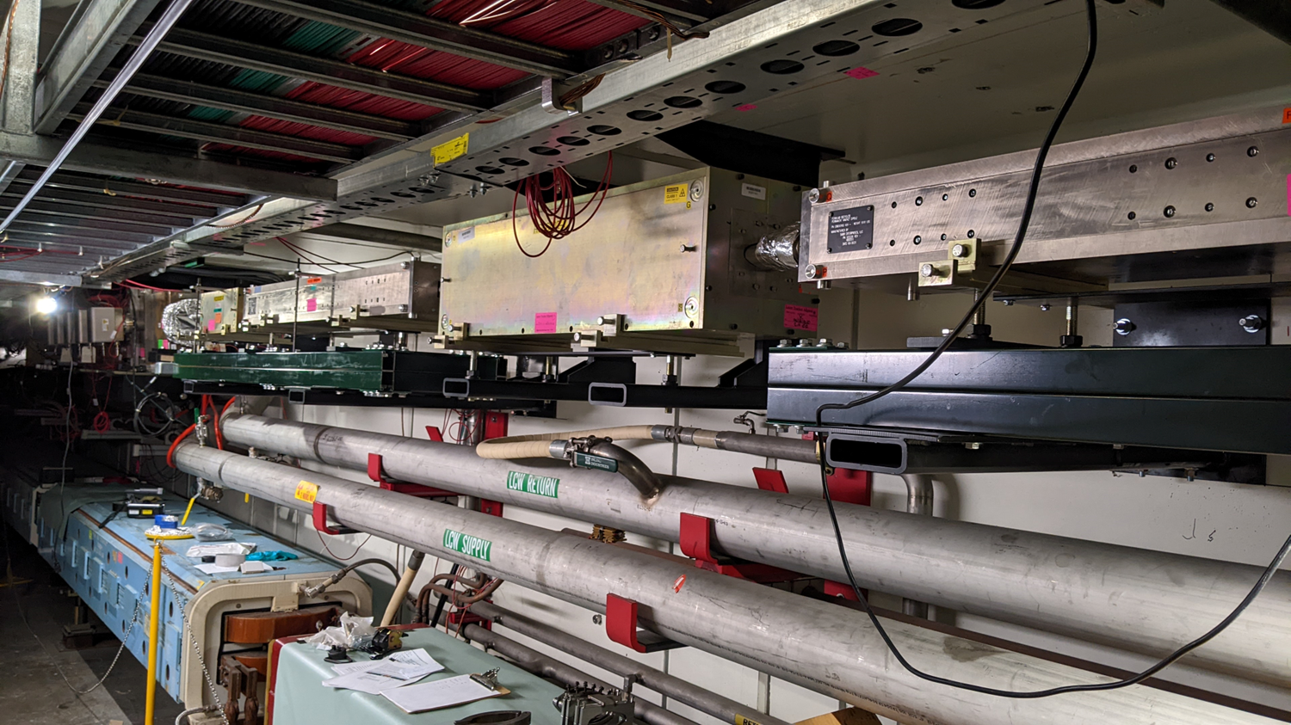
Tunnel Work
Recycler 232 aperture improvement underway:
Final alignment completed.
Installation of remaining vacuum beam pipe and weld preparation in progress.
Welding scheduled for next Tuesday.
5
MI Department Meeting | D. Morris
9/1/2022

Slide 6
Schedule
Power outages: (https://www-bd.fnal.gov/ops/calendar/)
September 6th: Kautz Road switched to Master Sub back-feed
Switch back is scheduled for the morning of the 12th
MI-8 Line:
Sept. 19th : Re-Core to operational keys
Sept. 20th : Search and Secure and SS Testing
Sept. 26th : CDC Testing
MI/RR:
Sept. 21st : Re-Core to operational keys
Sept. 22nd : Search and Secure
Sept. 23rd : Safety System Testing
Sept. 27th : CDC Test
Sept. 28th : Ramp/Studies
6
MI Department Meeting | D. Morris
9/1/2022

Slide 7
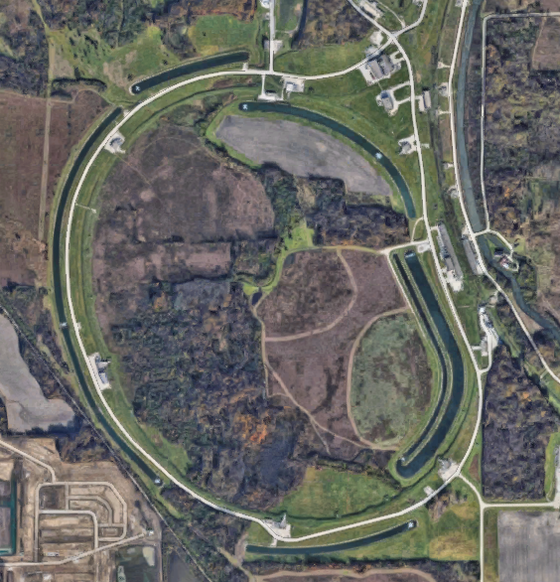
FESS Excavations
MI-62 Culvert
MI-20 sump discharge
Being abandoned/
Being replaced.
MI-62 sump discharge
Sink hole
Kautz Rd/NuMI site
riser sink hole
Kautz Rd Culvert
MI-60 pond inlet
Sink hole behind MI-50
Pond inlet for MI-52
MI-50 Culvert
7
MI Department Meeting | D. Morris
9/1/2022

