Slide 1
2x2 Purity Monitor Update Alexandra Moor

Slide 2
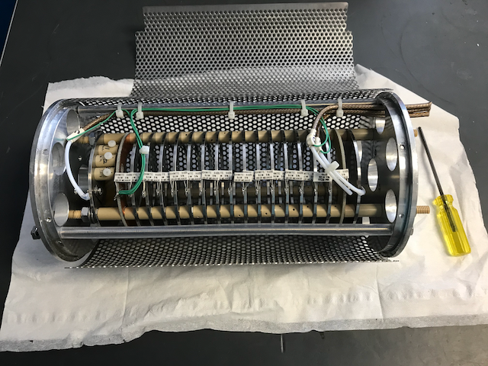
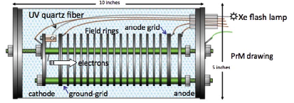
The Need for a Purity Monitor
This system monitors the electron lifetime in the cryostat’s liquid argon (LAr) → This helps to diagnose purity problems in the early stages of the cryostats operation, and immediately deal with them → At some point the TPC itself will be able to take over measuring the purity
M. Adamowski et al. The Liquid Argon Purity Demonstrator. JINST, 9:P07005, 2014.

Slide 3
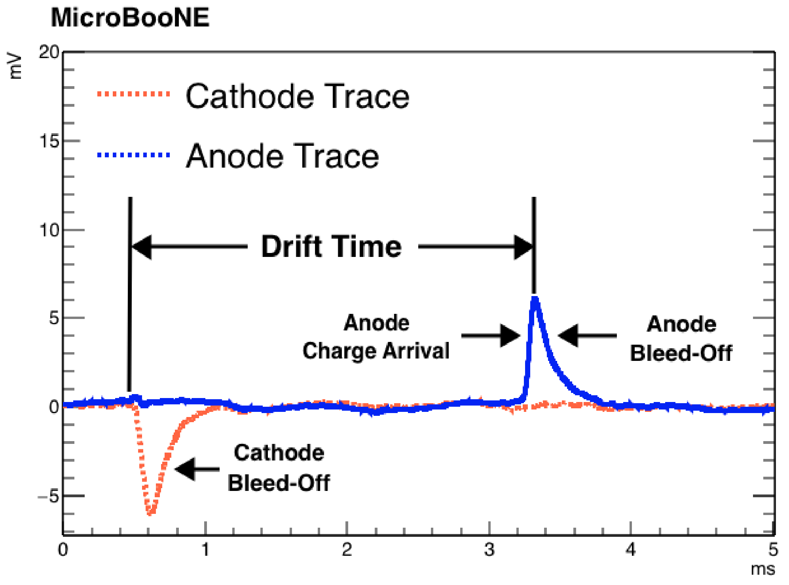
How do we get the electron lifetime?
A flashlamp is used to free electrons from the photocathode, which are then drifted though the Purity Monitor
MICROBOONE-NOTE-1003-PUB

Slide 4
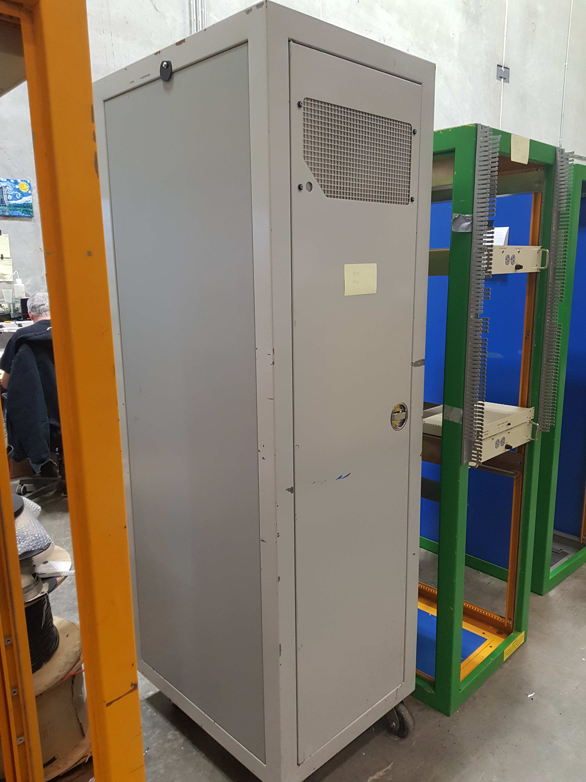
Control Rack Assembly
This is a collective of equipment used for monitoring and controlling the Purity Monitor system.
This has all been put together and wired up at PAB. It has undergone an ORC and been approved.

Slide 5
Control Rack Assembly
These two pieces of equipment are standard and will appear in every rack.
The Rack Protection System is in place to protect the rack in case of fire.
The Surge-X is a power conditioning unit and surge protector.

Slide 6
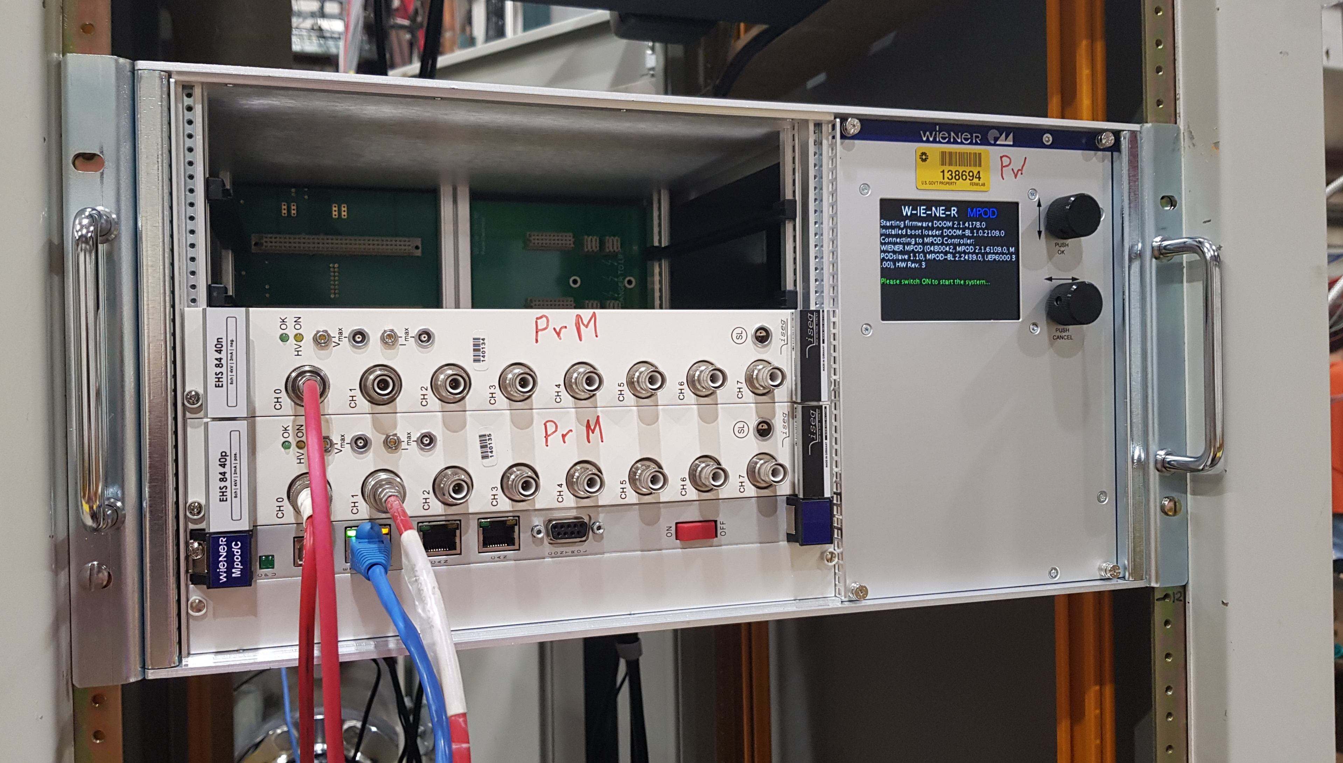
Control Rack Assembly
Wiener Minicrate
This acts as the housing and mainframe for High Voltage modules.
This module provides the High Voltage power to the system.
It also houses a control module, which can receive signals from the PC.

Slide 7
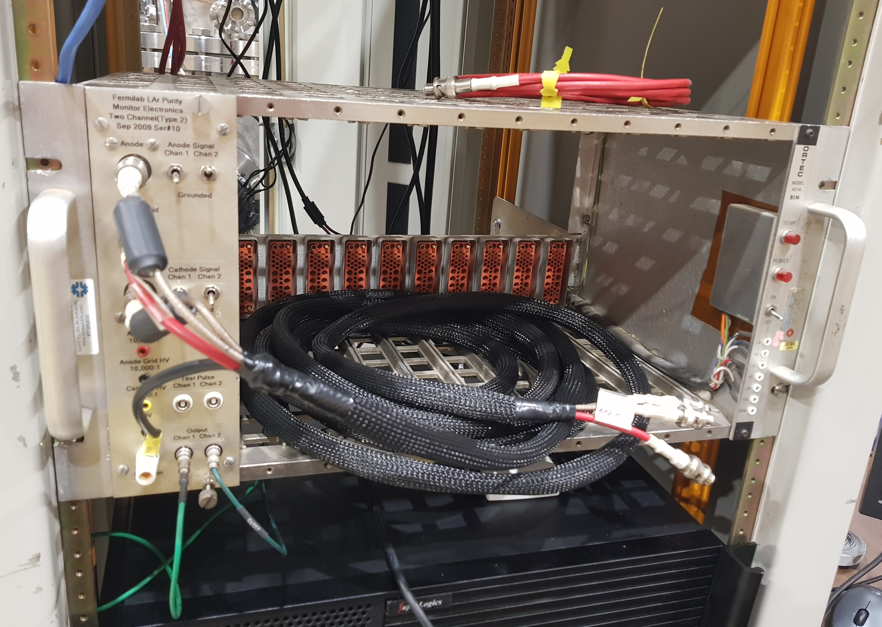
Control Rack Assembly
NIMbin
This is another housing module in the rack. It provides the housing for the PreAmplifier module.
The PreAmplifier module takes in high voltage power, filters it, and passes it to the Purity Monitor, then receives and amplifies the signals, sending them to the Digitizer in the PC.

Slide 8
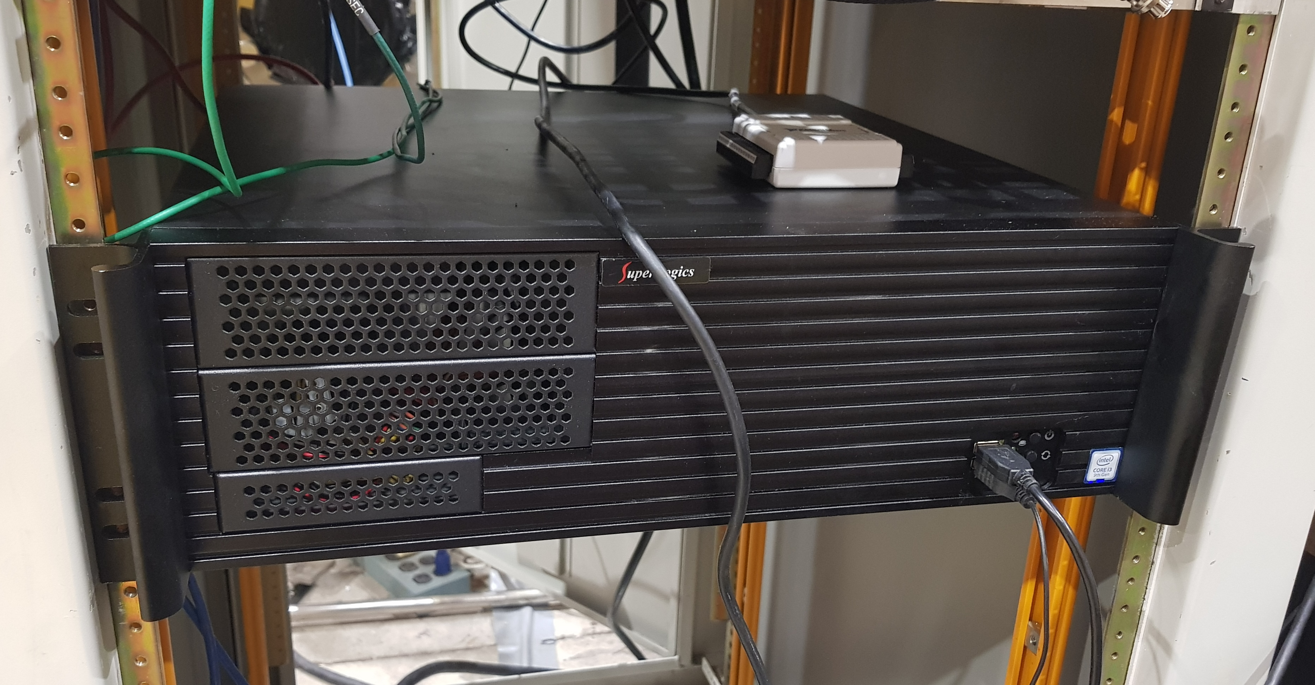
Control Rack Assembly
PC DAQ
This functions as the intelligence centre of the rack. It can be used to control different parts of the system.
It also houses the Digitizer module. This does all the useful things like trigger capture, recording, and setting off the flashlamp.

Slide 9
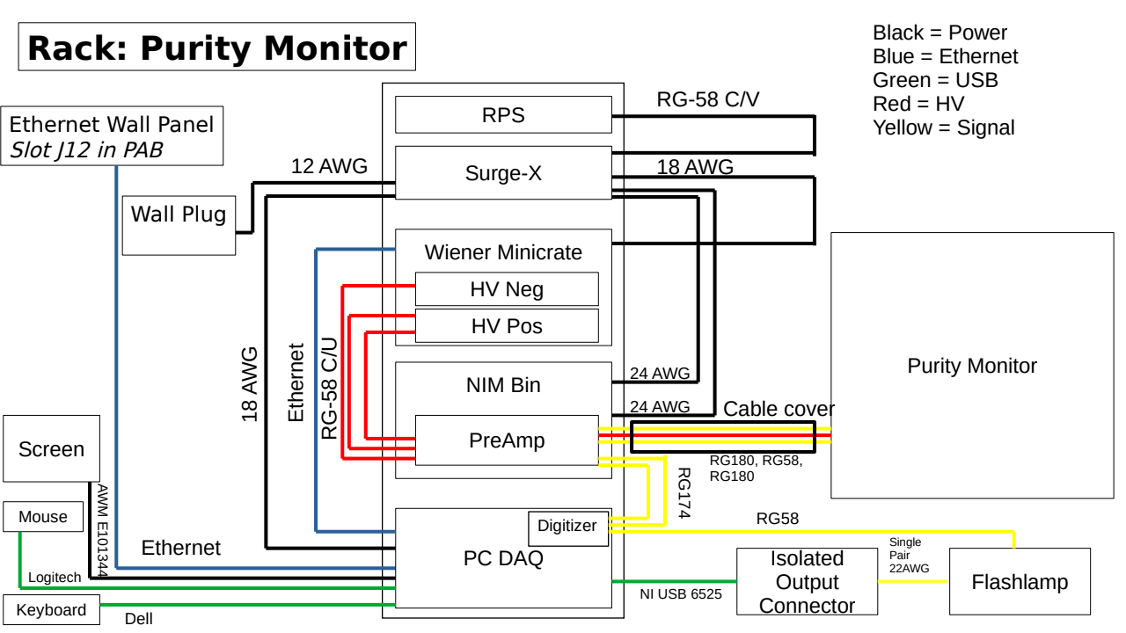
Overall Cable Plan

Slide 10
Purity Monitor System Testing
We are now ready to start on some basic testing of the system to see how well it works
On Friday we are planning to use a long Purity Monitor already set up with the vacuum/gaseous argon to connect to the rack and test data taking
The status of the LUKE cryostat is also being investigated, as it is hoping that this can be used to take data in liquid argon

Slide 11
Conclusions
The Purity Monitor rack has been set up, and passed ORC
All cabling is in place
We are now ready to try some testing in vacuum, gaseous argon, and liquid argon
This is using a different Purity Monitor than the actual one however as the top flange and support rod have not yet been fabricated

Slide 12
Backup

Slide 13
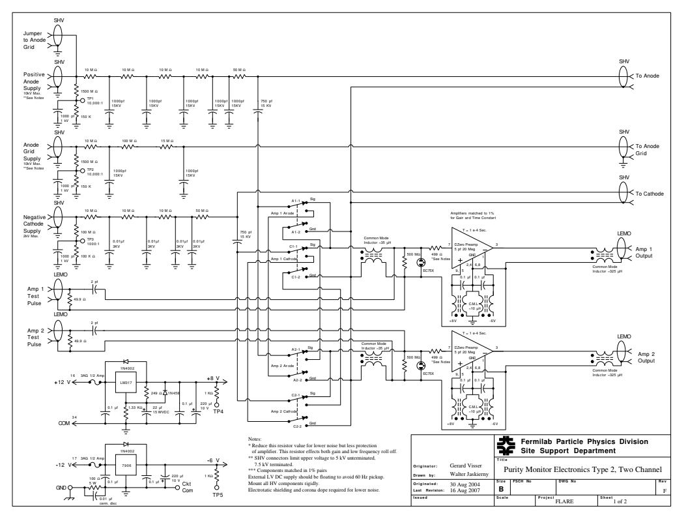
Pre Amplifier Electronics

Slide 14
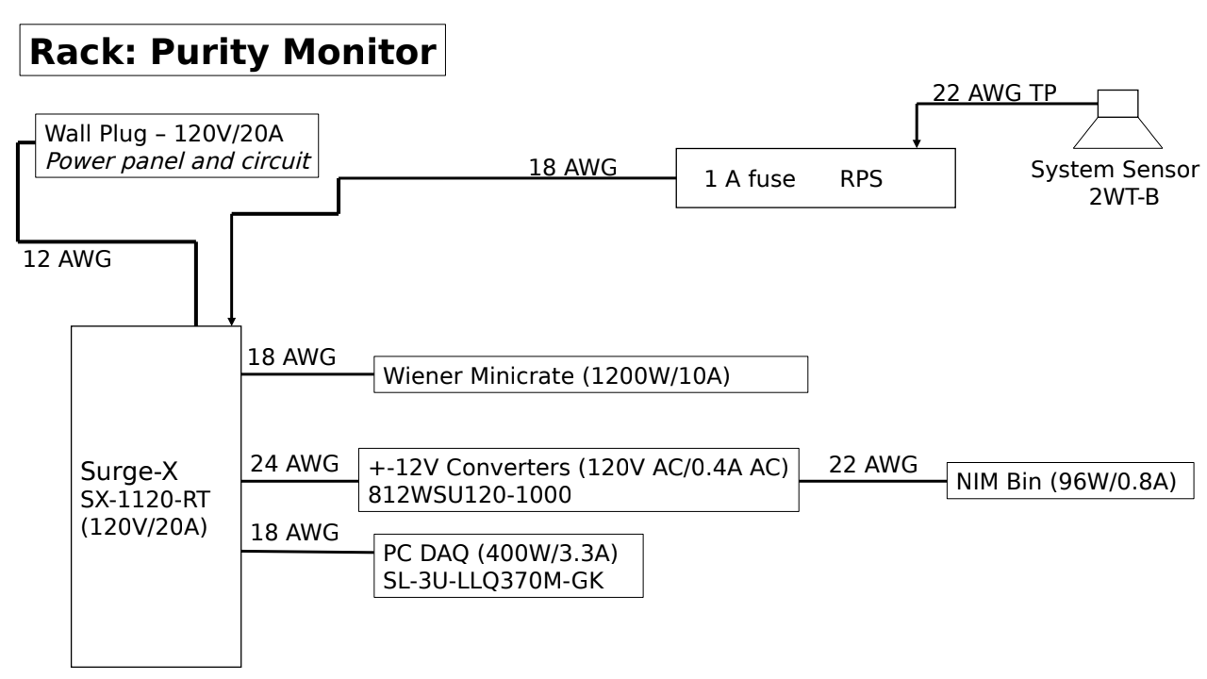
AC Power Draw

Slide 15
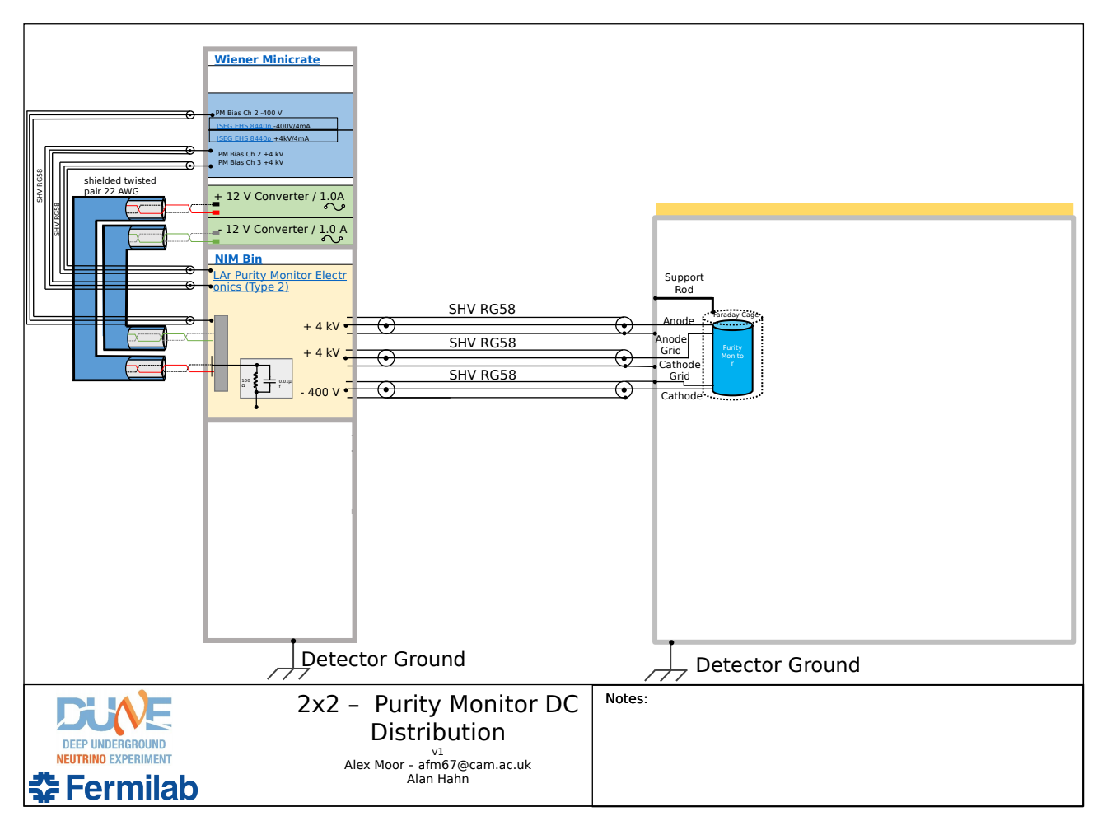
DC Power Draw

