Slide 1
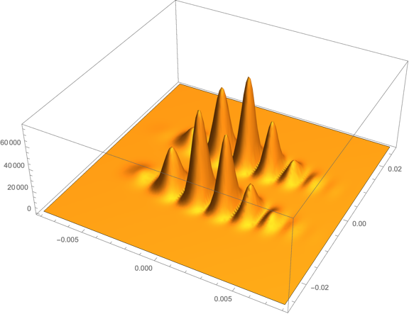
MAGIS-100: Towards a Proposed Offline Organization

Slide 2
Motivation
In the near future there are some important offline decisions to be made that will affect the way we all do our science, and hence need buy-in from the collaboration. Examples:
code management system
software packages & platforms used/supported
offline hardware configuration & requested FNAL computing resources
Offline effort needs to expand if we are to have a system that adequately meets our needs, and since we are a fairly small collaboration, we need to deploy the available effort efficiently
Who do you ask if you want to know where effort is most needed and how to plug-in?
In recent project management discussions, agreed to work towards a proposal for an offline organization structure for the MAGIS management to ratify/modify.
→ Get input from the collaboration on what offline organizational structure is needed and would work for MAGIS.

Slide 3
Process
Formed a small “initial discussion group” to make a first pass at an offline organization structure to facilitate this discussion.
Initial discussion group: SG , Mandy, Dylan, Jeremiah, Ariel, Michael
Next Steps
Modify straw proposal based on input from discussions
Deliver proposal to MAGIS management
Straw Proposal for Discussion:
Offline Coordinating Group (OCG)
appointed by MAGIS Management
OCG Lead
Offline Infrastructure Coordinator
Analysis Tools
Coordinator
Simulations
Coordinator
Liasion to Online
Physics Coordinator

Slide 4
Offline Organization: Straw Proposal
Offline Coordination Group. (OCG)
Collaborators appointed by MAGIS management to serve terms that are long enough to take us through commissioning and early data taking.
OCs responsible for organizing effort within their areas & communicating to collab-oration progress & opportunities for added contributions. Their first task will be to refine their areas-of-responsibility so there are no holes or duplication within the OCG.
OCG Members (2 coordinators per role)
OCG Lead: Senior member of the collaboration familiar with the “big picture”. Calls regular meetings of the OCG. Makes sure all offline tasks are covered, all the pieces fit together. Talks with the online coordination group.
Offline Infrastructure Coordinator: Main interface with FNAL SCD. Responsible for coordinating design & implementation of the computing system: grid submission scripts, databases, bookkeeping/management scripts, data pipeline & calibrations, MC/sim production & reconstruction. Coordinate production runs (using tools developed by other areas).
Analysis Tools Coordinator: Responsible for coordinating development and testing of official reconstruction, calibration and analysis algorithms, and the maintenance of a well documented working toolset. , reconstruction code, core software to coordinate the algorithms
Simulations Coordinator: Responsible for coordinating development of all simulation tools for science & technical studies, and the maintenance of a well documented working toolset. Includes incorporating real data into simulations. Prepare official simulation datasets.
Liaison from Online: It is anticipated there will be common algorithms shared with the online reconstruction/monitoring. Responsibility from online group to provide person.
Physics Coordinator: Probably not required yet, but eventually will need someone or some group that covers this.

Slide 5
Some Discussion Points
Some of the coordination roles could be initially combined and split later if/when needed
Simulation & Analysis
Analysis & Physics
Some of the roles (offline infrastructure for example) are big coordination tasks as defined … and it would be good to have two coordinators for these roles if practical.
The coordination tasks are important and expected to be time consuming
Coordinate existing effort
Identify what’s missing and recruit required additional effort from within the collaboration
Keep track of progress & communicate to Collaboration

