Slide 1
Overview of the FD1 TPC Electronics
Cheng-Ju Lin
Lawrence Berkeley National Laboratory
FD1 TPC Electronics Final Design Review
29-30 September 2022

Slide 2
Thank you for taking time to serve on the FD1 TPC Electronics FDR Committee
Your assessments and recommendations are important to us

Slide 3
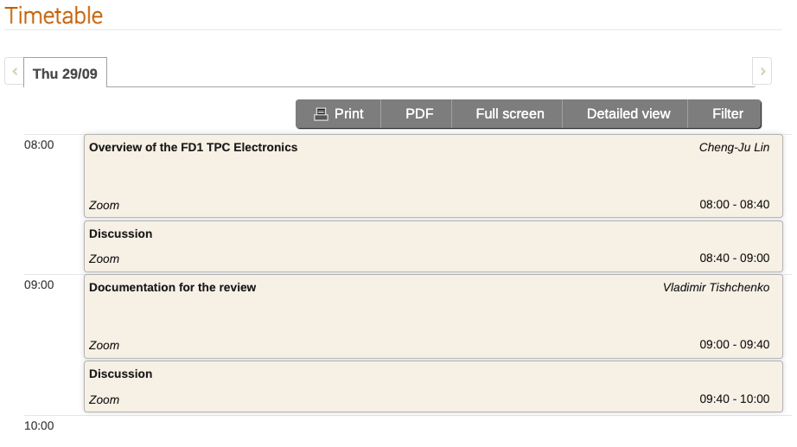
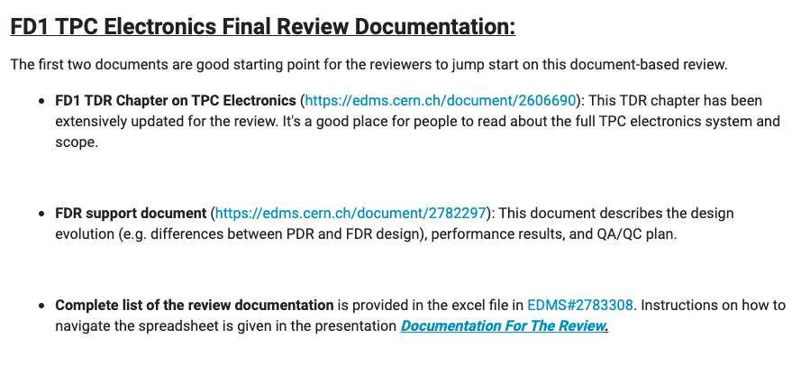
Agenda for this Review
Document-based review. Reviewers will have a few weeks to go over the documentation and ask questions
Two presentations today: overview talk and another one on the documentation
Plenty of time for discussion
3

Slide 4
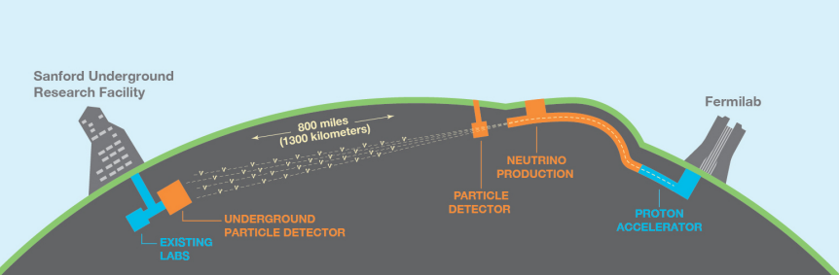
Deep Underground Neutrino Experiment (DUNE)
Future flagship neutrino oscillation experiment
Three major components: neutrino beamline, near detector, and liquid Argon far detector modules
Broad physics program: BSM studies supernovae, solar neutrinos, three-flavor oscillation measurements
>1300 people, > 200 institutions, 33 countries + CERN

Slide 5
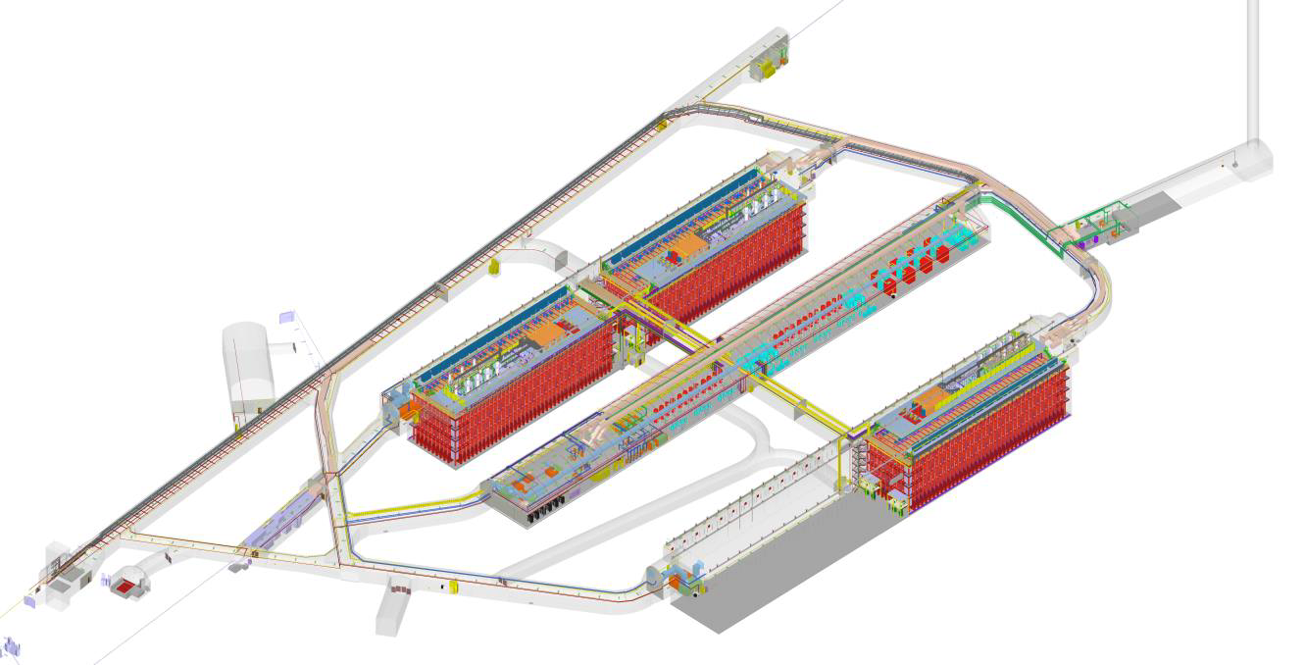
DUNE Far Detectors
Four 10-kTon (fiducial) liquid argon detectors
~1500m underground
FD1
FD2

Slide 6
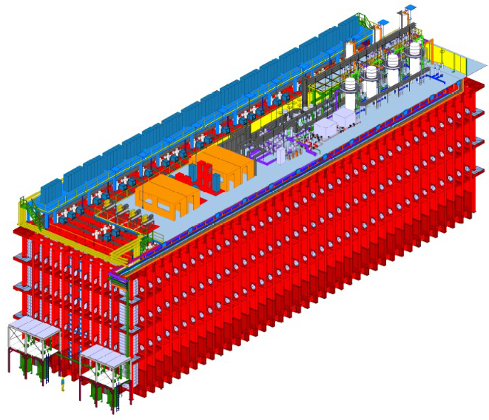
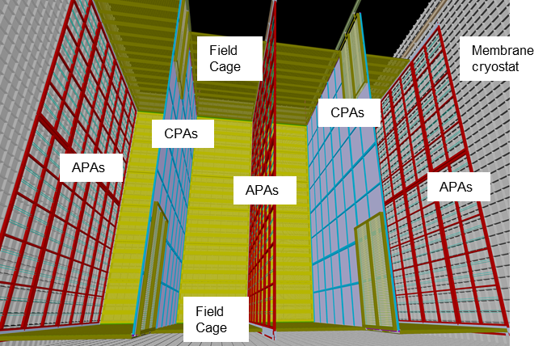
DUNE Far Detector #1
LAr Cryostat
Cryostat dimensions:
~65m (L) x 19m (W) x 18m (H)
Time Projection Chamber (TPC) Elements:
Anode Plane Assembly (APA). Sense wires for detecting drift electrons in the TPC
Cathode Plane Assembly (CPA) at -180kV. Electron drift field of 500V/cm
Distance between CPA and APA plane = 3.5m (maximum electron drift distance)
Inside the Cryostat

Slide 7
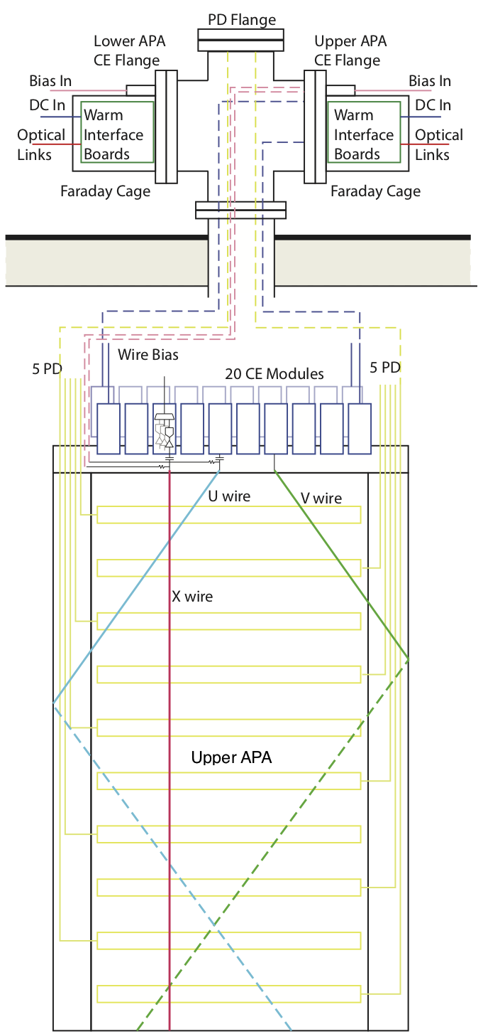
Anode Plane Assembly (APA)
Far detector #1 has 150 APAs
Each APA has four wire planes:
  960 grid wires (un-instrumented)
  800 U (1st induction wires)
  800 V (2nd induction wires)
  960 X (collection wires)
Readout electronics are integrated close to the sense wires on the APA and immersed in LAr to yield the best SNR → Cold Electronics
20 Cold Electronic (CE) Boxes are mounted on the top of each APA and connected to 2560 sense wires
20 Cold Electronics boxes

Slide 8
TPC Readout Electronics
Warm interface electronics:
Outside the cryostat
Interface with the online DAQ system
CE Flange:
On top of the cryostat
Connect cold cables to the Warm Interface Electronics
Signal feedthrough:
14” conflat
Cable strain relief
Cold cables:
Low voltage and data cable to Frontend motherboard
Frontend Motherboard (FEMB): 128 channels of digitized wire readout enclosed in CE box

Slide 9
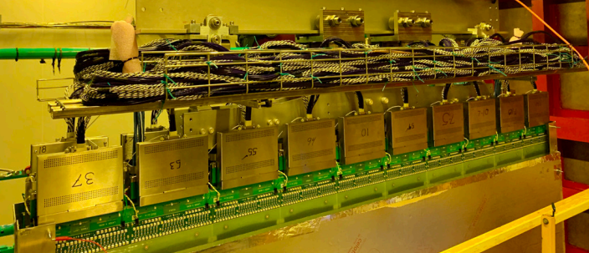
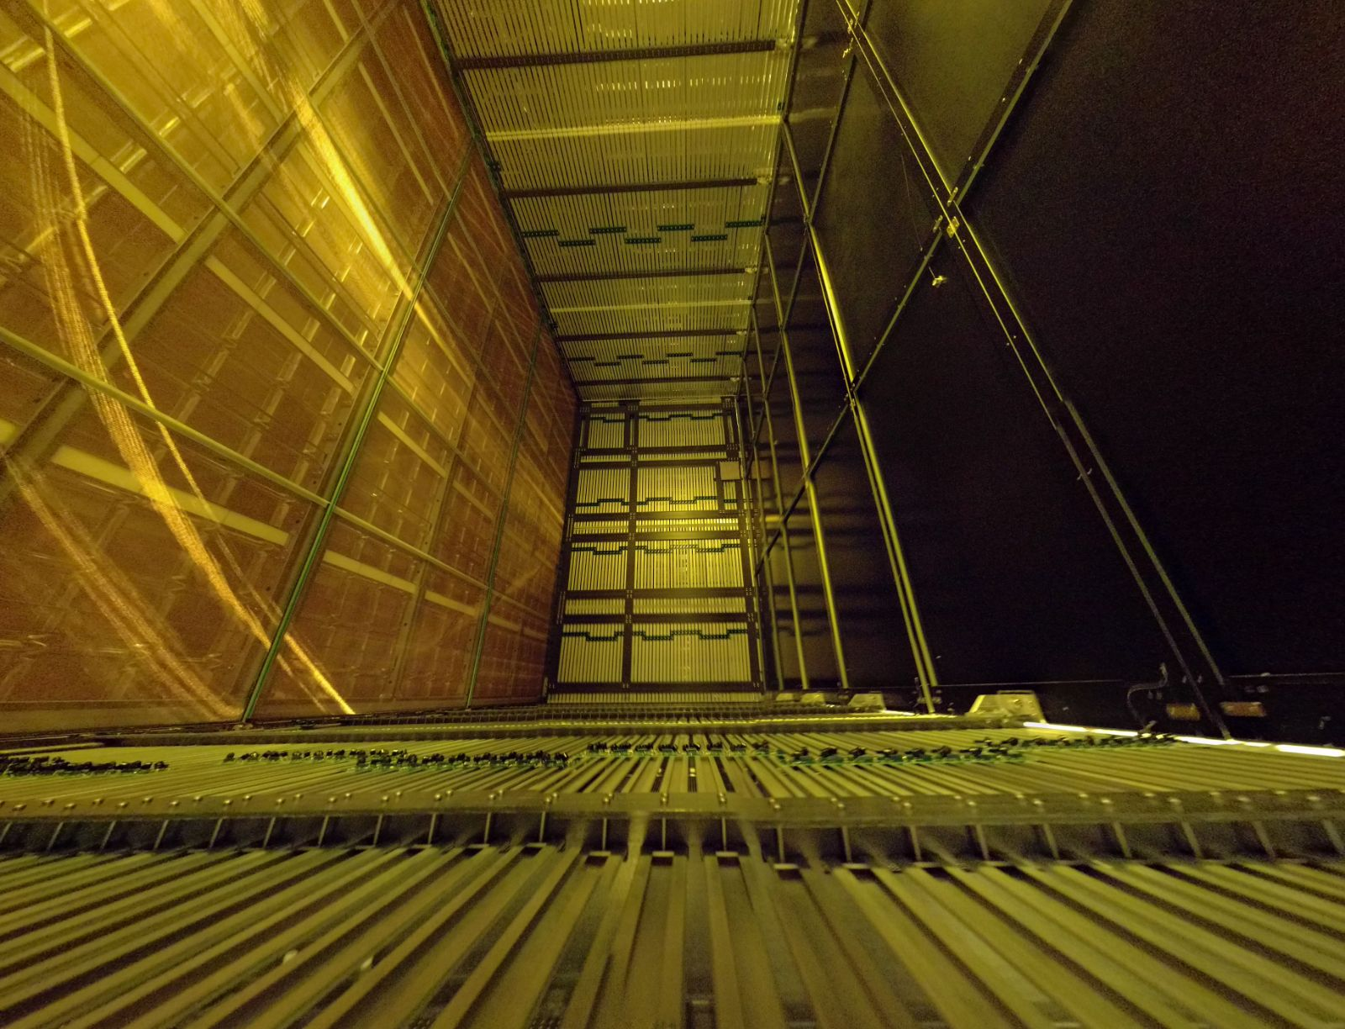
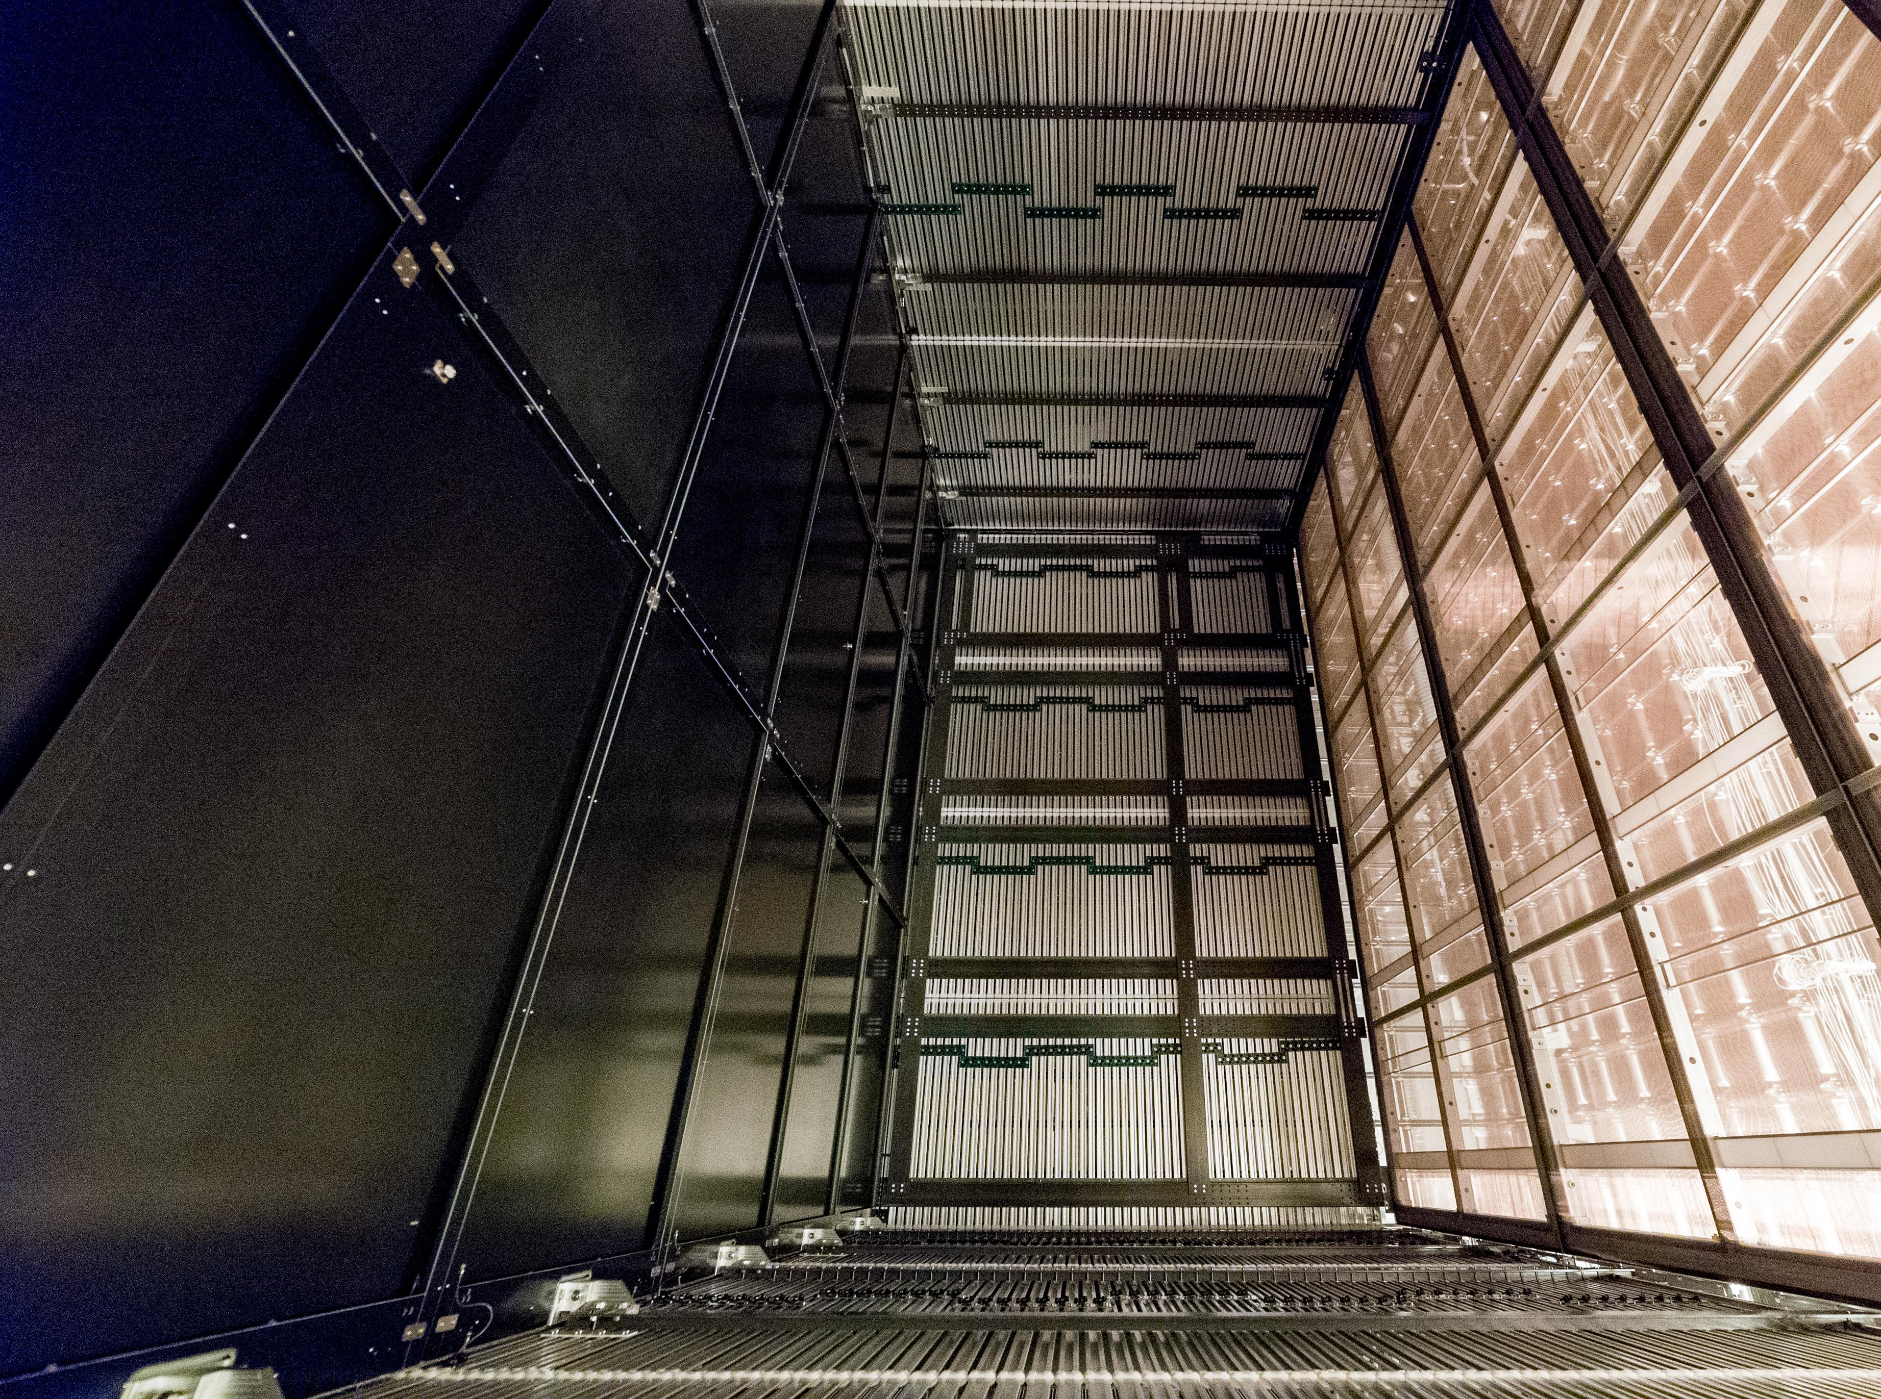
ProtoDUNE-1 operated in LAr for about 2 years
FEMB in CE Boxes
APA#1
APA#2
CPA
APA#5
CPA
APA#3
APA#6
Beam-Right TPC Volume
Beam-LEFT TPC Volume

Slide 10
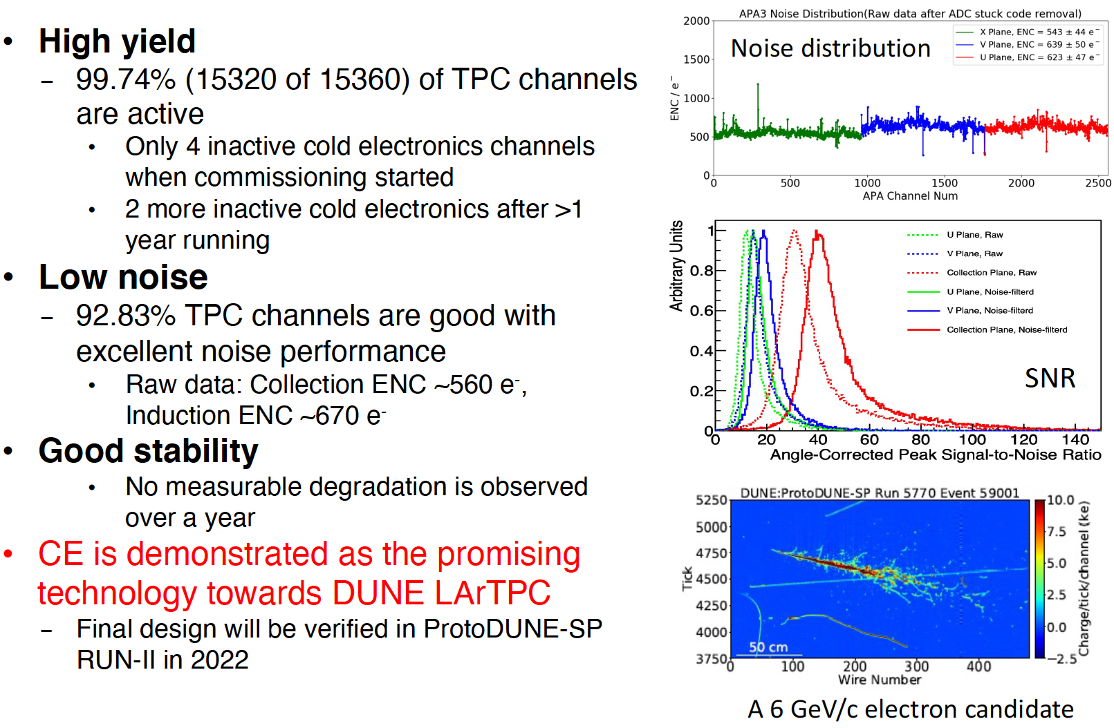
ProtoDUNE Run-1 Performance

Slide 11
TPC Electronics Design Review History
All subsystems have gone through Preliminary Design Review
  Mechanical structure PDR (11-12 Feb 2019)
  ASICs and FEMB PDR (5-7 Feb 2020)
  Warm Electronics PDR (17-March to 7-Apr 2020)
All three custom ASICs (LArASIC, ColdADC, COLDATA) have gone through Final Design Review (21-22 Jul 2021)
LArASIC has gone through Production Readiness Review (7-8 Mar 2022)
For this FDR, we are reviewing everything except the ASICs
(Note: click on the review dates to link to the review page)

Slide 12
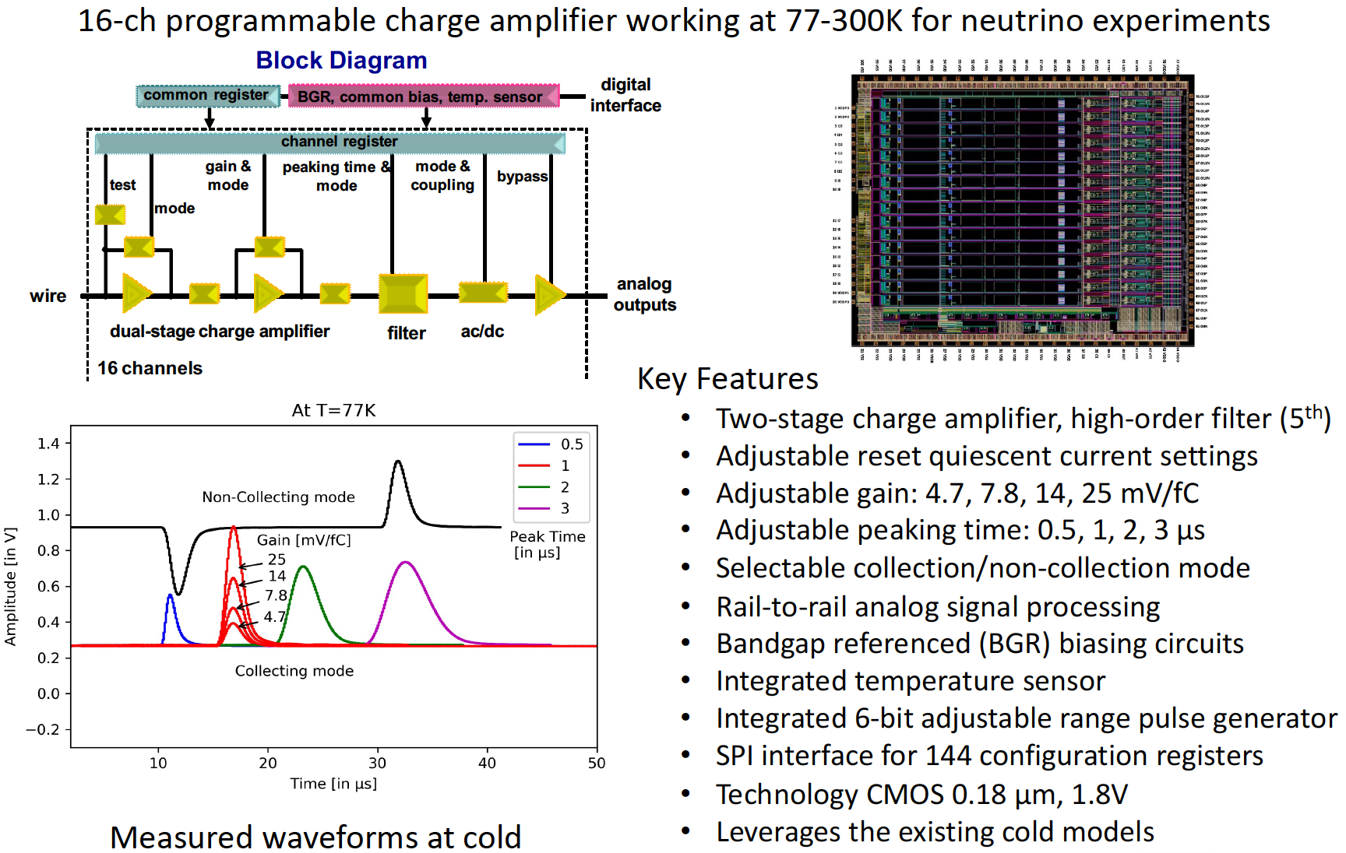
LArASIC ASIC

Slide 13
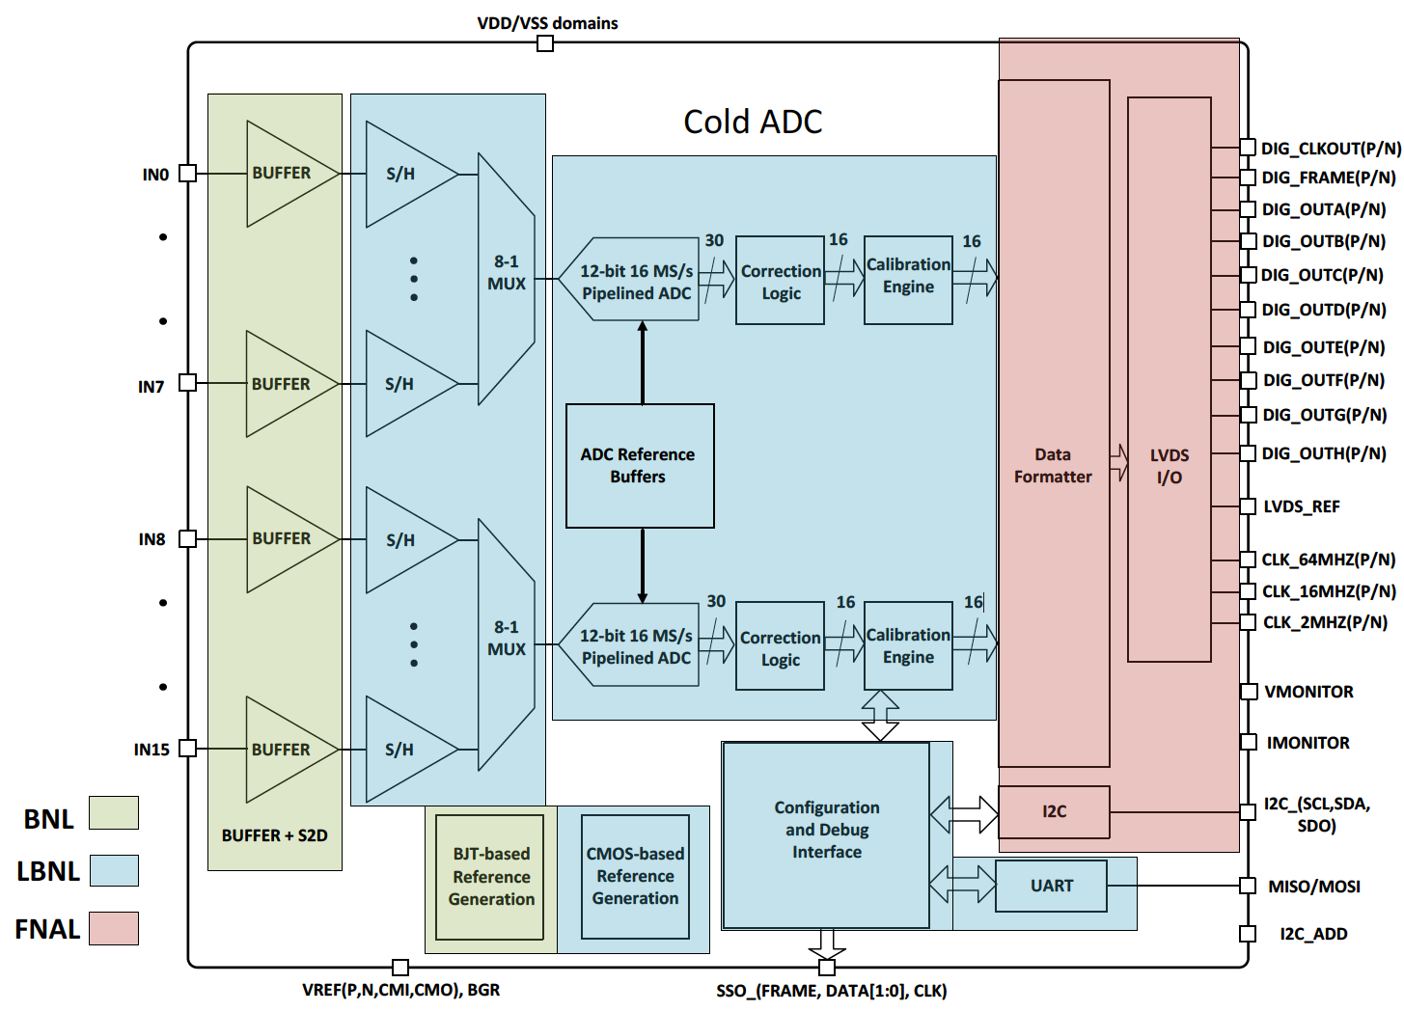
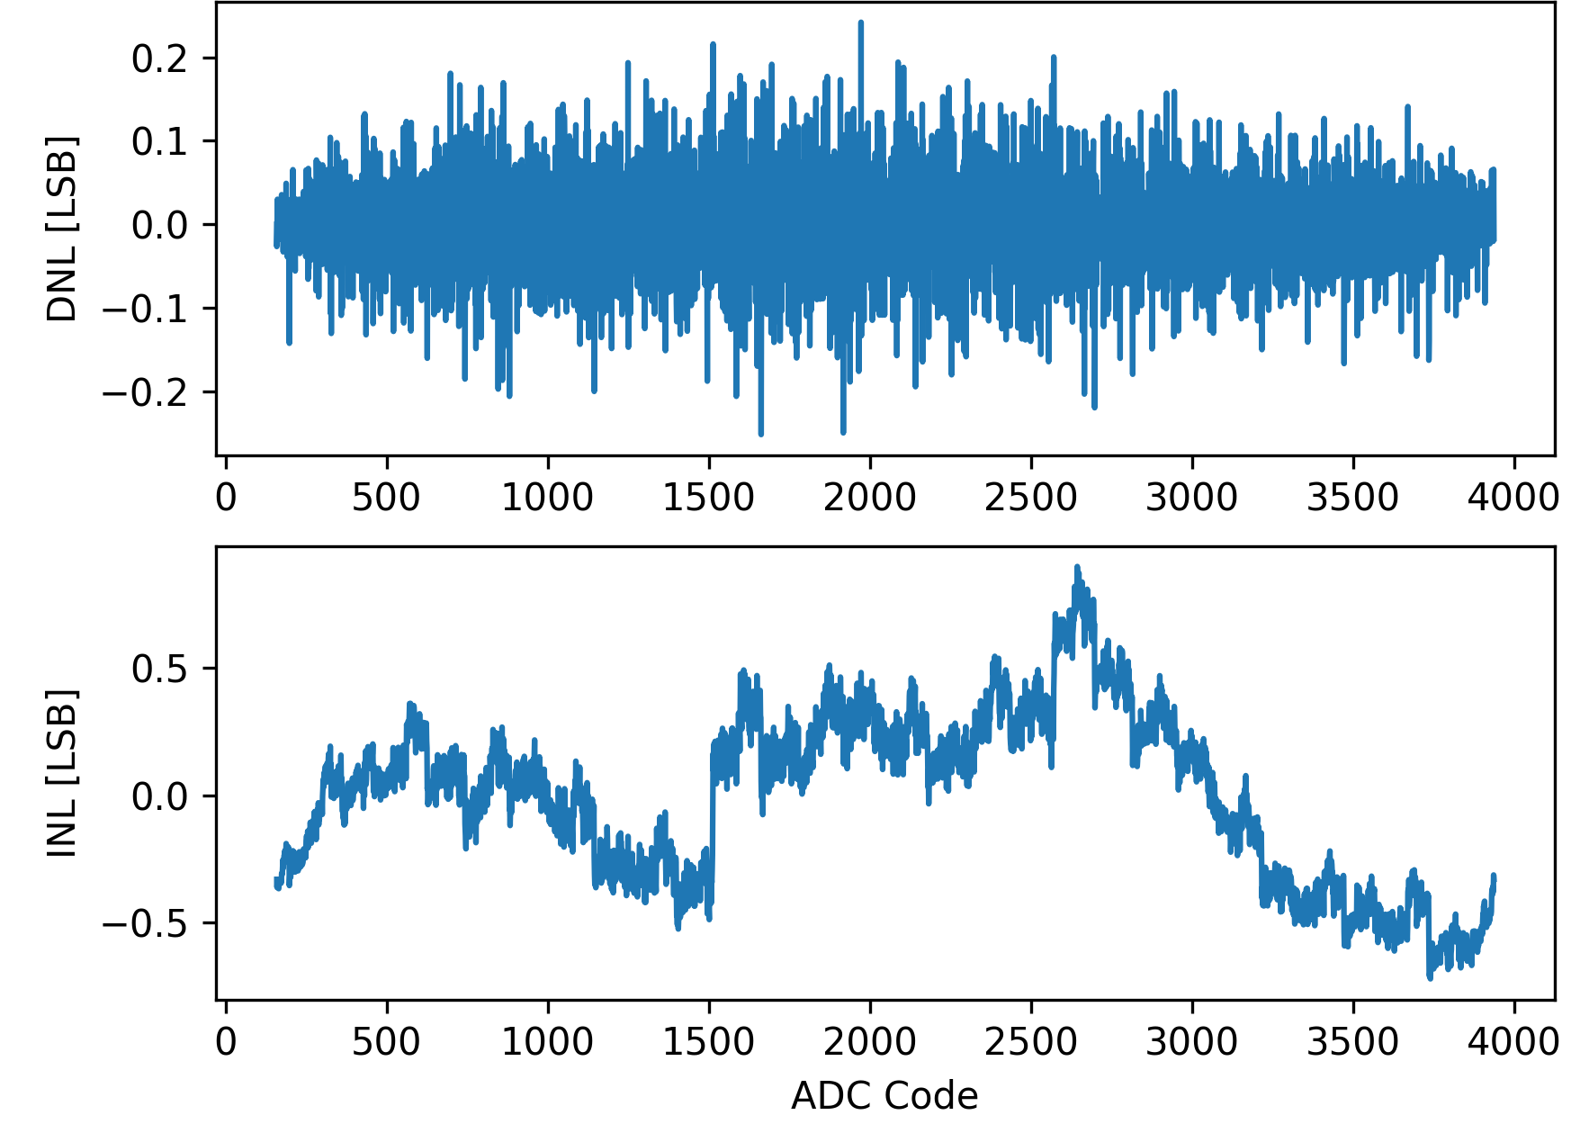
ColdADC ASIC
ADC Block Diagram
ADC Static Linearity
Key Features
16-channel, 14-bit 2MS/s digitizer ASIC for 77-89K
Two 15-stage piped-line ADCs
Low-noise and long lifetime operation in LAr
65nm CMOS process, 9 metal stack
Digital self-calibration for interstage gains
Chip size: 6860 μm x 7610 μm

Slide 14
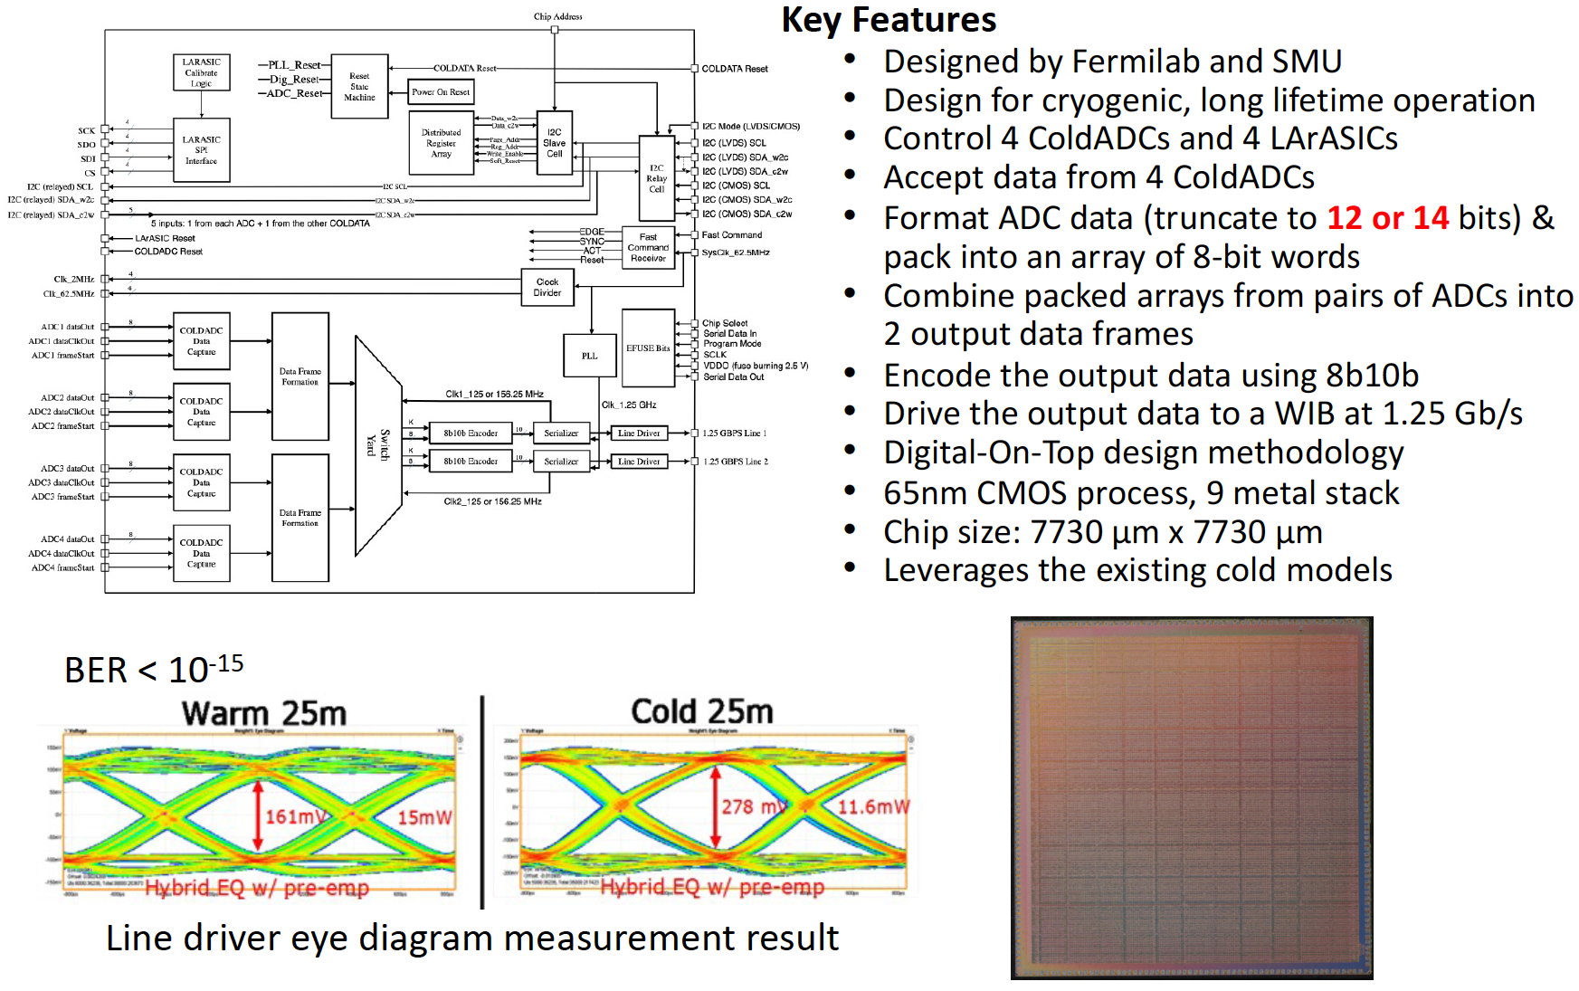
COLDATA ASIC

Slide 15
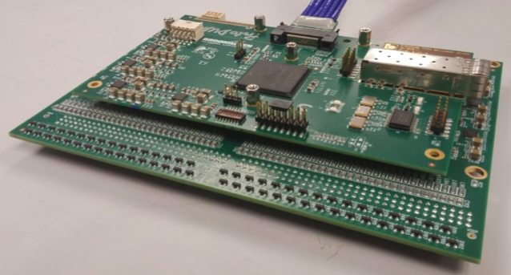
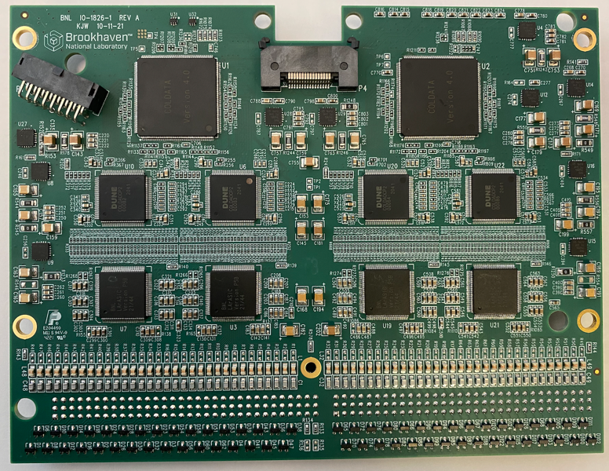
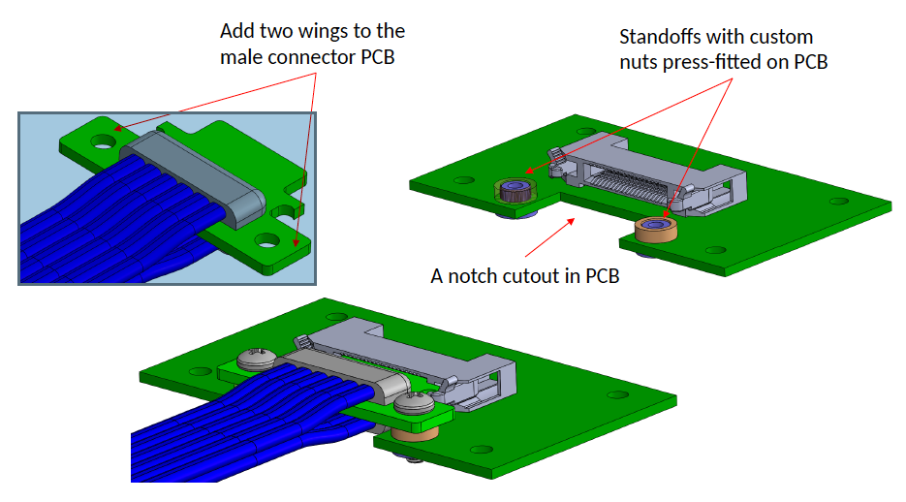
Monolithic FEMB
ProtoDUNE-I FEMB uses previous generation of LArASIC, ADCs and a commercial FPGA on a mezzanine card
ProtoDUNE-II FEMB uses final custom ASICs on a single PCB (monolithic FEMB)
Many other changes and improvements. See EDMS#2782297 for the complete list
Analog monitoring of channel response, bandgap reference, temperature, ColdADC reference voltages, etc.
Improved SAMTEC cable connection based on ProtoDUNE-I lessons-learned
ProtoDUNE-I FEMB
Monolithic FEMB

Slide 16
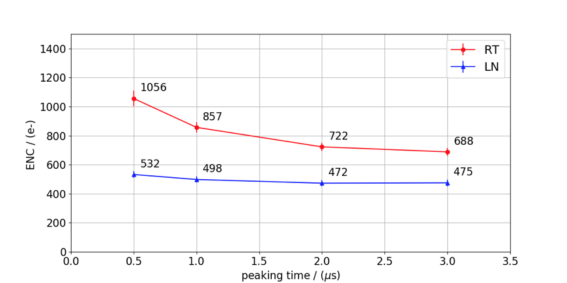
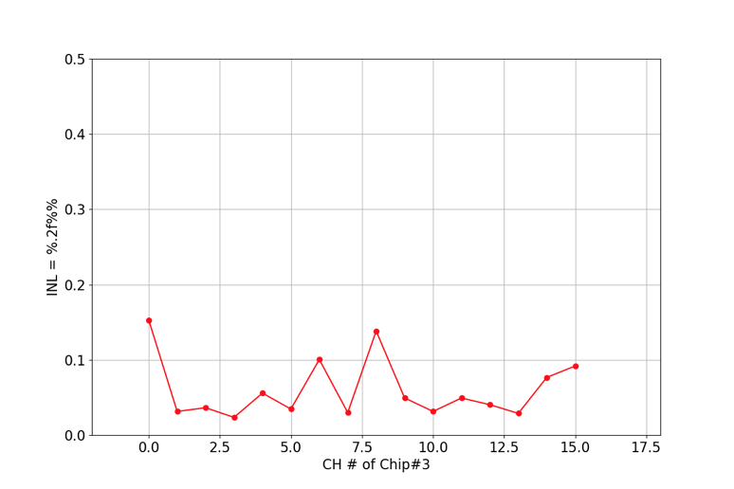
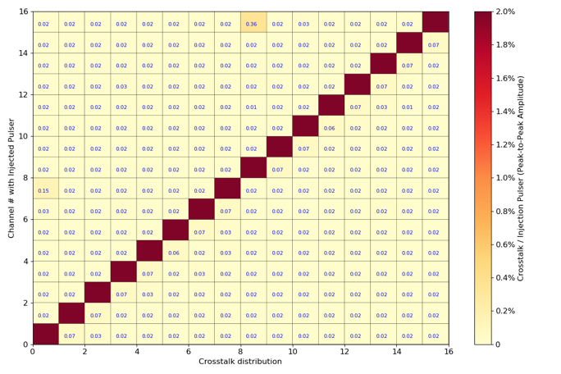
Benchtop Performance of Monolithic FEMB
Noise requirement < 100 e- ENC (in LAr)
Linearity requirement < 1%
(In LN₂)
Cd=150pf
Channel cross talk requirement < 1%
Performance of monolithic FEMB well exceeds DUNE requirements
Detailed FEMB QA/QC procedure in the documentation (EDMS#2782297)
(In LN₂)

Slide 17
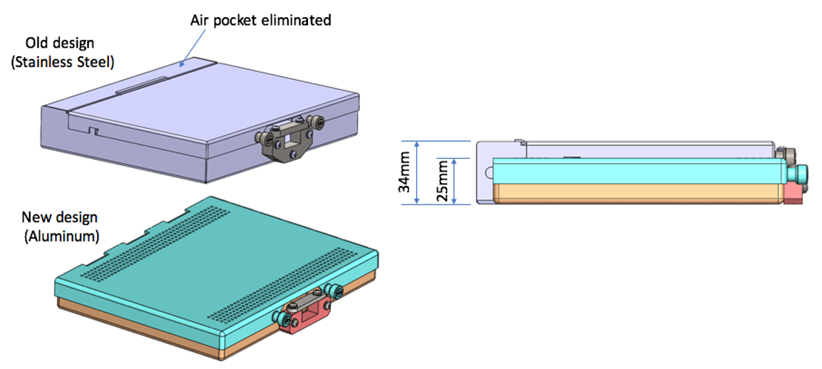
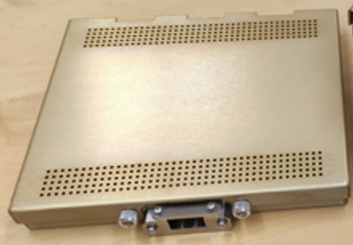
New CE Box Design
Thinner enclosure box for the monolithic FEMB
Change material from stainless steel to aluminum to reduce weight (~50% lighter). This change is important for FD2 since CE boxes mounted on the CRPs introduce significant stress on the structure of the CRP composite frame
Same enclosure design is compatible for FD1 APA and FD2 CRP mounts

Slide 18
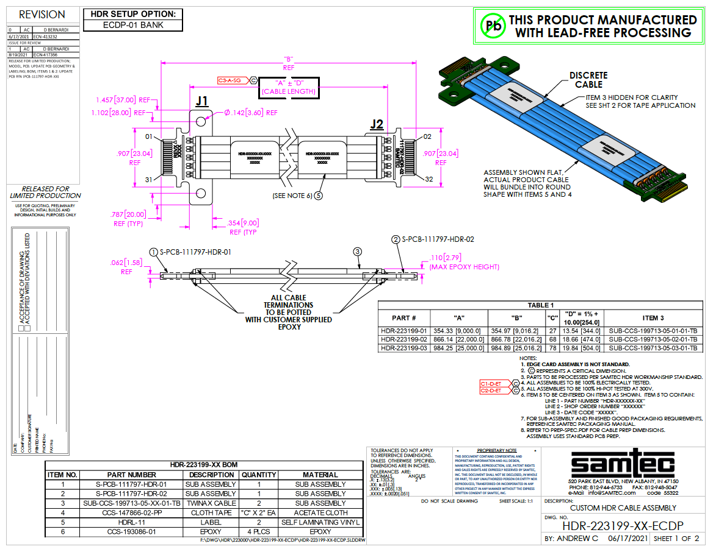
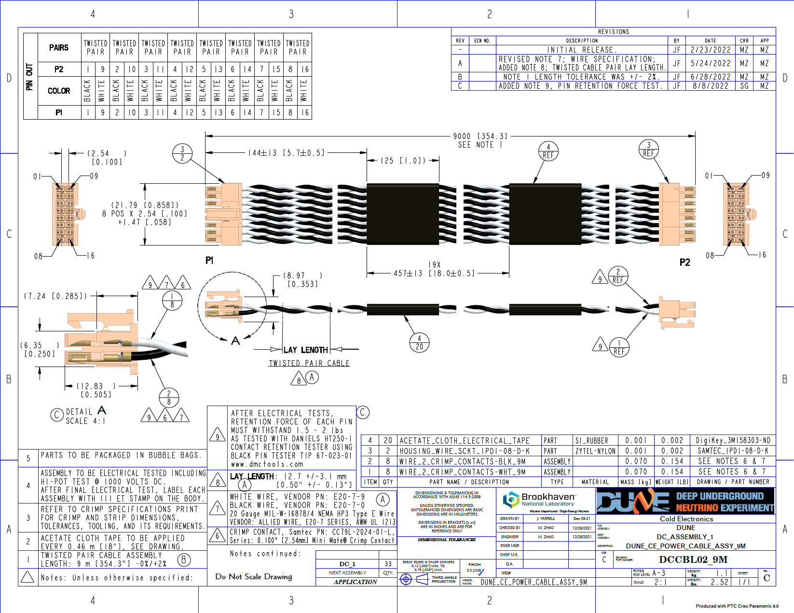
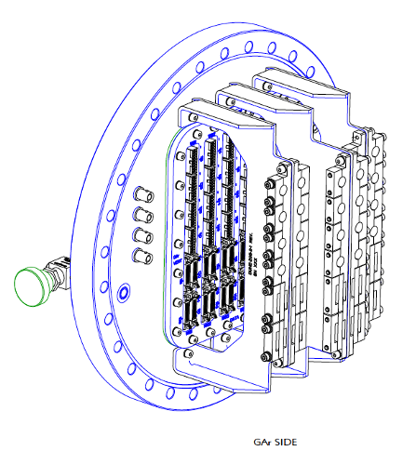
Cold Cables and Strain Relief
Low Voltage Power Cable
Signal Cable (Samtec)
Strain Relief At Feedthrough Flange
Fewer conductors needed for the monolithic FEMB:
  Signal cable 12 → 10 twinax pairs
  Power cable 9 → 8 twisted pairs
FD1 needs 9m and 22m lengths. Will use the same length in ProtoDUNE-II
Flange cable strain relief modified to accommodate the thinner cables

Slide 19
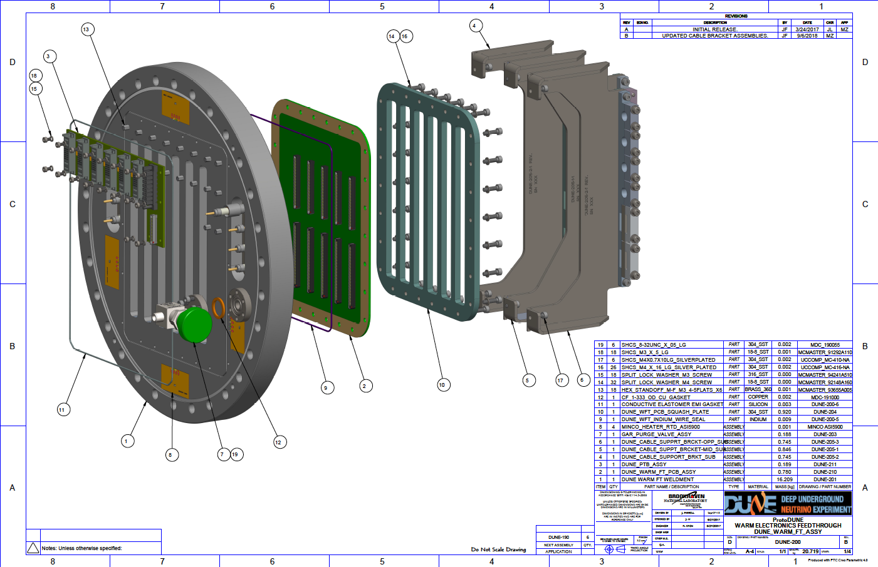
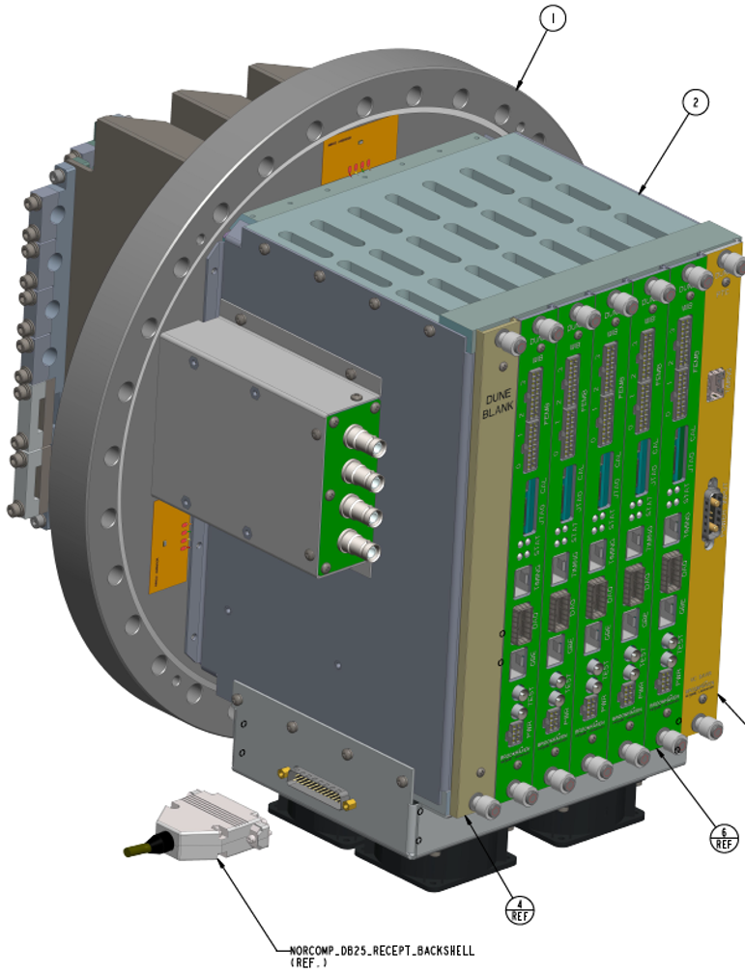
Warm Interface Electronic Crate (WIEC)
WIEC design is largely the same as ProtoDUNE-I
New flange board design to accommodate the new cold cables
New PTB backplane to accommodate future PTC upgrade
Filter box for APA wire bias voltages, FC termination, and ground plane monitor

Slide 20
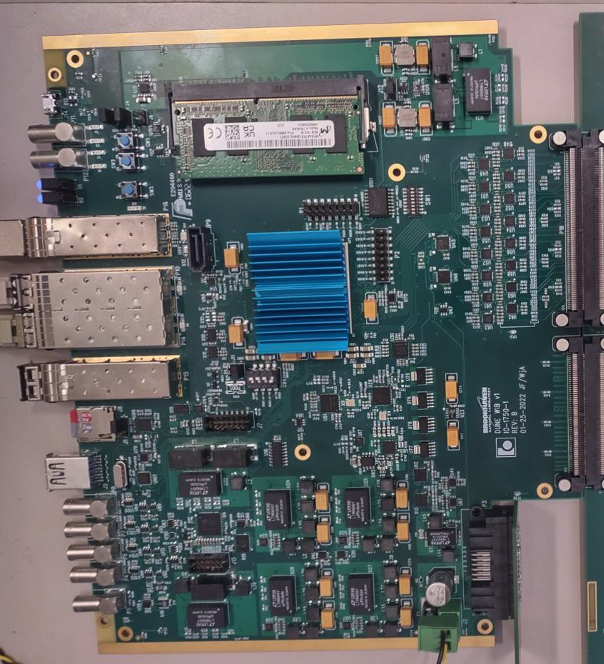
Warm Interface Board (WIB)
New WIB design for ProtoDUNE-II
Replaced Arria V FPGA with Xilinx Zynq UltraScale+ MPSoC FPGA
FEMB power scheme modified
QSFP replaced with dual SFP
Direct path from CDR clock to FPGA
16-bit DAC for calibration pulse injection to the FEMBs
New firmware written for the FPGA
+ many other improvements
A number of system integration tests: test-stand at BNL, ICEBERG at Fermilab, Vertical Slice Test-stand at CERN, and APA Cold Box at CERN
ProtoDUNE-II WIB (v3)

Slide 21
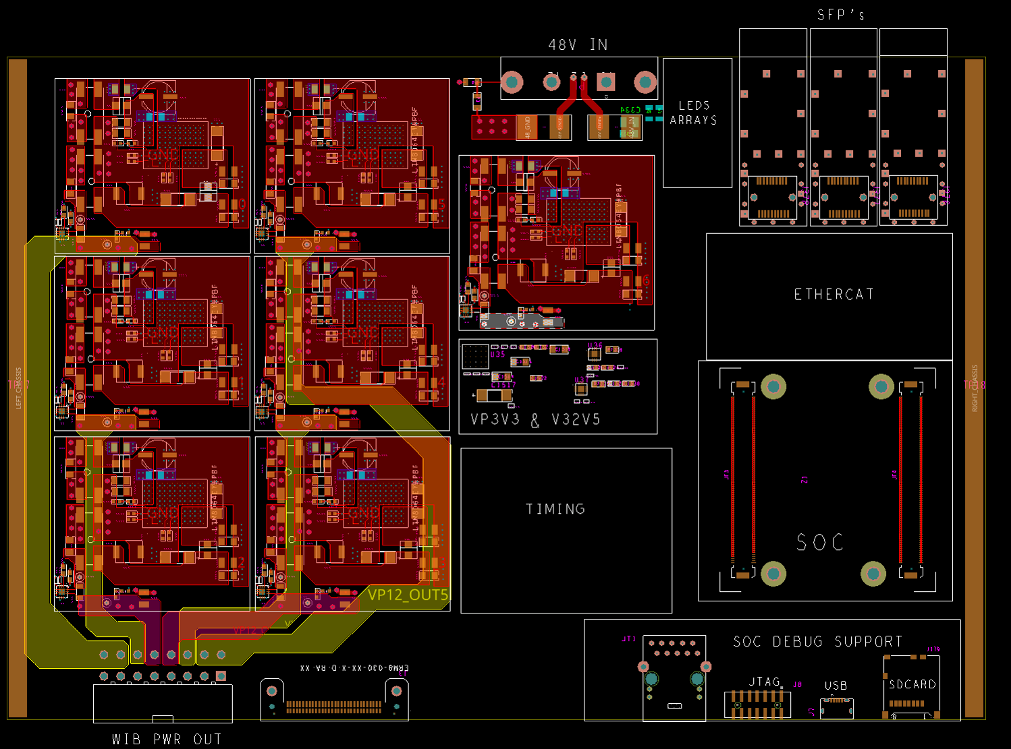
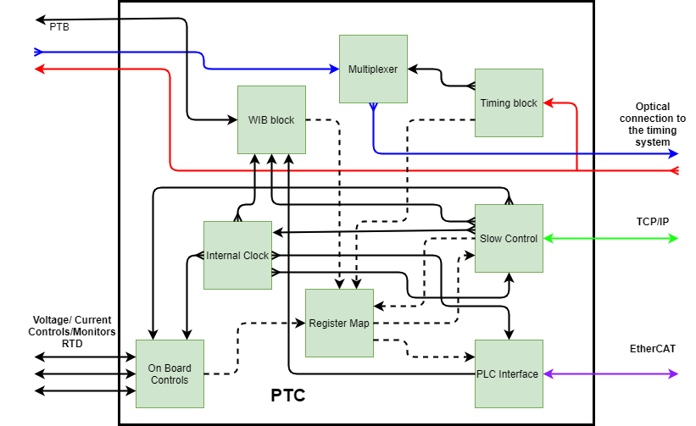
Power & Timing Card (PTC)
ProtoDUNE-I PTC meets all DUNE requirements
Same PTC is being used for ProtoDUNE-II
Existing PTC simply fanout the DUNE timing signal and power to the WIBs
New PTC is not needed for DUNE, but we are planning an upgrade now to increase the functionality of PTC
Adding an FPGA to the PTC so it can communicate with Slow Control and DUNE Detector Safety System
Current status: schematic design is completed, layout is about 20% complete
Expect prototype PTCs to be available in early 2023
Plan to integrate it for VD module-0
Layout of New PTC
Firmware Block

Slide 22
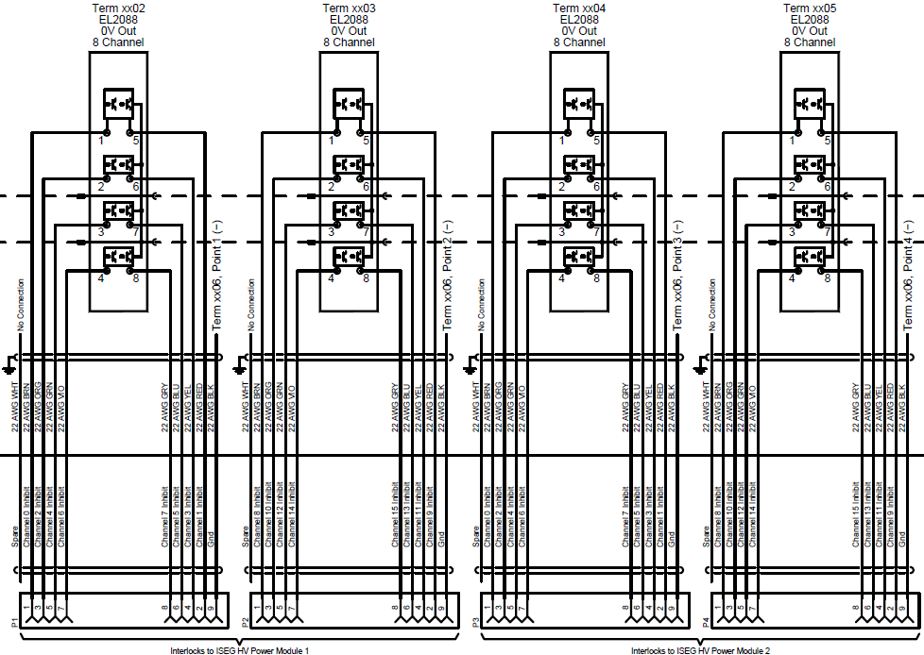
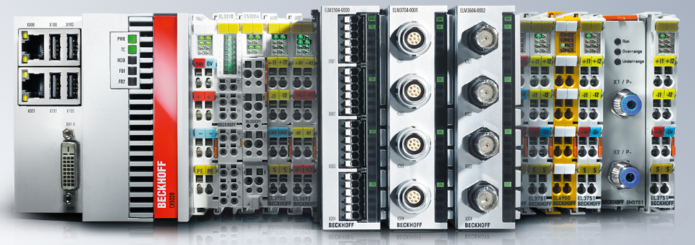
CE Hardware Interlock
Using commercial Beckhoff PLC for hardware interlock for the fans, RTDs, HV bias, and low voltage power supplies
Design is completed. See EDMS#2401090 for design detail, parts list, action matrix, power analysis, etc.
Components for the prototype systems have been purchased
Plan to first integrate the system at the ICEBERG test-stand at Fermilab
Depending on the time scale, could also integrate the interlock in VD module-0 at CERN
Bias HV Racks Wiring Diagram
9 Instances
per rack
(45 total)
Beckhoff Modules
ISEG
Interlocks
(16 channels)

Slide 23
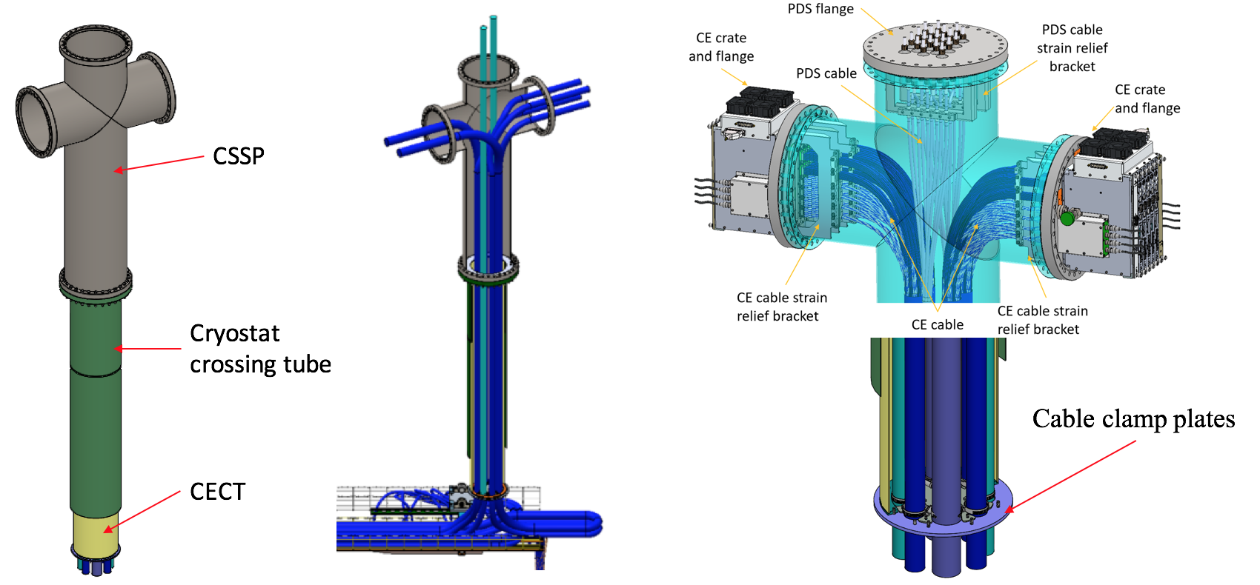
CE Cryostat Penetration and Cable Clamping Plate
ProtoDUNE-I design had 1 WIEC per penetration
ProtoDUNE-II is using the same design as FD1

Slide 24
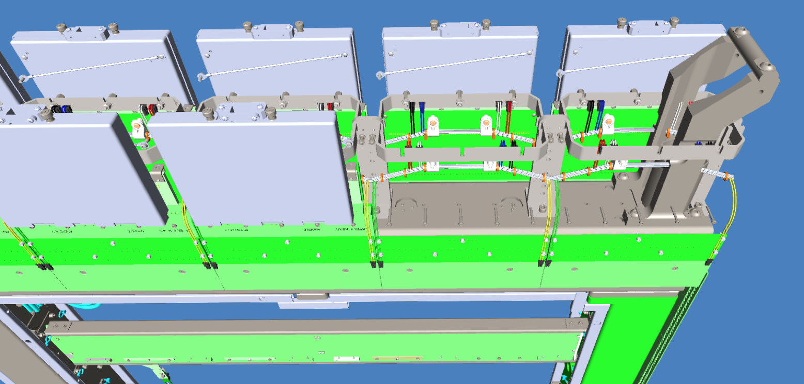
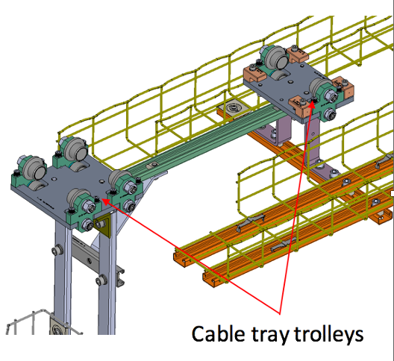
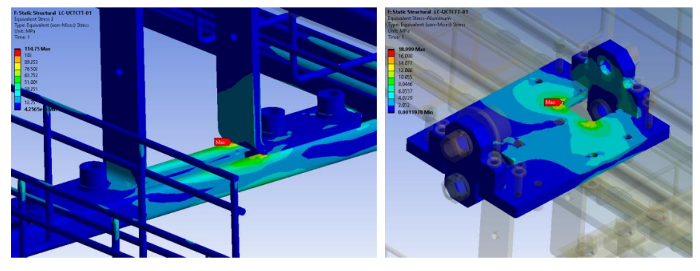
Mechanical Support Inside the Cryostat
CE Box Mounting Hardware
Cable Tray Supported by DSS Beam
Detailed structural analysis have been performed
Compliance Office has signed off on the studies:
  EDMS#2570048: analysis plan and results
  EDMS#2780876: CO report

Slide 25
Answer to Charge Questions
Detailed information addressing the charge questions are in the list of review documentation
Charge # 1: Has the TPC consortium responded appropriately to recommendations from past reviews?
  We believe we have. See the report from Technical Coordination and Review Office
Charge #2: Are the full specifications, the design files and complete documentation of all the components of the TPC Electronics system available in EDMS?
  We have uploaded the requirement and specification documents to EDMS
  3-D CAD models, parts drawings, assembly drawings, schematics, PCB layout, BOM, etc. are available in EDMS
  Index files are provided to help reviewer navigate through the maze of drawings
  See TDR chapter and EDMS#2782297 for standalone test results

Slide 26
Answer to Charge Questions
Charge #3: Do the standalone tests of the new generation of components indicate that the design goals have been achieved? Do these design goals meet the detector requirements? Have all issues observed in previous versions of the components been addressed? Do the performance measurements obtained from test-stands meet the expected performance?
  All benchtop test results have shown that the new generation of components satisfy DUNE requirements and our expectations
  Important lessons and problems from ProtoDUNE-I have been addressed (e.g. cable connector flaws, issues with ADC ASIC, etc.). These issues are discussed in more details in the ProtoDUNE-I lessons learned document

Slide 27
Answer to Charge Questions
Charge #4: What is the outcome of system tests? What are the plans and timeline for future tests?
  ProtoDUNE-II installation at CERN is ongoing. 3 out of 4 APAs have already been tested in the Cold Box with good performance. See EDMS#2782614
  Installation of the APAs in NP04 cryostat will start soon. Expect the installation to be completed by November 2022
  Due to LAr shortage in Europe. Testing in LAr and in beam will likely happen in the second half of 2023
  Same electronics will also be used in FD2 tests as well:
    CRP5A test (12 FEMBs) in LN2 next month at BNL
    CRP4 (24 FEMBs) in LAr at CERN cold box
    Module-0 installation early next year

Slide 28
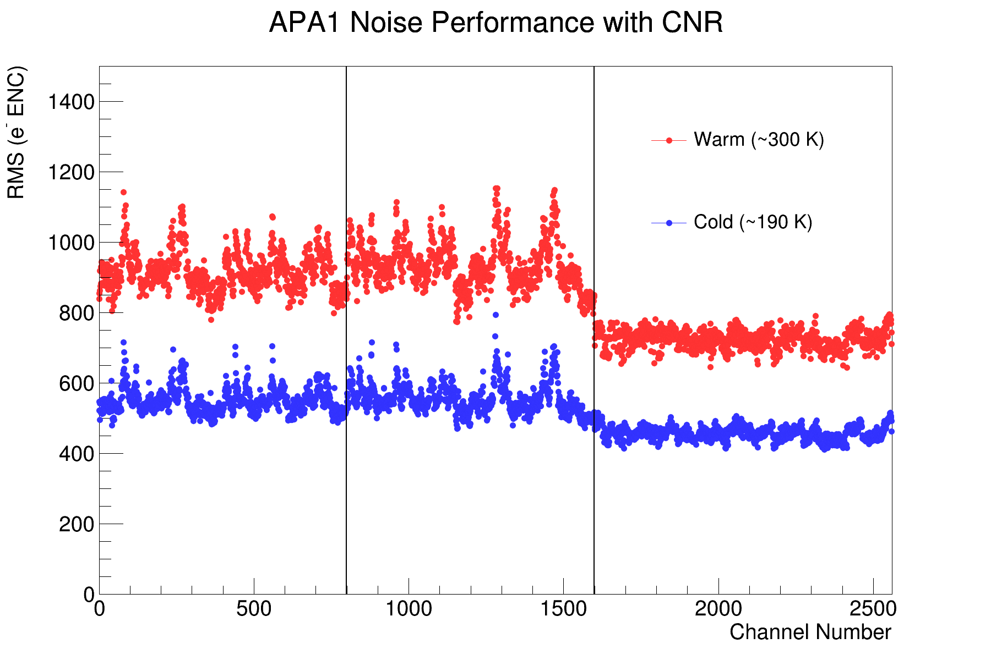
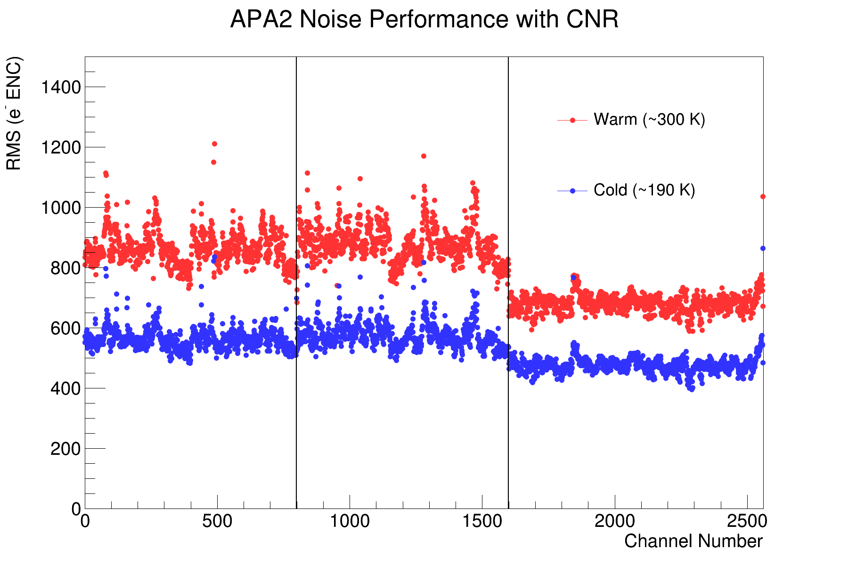

Answer to Charge Questions
Charge #4: What is the outcome of system tests? What are the plans and timeline for future tests?
ProtoDUNE-II cold box results
FEMB configuration: 2us shaping time; 14 mV/fC gain, single-ended input
Noise performance exceeds DUNE requirements of < 1000 e- ENC in LAr

Slide 29
Answer to Charge Questions
Charge #5: Are there any issues with the design of the TPC Electronics system that will complicate the procurement strategy and manufacturing plans for the different components
  The main issue for us is the supply chain problem. Many of the components for our system have very long lead time (~> 1 year)
  To mitigate this risk, we are procuring most of the components early under CD-3a (long lead procurement) cope
  FD1 CD-3a scope:
    All three ASICs
    All FPGAs for the WIBs and PTCs
    All discrete components for the FEMBs
    50% of the discrete components for the WIBs
    50% of the discrete components for the PTCs

Slide 30
Answer to Charge Questions
Charge #6: Is the QA/QC plan complete and documented? Have sufficient resources been allocated to successfully execute the QA/QC plan?
  QA/QC plans are discussed in a number of documents. See the document spreadsheet
  We have met with PIs from university groups to discuss QC contributions. At the moment we have 3 national labs and 7 university groups committed to QC testing. All QC testing needs have an institution assigned
  In P6, we have allocated budget for QC testing equipment, engineering and technician supports. In addition, we have contingency in the schedule and risk registry to provide more funding support if needed

Slide 31
Answer to Charge Questions
Charge #7: Is the probability that tests not yet performed or not yet fully understood may require a further design iteration negligible? Is the TPC electronics consortium ready for launching the preproduction of the components?
  We learned a lot from the prototype electronics with > 2 years of operational experience from ProtoDUNE-I
  Recent ProtoDUNE-II cold box test results have given us confidence that we have a system that meet the DUNE requirements. It is unlikely that we will need any significant revision on the components
  Fabrication of components for ProtoDUNE-II is ~ our preproduction run. In combination with FD2, we’ll have more preproduction experiences

Slide 32
Answer to Charge Questions
Charge #8: Are the Parts Breakdown structure, interfaces with other detector components, cost estimates, and schedule fully documented?
  Yes, see review documentation list for more information
  Please reach out if more detail is needed

Slide 33
Summary
Since this is supposed to be a document-based review, the presentation is not exhaustive. I selectively picked a few highlights to discuss. More information is in the documentation
Preliminary results from ProtoDUNE-II is very encouraging. So far the performance of the system has met or exceed our expectations
If you have trouble finding documents or need other info, feel free to contact us
Let us know if we should meet again tomorrow
A very big thank you!!!!

