Slide 1
Nano/Micro-fabrication of Josephson junction
Tommaso Bonaccorsi
University of Pisa, Department of physics "E. Fermi"
09/09/2022

Slide 2
Josephson junction theory pt.1

Slide 3
Josephson junction theory pt.2
$$ψ\left(z\right)=ψ_{1}e^{−βz}+ψ_{2}e^{β\left(z−b\right)}$$
$$I=I_{0}sinγ$$
If we resolve the Sch. Eq. we obtain
$$\frac{dγ}{dt}=\frac{4 πeV}{h}=2\frac{πV}{Φ_{0}}$$

Slide 4
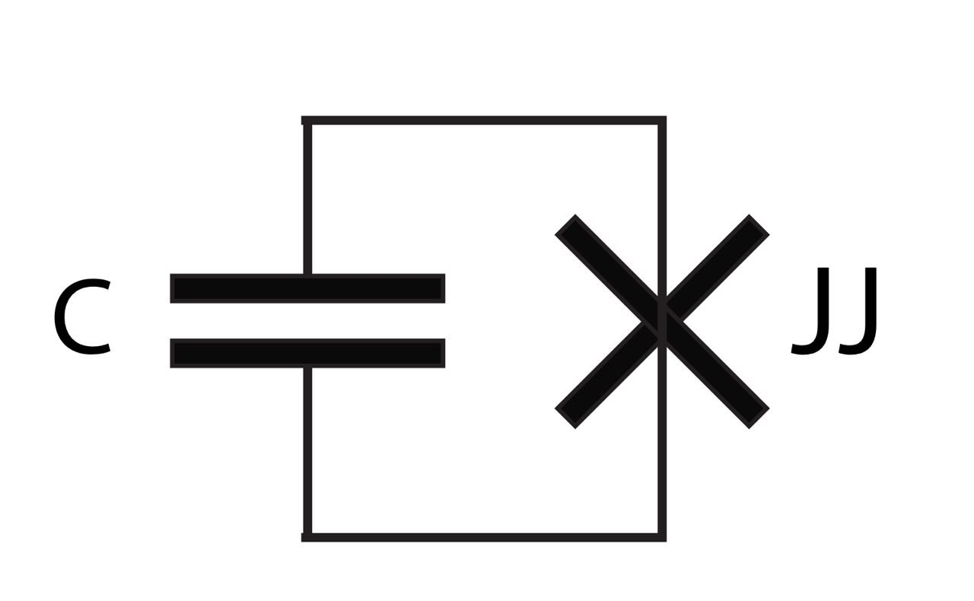
Josephson junction theory pt. 3
One can infer that the effective inductance of the Josephson junction is :
$$L=\frac{Φ_{0}}{2πI_{0}\cos\left(γ\right)}$$
JJ works as a non-linear inductance without adding dissipation
We can create an anharmonic oscillator with a JJ and a capacitor

Slide 5
Lift off Process (additive)
e-beam
PMMA
MMA (8.5) MAA
Substrate
Substrate
Substrate
Spin Coat Resist
E-beam Expose
Develop Resist
Substrate
Substrate
Solvent Lift Off
Metal Deposition

Slide 6
Stack of two resists for junction fabrication
The reason for this choice of resist staking is to achieve a wide undercut which is convenient for clean lift off as depicted in figure. Moreover , the undercut of the lower resist can be used to created suspended resist

Slide 7
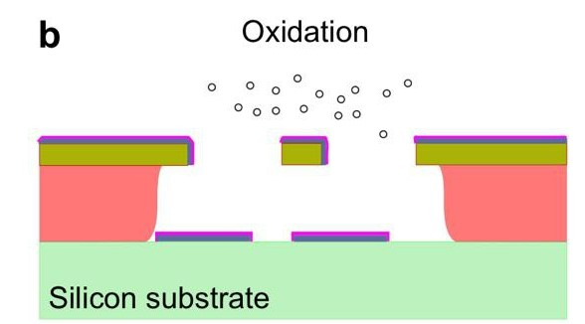
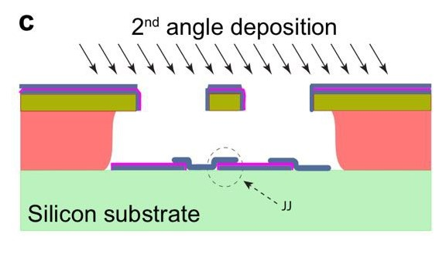
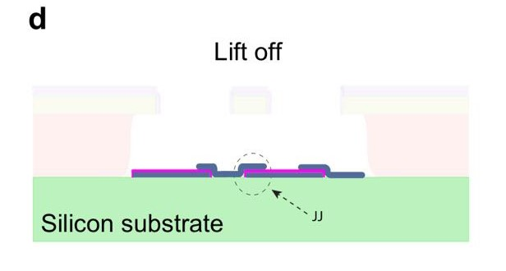
Shadow evaporation technique (ShET)

Slide 8
New technique to increase the coherence time of the qubit
BEFORE
NOW
They used ion milling before the deposition of the JJs on Nb pads to create the electric contact
During this weeks we have built JJs with a new technique called “patching”

Slide 9
Electrical contact between Nb pads and JJs with "patching"
Al bandaid
Josephson junction​
Nb pads

Slide 10
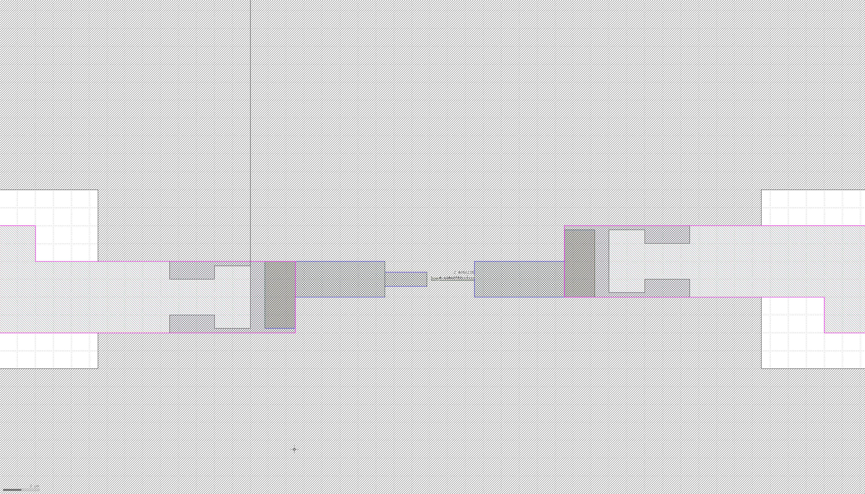
Second experiment with patching
We have deposited JJs between the pads to protect the junction from any charge build-up. In that case the electric contact is established between the parts only at the end.

Slide 11
Measurements
2° experiment
1° experiment
JJ surface [µm^2]
0.014
0.018
0.023
0.030
0.039
0.050
0.061
0.072
0.090
JJ surface [µm^2]
0.014
0.018
0.023
0.030
0.039
0.050
0.061
0.072
0.090
RESISTENCE [KΩ]
RESISTENCE [KΩ]
39.7 | 20.2 | 20.3 | 22 | 19.1
600 | 16.3 | 150 | 400 | 17.7
220 | 600 | 0.12 | 47 | 16
22 | 13.1 | 11.8 | 1.4 | 13.1
600 | 40 | 10.9 | 70 | 0.17
9.3 | 600 | 0.12 | 11 | 10
8.9 | 8.8 | 0.16 | 9.3 | 9.4
7.7 | 8.0 | 7.2 | 500 | 7.4
500 | 13.5 | 600 | 6.78 | 6.26
593 | 590 | 600 | 600 | 600
600 | 600 | 600 | 600 | 600
600 | 600 | 600 | 600 | 600
600 | 600 | 10.4 | 600 | 600
9.35 | 600 | 600 | 600 | 600
600 | 8.34 | 7.64 | 600 | 8.43
6.50 | 600 | 600 | 7.20 | 7.35
5.85 | 6.16 | 5.89 | 600 | 6.03
600 | 4.79 | 4.92 | 4.85 | 600

Slide 12
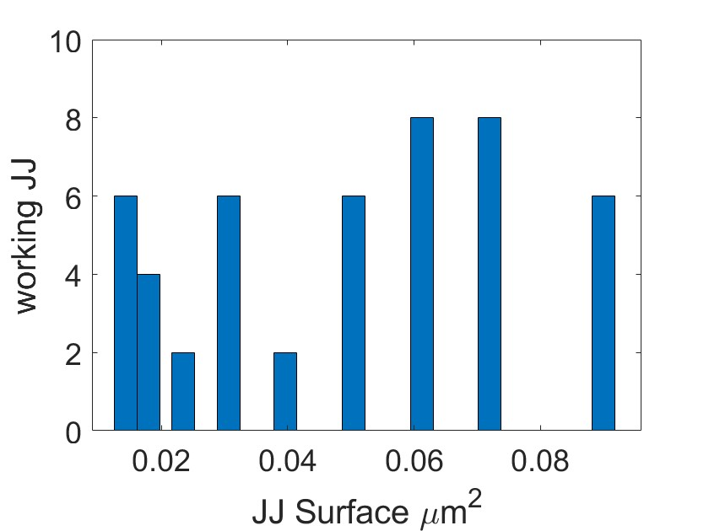
Measurements
JJ ON THE PADS
JJ BETWEEN THE PADS
For small size there is no working junction

Slide 13
Not working junction

Slide 14
Thanks for listening

