Slide 1
Modeling quantum state transport with SQMS devices
Filippo Antola
Supervisor: Yu-Chiu Chao
10/07/2022

Slide 2
Summary
Goal: Investigate the quantum communication between different cavities by pulse shaping.
How: Discuss approaches that could be implemented experimentally.
Our ideas are tested with simulations on QuTip based on experimental data on SQMS devices.
Possibility of creating a quantum network in the future
More computing potential!

Slide 3
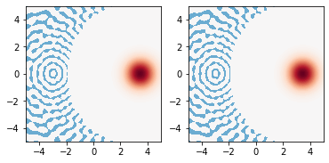
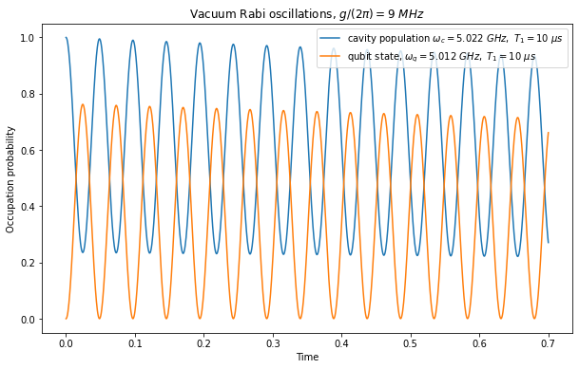
QuTip:
QuTip is a python library that let us simulate the evolution of a system within the laws of Quantum Mechanics.
Driving a cavity with a resonant pulse: Coherent state
$$\hat{H}=ε\left(t\right)\left(\hat{a}+{\hat{a}}^{†}\right) \hat{U}=e^{−i\int{\hat{H}dt}}=\hat{D}\left(−i\int{ε\left(t\right)dt}\right)$$
Blue lines on the left side are due to the finite dimension of the Hilbert space
Jaynes-Cummings model:
$\hat{H}=ω_{c}{\hat{a}}^{†}\hat{a}+ω_{q}σ_{+}σ_{−}+g({\hat{a}}^{†}σ_{−}$+$\hat{a}σ_{+})$
Different behaviour due to different detuning and coupling. Also we can add dissipation.

Slide 4
Transfer quantum states between cavities
For each cavity, we consider two modes
Q-switch

Slide 5
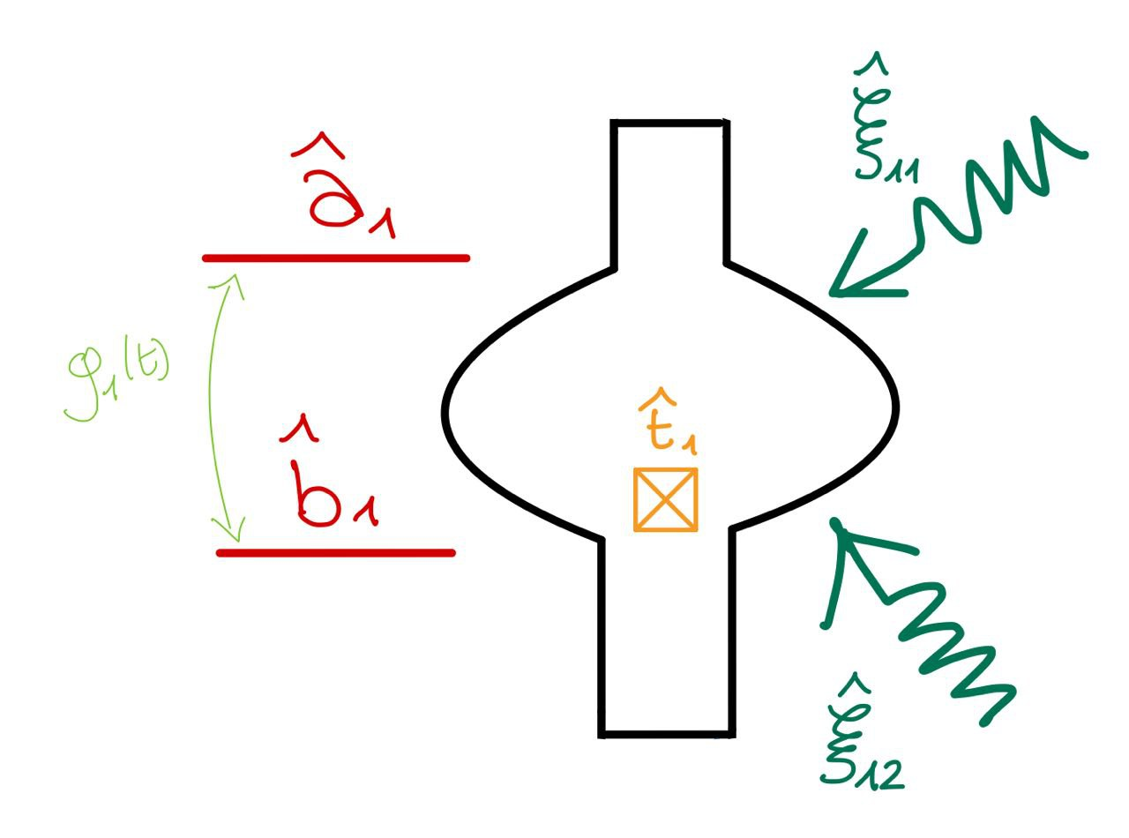
Q-Switch:
Goal: convert a state from a storage mode (high Q) to an output mode (low Q).
In the lab frame:
$$\hat{H}={\hat{H}}_{a}+{\hat{H}}_{b}+{\hat{H}}_{t}+{\hat{H}}_{p}$$
${\hat{H}}_{a}=ℏω_{a}{\hat{a}}^{†}\hat{a} {\hat{H}}_{b}=ℏω_{b}{\hat{b}}^{†}\hat{b}{ \hat{H}}_{t}=ℏω_{t}{\hat{t}}^{†}\hat{t}−$ $E_{j}\left(cos\left(\hat{ϕ}\right)+\frac{{\hat{φ}}^{2}}{2}\right)$
${\hat{H}}_{p}=ϵ_{1}\left(t\right){(e}^{−iω_{1}t}{\hat{a}}^{†}+e^{iω_{1}t}\hat{a})+ϵ_{2}\left(t\right){{(e}^{−iω_{2}t}{\hat{b}}^{†}+e^{iω_{2}t}\hat{b})}^{}$
$$\hat{H}=ℏg\hat{a}{\hat{b}}^{†}+ℏg^{∗}{\hat{a}}^{†}\hat{b}$$
Output mode strongly coupled to a transmission line:
the state does not return to the storage mode.

Slide 6
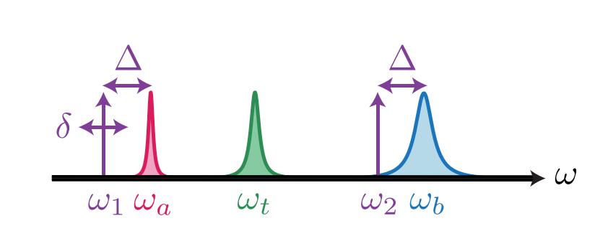
Q-Switch
Moving into a displaced and rotating frame and applying RWA:
Where$ξ_{i}=\frac{ϵ_{i}}{Δ_{i}}$ and we choose $Δ_{1}=ω_{a}−ω_{1}=Δ_{2}$.
$$\hat{H}={\hat{H}}_{1}+{{\hat{H}}_{2}+\hat{H}}_{i}$$
$$g=χ_{ab}{ξ_{1}}^{∗}ξ_{2}$$
$χ_{at}{,χ}_{bt}$ measured by spectroscopy methods.
$$χ_{ab}=\frac{α_{q}}{{2χ}_{at} χ_{bt}}$$
Pfaff, Wolfgang, et al. "Controlled release of multiphoton quantum states from a microwave cavity memory." Nature Physics 13.9 (2017): 882-887.

Slide 7
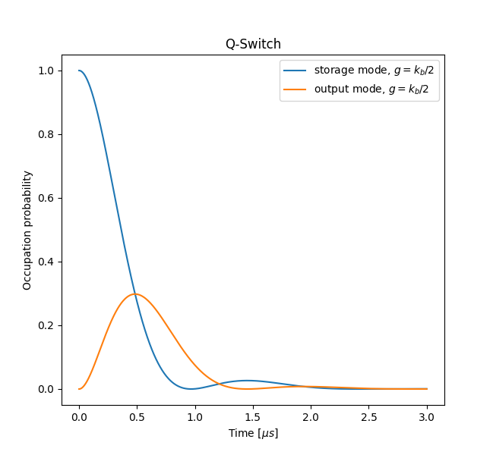
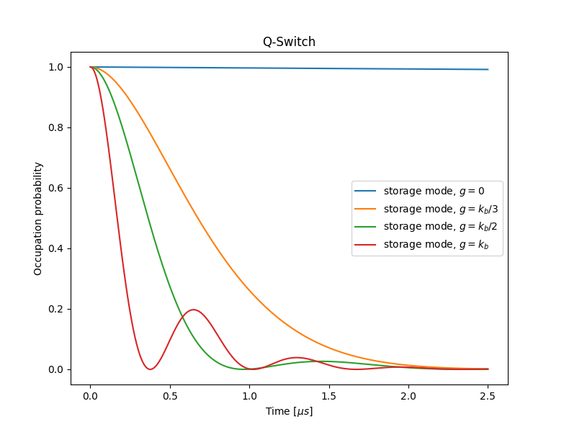
Simulations with master equation $\left(\frac{χ_{ab}}{2π}=60 kHz\right)$
This acts as a switch!
${g=k}_{b}/2$ shows the best behaviour

Slide 8
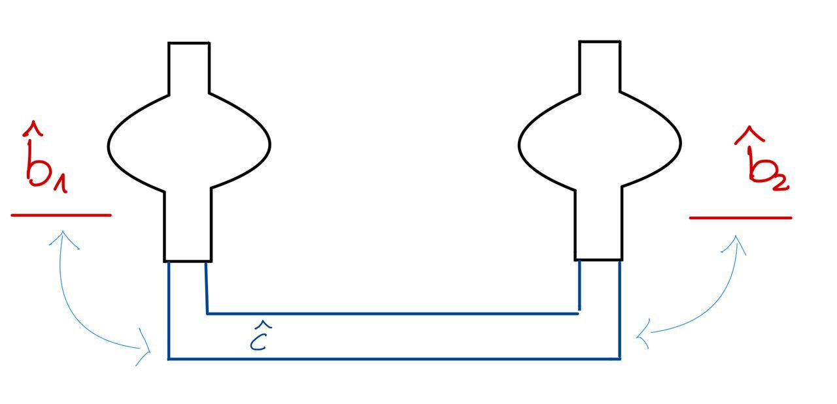
Two cavities:
Now we treat the transmission line explicitly:
$$\hat{H}={\hat{H}}_{cav1}+{\hat{H}}_{cav2}+{\hat{H}}_{line}+{\hat{H}}_{int}$$
Assumption: We control the coupling between the transmission line and the cavities
${\hat{H}}_{cavi}=ω_{i}{{\hat{b}}_{i}}^{†}{\hat{b}}_{i}$
$${\hat{H}}_{line} =\int_{−∞}^{+∞}{dω ωk\left(ω\right)}{\hat{c}}^{†}(ω)\hat{c}(ω)$$
$${\hat{H}}_{int}=γ_{1}\left(t\right)\left[\int_{−∞}^{+∞}{dω k\left(ω\right)}\hat{c}\left(ω\right){{\hat{b}}_{1}}^{†}+h.c.\right]+γ_{2}\left(t\right)\left[\int_{−∞}^{+∞}{dω k\left(ω\right)}\hat{c}\left(ω\right){{\hat{b}}_{2}}^{†}+h.c \right]$$

Slide 9
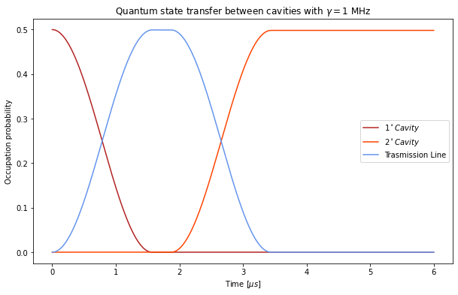
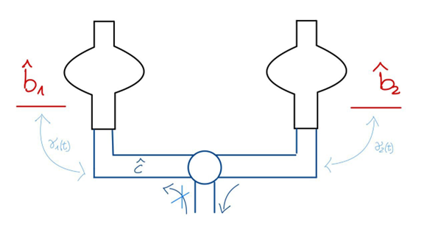
Simple model:
We make two assumptions:
Single mode transmission line;
We can switch off the couplings.
Constant ${ γ}_{i}$ with finite lenght in time
If we can’t put $γ_{i}=0?$
Add a circulator to the system:
how do we model the hamiltonian?
Shape the coupling.
If we can’t control $γ_{i}$(t)?

Slide 10
Two cavities and Q-switch
We properly choose the frame and we make some assumptions:
Single mode transmission line;
The output modes of the cavities are in resonance;
We drop stark shifts.
$$\hat{H}={\hat{H}}_{q1}+{\hat{H}}_{q2}+{\hat{H}}_{i}$$
$${\hat{H}}_{q}=ℏg(t)\hat{a}{\hat{b}}^{†}+ℏg^{∗}(t){\hat{a}}^{†}\hat{b}$$
${\hat{H}}_{i}=$ $γ_{1}\left[\hat{c}\left({{\hat{b}}_{1}}^{†}+ξ_{12}\left(t\right)e^{−iΔ_{12}t}\right)+h.c.\right]+γ_{2}\left[\hat{c}\left({{\hat{b}}_{2}}^{†}+ξ_{22}\left(t\right)e^{−iΔ_{22}t}\right)+h.c.\right]$

Slide 11
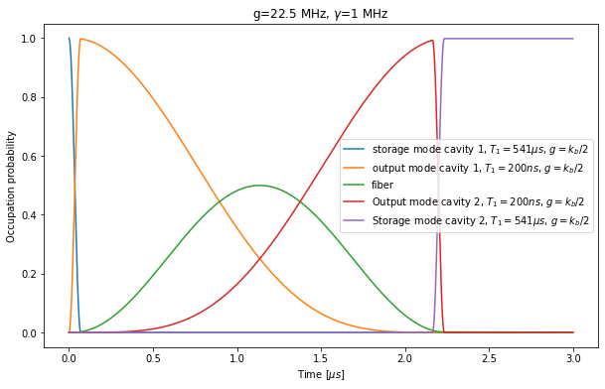
If $g≫γ ?$

Slide 12
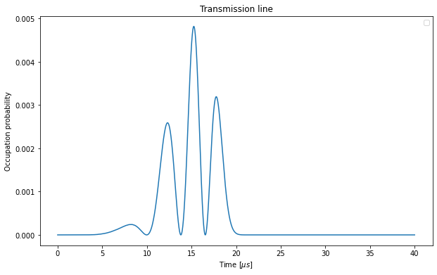
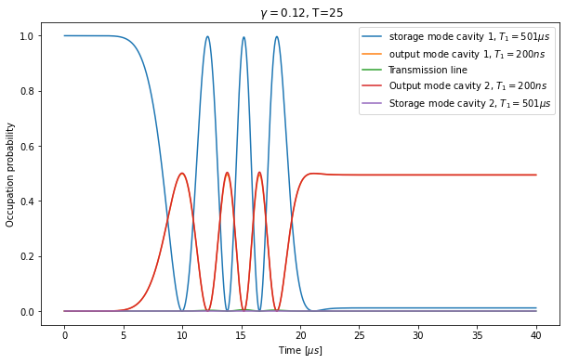
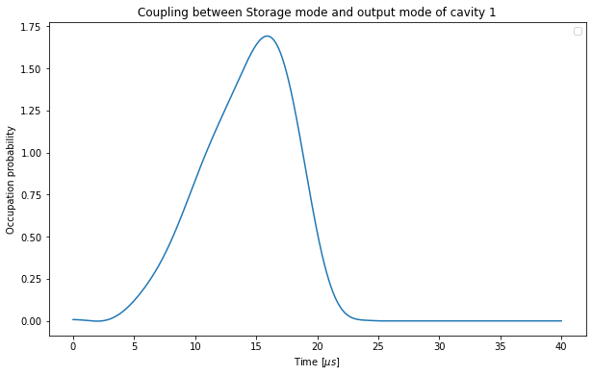
Shaping the pulses?
And so $g_{1}(ξ_{1,}ξ_{2})$
Goal: optimize the process shaping $ξ_{1}$
This idea is promising, but we need to better understand how to optimize this mechanism

Slide 13
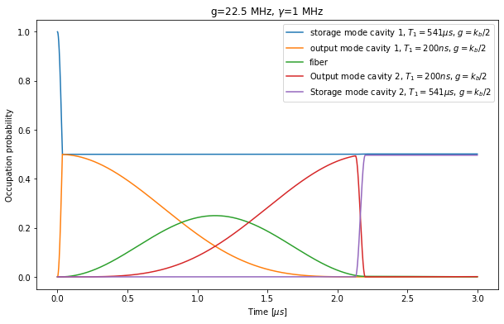
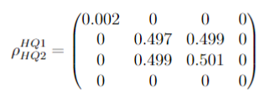
Entanglement
Create entangled states between the cavities:
Starting from a superposition of states;
Stopping the Q-Switch before oscillation has come to a maximum.
The reduced density matrix of the storage modes results:
As the Bell state $|ψ^{+}>$

Slide 14
Thank you for listening!
Summary:
The ability to transfer a quantum state between two different cavities could be a promising way to scale up the system.
To pursue this aim we need to control the coupling with the transmission line.
Q-Switch could be a way to exert control of this process.
This procedure also enables us to create an entanglement state between the cavities.
Special thanks to:
Chao for his constant support and enjoyable discussions.
Silvia for being helpful from the very beginning of this experience.
5 Sauk Circle and its inhabitants for being my home for these two months.

