Slide 1
Field Cage Update for Np02 Module-0 & possible Beam plug implementation
Francesco Pietropaolo
September 23, 2022

Slide 2
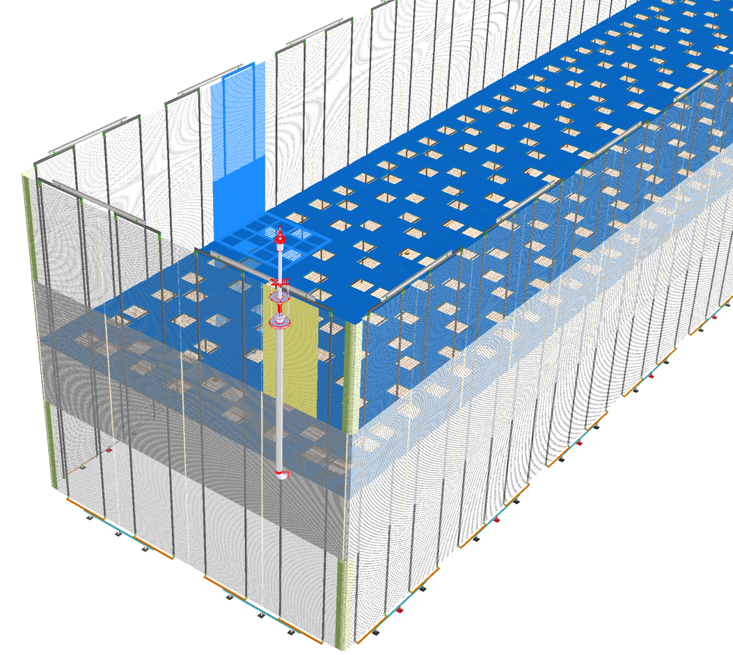
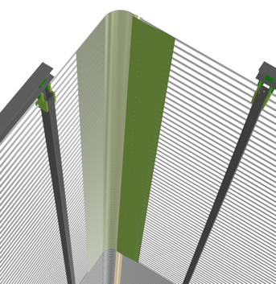
Present FD2-VD Field Cage design
70% transparent layout all around the FC for a height of 4m from the CRP’s
Thick profiles up to 2.4m from Cathode.
This configuration removes the previous transition from thick to thin profiles on the same equipotential “rings”:
This helps reducing the E-Field non uniform and the loss of electron trajectories
Insulating sheets are required on the corners of the thin profiles and in the extender region to mitigate local E-field distortion
We plan to implement this layout also in the NP02 Module-0

Slide 3
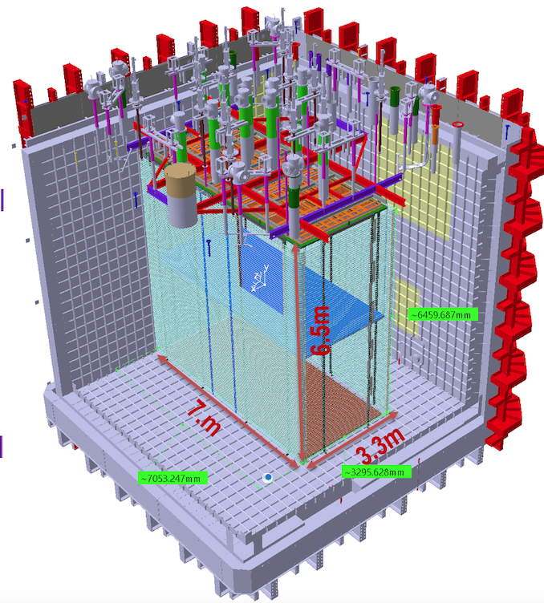
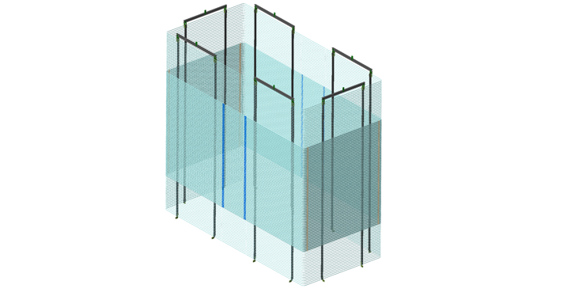
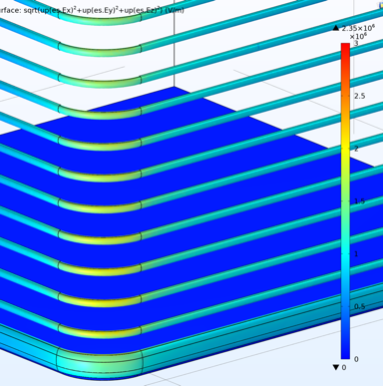
Present NP02 Module-0 FC layout
We propose to move from the old layout with the short walls fully at 70% transparency and long walls fully opaque to a layout more similar to the one of FD2
To achieve better e-field uniformity
To test the insulating sheets at the FC corners and in the extender region.
Scaling from FD2:
With same factor of 0.5 of the drift scaling, the thin profiles height would be 2 m;
From the HVS point of view the transition between thick and thin profiles can occur at any distance from the Cathode;
Even a fully 70% transparent FC with 300 kV applied on the Cathode (E_{drift} = 900 V/cm), the E-field at the corners is below 24 kV/cm (which safely satisfies the max local E-field requirements < E_{max} = 30 kV/cm)

Slide 4
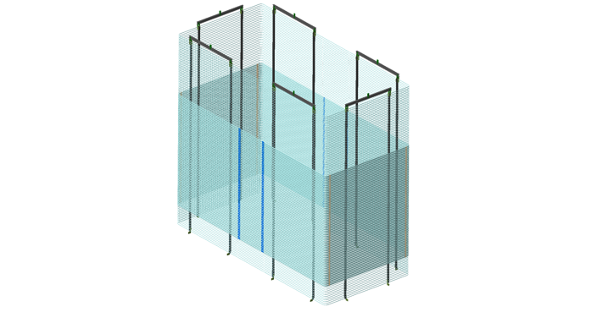
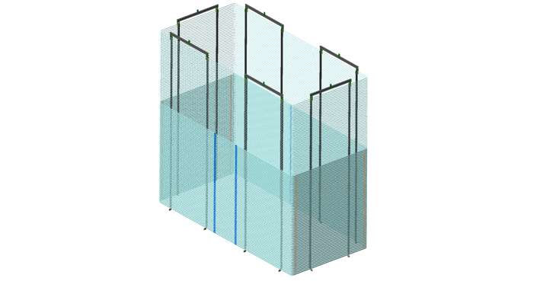
NP02 FC implementation
Symmetric
1500 mm
At present, we have already procured the thin profiles for the two short walls
315 pieces --3 m long --
Attempts to procure of more profiles is underway but it could be difficult or with long delay
If available, a fully transparent FC could be built
By now, with the available pieces, we can construct ~ 50 thin rings that can be arranged in several ways:
Assembly-wise the thick and thin profiles are interchangeable, hence from the HVS point of view all configurations are equivalent
The choice is mostly driven by the PD’s requirements
1500 mm
Intermediate
Scaling from FD2-VD
on top drift only
2000 mm
1000 mm
Fully asymmetric
3000 mm

Slide 5
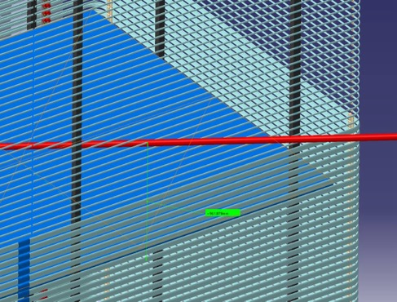
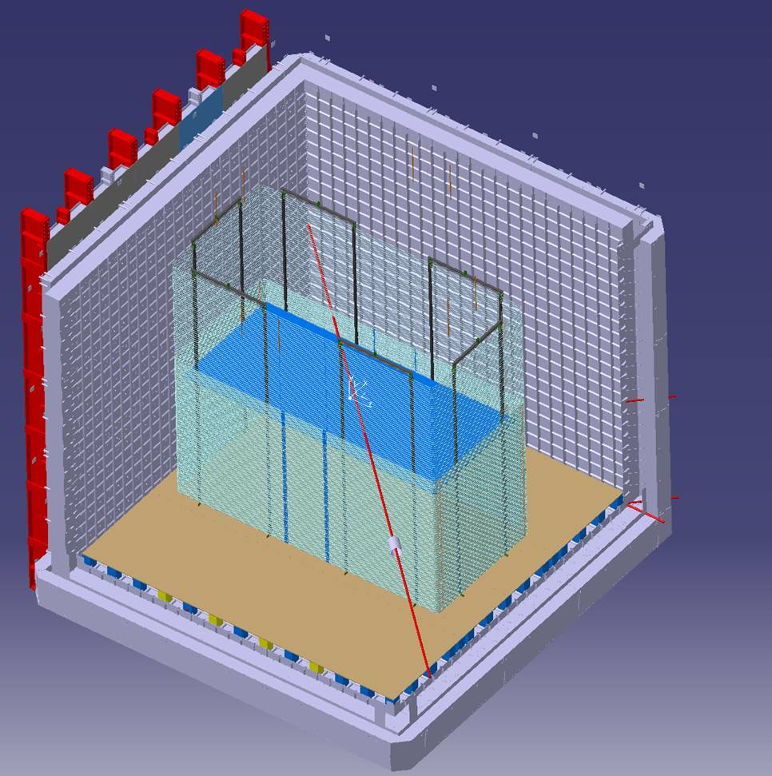
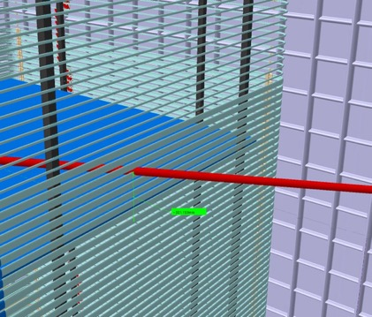
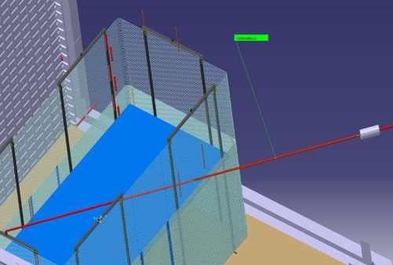
NP02 beam line
Entry point
In NP02 the beam is foreseen to cross the detector along a diagonal with a down slope of ~ 13 cm / 1m.
With the present VD Module-0 layout, the beam enters the active volume at 96 cm above the cathode and exit 32 cm above the cathode
The track length within the active volume is about 4.5 m
The distance form the cryostat membrane to the entering point into the FC is ~4.3m
Exit point
Distance in Lar outside the FC

Slide 6
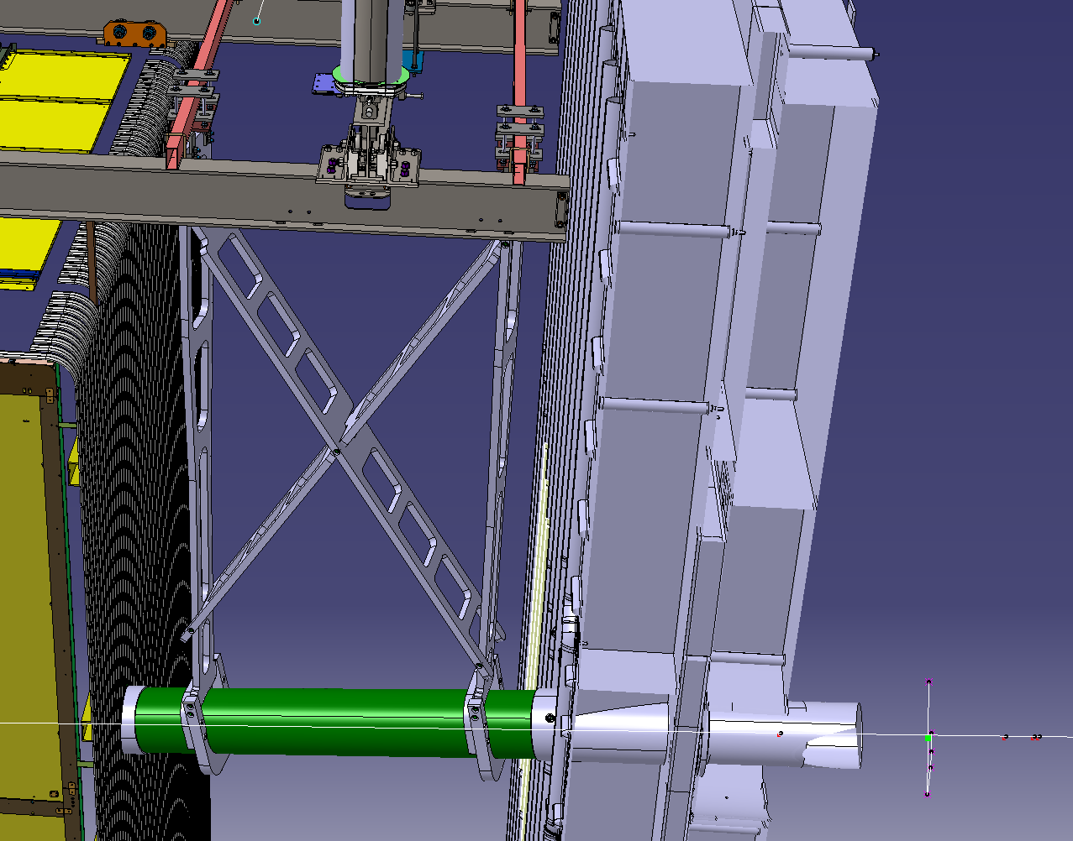
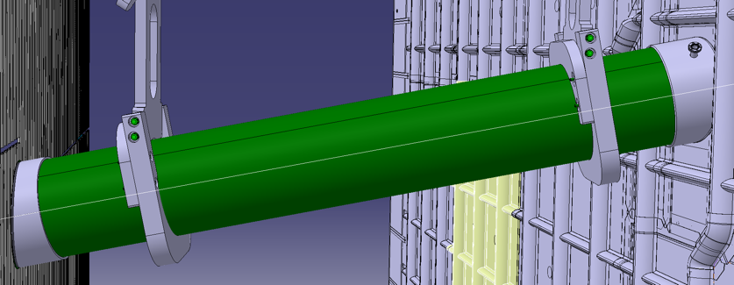
Beam Plug Feasibility
Given the 4.3 m distance from the membrane to the FC, a beam plug is required to allow pion, etc reaching the the active volume
A possible implementation is to start with the present NP04 Beam Plug design
This a 1.85 long G10 cylinder, 250 mm ID (275 OD) with stainless steel endcap (5 mm thick) glued on the G10, hanging from the DSS support structure.
Holds the vacuum during Cryostat filling, to monitor cooldown; Nitrogen filled during operation (vacuum also possible)
The G10 support structure is designed to deal with the 120 kg buoyancy of the BP when in LAr.

Slide 7
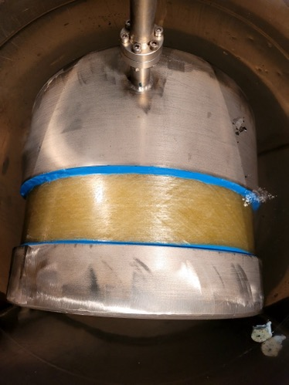
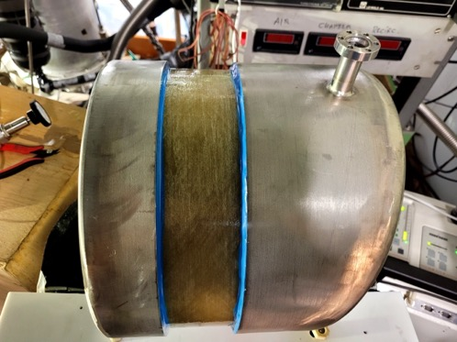
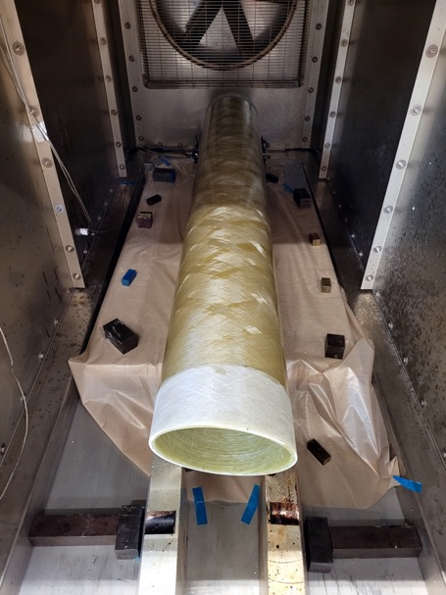
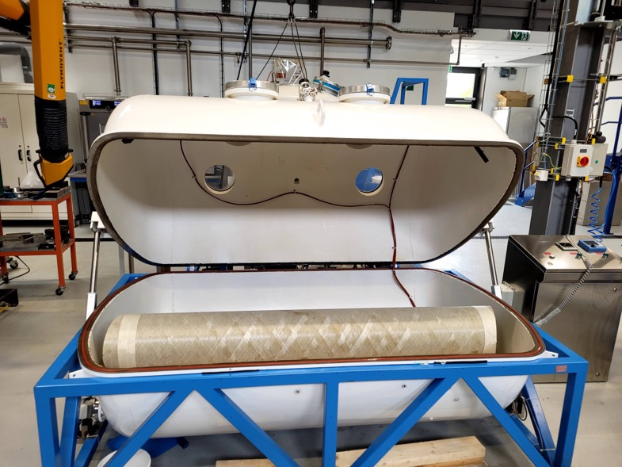
BP construction and test
Short prototype glued under vacuum by the CERN Polymer lab with certified cryogenic araldite LOCTITE Ablestik 286.
Widely used in LHC superconducting magnets.
Good bonding also between material with slightly different cte.
Leak tested (<10⁻⁸ mb-l/s) under UHV (~10-7 mbar) at warm and in LAr bath.
BP for NP04 ready for final assembly
G10 support structures also ready

Slide 8
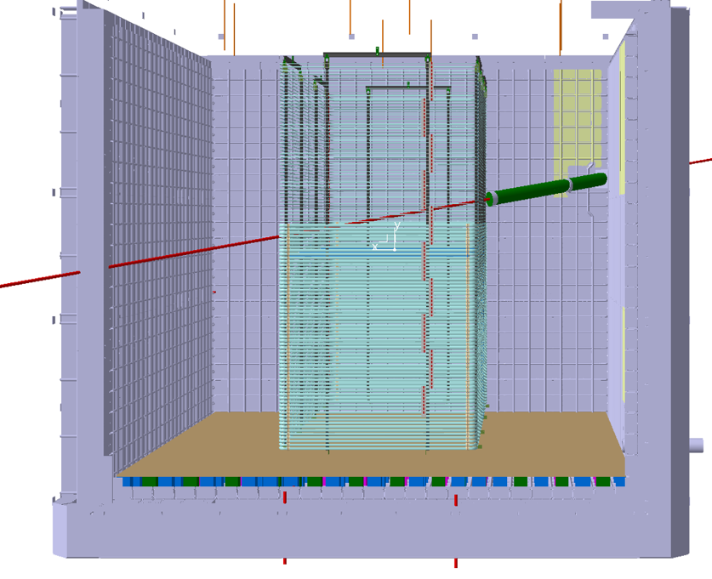
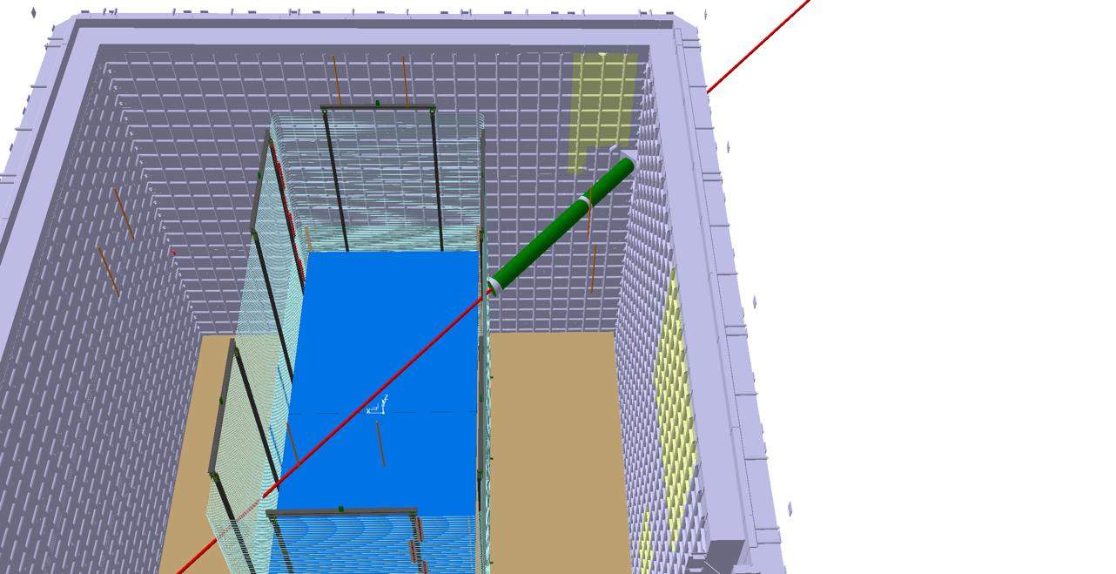
Possible Beam Plug configuration for NP02
Two (or three) BP’s with NP04 size in series along the 4.3 m long beam path in LAr.
Independently supported from the DSS (design still to be studied)
Feasibility should be guaranteed with NP04 design concept

