Slide 1
Summer Shutdown 9/23/22
Cons Gattuso

Slide 2
Next week outages
  Sept 26th Monday
    MI60 Conventional power
      08:00-16:00 hrs
        Special Note: MI timing signal offline during this time period
    A0 Generator Tie in (see next slide)
  Sept 27th Tuesday
    MI60 Conventional power
      08:00-16:00 hrs
        Special Note: MI timing signal offline during this time period
    Feeder 43 - All Transfer Gallery
      08:00-16:00 hrs
        Enclosure B switch sump to Booster power
  Sept 29th Thursday
    SSB, SY, G2, FCC 2&3, Enclosure F1
      08:00-16:00 hrs
    A0 Generator un Tie (see next slide)

Slide 3
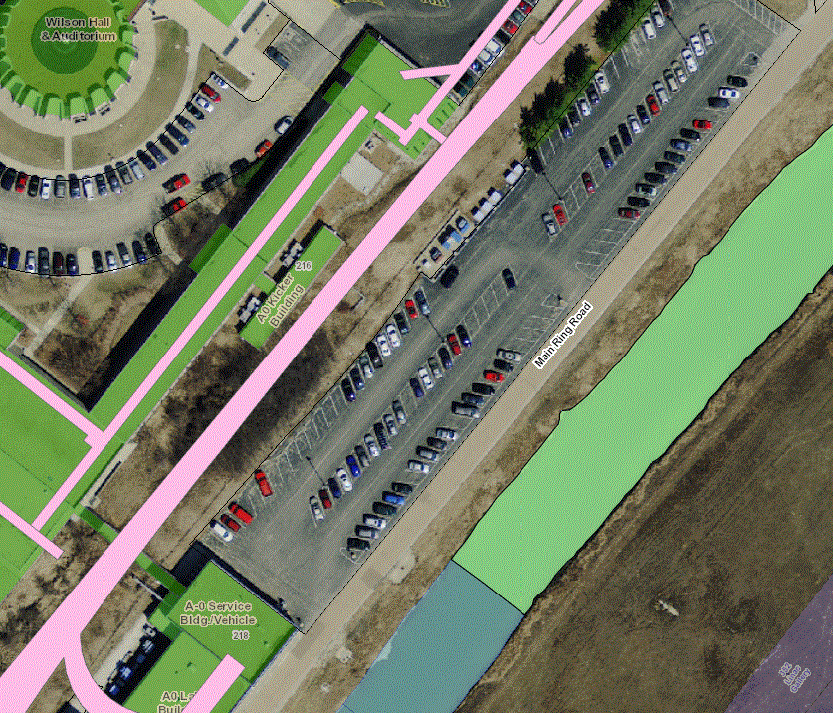
A0 Parking Restrictions
To maintain some level of cryo operations for G-2 during the Feeder 46A repairs the A0 compress building will be placed on generator power starting Monday 9/26 and proceeding through to Thursday 9/29. Below is the timeline of events that will get us into and out of this configuration.
Day 1:
  Outage to tie-in generators to A0 Compressor MCC. (5 hour duration)
  At conclusion of outage A0 Compressor MCC will be feed from generator power.
Day 2:
  A0 Compressor MCC will be feed from generator power.
Day 3:
  A0 Compressor MCC will be feed from generator power.
Day 4:
  Outage to remove generators from A0 Compressor MCC. (5 hour duration)
  At conclusion of outage A0 Compressor MCC will be feed from house power
This Job is being run by Josh Kenny, so if you have any questions on this please reach out to Josh.

Slide 4
Day 1: Friday, Sept. 23rd
  Prep for steel plate cover removal, sweep, vacuum, magnet sweep, barricades, and temporary lighting.
Day 2: Monday, Sept. 26th MI-60 Conventional Power Outage 0800-1600 hours
  Shutdown MI-60 for 8 hours, prep for trough “Safe to Work” area in LCW room and the first portion of Gallery trough
Day 3: Tuesday, Sept 27th MI-60 Conventional Power Outage 0800-1600 hours
  Shutdown MI-60 for 8 hours, complete “Safe to Work” area.
    “Safe to Work”
  Class 0 1000V Insulation blankets and clamps installed on all conductors and cable trays
  Soft barriers and hard barriers are temporarily installed to keep egress paths safe for evacuation at all times.
  HV101 cables are to be identified and marked as “Ready to be cut- de-energized” with a permanently installed label with “De-energized and the current date” applied.
  Cables to be left in place will be booted and no closer than 36” to the cables that are to replace them.
  Identify and cut/remove HV101 Cables at trough penetrations and confirm measurements with TM/CC
Day 4-9: Wednesday, Sept 28th through Wednesday, Oct 5th
  Replace all HV101 Cables and make any necessary repairs encountered trough inspections of existing infrastructure
  During this time frame MI LCW will restored
  Restore RF timing For Horn testing
Days 10 & 11: Thursday, Oct 6^{th,} and Friday Oct 7th MI-60 Conventional Power Outage 0800-1600 hours (it will be one of these two days the exact time will be determined just before the outage)
  High pot testing by EE support
  Upon successful high pot testing, remove Class “0” 1000V rated insulation blankets
  Upon successful high pot testing, terminate all conductors
Day 12: Monday, Oct 10th
  Replace all Steel plates
Day 13: Tuesday, Oct 11th
Test HV101 480 Volt disconnect for voltage test pint, and phase indicators

Slide 5
Weekend plan
Search and Secures
    Ops will then complete a valid secure of the following areas
      MI10 and MI20-62 enclosure including No Mans Land.
        Special instruction
          Search the MI-20 Sector.
          Take a picture of the Sector searched.
          Open Interlock #5
          Take a picture of the Sector dropped, ensuring Interlock #5A Sequence also dropped.
          Log in Interlocks Logbook.
      F-Sector
      Any anther enclosure that might be available
        MT6-1
        MT6-2
        MC7
        MB7

Slide 6
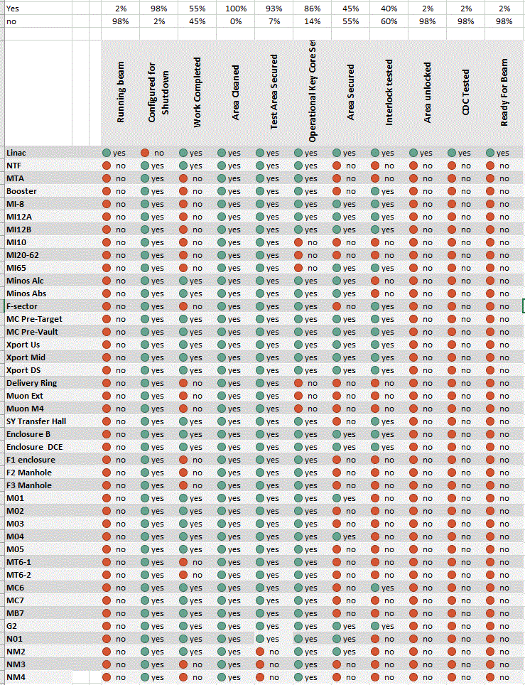
Interlock Testing: 40% Done
Areas Secured: 45% Done
Areas ready for unlocking: 2% Done
Areas CDC Testing: 2% Done

Slide 7
Sept 26th
Oct 3rd
Oct10th
Oct 17th
Oct 24th
M
T
W
T
F
S
S
M
T
W
T
F
S
S
M
T
W
T
F
S
S
M
T
W
T
F
S
S
M
T
W
RIL
Source running Beam
Linac
Linac running Beam
Studies.
Booster
SS
CDC
Booster running Beam
8 GeV line
CDC
BNB Running Beam
MI/RR
MI Q309 replacement
MI62
FDR95/97 PP
MI60
MI60
int test
Install last RF St
MI60
MI/RR Running Beam
Turn on LCW
LCW
SS
CDC
HV101 repairs
SSB/G2
NWA/NS4
Spin
NS1
SS
F1,2,3
MT4Q6 replacement
F-sector/TH
SYD +
Turn on LCW
SS
g2
Test G2
SS
meson
Test meson
Power Supply turnon
Running Beam
SS F1/2/3
Muon Campus
Open Hatch
Close Hatch
SS
Q205 replacement
D30 Vacuum Mod. Leak checking recovery
Install 3 Columns
SS test
NuMI
HV101 repairs
CDC
Running Beam
Key Core
Power Supply tests
Cask removal
Running Beam
Munters/cleaning/misc
Target scan
Install shielding wall

Slide 8
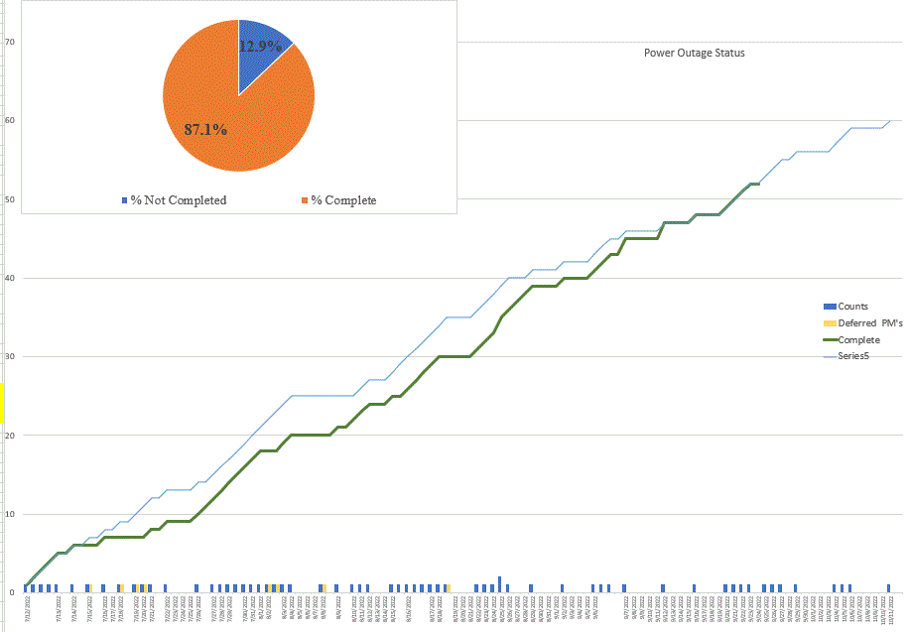

Slide 9
