Slide 1
Photon Detector
David Warner
FD1 PDS Rail/Cable PRR Introduction
4 October, 2022

Slide 2
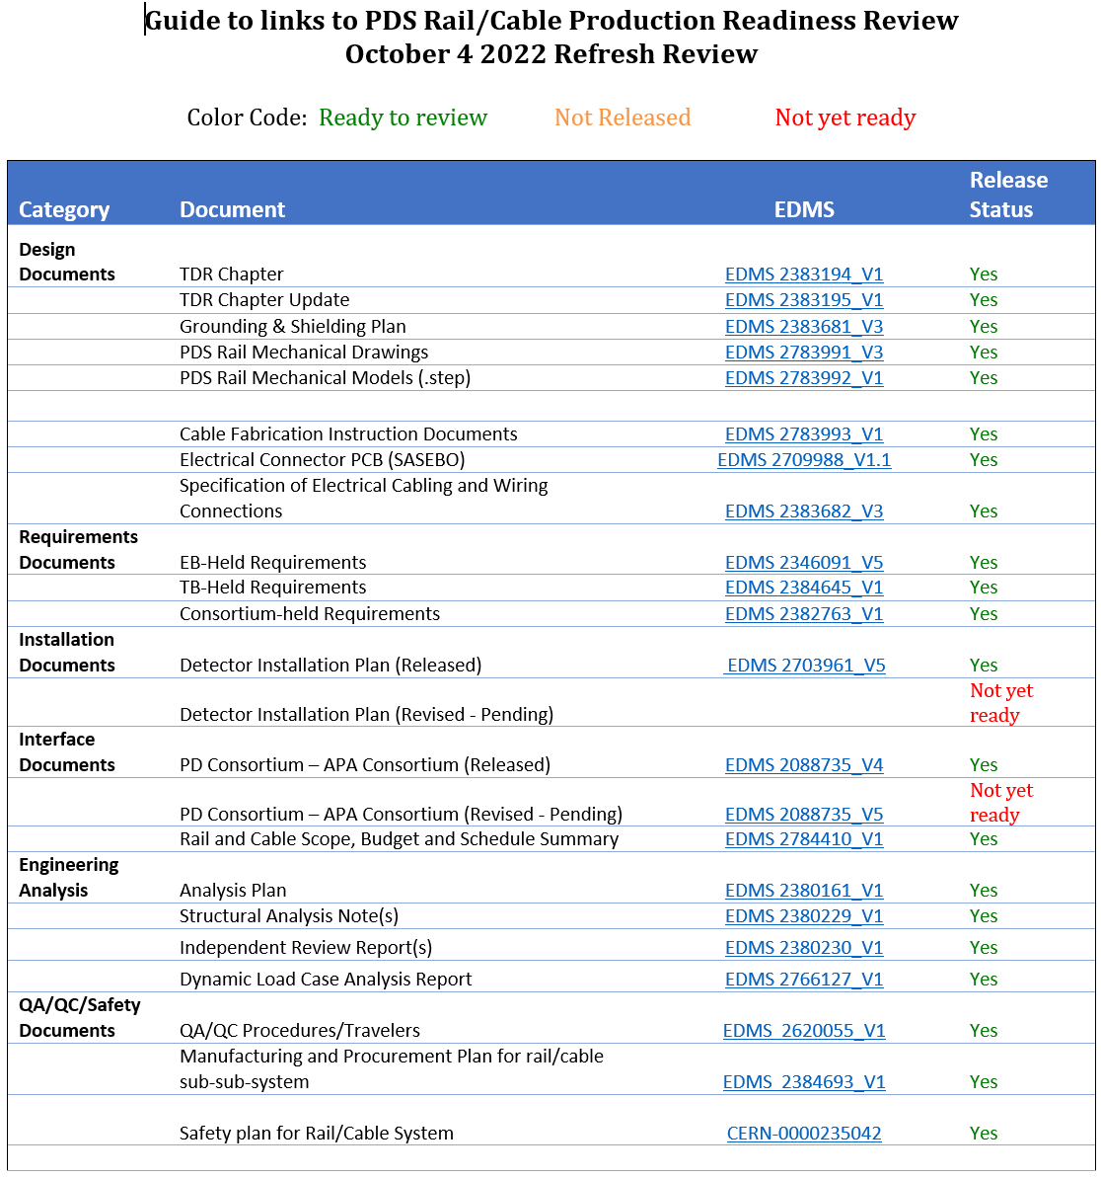
Review Documentation Links
Links to review documentation can be found on EDMS 2785144 V1.
https://edms.cern.ch/document/2785144/1

Slide 3
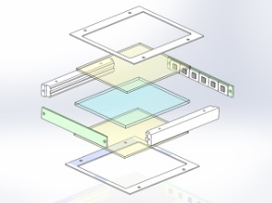
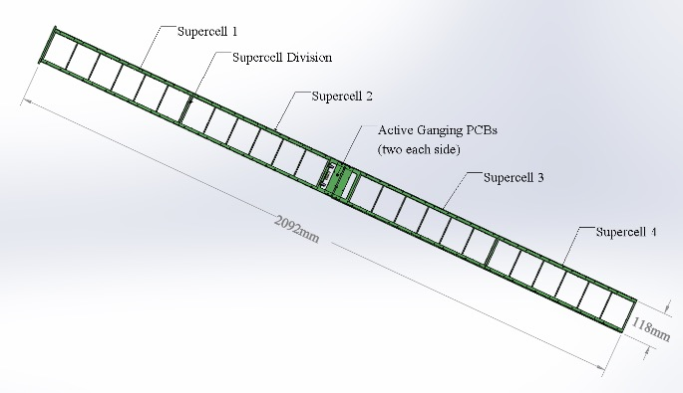
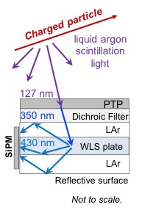
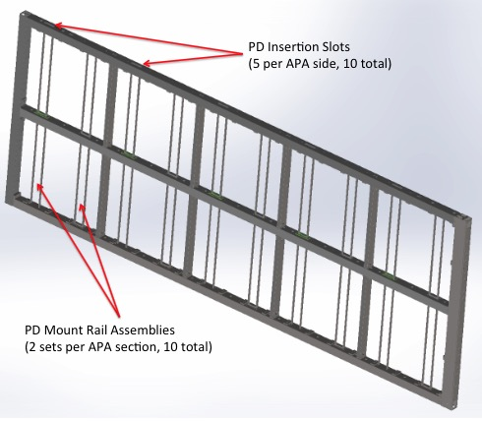
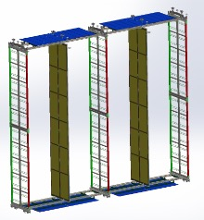
Photon Detector System Concept
The PD system is a LAr scintillation light collector based on the X-ARAPUCA light-trap concept.
  Provides T₀ for non-beam physics.
  Provides TPC-independent calorimetric information.
PD light collectors bars, also called modules, are arranged ten per APA, each 209cm long by 12cm wide. Single and dual-sided readout options.
Photon detectors are mounted inside the APA frame structure on stainless steel rails.
LED diffusers mounted to cathode planes inside the TPC provide system monitoring.

Slide 4
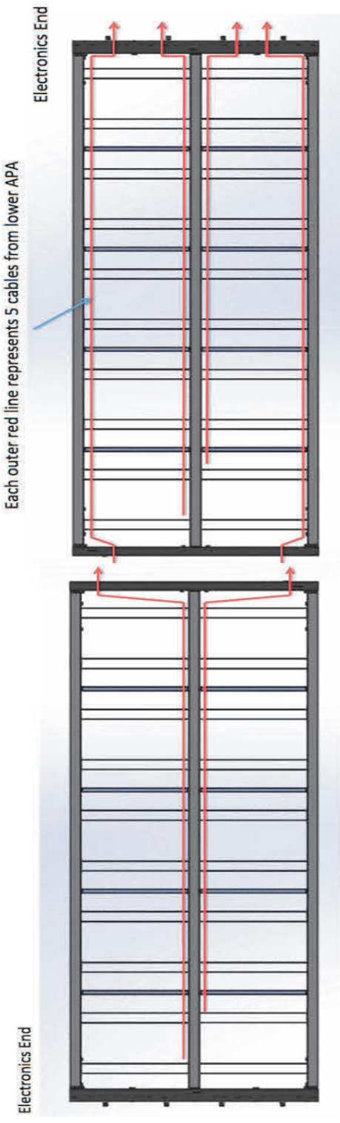
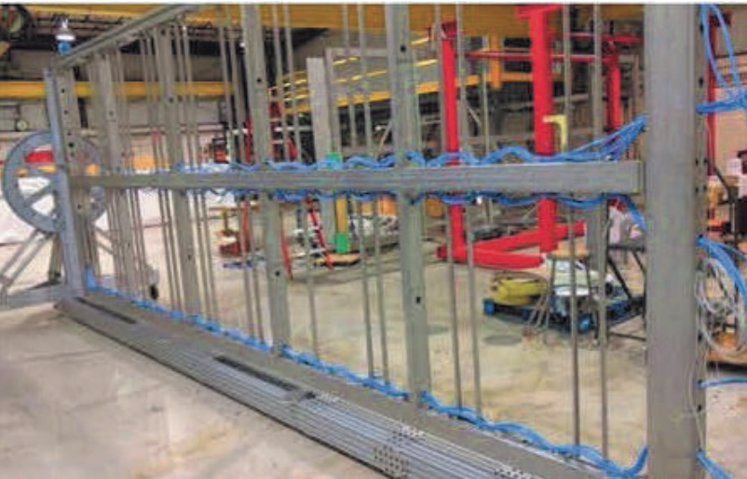
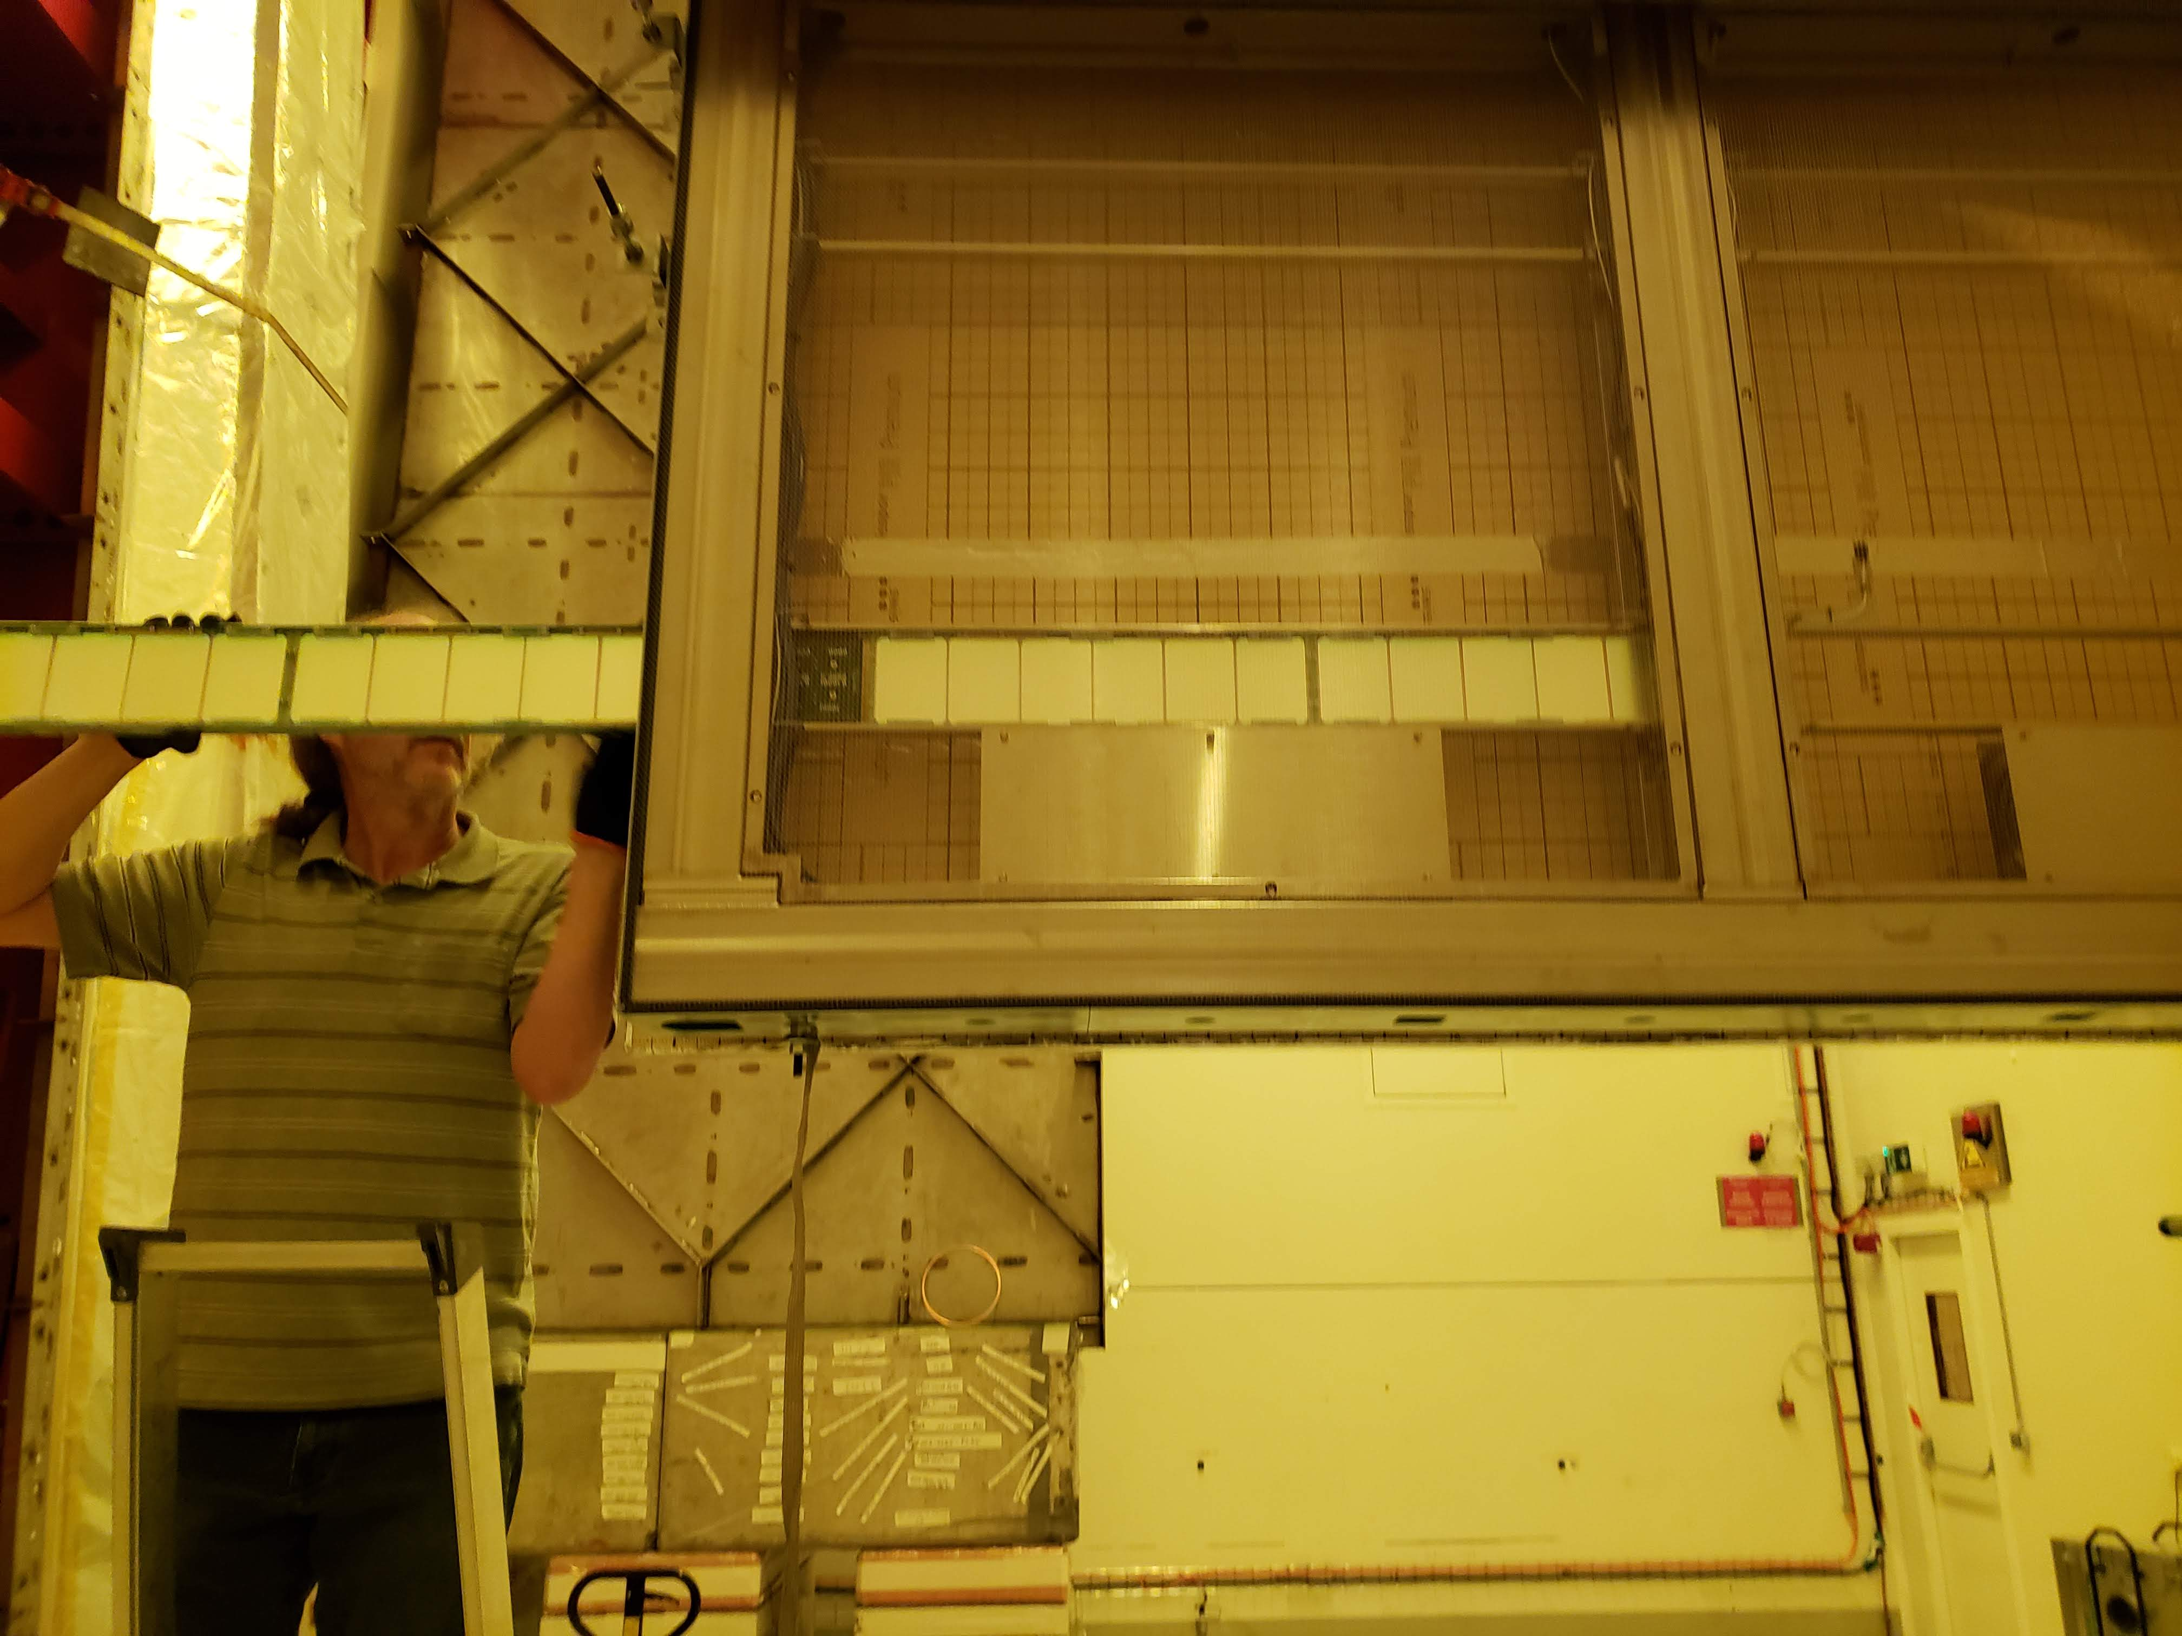
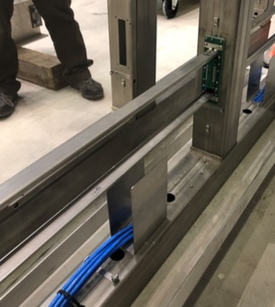
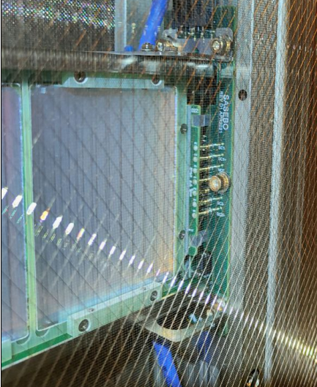
PD Support Rail/Cable Scope
PD rail cables to support PD modules inside the APA (10 per APA, 1,500 total)
Bottom APA configuration readout cables (75 sets)
Top APA configuration PD readout cables (75 sets)
Top APA configuration PD signal pass-through cables (75 sets)
Must be installed in APA prior to wire wrapping
PD Rail Assemblies

Slide 5
121.FDC.05.02 FD1 Photon Detector Scope 2/2
Component | Description | Quantity (per 10 kT) | Responsibility
Project Mgt./Technical support | US L2 Manager Consortium Technical lead |  | US/DOE Colorado State
Detector support | Support rails, electrical connectors, cables | 10 per APA. 1,500 total | US/DOE Colorado State
 | Rail assemblies including hardware | 10 per APA. 1,500 total
 | Lower APA configuration readout bundles | 10 lengths. 2 bundles per lower APA 75 High Slot Beam 75 Low Slot Beam
 | Upper APA Signal Cables | 10 lengths. 2 bundles per Upper APA 75 High Slot Beam 75 Low Slot Beam
 | Upper APA Signal Pass-Through Cables | 1 lengths. 2 bundles per Upper APA 75 High Slot Beam 75 Low Slot Beam

Slide 6
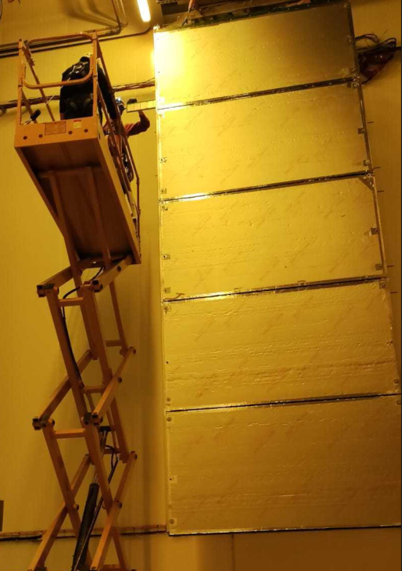
FD1 Photon Detector (PDS) CD-3a Design Status
PD rails and cables have been installed in 4 ProtoDUNE 2 APAs (2 upper-configuration and 2 lower configuration
40 modules successfully installed and tested in CERN cold box
Required readout performance observed
  No interference with APA electronics
Small design improvements made, leading to this refresh review
Full End-to-end readout of SiPMs
(S/N >4)

Slide 7
FD1 Photon Detector (PDS) Interfaces and Installation Documents
The critical interface with APA consortium managed by ICD in EDMS 2088735 v4
  This interface is well-understood due to extensive prototyping at Ash River and in the ProtoDUNE 2 installation.
  The PD rail/cable system was included in the already-completed APA PRR.
  This refresher PRR is needed due to small design changes due to interferences discovered during ProtoDUNE 2 installation. Updated documents will be posted to EDMS 2088735 v5 w
The Installation documents between the APA consortium managed in EDMS 2703961 v5
  The procedure is well-understood due ProtoDUNE experience
  Changes to the installation procedure are required due to the design revisions mentioned above. Updated documents will be posted to EDMS 2088735 v6 when available

Slide 8
PD cable issues
Two channels (one channel per supercell) in APA 2 were observed to have no connection when installed into APA.
  We have tested 3 APAs at this point (120 channels, 80 cold tested) and have only seen these 2 channels.
  One channel recovered when in the cold box, one did not.
  (PD non-conformity report being generated as part of QC record).
A site visit to Daresbury the week of July 25 2022 was conducted to trace potential issues.
Four lessons learned:
  Interference between cable clips and PD cable connector require re-design of tie-down points.
  Additional strain relief required to support PD cable connectors.
  Procedure changed to have continuity check of cables AFTER cinching down cable ties.

Slide 9
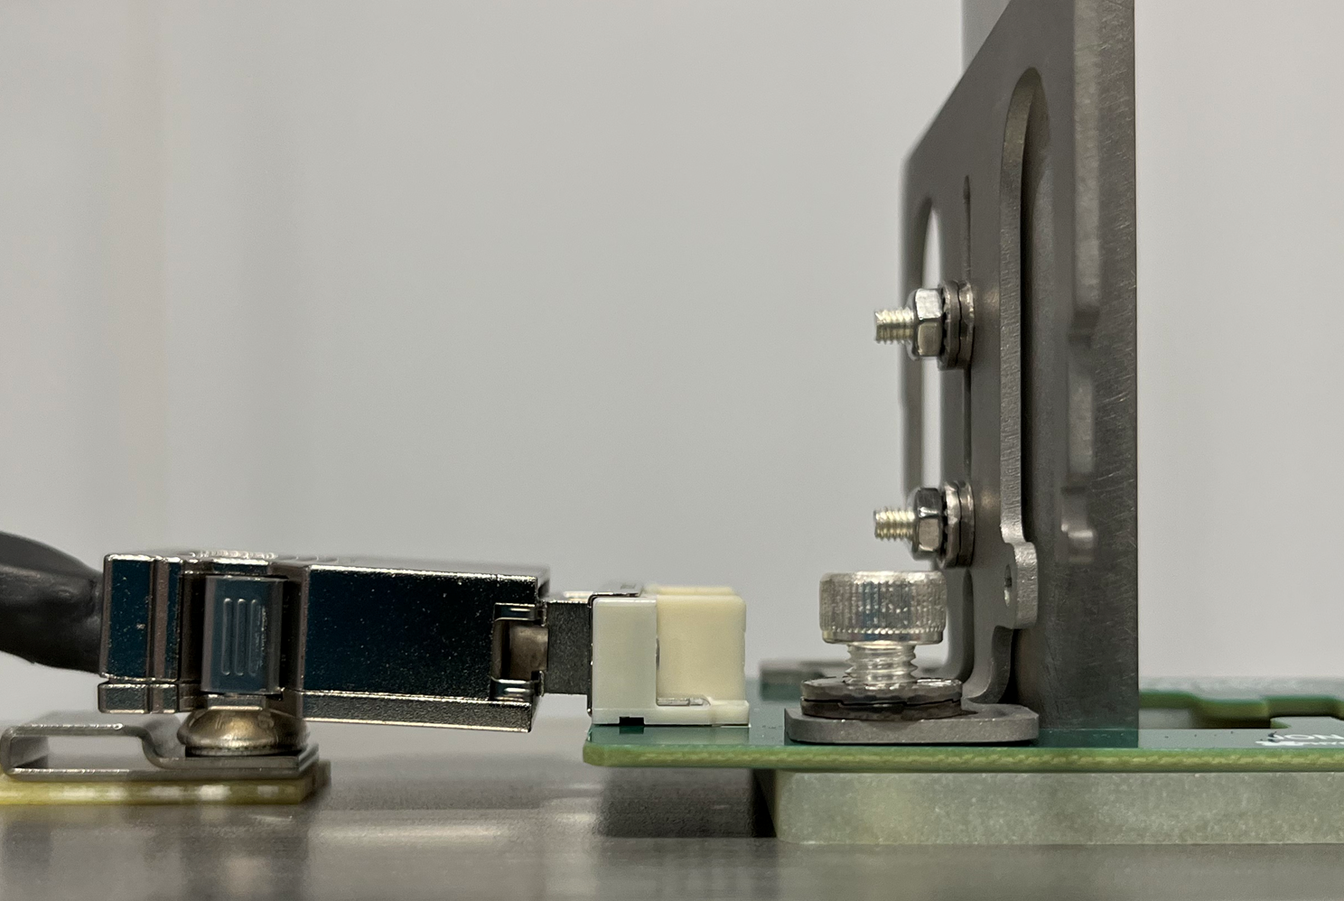
Significant (~2mm) PD cable interference with temperature sensor and cable tie clip (Upper APA only)

Slide 10
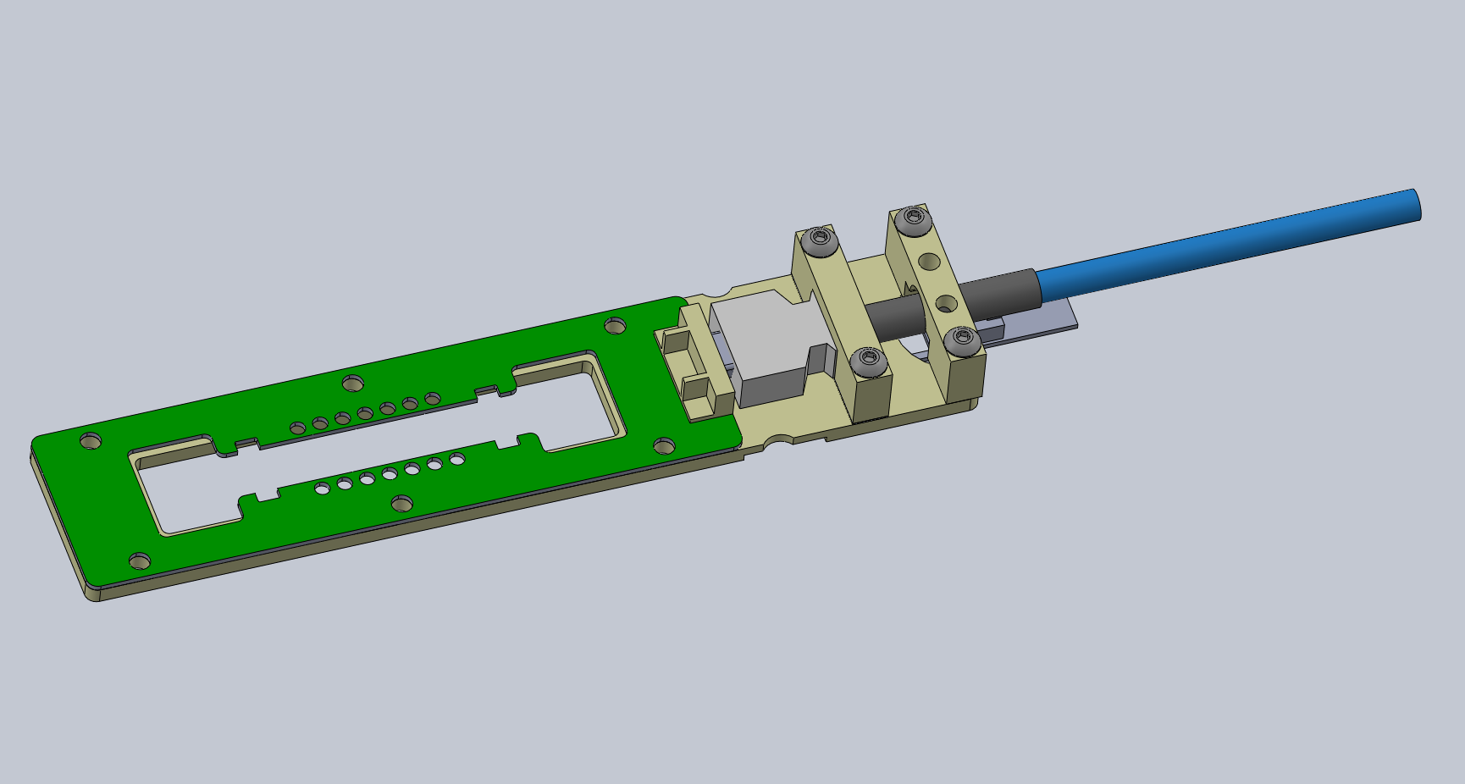
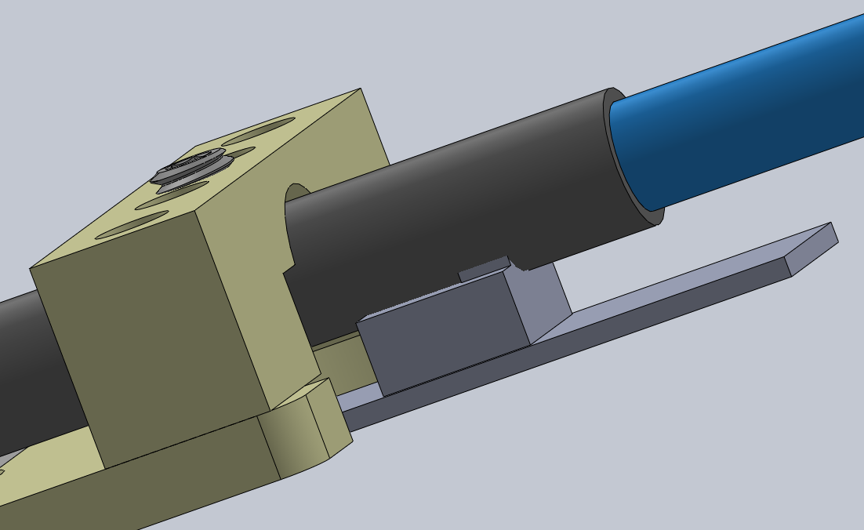
New PD cable strain relief (prototype August 2022)

Slide 11
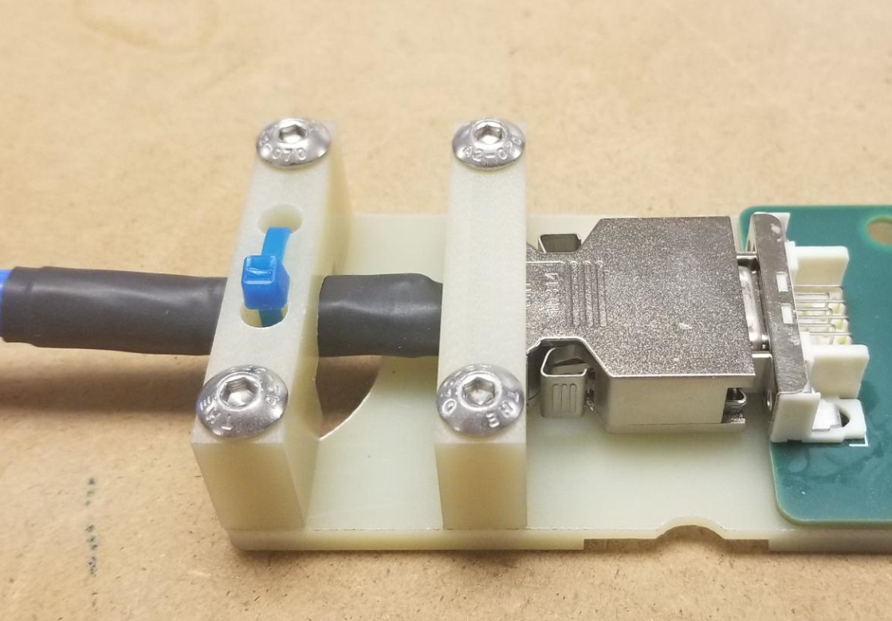
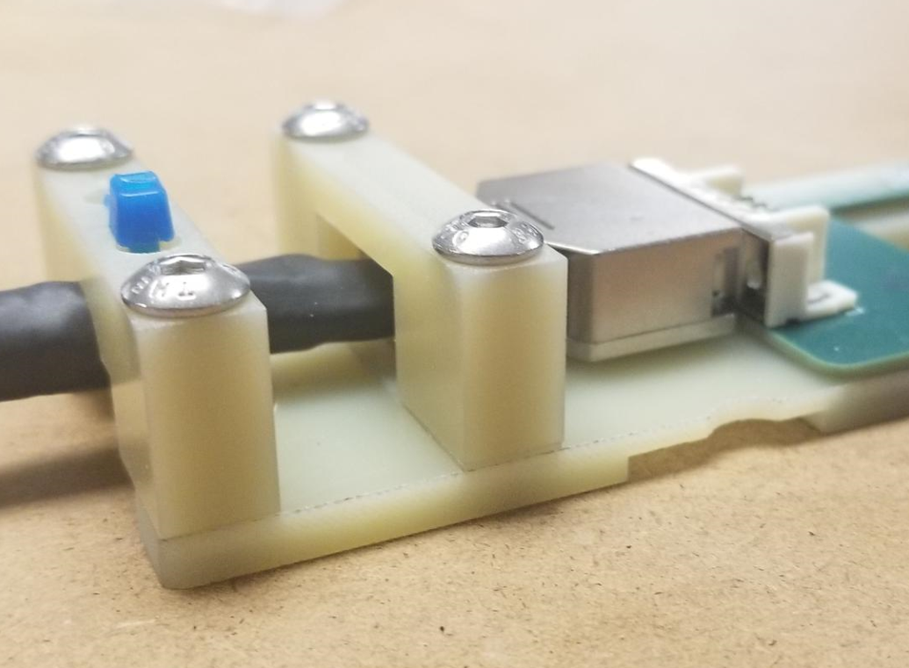
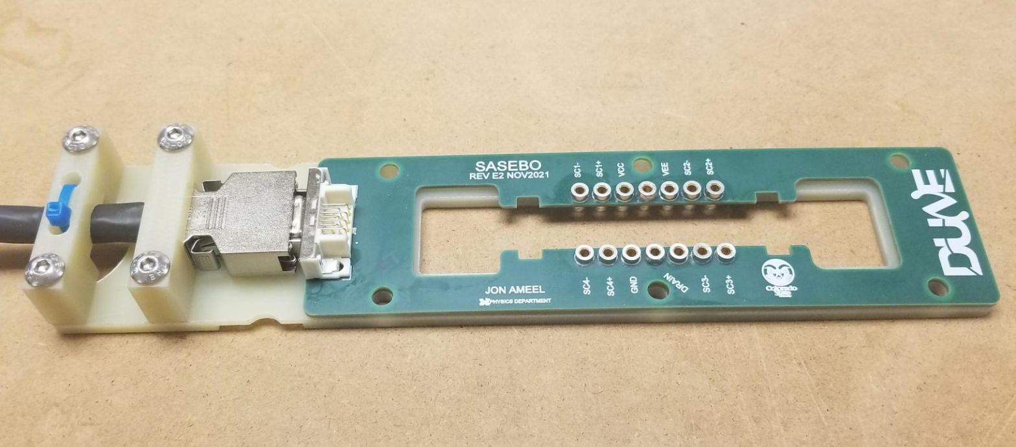

Slide 12
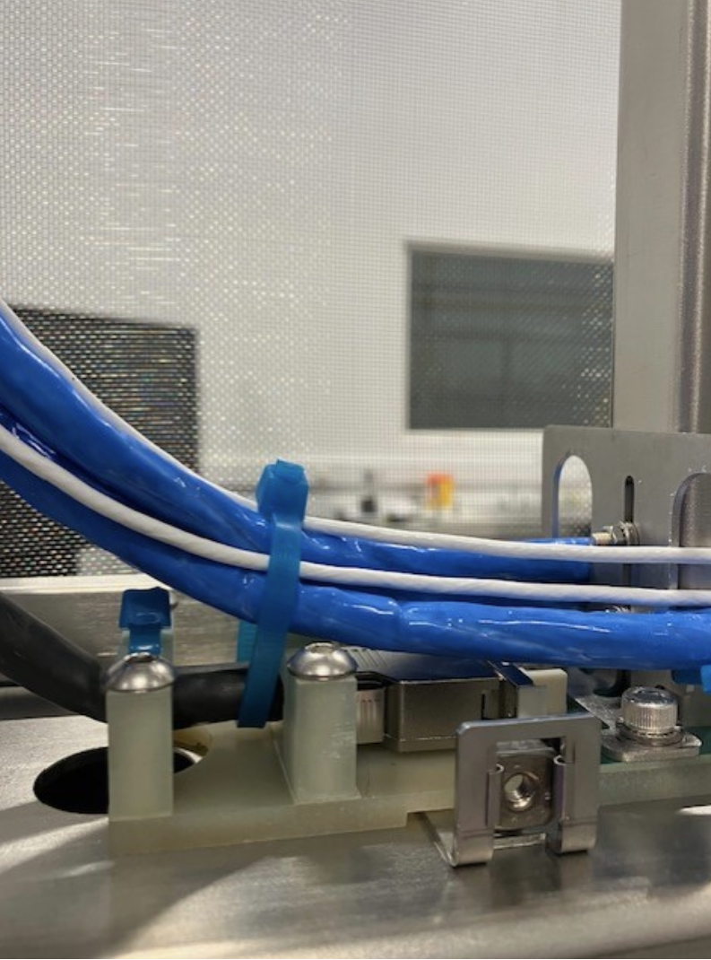
New Connector Support Tested in APA
40 sets of the new-design connector support sent to Daresbury for test installations.
Initial testing looks very promising.
Will be tested in CERN cold box spring 2023.
Procedures and interface documents being modified to reflect new design.

Slide 13
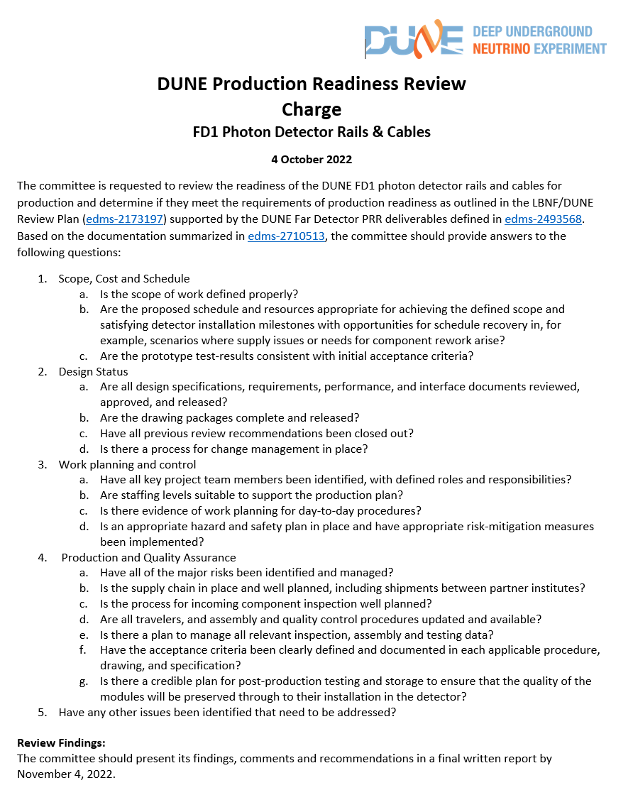
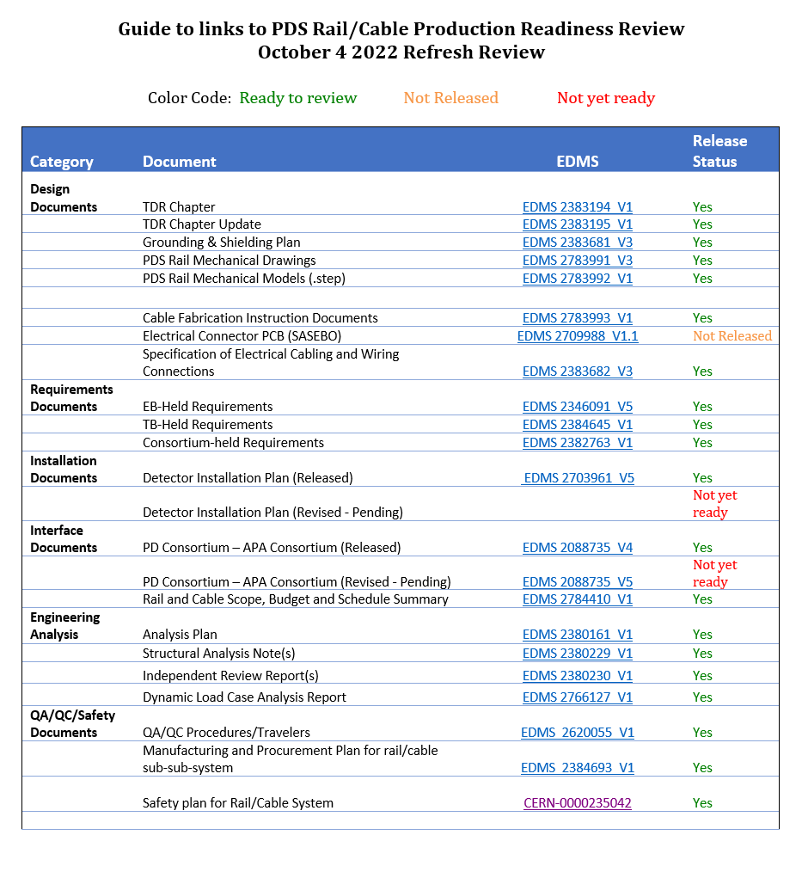
Review Charge with Links
Q1
Q1
Q2
Q2
Q2
Q2
Q2
Q2
Q1
Q1
Q1
Q3
Q3
Q3
Q3
Q1, Q3
Q1
Q1
Q1
Q1
Q4
Q4
Q3
Q5: See this talk

Slide 14
Drawings, Engineering and Procedures
The following documentation can be found in the guide document to EDMS:
  A summary document detailing the scope, schedule and planned labor.
  A full set of drawings (in .pds) and solid models (in .step) formats.
  Interface drawings are contained in the Interface Control Document, which will be updated shortly (by 10/15/22).
  Mechanical and cable assembly procedures.
  Full documentation of the PDS Rail and cable QC plan.
Compliance office review of the PDS rail design underway.
Should conclude as part of this review.
Static, thermal and dynamic load cases were examined:
  PD rail angles DO NOT PASS the APA drop load case. This was mitigated by stringent handling conditions imposed on APA shopping.

Slide 15
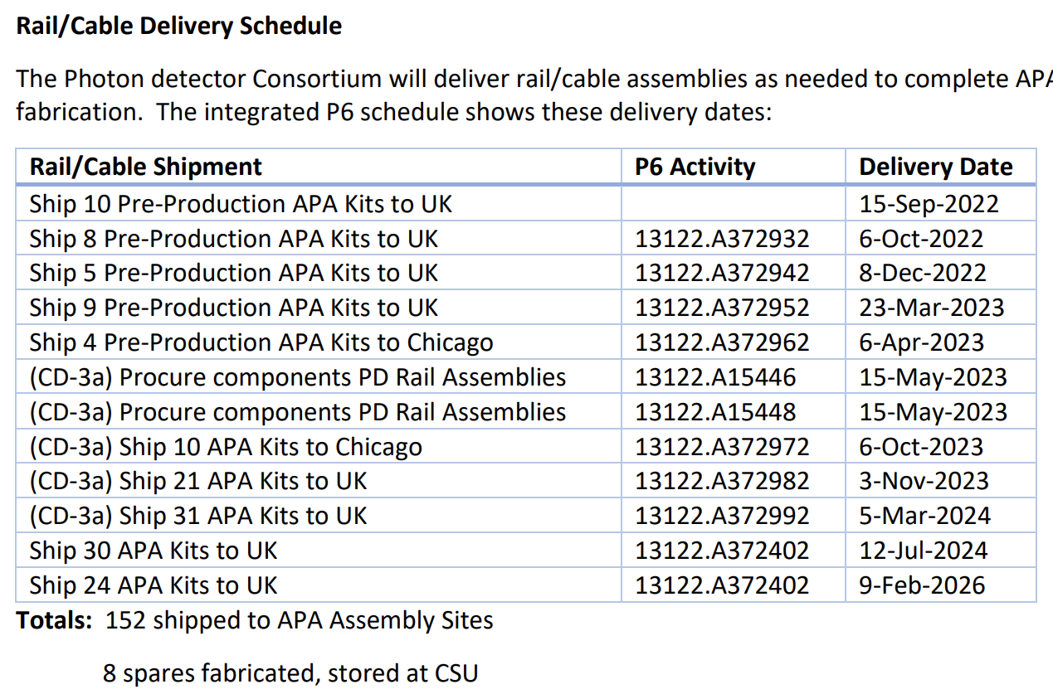
Production schedule (tied to APA fabrication in P6)

Slide 16
Summary:
Documentation has been provided to the committee to respond to the charge document:
  We understand the scope, cost and schedule.
  The design is complete, including procedures and QC procedures and travelers
    N.b.: The new cable containment brackets still need to be included in the interface and assembly procedures
  Work planning is well understood with procedure documents and schedule.
    Cost is well documented in P6.
  A production and quality control plan is available in EDMS.
  Additional problems identified during ProtoDUNE II have been identified and addressed, and included in the PDS plan.

