Slide 1
DUNE Education and Outreach Committee
Committee
Matteus Carneiro (BNL)
Linda Cremonesi (QMUL)
Kirsty Duffy (Fermilab)
Maxine Hronek (Fermilab)
Helio da Motta (CBPF)
Albert de Roeck (CERN)
Kate Shaw (Sussex) chair
Mailing list: dune-outreach@listserv.fnal.gov
Email: dune-outreach@fnal.gov
Discussion points:
How often to hold meetings
Committee, any new people to join
Should we setup some roles in the group?

Slide 2
DUNE Education and Outreach Committee
The responsibilities of the EOC include:
1 Initiate, plan, and organize education and outreach activities related to DUNE science goals and technologies. 2 Work with the Fermilab Communications team to develop material communicating DUNE science to the public, including DUNE’s public web presence. 3 Maintain the social media presence of the DUNE Collaboration. 4 Coordinate education and outreach activities with other collaborations. 5 Centrally support local DUNE education and outreach activities organized by DUNE collaborators at an appropriate level. 6 Approve centrally used DUNE education and outreach material.

Slide 3
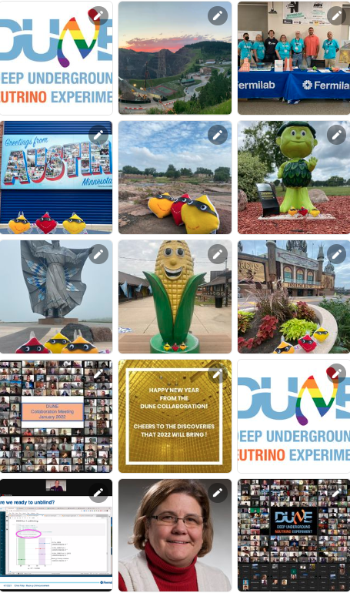
DUNE Education and Outreach Committee
Discussion points
1 Initiate, plan, and organize education and outreach activities related to DUNE science goals and technologies.
Communicate, involve more of the collaboration
Create a E&O Strategy together
2 Work with the Fermilab Communications team to develop material communicating DUNE science to the public, including DUNE’s public web presence.
3 Maintain the social media presence of the DUNE Collaboration.
Content development, multimedia
Communications Strategy
Social Media Strategy, campaigns

Slide 4
DUNE Education and Outreach Committee
Discussion points
4 Coordinate education and outreach activities with other collaborations.
5 Centrally support local DUNE education and outreach activities organized by DUNE collaborators at an appropriate level.
6 Approve centrally used DUNE education and outreach material.
Strategy to include collaboration engagement
Resource and material development
Host material, strategy on wiki/website
Give regular updates and host open outreach sessions

Slide 5
DUNE Education and Outreach Committee
Strategy
Events and Activities – Online and In-person events
SURF Neutrino Day
Communications and Social Media
Items, news, campaigns/ Int Days for webpage/Web
Twitter, Facebook, YouTube
DUNE videos
Materials and Resources
Online content, multimedia, images, videos, gifs, banners
Models, Lego
Brochures and written content

