Slide 1
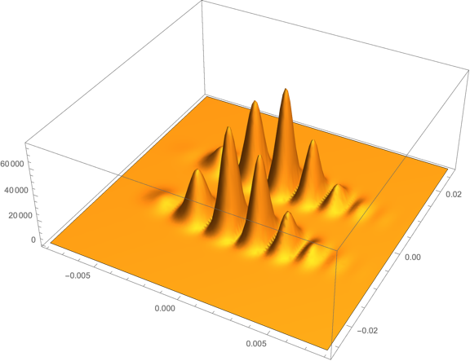
MAGIS-100: Towards a Proposed Offline Organization - Update

Slide 2
Straw Org Chart from Last Time
Offline Coordinating Group (OCG)
appointed by MAGIS Management
OCG Lead
Offline Infrastructure Coordinator
Analysis Tools
Coordinator
Simulations
Coordinator
Liasion to Online
Physics Coordinator
Some points raised in the discussion on Sept 14th
Good to have two co-coordinators for some of the boxes.
The Analysis and Simulations coordinator boxes could be combines initially (with two co-coordinators) and split later, as needed.
These organization tasks would be good for some of the younger folks in the collaboration … opportunity to grow.

Slide 3
Updated Proposed Org
Offline Coordinating Group (OCG)
appointed by MAGIS Management
OCG Lead
Offline Infrastructure Co-Coordinator 1
Co-Coordinator 2
Analysis Tools & Simulations
Co-Coordinator 1
Co-Coordinator 2
Liasion to Online
Physics Coordinator
NOTES
Offline Infrastructure: One of the co-coordinators should be designated the primary POC to the Fermilab Computing Div. This should probably be a Fermilab person.
The Analysis Tools & Simulations box might eventually be split into two separate boxes. … as needed. This should be kept in mind when appointing the co-coordinators. First job of these coordinators is to assess need to split in two.
In the short term, the Physics Coordinator box is a placeholder … probably not needed until later.
The Liaison to the Online activities should be appointed by those responsible for organizing the online software & infrastructure.

