Slide 1
ICARUS
Commissioning and Operations
C. Montanari
FNAL – INFN Pavia
SBN Oversight Board Meeting - December 9, 2022

Slide 2
Detector status
  The activities planned at the end of the summer shutdown were interrupted by a fire that occurred on September 14, during the regeneration of the West module liquid recirculation filters.
    Some multi-layer superinsulation was destroyed by the fire and a thin layer of soot covered most of the equipment, including the readout electronics. Some cables, connecting cryogenic equipment, and some other minor objects were damaged by the fire.
    Clean-ups and replacements took about 4 weeks, including completion of the filters regeneration.
    The detector was brought back to normal operation around mid October with the free electrons lifetime in the East module at about 1 ms, while we had to wait for the return of the recirculation pump from Barber-Nichols, at the beginning of November, to restart the liquid recirculation in the West module.

Slide 3
LAr purity as of December 2, 2022
  The free electrons lifetime in the two modules, as measured at 11:00 am of December 2, 2022 was:
    WEST module: 6.6 ms
    EAST module: 3.4 ms
  The purity has been steadily improving in both modules, with a linear and relatively slow trend in the EAST module, while the trend in the WEST module slope, exponentially increasing after the restart of the liquid recirculation, is presently flattening out at about 7 ms lifetime.
  Periodic venting of both modules is required to improve the LAr purity (4 vents of 10 minutes / day / module).

Slide 4
Free electrons lifetime trend in the WEST module
  A simple recirculation model, based on the measured values of recirculation speed and impurities input, predicts an asymptotic value of about 5.3 ms.
  The measured trend is faster than the prediction and has already reached 6.8 ms.
● - Data
● - Calculated from simple recirculation model
Free Electrons Lifetime (ms)
Elapsed time (hours)
Nov 6, 2022
Dec 2, 2022
DEC 11, 2022

Slide 5
Free electrons lifetime trend in the WEST module
  A simple recirculation model, based on the measured values of recirculation speed and impurities input, predicts an asymptotic value of about 5.3 ms.
  The measured trend is faster than the prediction and has already reached 6.6 ms.
● - Data
● - Calculated from simple recirculation model
Free Electrons Lifetime (ms)
Elapsed time (hours)
Nov 6, 2022
Dec 2, 2022
DEC 11, 2022

Slide 6
Free electrons lifetime trend in the EAST module
  EAST module’s lifetime is increasing linearly, since the venting was regularized.
  The present increase rate is about 0.3 ms / 10 days
  This trend appears to be slowly flattening out.
Free Electrons Lifetime (ms)
Elapsed time (hours)
Nov 6, 2022
DEC 11, 2022

Slide 7
Neutrino data taking
  Following the discussion in the ICARUS Executive Board, last November 14th, a technical meeting was held, on November 23rd, to verify the status of the various sub-systems in relation to the start of continuous data taking with the beams.
  All sub-systems (Cryogenics and purification, TPC, PMTs, DAQ, Trigger, …) have declared their readiness to start continuous data taking.
  Start of Run 2 has been confirmed by the ICARUS Executive Board on November 30, 2022.
  Some optimization activities are also planned:
    PMTs require a gain re-calibration: this is a process that takes place in parallel with the data taking and does not prevent it. It impacts the trigger energy threshold.
    PMTs will eventually require a laser calibration, with dedicated runs of short duration. Laser runs have recently being performed. No impact on acquired data.
    Some TPC readout boards on the corner chimneys will be replaced with others equipped with improved noise filters. This will require an interruption of the data taking for few hours.

Slide 8
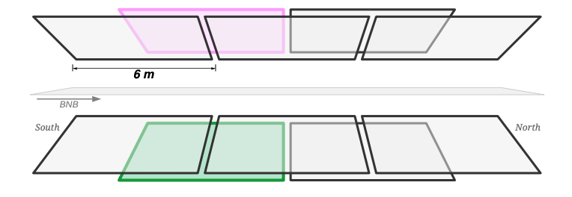
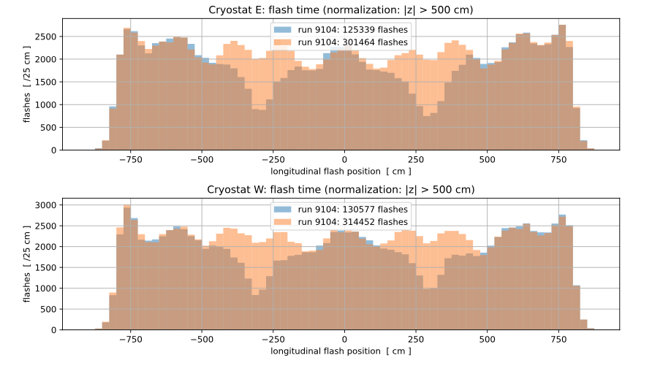
Trigger developments during the summer shutdown
The standard trigger logic used in Run1 presented some inefficiencies in recording the cosmic rays out-of- spill with PMT pair majority Mj> 10 as detected along the beam coordinate (z). This fact is related to cosmic rays
crossing near the border of two adjacent 6 m windows.
In order to mitigate this effect a new “overlapping window” logic has been adopted, introducing two new 6 m windows partially superposed along z to the original ones.
Moreover, specific tests are being performed to lower the majority level for out-of-spill triggers from 10 to 5/6 PMT pairs, increasing the detection efficiency for the cosmic rays.
Cosmic rays: Mj= 10
3 windows
5 overlapping windows
Both these changes, resulting in a more efficient/uniform trigger, have been implemented in the default trigger for physics.

Slide 9
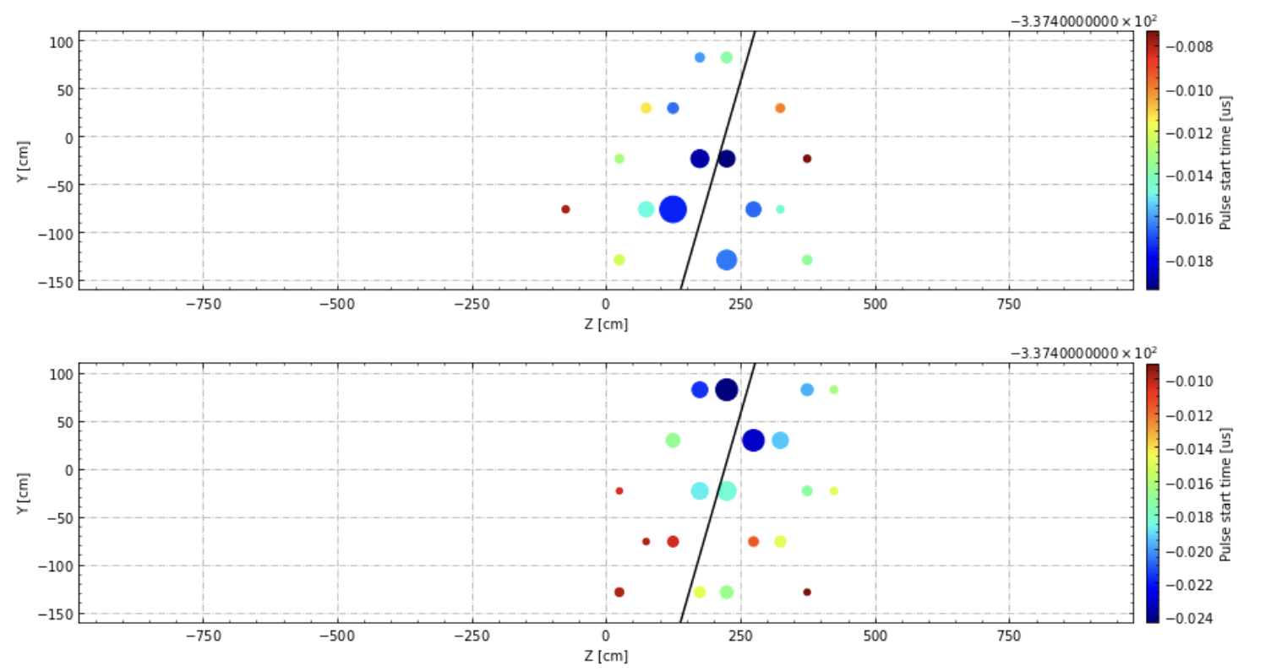
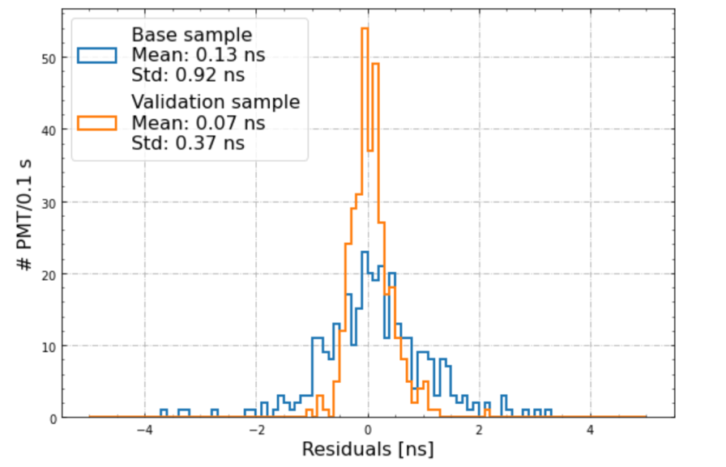
PMTs timing calibration
late
East
Up
A PMT time resolution of ~1 ns is crucial to exploit particle TOF and the bunched structure of BNB spill.
The transit time of each individual PMT is obtained by flashing it with a laser and measuring the delay w.r.t. the reference laser start time.
This time reconstruction is checked with ~vertical cosmic muons, by performing a linear fit of time vs. y coordinate. The residual of each PMT w.r.t. the fit is then computed.
Down
early
late
West
Up
Down
early
Z coord. (cm)
Base μ sample:
<>=0.13 ns
σ=0.9 ns
Validation
sample:
<>=0.07 ns
σ=0.37 ns
These residuals are then used for a finer correction (σ~1ns) of each PMT’s transit time
Iterating the procedure on another independent cosmic muon sample, the resolution improves to ~0.4 ns
# of PMTs/0.1 ns
Average residuals from μ procedure (ns):

Slide 10
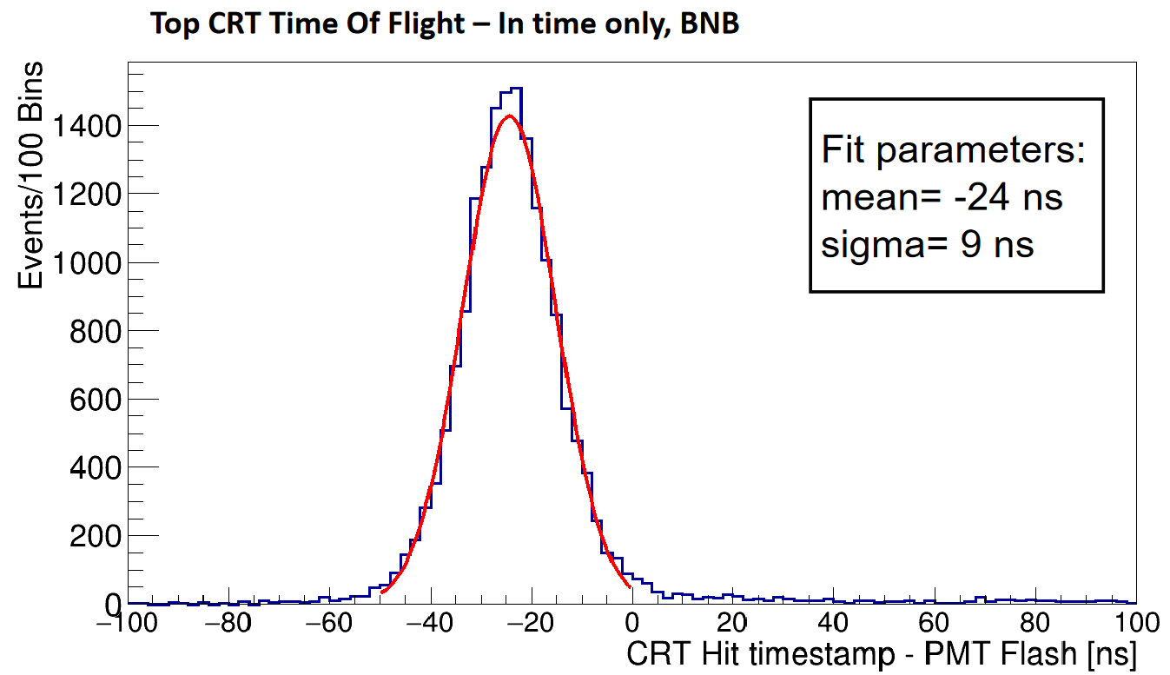
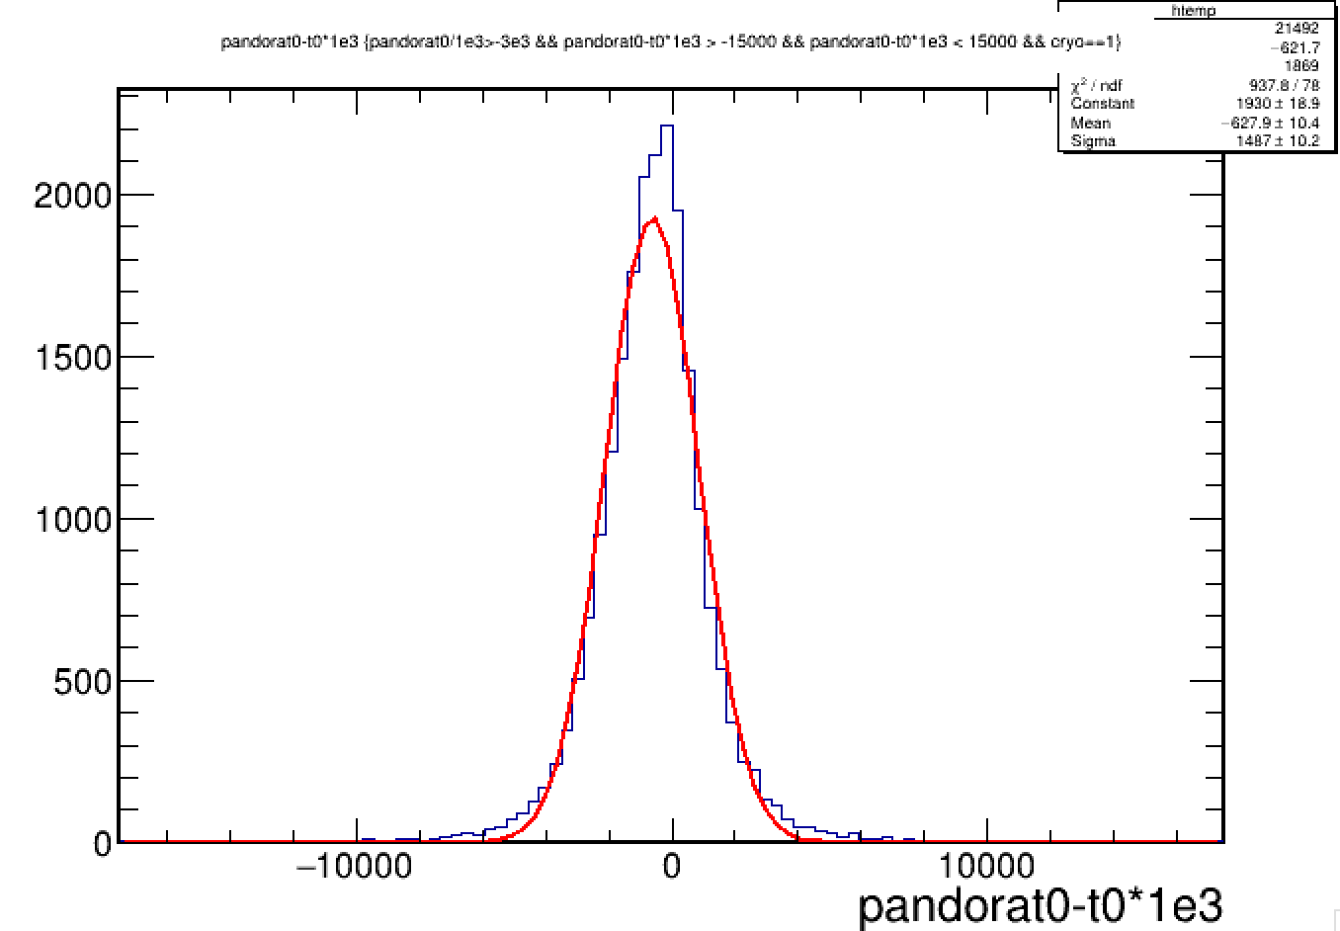
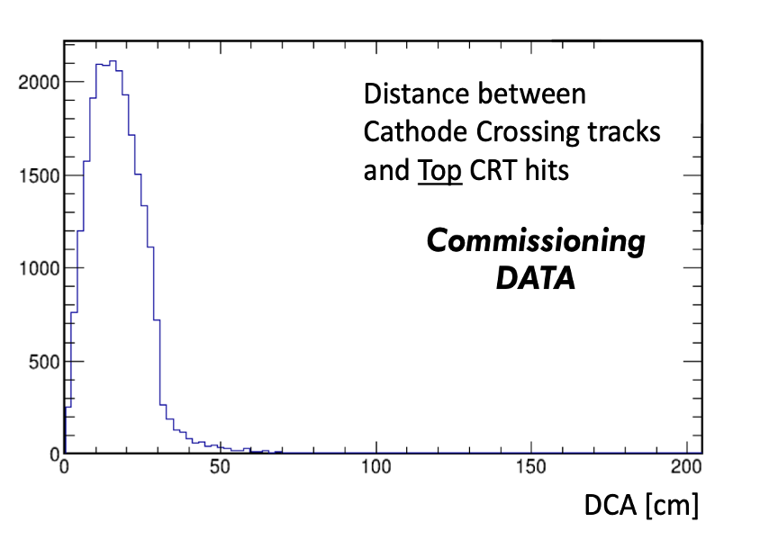
CRT matching with PMTs and TPC
Top CRT-PMT time difference
CRT time offset has been corrected for: it is now possible to match CRT signals in time with both PMT and TPC.
The time difference between top CRT and internal PMTs shows a clear peak for incoming cosmics: the width ~9 ns includes both intrinsic resolution and geometrical variance.
Matching with the TPC was checked with cathode-crossing cosmic muons resulting in σ~1.5 μs dominated by the TPC resolution.
ICARUS Preliminary
t_{CRT}-t_{PMT} (ns)
CRT-TPC time difference for West cryo
Cathode crossing cosmic muons
ICARUS Preliminary
σ~1.5 μs
Matching in space (distance of closest approach, SBND algorithm) with cathode-crossing cosmic μs

Slide 11
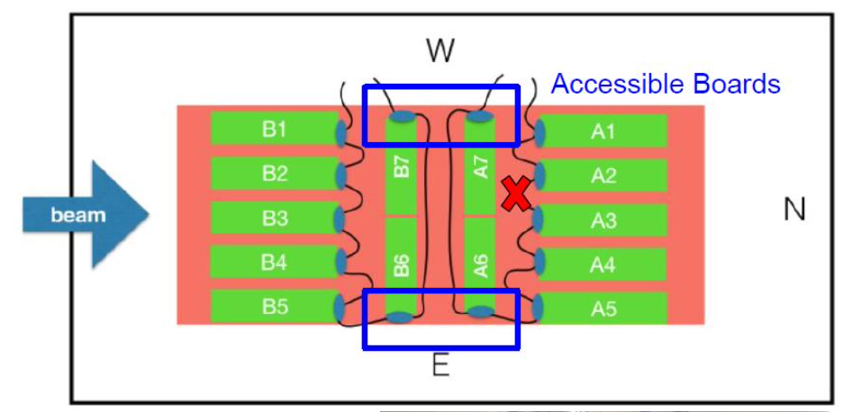
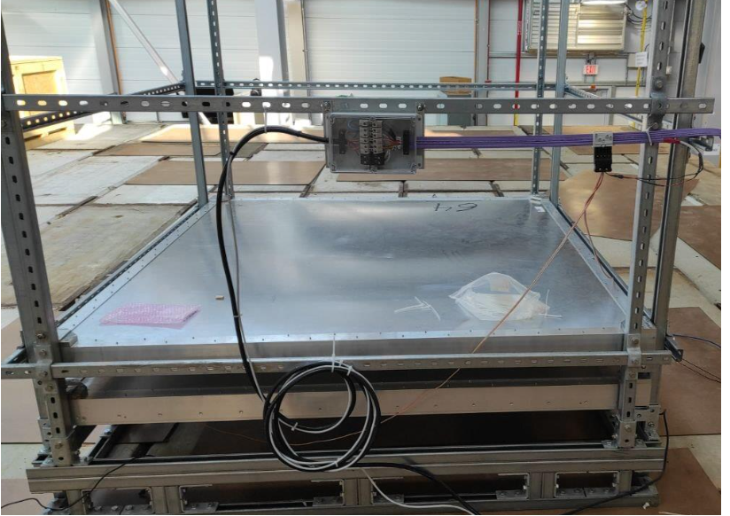
Other activities during the summer shutdown
  DAQ improvements: several issues in the data acquisition were debugged and fixed. This allowed to run calibration campaigns at high rate (~4 Hz) with high DAQ stability. Logging was also improved. Studies of data compression are ongoing.
  Bottom CRT acquisition: part of bottom CRT, damaged by a flood in 2019, was repaired and data can be recorded. DAQ is still standalone, integration into general ICARUS system is ongoing.
  Top CRT telescope: two spare CRT modules have been connected and placed on top of overburden. They will create a movable “telescope” to select cosmics in particular locations. The telescope is fully integrated into the ICARUS DAQ
  Monitoring tools have been improved!
Accessed bottom CRT boards
Top CRT telescope

Slide 12
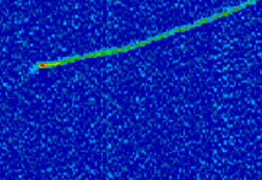
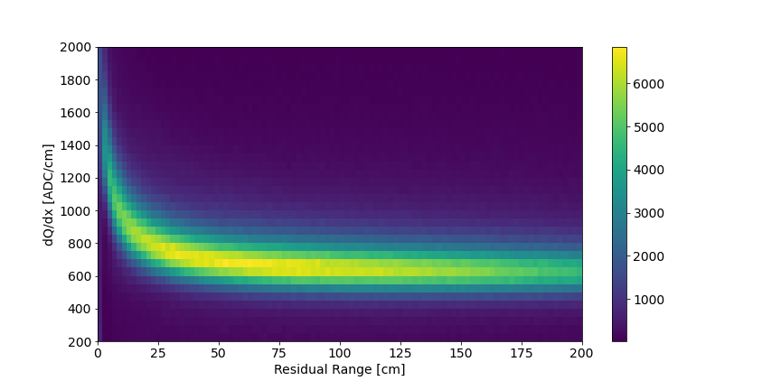
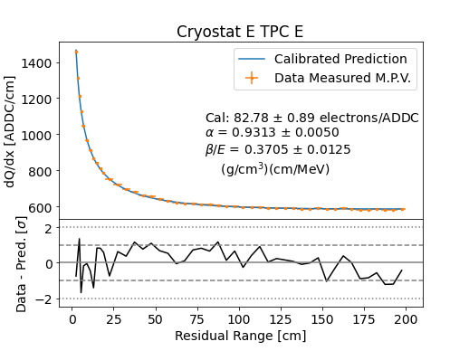
TPC Wire signal calibration
A full calibration chain has been developed, based on the study of the ionization vs residual range for cosmic muons crossing the cathode and stopping/decaying in active LAr.
Bragg peak
It allows to
  correct for the electron lifetime
  equalize the electronic response over the full detector
  calibrate the absolute energy scale
  improve modeling of e- recombination, diffusion, space charge, wire field response
Stopping Muon Event
(First Induction Plane)
dQ/dx vs. Residual Range
Stopping Muons
dQ/dx vs. Residual Range

Slide 13
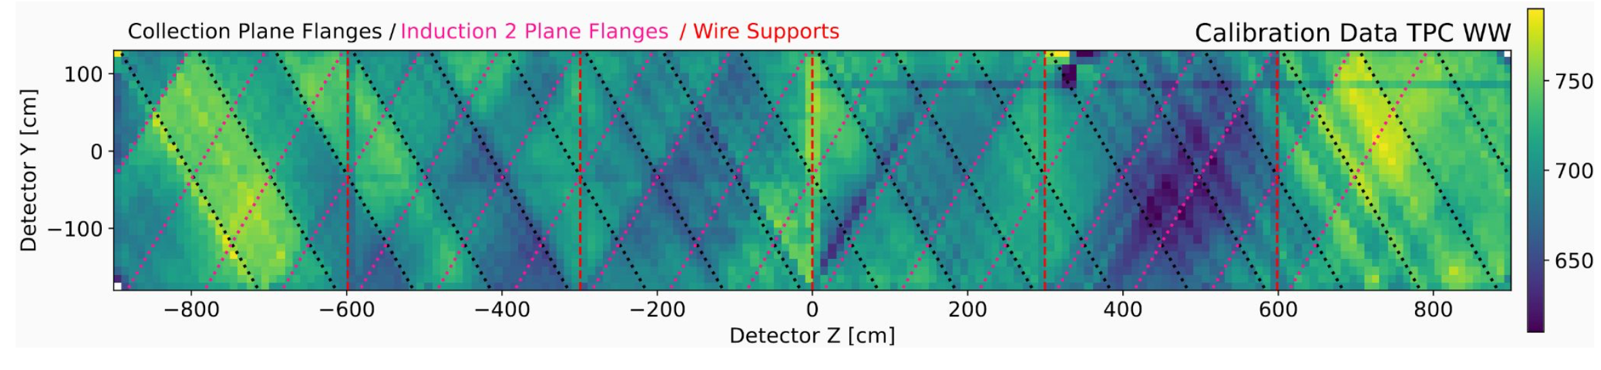
TPC energy response non-uniformity
Cosmic muon dQ/dx has shown some dis-uniformities in y-z plane within a 8% spread:
  They seem to ~ follow the direction of Induction 2 and Collection wires, and appear very stable in time;
  The hypothesis is that they reflect variations in wire transparency of one or both Induction planes, possibly due to bias voltage differences.
Plot shows Collection wire plane in WW TPC.
In order to test this hypothesis, a very large calibration campaign has been conducted with cosmic rays during the summer shutdown, taking data with different wire bias voltages and/or lower electric field in the drift volume.
A calibration procedure is being developed to correct for these non-uniformities

Slide 14
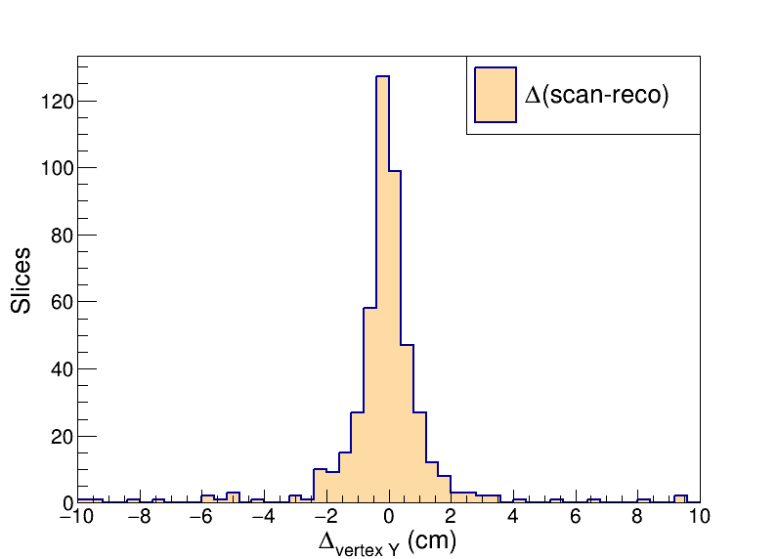
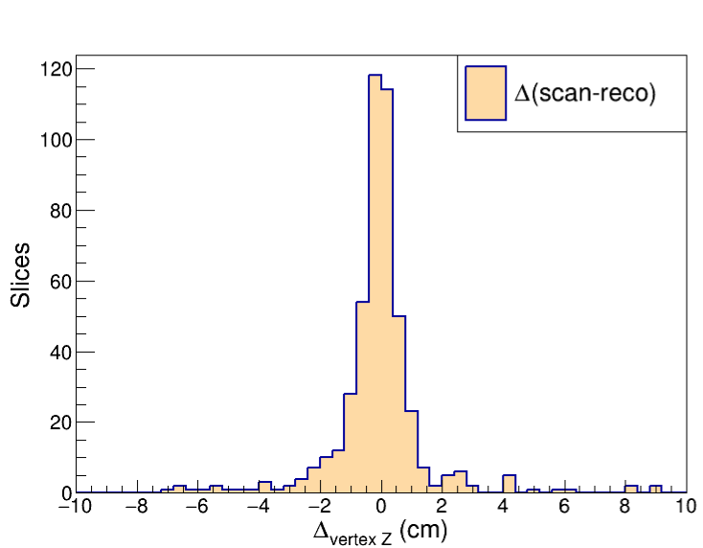
TPC events reconstruction
Quality of the automatic (Pandora-based) pattern recognition of both vertices and tracks in the TPC is being validated by comparison with visual scanning
A first sample of ~600 νμCC interactions from BNB has been analyzed:
  ~61% of them are “good matches” (automatic reconstruction well matched to scanned events for both the 3D neutrino vertex position and 3D muon track length).
  ~25% “almost good matches” (the vertex is well reconstructed but the muon track is not – often “broken” in two or more pieces).
  ~14% are not recognized by the pattern recognition procedure.
Difference Δy of vertical coordinate y between automatic and manual measurement
Residual reconstruction failures are being studied in detail
Alternative algorithms for matching between wire planes and track “stitching” are being developed
ν vertex
μ end point
Δy (cm)
Δy (cm)

Slide 15
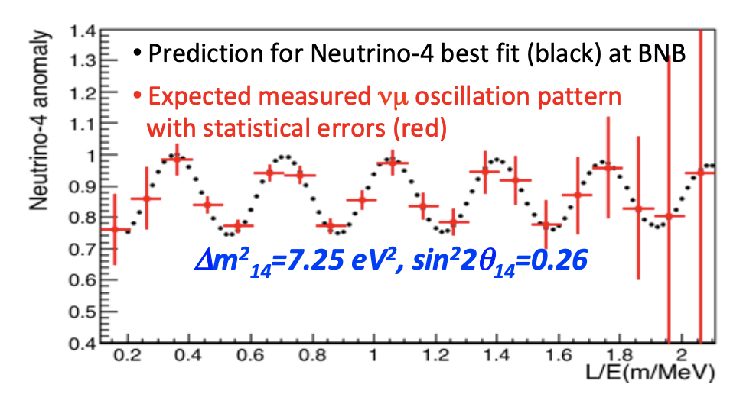
Neutrino-4 analysis
The first ICARUS-only analysis will verify the Neutrino-4 claim (Phys. Atom. Nuclei 83 930-936 (2020)) by looking at fully contained νμCC QE events from BNB
The oscillatory pattern can be visible in ~3 months (~7 10¹⁹ pot), corresponding to ~8500 such events (with μ longer than 50 cm).
In the same time ~200k in spill cosmics are expected. A selection and cosmic rejection procedure is set up, taking advantage of information from all subdetectors:
  Pandora will identify neutrino candidates in TPC and reject “clear cosmics”;
  Matching of wire and PMT signals will identify in-spill and reject out-of-time events;
  CRT will tag incoming cosmic rays;
  Detailed localization of the primary vertex will allow definition of a fiducial volume (25 cm from sides, 30 (50) from upstream (downstream) wall) and identify particles outgoing from the vertex.

Slide 16
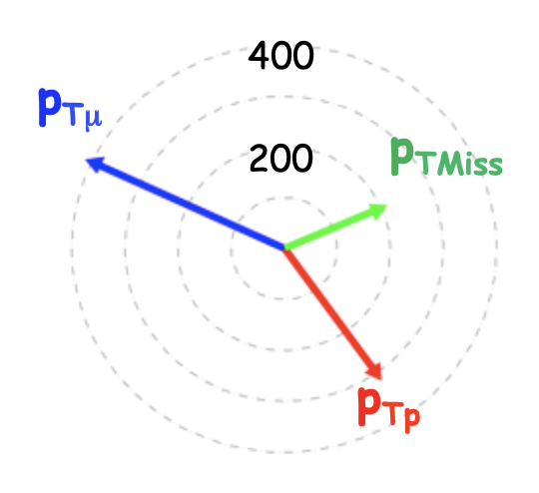
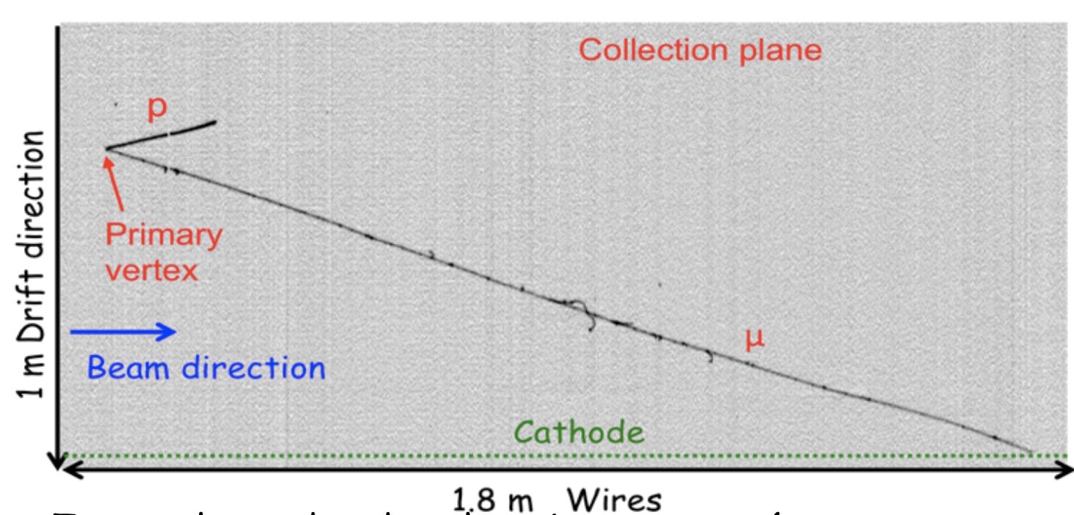
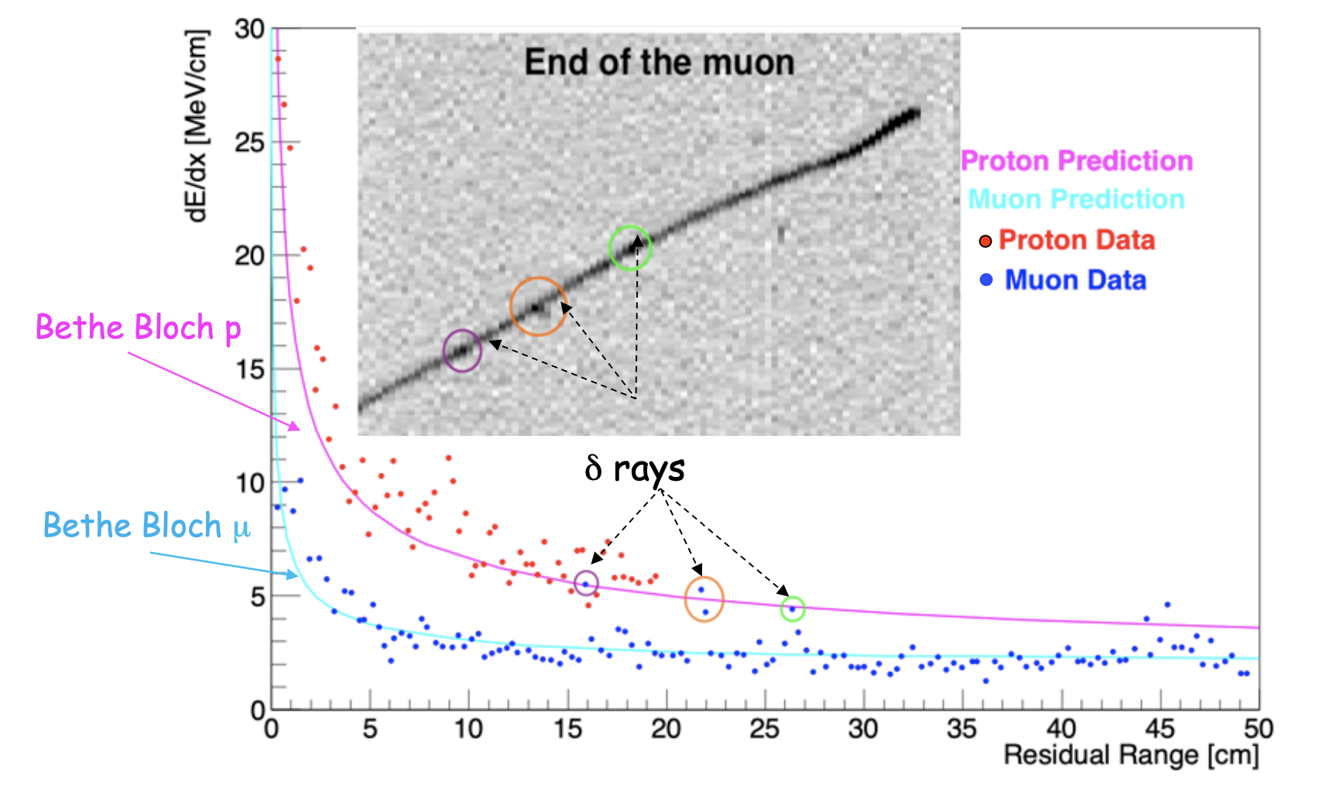
Example of a selected candidate for Neutrino-4 analysis
μ (3.8m, stopping) and p (20cm) produced at primary vertex
Total deposited energy ~1.1 GeV
Transverse momentum ~200 MeV (~8º wrt beam)
The present calibration allows an effective PID based on dE/dx vs. range
Both proton and muon hits are clearly distinguished
Delta rays along the μ track are also identified

Slide 17
Conclusions
  At present, the operating conditions have recovered from the consequences of the filters regeneration and the fire occurred on September 14. In terms of LAr purity and detector stability, they are not significantly different from those of the last neutrino run, before the summer shutdown, when we declared that we were ready to take data for physics.
  Several activities planned for the summer shutdown have been successfully completed. These included calibrations and developments on various sub-detectors: TPC, PMTs, CRT, Trigger.
  Data analysis and reconstruction activities have made significant progress toward the short term goals of automatic event selection and reconstruction in view of the Neutrino-4 analysis.
  The ICARUS Executive Board has confirmed the conditions were met to start physics Run 2 at the end of November.

