Slide 1
The DUNE FD1-HD HV System: overview, status and plans
Francesco Pietropaolo (CERN)
on behalf of the HVS Consortium
HVS Final Design Review, October 12th, 2022

Slide 2
Outline
FD1-HD HVS design update:
System overview
Evolution since the last PDR (June 2020) and TDR
Value engineering upgrades
Lessons Learnt from Ash River tests and ProtoDUNE-II installation
Structural Safety analysis
QA/QC plans, shipping/installation strategy, schedule
Plans toward Production Readiness Reviews

Slide 3
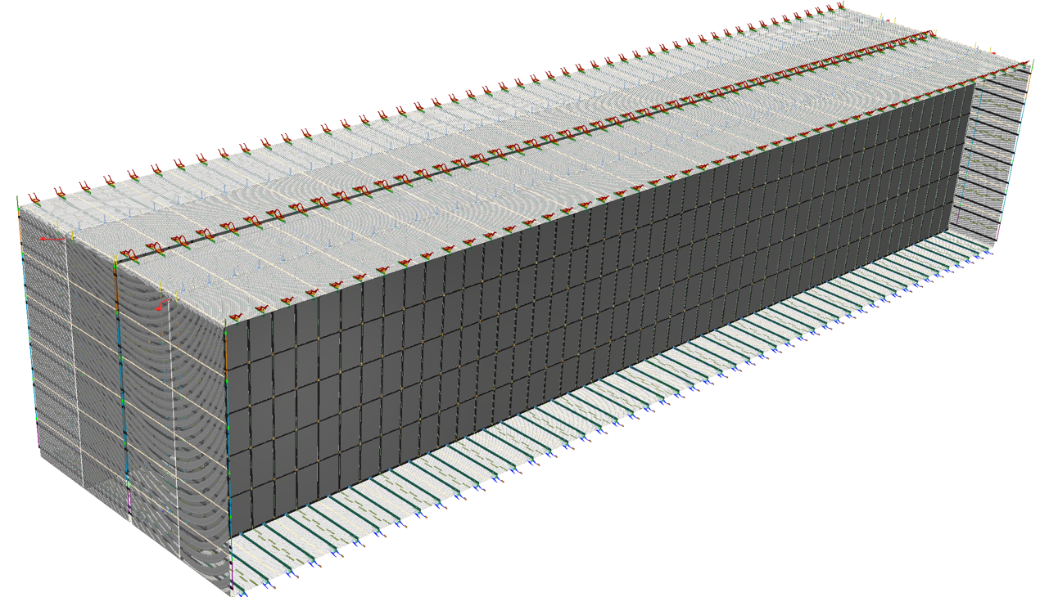
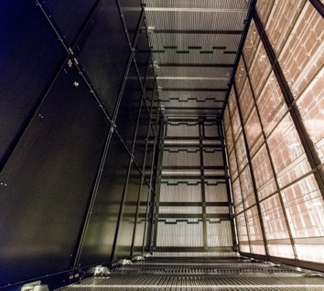
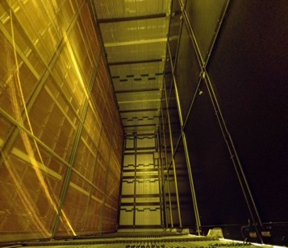
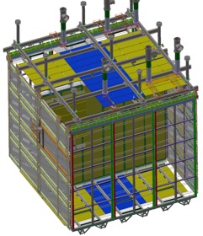
HVS Consortium Scope for the FD1-HD
Design, fabricate, test and assemble:
100 CPA resistive panels forming two cathode arrays (1400m²)
100 top + 100 bottom field cage modules, 48 End Wall field cage modules (2000m²)
2 sets of HV power supplies, cables, ripple filters, and feedthroughs
Digitizers for HVPS and ground plane monitoring
Cameras for HV monitoring
Top Field Cage
CPAs
58m
12m
Endwall Field Cage
Bottom Field Cage
Compared to ProtoDUNE-I:
CPA: 33x
T/B FC: 17x
EW FC: 4x
14m
As part of these calls, we would like to cycle through a series
of thirty minute presentations from the each of the SP consortia. We would like for the first fifteen minutes of each presentation to summarize consortium plans moving forward towards ProtoDUNE-II and the first far detector module. Then, we would like to see the second fifteen minutes of each presentation used to advertise areas in which the consortium could benefit from the participation of additional collaboration institutes. Essentially, the idea would be to present a list of uncovered deliverables with a goal of soliciting additional participation from the collaboration.

Slide 4
HVS Institutional Responsibilities (FD1-HD)
Institutions | Deliverables
CERN | System Design, Requirements, R&D, Data Analysis, HV delivery installation and Monitoring, FC profiles, CPA resistive panels
ANL | System Design & Analysis, QA/QC, CPA production and installation
BNL | System Design & Analysis, Project Management, Interfaces, Cold Cameras
KSU | HV Bus & Interconnects, GP Monitoring System
LSU | Resistive Divider Boards, FC Termination Boards, End Wall Field Cage Production & Installation
SBU | Top Field Cage Production & Installation
UTA | Bottom Field Cage Production & Installation
W&M | CPA Production & Installation

Slide 5
Final Design Review charge questions
The committee should consider:
ID | Description
1 | How design choices satisfy the requirements
2 | The completeness of the documentation of mechanical specifications, including 3D model and the 2D drawings for standard and custom components as well as the Compliance Office evaluation focusing on both safety and the proper application of design codes and standards.
3 | The completeness of the documentation of electrical specifications, including system schematics, drawings, connections, and grounding details.
4 | Whether transportation and installation plans are mature enough to provide assurance that the HVS components, as currently designed, can be safely transported and installed within the detector.
5 | Plans for the further testing of HVS components in ProtoDUNE-II and whether lessons learned from ProtoDUNE-SP and other prototypes have been incorporated within the current design.
6 | If draft documentation detailing plans for procurement, manufacturing, quality control, and part identifiers exists at a sufficient level of maturity for this stage of the design
7 | If project planning materials including interface documents, risk assessments, schedules, and cost estimates exist at a sufficient level of development for this stage of the design.
8 | Whether recommendations from previous reviews have been appropriately addressed.
The HVS consortium believes that all questions have been fully addressed

Slide 6
HVS high level requirements (FD1-HD)
Charge Question #1
ID | Description | Spec (Goal)
SP-FD-1 | Minimum drift field | 250 V/cm (500 V/cm)
SP-FD-11 | Minimum drift field uniformity | < ±1% [in 99.8% volume]
SP-FD-12 | Cathode HV power supply ripple contribution to system noise | < 100 electrons
SP-FD-17 | Cathode resistivity | > 1MOhm/sq. (1GOhm/sq.) [upper limit 10 Tohm/sq.]
SP-FD-24 | Local electric field | <3.0 kV/cm (with specific exceptions to be tested separately (e.g. HV feed through)
SP-FD-29 | Detector uptime | > 98% (> 99%)
SP-FD-30 | Individual detector module uptime | > 90% (> 95%)
SP-HV-1 | Power supply stability | > 95% uptime
SP-HV-2 | Provide redundancy in all HV connections | Two-fold (Four-fold)
No changes in the requirements list were requested since the 2020 PDR.
Mostly fulfilled by ProtoDUNE phase-I.
Confirmation expected from ProtoDUNE Phase-II assembly and operation.

Slide 7
HVS Electrical Design Specs
1 | HV power supply ripple specification | <1E-5
2 | HV cable/ low pass filter attenuation factor specification | <5E-4 in CE pass band
3 | HV filter series resistance | <127MOhm
4 | HV feedthrough test voltage in LAr | >250 kV
5 | Resistive divider board resistor value | 2 parallel of 5GOhm
6 | Resistive divider board resistor value tolerance | +/-1%
7 | Resistive divider board varistor resistance @ 1.5kV in LAr | >100GOhm
8 | Resistive divider board varistor conduction voltage | >1.7kV
9 | FC termination step down resistance, top/bottom modules | 3750MOhm
10 | FC termination resistance, top/bottom modules | 227MOhm, +0/-20MOhm
11 | FC termination step down resistance, endwall modules | 625MOhm
12 | FC termination resistance, endwall modules | 38MOhm, +0/-4MOhm
13 | Nominal FC termination bias voltage | -273V
14 | Maximum resistance between any two points on the HV bus | <6 MOhm
15 | maximum contact resistance to CPA resistive surface | <1GOhm
16 | HVPS voltage and current digitization rate | >= 10 kHz
17 | GP current digitization rate | >= 10 kHz
All fulfilled by present design and validated by ProtoDUNE

Slide 8
HVS Mechanical Design Specs
1 | Cathode array flatness
1.1 | Along drift direction, absolute | < +/- 10mm
 | Along drift direction, relative misalignment between modules | < +/- 5mm
1.2 | Along beam direction | < +/- 10mm, no gap > 15mm
1.3 | Along vertical direction, absolute | < +/- 20mm
 | Along vertical direction, relative between modules | < +/- 5mm
2 | Field cage module
2.1 | Length | hold 57 profiles @ 60mm pitch, no interference with APAs, CPAs, and CEs in there installed positions
2.2 | Width | 2330mm +/- 5mm for middle rows
2.3 | FC profile offset from active volume | >40mm
2.4 | Field cage flatness, global | < +/- 20mm
 | Field cage flatness, local | < +/- 10mm
2.5 | Field cage profile placement accuracy along drift direction
 | absolute | < +/- 5mm
 | relative between profiles | < +/- 2mm
2.6 | Field cage profile placement accuracy normal to FC plane
 | Absolue | < +/- 10mm
 | relative between profiles | < +/- 3mm
 | Along the profile | No physical interference with neighboring module; maximum gap width with neighboring module <20mm
3 | CPA/EWFC profile bending radius
 | maximum | flat flange face of profile is >40mm away from the TPC active volume
 | minimum | > 50mm, or <30kV/cm surface E field
4 | CPA panel to panel warm envelop clearance | 5mm
5 | CPA FSS outer edge offset from FC profiles | >10mm <40mm
Fulfilled by present design: lessons learnt from ProtoDUNE applied
Final validation with ProtoDUNE phase-II

Slide 9
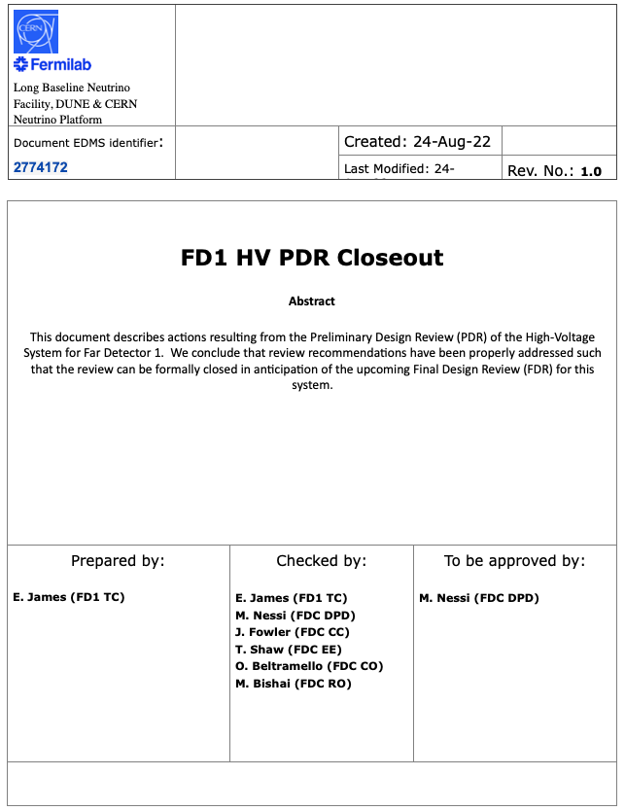
Recommendations from last PDR (2020)
Charge Question #8
Most recommendations (10/12) properly addressed
Solutions documented and incorporated into present FD1-HD and ProtoDUNE phase-II HVS designs
Two remaining open issues
Validation of the EW installation procedures: final Ash river trial (row 25) planned in the next few months.
Removal of bottom GP requiring detailed definition of interfaces with TC, Cryo, CALCI: this is in progress and will be defined most likely within next January.
PDR formally approved and closed by FD1-TC and FDC-DPD.

Slide 10
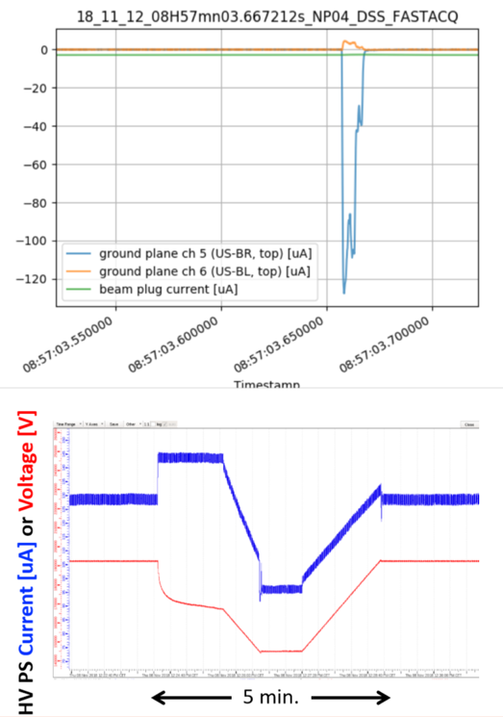
Lessons Learnt from ProtoDUNE:
Charge Question #5
The HVS goal of 180kV on CPA (the highest in a SP LAr-TPC) was reached and maintained soon after the LAr fill (Sept 2018).
Remarkable uptime was achieved:
during beam run: > 98%,
during long term stability run: ~ 99.5%.
Just two classes of instabilities recorded through out the detector live-time:
Fast discharges: O(10/day), ~10ms duration; self recovering
Sustained excessive current (“streamers”): nearly all from the same specific location. Recovered by lowering the voltage using an auto-suppression script.
No system degradation observed over nearly two years of operation
Adequate monitoring and HV controls allowed the remarkable uptime
CPA alignment measured with cosmic muons shows tilts but mostly within requirement
The behavior of the “streamers” possibly explained as a charging up effect of insulating materials in the strong e-field regions outside of the field cage

Slide 11
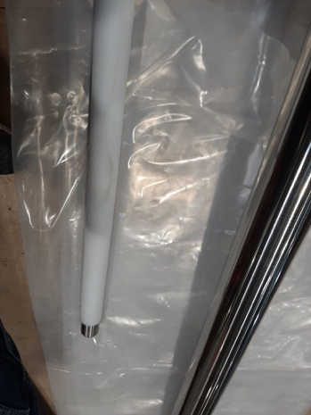
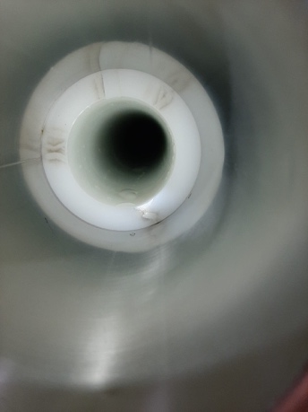
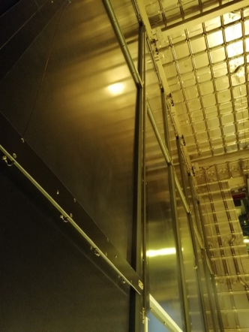
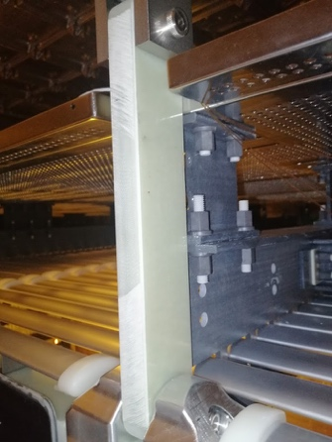
ProtoDUNE-I Decommissioning: HV findings
Charge Question #5
After termination of operations
HV-FT inspection :
thin traces of arcing found on the tip of the HV cable in HV–FT receptacle (most likely due to thin 200 kV cable)
thin layer of Ice accumulated (in two years) in the HV-FT receptacle making it difficult to extract HV cable.
--> HV-FT design has been modified to cope with both issues (longer FT to avoid low temp. in receptacle, deeper cable receptacle)
After TCO opening
bowing of central CPA column (< 1cm) consistent with measurements made in LAr with cosmic rays
Improved columns alignment system included in new design
CPA lifting bars (facing GP-6) shows gray streaks; surface analysis indicates to be metal residuals that could be the cause of the « HV streamers » observed during operations.
Improved surface quality control included in QA/QC procedures
Not responsive EW current termination monitor due to disconnected SHV on the APA5 filter-panel (fail-safe varistors allowed EW biasing); similar problem with APA3 grid biasing.
SHV panel accessibility may remain an issue for the APAs

Slide 12
ProtoDUNE-I: HV decommissioning-recycling
Charge Question #5
With the exceptions noted in the previous slide, All HVS system components found in excellent conditions (from visual inspection)
No oxidation of aluminum
No resistor / varistor damaged
No delamination of CPA resistive surface
No cracks on the PE endcaps
Material now reused in ProtoDUNE-II fully recovered and temporary stored in NP02 clean room
All TBFC aluminum profiles 2.3 long (from 12 modules)
All Resistive Divider Boards: 5 GOhm version (from 7 modules) reused as is; 1 GOhm version (~100), replaced with 5 GOhm and mounted in PD2
All End Caps
The CPA panels (the two central ones dismounted and kept as spare parts)
All Ground Planes
HV Donut (arm rebuilt)
HV Feedthrough (as spare of the upgraded version under test)
HV Power Supplies (200 kV and 300 kV ones) & cables

Slide 13
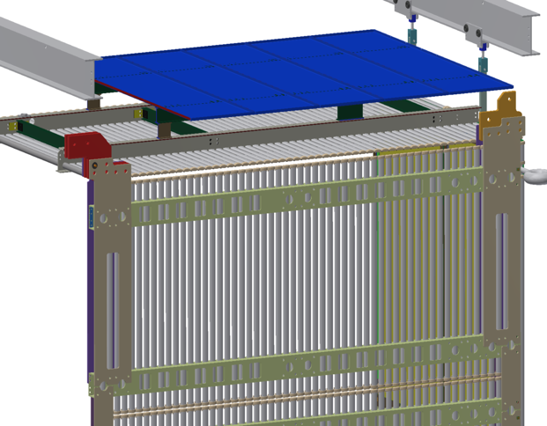
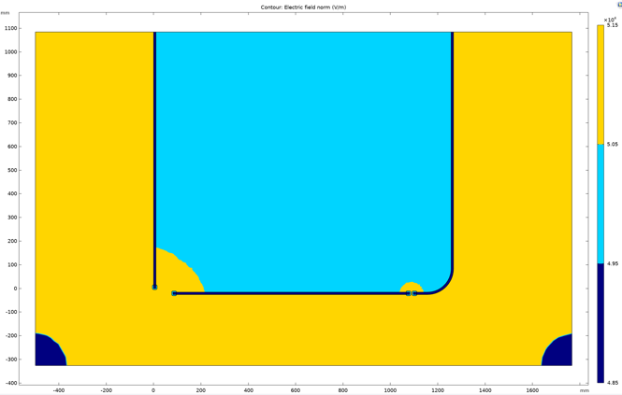
Improving the FC Design
Optimization of the field cage:
Eliminating nearly all insulating materials on the outside of the field cage to reduce the probability of surface charging in the high E field region
Increasing field cage to top ground plane distance, and remove bottom ground plane to further reduce E field, and stored energy (GPs moved out of HVS scope)
Introducing bent profiles at the End Wall field cage corner edges to improve drift field uniformity.
Present FC design
2019 TDR FC design
Value engineering:
The changes result in simplified design, lighter, more robust construction, and significantly lower material cost.
All FC assembly and testing will be done underground; only shipping of the ”prepared and QC’ed components” of the field cage is required
the EWFC support design ensures EWFC verticality regardless of the cryostat roof motion (NEW wrt last PDR)
E-field uniformity in PD1 (lower left) and PD2 (lower right). Yellow (>1% nominal value)k , Blue (within 1%).

Slide 14
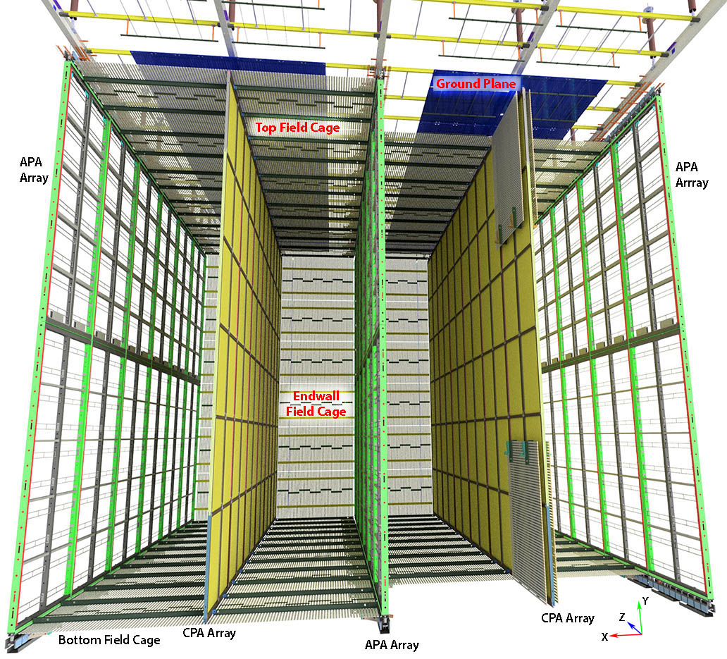
The New HVS Design
Charge Question #3
2 End Wall FC’s each made of:
24 2m x 3.5m EW modules (arranged in 4 identical columns, 6 modules tall) with top/bottom modules hosting bent aluminum profiles
25 mostly identical CPA/TBFC/GP rows, each made of:
2 CPA’s: 12 units each (1.15m x 2 m)
8 Top/Bottom FC module (3.5m x 2.3m)
4 Top Ground Planes (4 units each: 2.3m x 0.5m) hung independently to the DSS beams (NOT in HVS scope except for readout and monitoring)
Assembly & Installation:
Performed fully underground (ProtoDUNE Phase-II experience on FC)
about 1 month for each EW
1 week for each CPA/TBFC slice: deployment of FC at the end of installation.
Personnel requirements and assembly times being validated at ProtoDUNE Phase II

Slide 15
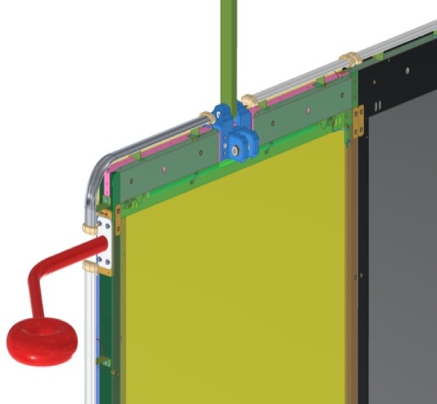
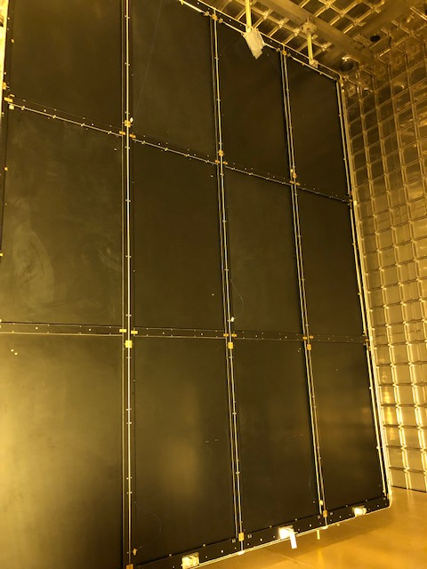
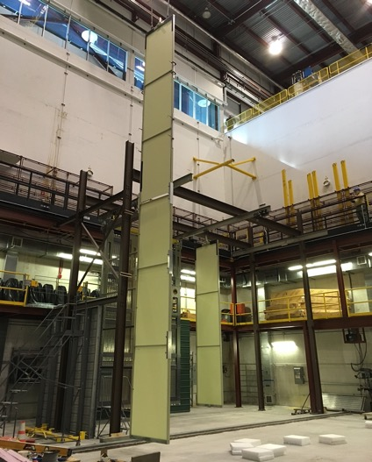
CPA
Charge Question #2
Constructed from 50 side by side panels :
Each Panel is 1.15m in width and 12m tall, formed with 6 vertically stacked Resistive Kapton laminated modules
Hanging through a single link
HV bus is integrated in each CPA Panel for electrical interconnection between panels.
Resistive Field Shaping Strips to ensure E-field uniformity around the frame
“Donut” shaped receivers attached to the outermost CPA panels to receive HV feedthrough tip contact
Minor modifications wrt TDR & last PDR:
bent profiles at corners,
FFS layout
New PD diffuser mounting scheme, implemented and to be validated at PD
More inter-panel alignment pins and slots
Anti-rotation feature to improve cathode plane planarity
Double sided HV bus for increased redundancy

Slide 16
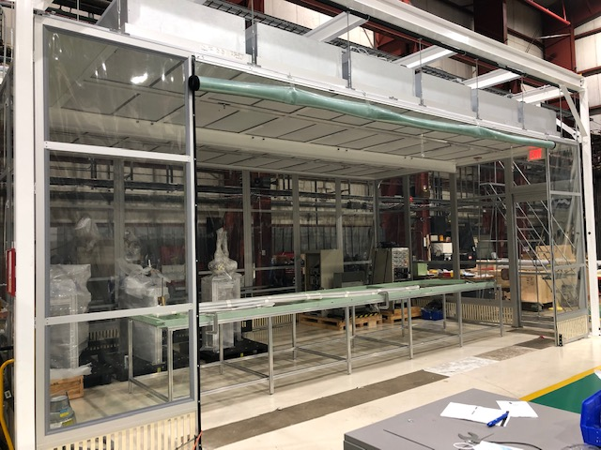
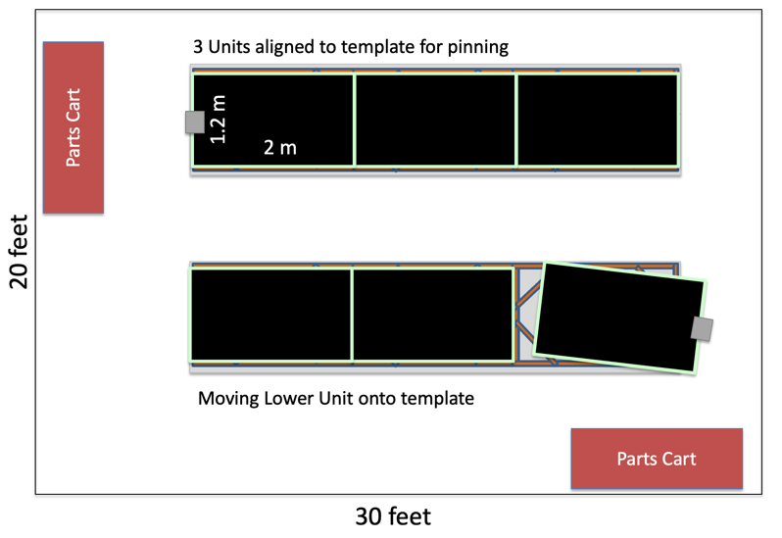
Clean Room @ANL for CPA Production
Charge Question #2
Clear plastic walls
Ceiling fan units create positive pressure air system
Ceiling lighting
Size fits 2 – 20 foot long tables plus room for carts containing all parts and hardware needed for a single CPA panel production (6 CPA Units – 12 m tall
Factory Configuration
8020 Al table with 3-unit CPA template made from spare frame parts
Already used for PD2 CPA assembly
Ready for FD1 production

Slide 17
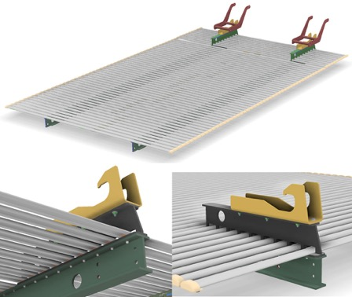
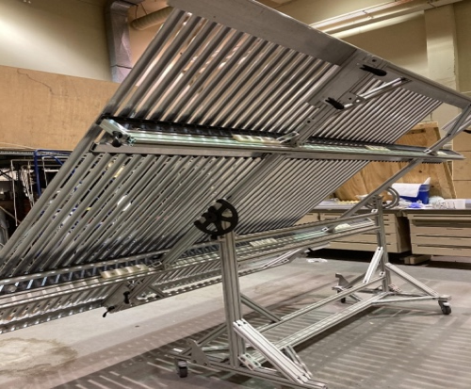
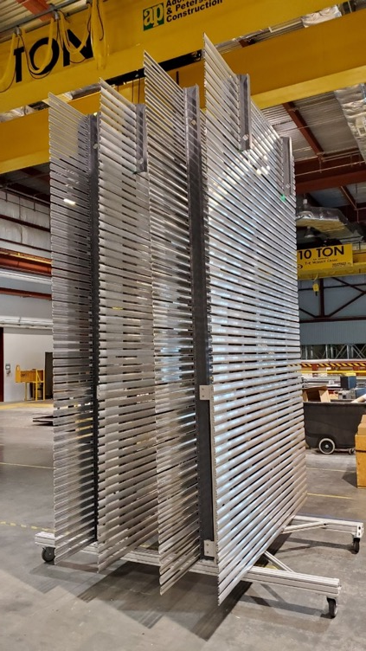
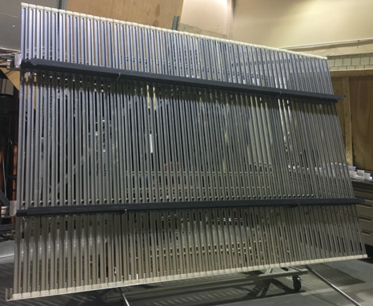
Top/Bottom Field cage modules
Charge Question #2
Very simplified structure wrt TDR solution (no change from last PDR)
No change in dimensions (2.3 x3.5 m2).
Same electrodes shape and 6 cm pitch
No standoffs for Ground Planes
Lighter FRP 4 inches I-beams
Profiles sitting outside the beams
Non-metallic hinge on FC for CPA connection
Simpler aluminum latches to APA
Activities at production sites (SBU/UTA)
FC assembly procedures developed via test assemblies:
Several iterations of assembly cart modifications performed to optimize assembly procedure
QA/QC finalized procedure for newly designed FRP parts, including the QC jig development
TBFC for PD2 fully assembled at CERN
With assembly tools and storage cart shipped to CERN

Slide 18
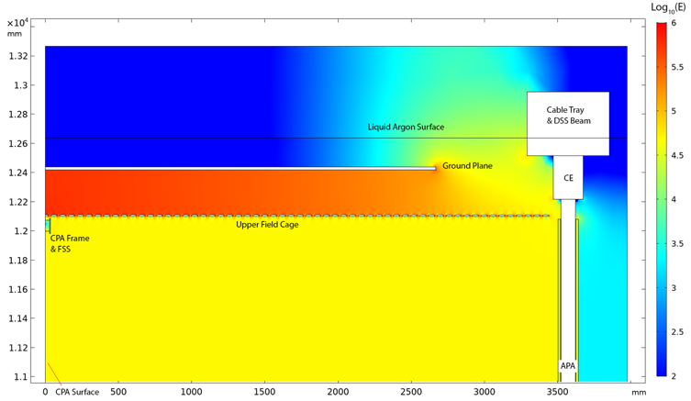
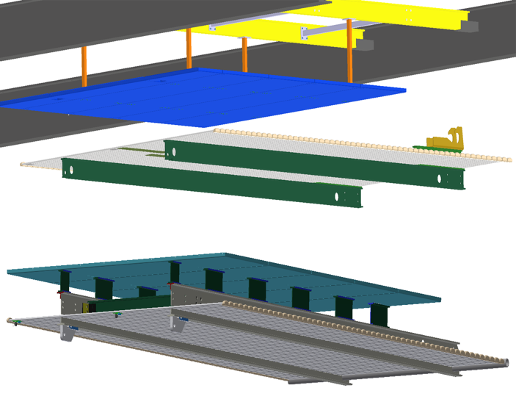
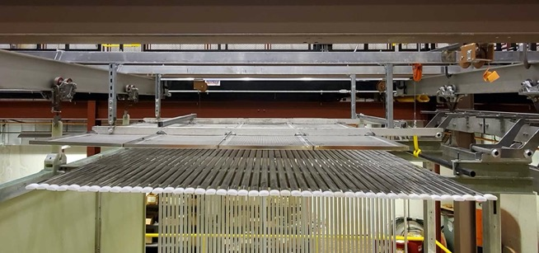
Ground Planes
Charge Question #2
Used to confine the E-field below the Liquid Argon surface
New wrt TDR:
Hanging from DSS
No GP’s at the bottom (cryo pipes have been moved away from under the TPC)
30 cm distance above Top field cage Modules (50% increase from PD1 and TDR)
No insulators connecting FC to GP
Moved out of HVS scope except for current monitoring system
Layout and Installation tested in Ash River and being validated in ProtoDUNE-II
New design
Old design

Slide 19
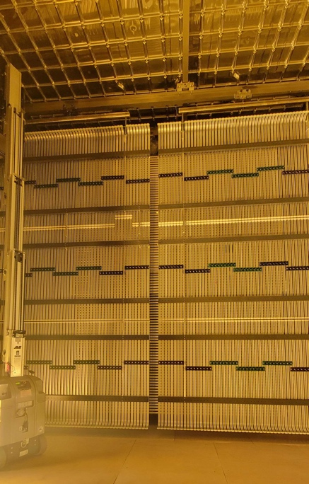
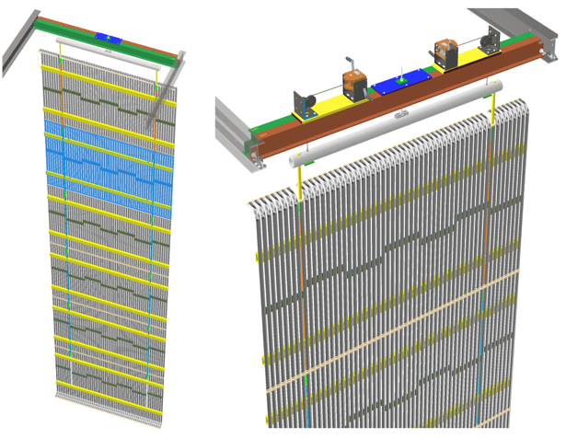
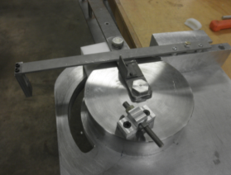
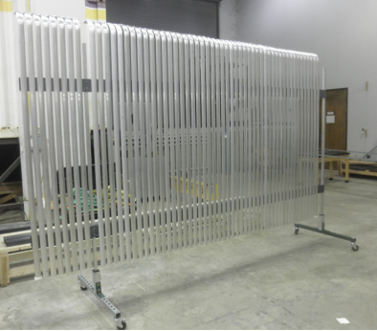
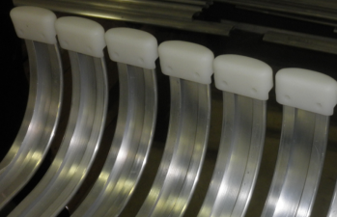
End Wall Field cage modules
Charge Question #2
Significant modifications with respect to ProtoDUNE-I (and TDR)
Panel height 2m (it was 1.5 m)
Aluminum profiles sittings outside of smaller cross section FRP box beams
Aluminum holding bars for easy connection of 6 panels forming a wall.
Bent profiles (tool successfully prototyped at LSU production site) in the top & bottom most panels to minimize E-field distortions at the edges of the FC
New: Yoke to hang on a single point to DSS to guarantee verticality also in case of DSS/Roof deformations.
Full panel assembly to be performed underground with dedicated tooling and supporting structures
Validated by LSU team at CERN for ProtoDUNE-II
Bending and QC procedures
Modules assembly and installation

Slide 20
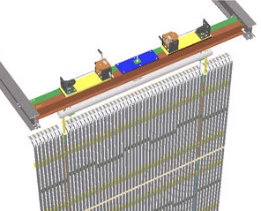
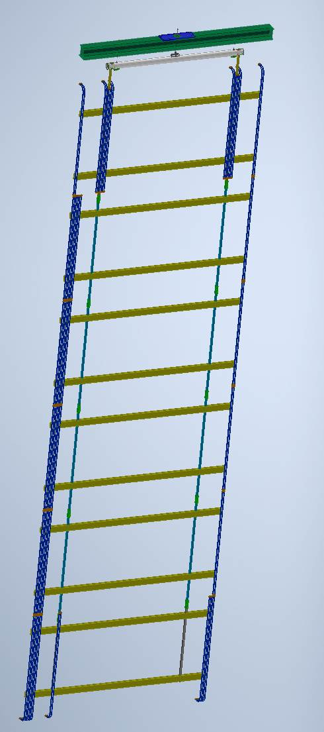
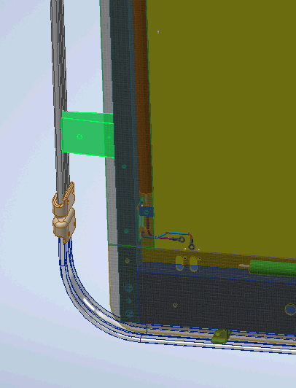
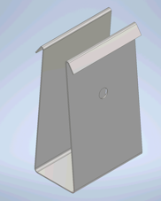
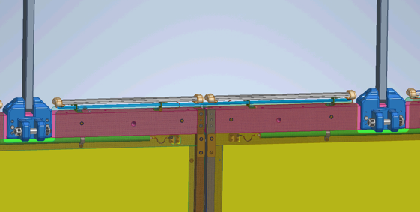
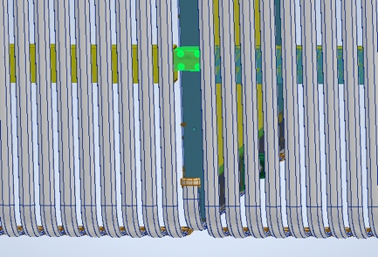
Changes to Design Since Last PDR
Charge Question #2
EW support from DSS changed to double FRP I-Beam
Single point EW hanging system
Winch system for assembling EW has been updated
Design of diffuser attach on CPA being updated
FSS Geometry has been updated and optimized
Snap clips for profiles on CPA added
EW/APA and EW/CPA restraints updated
Latch system od TBFC to APA optimized
Updated tolerances on dwgs
Added redundant HV bus and connections to CPA
Added anti-rotation rods to top and bottom of CPA

Slide 21
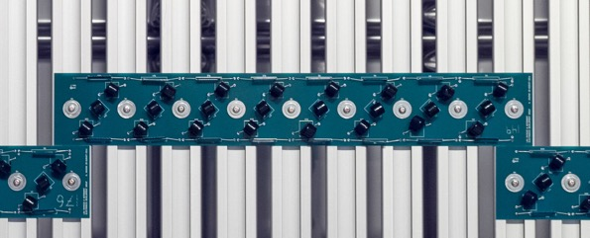
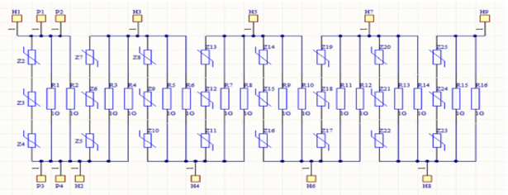
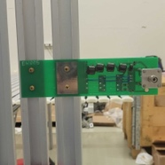
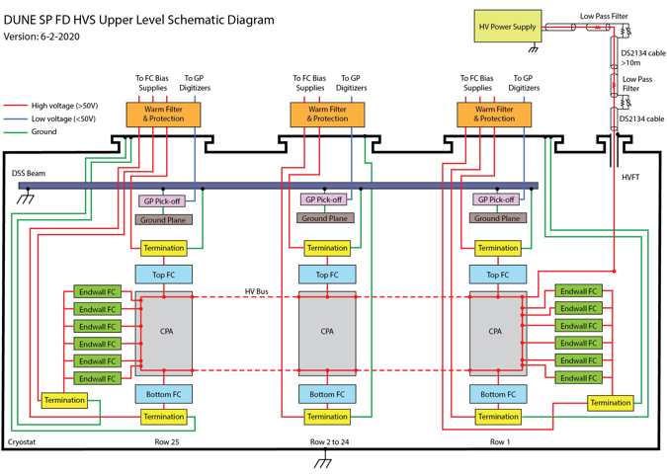
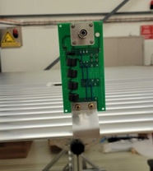
Divider boards & electrical interconnections
Charge Question #2
NO change with respect to TDR and PDR
Two 5 GOhm resistors in parallel in each step of 3 kV / 6 cm
For redundancy: 3 varistors in series (opening at 1.7 kV each), in parallel with the resistors
In case of resistor failure, DeltaV goes from 3kV to ~5 kV
Well defined QA/QC plans (LSU)
Applied and successfully tested for the ProtoDUNE-II assembly
Termination boards for both EW and TBFC also designed and produced for PD2
Similar interconnection scheme as for ProtoDUNE and TDR

Slide 22
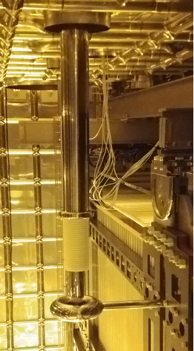
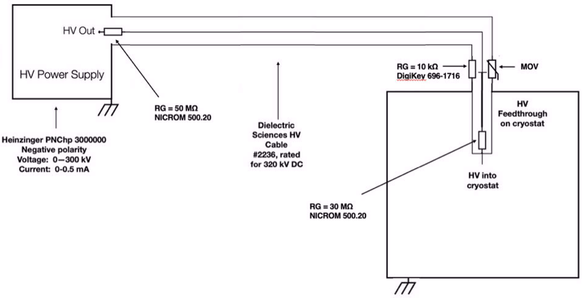
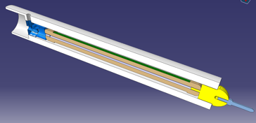
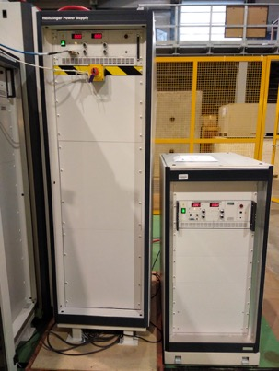
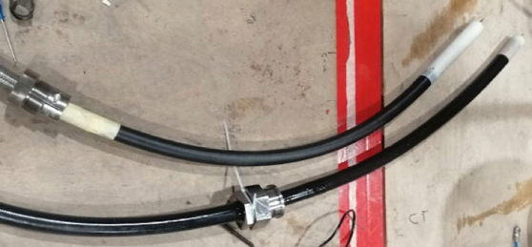
HV delivery
Charge Question #2
Main differences wrt TDR & 2020 PDR:
HV FT: unified design with FD2-VD (300 kV rated)
Scaled up version of the ones successfully tested in PD1 (NP04 and NP02) -> 4m length, 150 mm diameter.
1 m long warm section to avoid the ice formation issue in the cable receptacle
Accepts 320 kV rated HV cable (200 kV option with termination adapter)
Under construction at CINEL (same as previous FT’s)
Simplified ripple filtering system
Commercial HV Resistor located in cartridges integrated into the cable terminations
Tested at 300 kV in NP02 HV stability run
Power Supply: Heinzinger 300 kV (200 kV also possible if no E-Drift > 500 required)
Sliding contact

Slide 23
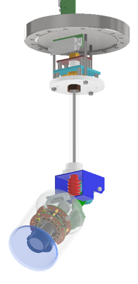
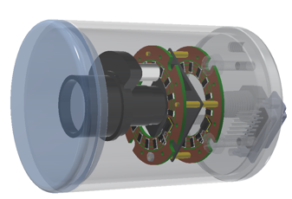
HV monitoring & grounding
Charge Question #2
Similar to TDR & PDR
Ground planes current pickoff monitors (100 channels)
Termination current on each voltage divider chain (208 channels)
HV-PS voltage/current and ramping up/down features
(discharge monitors on HV filters)
Also in HVS scope:
Cold cameras (~16) similar to those used in ProtoDUNE-SP and DP to visually monitor critical spots: HV feedthrough, end wall edges
Grounding scheme follows DUNE prescriptions, as successfully applied in ProtoDUNE-I

Slide 24
Advances following the last PDR in 2020
Charge Question #2
Design
Modified the end-wall support structure to avoid impact from cryostat roof deformation
Changed the warm FC lengths to ensure cold length is 3574mm between APA-CPA beams.
Added EWFC-CPA and EWFC-APA interconnect features
Updated safety analysis plan and completed the analysis
Prototyping
FD TBFC modules, two rounds of assembly table
FD EWFC modules, assembly and profile bending tools
FD CPA modules: 2 columns of 12m high assembly with mobile QC
Ash River ProtoDUNE II phase 1 beam left
ProtoDUNE II assembly and installation (ongoing): mobile QC adopted of all HVS components
FD1 row 25 trial installation

Slide 25
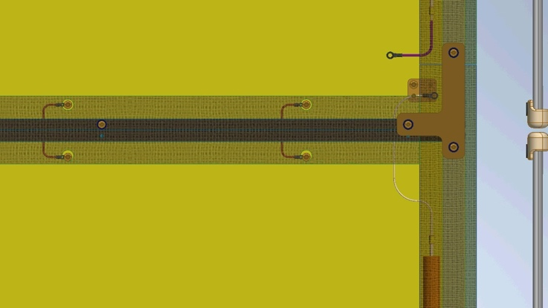
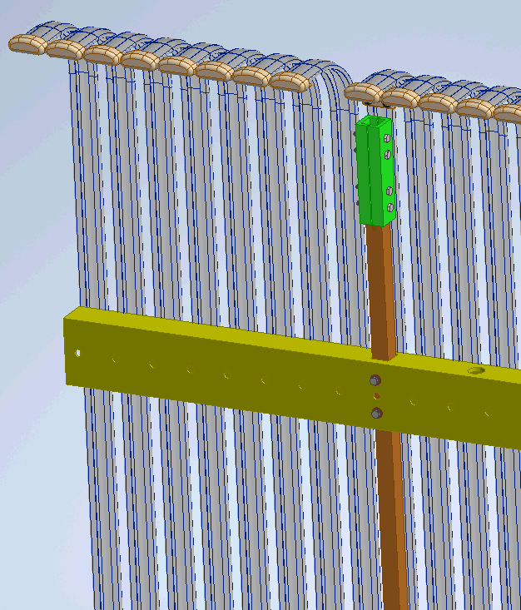
Open Design Issues (to be settled before PRR)
Charge Question #2
Camera signal feedthrough flanges have not officially been assigned (proposed to tee off 4 DSS penetrations).
Mounting hole pattern for the GP pickoff boards and EWFC support beams have to be agreed upon by DSS
Based on lessons learnt from PDII experience, the following changes are to be made
Updated Diffuser design (provided by PDS) has to be finalized and implemented on CPA.
Holes for the HV jumpers between panels need to be enlarged to ease the installation
Enlarge holes on FSS to allow for more adjustment (flatness)
Update dimensions and tolerance on EndWall C-clamp connectors
FC and EW assembly tooling and fixtures need to be optimized and finalized according to ProtoDUNE Phase-II experience

Slide 26
Structural Safety Analysis
Charge Question #2
CPA Top Beam Bending
During Installation
EDMS#2579744
Guided by approved Analysis Plan #2520669
Installation and gravity loads during dry and wet operation
Incorporated material properties for orthotropic behavior
CPA
Lifting individual modules
Full structure with Field Cage loading
End Walls
Symmetric model looking at one column
Field Cage
Lifting FC onto CPA
Lifting FC to deployment
Operational cases
Notable Analysis Result
CPA Top beam bending stress was critical section for operation case
EW pipe stress concentration for lifting case was important to investigate, c-clamp was critical section
FC lifting onto CPA was investigated and stresses were below limits
FC Hanger Beam Stress Lifting onto CPA
C-Clamp Stress Plot
EW Pipe Stress Concentration for Lifting Case

Slide 27
Structural Safety Analysis: CO validation
Charge Question #2
Validation Process performed with frequent and efficient feedback between HVS and CO
The main outcomes are:
The HVS was verified for all load cases defined in the Analysis plan and some others identified during the review of the documents.
The frame members strength and stability as well as the connections were verified for all LCs in accordance with the relevant standards (appropriate safety factors were used).
The utilization ratios are within the acceptable limits
The following considerations remain to be addressed (to be finalized before PRR):
Strategies and checks for the management of deformations (during cooldown and operations) to ensure the squareness of the HVS → in progress, TC also involved (for the definition of the DSS beam distances at warm and cold)
An envelope study (nominal dimensions plus deformations and tolerances) of the system in operational dry and wet configurations: → in advanced stage, close contact with CO

Slide 28
Ash River Trial Assembly
Charge Question #5
Throughout the early part of the Covid pandemic, while most of the facilities were in full or partial lockdown, the Ash River crew continued their work on fabrication, assembly, and installation trials of key TPC parts.
Officially not part of the HV Consortium, the Ash River crew, led by Bill Miller and Tom Wieber made invaluable contribution to the development of the HV system for FD1
Fall 2020: 12m tall FD1 full height CPA installation
Spring 2020: FC assembly and storage cart
Spring 2020: Initial ProtoDUNE II CPA/FC/APA trial Installation

Slide 29
Ash River Trial Assembly: FD1 row 25
Charge Question #5
A first installation workshop was held at Ash River in Dec 2021 to demonstrate the installation of the row 25 TPC, which is the most challenging part of the FD1 HVS installation due to limited access and floor space.
This exercise addressed the current FD1 HVS installation plan.
Lessons learned compiled during the trial led to several improvements in the procedures and tools, which are being successfully implemented in ProtoDUNE II
Further AR validation tests planned in late 2022
Complete one drift cell of row 25
Symmetrical deployment of the bottom FC modules
Installation of the full height EW FC modules

Slide 30
QA/QC
Charge Question #6
HVS coordinator working closely with production sites and DUNE QA/QC representatives.
Co-leading the development of mobile app integrating checklist / traveler system for accurate, real time recording of QC information
Procedures finalized (based on ProtoDUNE-I experience, being validated in ProtoDUNE-II) for all the HV system construction phases:
development and design
Electrical/mechanical analysis; material testing in cold; small scale test validation
prototyping
Ash River trial assemblies (modules, ProtoDUNE scale, FD scale)
ProtoDUNE–II / Module 0
production
screening of critical components;
tagging components & implementation of electronic checklists / traveler documents
Installation
planned checklist to ensure correct function and interconnect of installed components

Slide 31
QA/QC – iPad app
Charge Question #7
Plan for QC on all parts, production modules, assembly and installation procedures for DUNE.
Procedures and Checklists contained in an iPad app with automatic uploading of data to DUNE Hardware Database.
Unique Parts IDs for HVS components allow tracking of parts through production, assembly, installation and detector operation.
Component page
Final CPA/FC/EW Checklist
Home screen of app

Slide 32
QA/QC Hardware database link
Charge Question #7
Screenshots from DUNE Hardware Database (for CPA in PD2)
Top left: Listing of some of the database entries for CPA.
Top middle: Contents of entry for CPA Plane US (upstream CPA Panel pair).
Inset shows test logs from checklist for this Plane
Note subcomponents of this Plane are the 2 CPA Panels
Test log data includes gap size (8 mm) between Panels
Top right: Contents of Panel 6 (most upstream of the panel pair) subcomponent with its inset checklist test log.
Bottom: Entry for CPA component part – Mini-resistor Board (MRB)
Inset shows test log from checklist for this MRB
Data stored is the board’s resistance (2.4 Gohms)

Slide 33
Interface Requirements
Charge Question #7
1 | The mechanical connections between the top/bottom field cage modules and the APA shall not impart moment loads to the APA frames.
2 | The end wall FC modules shall be constrained to the APA and CPA arrays.
3 | The top field cage shall maintain a clearance of at least 30cm from the bottom surface of the ground plane
4 | The top field cage shall have openings large enough to allow the calibration laser periscope heads to penetrate through the plane of the field cage profiles.
5 | The CPA shall provide attachment points for the PD calibration diffusers to be mounted on both sides with clear view of the APA arrays.
6 | Each FC termination circuit shall have an additional failsafe current return path to detector ground to guard against FC termination cable failure.
7 | The FC termination bias power supply specifications: maximum output voltage: -1kV, maximum output current: 1mA, output voltage ripples: <0.1V, minimum V/I readout freq: 1Hz
8 | FC termination and failsafe current return paths shall avoid the APAs

Slide 34
Interfaces with other consortia
Charge Question #7
Essentially finalized with most detector consortia.
Interface documents with DSS, facility, installation in advanced development.
Consortia | EDMS number | Key Interface Items
APA | 2088738 | Field cage support on APA frames
PDS | 2088721 | PD calibration flashers and fibers on CPA
CE | 2088706 | FC termination and ground plane monitor cable routing, warm filters on SHV feedthroughs, termination bias supplies
CALCI | 2145142 | FC openings for lasers, target mirror assemblies on FC profiles
DAQSC | 2145154 | HV vs. LAr level interlock, ground plane and HVPS digitizers, cold camera power supplies
Installation | 2145184 | Installation activities in UG cleanroom, cryostat
Facility | 2145170 | HV feedthrough locations; rack and cable trays; liquid and gas flow in cryostat
DSS | 2339392 | Support of the CPA/FC modules on DSS; ground plane design, support, and installation; cable routing

Slide 35
Transportation Requirements
Charge Question #4
1 | The shipping crates and packing material shall not release particulates inside the UG cleanroom under normal operating conditions. If such construction is not economical, the content shall be transferred to a clean container before entering the cleanroom
2 | All shipping crates with length greater than 3.65m (inner length of the Ross cage) shall be compatible with lifting in both horizontal and vertical orientations, including inverted from normal shipping orientation, and shall provide all necessary lifting points for both orientations.
3 | Contents of all shipping crates shall be double bagged before reaching the UG cleanroom
Installation Requirements
1 | The temporary EWFC support beams shall be able to move along the DSS beams for at least 20cm with the full load of the EWFC modules.
2 | The attachment features between the EWFC and the APAs and CPAs shall be accessible from either inside or outside of the TPC
3 | The HVFT receptacles shall accommodate the shrinkage of the TPC to maintain good electrical contact to the tips of the HV feedthroughs without interference
4 | The EWFC storage cart shall not interfere with the existing TPC components when positioned to installation positions.
5 | The design and installation of the field cage shall allow the final FC deployment to be as late and as quick as possible to enable maximum TPC component access

Slide 36
Shipping of the HVS components
Charge Question #4
No major changes from 2020 PDR
Main parts to ship: CPA modules, FC profiles, FC beams, HV delivery, divider boards, assembly tools.
All crates fulfill shipping requirements (size and weight for shaft lift transportation, cleanliness for clean room).
All crates designed to fit on the underground transport cart and within the lift cage
All parts wrapped in plastic bags and placed in wooden crates at production sites
Possible visual inspection at SDWF
Crates to be delivered outside FD1 assembly area, sides removed before entering the Clean Room (only parts in plastic bags)
Prototype crates produced: shipping to CERN successfully tested for all the equivalent ProtoDUNE-II HVS parts.

Slide 37
Shipping of the HVS components
Charge Question #4
FC profiles
96” x 38.3” x 29”, 1000 LB
25 Loads of FC, 6 Loads of EW
FC beams
139” x 38.3” x 29”, 1400 LB
2 EW Loads, 8 FC Loads
CPA modules
95.” x 52” x 68”, 1400 LB
50 Crates/Loads down shaft
HV delivery tools
HVP, HVFT and HV cable transport crate provided by vendors (shipping tested from CERN to FNAL)
Shipped in dedicated crates
Parts for EW FC assembly tables, EW bending tools
Deployment tools
Lift Frame Carries 480 = 8 modules Profiles, spaced as shown
Top / Side removed to load or unload
Lift Frame Carries 56 EW Box Beams and/or FC I-Beams
Crate carries Twelve 2m CPA Panels, two complete 12m Assemblies, sufficient for one CPA/CF Module
CPA Panels are bagged & stacked, foam blocks (shown in pink, drawings provided) are used to separate panels & prevent damage

Slide 38
Underground Assembly and Installation
Charge Question #4
The start of the FD1 installation is currently projected to be in the summer of 2026, when the inside of the cryostat and the adjacent cleanroom are completed.

Slide 39
Underground Assembly and Installation
Charge Question #4
The first major TPC component to be installed is the east EW FC modules (~1 month).
The CPAs and T/B FC modules are integrated and installed into the cryostat at a rate about 1 week per row, with the FC modules folded against the CPAs.
In parallel, the APAs are being installed at a rate about 1.5 week per row. Only after all the CPA and T/B FC are installed, the FC modules are deployed at a rate about 2 rows per week. This gives extra time to access the APAs and electronics if needed.
The west end wall FC modules are installed before row 25 FC modules are deployed when floor access is still available. The deployment of row 25 is done from outside of the TPC through a temporary gap over the top of the EW FC modules. The EW FC is moved to final position after the row 25 T/B FCs are deployed.
A low voltage test of the entire HV system will be performed in air to verify all connections.

Slide 40
HV system for ProtoDUNE II (module-0)
Charge Question #5
TPC in ProtoDUNE-II: 2/3 of the volume of the first run, 2 of 4 APAs in inverted orientation. TPC centered in the beam direction with larger clearance outside of End Walls (similarly to FD-SP-HD)
Purpose for HVS: Validation of FD1-HD design, installation, performance of new field cage modules, new ground plane configuration, HV delivery
HVS components
The CPAs has been reused with minor modifications to reflect current design changes: new frames, anti rotation bars, double HV bus,…)
The HV distribution (HVPS - cable - filters - HV feedthrough) is being upgraded with the common HD-VD layout. Fall back to old NP04 HVFT still possible in case the new HVFT is not fully tested when installation in NP04 is required.
Top/bottom and End Wall field cage modules with new FD design assembled and mounted
Most of the resistive divider boards reused after upgrade with 5 GOhm resistors and full QAQC’d in LSU and CERN
Parts for the FC modules prepared at production sites (LSU, SBU, UTA) and shipped to CERN to be assembled on site similarly to what is planned for the FD.
Mechanical connections to APAs and DSS will represent the FD design as much as possible.
Few key differences wrt FD1 with impact on HVS:
Special support structure required to tie the bottom of the upright APA to bottom FC and top of the inverted APA to the top FC.
Different top/bottom clearance (GP’s also at the bottom)
Beam plug (out of HVS scope)

Slide 41
HV system installation in ProtoDUNE II
Charge Question #4
From early 2022, teams from production sites (ANL, LSU, SBU, UTA) gathered at CERN for the assembly and installation of the HVS subsystems, in close collaboration with the CERN and Ash River Installation team.
Subsystem parts shipped in crates as for FD1
NP02 clean room used as assembly area
Assembly procedures carefully applied and optimized.
QC procedures followed by means of the online applications
Personnel requirements and assembly times recorded and validated
Lessons learned collected and discussed. FD1-HD HVS design and tools modified accordingly.
At present, all CPA and FC elements are built and hanging inside the NP04 cryostat
No major issues encountered
FC Deployment procedures partially tested.
Deployment tools tested, optimized and validated
CPA-FC-APA and CPA-EW-APA warm alignment partially tested
Next (Saleve side) installation steps with HVS team involvement:
BP installation
Top GP’s deployments and electrical connections
Upstream EW positioning and electrical connections (CPA, terminations boards), QC
Top FC’s deployment, alignment and electrical connections, QC
Bottom GP’s deployments and electrical connections (False-floor removal)
Bottom FC’s deployment, alignment and electrical connections, QC
Downstream EW positioning and electrical connections (CPA, terminations boards), QC
Jura side and HV delivery will follow

Slide 42
ProtoDUNE II HVS photogallery
https://photos.google.com/share/AF1QipMORrWjxMKuCObJaXZjCGwk8ZAxZEympW0WEp_CjC19gfc_Br_Cjt9B5cIJ8PgEhg?key=eVBUV1owemRRbXdlMHFTR2d6UVpkTWVheDRSVWN3

Slide 43
ProtoDUNE II HVS photogallery

Slide 44
ProtoDUNE II HVS photogallery

Slide 45
Plan towards FD1-HD
Key milestones:
FD1 HVS final design review: now ongoing
ProtoDUNE II installation and commissioning: now to summer 2023
Post PD2 HVS review: initially planned for Spring 2023, most likely to be pushed just after PD-II commissioning
At least few weeks of HVS operation in PD2 to determine if any changes are needed for FD1-HD production ?
Start of procurement of long lead time items
Start of production tooling fabrication, set up assembly sites
Produce pre-production components
Production Readiness Review at each production site: late Fall 2023
Start full production: Early 2024
Start shipping to SURF: 2025 (when SDWF available)
FD1 start of installation: Summer 2026

Slide 46
Summary
The HV System in ProtoDUNE SP operated at the goal voltage of 180kV (highest in a large LArTPC) with >99% uptime during long term operation.
At the design level, actions were taken to mitigate the occasional HV instabilities observed in ProtoDUNE by increasing the FC to ground plane distance and removing the exterior insulating FC support structures.
As a value engineering case, a significant reduction of the estimated material and labor of the FC production and assembly has been achieved → validation in progress with ProtoDUNE-II
Field cage assembly and testing procedures have been highly simplified and will mostly take place at the underground far detector site. → validation in progress with ProtoDUNE-II
Structural safety analysis completed and approved by CO. Open issues related to interface with DSS to be settled before DSS FDR.
The plan toward the PRR and FD1-HD is defined and well advanced (no major critical issues identified).

