Slide 1
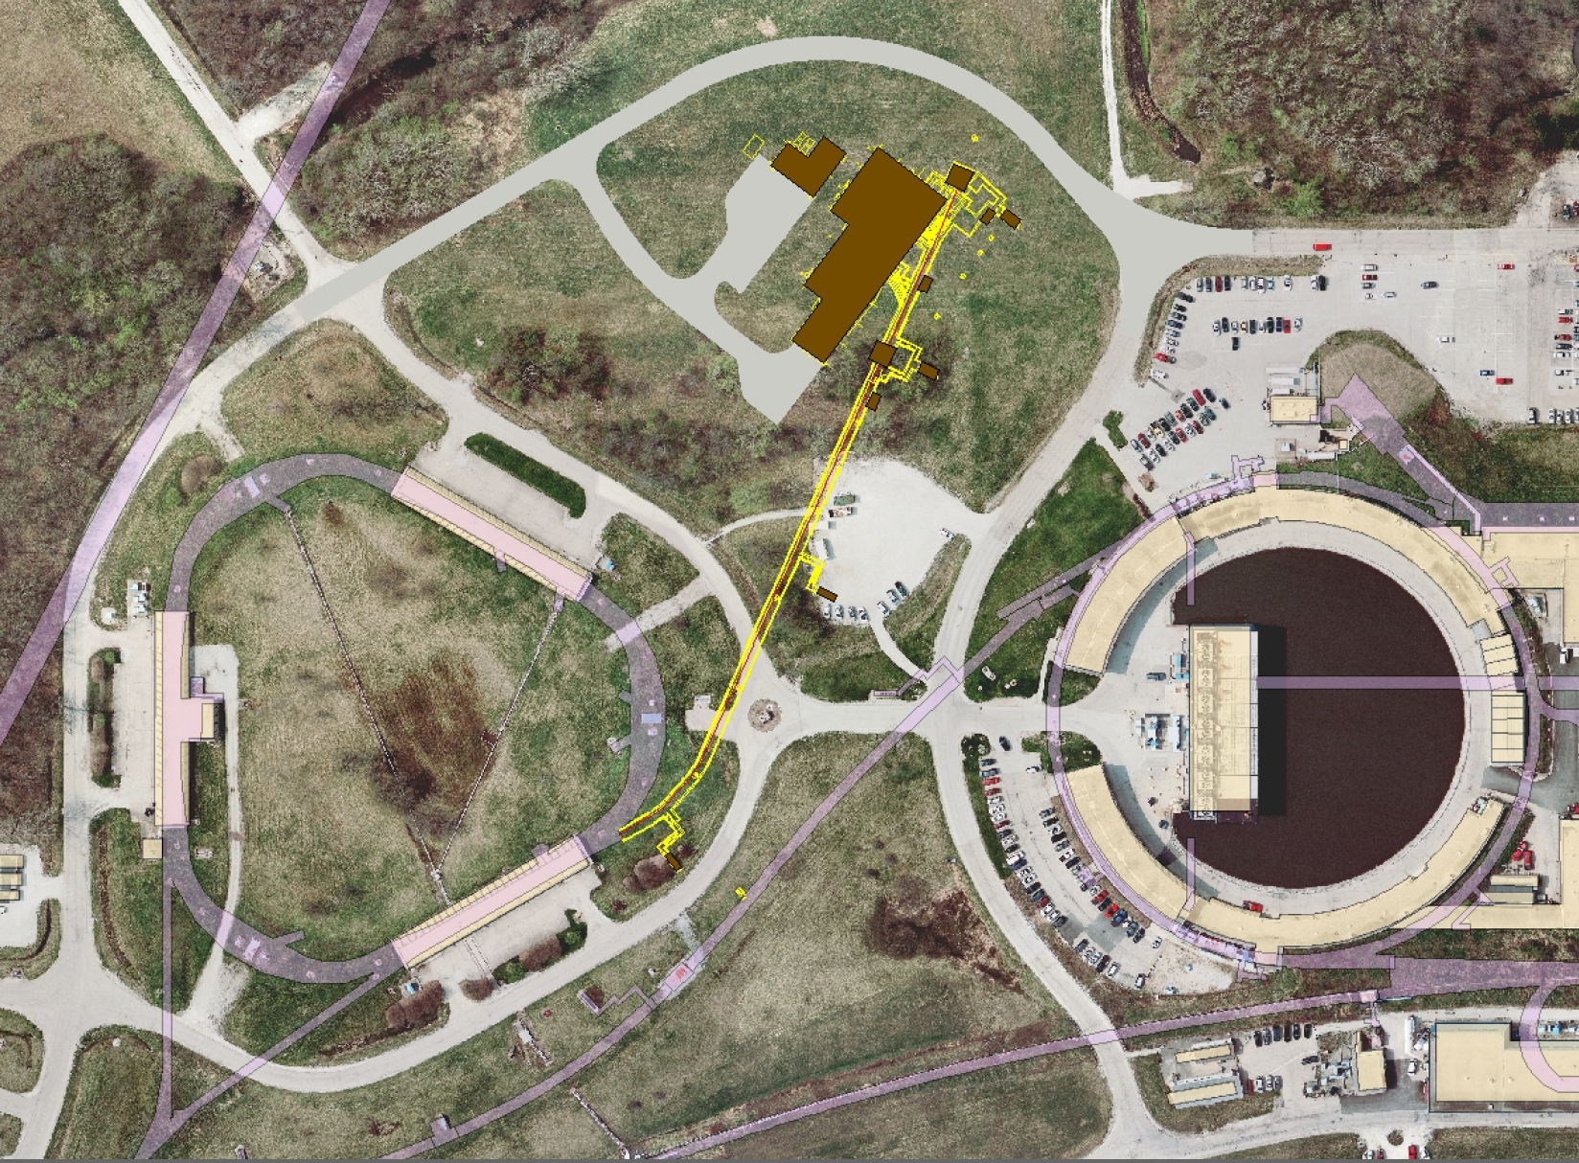
Accelerator Instrumentation:
Intensity Measurements for g-2 and Mu2e
Brian Drendel
June 18, 2012

Slide 2
Intensity Measuremetns for g-2 and Mu2e
Overview of Beam Requirements
Overview of available instrumentation
    Beam Position Monitor
    Ion chamber
    Toroid
    Wall Current Monitor
    SEM (covered in last weeks’ meeting)
Overview of Beam Studies
What needs to be done?

Slide 3
Mu2E
Beam lines
  An 8.89 GeV/c proton bunch, 120 ns long, is transported to the Delievery Ring via M1 and M3 (bypassing the Target Station) at an average rate of 6 Hz with 18 Hz bursts
The 8.89 GeV/c bunch is injected into the Debuncher in the 30 straight section with Lambertsons and a kicker
A 2.5 MHz RF system maintains the short bunch as it circulates in the Delivery Ring
The proton bunch is resonantly extracted over 54msec into the Extraction beam line, and then transported to an external Target Station to produce an intense muon beam.
The remaining proton beam that is not resonantly extracted is aborted in the 50 straight section and transported to a dump
J. Morgan
J. Morgan

Slide 4
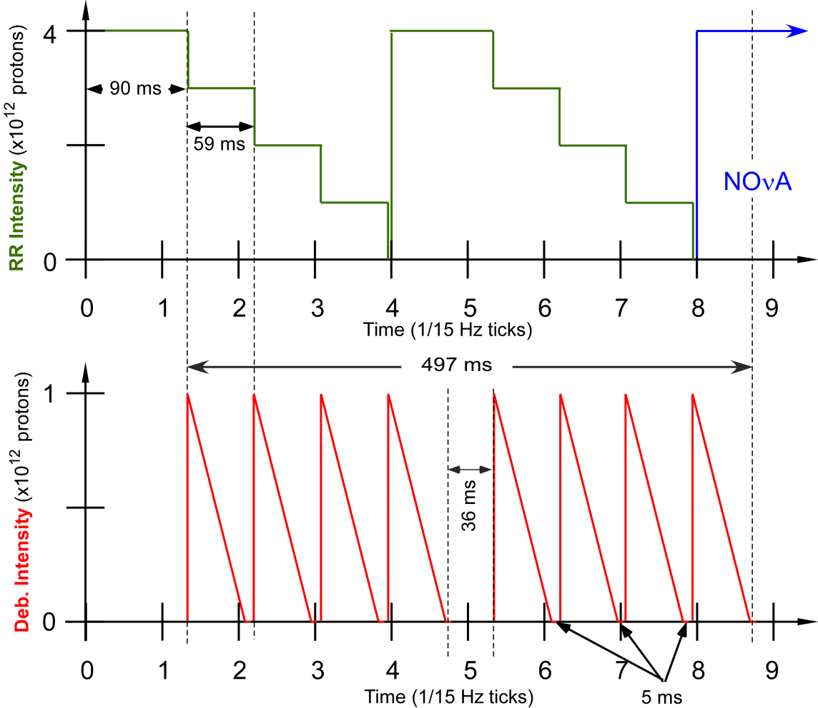
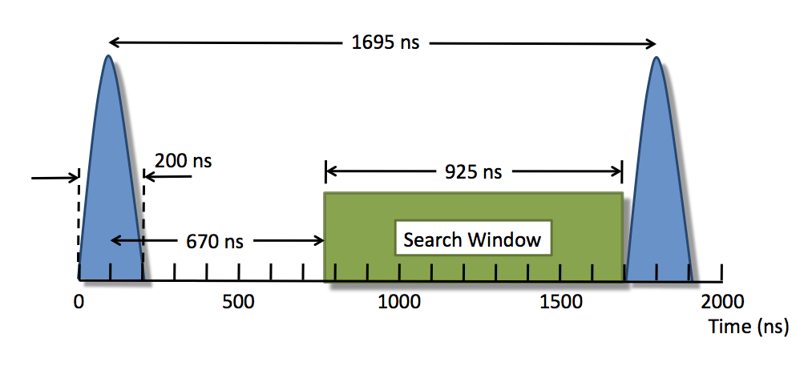
Mu2e Operations
For each 1.33 sec Nova cycle, the first eight of the twenty 15 Hz ticks will be used by Mu2e
During that time:
  One 8.9 GeV/c Booster batch injected to RR, divided into four 2.5MHz bunches.
  One bunch is sent to the Delivery Ring where it is slow extracted to Mu2e.
  Repeat for all four bunches.
  Repeat with a second Booster batch.
Repeat entire process on next Nova cycle.

Slide 5
Muon g-2
Beam lines
  An 8.89 GeV/c proton bunch, 120 ns long, is transported to the Target Station via the M1 line at an average rate of 12 Hz, with 100 Hz bursts (20 bunches, 10 ms interval)
A 3.1 GeV/c Positive secondary beam travels down M2 and M3 and is injected into the Debuncher in the 30 straight section with Lambertsons and a kicker
Some of the pions decay into 3.09 GeV/c muons as they travel down M2/M3
Muons can circle the 550 meter Delivery Ring as many times as desired.
The abort located in the 50 straight section can be used to remove protons
The entire pulse of 3.09 GeV/c muons are extracted into the M4 line, and then are bent into the g-2 line that transports them to the experiment.
J. Morgan
J. Morgan

Slide 6
g-2 Operations
For each 1.33 sec Nova cycle, g-2 will use four Booster batches will be spread through the first eight of the twenty 15 Hz ticks.
During that time:
  One 8.9 GeV/c Booster batch injected to RR, divided into four 2.5MHz bunches.
  One bunch is sent to the AP0 target, where 3.1 GeV/c secondaries are sent to the Delivery Ring
  The secondaries circulate in the Delivery Ring a few times and the entire bunch is extracted to g-2.
  Repeat for all four bunches.
  Repeat Booster batch injection three more times.
Repeat on next Nova cycle.

Slide 7
Beam Requirements
Beam Line/Ring (Service Building) | g-2 | Mu2e
P1->P2->M1 (Ap1) (MI-60, F0, F1, F2, F23, F27, AP0) | 1.0E12 primary beam (protons) 2.5 MHz Single 120 nsec bunch 8.89 GeV/c <rate>=12Hz burst up to 100Hz | 1.0E12 primary beam (protons) 2.5 MHz (no longer 53MHz) Single 120 nsec bunch 8.89 GeV/c <rate>=6Hz burst up to 18Hz
Target (AP0) | AP0 | N/A
M2 (AP2) ->M3 (AP3) (AP0, F27, AP30) | Low intensity secondaries (10⁵ μ⁺, 10⁷ π⁺, 2 x 10⁷ protons) 3.1 GeV/c | Same as P1->P2->M1 {No M2}
Delivery Ring (AP10, AP30, AP50) | 3.1 GeV/c Secondaries (10⁵ μ⁺, 2 x 10⁶ π⁺, 2 x 10⁷ protons) Circulates a few turns Extract entire bunch | Same as P1->P2->M1 Slow Resonant Extraction every 56 msec
Abort Line (old downstream AP2) (AP50) | Low intensity 3.1 GeV/c protons 10msec burts | 3 to 5% of primary protons
M4 (new), g-2(new) (AP30, MC-1, Mu2e) | < 10⁵ μ⁺ (3.1 GeV/c) Pulses every 10msec | 1.0E12 every 56 msec Slices of 3 x 10⁷ every 1.695μsec.
Notes:
Production per proton at the exit of the pulse magnet (Cary Yoshikawa):
Pi+ = 0.87E-5
Proton = 1.99E-5
Muon+ = 0.00731E-5
Assume 80% of the pions are gone by the time you get to the Delivery Ring
Spill:
Single 2.5MHz bunch takes 1.695 usec/rev and is spilled over 56msec.
33,038 revolutions over the spill cycle.
3E7 is spilled per revolution.

Slide 8
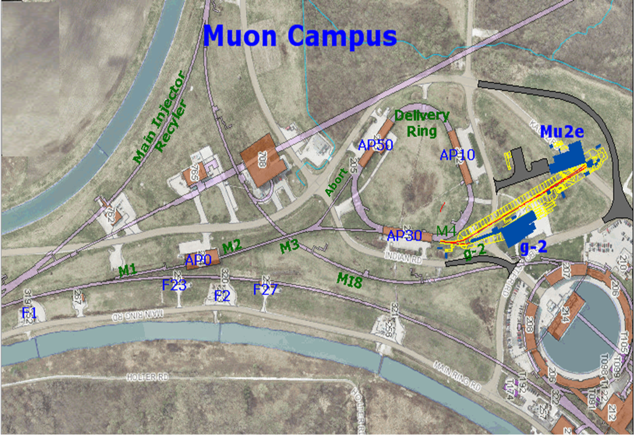
Muon Campus
Pbar Department changed to Muon Department
The Beam lines and Ring(s) may be combined into a “muon campus” that would serve multiple experiments
    Muon g-2
    Mu2e

Slide 9
Muon g-2 and Mu2e Beam Profiles
Primary Proton Beam (P1, P2, M1):
    We are hoping this to be fairly straight forward to use existing instrumentation with some minor upgrades.
    Both Mu2e and g-2 will be 8.89GeV/c protons in single 120nsec 2.4MHz bunches .
    For Mu2e the primary proton beam extends to the M3 and Delivery Ring.
g-2 Secondary Beam (M2,M3, Debuncher, Debuncher Abort Line, M4 and g-2 Line):
    Measuring the low intensity g-2 secondaries will be challenging.

Slide 10
How can we measure beam intensity?
Beam Position Monitors
Toroid
Ion Chamber
Wall Current Monitor
Secondary Emission Monitor

Slide 11
Echotek Beam Position Monitors
P1, P2, M1 and M3 BPMs are designed to see four 2.5MHz bunches.
M2 and Debuncher BPMs can only see 53MHz and will be upgraded to Echotech for Mu2e.
BPMs used to measure beam position for autotune program.
Preamps used for downstream AP2 (10¹⁰ particles)
Two cascaded preamps for a total gain of 50dB used for ~ 2 x 10⁸ D/A line beam.
BPMs can be used for P1, P2, and M1 autotune.
BPMs cannot be used for g-2 operations in the M2, M3, Debuncher Abort, M4 or g-2 or lines.
BPMs can likely be used for Mu2e operations in the M2, M3, and Debuncher.
Notes:
Pbar has three different styles of BPMs.
Provide sub-millimeter resolution of the horizontal and vertical positions.
Debuncher BPM’s are cylindrical with an 18 cm diameter. BPM's can also be found in the AP1, 2 and 3 beamlines. The AP-1 line has 7.6 cm diameter combined horizontal and vertical BPM’s at every quadrupole location while the AP-2 and AP-3 lines are single-plane and 13 cm in diameter, generally alternating planes at quadrupole locations.
The 120 Debuncher BPMs are divided into six “houses” of 20 BPMs each (10 horizontal and 10 vertical) – can only see 53MHz beam.
The P1, P2, AP1 and AP3 lines all share the Echotek style BPM electronics that were built as part of the “Rapid Transfers” Run II Upgrade. Electronics racks reside in MI60-S (P1 Line), F1 (P2 Line), F23 (AP1 and AP3 Lines), F27 (AP3 Line) and AP30 (AP3 Line). These BPMs are designed to detect seven to 84 consecutive 53MHz proton bunches in reverse proton or stacking mode, and four 2.5MHz pbar bunches in Accumulator to Recycler antiproton transfer mode. There are two crates used to process the BPM data: the analog crate and the VME crate. Figure 7.7 gives an overview of the Echotek BPM layout.
-Signals from the BPM A and B plates in the tunnel are sent up to the service buildings via RG8/RG213 cables and are connected to the back of the analog filter cards in the analog crate. The analog cards filter, attenuate and amplify the analog BPM signals as needed. Each analog card can handle two BPMs (four BPM plate signals) which are processed and output through the front panel cables to Echotek cards in the BPM VME crate. The analog crate also contains a test/control module that handles setup of the filter modules including test pulses. The entire crate is powered with an external +5V power supply that is found near the bottom of the rack.
- Secondary particles in the AP-2 line have the same 53MHz bunch structure as the targeted proton beam, so BPM’s can be used to detect beam position. There are 34 BPMs in the AP-2 beam line and seven BPMs in the D to A line that share common design features. When stacking, the number of antiprotons and other negative secondaries (mostly pions and electrons) in the AP-2 line is relatively small, on the order of 1 x 10¹¹ at the beginning of the line and 1 x 10¹⁰ at the end of the line. The beam intensity in the D to A line is even smaller, with ~10⁸ or less reaching the Debuncher. In addition, the AP-2 BPMs on the Debuncher end of the line see significant electrical noise from the Debuncher Injection kicker. For these reasons, the AP-2 and D to A Line BPMs could not be used for measuring pbars in past years. In 2005, new BPM electronics were designed for use in the AP-2 line. After the electronics were installed and deemed a success, they were then propagated to the D to A line BPMs. AP-2 BPMs can be used to look at both bunched stacking secondaries and bunched reverse proton beam while D to A line BPMs are only used under special conditions. During stacking, the D to A BPMs are only used with the Pledge Pin application (currently P155) for tuning on closure into the Accumulator. The D to A line BPMs can also be used to look at bunched reverse protons.
As beam decreases in intensity while traversing the AP2 and the D to A lines, increasing amounts of amplification is needed before the signals can be processed. The upstream AP2 BPM (701-715) plate signals are sent straight up to the F27 service building where they are amplified by 20dB RF amps. The downstream AP2 BPM (716-734) plates have low noise Hittite amps with 25dB gain located in the tunnel. The D/A line BPMs must read even lower intensities, so two cascaded Hittite amps with a total gain of about 50dB are attached to the pickup plates in the tunnel.
P1, P2, AP1 and AP3 lines hardware and Echotek electronics are already in place and are already are capable of seeing 2.5MHz beam.
Debuncher BPM tunnel hardware can be reused. Electronics would need to be removed and replaced with the Echotek system to see the 2.5MHz beam.
Echotek electronics would be repurposed from the Tevatron and Recycler.
Beam only circulates in the Debuncher three times, we need to determine if we can see this beam with the proposed BPM system. Debuncher abort line would use the AP2 line BPM tunnel hardware and update the electronics to the Echotek system.
We will not likely be able to use them in AP3, Debuncher, Abort or Extraction Line

Slide 12
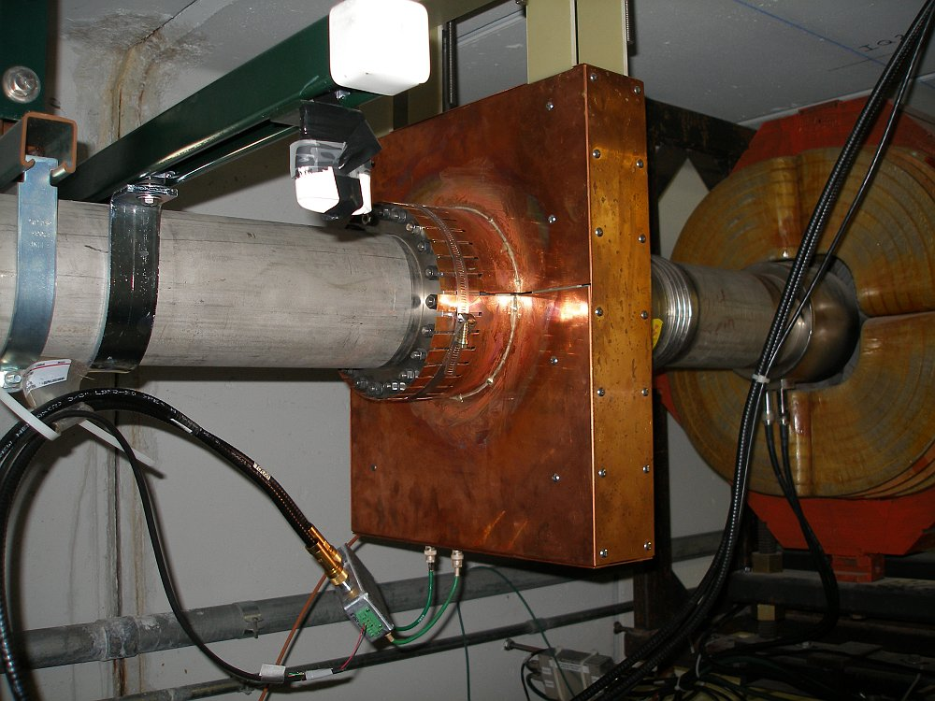
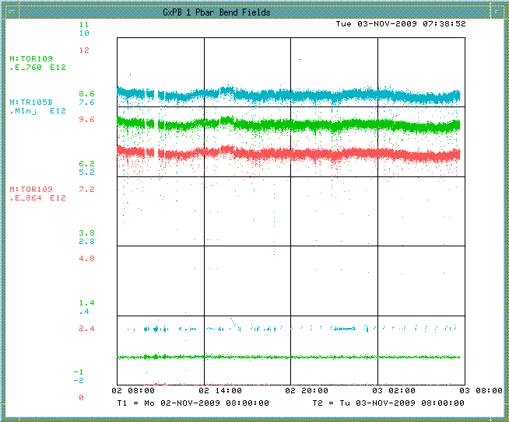
Toroid
Toroids exist in the transport lines to monitor beam intensity.
They are beam transformers that produce a signal that is proportional to the beam intensity (1V for every 1A of current).
Toroids in the P1, P2 and M1 lines will still be used to measure high intensity primary beam.
Previously toroids to measure low intensity secondary pbar beam measured 10¹⁰ but required high gain and careful filtering.
10¹⁰ particles in 1.6microsec is equivalent to 1mA of current through toroid.
Toroids in the M2 and M3 lines may not be able to measure the low intensity secondaries for g-2 operations, but will be able to be used for measuring the high intensity primary beam in Mu2e operations.
Notes:
Pearson single turn large aperture toroids are located in the transport lines to monitor beam intensity. They are beam transformers that produce a signal that is proportional to the intensity (1 V for every 1 A of current). The toroids make use of integrators that sample over a gated period that is defined by a Main Injector Beam Synch (MIBS) timer.
Two toroids in P1, one in P2, two in the M1 line, three in the old AP2 line and one in the D/A line.
Toroids configured for high intensity running can measure 10^12 or 10^13.
- Use existing Toroids and insulators in the P1, P2 and M1 beam lines. Some work needed on some of the stands, signal cables and calibration cables. A couple of Toroids may need to be added or moved. VME crate, controllers and timing cards re-purposed from other accelerator locations.
Toroids for low intensity pbars in the AP2 line measured 10^10 to 10^11, but won’t be able to be used in the M3 line. A pulse of 10¹⁰ particles in 1.6 microseconds is equivalent to 1 mA of current flowing through the toroid. This produces an output signal of only 1 mV, requiring high gain and careful filtering. In the AP2 line we connected to scopes.

Slide 13
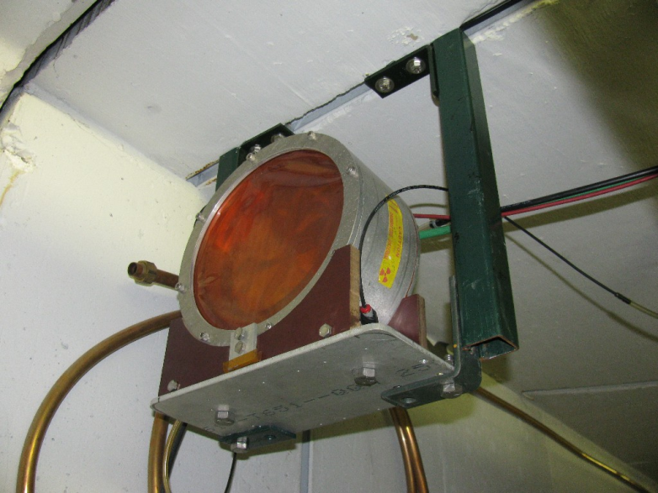
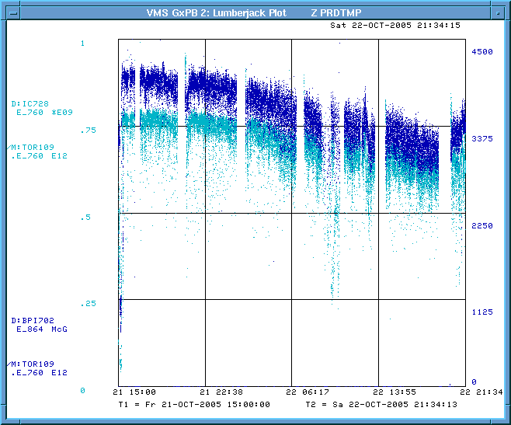
Ion Chamber
Contains a high voltage electrode and a signal electrode and is filled with gas (Helium, ArC02, etc…). Particles pass through the chamber and ionize the gas giving a signal proportional to beam intensity.
Can measure smaller beam currents than toroids.
Good for measuring beam in the 10⁵ to 10¹¹ range.
Ion chambers require a vacuum break and sometimes leak gas into the beam pipe.
Have a pool of spares available plus a couple potentially available from BNL.
For g-2 operations, we could put one at the end of the M2, one at the end of M3, one in the Debuncher and one in the g-2 line.
Will not be used for Mu2e operations.
Notes:
Requires a vacuum break, ArCo2, degrades beam quality.
Good for measuring beam intensities from 10^5 to 10^11
Used to use one in the AP2 line at the 728 location. Further back also at 704 and 806
-The ion chamber has a high voltage electrode at -300V and a signal
electrode contained in a chamber filled with helium gas. Secondary particles
traveling down the AP-2 line pass through the chamber and ionize the helium
resulting in a current path to the signal electrode. The result is a signal
proportional to the beam intensity.
-A small amount of helium passes out of the ion chamber through a
bubbler, however the loss rate is very small.
An ion chamber is able to measure smaller beam currents than a toroid
so it is an appropriate choice for low intensity secondaries.
- The ion chambers have a tendency to leak gas into the beampipe

Slide 14
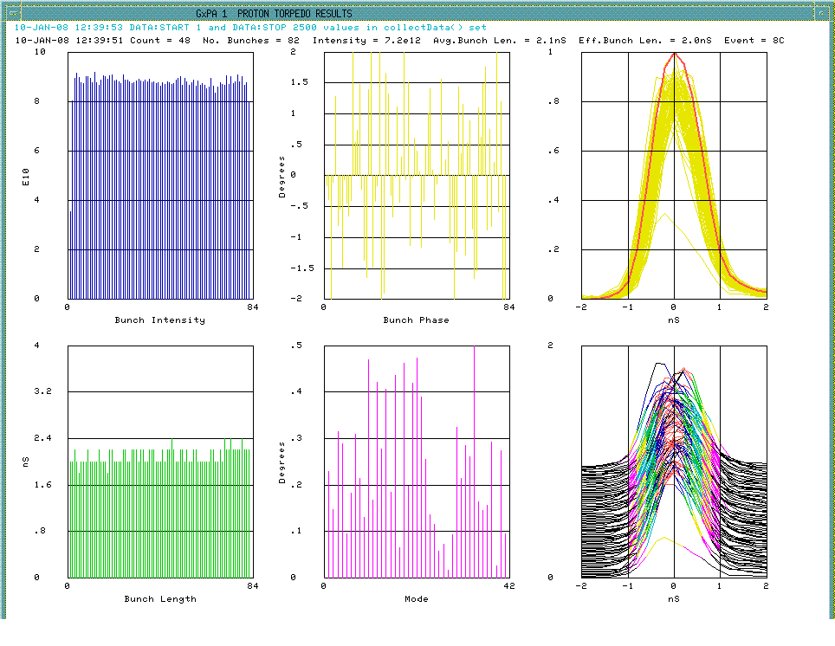
Wall Current Monitor
Wall current monitor could be used to measure the beam intensity.
For stacking we used a wall current monitor in AP1 for both stacking and unstacking.
For g-2 operations, we might be able to add a WCM to the Delivery Ring and/or the beam lines to measure low intensity circulating beam intensity.
Currently there is not a plan for using WCMs for Mu2e operations.
Notes:
Beam with a bunch structure causes current to flow on the inside of a metallic beam pipe, such as the stainless steel beam pipes used in the Antiproton Source. By breaking the metal beam pipe with an insulating ceramic gap and placing a resistor across the gap, one can measure the voltage drop across the resistor that is proportional to the beam current.
The frequency response of the pickup rolls off on the low end because of beam pipe conditions external to the pickup, so the pickup is housed in a shielding box loaded with ferrite material to provide a known value of inductance. The geometry of the ceramic gap and the resistors are chosen to form a properly terminated transmission line. The low frequency response of the wall monitor is determined by the time constant set by the ferrite (16 mH) and the gap resistance (0.5Ω), it is about 5 kHz. The characteristics of the ferrite inductors also set the high frequency response of the pickup. Two types of ferrites and a coating of microwave absorbing paint inside the shielding box are used to provide an even frequency response to 6 GHz.
As beam passes irregularities like bellows in the beam pipe, it induces microwave fields at frequencies determined by the dimensions of the beam pipe structures. That energy travels down the inside of the pipe and can be detected by the wall monitor. To avoid those noise problems, ferrite chokes are installed on both ends of the wall detector.
Signals are taken off the gap at four points around the circumference and summed to minimize sensitivity of the output signal to variations in beam position within the pipe. The overall sensitivity of the monitor, accounting for gap resistance, summing of the four signals, 50Ω terminating resistor, etc. is approximately 0.15Ω.

Slide 15
Beam Studies
120 Gev/c Protons
-8.89Gev/c
1E11
Stacking
Pbars
1)
target
AP1
704
AP2
733
120 Gev/c Protons
-3.1Gev/c
2)
target
AP1
704
AP2
733
8.9 Gev/c Protons
-3.1Gev/c
3)
target
AP1
704
AP2
733
120 Gev/c Protons
+3.1Gev/c
4)
target
AP1
704
AP2
733
8.9 Gev/c Protons
+3.1Gev/c
5E7
Similar
to
g-2
5)
target
AP1
704
AP2
733

Slide 16
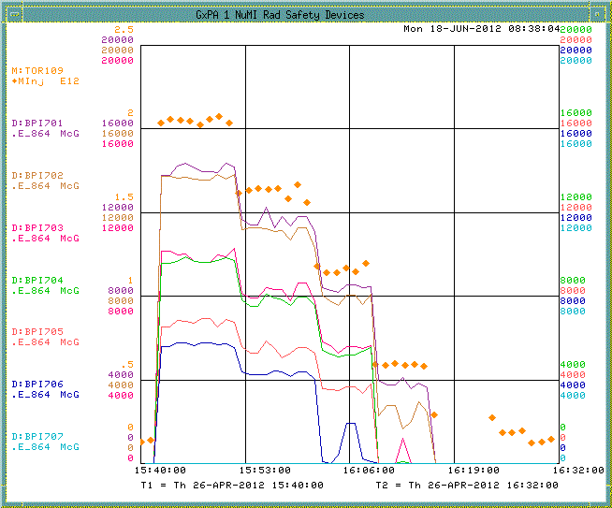
AP2 BPMs
8.9Gev/c primaries, 3.1 GeV/c positive secondaries.
Beam intensity plot stepping down from 2E12 on target to ~1E11.
Only first couple of BPMs in the AP2 line have intensity data with 1E12 POT.

Slide 17
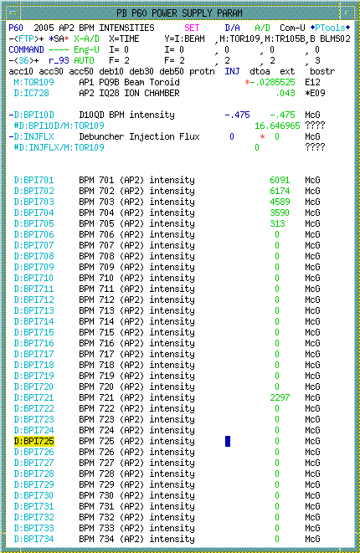
AP2 BPMs
1E12 8.9Gev/c primaries, 3.1 GeV/c positive secondaries.
We only see beam intensity data on the first five BPMs.
Units are not calibrated to number of particles.
This beam that is eighty 53MHz buckets and not a single 2.5MHz bucket as will be seen in g-2 operations.

Slide 18
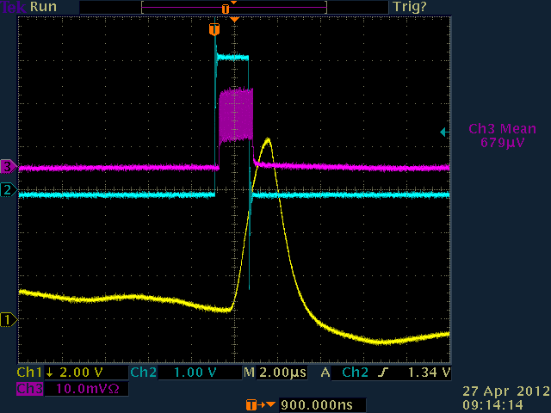
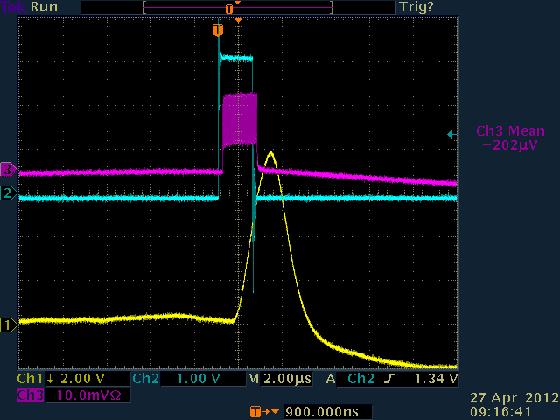
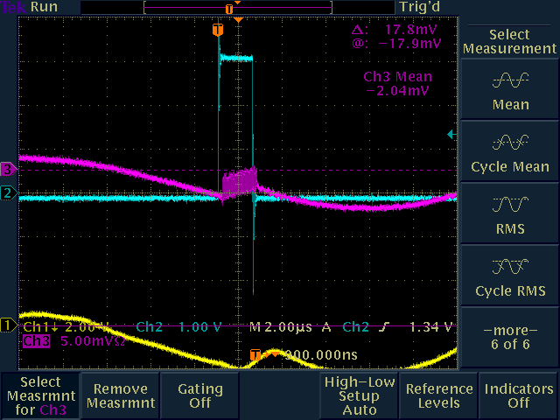
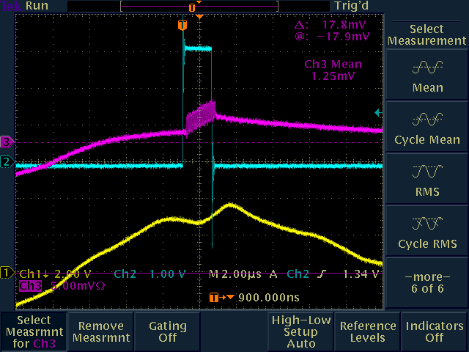
Tor704 Test Signal Response
2E9
Test Pulse
2E8
Test Pulse

Slide 19
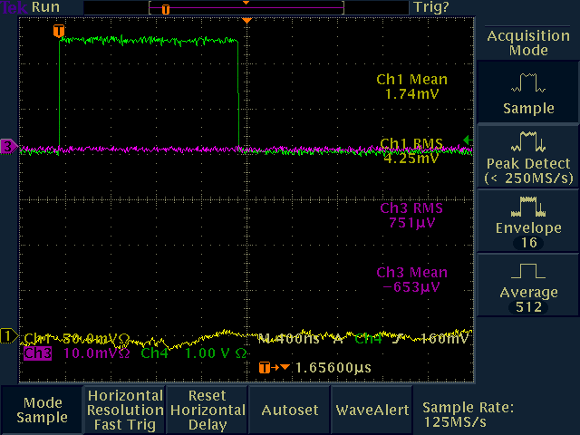
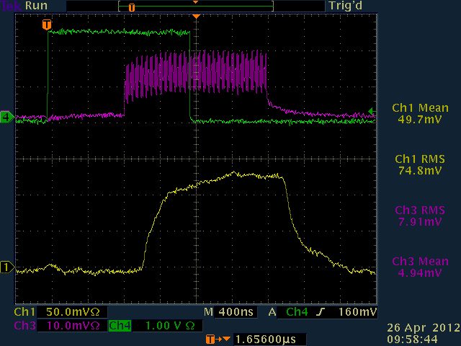
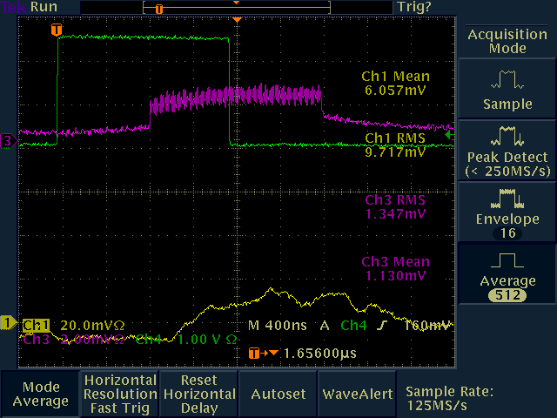
Tor724 Test Signal Response
No Signal
2.4E9
Test Pulse
2E8
Test Pulse

Slide 20
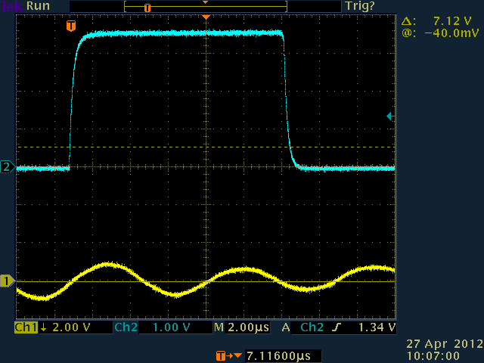
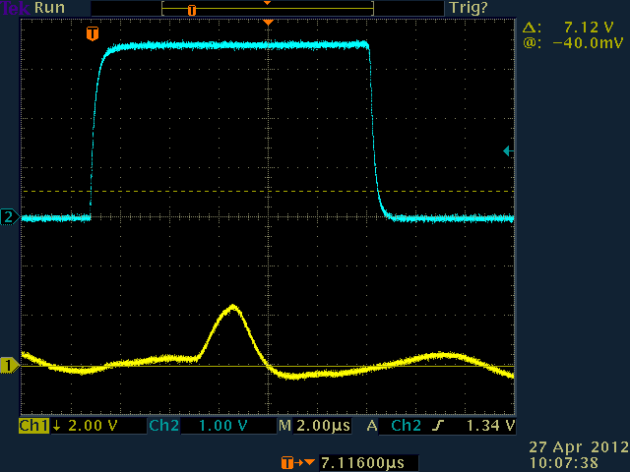
Tor704 Beam Response
No Beam
Beam
Similar conditions to g-2 we see a small beam signal.
  1E12 protons on target (8.9 GeV/c) with 3.1 GeV/c secondaries
  OAC shows 2e9, but based on calibration signal we are more like 5e8.
Model shows beam at Tor724 should be a factor of 8 reduction. We see no signal at 724.

Slide 21
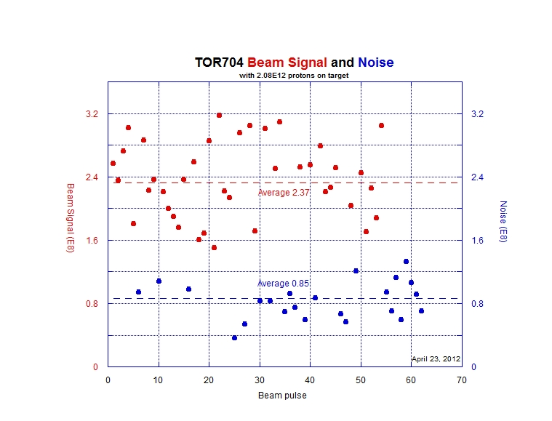
Tor704 Beam Response
J. Morgan
2.08E12 8.9Gev/c primaries, 3.1 GeV/c negative secondaries.
Approximately double the POT that will be used for g-2.
Average intensity 1.5E8 with signal subtracted from noise.
Cary’s simulation results predict 1.02E8

Slide 22
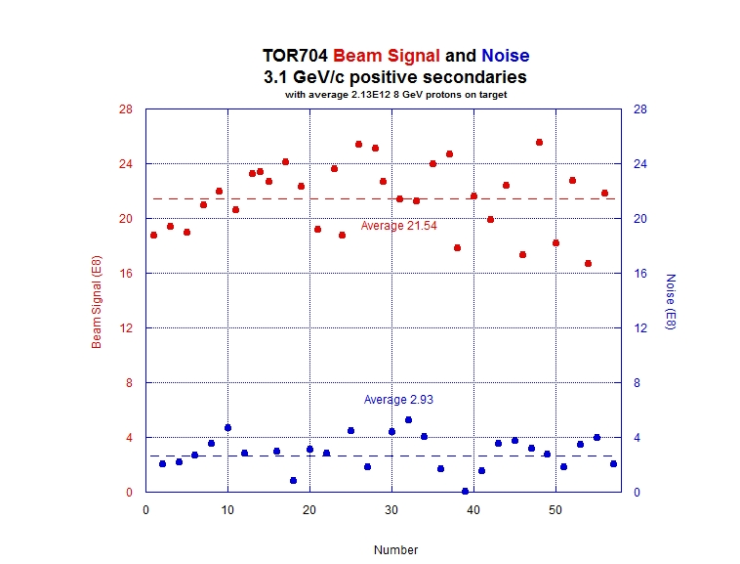
Tor704 Beam Response
J. Morgan
2.13E12 8.9Gev/c primaries, 3.1 GeV/c POSITIVE secondaries.
Approximately double the POT to be used for g-2.
Average intensity 1.86E9 with signal subtracted from noise.
Cary’s simulation results predict 4.7E8

Slide 23
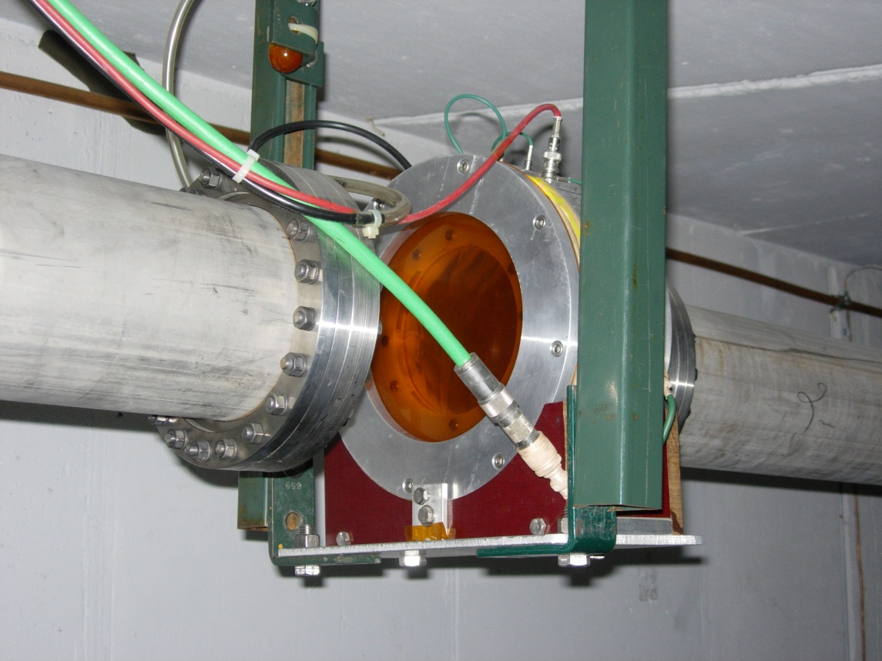
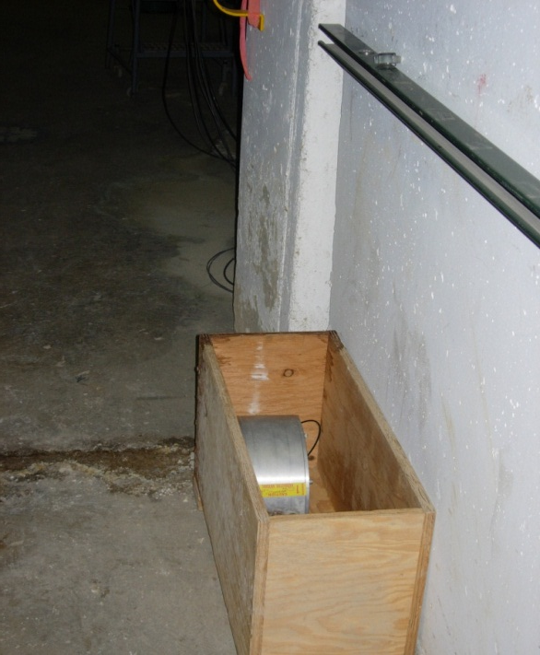
IC728
Original ion chamber.
Removed, but still in the tunnel
Believed to have a gas leak
Second ion chamber was installed.
No gas leak, but relative calibration is questionable.

Slide 24
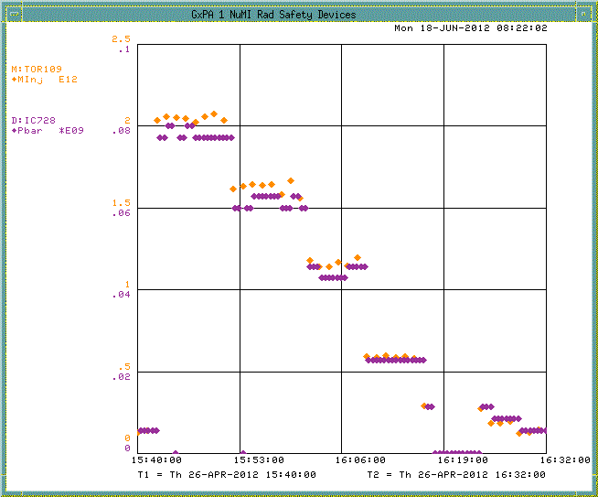
IC728 Beam Response
8.9Gev/c primaries, 3.1 GeV/c positive secondaries.
Beam intensity plot stepping down from 2E12 on target to ~1E11.
Ion chamber tracks beam on target.
Ion chamber intensities read 8E7 down to ~5E6.

Slide 25
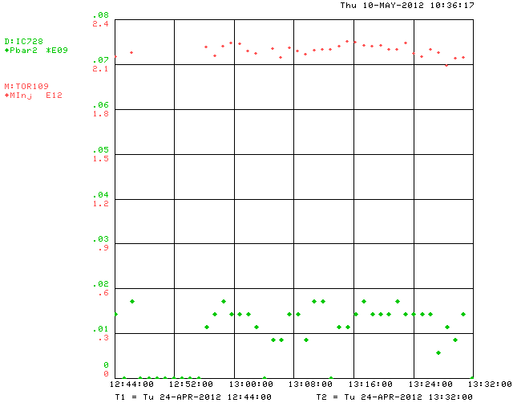
IC728 Beam Response
J. Morgan
2.2E12 8.9Gev/c primaries, 3.1 GeV/c negative secondaries.
Approximately double the POT that will be used for g-2.
Ion chamber measures ~1.5E7.
Cary’s simulation results predict 6.7E6.

Slide 26
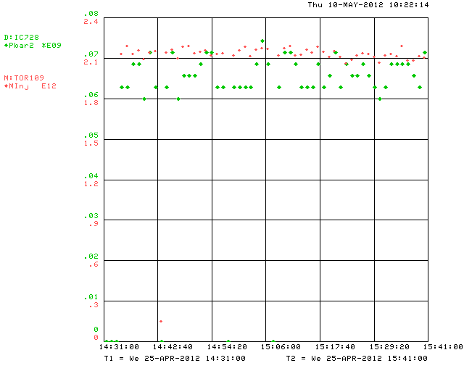
IC728 Beam Response
J. Morgan
2.1E12 8.9Gev/c primaries, 3.1 GeV/c positive secondaries.
Approximately double the POT that will be used for g-2.
Ion chamber measures ~6.6E7.
Cary’s simulation results predict 6.7E7.

Slide 27
Summary
Intensity measurement studies were made with beam intensity conditions similar to that expected for g-2 operations:
  1E12 primary proton beam on target at 8.9GeV/c.
  3.1 GeV/c secondary beam in the AP2 line
The RF structure of the beam during our studies did not match g-2 operations.
  Studies: 1.69usec bunch train of eighty 53MHz bunches
  g-2 operations: Single 120nsec 2.5MHz bunch

Slide 28
What’s next?
After the current long shutdown we will have another opportunity to complete beam intensity studies.
What options exist for
  BPMs
  Toroids
  Ion Chambers
  Wall Current Monitor
  SEMs (covered in last weeks’ meeting)

Slide 29
Meeting Notes (1/2)
Peter has some confidence that they will be able to see M2 and M3 line beam on the BPMs.
  The 1e12 single bunch 2.5MHz beam should be easier to see than the same beam spread over eighty 53MHz bunches.
  Dynamic range is 55dB.
Toroids
  Don’t have a good high frequency response. Will be harder to see the 2.5MHz beam.
  The Preamp shielding was good enough for stacking beam, but we will likely need additional shielding around the toroids for g-2 and Mu2e operations.
Ion chambers
  Calibration depends on gas type, distance between anode and cathode and pulse length.
  Bunch structure and sign of the charge do not have a large factor on bunch structure.
  The best that an ion chamber can be calibrated is about 5%.
  Ion chambers (non-retractible) are inexpensive, or about 10%.
Wall Current Monitors
  Peter is making a prototype to measure spill intensity for Mu2e. If it works, it would also work to measure low intensity (e7) secondaries for g-2.
  Can cost $30K to build, so it is not a cheap option.
Cerenkov Counter
  Has arrived from BNL and is at receiving.
  Other instrumentation (SWICs) have not arrived from BNL.

Slide 30
Meeting Notes (2/2)
Peter Prieto requests information on:
  Exact frequency of RR RF? Delivery Ring RF?
  Full bunch structure of 120nsec bunch length beam? Sigma?
  BNL instrumentation literature (look up author Brown)
  What is the percent beam loss through vacuum windows at IC728?
  What is the percent beam loss through IC728
    Gianni believes that the majoirty of the beam loss is in the vacuum windows on either side of the ion chamber.

Slide 31
References
J Morgan, B Drendel, et al, Antiproton Source Rookie Book, Fermilab Accelerator Division Document Database #2872, June 2010.
B. Drendel, Accelerator Controls and Instrumentation for Mu2e and g-2, g-2 Document Database #159
S. Werkema, Control of Trapped Ion Instabilities in the Fermilab Antiproton Accumulator, Proceedings of the 1995 Particle Accelerator Conference, p3397, May (1995).
K. Unser, A Toroidal DC Beam Current Transformer with High Resolution, IEEE Transactions on Nuclear Science, Vol. NS-28, No.3 , June 1981.
S.D. Holmes, J.D. McCarthy, S.A. Sommers, R.C. Webber, and J.R. Zagel, The TEV I Beam Position Monitor System.
J. Zagel, SEM Test Event Generator = STEGOSAUR, Unpublished.
K. Gollwitzer, D. Peterson, J. Budlong, M. Dilday, D. Nicklaus, Patrick Sheahan, Antiproton Source Debuncher BPM using Synchronous Detection, Beams Document Database #1019, http://beamdocs.fnal.gov/AD-public/DocDB/ShowDocument?docid=1019, February, 13, 2004.
Bill Ashmanskas, Debuncher BPM Intensity, http://pbardebuncher.fnal.gov/wja/docs/bpi10d/, May 22, 2006.
Bill Ashmanskas, AP2 BPM Boards, http://pbardebuncher.fnal.gov/wja/docs/ap2bpm/, March 2007.

Slide 32
References
Nathan Eddy, Elvin. Harms, Requirements for P1, P2, AP1, AP3, A1 line BPM upgrades, Beams Document Database #1279, https://beamdocs.fnal.gov/AD-private/DocDB/ShowDocument?docid=1279, September, 2004.
Nathan Eddy, Rapid Transfer BPM 53MHz Signal Expectations, Beams Document Database #1768, https://beamdocs.fnal.gov/AD-private/DocDB/ShowDocument?docid=1768, April, 2005.
Nathan Eddy, BPM Filter Module for Transfer Lines, Beams Document Database #1849, https://beamdocs.fnal.gov/AD-private/DocDB/ShowDocument?docid=1849, May 2005.
Nathan Eddy, Beam Monitoring and Control with FPGA Based Electronics, Beams Document Database # 2541, https://beamdocs.fnal.gov/AD-private/DocDB/ShowDocument?docid=2641, February, 2007.
Vic Scarpine, First Tests of an Optical Transition Radiation Dector for High-Intensity Proton beams at Fermilab, Beams Document Database #846. https://beamdocs.fnal.gov/AD-private/DocDB/ShowDocument?docid=846, September 23, 2003.
Vic Scarpine, Prototype OTR Design Review. Beams Document Database #555. https://beamdocs.fnal.gov/AD-private/DocDB/ShowDocument?docid=555, April 10, 2003.
Vic Scarpine, Optical Transition Radiation (OTR) Detectors and Beam Diagnostics. Beams Document Database #2110, https://beamdocs.fnal.gov/AD-private/DocDB/ShowDocument?docid=2110, January 24, 2007.
Vic Scarpine, G. R. Tassotto, A. H. Lumpkin. Proposed OTR Measurements of 120 GeV Proton and Antiprotons at FNAL, 2004 Beam Instrumentation Workshop, 2004.

Slide 33
Supplemental Slides
Slides presented to the AD/Controls and AD/Instrumentation Department in 2011 and 2012.

Slide 34
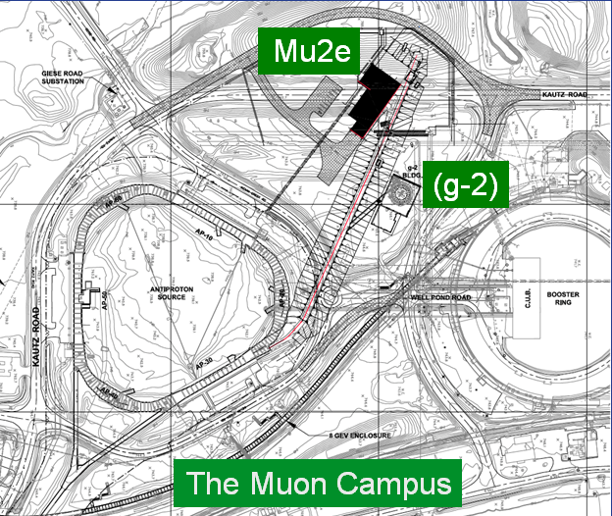
Muon Campus
Pbar Department changed to Muon Department
The Beam lines and Ring(s) may be combined into a “muon campus” that would serve multiple experiments
    Muon g-2
    Mu2e

Slide 35
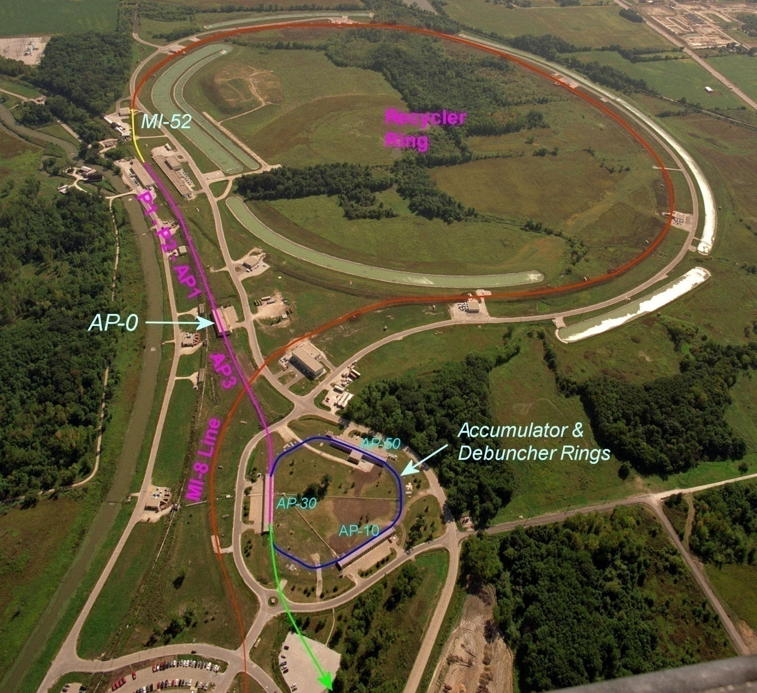
Beam path from Booster to the g-2 and Mu2e experiments
  A Booster batch of intensity ~4E12 is sent to the Recycler.
  The batch is divided into 4 2.5 MHz bunches, which are individually extracted to the Debuncher.
External beamline
J. Morgan

Slide 36
Beam path from Booster to the g-2 and Mu2e experiments
The bunches are transported to either the Target Station at AP0 or Debuncher via multiple beam lines
Extracted at MI-52 from Recycler to the P1 beam line (new)
g-2:
P1 → P2 → AP1 → Target Station → AP3 → Debuncher Ring
Mu2e:
P1 → P2 → AP1 → AP3 → Debuncher Ring
External beamline
J. Morgan

Slide 37
Beam path from Booster to the g-2 and Mu2e experiments
New AP-3 to Debuncher beam line connection for final 50 meters
Abort in 50 straight section can be used for:
  g-2: proton removal
  Mu2e: proton clean-up
Beam in Debuncher is extracted to the external beamline (new)
  g-2: entire pulse extracted at once
  Mu2e: Beam resonantly extracted.
External beamline
J. Morgan

Slide 38
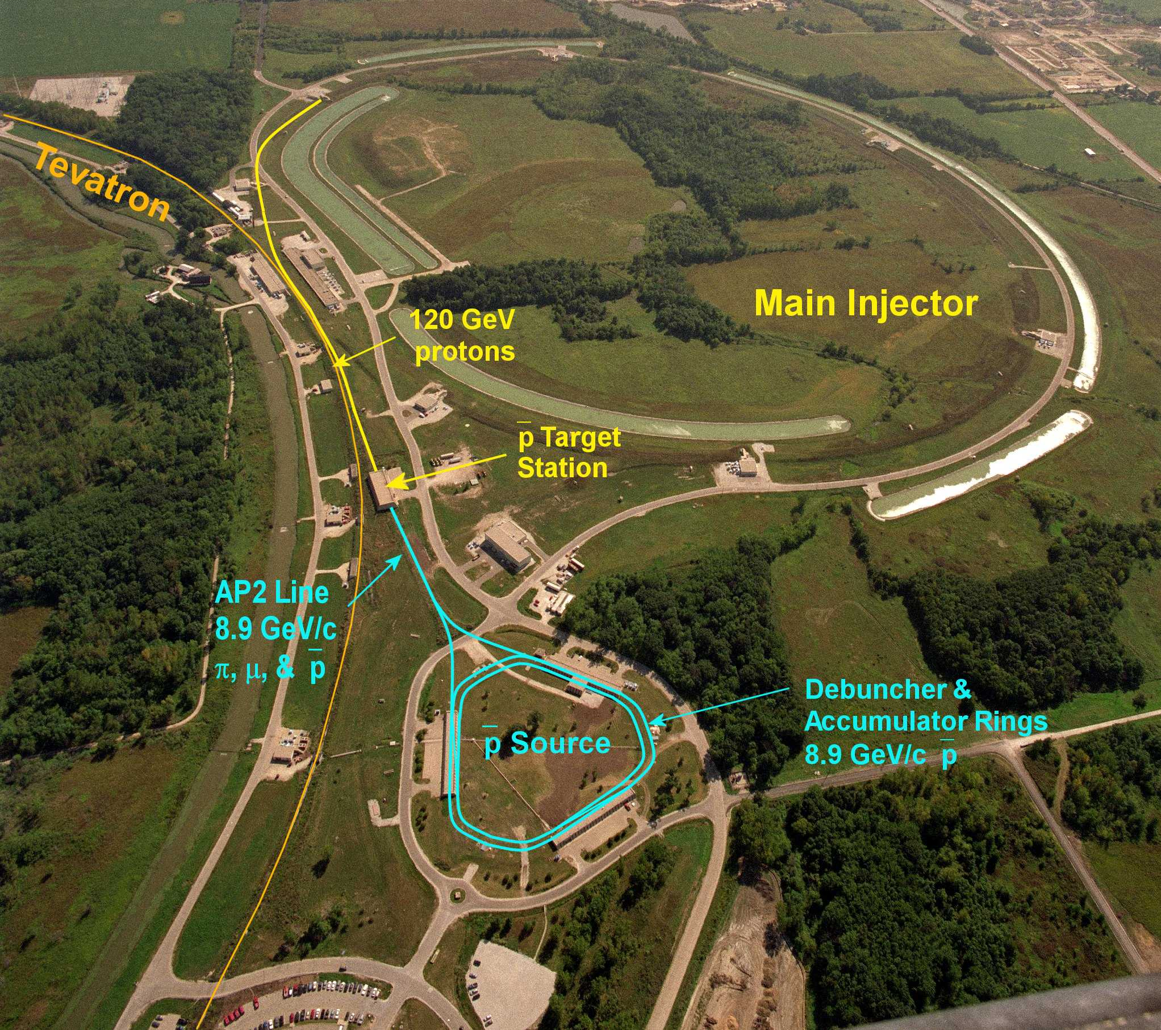
What we’re starting with – the Pbar source

Slide 39
Antiproton Source
Beam lines
  A 120 GeV/c proton beam is transported to the Target Station via AP-1 every 2.2 seconds
An 8.89 GeV/c negative secondary beam travels down AP-2 and is injected into the Debuncher
8.89 GeV/c antiprotons are bunch rotated and stochastically cooled in the Debuncher, then transferred to the Accumulator via the D/A line
Antiprotons are accumulated over hours, then transferred to MI via the AP-3 and AP-1 lines
8.89 GeV/c protons can be “reverse injected” or sent in the reciprocal direction of the antiprotons for tune-up

Slide 40
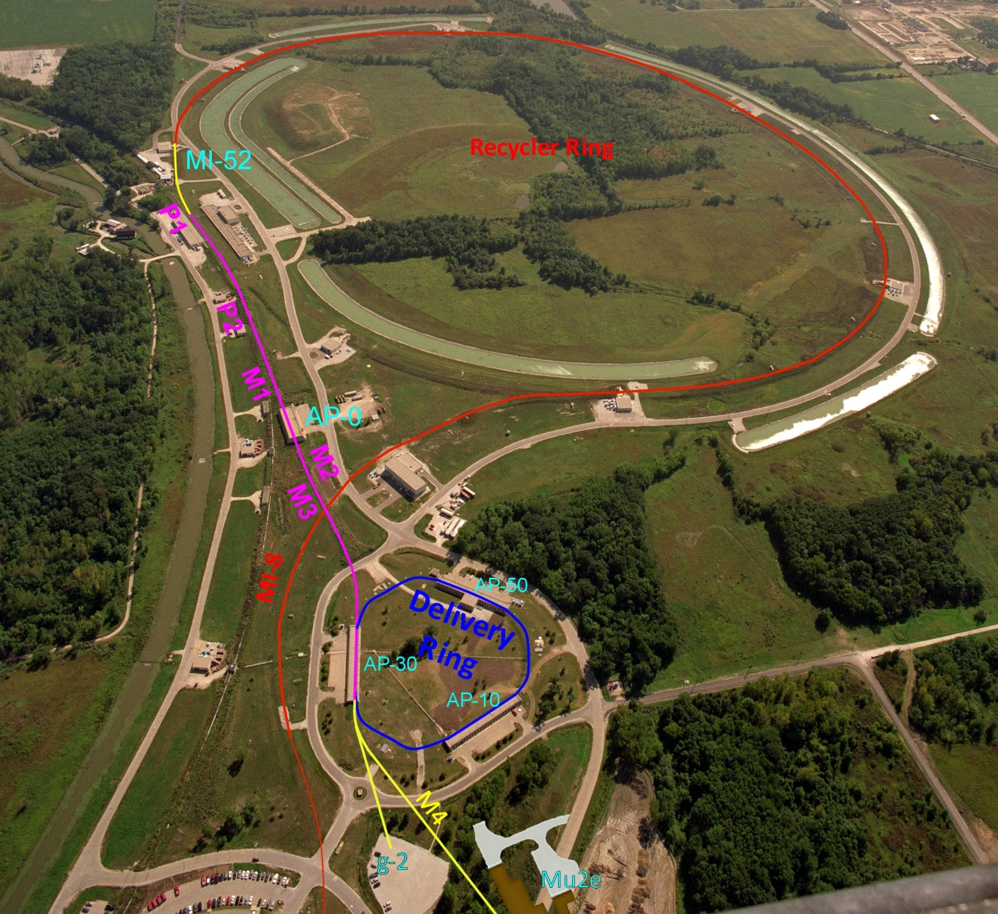
Beam path from Booster to the g-2 experiment
  An 8.89 GeV/c Booster batch is sent to the Recycler, where it is divided into 4 2.5 MHz bunches, which are individually extracted to the Debuncher
The bunches are transported to the Target Station at ~10 ms intervals
Extracted at MI-52 from Recycler to the P1 beam line
P1 → P2 → M1 → Target Station
The 3.1 GeV/c secondary beam is transported to the Delivery Ring
Target Station → M2 → M3 → Delivery Ring
Mu2e Abort in 50 straight section can be used for g-2 proton removal
Beam in Debuncher is extracted to the M4 line
The g-2 line connects M4 to the g-2 experimental hall

Slide 41
g-2/Mu2e Configuration
  The Accumulator and D/A line are no longer needed and will be used for parts
  M1 is the new name for AP-1, apertures will be improved to accommodate the larger 8.89 GeV/c primary beam
AP-2 will be removed and a similar, but shorter, secondary line will be called M2
The secondary beam will be transported to the D30 straight section instead of D50
The new line connecting M2 to the Delivery Ring in the D30 straight section will be called M3
M2 and M3 will have a higher quadrupole density than AP-2 did (4 m spacing upstream of bend, increasing to 6 m downstream)
M3 needs to be designed for use by both g-2 and Mu2e
The old injection region for AP-2 will become an abort for Mu2e and could be used for proton removal for g-2
The extraction line will be called M4
The g-2 line connects M4 to the experiment

Slide 42
Muon g-2
Beam lines
  An 8.89 GeV/c proton bunch, 120 ns long, is transported to the Target Station via M-1 at an average rate of 12 Hz, with 100 Hz bursts (16 bunches, 10 ms interval)
A 3.1 GeV/c Positive secondary beam travels down M2 and M3 and is injected into the Debuncher in the 30 straight section with Lambertsons and a kicker
Some of the pions decay into 3.09 GeV/c muons as they travel down M2/M3
The M2 and M3 lines have an increased quadrupole density to improve muon efficiency
Muons can circle the 550 meter Debuncher as many times as desired
The abort located in the 50 straight section can be used to remove protons
3.09 GeV/c muons are extracted into the M4 line, then bends into the g-2 line that transports them to the experiment

Slide 43
Mu2e needs to use the same Beam lines
What’s different?
  An 8.89 GeV/c proton bunch, 120 ns long, is transported to the Debuncher via AP-1 and AP-3 (bypassing the Target Station) at an average rate of 6 Hz with 18 Hz bursts
The 8.89 GeV/c bunch is injected into the Debuncher in the 30 straight section with Lambertsons and a kicker
A 2.5 MHz RF system maintains the short bunch as it circulates in the Debuncher
The proton bunch is resonantly extracted with an electrostatic septum and Lambertsons into the Extraction beam line, that transports them to an external Target Station to produce an intense muon beam
The remaining proton beam that is not resonantly extracted is aborted in the 50 straight section and transported to a dump

Slide 44
Recycler to P1 line connection
From Mu2e CDR
Recycler
Q523
Q522
Q521
Q520
ODH Barrier
Q901
RRLAM
Q903
Q902
0.7364 m
HBend
Q904
P1 line
Q706
Q705
Q704
Q703
Q702
Q701
I:LAM52
VBend
C
B
A
Main Injector
V700
Q527
Q526
Q525
Q524
Q523
Q522
Q521
Q520
New beam line connects Recycler to P1 line.
Meiqin Xiao

Slide 45
John Johnstone

Slide 46
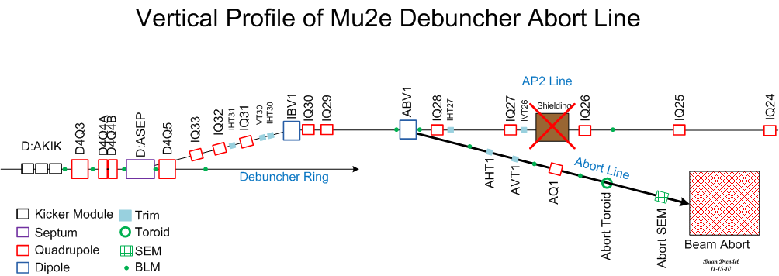
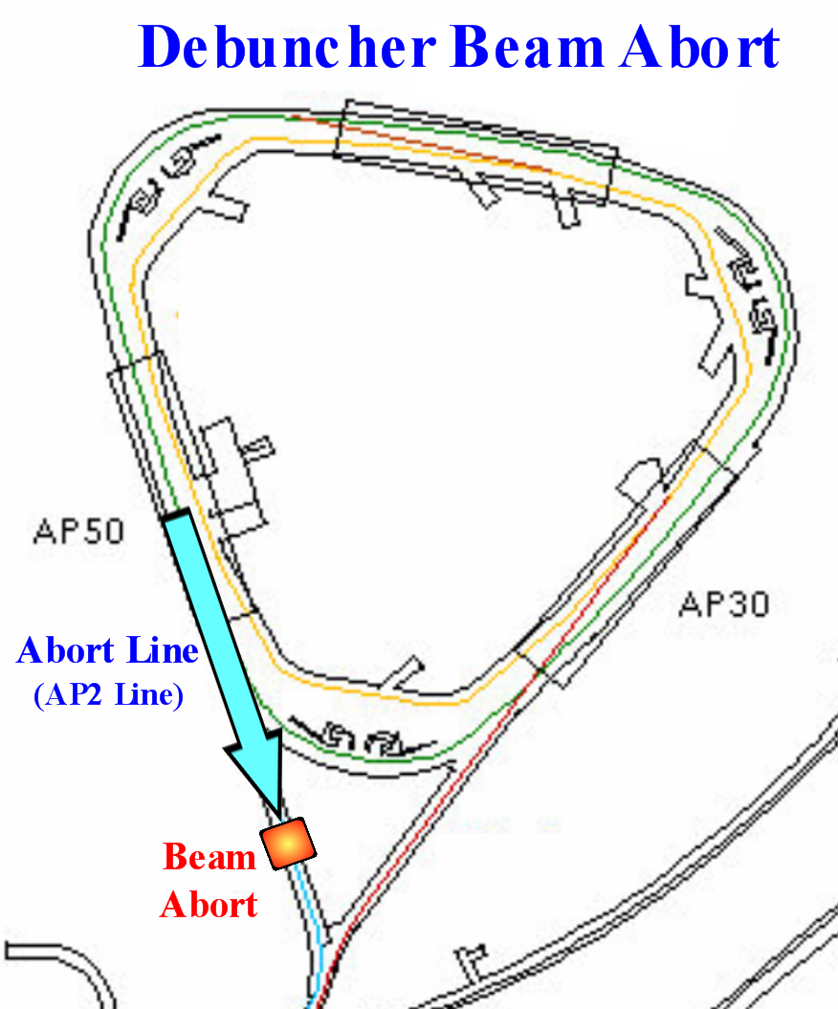
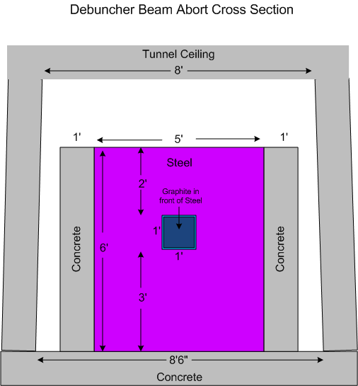
Beam abort/proton removal
D50
Transport

Slide 47
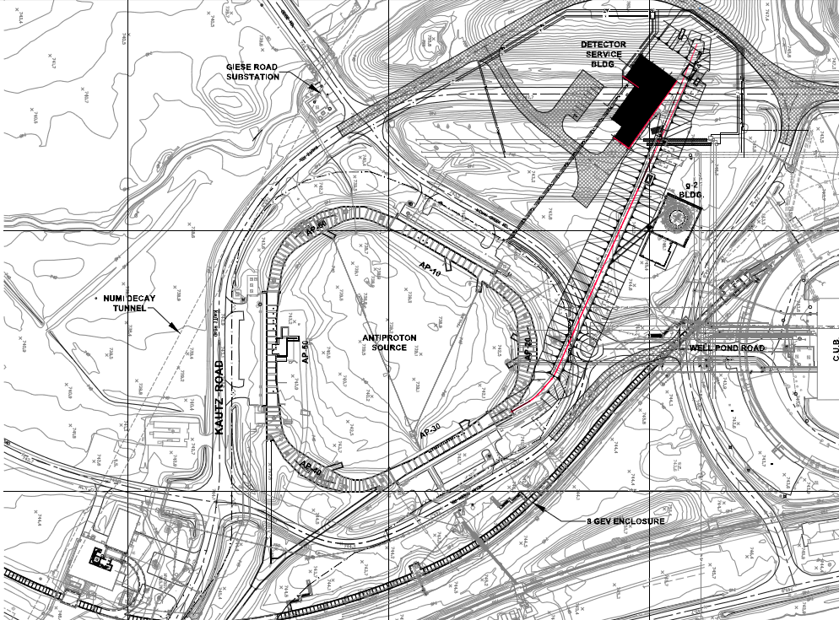
External beam line
Mu2e
g-2

Slide 48
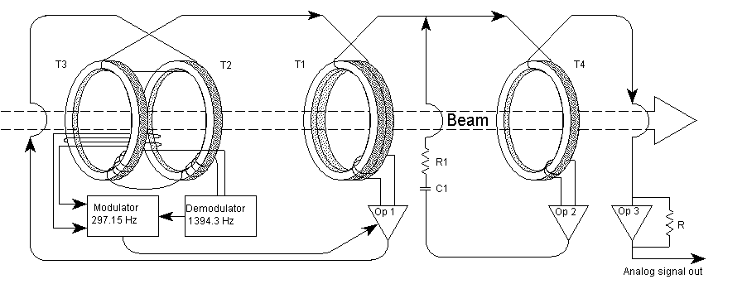
Direct Current Current Transformer
DCCT was the primary intensity measuring device in the Debuncher Ring.
    Accuracy is one part in 10⁵ over the range of 10¹⁰ to 300 x 10¹⁰ of beam current.
    Due to the slow sample rate and large beam intensity scale, the DCCT is not useful to measure the low intensity secondary beam that will circulate a small number of turns around the Debuncher ring during g-2 operations.
    The DCCT will be used to measure beam intensity for Mu2e operations.
Notes:
-A DCCT or Direct Current Current Transformer is a device used to measure the quantity of circulating beam with high precision. Accuracy is one part in 10⁵ over the range of 10^10 to 300 x 10^10 of beam current.
The pickups are supermalloy tape-wound toroidal cores with laminations, which act to reduce eddy currents. Beam goes through the hole of the donut and acts as a single turn on the toroid transformer. The beam sensing electronics are attached to wire windings on the toroids. Passing beam induces magnetic flux in the toroids and the electronics sense the second harmonic of the 801 Hz pilot signal (caused by the non-linear hysteresis characteristics of the toroid) and produces an equal and opposite current that minimizes the harmonic and thus keeps the net toroid flux at zero. T1 senses the AC portion of the beam while T2, T3, the modulator, and demodulator sense the signal caused by the DC portion. The DC and AC signals are summed in OP1, which drives each toroid just hard enough to cancel the beam-induced flux. The beam cancellation signal is measured across the heatsinked power resistor R. The accuracy of the measurement is dependent on the resistance staying constant.
The DCCT toroids are contained in 40 inch long by 10 inch diameter structures that reside in straight section 10 of both rings. Signals go to a receiver chassis upstairs at AP10. Each receiver chassis has a slow (1 Hz), medium (100 Hz) and fast (220Hz) output. Each output can be configured to be sampled on a small scale (5 mA/V) or full scale (40 mA/V).
Due to the slow 1 Hz sample rate and large beam intensity scale, D:IBEAM is not useful to measure g-2 beam

Slide 49
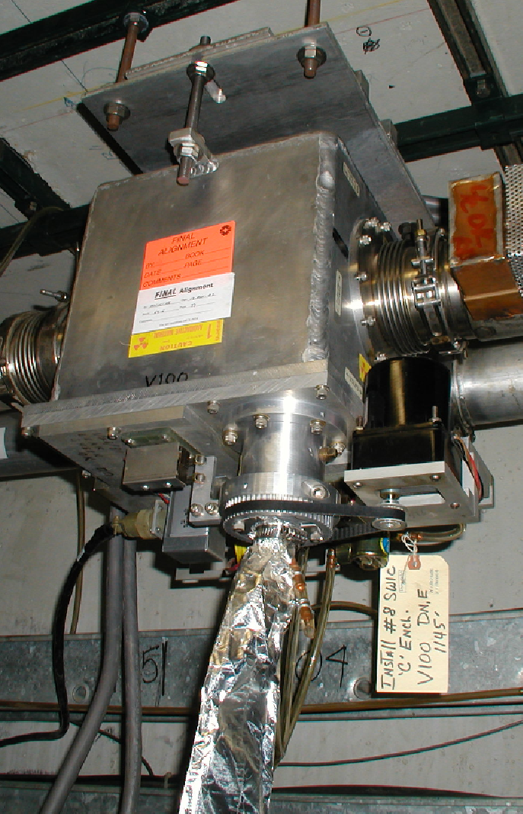
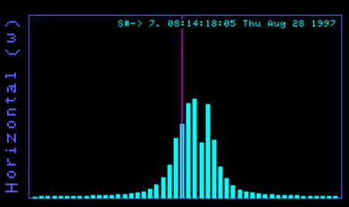
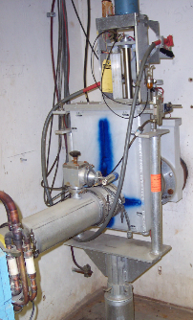
Segmented
Wire
Ion
Chamber
Displays transverse beam profiles using 48 horizontal and 48 vertical wires
Measures beam intensities from 10⁵ to 10¹³, so they can be used to measure the low intensity secondaries.
Destructive beam measurement. 7E9 lost in one pass from 5E12.
Two styles: SY and Bayonet (spare pool?).
ArC0₂ gas flows through vacuum can.
3-4 mil titanium vacuum window.
Vacuum boxes don’t normally hold good vacuum. 10⁻⁶ torr at best.
SWICs could be used in the M2, M3, Debuncher, M4 and g-2 lines for g-2 operations.
There is no plans to use SWICs for Mu2e operations.
Notes:
48 Horizonal and 48 vertical wires near ground. Center diagonal at HV
ArC02 gas flows through vacuum can
3 to 4 mil titanium vacuum window separates vacuum can from beam line
Gas ionizes – positive ions move toward signal wires.
Destructive measurement of beam.
Each SWIC loses 7E9 per 5E12
Two styles – SY (square box – wires rotate vertically) and Bayonet can (wires move up/down)
Vacuum cans have 4” beam flange, but can accommodate up to 6”
Wire spacing 0.5 to 3mm
Measure beam intensities from 10^5 to 10^13.
Instrumentation doing an inventory from spares. There appears to not be enough spares to cover everything, so additional ones would have to be made.
Vacuum boxes don’t normally hold good vacuum. 10^-6 tor at best.

Slide 50
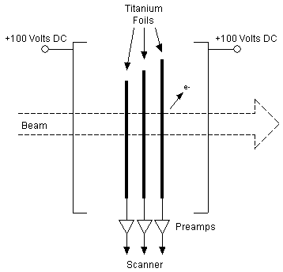
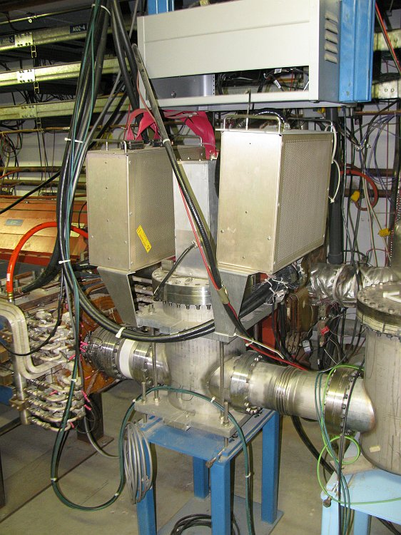
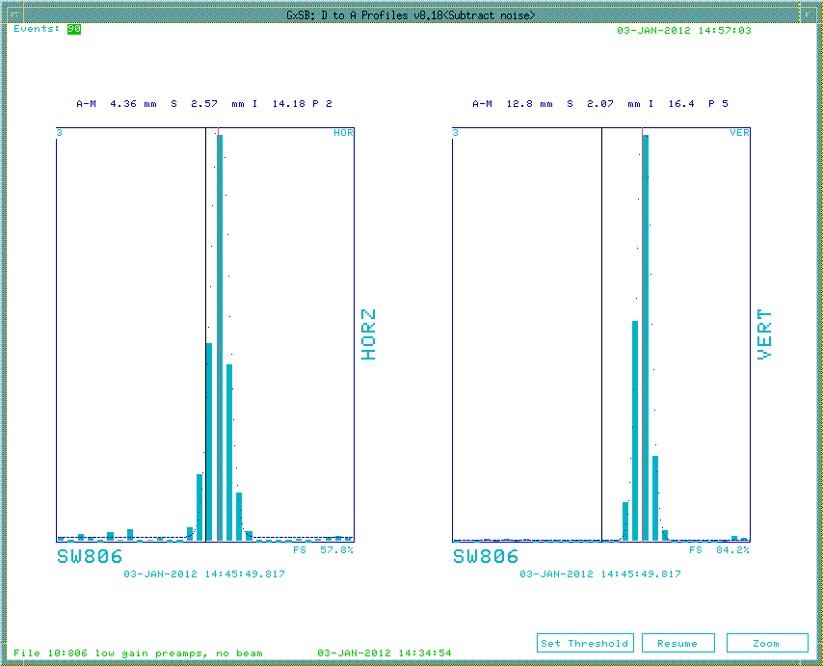
Secondary
Emission
Monitor
Measure the beam profile using 30 horizontal and 30 titanium strips.
Beam particles have elastic collisions with the strips, dislodging them, creating current. 2.5% to 5% efficient.
Destructive measurement like the SWIC, but operate at beam pipe vacuum and have no gas.
Originally thought to be not sensitive enough for secondary beam.
D/A line SEMs have special high gain preamps that make them 260 times more sensitive. Three D/A SEMs and one spare.
Instrumentation investigating to see if they could make this work with g-2 secondaries.
SEMs “may” be able to be used for low intensity secondaries in the M2, M3, Debuncher, M4 and g-2 lines for g-2 operations.
SEMs can be used for occasional diagnostics in the beam lines for M2e operations.
Notes:
SEM grids are used to measure the beam profile in the horizontal and vertical planes. SEMs consist of rows of 30 vertical and 30 horizontal titanium strips that can be placed in the path of the beam. Beam particles have elastic collisions with electrons in the strips and dislodge them (see figure 7.8). This causes a current to flow in the strips, which is amplified by preamplifiers.
Wire spacing is either 1.5mm or 3mm and most are 3mm.
For every forty protons or antiprotons passing through the SEM, one electron is dislodged yielding a detector efficiency of 2.5%. A
clearing voltage of +100 VDC can be applied to foils placed before and after the strips to improve the work function of the titanium and double the efficiency to 5%. Since a small amount of the beam collides with the titanium strips, SEM grids are not completely passive devices. Most SEM grids are located in the transport lines, although a few are located near injection and extraction points in the rings to be used during initial tune-up. If one of the ring SEM grids is left in, beam will be rapidly lost.
The SEM grids operate at beam pipe vacuum pressure and thus have no gas gain like the Segmented Wire Ionization Chambers (SWICs) found in Switchyard. Preamp boxes are used to amplify the signals generated by the SEM. Preamp boxes contain a pair of motherboards with 30 preamp boards plugged into each (one horizontal and one vertical set). Some versions of the preamp box have charge splitters that, when selected, attenuate the signal to the preamps 15 times when the charge split input is +5V. D to A line SEMs use preamps with two available gain configurations. Switching the gains requires a tunnel access. D to A line SEM gains are up to 260 times more sensitive than those of the other SEMs due to the low beam intensities found during stacking.
P1, P2, AP1 and AP3 :
Existing SEM/Multiwire tunnel hardware will be used.
Some refurbishing will be required on some of the cans.
Electronics will be upgraded to an instrumentation standard.
Debuncher There is currently one SEM in the Debuncher Ring.
Debuncher Abort One or two existing AP2 SEMs can be used for the Debuncher abort line
Extraction Line Need to develop a plan for SEMs in the extraction line.
BNL SWICS and/or ion chambers
Instrumentation experts will determine if we can use the SWICs and Ion Chambers used by the BLN g-2 decay line.

Slide 51
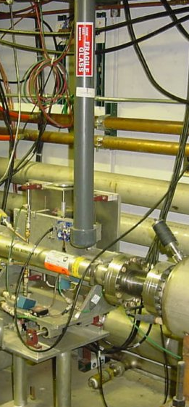
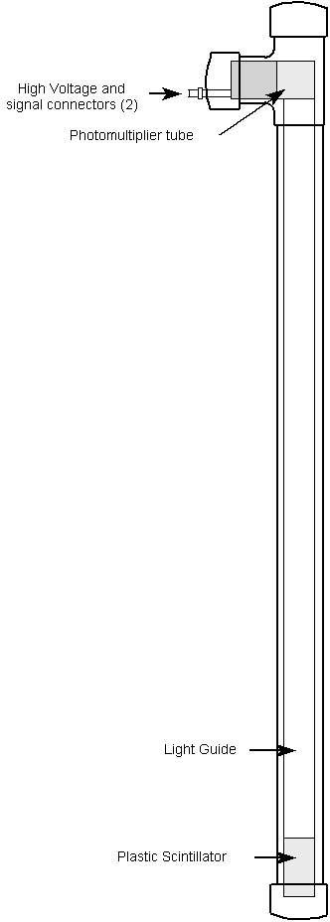
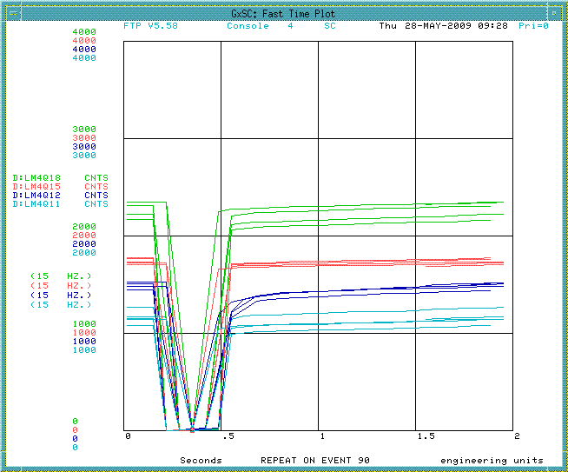
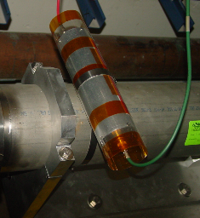
Beam Loss Monitor
Tevatron ion chamber loss monitors (lower left) will be used in the P1, P2 and M1 lines.
No coverage in M2, M3 M4 and g-2 lines.
More sensitive plastic scintillator design (top left and right) already exist in the Debuncher. This is being upgraded to the ion chambers for Mu2e. This may be a problem if we have to switch back and forth between g-2 and Mu2e.
Notes:
- There are two types of Beam Loss Monitors (BLMs) in the Antiproton Source, ion chamber and plastic scintillator with a photomultiplier tube (PMT). The ion chamber BLMs can be found in the P1, P2, AP-1 and part of the AP-3 beamlines and are used to monitor losses during stacking and pbar transfers. The plastic scintillator BLMs are distributed throughout the Accumulator and Debuncher rings and can be used for studies or for locating loss points.
- The ion chamber monitors are the same as those used in the Tevatron. The BLM detector is a sealed glass ion chamber with a volume of 110 cubic centimeters that is filled to 1 atmosphere with Argon. A high voltage power supply is daisy- chained to a string of BLMs and provides about a 1,500 Volt bias to the chamber. The output goes upstairs on an RG58 signal cable to a beam loss integrator and then to a Multiplexed Analog to Digital Converter (MADC). The MADC is read by the control system in the usual way.
- The plastic scintillator design BLM is sensitive to a small number of particles, something the ion chamber loss monitors aren’t. The loss monitors are made up of a 4"x2"x1/2" piece of plastic scintillator glued to a 36" long Lucite light guide (see Figure 7.3). At the end of the light guide, a small Lucite coupling attaches it to an RCA 4552 PMT. The PMT's were recycled from old “paint can” loss monitors and are relatively rugged. The intent of the light guide is to keep the scintillator near the magnets but to extend the phototubes up and away from the region of beam loss. This assembly is mounted in a housing made up of PVC pipe and has feed-throughs for the high voltage and signal cables.
- P1, P2, AP1 Repurpose BLM chassis from Tevatron and assemble integrator cards. Refurbish some of the existing ion chambers. Repurpose additional ion chambers from the Tevatron. Debuncher: For Mu2e operations, the current BLM system will be replaced by Tevatron style BLMs, but this may not be appropriate for the smaller g-2 beam intensities.
- The existing Debuncher BLM system was designed for low intensity secondaries and may be more suitable for g-2 operations. Debuncher Abort Line: Need to develop a plan for BLMs in the Debuncher abort line
Extraction Line Need to develop a plan for BLMs in the extraction line.

Slide 52
Optical Transition Radiation
An OTR may allow us to distinguish pions from protons from muons in the M3 line.
Metal foil in the beam.
Reflected OTR directed to camera
Two dimensional profile of the beam that gives transverse profile, position and intensity.
All secondaries have the same momentum, but also have different gammas since their rest energies are different.
The optical distribution of each type of particle will be different.
OTR was tested in Pbar with 120GeV protons, but never the lower intensity 8 GeV secondaries.
OTRs may be able to be used to measure beam intensities of the secondary g-2 beam down to 10⁵.
OTRs may be able to measure beam profiles and distinguish between types of particles down to 10⁷. This option starts to get expensive due to the camera cost.
Notes:
- Optical Transition Radiation (OTR) is generated when a charged particle beam transits the interface of two media with different dielectric constants. An OTR detector works by placing a metal foil in the path of the beam. The interface between the vacuum and foil creates OTR when beam hits the foil. The foil is thin to minimize beam scattering and is placed at an angle with respect to the beam, so that the reflected OTR can be directed to a camera. The camera can then record a two dimensional beam profile that includes information about the transverse profile, transverse position, emittance, and intensity of the beam.
- OTR detectors are a commonplace diagnostic in electron accelerators. Fermilab experts are attempting to expand the use of this diagnostic to proton and antiproton beams in the various transfer lines. A prototype OTR detector was installed in the AP1 beamline just downstream of EB6 (D:H926) for evaluation. Figure 7.10 is a block diagram of the AP1 OTR system. Foils were composed of 20 mm Aluminum or 12 mm Titanium. It was found that the Aluminum foil provided a brighter signal, but the Titanium foil was more resistant to particle flux. As a result, the choice of OTR foil is dependent on the expected particle flux in the line. A single lens is used to focus the OTR signal onto a radiation-hardened Charge Injection Device (CID) camera. To minimize radiation damage, the camera and lens are placed as far away from the foil as the optics will allow. The foil is located in the beampipe vacuum with a transparent vacuum window between it and the camera and lens which are enclosed inside a light-tight box. Motion control is provided to adjust the angle of the foil and the focus of the camera. For best focus, the camera is placed at the Scheimpflug angle, which defines where the best focus occurs when the subject plane (foil) and image plane (camera) are not parallel. Controlling electronics are connected to a Labview PC located at the F27 service building. Data collection is currently an expert-only task, as
there is not yet an ACNET interface to this system.
-OTR images were successfully gathered for 120 GeV proton beam during stacking, providing a 2-dimensional beam profile that (unlike a SEM) included the rotation of the beam ellipse. The OTR is downstream (stacking direction) of the AP1 to AP3 line split so that the vacuum windows won’t cause pbar emittances to grow during transfers to the Recycler. Also, the OTR was most suitable as a 120 GeV diagnostic because the lower energy 8 GeV beam generates a wider optical distribution, resulting in less light collection. The optical distribution of the OTR peaks at roughly 1/g, where . The gamma (g) for 8 GeV protons is approximately 13 times smaller than that of 120 GeV protons, so the optical distribution generated by the OTR would be about 13 times larger.
Experts also considered installing an OTR detector in the AP2 line. In this case, one could use secondary particles rather than Pbars to make the OTR signal. All negatively charged secondaries going down the AP2 line have a momentum of 8.9 GeV/c, but all have different gammas since their rest energies are different. As a result, the optical distribution for each type of particle would be different. Beam in the AP2 line is overwhelmingly dominated by pions, which outnumber Pbars by orders of magnitude. In addition, the pions have a gamma that is seven times larger than that of an equal momentum pbar, making the spot size seven times smaller. Consequently, experts believe that it is feasible to put an OTR in the AP2 line if desired.

Slide 53
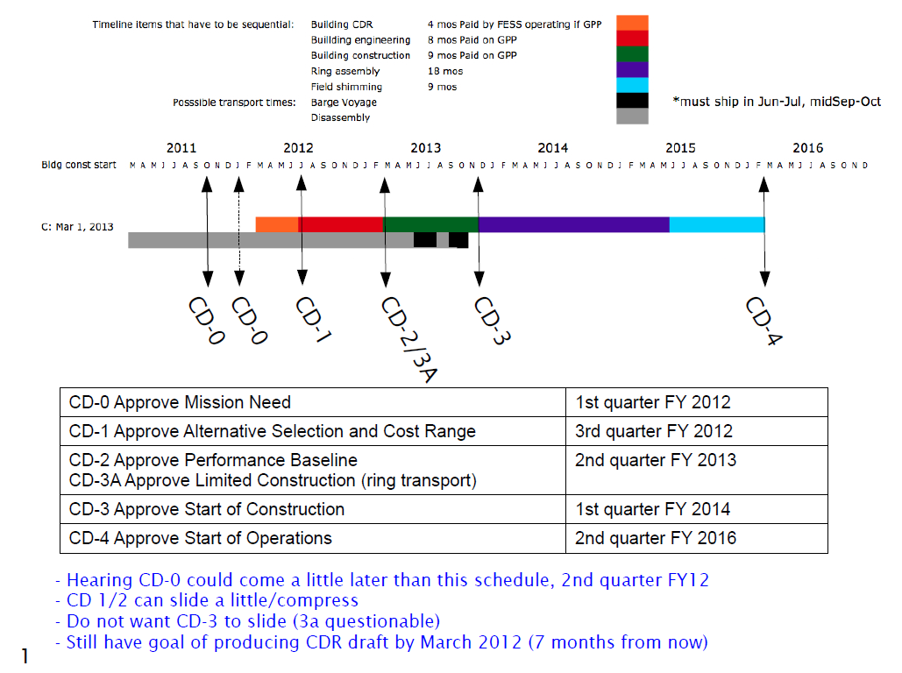
g-2 Schedule
C. Polly

Slide 54
Monitoring g-2 Secondaries
By the way, in the BNL experiment, the monitoring of the secondary pi/mu beam was done with 6 Segmented Wire Ion Chamber (SWICs) and three ionization chambers to monitor the total beam flux at critical locations.
O
\
\
\----------------------------------O\
\
\
O
The g-2 beamline at BNL had two bends. The first selected the pion momentum,
and the 2nd selected the muon momentum. The O's in the above ASCII art show
roughly where the ionization chambers were. Of course the ring only accepts a very
particular muon momentum so these bends were more about killing off unwanted
pions then about selecting the muon momentum.
You can imagine, we will want a similar setup here. SWICS distributed throughout
the beamlines to give us the profiles and ionization chambers to give us quick feed
back on flux at points where significant tuning is probably required.
Best,
Chris
C. Polly

Slide 55
References
Werkema, et al, Mu2e Accelerator Conceptual Design Report, Mu2e Document #
Glenzinski, D., Status of the Mu2e Experiment, Mu2e Document #, December 2011
Polly, C., Bringing Muon g-2 to Fermilab, g-2 Document #115, October 2011.
Polly, C., G Minus 2 Experiment, g-2 Document 82, September 2011.
Morgan, J. , Debuncher Injection and Extraction, g-2 Document #148, November 2011.
Ray, R., Project Overview: Independent Design Review of Mu2e, Mu2e Document #1526, May 2011.
Werkema, S., Accelerator Division Impact Statement for the TAPAS Proposal, Beams Document #4012, December 2011.

