Slide 1
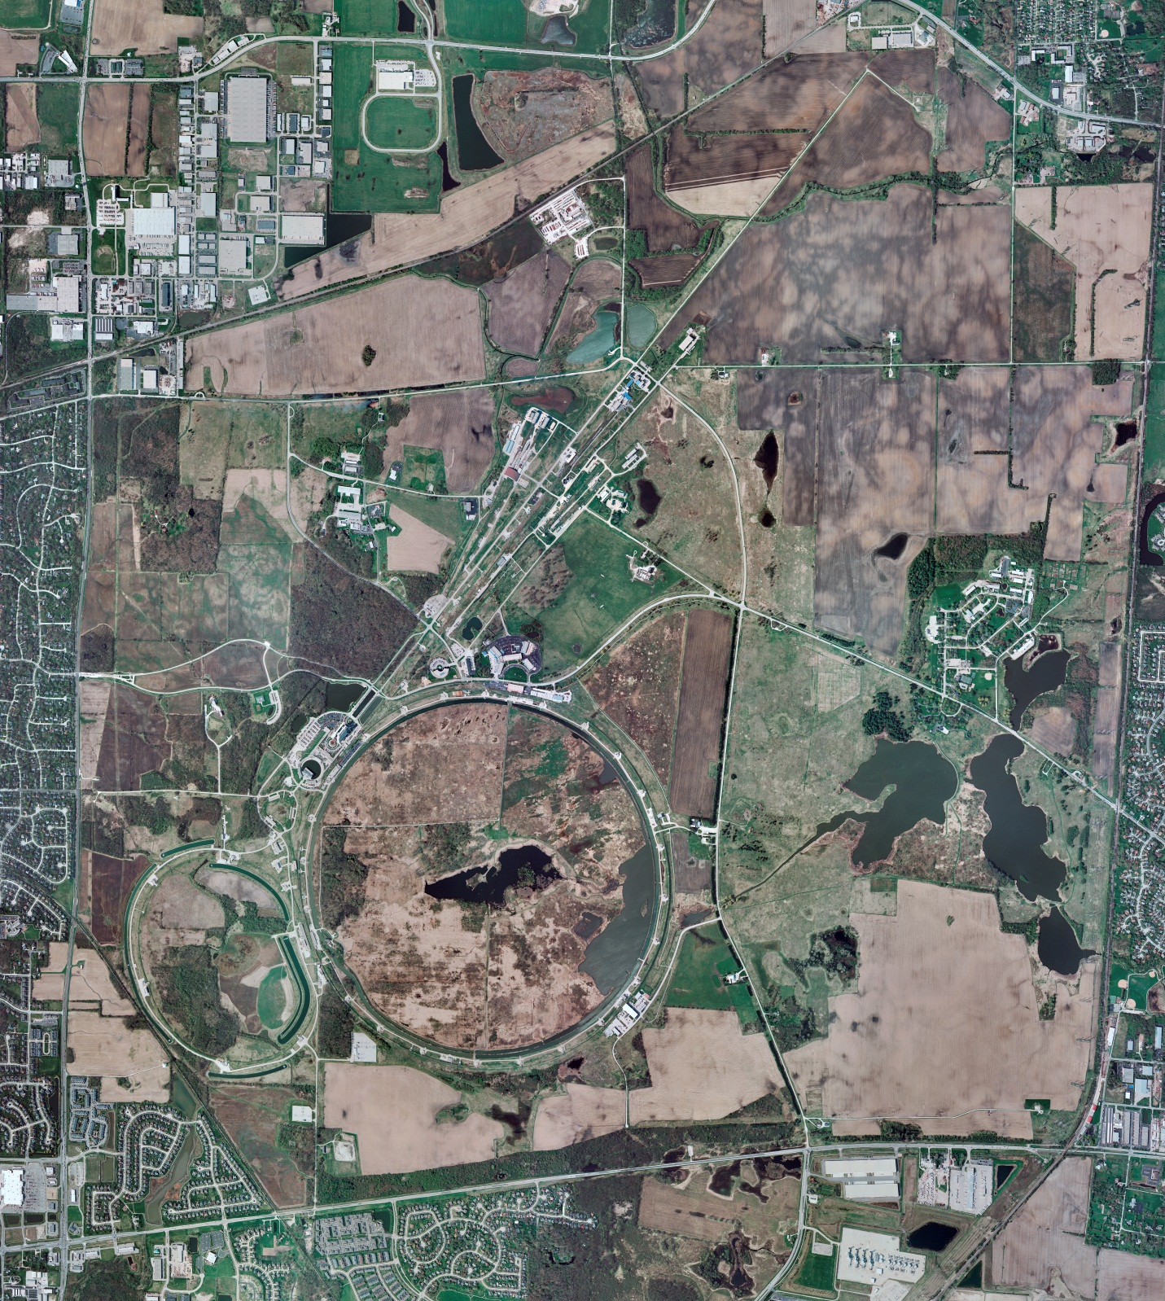
Helium Cryogenics
Status 9/30/2022 J.Makara
CMTF: SCP cryo system cold and running fine
CMTS: at RT with HECM22 ready for cooldown to start next weel
PIP2IT: SSR1 at RT and HB650 installation prep continuing
MCTF: cryo system running fine with 3 comprs and 2 Fridges; recovered from power glitch; planned warmup to RT this weekend
MDB/HTS: at RT
MDB/STC: LB650 at 2 K; to be warmed up to RT
MDB Magnet: at RT
NML/FAST: Cryo system cold and recovered from multiple compr trips and power glitch; still addressing system capacity stability
CC1: cold at 2 K
CC2: cold at 2 K but issues with RF conditioning and cryo stability
CM: cold at 2 K
IB1: cryo system cold and operating fine with test stands at 4 K or 2 K; CB2 commissioning in progress
Muon Campus: A0 comprs (3) online with MC-1 g-2 cryogenic system at 80 K mode but cooldown to 5 K to begin; A0 Fd46A cable replacement with A0 compr on generator power went well Mon. to Thurs.
Misc: Ghe cylinder allocation still in effect

