Slide 1
Current Status of MICE 201 Cavity
Tianhuan Luo
University of Mississippi
201-MHz Single-Cavity Module Workshop, Fermilab, 06/19/2012

Slide 2
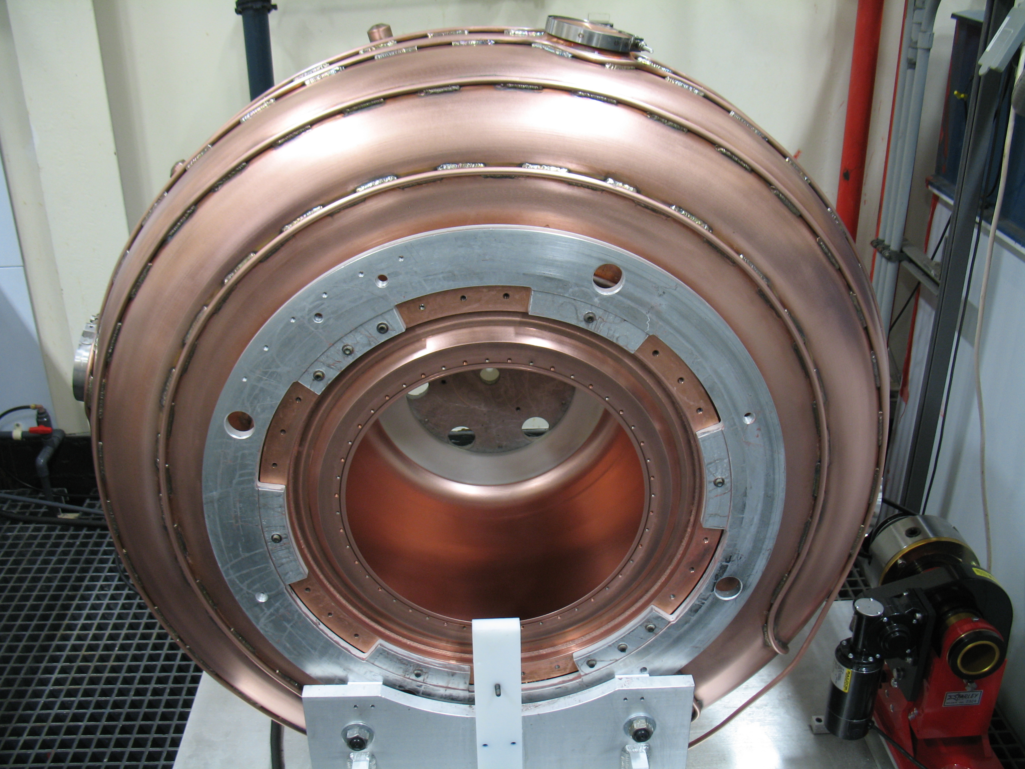
Electropolished cavity

Slide 3
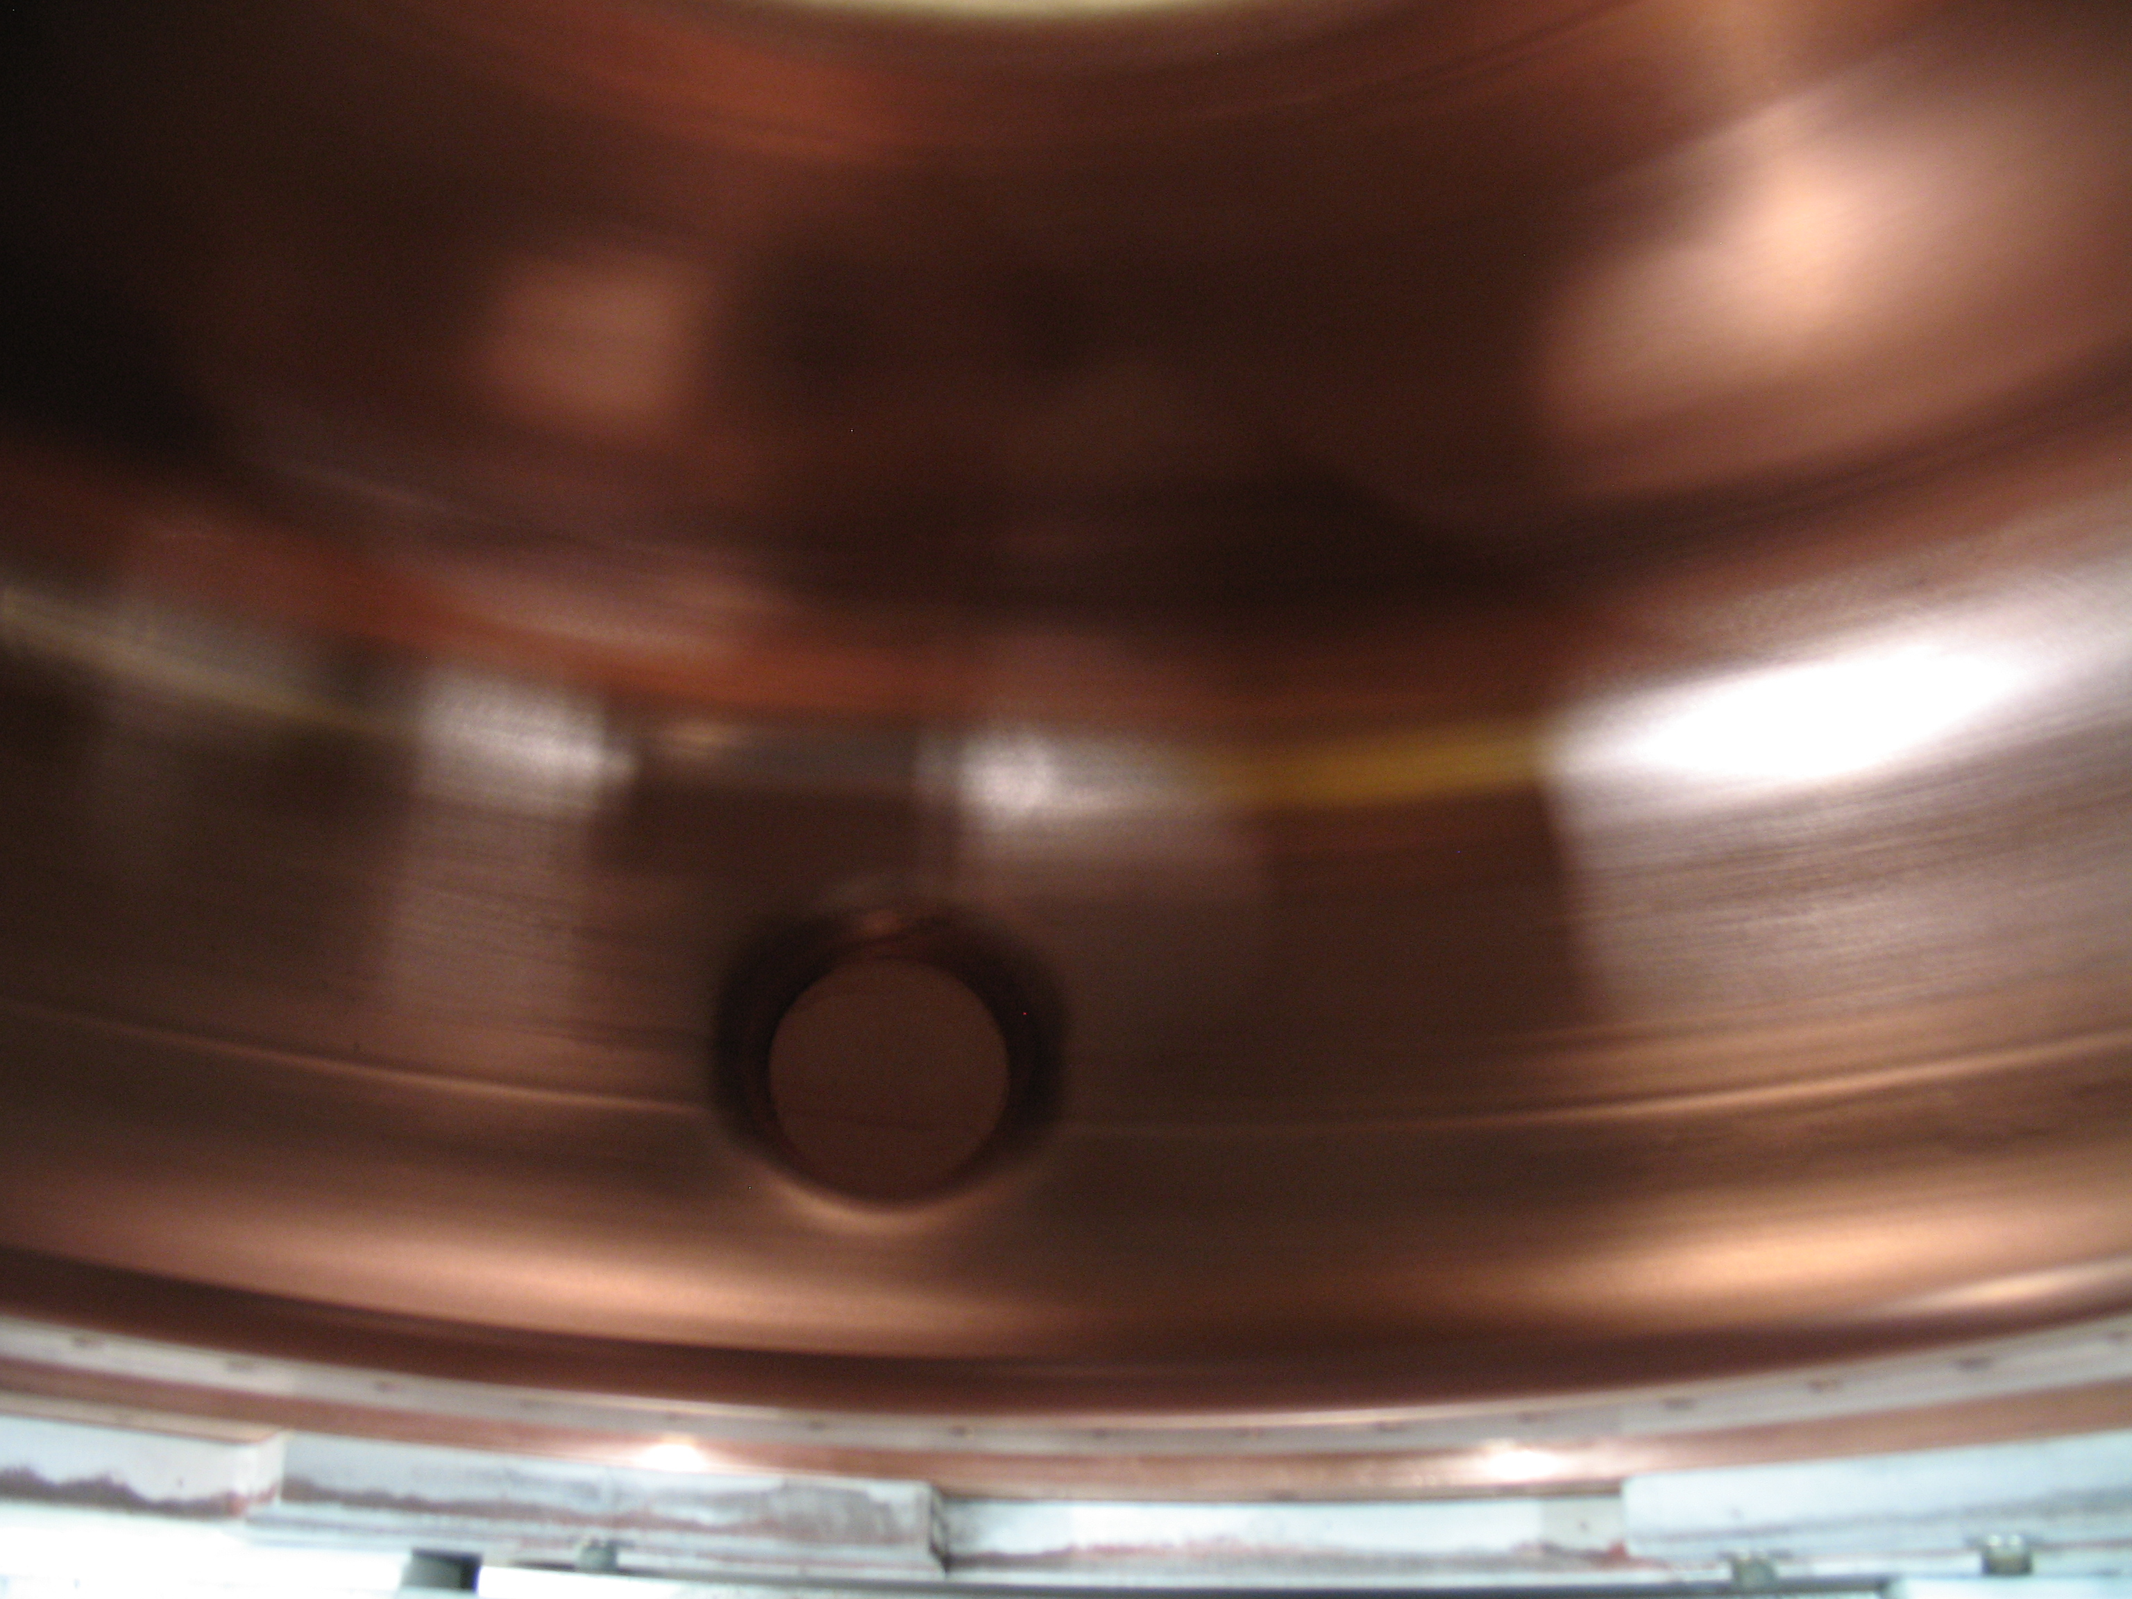
Cavity Surface (1)

Slide 4
Cavity Surface (2)

Slide 5
Cavity Packaging
Cavity has been put back and secured in the wooden crate. This picture shows the cavity lying on the groud before being picked up to put into the crate.

Slide 6
Summary
Electroplishing is done on one cavity.
The surface is smooth and fairly shining.
Now the cavity is stored back into the shipping crate, with two aluminum covers sealing the openings for beryllium windows.
Nitrogen backfill?

