Slide 1
Lab 6 Polystyrene Polymer Tests – IP2I Extrusion

Slide 2
IP2I Extrusion
Part Dimensions: 25mm x 5mm w/ 1 hole

Slide 3
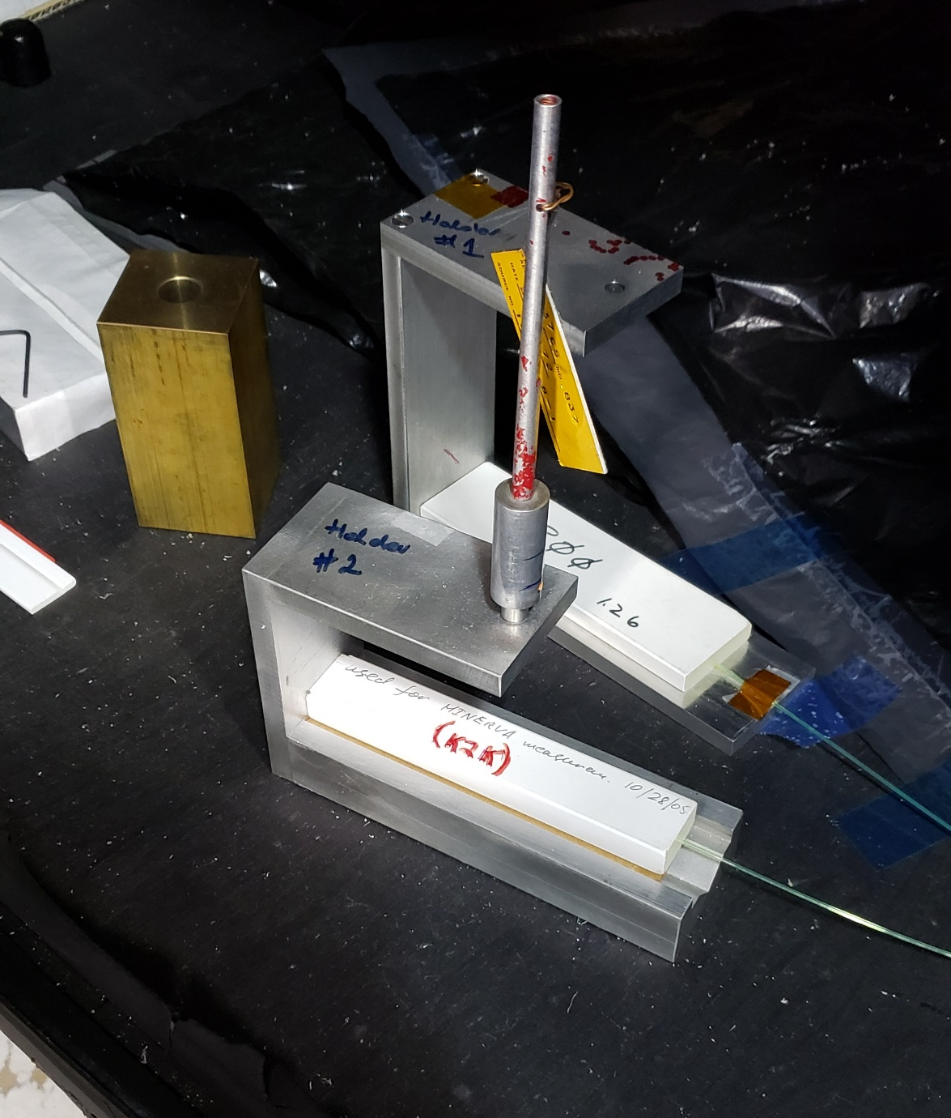
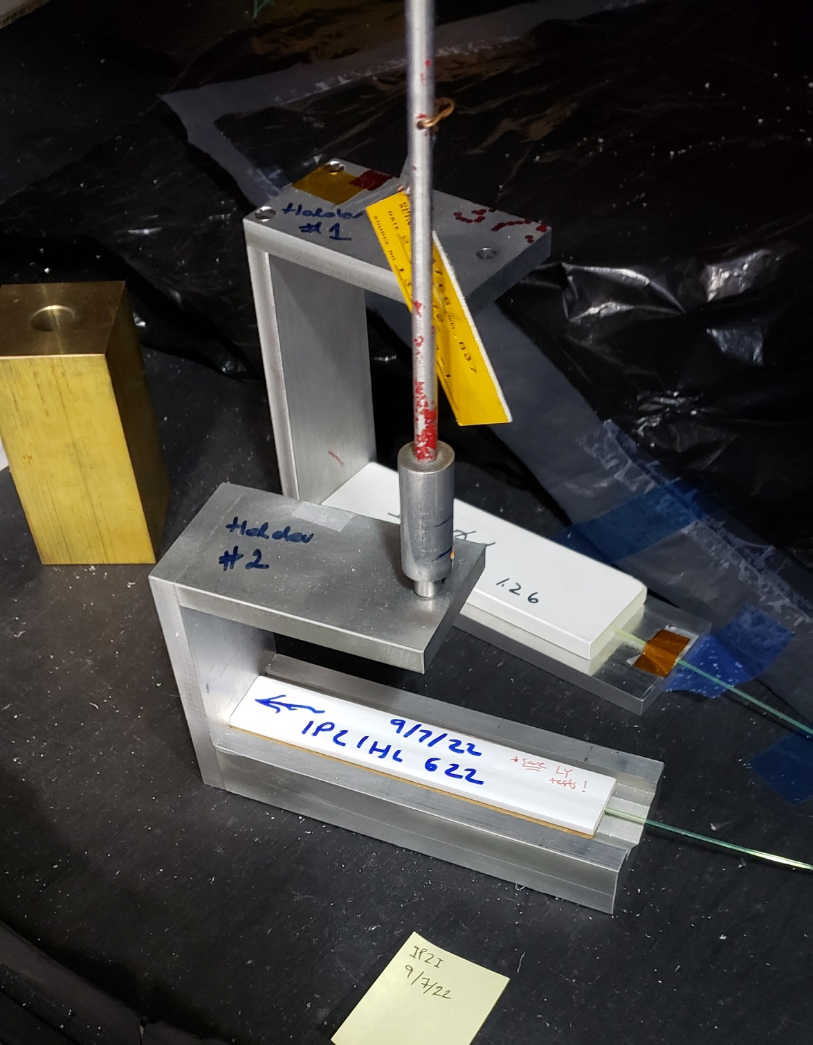
Light Yield Testing
Measurements performed using: Cs-137
K2K Reference
IP2I Extrusion

Slide 5
Future Testing:
Continue monitoring IP2I Extrusion Light Yields over time
Reference with Mackenzie’s TiO₂ Reflectance data
Additional Polystyrene Sample tests (various vintages)

