Slide 1
Search for a new PS supplier
A. Bross
Scintillator R&D Meeting
October 7th, 2022

Slide 2
Search for Optical-quality PS
Given the ongoing issues with the polymer from American Styrenics, I began searching for new suppliers.
None in the US
Found the following companies produce a product that might be appropriate
Resirene (Mexico)
Taita (Taiwan)
Trinseo (China)

Slide 3
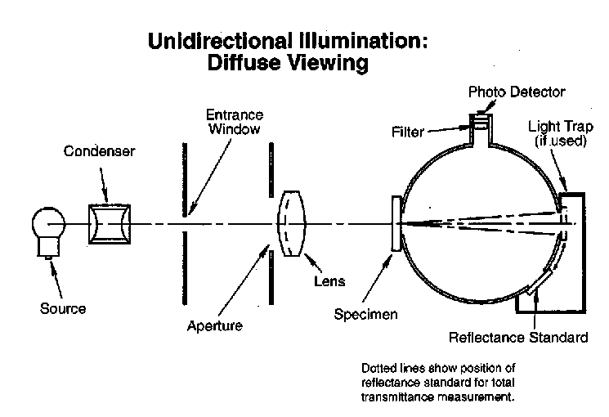
Resirene: HH 108
Looks like a good alternative
to 665. No US offices appear
to be in operation.

Slide 4
Taita: GPPS 808
Listed as equivalent to Nova PS
Known to be very-high quality
Listed as Optical grade
Should be able to get a sample
Would have to order full batch (~ 200t)

Slide 5
Trinseo: STYRON™ 2678 MED
Looked promising
Not supplied to North America
But Trinseo has ½ ownership in US PS market
Contacted AmSty

Slide 6
AmSty
I contacted Trinseo asking for a sample of the STYRON™ 2678 MED
They told me that they do not supply to NA, but gave me a contact at AmSty in Ohio.
I contacted Keven Stallmo who put me in contact with Laren Shoup.
Laren has been given the information regarding lot #s for the bad 665 and will look into their production records
He also suggested that we look at EA3130 (already did it) and 666D
Plan to have zoom meeting in the near future

Slide 7
666D

Slide 8
665

Slide 9
Conclusions
Both the Resirene HH-108 and the Taita GPPS 808 look promising (especially the latter).
Both have supply issues.
Have made first contact with AmSty and Laren Shoup has been quite helpful so far and open to future in-depth discussions.
Finding a solution with AmSty is for obvious reasons a more direct approach.

