Slide 1
QXFA227 Coil Review
Jesse Schmalzle
November 2, 2022

Slide 2
Outline
Coil Fab DRs
Additional Info
Coil length, Pole gaps
Reaction plots
Electrical Data
Notes:
Series coil.
After to change for B6 adjustment.

Slide 3
QXFA227 - DRs
DRs posted to interface traveler.
Critical = Affecting Form, Fit or Function
(as found)

Slide 4
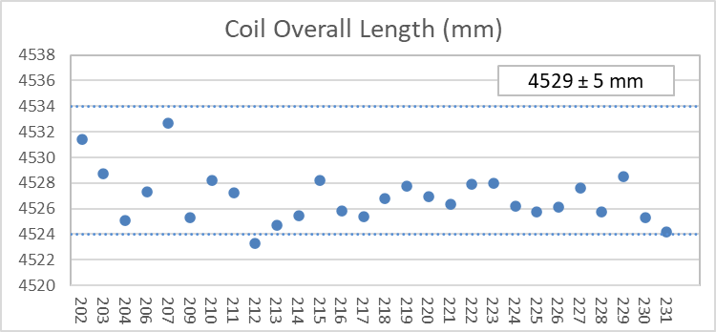
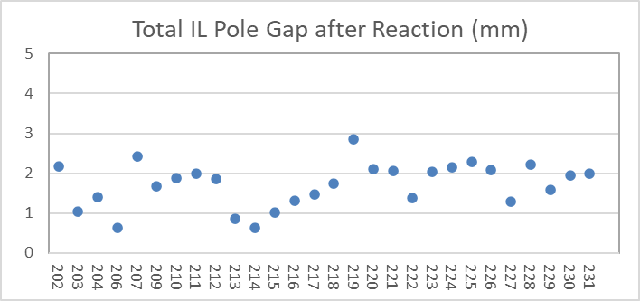
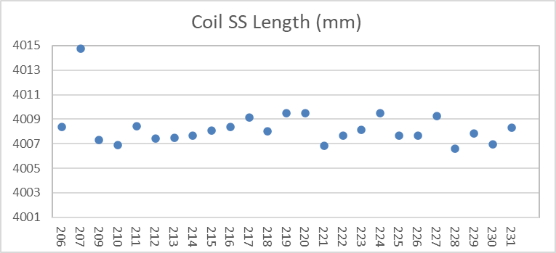
QXFA227 – Length, Gaps
Coil length within spec.
(207 error in initial pole gap setting)

Slide 5
QXFA227 - Reaction
Temperatures and dwell times all within spec.

Slide 6
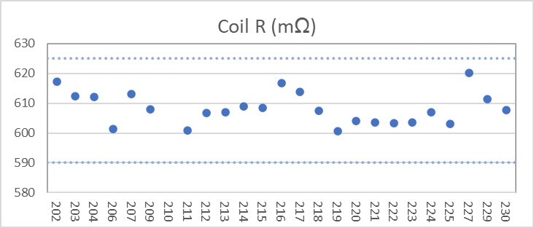
QXFA227 - Electrical
Final electrical checks – all passed

Slide 7
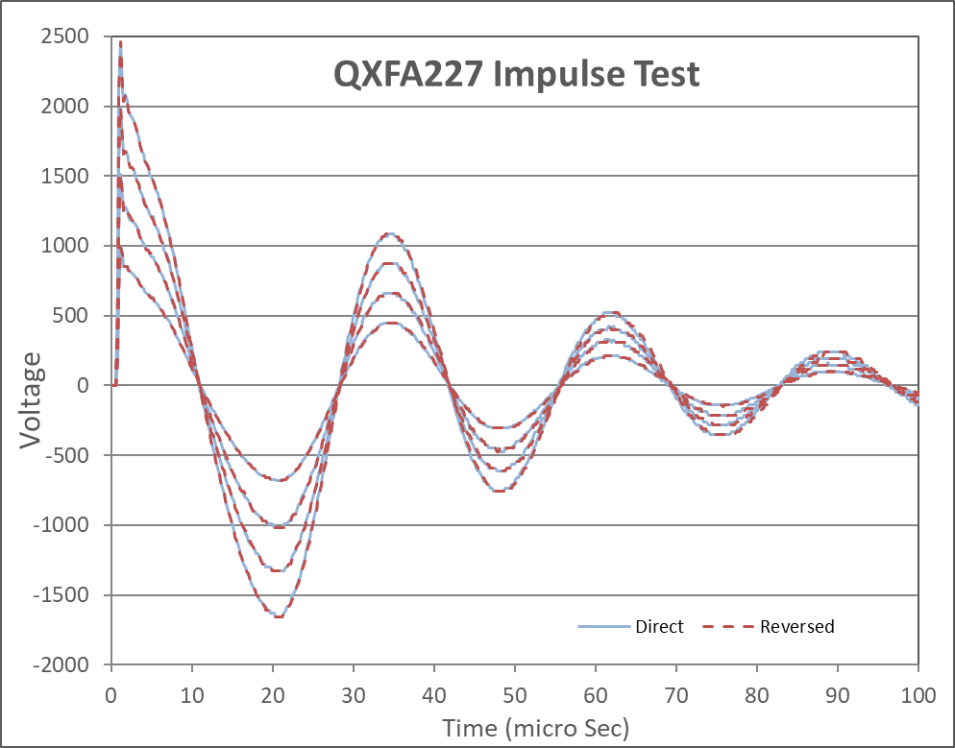
QXFA227 - Electrical

