Slide 1
DC-DC Topologies
Michael Miller
Jane Nachtman
Yasar Onel
The University of Iowa

Slide 2
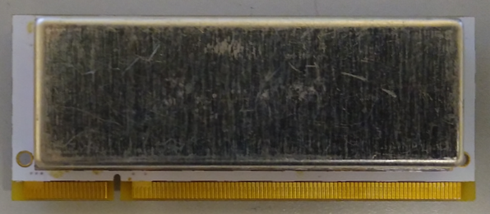
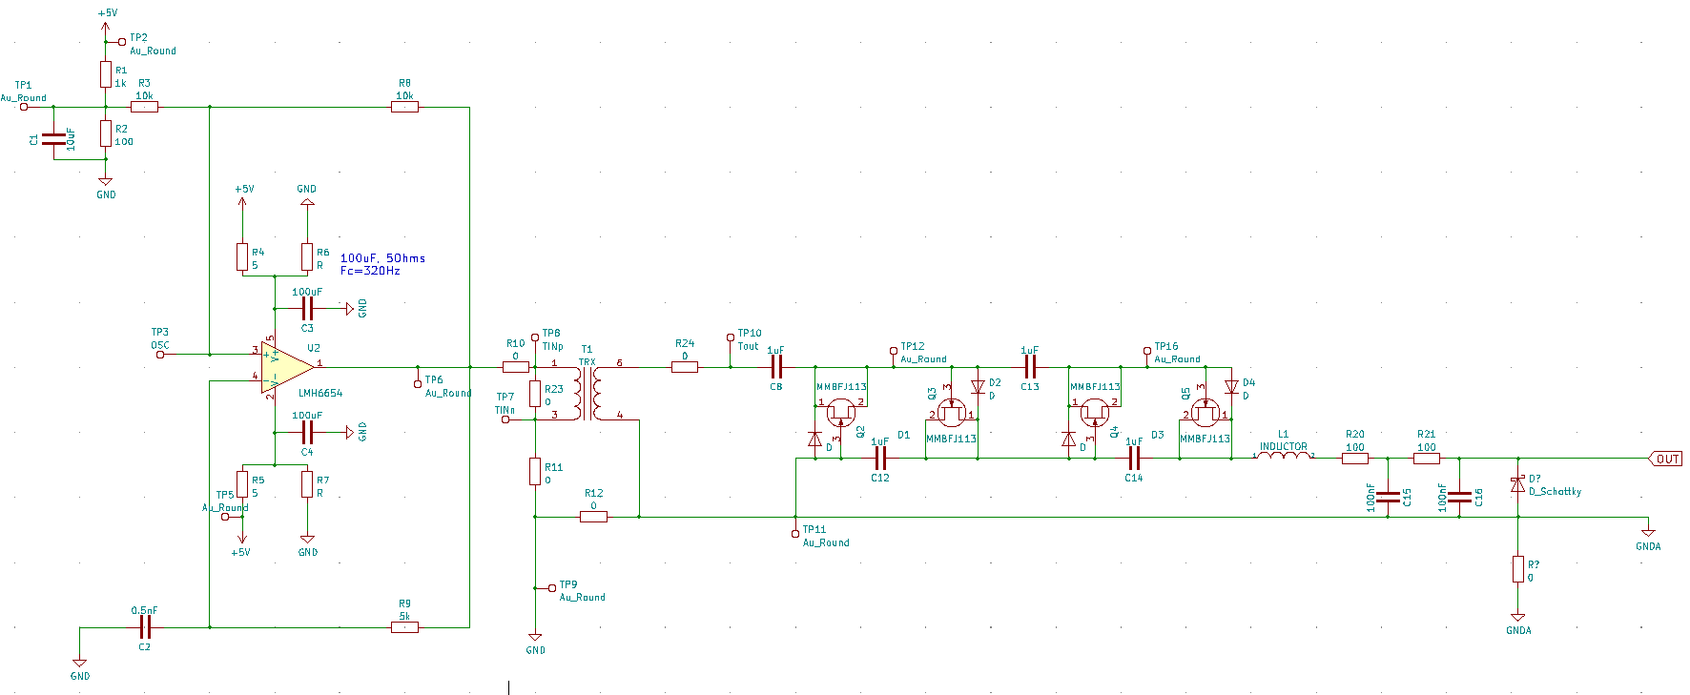
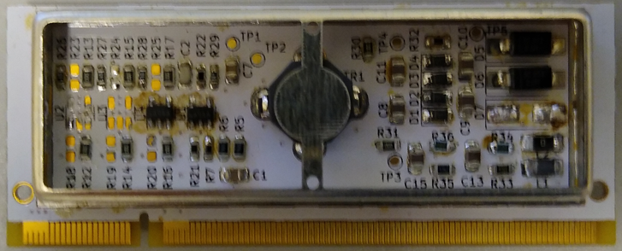
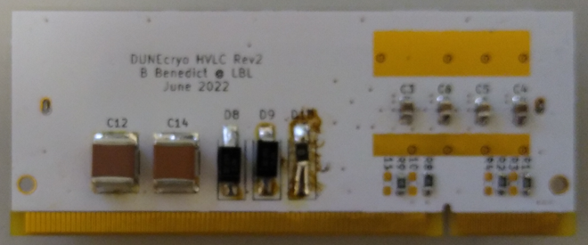
Cockroft Voltage Multiplier (LBL)
Top with shield
4X
Top no shield
Tested warm and cold (77K) no change of components or adjustments needed;
Regulated;
Capable of delivering up to 1mA;
Utilizing opamp proven to work 10 years in LAr (GERDA experiment)
Can perform with input voltage as low as 4.6V and as high as 6V
Bottom

Slide 3
LBL Card at CERN

Slide 4
Status of the Berkeley Circuit
Noise at Iowa measured to be 500 uV pk-pk
Noise at CERN measured at several mV
Have not drawn a conclusion why noise was higher at CERN
20 Boards are currently being produced at Berkeley

Slide 5
Self-Excitation Isolated Transformer Circuit (Pico 5A48)

Slide 6
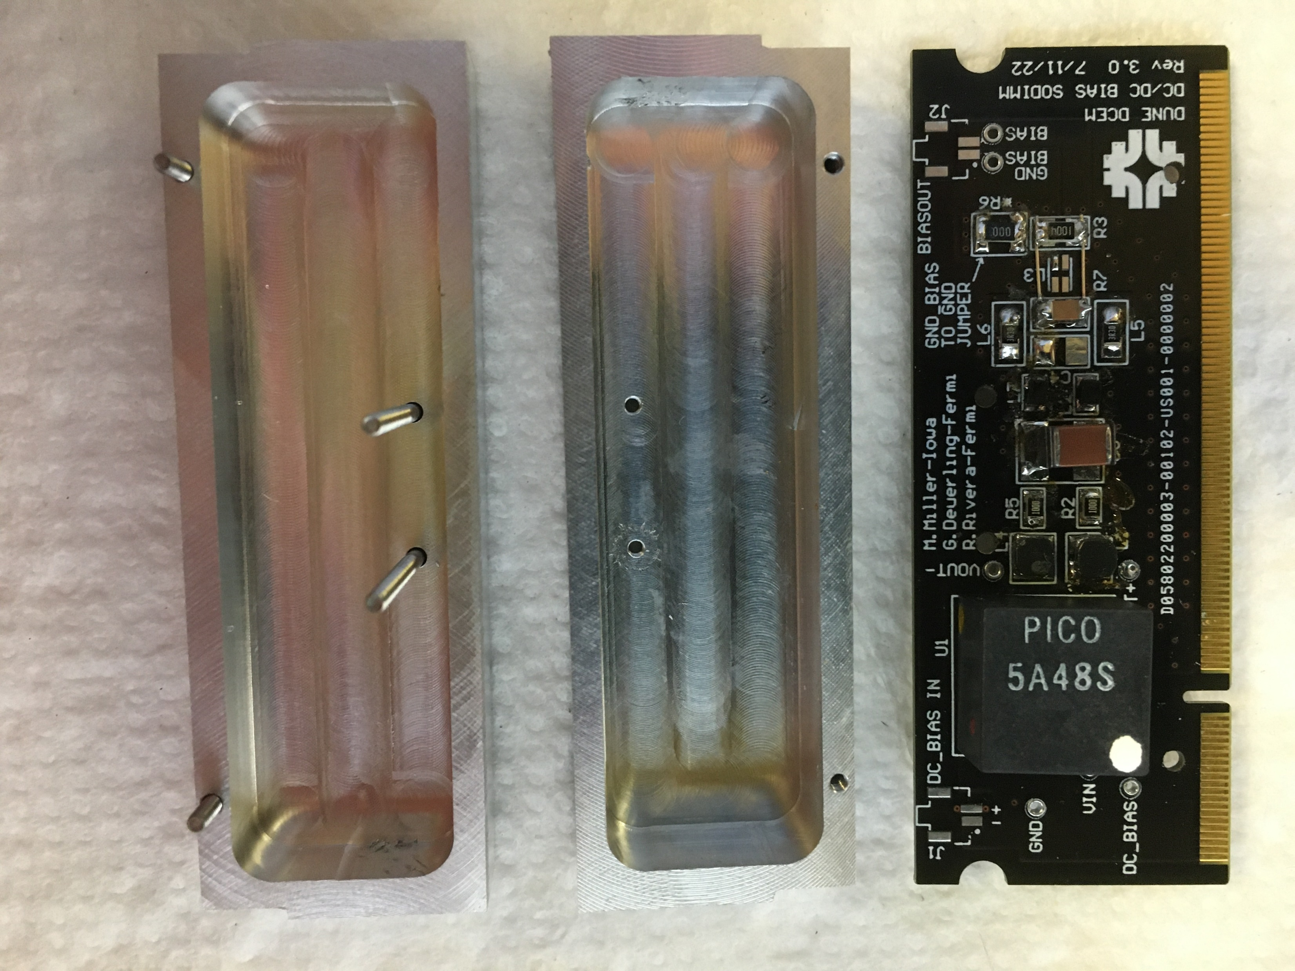
Filter Circuit for the Pico 5A48S

Slide 7
Unshielded Pico Card at CERN

Slide 8
Test Results for the 5A48S
Noise at Iowa measured ~ 250 uV pk-pk without shielding
Shielding reduced noise to less than 200 uV pk-pk
Pico devices did not generate observable noise at CERN
Thermal start-ups did not reveal any anomalies
Awaiting 30 year approval of 5A48S component

Slide 9
Berkeley and Pico Board
 | Berkeley Card | Pico Card
Bias Tuning | Adjustable by zener diode | Adjustable by input voltage, input resistor or zener diode
Circuit Complexity | Moderate to complex | Very simple – Active Components 2 transistors and 2 diodes
Noise Testing | Good result (500 uV at Iowa); problem at CERN | Better result at Iowa (< 200 uV at Iowa); Good result at CERN
Current Construction | 20 boards being assembled at Berkeley | 20 boards to be completed by December 1
Purchasing | Cost: ~ $32 ea. in quantity | Cost: ~ $85 ea. in quantity

