Slide 1
Estimate Energy deposition of muons at individual pixel in Muon Monitor 1
Katsuya Yonehara
October 5, 2022

Slide 2
Goal
Estimate energy loss of muons at individual pixel in muon monitor 1 via the ionization energy loss process
Ionization energy loss represents the electrical signal of ion chamber
  Electron ion pair creation rate in Helium gas is proportional to the ionization energy loss rate
  Ion chamber signal output is the total amount of collected electrons (and/or ions)
Muon flux is simulated by Yiding
This is the first estimation, i.e. no plasma process is considered except for ionization process
If further correction is needed, we will add the plasma process later

Slide 3
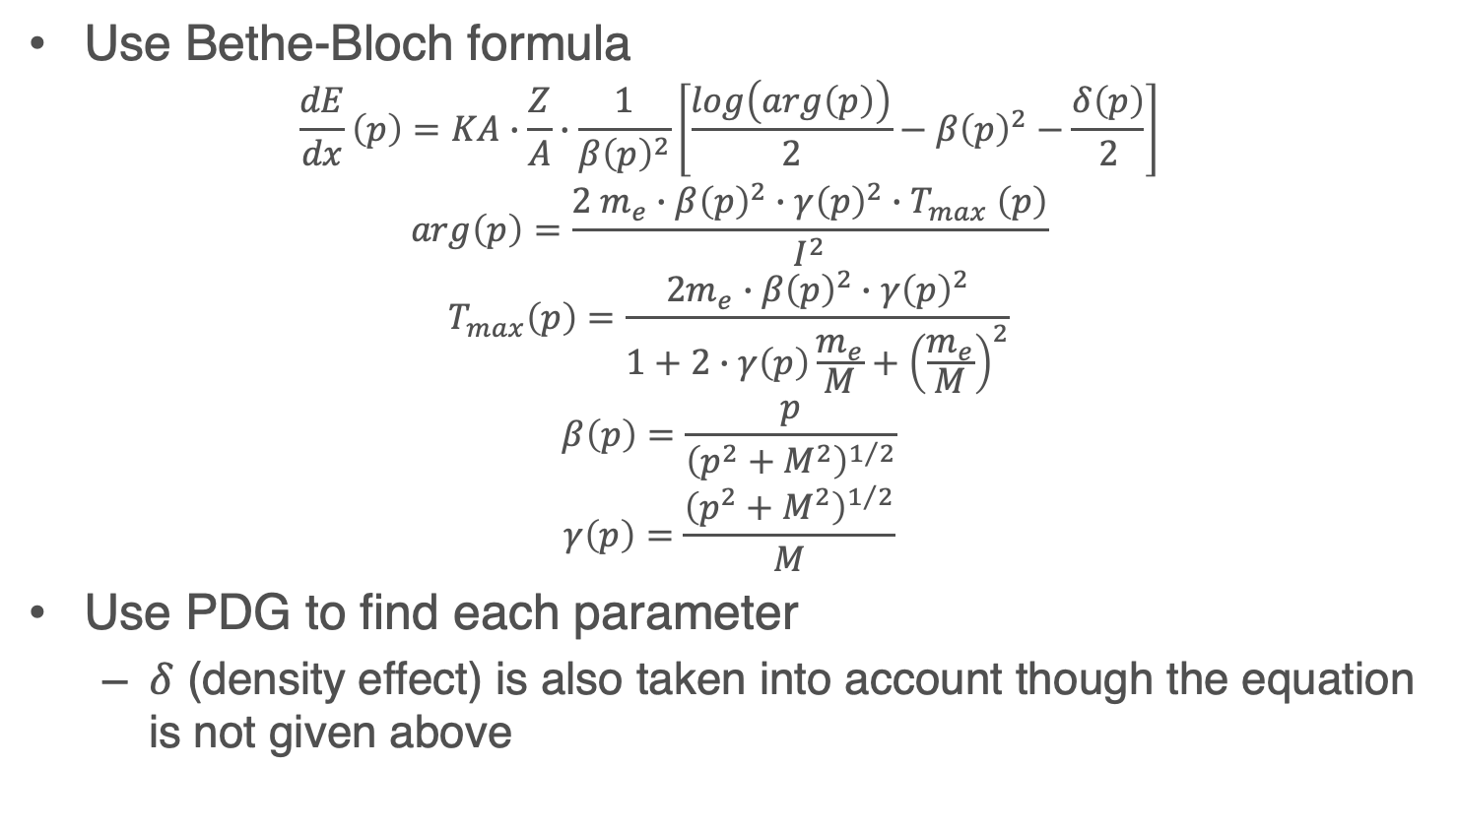
Energy loss rate
Use Bethe-Bloch formula
$$\frac{dE}{dx}\left(p\right)=KA∙\frac{Z}{A}∙\frac{1}{{β\left(p\right)}^{2}}\left[\frac{log\left(arg\left(p\right)\right)}{2}−{β\left(p\right)}^{2}−\frac{δ\left(p\right)}{2}\right]$$
$$arg\left(p\right)=\frac{2 m_{e}∙{β\left(p\right)}^{2}∙{γ\left(p\right)}^{2}{∙T}_{max}\left(p\right)}{I^{2}}$$
$$T_{max}\left(p\right)=\frac{2m_{e}∙{β\left(p\right)}^{2}∙{γ\left(p\right)}^{2}}{1+2∙γ\left(p\right)\frac{m_{e}}{M}+{\left(\frac{m_{e}}{M}\right)}^{2}}$$
$$β\left(p\right)=\frac{p}{{\left(p^{2}+M^{2}\right)}^{1/2}}$$
$$γ\left(p\right)=\frac{{\left(p^{2}+M^{2}\right)}^{1/2}}{M}$$
Use PDG to find each parameter
  $δ$ (density effect) is also taken into account though the equation is not given above

Slide 4
Compare PDG data and my estimation
Solid line: My estimation
Point: Data from PDG
dE/dx [MeV/g cm2]
p [MeV/c]
Good agreement

Slide 5
Simulated Muon Spectrum at Pixel
Y1
Simulated muon spectrum
Y2
given by Yiding
Y3
Y4
X1
X1
X2
X3
X4
X5/Y5
Y6
Y7
Y8
p [GeV/c]
Y9
Bin size: 0.2 GeV/c
Beam view

Slide 6
Apply energy loss rate into muon spectrum
Bethe-Bloch formula is a function of momentum p
Multiply the output of Bethe-Bloch formula with the simulated amount of muons per bin
  Note that bin is momentum
Since Bethe-Bloch value is very small, I multiply 500 to match the size of energy loss weighted value with the muon spectrum
Following plot is the energy loss weighted histogram and the original muon spectrum
  Note that vertical is arbitrary
    The energy loss weighted value always larger than the muon spectrum but it is artificial

Slide 7
Compare energy loss rate weighted muon histogram vs muon spectrum
X1
Red: energy loss rate weighted
muon histogram (arb. unit)
Blue: original muon spectrum
p [GeV/c]

Slide 8
Compare energy loss rate weighted muon histogram vs muon spectrum
X2
Red: energy loss rate weighted
muon histogram (arb. unit)
Blue: original muon spectrum
p [GeV/c]

Slide 9
Compare energy loss rate weighted muon histogram vs muon spectrum
X3
Red: energy loss rate weighted
muon histogram (arb. unit)
Blue: original muon spectrum
p [GeV/c]

Slide 10
Compare energy loss rate weighted muon histogram vs muon spectrum
X4
Red: energy loss rate weighted
muon histogram (arb. unit)
Blue: original muon spectrum
p [GeV/c]

Slide 11
Compare energy loss rate weighted muon histogram vs muon spectrum
X5
Red: energy loss rate weighted
muon histogram (arb. unit)
Blue: original muon spectrum
p [GeV/c]

Slide 12
Compare energy loss rate weighted muon histogram vs muon spectrum
Y1
Red: energy loss rate weighted
muon histogram (arb. unit)
Blue: original muon spectrum
p [GeV/c]

Slide 13
Compare energy loss rate weighted muon histogram vs muon spectrum
Y2
Red: energy loss rate weighted
muon histogram (arb. unit)
Blue: original muon spectrum
p [GeV/c]

Slide 14
Compare energy loss rate weighted muon histogram vs muon spectrum
Y3
Red: energy loss rate weighted
muon histogram (arb. unit)
Blue: original muon spectrum
p [GeV/c]

Slide 15
Compare energy loss rate weighted muon histogram vs muon spectrum
Y4
Red: energy loss rate weighted
muon histogram (arb. unit)
Blue: original muon spectrum
p [GeV/c]

Slide 16
Compare energy loss rate weighted muon histogram vs muon spectrum
Y5
Red: energy loss rate weighted
muon histogram (arb. unit)
Blue: original muon spectrum
p [GeV/c]

Slide 17
Compare energy loss rate weighted muon histogram vs muon spectrum
Y6
Red: energy loss rate weighted
muon histogram (arb. unit)
Blue: original muon spectrum
p [GeV/c]

Slide 18
Compare energy loss rate weighted muon histogram vs muon spectrum
Y7
Red: energy loss rate weighted
muon histogram (arb. unit)
Blue: original muon spectrum
p [GeV/c]

Slide 19
Compare energy loss rate weighted muon histogram vs muon spectrum
Y8
Red: energy loss rate weighted
muon histogram (arb. unit)
Blue: original muon spectrum
p [GeV/c]

Slide 20
Compare energy loss rate weighted muon histogram vs muon spectrum
Y9
Red: energy loss rate weighted
muon histogram (arb. unit)
Blue: original muon spectrum
p [GeV/c]

Slide 21
Integrate histogram
Pixel | Integrate weighted hist | Integrate spectrum | Ratio Wgt/Spct
X1 | 28514.0 | 23223.3 | 1.228
X2 | 53130.1 | 42441.9 | 1.252
X3 | 79632.9 | 62934.3 | 1.265
X4 | 86518.5 | 68579.3 | 1.262
X5 | 87769.1 | 69700.4 | 1.259
Y1 | 26281.9 | 21446.0 | 1.225
Y2 | 48157.7 | 38515.5 | 1.250
Y3 | 73800.8 | 58447.9 | 1.263
Y4 | 82809.7 | 65672.7 | 1.261
Y5 | 87769.1 | 69700.4 | 1.259
Y6 | 86518.5 | 68579.3 | 1.262
Y7 | 79632.9 | 62934.3 | 1.265
Y8 | 53130.1 | 42441.9 | 1.252
Y9 | 28514.0 | 23223.3 | 1.228

Slide 22
Discussion
The ion chamber output from individual pixel can be calibrated by taking into account the ionization energy loss rate
However, the calibration value is small
  At most 2.5 % for X1, Y1, Y9
  Other calibration is 1 % or less
I guess that Yiding sees bigger discrepancy between the simulation and the measurement
Should I apply the plasma process?

