Slide 1
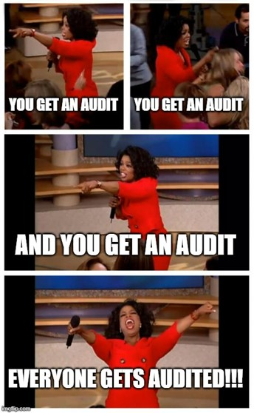
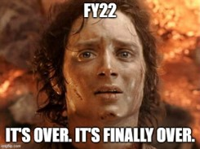
Finance Updates
FY22 close complete
Mostly on budget in our B&Rs.
Yay.

Slide 2
Finance Updates – cont’d
FY23
As always, current year rates have not been issued yet
Resource allocations are coming along
Engineering/Tech departments almost complete
Next up: reviewing Research departments
AFP is “at the lab” but details have not been distributed to the divisions yet
Carry-over: New Policy
Pools (PS, CSS, G&A) don’t get carry-over, positive or negative
No budget for RIPs or Open Commitments
Everything else gets the budget balance as of the end of FY22, positive or negative
Charging Practices: New Methodology

Slide 3
Finance Updates – Charging Practices Notable Changes
EDI & EPE
Separate task codes for each
No longer charged to Lab Committees & Groups
Training
General training – primary effort
Discontinued usage of General Training task
Management-specific training – Mgmt & Supervision task
Job-specific training – direct charge
Management & Supervision
Department Management & Supervision – primary effort or Mgmt & Supervision task
Management & Supervision of Experimental Ops, Collaborators, G&V – direct charge
Business Development
New task!
Engineering support, equipment support and tool support
Sometimes direct charge, sometimes primary effort, sometimes burden pool

Slide 4
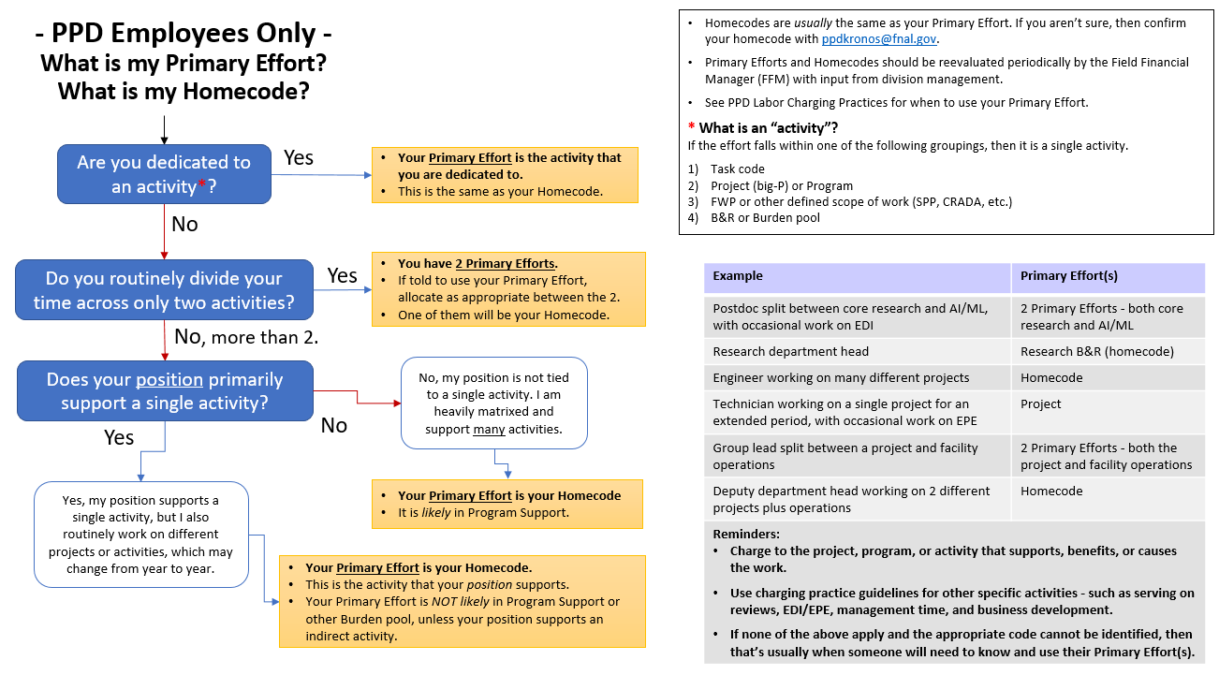
Finance Updates – Primary Effort code

