Slide 1
PPD Department Heads Meeting
ESH
October 12, 2022
Raymond Lewis and Katie Swanson

Slide 2
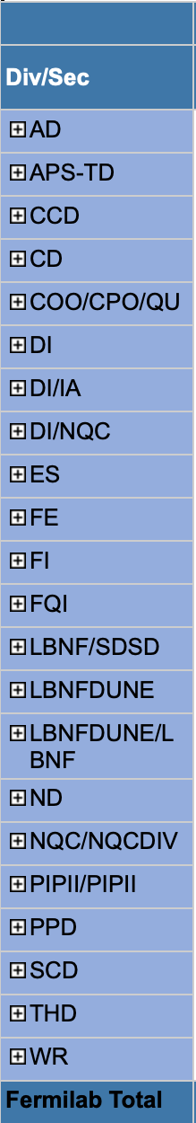
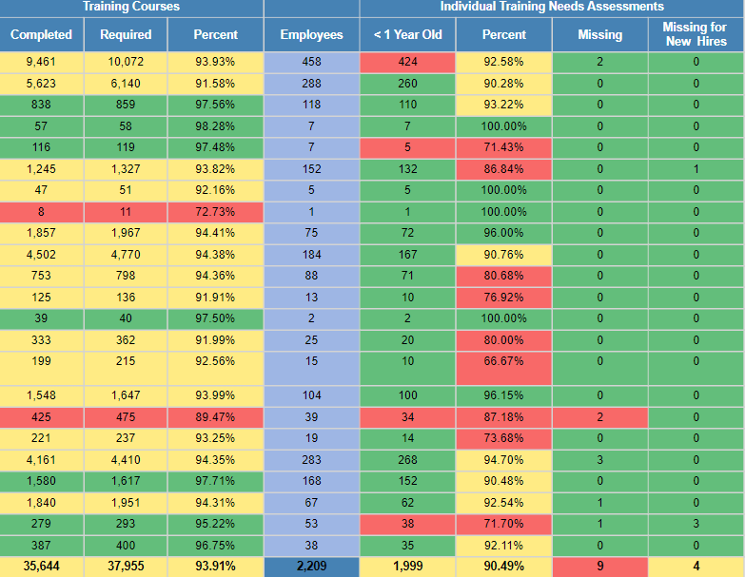
ESH Training and ITNA Status for employees – as of 10/11/2022
Last month:

Slide 3
FESHM/QAM/FRCM Chapters Updated in August
FESHM Chapter 9170 - Uninterruptible Alternating Current Power Back-Up Systems
Revised title and added sections covering facility generator sets and transfer switches.
Added last paragraph to section 4.2 making the provision of a bypass switch for a UPS a default requirement.
FESHM Chapter 10210 – Equipment Transport
Initial Release.
QAM Chapter 12002 – Fermilab Quality Assurance Program
Integrated references to DOE Order 414.1D, Quality Assurance, as the Order has been reintegrated into the FRA Prime Contract.
Updates throughout the document to reflect minor functional changes and references in the organization.
Minor language updates to references and definitions for clarity.

Slide 4
FESHM/QAM/FRCM Chapters Updated in September
FESHM Chapter 2060 - Work Planning and Control
Added definitions for work group and loaned worker.
Added communication steps to incorporate FESHM 2020 Work Planning and Notification elements.
Added language to ensure 2+ persons for hazardous work in remote locations.
Added and clarified language about multiple work groups, cross divisional/dept work.
Added section Integrated Work Planning.
Risk Matrix – Clarified heading language. Added Fall exposure section, updated green hazard to include work from mobile elevating work platforms (MEWPs).
Added Equipment Transportation Risks.
Addition of Technical Appendix to capture the Hazard Specification Sheets for enclosures accessed via the MCR.
FESHM Chapter 7010 – Construction ES&H Program
Modified Section 6, Trainings Requirements for CC/TM and added another category, Low and High Voltage tasks.
Tweaked document throughout from ESH&Q to ES&H.
Clarified 6-ft fall rule for scaffolding and steel erection.
Added a paragraph in Section 5.4, Subcontractor’s training records and Fermilab’s right to verify.
QAM Chapter 12050 – Fermilab Quality Assurance Program
Added definition and guidance for “apparent cause.”
Clarified language regarding “causal analysis” and “root cause analysis.”
Updated language referencing “investigation” to “event.”

Slide 5
Unplanned Events/ Injuries in August
August 3rd – First Aid, APS-TD
  On 8/3/2022 in IB1, the employee was assisting with loosening a rusted/seized bolt on a pipe clamp. The employee was using pliers to hold one side of the bolt as another employee was utilizing a wrench to loosen it. As this was occurring the pliers lost grip and the employees left index finger got pinched between the pliers’ handles.
August 16th – Recordable, FESS
  The employee was handing a small step ladder over components to a coworker when the ladder swung open and pinched his finger in the top of the ladder. The braces engaged and locked, trapping his thumb in the opening. The top design of the ladder was two steps and when folded, the ladder allowed enough room for the employee to grasp the ladder with his thumb between the two steps. When it opened, the gap decreased to pinch his thumb. The employee was sent for x-rays, which were negative, but given an antibiotic.
August 18th – DART, APS-TD
  On August 18th an employee was assisting in setting up a display for a tour. The employee had moved a display table and was placing a mini magnet display coil on the table using both arms. The display coil weighs approximately 24 pounds. While placing the display coil on the table the employee felt an odd sensation in their right bicep and upper arm. The employee worked a full day the following day. On August 23rd the employee notified their supervisor of the injury. They were seen at Fermilab's Occupational Medical Office and later sent to an orthopedic physician. The employee received an MRI which revealed the employee had multiple tendon tears. Fermilab Occupational Medical Office learned on September 20th that the employee will need surgery.

Slide 6
Injuries/Illnesses in August, continued
August 29th – Recordable, APS-TD
  Employee was driving in lab vehicle when he felt a sting to his left forearm from a wasp. Employee went home and self treated. Reported to FOMO on 8/30/22, when the arm was swollen and tight. Rx was given.
Unplanned Dose at AD Test Stand
  Upon receipt of the lab’s second quarter (CY) dosimetry results one badge was flagged with a dose of 530 mrem for an AD employee. The test stand where the individual works contains a radiation generating device, and the initial exposure investigation indicates there was exposure to x-rays from this test stand.
  Review underway

Slide 7
Unplanned Events/ Injuries in September
Sept 8th – First Aid, LBNF
  The employee was walking in the 4850 level and was proceeding to return a Class 3R laser pointer to the chest pocket of their reflective vest. As the employee placed the laser into the pocket, light from the laser shone up towards the employee’s right eye. The employee felt discomfort on the right side of their eye. Immediately upon returning to surface, the employee reported the incident to the FRA Project Manager and to the ESH Coordinator. The employee was taken to the Lead Deadwood Occupational Health Clinic where they were examined by a doctor. No damage to the eye was discovered, no treatment was delivered, and the employee was released to full duty.
Sept 13th – First Aid, AD
  The employee had been working with an engineer and another technician on a CMTF RF isolator for 2 months. The work involved testing different component arrangements which required frequent bolting and unbolting of flanges on the isolator using manual wrenches. The initial phase of the work occurred at F0 Service Building. The final phase occurred when the isolator was installed at CMTF. While tightening a bolt on a flange at CMTF, the employee heard and felt a 'pop' in his right shoulder and felt some pain in the shoulder. He paused the task briefly and then completed the final bolting task. The pain continued the next day, and he reported the incident to the Fermilab Occupational Medicine Office where he was diagnosed with a shoulder strain. At FOMO he received first aid treatment and was returned to work with limitations that did not prevent him from performing his routine job functions.

Slide 8
Fire at SBN-FD in September
Small Fire at SBN-Far Impacts Restart of Experiment Cryogenic Operations
  View ORPS report here: http://www-esh.fnal.gov/private/Occurr_Rep/2022/2022_0015.pdf
    Found on this page: https://eshq.fnal.gov/atwork/safety-occupational/nts-orps/
  Email sent out:

Slide 9
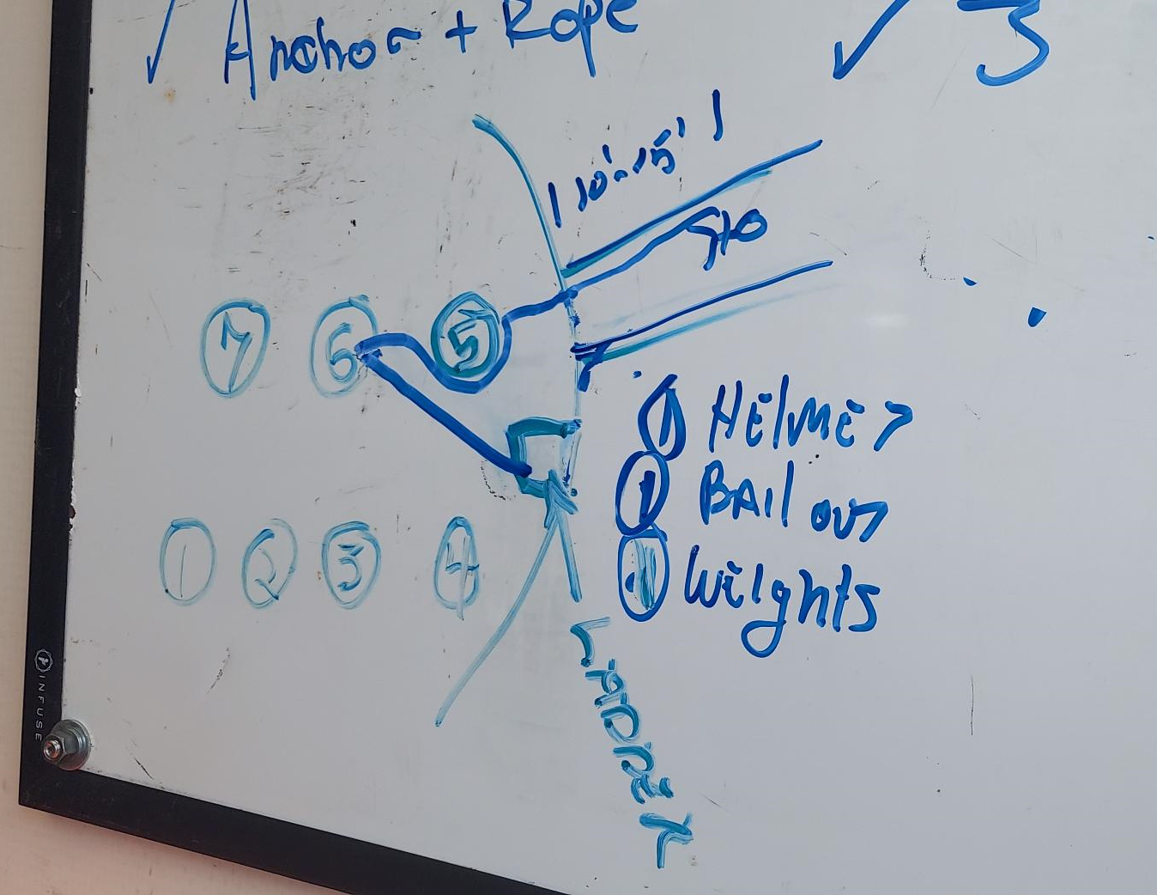
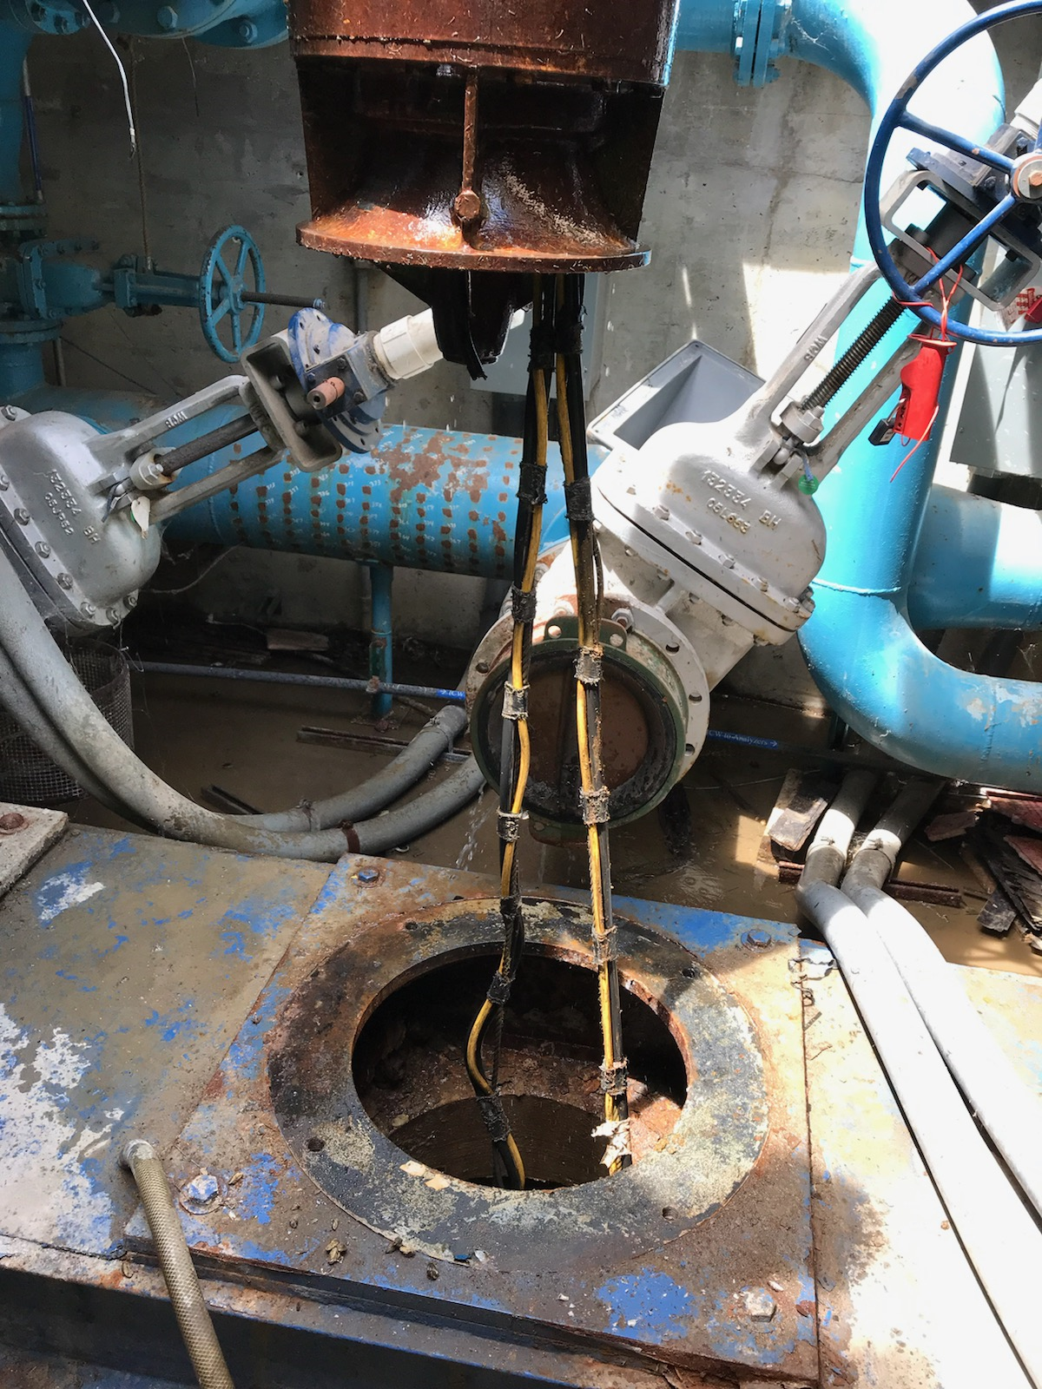
Casey’s Pond Diving Near Miss Event Summary
July 25th, diving crew on-site to remove zebra mussels and silt from 80-foot long pond intakes and then replace chemical lines used to treat water with chlorine to control zebra mussels.
Casey’s Pond Pump House supplies water to the lab’s fire suppression system, as well as cooling water for chillers, cryo compressors, and magnet test stands.
  ICW demand was high that day, could not shut down two of the 400-hp pumps b/c of the high demand. Diving crew elected to not put screens on the pump intakes and were confident they could avoid the area.
Towards the end of zebra mussel cleaning, the diver felt themselves be pulled through the pipe intake back into the wet well. The diver realized their air supply had been cut off, quickly made decision to bail out. Left helmet, bailout bottle and harness at bottom of wet well and swam to surface.
Diving supervisor was in truck monitoring comms and air supply. Heard air alarm go off and turned on back-up air supply, then ran into pump house.

Slide 10
Casey’s Pond Diving Near Miss – Causes/Contributing Factors
ICW demand was too high – this work is typically done in the cooler months so there is less demand on ICW. Caused pumps to trip off when attempting to shut down to allow screens to be installed.
Decision was made to not cover the operating pumps intakes with a screen. (Past dive crews would do this, but ICW demands were lower. FESS offered to shut down pumps briefly to allow for screen installation, but dive crew declined. We accepted this considering the dive crew to have more expertise.).
  Critical safety decision making in the field.
  This practice of utilizing screens and the LOTO process involved is not currently documented in a procedure.
Tender allowed too much slack in the hose and the communication between the diver and tender was LTA (potential delay as they were not in direct communication – comms went through diving supervisor to each).

Slide 11
Other news…
Paul Satti named Manager of the Work Planning and Control Program

