Slide 1
HL-LHC Accelerator Upgrade Project PMG #48
Giorgio Apollinari/Ruben Carcagno
Project & Deputy Project Manager
PMG – October 18, 2022

Slide 2
Plans for Today
AUP Status – Apollinari/Carcagno
Funding
Cost and Schedule Performance (August Update)
HL-LHC Collaboration Meeting in Uppsala
Rebaseline Director’s Review outcome
Rebaseline DOE review preparations
Root Cause Analysis (RCA) review
ES&H Safety Week 2022
Technical Status
Next PMG Considerations:
Propose to skip Nov 15th PMG to allow continued preparation for DOE Review
Next PMG: Dec 20th (PMG after the DOE Rebaseline Review)

Slide 3
AUP Funding
FY22 Done
AUP received $38.355M in Inflation Reduction Act (IRA) funding on 9/23/2022:
Total FY22 funding: $25M + $38.355M = $63.355M
IRA funding spending needs to be tracked separately
AUP will select some FNAL WBS elements to use this funding (task numbers will remain the same, project number will change)
FY23 Funding guidance at PBR level ($30M)
DOE HL-LHC AUP - Funding Profile Guidance
($ in Millions)
 | FY16 | FY17 | FY18 | FY19 | FY20 | FY21 | FY22 | FY23 | Total
CD-2 Profile
OPC-Funds | 0.12 | 0.5 | 6.4 |  |  |  |  |  | 7.02
TEC-Const. |  |  | 20.6 | 50 | 52.02 | 43 | 63.36 | 30 | 259.98
Total | 0.12 | 0.5 | 27.0 | 50 | 52.02 | 43 | 63.36 | 30 | 266.0

Slide 4
FY23 Funding Distribution
AUP proposed to DOE the following distribution of FY23 funds based on labs FY23 obligations :
DOE confirmed the following FY23 plan, consistent with the proposed distribution:
The “FY 2023 AFP Change” column represents the funds DOE plan to release in October to cover the first quarter needs
This DOE plan is an update of the initial FY23 Annual Plan communicated to the Labs that had $3M for both BNL and LBNL
 | FY23 Ann. Plan | IRA Funds | Total
BNL | $9.1M |  | $9.1M
FNAL | $16.3M | $38.36M | $54.66M
LBNL | $4.6M |  | $4.6M
Total | $30M | $38.36 | $68.36M

Slide 5
Cost Performance Report (August 2022 Report)
August 2022 Status:
SPI = 0.96 (Stable), CPI = 1.05 (stable)
Total Project Cost (TPC): $242.7M
Budget At Completion (BAC): $226.4M
Estimate at Completion (EAC): $226.0M
ETC_{EAC} (EAC-ACWP): $82.6M
Contingency_{EAC} (TPC – EAC): $16.7M
% Complete: 66.4%
Contingency as % work-to-go: 21.5% (on BAC)
20.2% (on EAC)

Slide 6
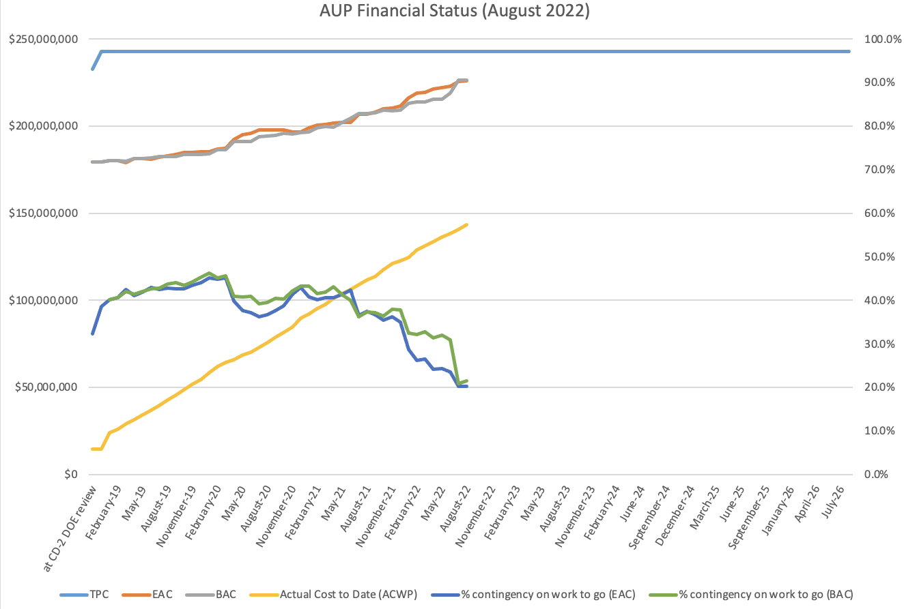
Financial Situation (Status)
Contingency
Work To Go
Estimate at Completion
$$\frac{Contingency}{Work To Go}≈20\%$$
Actual Cost
BAC/EAC include 12.3M$ COVID impacts (actuals and predicted through Dec. ’22).

Slide 7
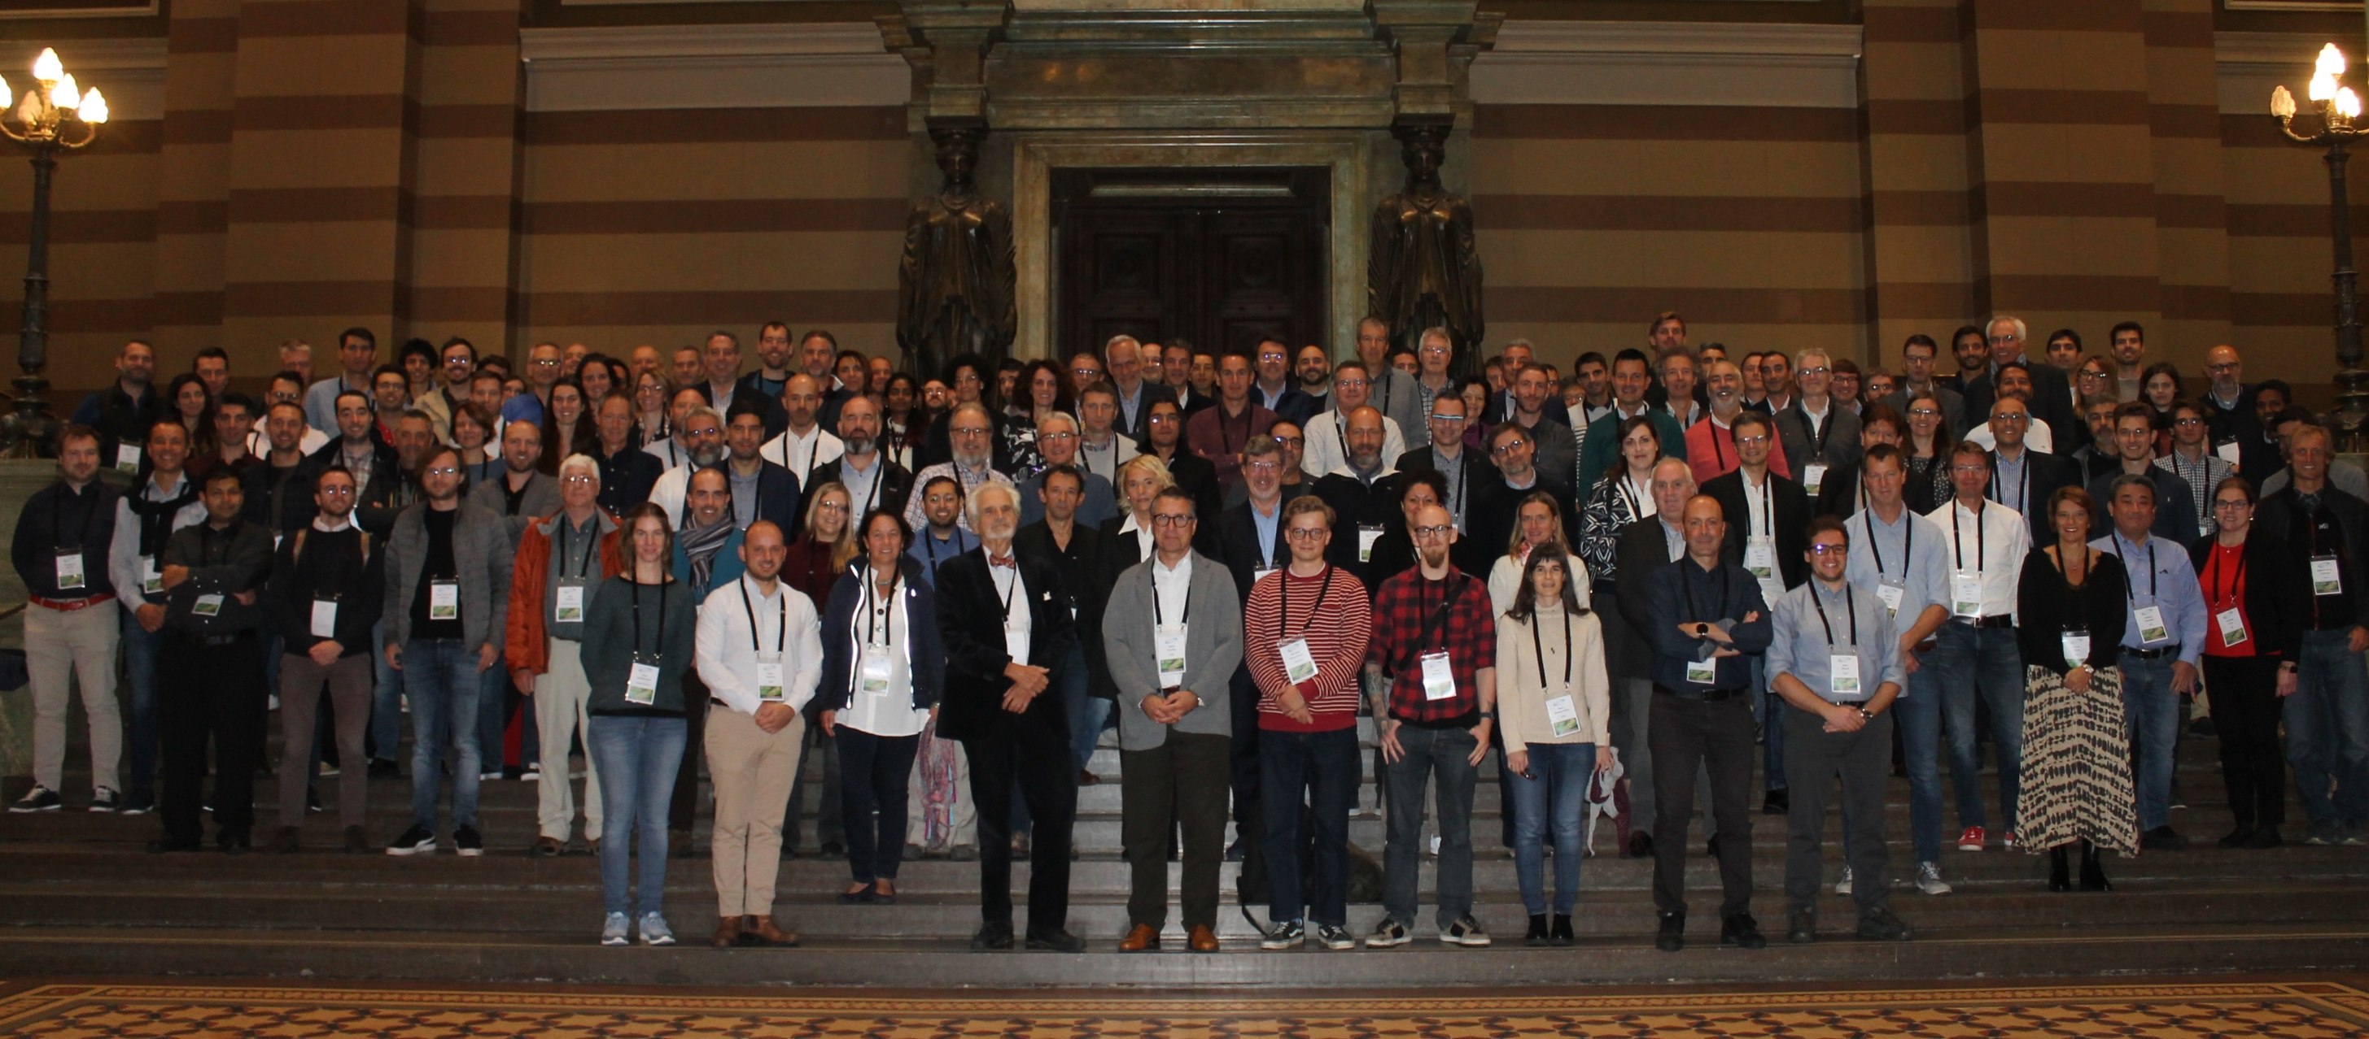
2022 HiLumi Collaboration Meeting in Uppsala, Sweden – Sep 19-22, 2022
1st in-person meeting in ~3 years !

Slide 8
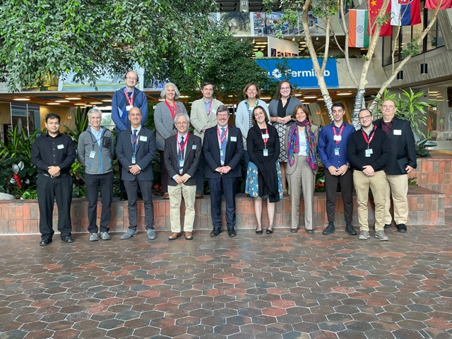
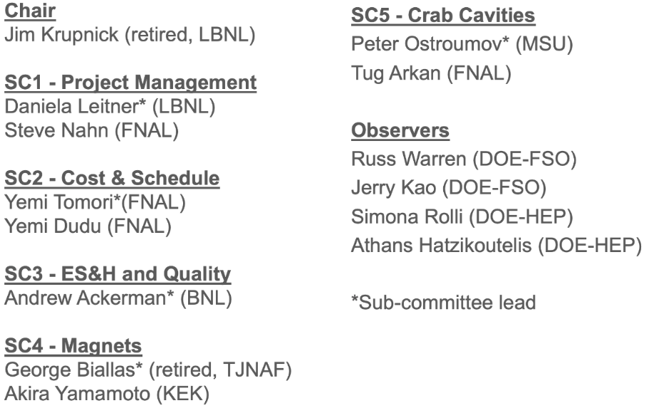
Director’s Rebaseline Review
September 27-29, 2022 – Hybrid review
AUP proposed to increase the TPC to $266M (from $242.72M), and delay CD-4 by 21 months, to account for the total cost and schedule impact of COVID and abnormal escalation.
Some of the in-person participants:
Main committee conclusions:
“The project’s management team is strong and has an excellent mix of both technical and operational managers.”
“There is a strong expert technical team in place that is capable of delivering on the project’s commitments to CERN”
“The committee believes that the cost and schedule impacts of COVID-19 have been well estimated, that the root cause and risk analyses were performed appropriately, and that the draft BCP is both credible and complete. In short: the team presented a coherent case for the rebaselining.”
“We conclude that the project is ready and should proceed to the DOE IPR.”
Review committee:

Slide 9
Director’s Rebaseline Review Answers to Charge Questions
All 8 Charge Questions answered “yes”
Has the method used to estimate the cost and schedule impacts of COVID-19 resulted in a reasonable, complete, and well documented estimate? Are the associated cost and schedule increases clearly traceable?
Yes
Has an objective and complete root cause analysis been performed identifying the underlying issues that are expected to contribute to the anticipated project’s performance baseline deviation? Have appropriate corrective actions been identified and included in the draft BCP?
Yes, but the BCRs that were not related to COVID or abnormal escalation should be presented more clearly.
Has a thorough and rigorous risk analysis been performed and incorporated into the draft BCP, including potential future impacts from COVID-19? Are the assumptions associated with this analysis complete and clearly documented in materials supporting the BCP?
Yes, but we recommend adding one additional risk. See section 3.
Is the draft BCP credible and complete, and, upon approval, will the new Performance Baseline provide for adequate cost and schedule contingencies to complete the defined project scope and achieve the Key Performance Parameters?
Yes, the BCP is credible and complete. The cost and schedule contingencies are reasonable given the significant technical challenges that remain
Are Environment, Safety, and Health aspects, including COVID-19, being handled appropriately?
Yes
Has the project responded satisfactorily to recommendations from previous reviews?
Yes
Is the documentation required by DOE O413.3b for a BCP complete and in good order?
Yes
Is the project being well managed and is Fermilab providing the appropriate support to complete the project?
Yes. A strong management team is in place and is performing well. There is strong support from all partner labs. Some technical resource concerns have been raised.

Slide 10
Director’s Rebaseline Review Comments and Recommendations
There were several comments highlighting strong points and providing helpful and constructive feedback to further strengthen some presentations and documents.
Recommendations:
Crab Cavities
1. Evaluate the risk of significantly higher-than-expected costs for procuring the 11 jacketed cavities, and consider including a specific entry in the risk register to address it.
Magnets and CryoAssemblies
None
ESH&Q
None
Cost and Schedule
2. Provide additional documentation explaining how non COVID costs were separated from COVID Impact and Abnormal Escalation BCRs. (before DOE review of the Baseline Change Proposal).
3. Proceed to DOE review of the Baseline Change Proposal.
Project Management
4. Finalize delivery dates with CERN and TRIUMF prior to DOE Rebaseline Review in Dec. ‘22
5. Fill the critical technical resources for cryomodule assembly and RF cavity assembly as soon as possible
6. Proceed to the DOE Rebaseline review

Slide 11
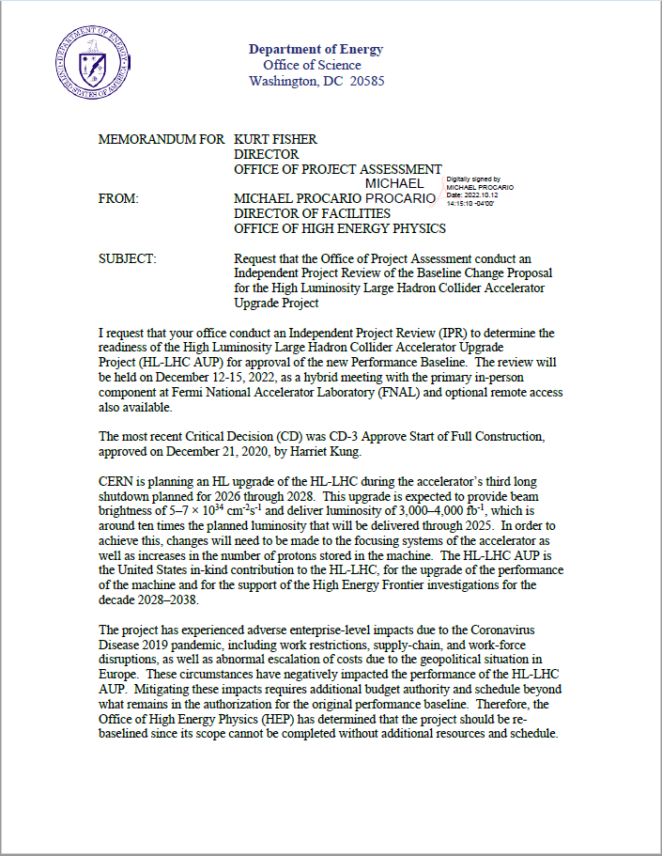
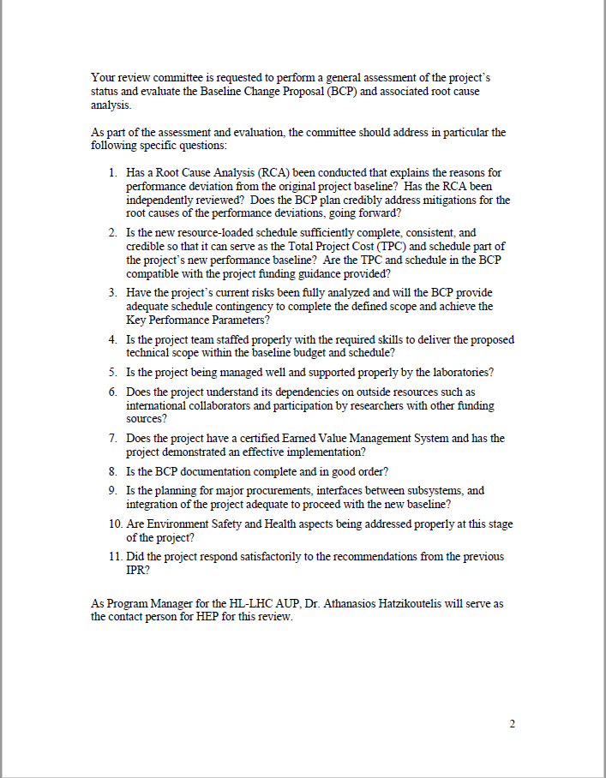
DOE Rebaseline Review Preparations
Scheduled for December 12-15, 2022
Based on September 2022 closing
Charges received on 10/12/2022:

Slide 12
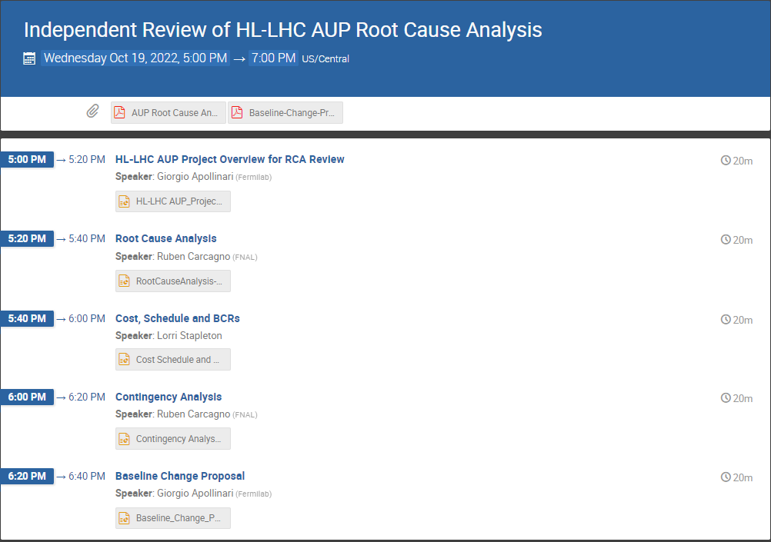
DOE Rebaseline Review (and RCA Review)
Charges similar to Director’s review, with one surprise in Charge #1 (highlighted):
DOE encouraged FNAL CPO/AUP to conduct this independent review focused on the Root Cause Analysis prior to the DOE review in December.
FNAL CPO organized this review as an “asynchronous” review to be conducted over a couple of weeks starting Oct. 19th .
Will use the July ‘22 closing data presented at the Director’s review
Minor changes expected for the DOE review as a result of normal project execution business (BCRs, etc.)
RCA conclusion not expected to change
RCA Review Committee: Stephen Meador, Jim Krupnick, Greg Bock

Slide 13
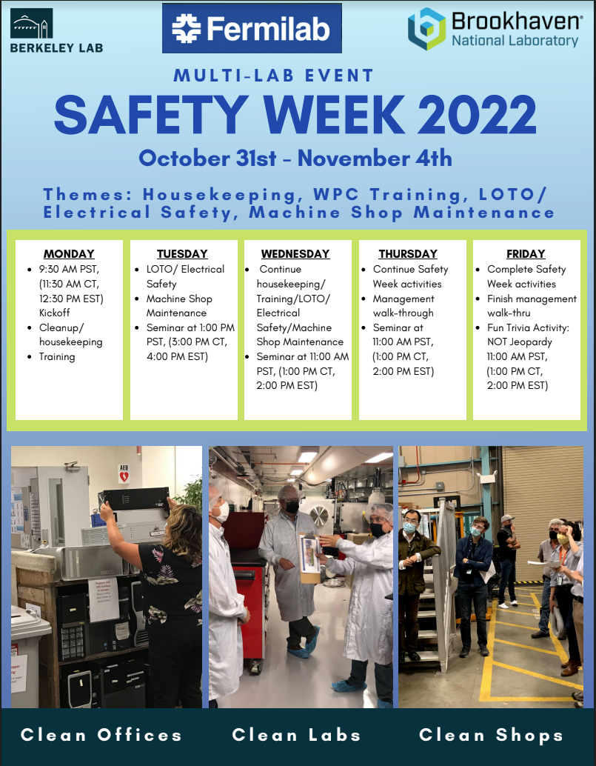
ES&H – Multi-Lab Safety Week 2022
Oct 31st – Nov 4th, 2022
Multi-lab activity
First of its kind!
Began at LBNL/ATAP in 2015 and has taken place every year
This year AUP team will participate at BNL and FNAL
https://atap.lbl.gov/safety-week-2022/
Activities include safety seminars, workplace cleanups, management walkthroughs
Safety themes focused on:
Housekeeping
Work Planning
LOTO
Electrical Safety
Machine Shop Maintenance
Multilab organizing committee for Safety Week 2022 - Pat Thomas and Asmita Patel/LBNL,
Marteenio Samms/BNL and Amy Pavnica/FNAL

Slide 14
Technical Status of the Project

Slide 15
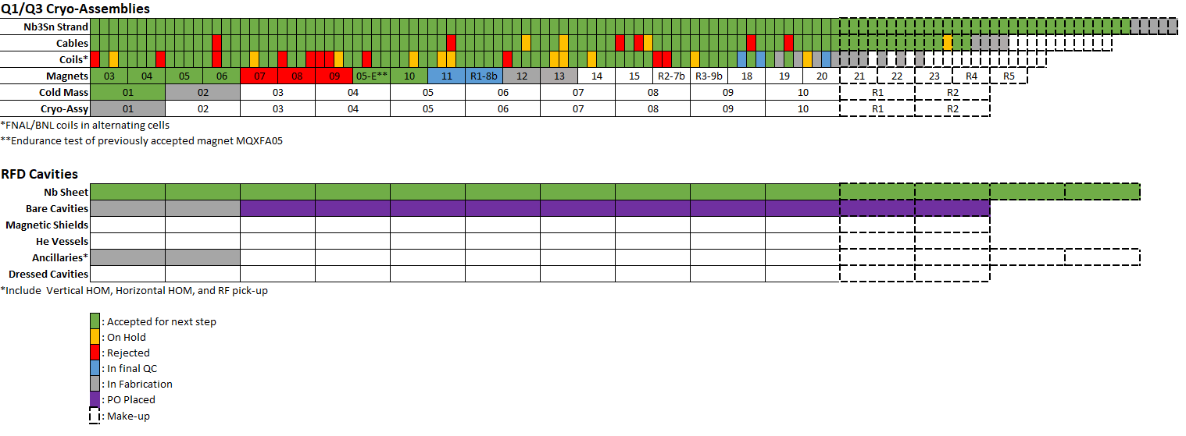
Production Status
Make up components for Yield < 100%
“Basic” deliverables
80 coils, 20 magnets, etc.

Slide 16
Strand & Cables
G. Ambrosio
Past strand orders (2500 km):
100% conductor has been received
Last procurement (160 km for 8 cables):
1st batch (60 km) has been received
Cable Fabrication Status:
Fabricated:
Bare cables up to #98; Completed QC up to #94
To be fabricated:
11 cables (up to #109)
Fabrication slow down since July
Cable yield:
Yield is 91.6% (6 rejected, 4 on-hold), 90% assumed in Baseline

Slide 17
Coil Fabrication at FNAL/BNL
G. Ambrosio
 | Coils at FNAL | Coils at BNL | Total
Accepted | 29* | 28 | 57*
In Fabrication | 5 | 6 | 11
Rejected | 4 | 3 | 7
On Hold | 6 | 3 | 9
Total | 44 | 40 | 84
Simple Fabric. Yield | 82.8% | 87.5% | 85.0%
After Integrat. & Test | 79.1%** | 79.2%*** | 79.1%
Coils to be fabricated: 102
Simple Coil Fabrication yield computation:
In fabrication = 1/3; On hold = ½
* Accepted for shipment; does not include QXFP06 (4 m prototype coil)
**1 coil on hold after magnet integration; 1 MQXFA09 coil rejected because of folded midplane insulation
***2 coils rejected after vertical test (MQXFA07 and MQXFA08); 1 MQXFA09 coil rejected because of folded midplane insulation

Slide 18
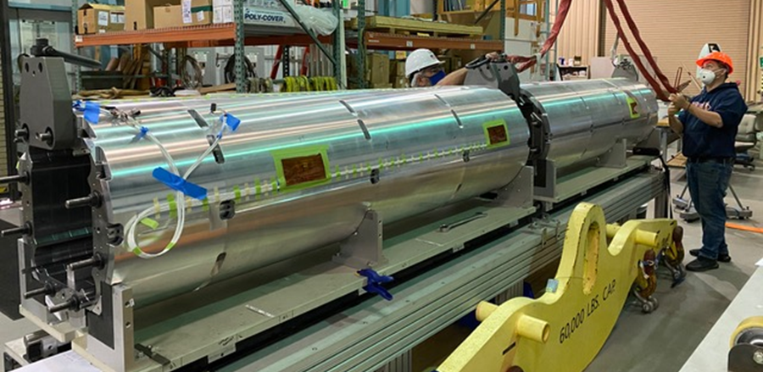
MQXFA Structures and Assembly
G. Ambrosio
Magnet assembly is at peak production with two assembly lines fully operational
MQXFA10 test was successfully completed at BNL
MQXFA11 met all requirements during 1st thermal cycle at BNL vertical test facility
It was involved in truck accident during shipment from LBNL to BNL
MQXFA08b is at BNL for vertical test
MQXFA12 assembly is in progress
MQXFA08 shell-yoke assembly
Notes:
Failure Mode Analysis
Magnet disassembly and reassembly needed to meet the requirements
- Structure Fabrication and Magnet Assembly Threat RT-302-2-07-007 Magnet disassembly and reassembly needed to meet the requirements If after a magnet is assembled, and the magnet does not meet requirements then disassembly and
reassembly are needed, which will increase labor cost and cause delay to the schedule

Slide 19
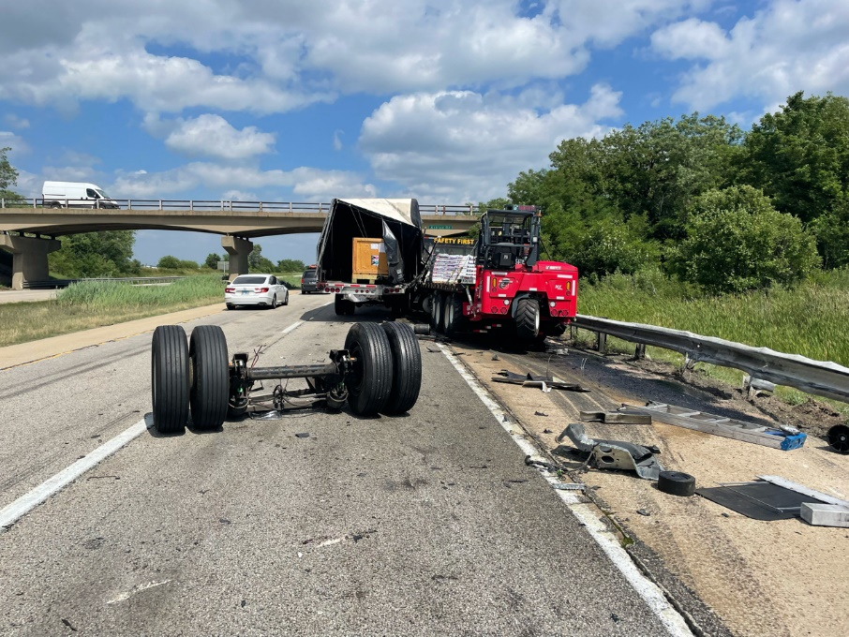
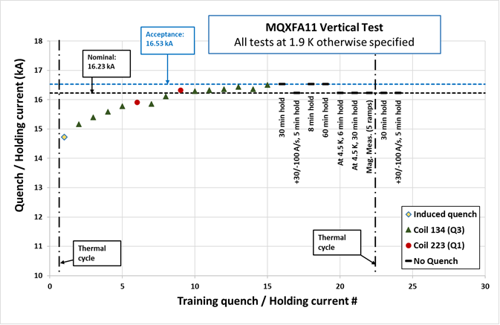
Magnet Testing Progress
S. Feher
302.4.01 Magnet Vertical Test
MQXFA11 test first Thermal Cycle and start of second thermal cycle was successful; test in progress
Both the facility and the magnet performance was excellent.
Second top plate repair is in progress
MQXFA11 was involved in the truck accident reported previously

Slide 20
Cold Mass and CryoAssembly Progress
S. Feher
302.4.02 Cold Mass Assembly Fabrication
MQXFA05 and MQXFA06 (magnets for CM02) are being prepared for installation to CM02 – resolving both magnet’s non-conformities are in progress
Alignment station has been re-aligned and it is ready for CA02 installation
Pressure Vessel note has been revised and it is under a review process
302.4.03 Cryo-Assemblies Fabrication
Instrumentation Feedthrough System (IFS) and CLIQ/Kmod assembly final welding completed and successfully RT was completed
Cold Mass Position Monitoring system has been installed and ready for the CA cold test
Preparation for the final pressure test is in progress
IFS and CLIQ/Kmod assembly instrumentation wiring is in progress
302.4.04 Cryo-assembly Testing
All the fabrication processes are completed
ORC is complete

Slide 21
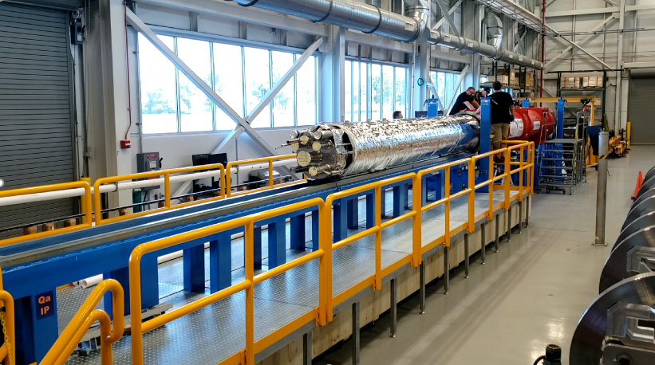
Cold Mass Insertion in Cryostat
S. Feher
August 31st, 2022: successful first insertion of an AUP HL LHC cold mass into a vacuum vessel

Slide 22
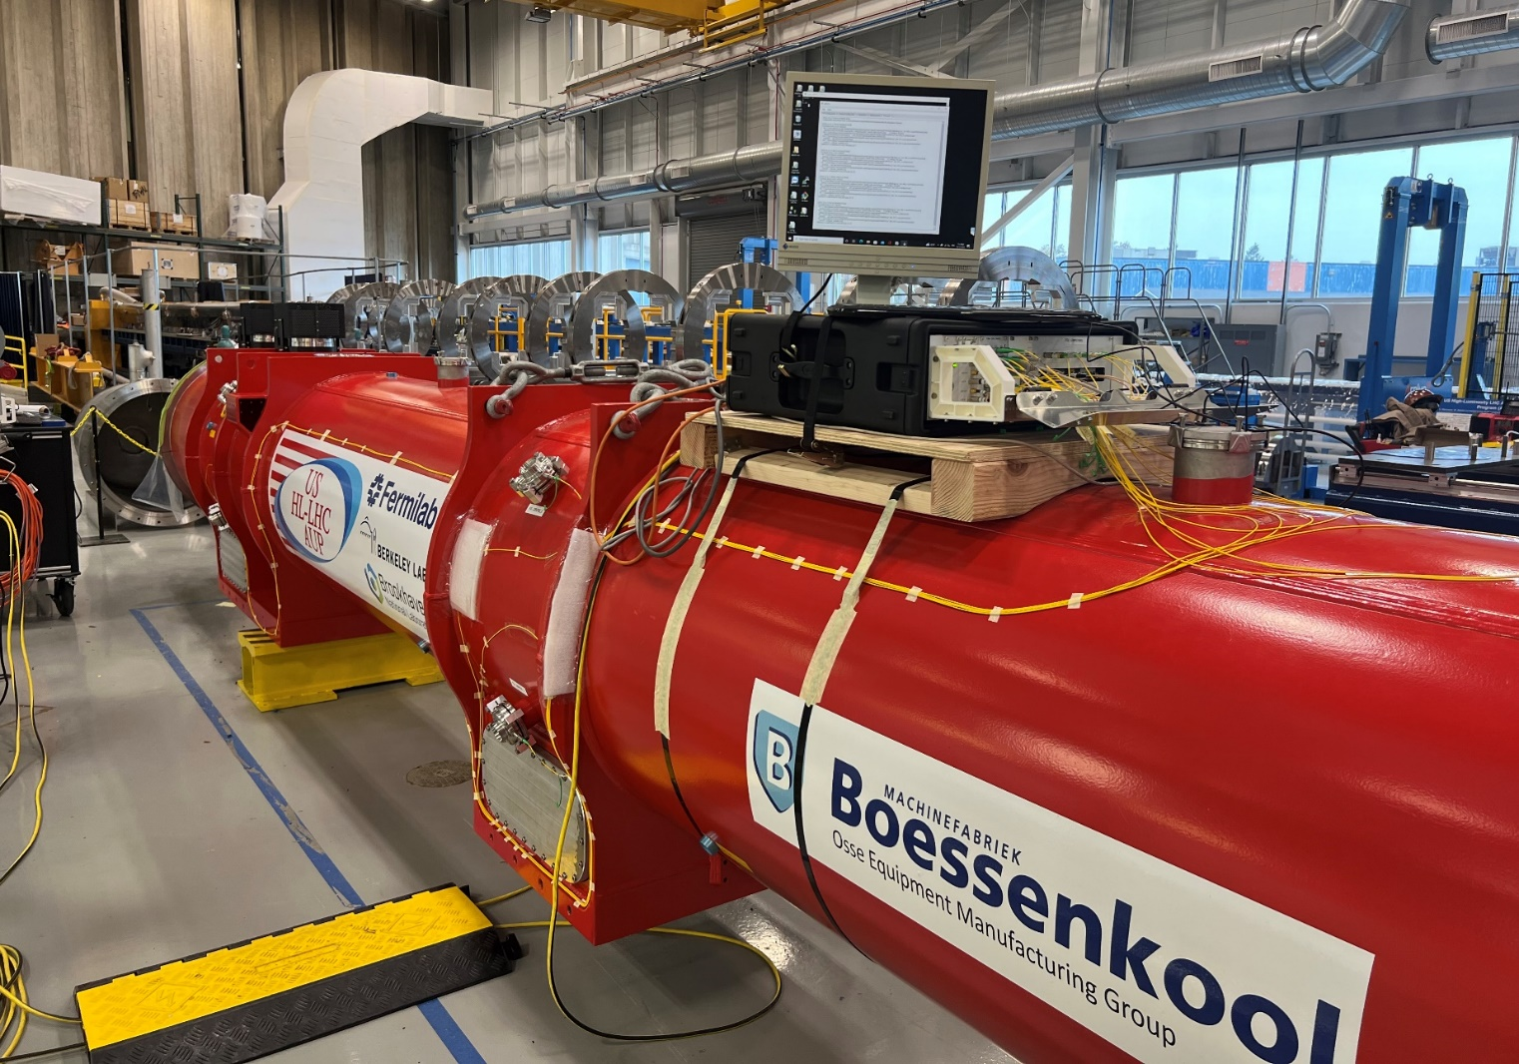
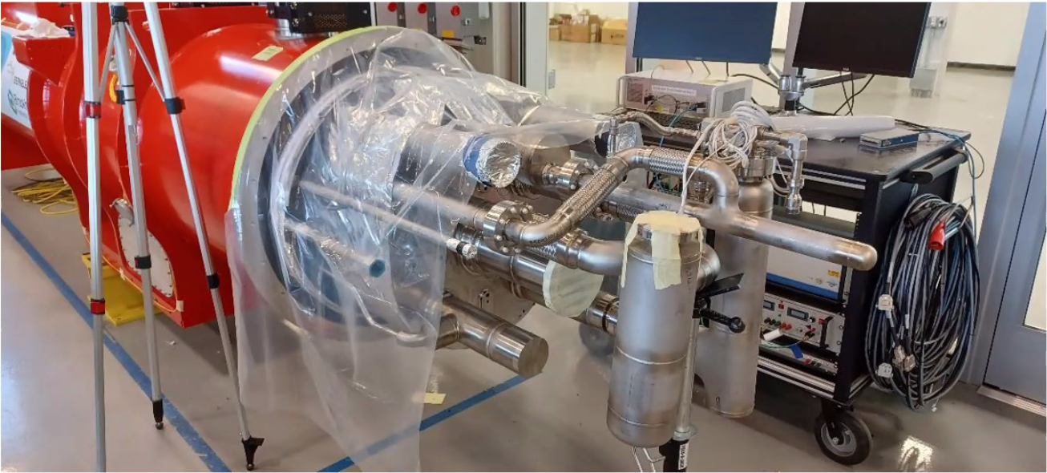
CryoAssembly 01 Fabrication
S. Feher
Fabrication near completion, expected delivery to FNAL test facility by the end of October
Cold Mass Position Monitoring System

Slide 23
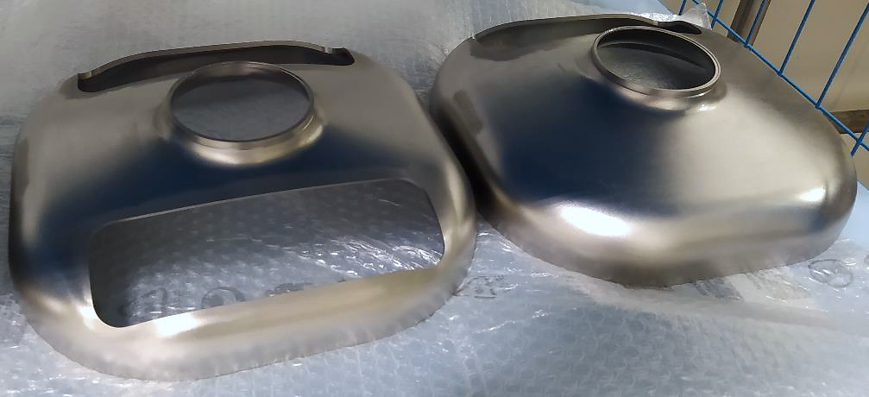
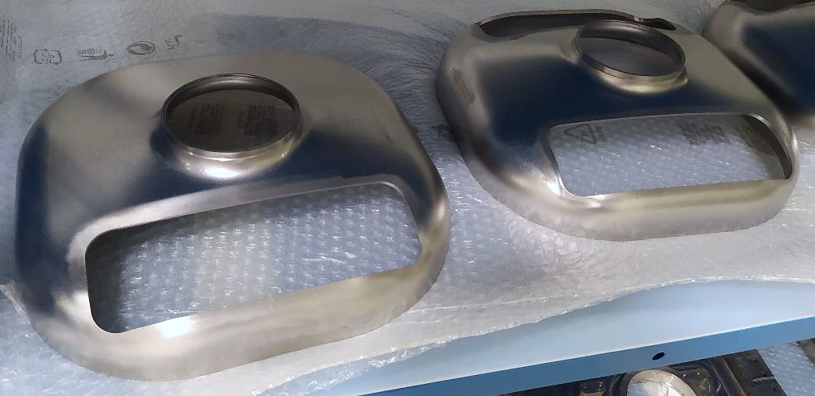
Pre-series End Caps and Waveguides
L. Ristori
Trim-tuning operations with FNAL representatives expected before end of year.
First pre-series cavity expected at FNAL Feb-Mar 2023.

Slide 24
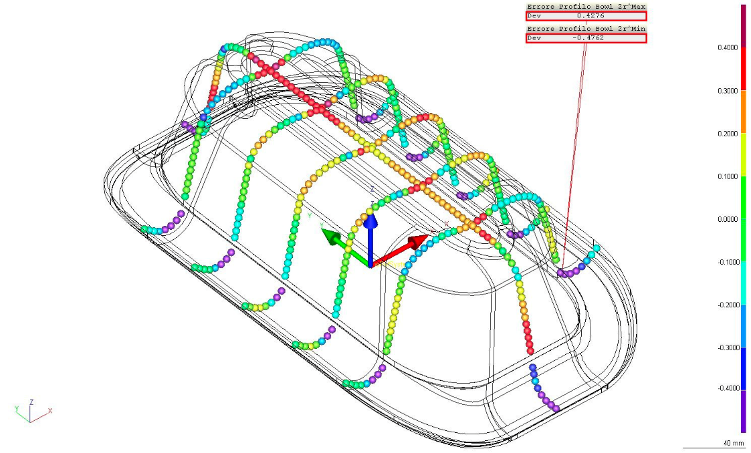
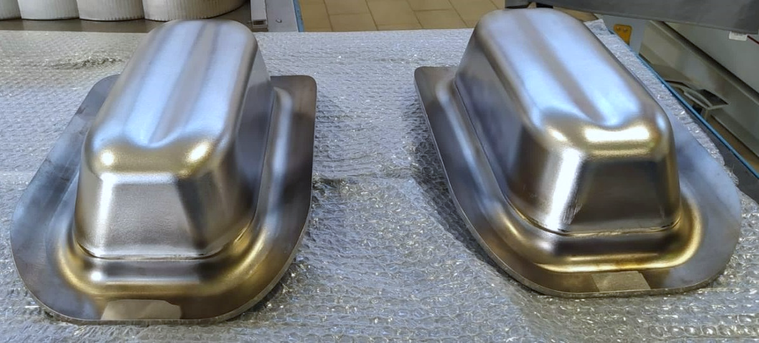
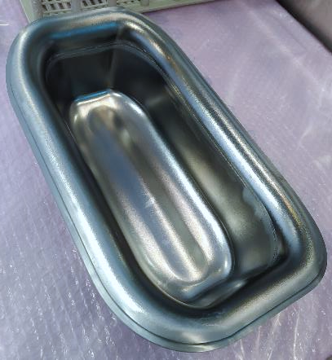
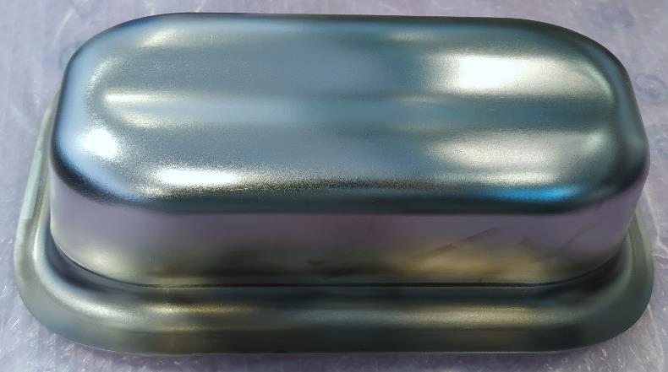
RFD Pre-series BOWLs (Pole + Corner)
L. Ristori
Metrology results improved compared to prototypes:
BOWL Prototypes shape accuracy 1.19 - 2.34mm
BOWL Pre-series shape accuracy 0.88 - 0.95mm
Still Slightly Out-Of-Tolerance: NCR submitted to CERN

Slide 25
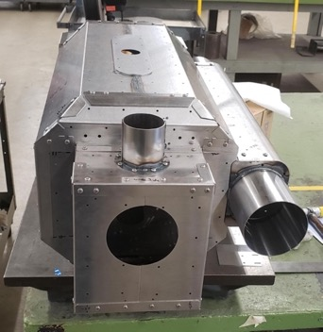
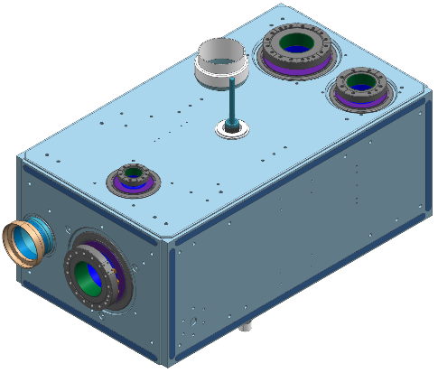
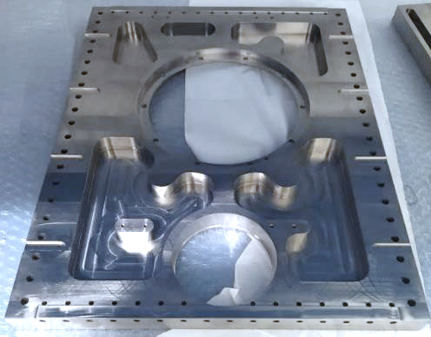
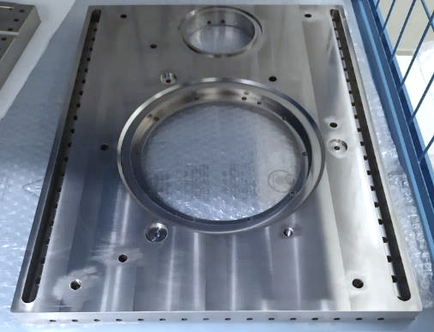
Prototypes Jacketing, Processing and Tests
L. Ristori
Proto #1 is at Zanon, Proto #2 is at Jlab for cold test with HOM dampers.
Contract is in place for 2 He Tank prototypes at Zanon. Most of the sub-components have been manufactured (see Titanium plates below).
Proto #1 will receive a full processing cycle (Bulk BCP, 600C bake, light BCP), it will be outfitted with cold magnetic shields (right) and outfitted with the Helium Tank.
Finally, it will be fully prepared at Zanon by means of HPR, clean room assembly + RF antennas, and shipped to FNAL for a cold test.
3 Shield Assemblies are at Zanon

Slide 26
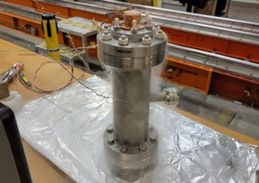
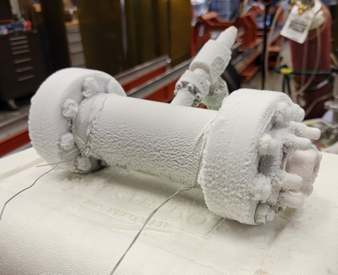
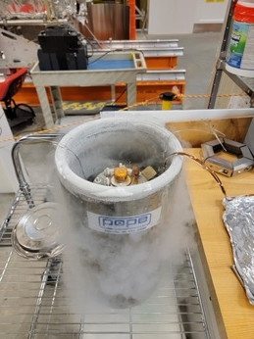
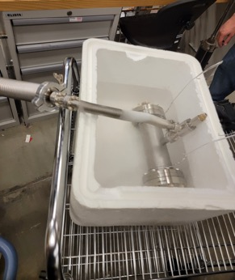
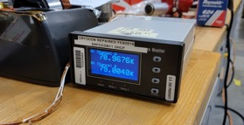
HOM Dampers - Status
L. Ristori
Continued troubleshooting prototype ancillaries that caused leaks at FNAL during cold tests.
Achieved leak tightness for 1 set at liquid nitrogen temperature on test bench (see pictures below).
Thanks to CERN for sending test spool piece (pictured below).
Jlab will be installing this set on Prototype #2 and perform a cold test at Jlab vertical test facility.
Minor interface tooling being finalized to allow the cold test in the next month.
Cold shocks
Cold leak-checks

Slide 27
Summary
Received $38.4M in IRA funding. FY23 funding disbursement plan ($30M) communicated to DOE and confirmed by FPM.
Successful AUP Rebaseline Director’s Review. Charges received for DOE Rebaseline Review in December
An independent Root Cause Analysis (RCA) review will be conducted in advance of the DOE review
Magnet assembly at peak production at LBNL. First re-worked production magnet (MQXFA08b) delivered to BNL for testing.
Successful first thermal cycle of Magnet 11 (the one that was involved in a truck accident). Second thermal cycle in progress at BNL.
First Cryo-Assembly fabrication near completion at FNAL, delivery to the FNAL test facility expected by the end of October.
Pre-series bare cavities fabrication proceeding at Zanon. Zanon also started machining helium tank components for the first dressed cavity prototype
HOM dampers prototyes being prepared for cold testing in a prototype cavity at Jlab

