Slide 1


302.4.04 - Cryo-Assemblies Horizontal Test
Guram Chlachidze- FNAL
HL-LHC AUP Rebaseline DOE Rev. – Dec. 13th–15th 2022

Slide 2
Outline
Scope, Interfaces, Dependencies & Team
Achievements since CD-3
Contingency Consumption
COVID and Abnormal Escalation Impacts
Procurement Status
Schedule
Cost and Schedule Performance & VAR Reports
Estimate at Completion
Risks
Summary

Slide 3
WBS 302.4.04: Scope
Charge #2
Scope of work is the horizontal test of 12 cryo-assemblies
  3 pre-series, 7 series production and 2 re-works
  Upgrade of the existing horizontal test facility to meet the Q1/Q3 cryo-assembly test requirements. Development of the magnetic measurement systems
WBS Deliverables are Test Facility Upgrade, a total of 12 cryo-assembly tests and test reports
See details in WBS Dictionary
US-HiLumi-doc-39

Slide 4
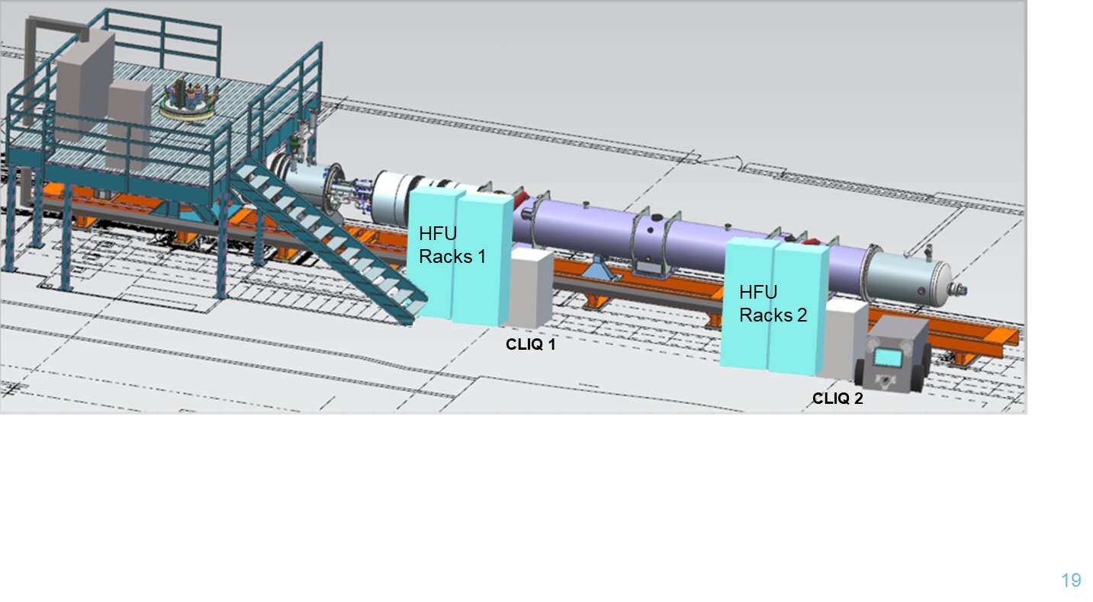
Horizontal Test Facility at Fermilab
The only test facility in the USA capable to test the HL-LHC AUP Q1/Q3 cryo-assemblies
  Horizontal test facility (Stand 4) previously was used for testing the present LHC inner triplet quadrupoles at Fermilab in 2001-2006
Refurbishment & new fabrication of some test stand components was necessary to meet the HL-LHC Q1/Q3 cryo-assembly design & test requirements
Stand 4 layout for cryo-assembly test

Slide 5
Horizontal Test Stand Upgrades
Charge #5
AUP-supported major cryo-mechanical upgrades included
  Cryogenic Feed-Box modifications. Design and fabrication of the Adapter Box between the Feed-box and the cryo-assembly, as well as of the new End-Box, Interconnects and Vacuum adapters
  Controlled cool-down/warm-up system, new external cryogenic lines
  Cryo-assembly supports, lifting fixture
  Power bus refurbishment, new water-cooled flexible power leads
  New warm finger (anti-cryostat) for magnetic measurements
AUP-supported development of magnetic measurement systems
Test stand refurbishment required for reliable electrical and cryogenic operation is supported off-project
  Process Controls system upgrade, new Quench Protection and Monitoring Systems, Quench recovery line
All these upgrades are now completed

Slide 6
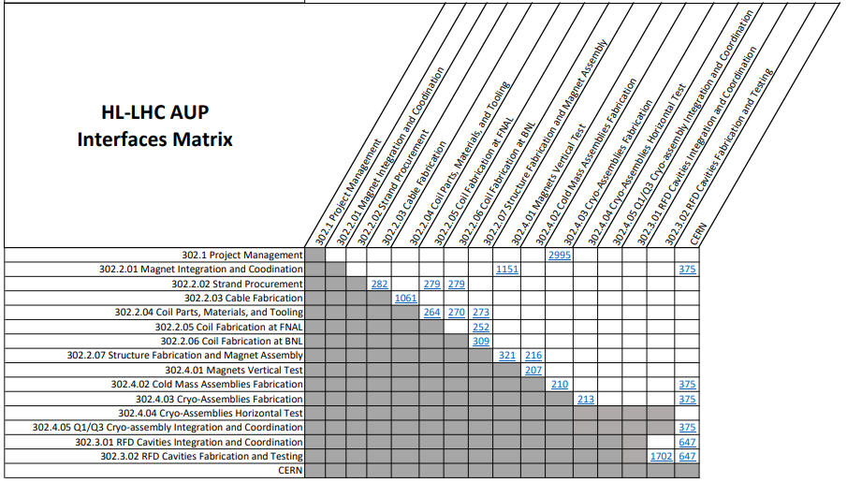
WBS 302.4.04: Interfaces
Charge #9
According to HL-LHC AUP Interfaces Matrix Interfaces have been established with 302.4.03 Cryo-Assemblies Fabrication
Interface Control Documents are described in US-HiLumi-doc-213
US-HiLumi-doc-219

Slide 7
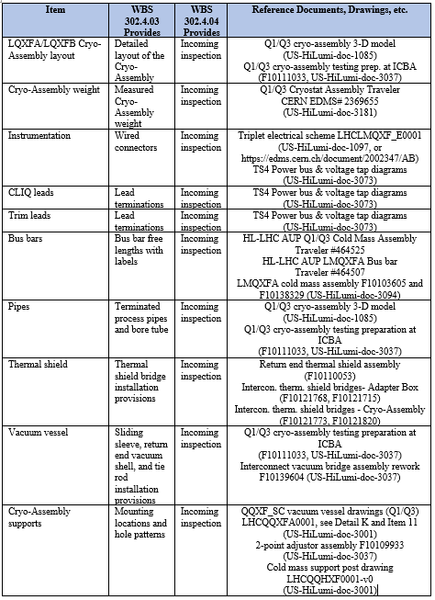

WBS 302.4.04 Interfaces (2)
Charge #9
All interface documents have been developed
Physical Interfaces
Data Interfaces

Slide 8
WBS 302.4.04 Documentation
Q1/Q3 CA and Horizontal Test Final Design Report US-HiLumi-doc-2882
  Test stand related engineering drawings are described in US-HiLumi-doc-3010. More than 800 drawing are collected in US-HiLumi-doc-3037 & 3049
Test Stand Requirements for testing Q1/Q3 Cryo-assemblies US-HiLumi-doc-1109
Various procedures and documents are developed for cryo-assemblies installation and testing at Stand 4
  Procedure for Interconnect and return end assembly US-HiLumi-doc-4302 (in ICBA), and US-HiLumi-doc-4355 (in IB1)
  Procedure for CA transportation between the CA fabrication and test facilities US-HiLumi-doc-4352
  Test parameters and checkout forms, Run plan US-HiLumi-doc-4249 and US-HiLumi-doc-4255

Slide 9
WBS 302.4.04: Organization
Charge #4
302.4
Q1/Q3 Cryo-assemblies Fabrication
L2: S. Feher
(T. Strauss)
302.4.02
Cold Mass Assemblies Fabrication
L3/CAM: S. Feher (A. Vouris)
302.4.03
Cryo-Assemblies Fabrication
L3: S. Feher (R. Rabehl)
CAM: T. Strauss
302.4.04
Cryo-Assemblies Horizontal Test
L3/CAM: G. Chlachidze
(S. Stoynev)
302.4.01
Magnets Vertical Test
L3: P. Joshi (A. Yahia)
CAM: P. Joshi
302.4.05
Q1/Q3 Cryo-assembly Integration and Coordination
L3/CAM S. Feher (T. Strauss)
302.4.04.03
Horizontal Test Stand Operations
L4: G. Chlachidze (S. Stoynev)
302.4.04.02
Instrumentation and Mechanical Horizontal Test Stand Upgrade
L4: G. Chlachidze (S. Stoynev)
302.4.04.01
Cryo-Mechanical Horizontal Test Stand Upgrade
L4: R. Rabehl
302.4.04.99
L3 Management Cryo-assemblies Horizontal Test
L3: G. Chlachidze (S. Stoynev)
Control Account
Guram Chlachidze - L3 and CAM
Stoyan Stoynev – L3 Deputy
L4 for cryo-mechanical upgrades – Roger Rabehl
Experienced team members participating in the project from the very beginning:
R. Rabehl, S. Feher, C. Reid, D. Richardson,
V. Nikolic, A. Makulski, D. Orris, J. Nogiec,
J. DiMarco, T. Cummings, C. Arcola, etc.
Fermilab APS-TD provided the adequate support and infrastructure
Only in FY21, due to funding issues, AUP covered test stand restoration cost (BCR 203)

Slide 10
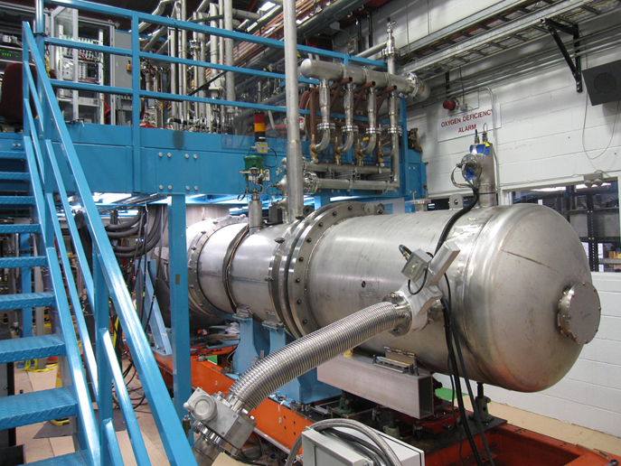
WBS 302.4.04: Achievements since CD-3
Charge #5
Zero magnet test in Oct-Dec 2020 was a critical milestone for the Horizontal Test Stand Upgrade Project
  Most upgrades have been installed and successfully verified in a shorted-bus (no-magnet) test configuration

Slide 11
Zero-magnet Test Results
Charge #5
Functionality of the upgraded systems were successfully verified
  New adapter box, Feedbox to Adapter box Interconnects, new End box
  New transfer lines, U-tubes
  Insulating vacuum
  High Voltage Withstand Levels passed at room and cryogenic temperatures (300 K, 4.5 K and 100 K)
Controlled cooldown and warmup procedures verified
  With new lambda plug location in the Adapter box
Safe operation at high pressure (17 bar)
  Matching the LHC operating conditions
Main vapor-cooled power leads tested up to 18.5 kA
New Quench Protection and Monitoring Systems verified

Slide 12
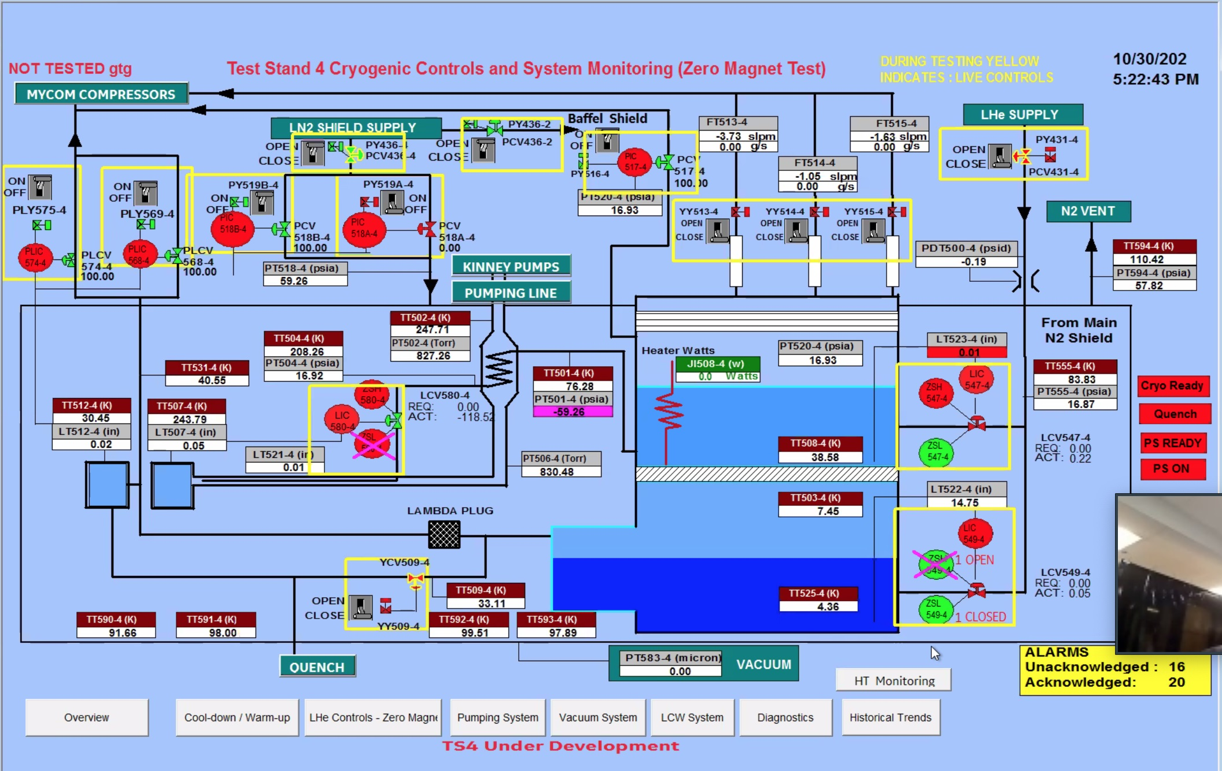
Zero-magnet Test Results (2)
Charge #5
New Process Controls system, supported off-project, was successfully used during the zero-magnet test
  Additional automation capabilities were added
  Control loops for feed box liquid helium level, return end liquid helium level, feed box pressure control, and thermal shield pressure control were tuned
It was the first for many years successful cooldown at Stand 4
Test Stand overview screen

Slide 13
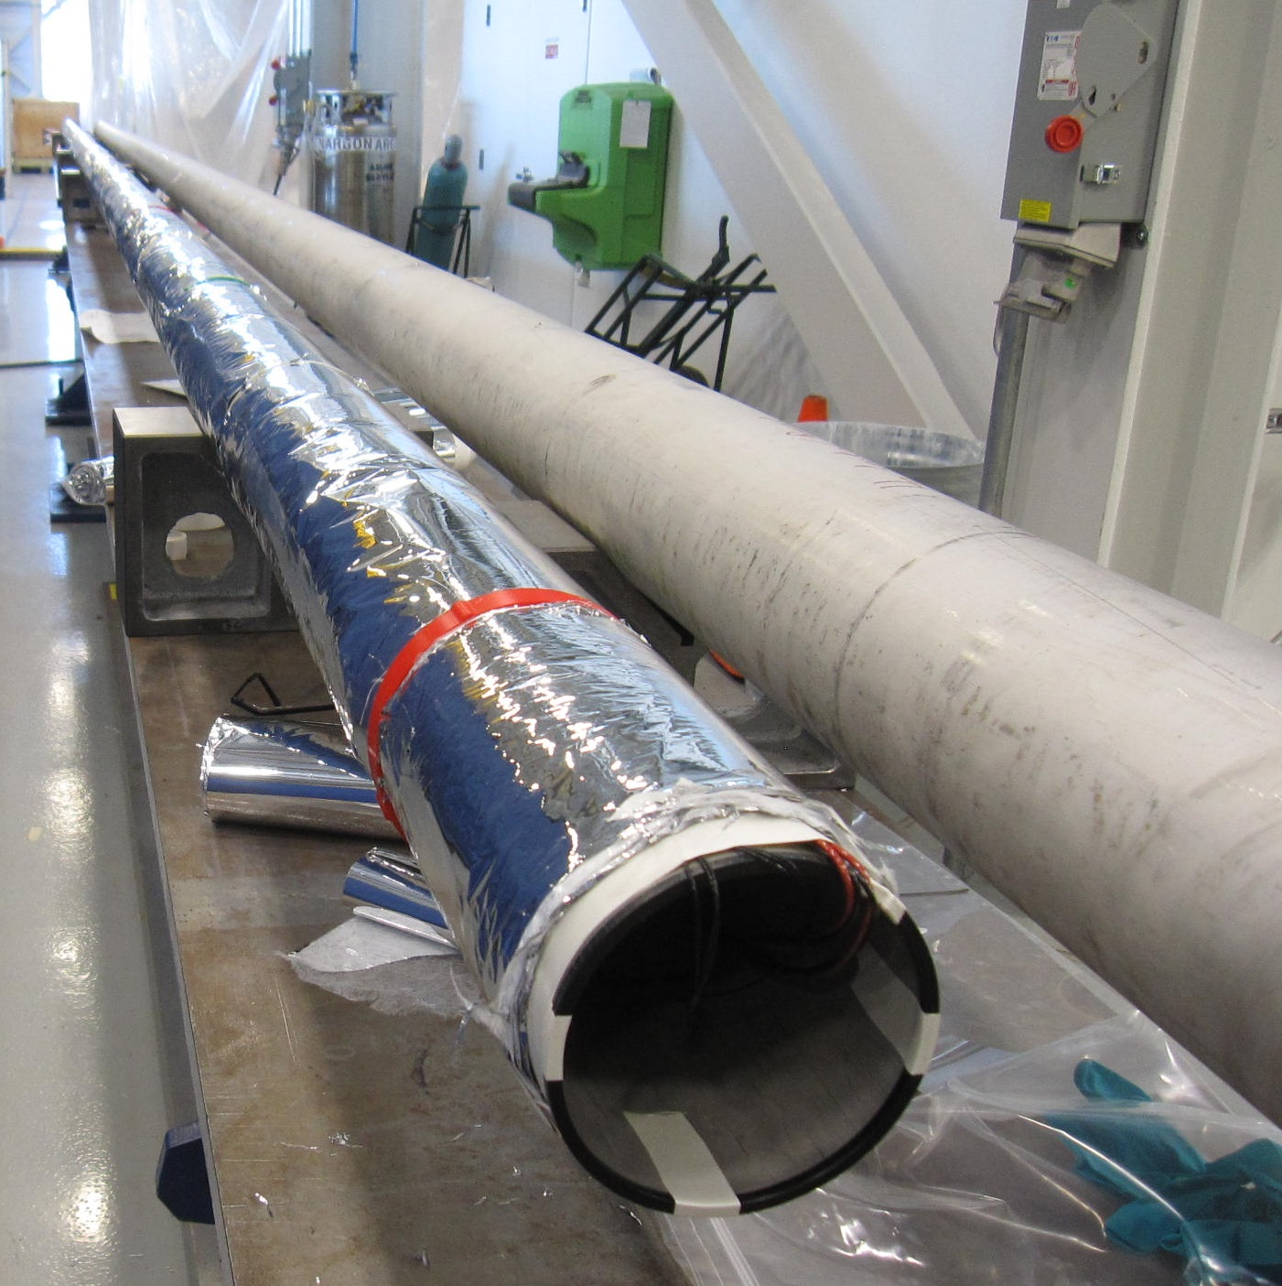
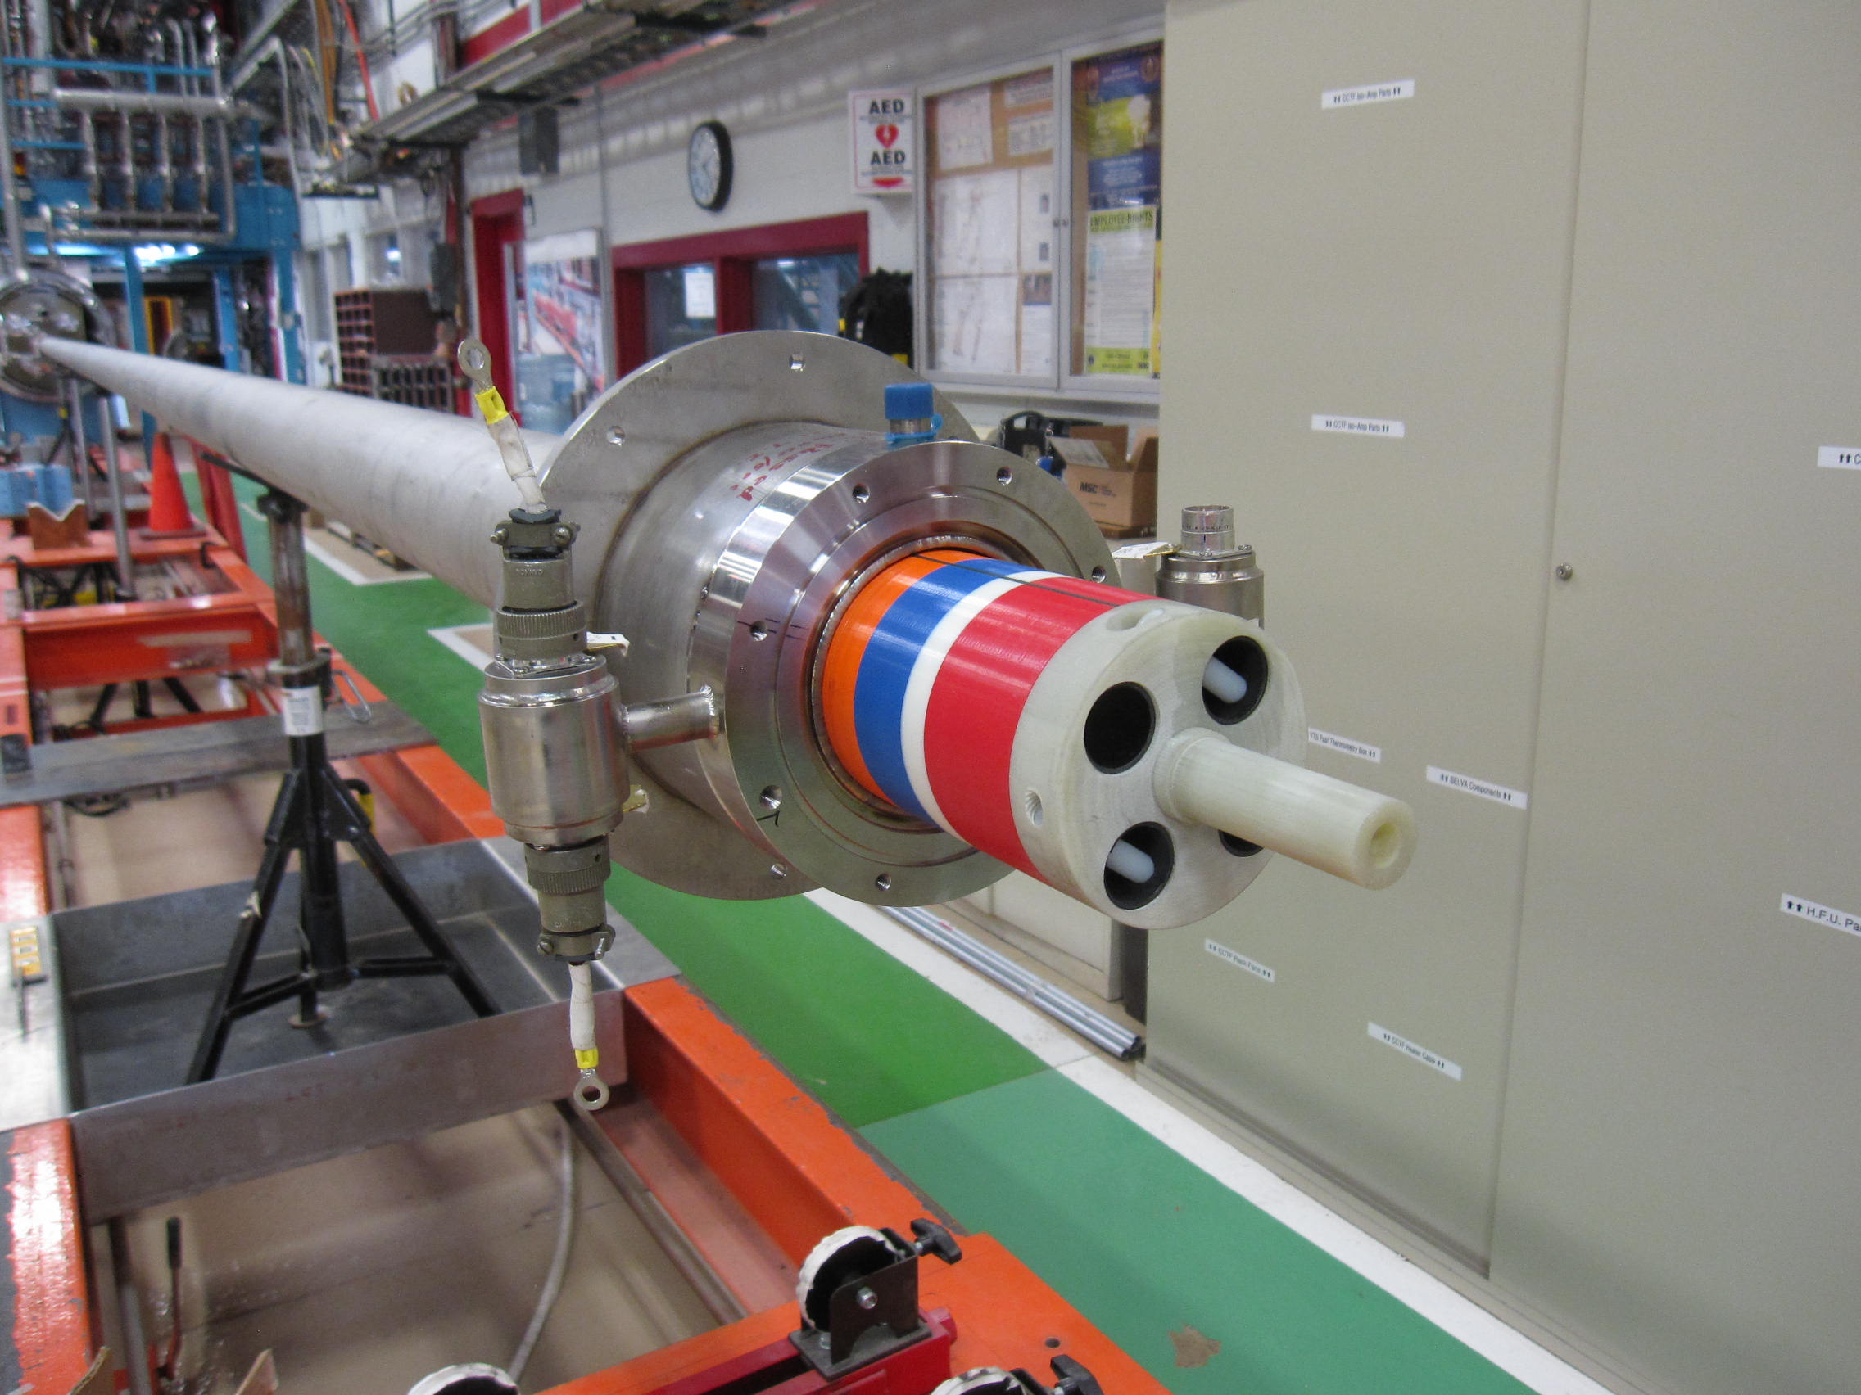
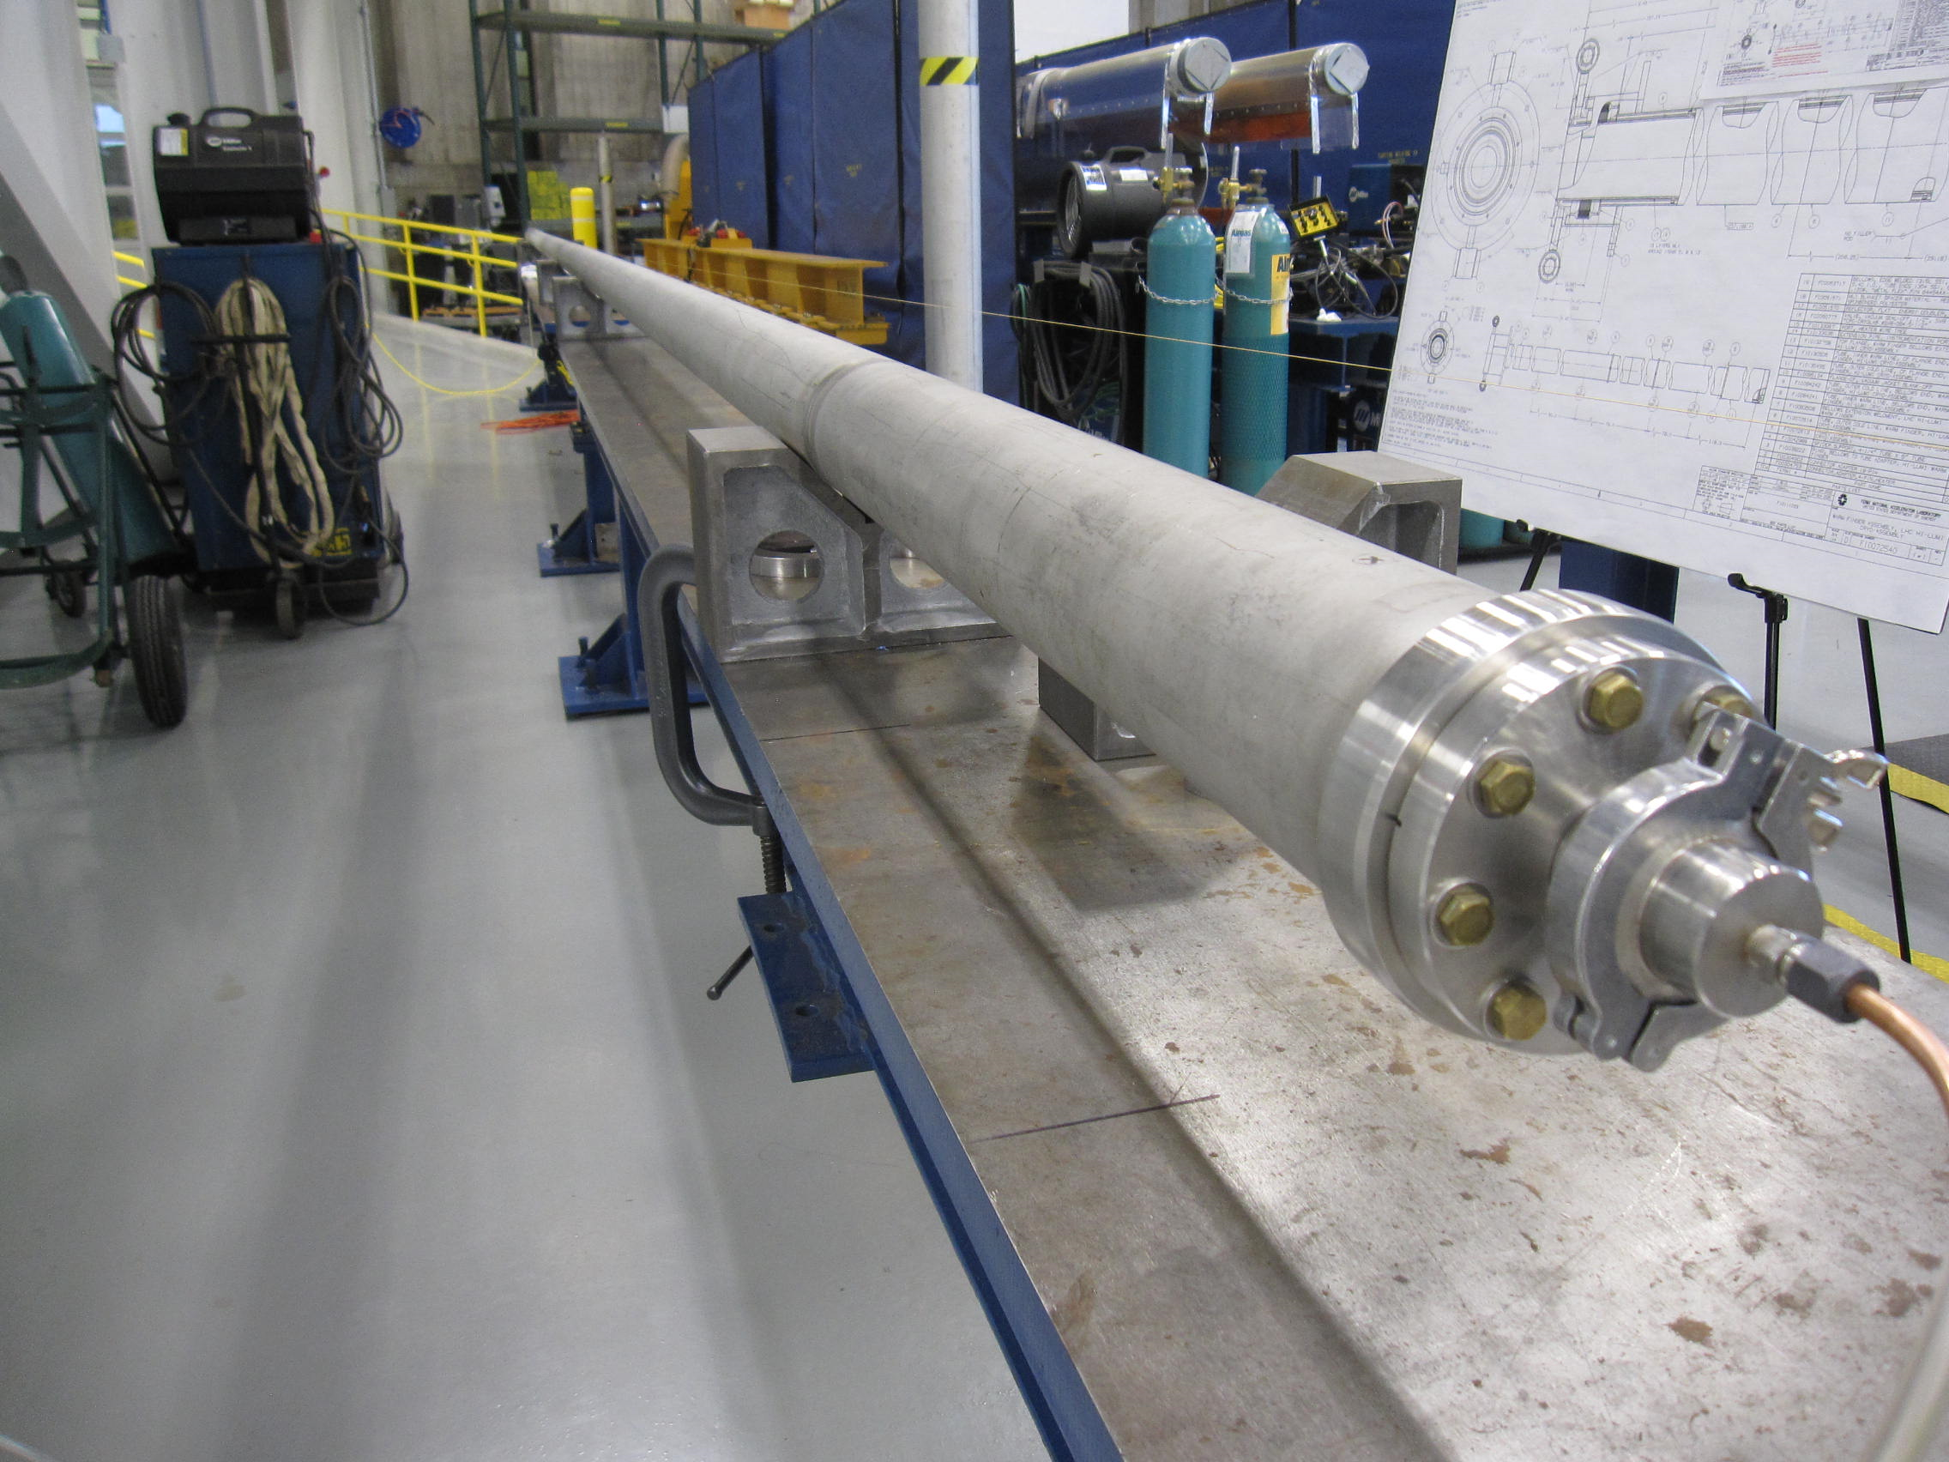
WBS 302.4.04: Achievements since CD-3 (2)
Charge #5
Warm finger (anti-cryostat) with 100-mm inner diameter was fabricated for field quality measurements in Q1/Q3 cryo-assemblies
  WF is equipped with temperature sensors and heaters
MLI applied to the inner tube
Warm finger assembly tested at Stand 4 with the upgraded probe drive system
Leak check after welding
WF with the measurement probe inside

Slide 14
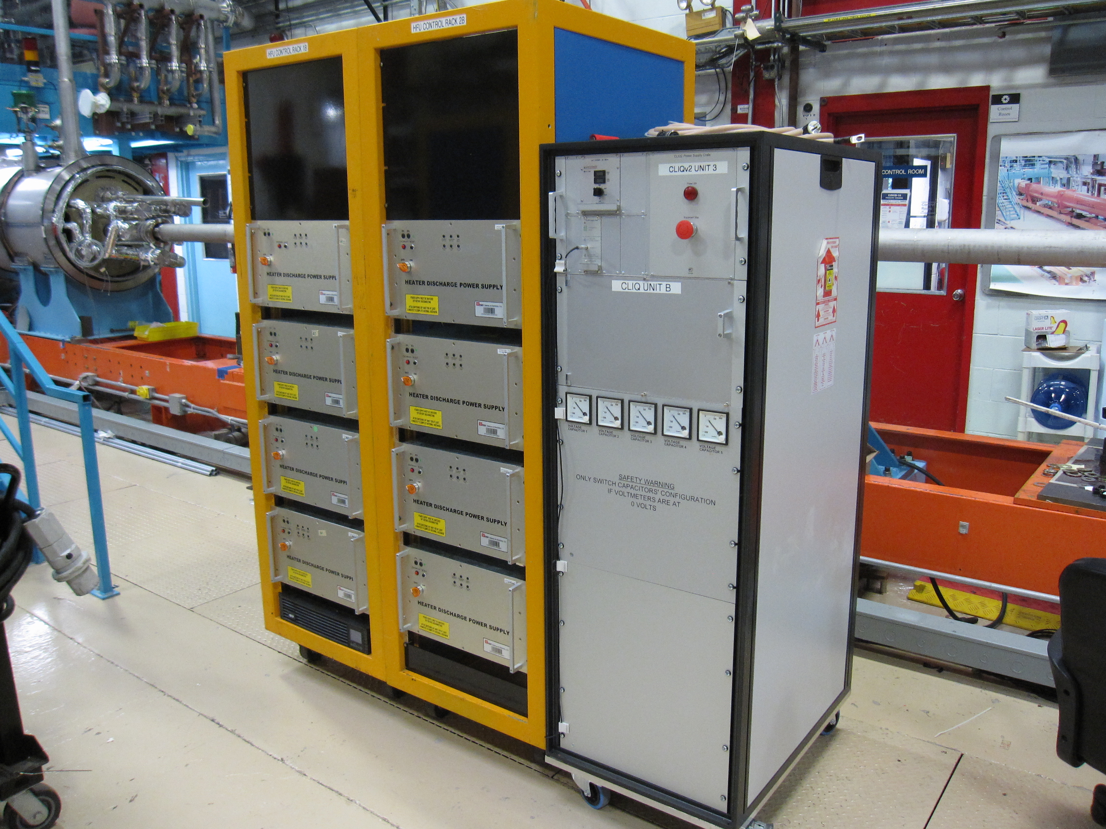
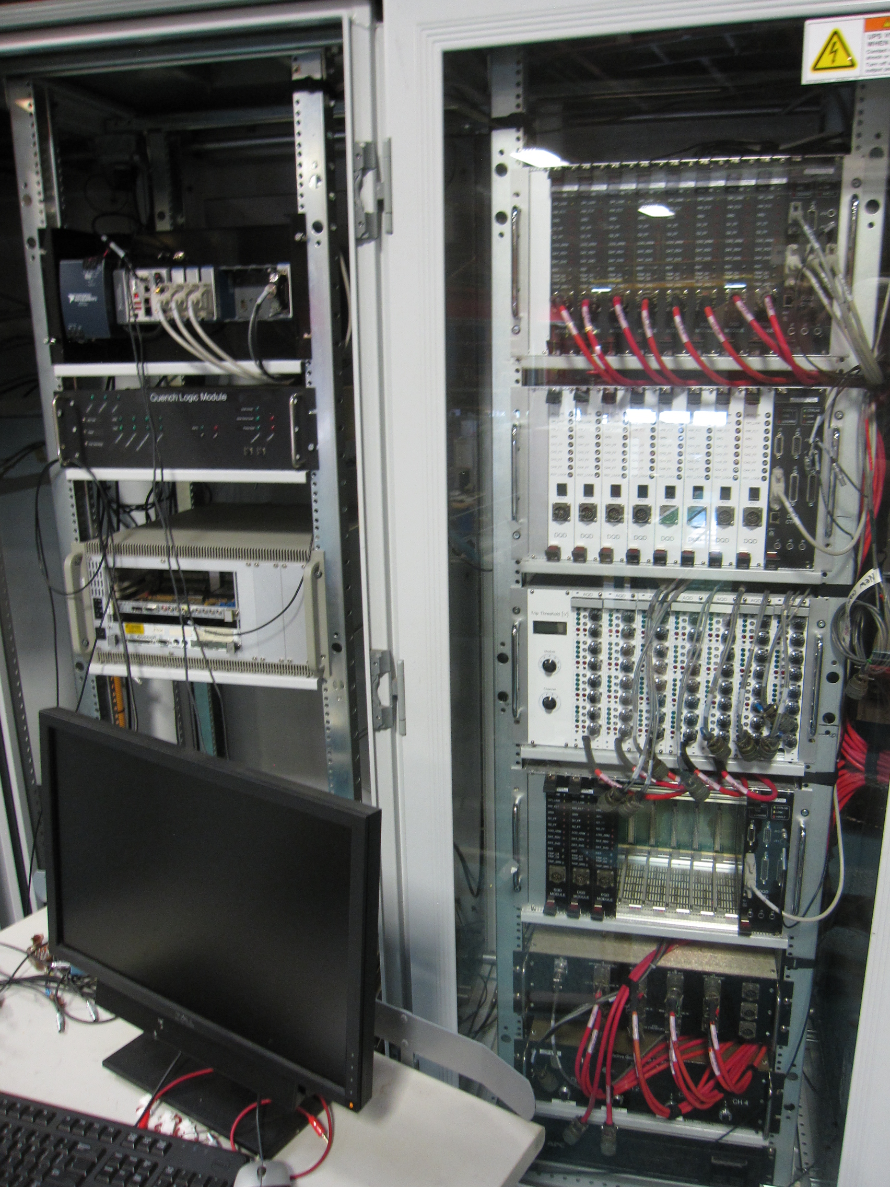
WBS 302.4.04: Achievements since CD-3 (3)
Charge #5
Quench Protection and Monitoring system (off-project) was extended to the full production configuration
  Additional quench detection (AQD, DQD) and monitoring channels
  Symmetric grounding system implemented
  QPM Quench Logic Module review in Jan. 2021
New current control and readout system implemented
Production QPM was successfully commissioned during the shorted bus test in Apr 2022
Production QPM
HFU and CLIQ at Stand 4

Slide 15
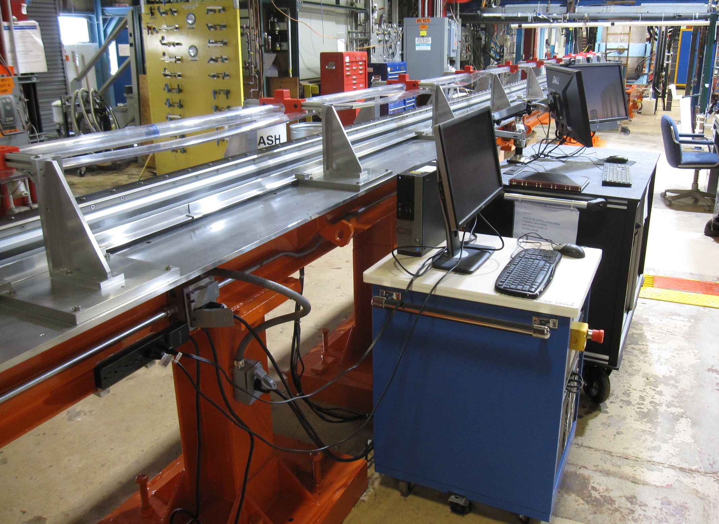
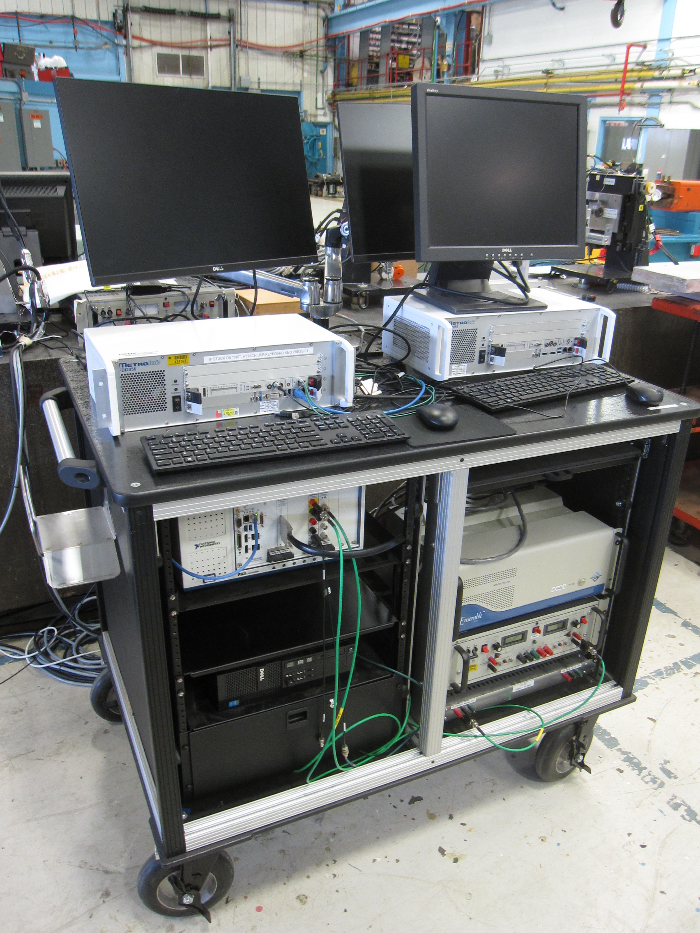
Magnetic measurement systems
Charge #5
New Single Stretched Wire (SSW) and Rotating coil systems will be used for alignment, field strength and harmonics measurements
Two identical SSW systems are assembled and ready for operation
  SSW1 successfully used during the first pre-series cold-mass assembly
  SSW2 cross-checked and tested with room temperature magnets
Integration tests of the Rotating coil measurement system completed
  New measurement probe is assembled and tested
Rotating coil system
SSW2 system

Slide 16
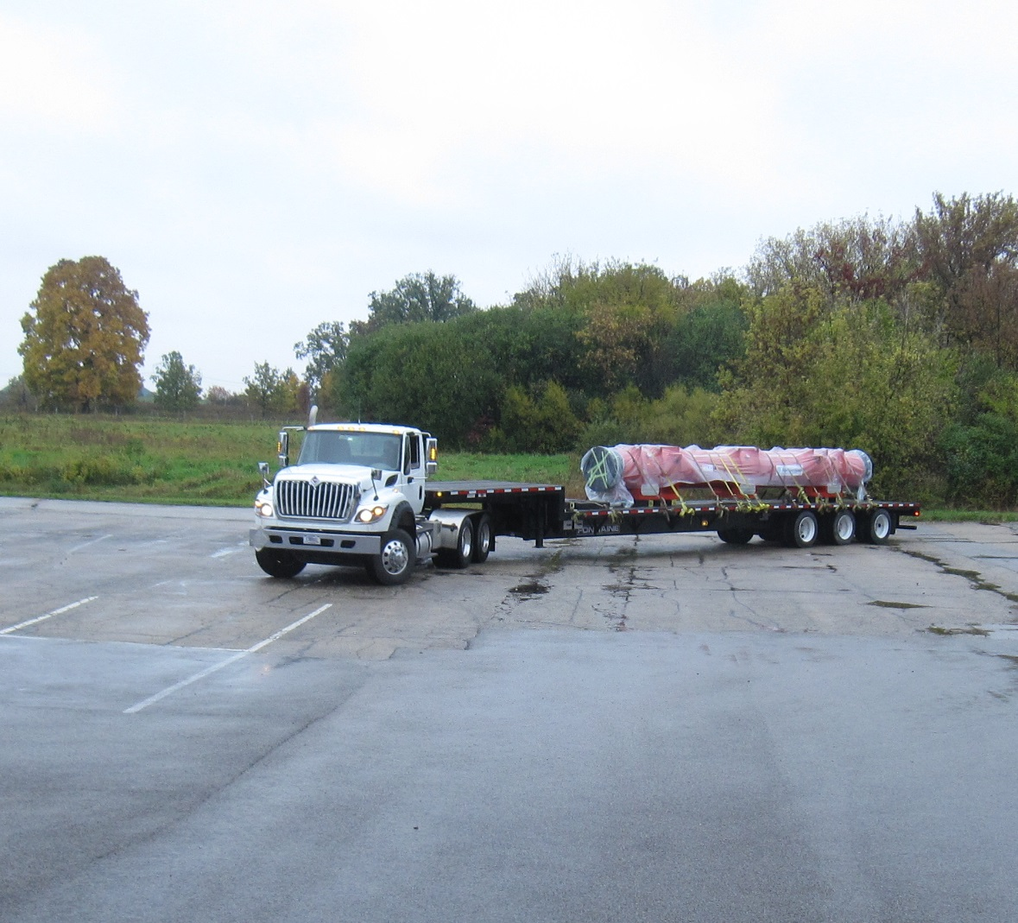
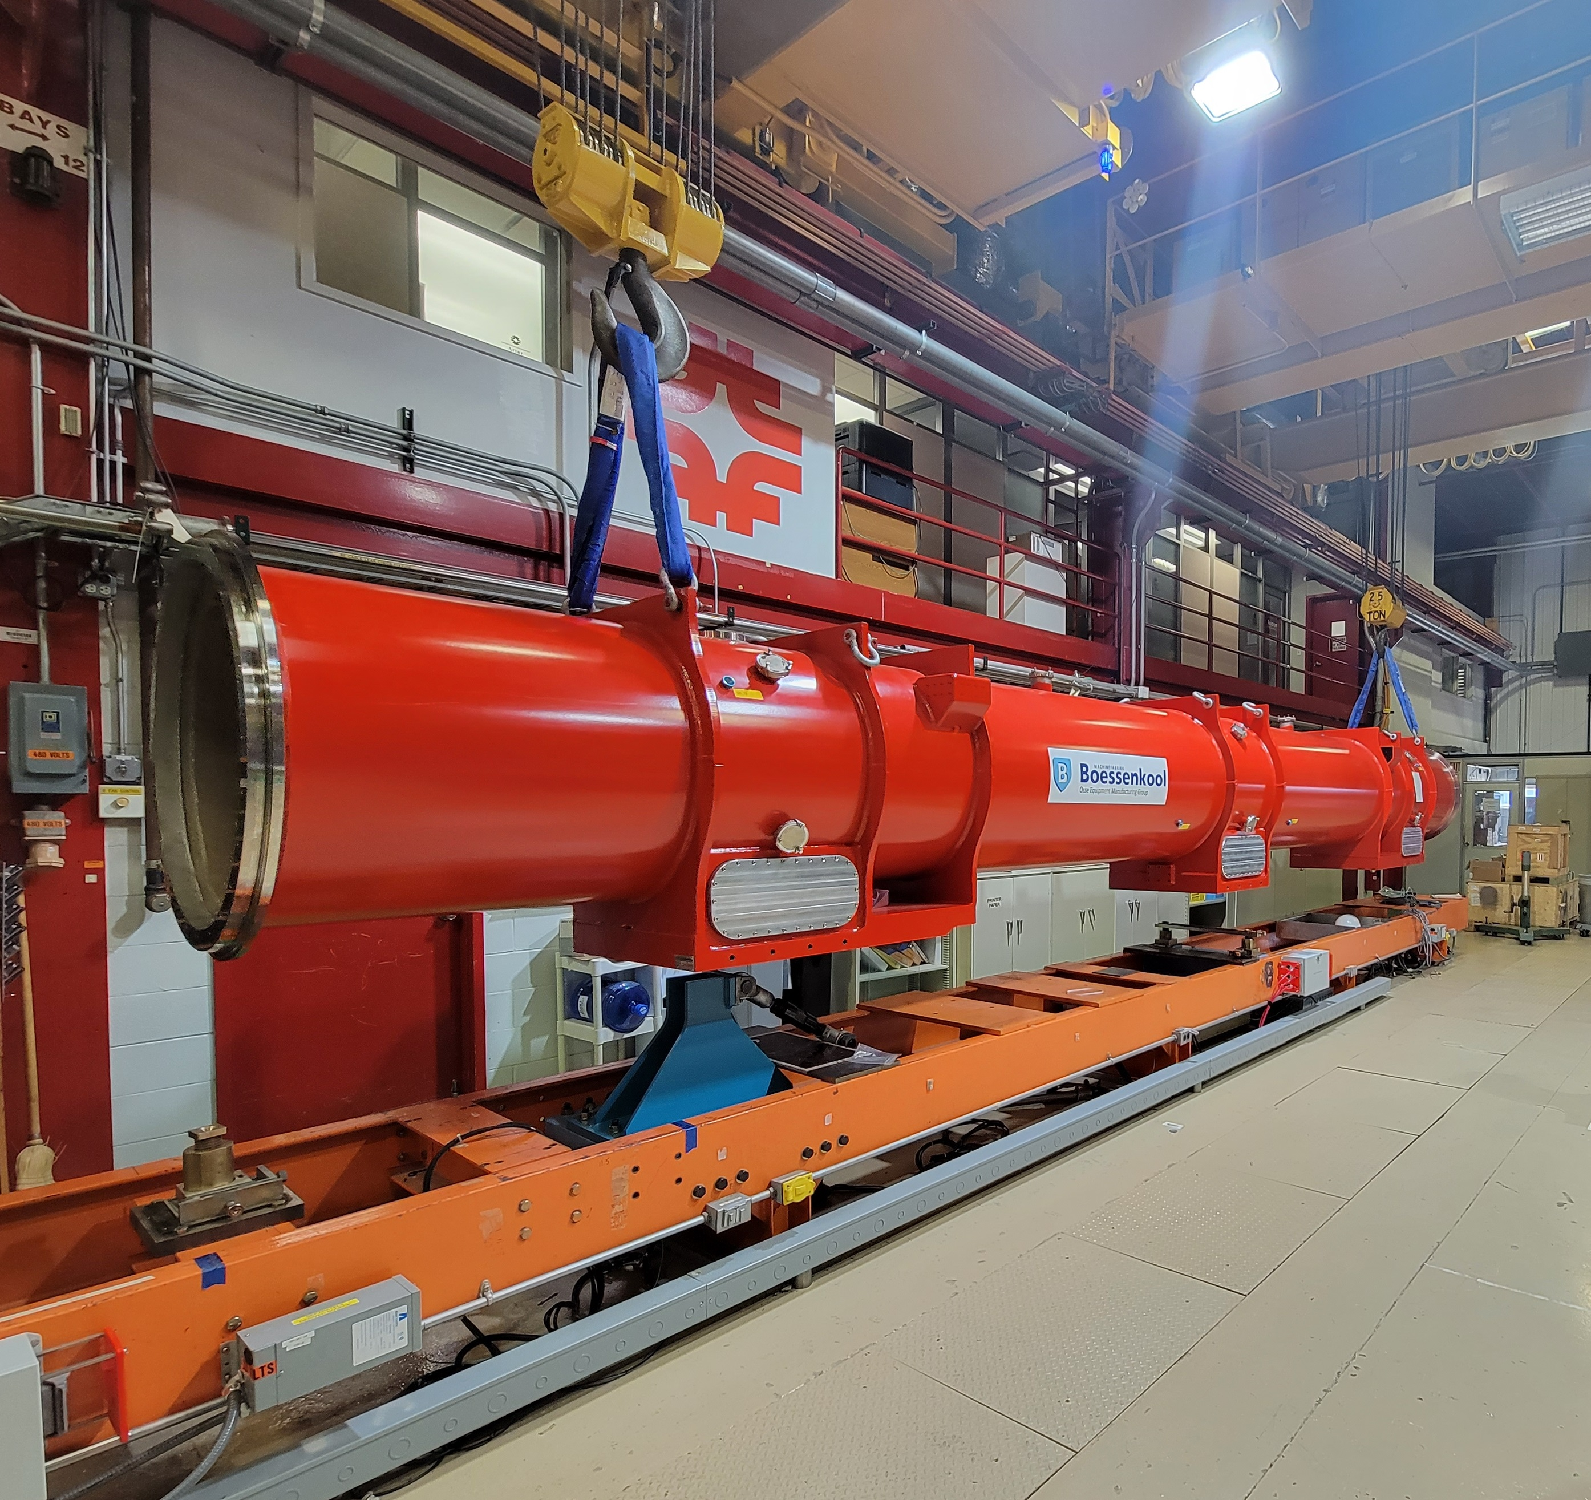
Vacuum vessel transportation test
Charge #5
AUP vacuum vessel transportation from the cryo-assembly fabrication area to the horizontal test facility has been verified
  Dedicated truck and trailer, purchased off-project, were used for the transportation test
  Vacuum vessel successfully was installed on the staging area first and then on Stand 4 using the 3-point supports

Slide 17
WBS 302.4.04: Contingency Consumption
Charge #1
Estimated COVID impact of ~$337k includes COVID related efficiency drop, LOE and schedule adjustments
Abnormal escalation impact of $115k from Summer 2022 ETC
  M&S for the first two pre-series CA testing was adjusted with more recent cryogen cost

Slide 18
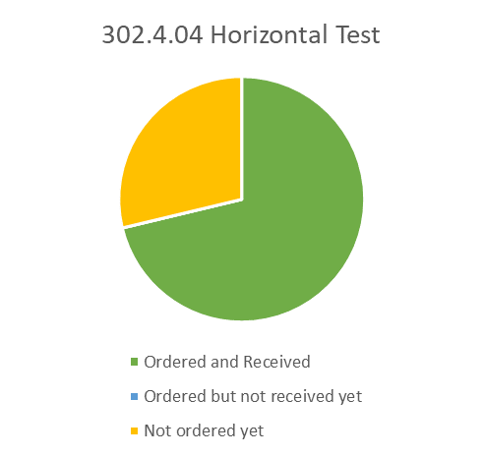
WBS 302.4.04: Procurement Status
Charge #9
Total M&S is ~ $2.7M, with ~$0.7M still
to be ordered
All major procurements are completed
Remaining procurement (not ordered yet)
is only cryogens (Helium and Nitrogen)
required for supporting “cold” testing at Fermilab’s horizontal test
facility
FNAL gas supplier contract renews in Nov. 2022, we anticipate doubling in cost due to worldwide Helium shortage and inflation
  New cost will be announced around or soon after this review

Slide 19
WBS 302.4.04: Schedule
Charge #2
Cryo-assemblies Horizontal Test, the last activity before shipment, becomes critical path upon Cryo-assembly Rework # 2 until end of the project
CA cooldown at Horizontal Test
Stand expected in December

Slide 20

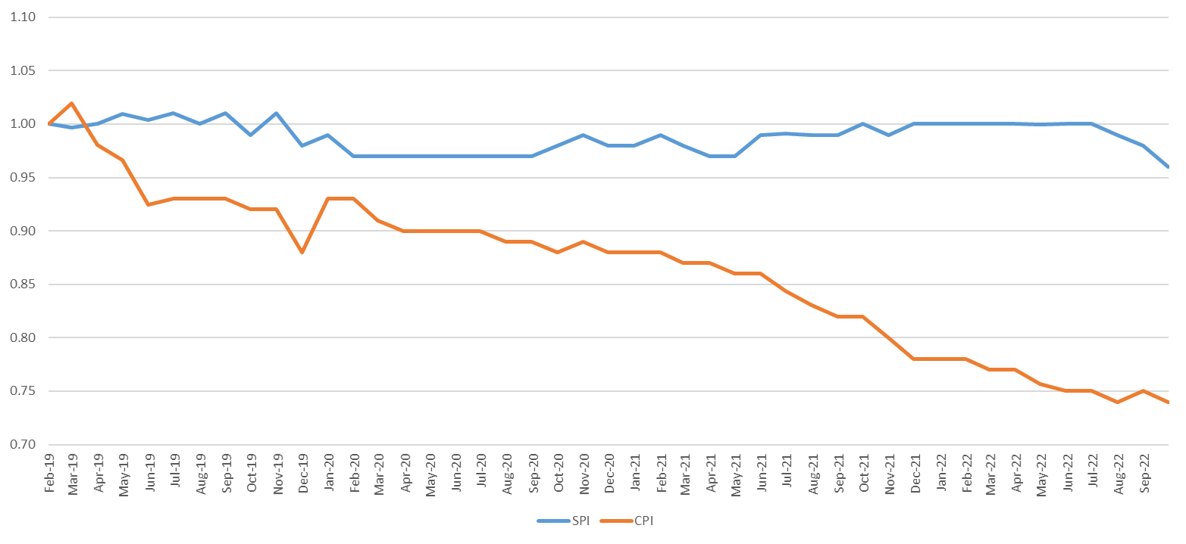
WBS 302.4.04: Cost and Schedule Performance
Charge #2
Work progress mostly according to plan
Negative CV due to underestimated efforts for Stand 4 upgrade
  Test facility upgrade requires the efforts of technicians, designers, and engineers to address issues with new assemblies, revise designs as needed, and update/approve drawings before assembly can proceed
Since Stand 4 upgrade is complete, flattening of CPI is expected
SPI ~ 96%
CPI ~ 74%

Slide 21

WBS 302.4.04: Estimate at Completion
Charge #2
Variance at Completion (VAC) includes $2.2M accumulated CV and $1.7M manual adjustment to EAC
  We expect the CV stabilized since Stand 4 upgrade is complete
Manual EAC adjustments include:
  M&S due to anticipated cost increase of cryogens for series CA tests
  Additional labor for cryo-assembly preparation for horizontal testing and for disassembly of interconnects after the test
  Additional LOE to finish the control account activities
  Additional set of reusable components for interfacing with the test facility to pipeline CA fabrication under the tight test schedule conditions

Slide 22
WBS 302.4.04: Risks
Charge #3
We have closed one risk since CD-3 review
  RT-302-4-04-006 – Upgrade of horizontal test stand is not completed by the planned start time
One new risk was added since CD-3 review
  RT-302-4-04-011 – Price of cryogens is higher than expected
  Original probability of the risk (50%) was increased by 25% to include COVID impact
Two medium ranked risks could be managed during or after the first cryo-assembly horizontal test
  RT-302-4-04-011 and RT-302-4-04-003
RI-ID | Title | Probability | Cost Impact | Schedule Impact | Risk Rank
RT-302-4-04-011 | Price of cryogens is higher than expected | 50% + 25% Due to COVID | 106 k$ | 0 months | 2 (Medium)
RT-302-4-04-003 | Horizontal Test takes longer than expected | 50% | 0 k$ | 0.25 -- 0.75 months | 2 (Medium)
RT-302-4-04-001 | Horizontal Test Facility - Non-Cryogenic System Failure | 20% | 0 -- 20 -- 200 k$ | 0.15 -- 0.24 months | 1 (Low)
RT-302-4-04-004 | Horizontal Test Facility - Magnetic Measurement System Failure | 20% | 0 -- 60 k$ | 0.1 -- 0.24 months | 1 (Low)
RT-302-4-04-002 | Horizontal Test Facility - Cryogenic System Failure | 20% | 0 -- 15 -- 65 k$ | 0.05 -- 0.4 months | 1 (Low)
RT-302-4-04-007 | Excessive Heat Load to 1.9K Cooldown | 20% | 0 -- 2 k$ | 0 -- 1 months | 1 (Low)

Slide 23
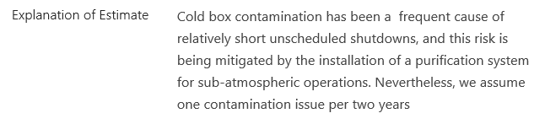
WBS 302.4.04: Risks (2)
Charge #3
RT-302-4-04-002 – “IB1 Cryogenic System Failure”
Various improvements (off-project) have been made to improve overall reliability of the cryo-plant
  Full stream purification system is implemented
  Four 30,000-Gal tanks were added to the existing six buffer tanks for storage of helium gas
  New liquefier was installed this year, increasing total LHe make rate to 600 ltr./hour and total liquid storage volume to 14,000 ltr.
Combination of higher liquefaction and He storage capacities will significantly increase throughput in magnet and SRF cavity testing
  Practically eliminating downtime due to cryo-plant maintenance

Slide 24
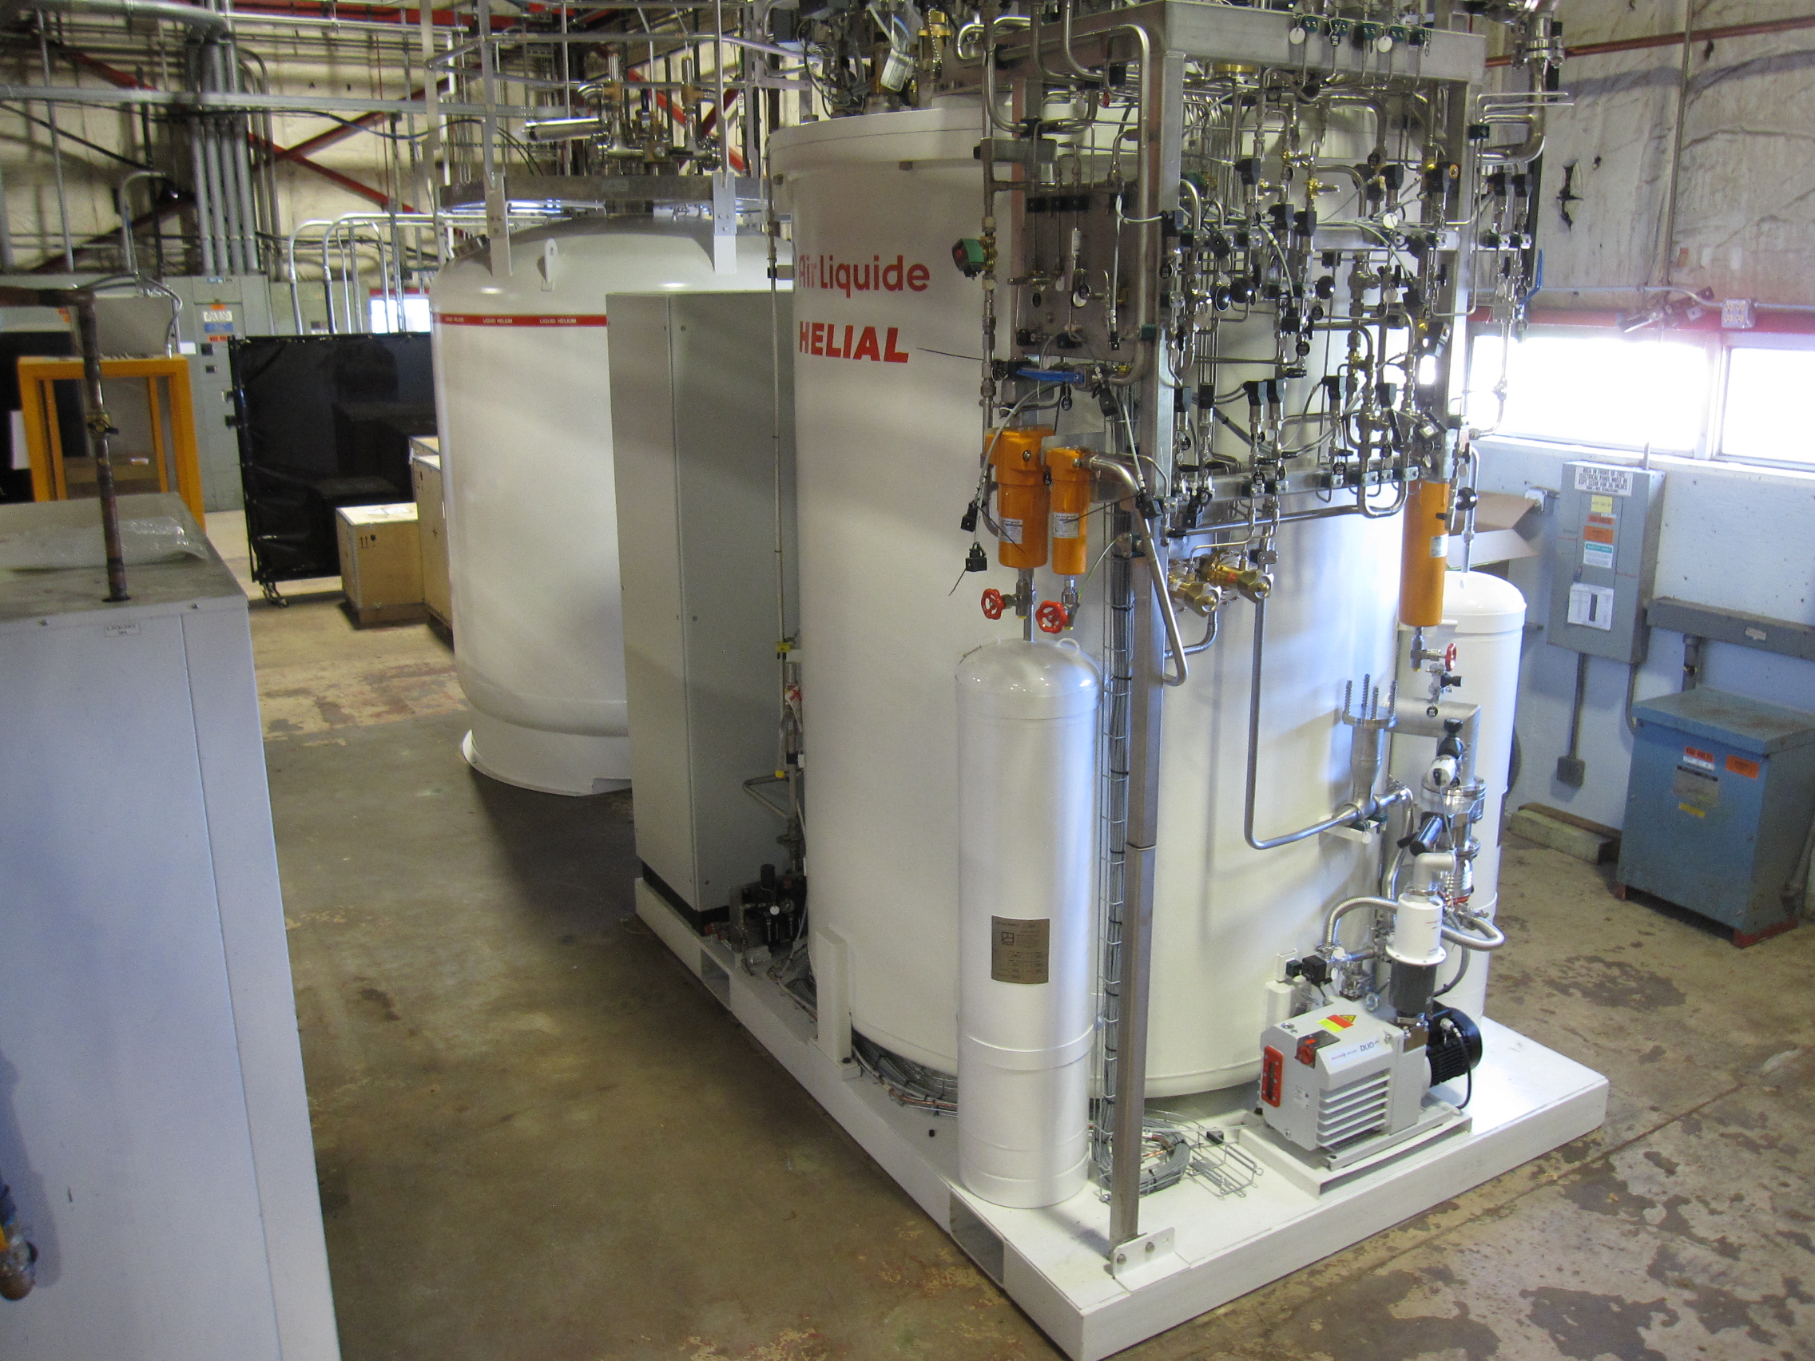
New Liquefier at Magnet Test Facility
New liquefier is fully functional. Acceptance tests are completed, integration with existing IB1 cryogenic system in progress
  Off-project FNAL infrastructure support
  LHe make rate will be increased from 300 to 600 ltr./hour and total liquid storage volume – from 10,000 to 14,000 ltr.

Slide 25
WBS 302.4.04: Summary
COVID cost and schedule impacts are understood and properly estimated
Cost & schedule elements are understood, EAC is up-to-date
Risks have been identified and actively managed
ES&H fully incorporated into planning
Horizontal test stand upgrade is complete
Cryogenic and electrical operation permits are obtained, we are ready for the first pre-series cryo-assembly test

Slide 26
Backup Slides

Slide 27
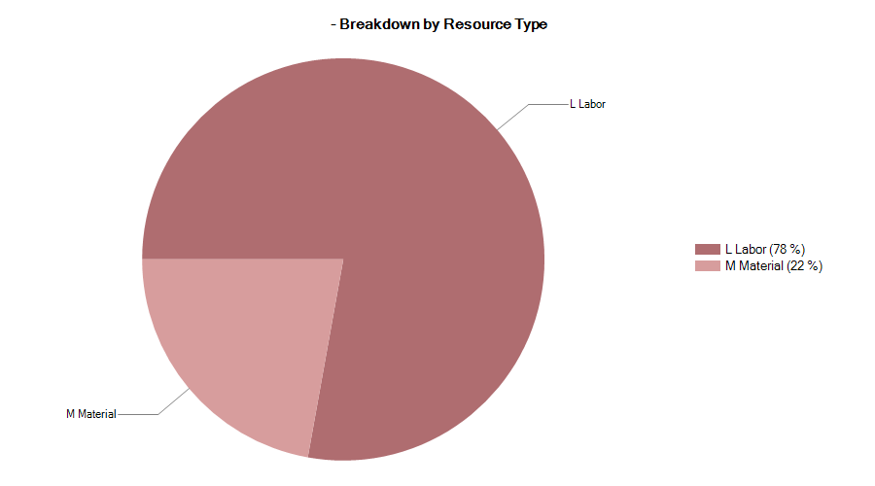

302.4.04: Resource Type Breakdown
Charge #4
78% Labor, 22% M&S (mostly cryogenic gases)

Slide 28
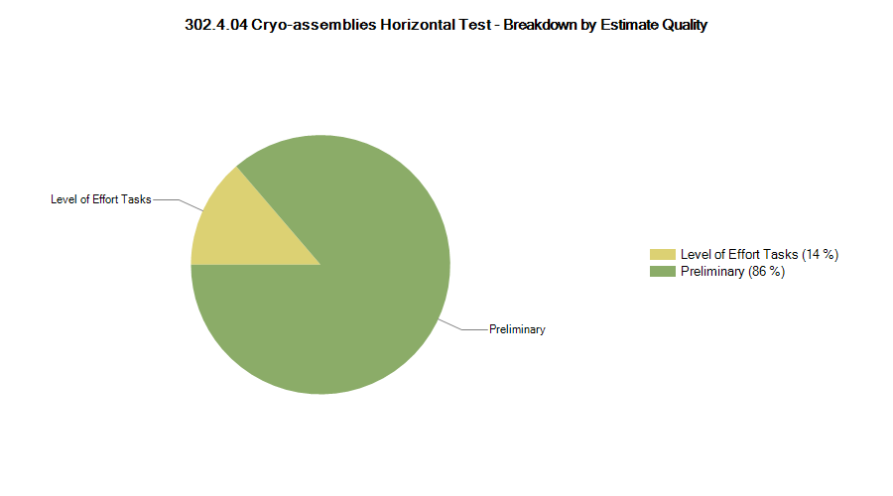

302.4.04: Estimate Quality
Charge #4
Dominated by preliminary estimate type (86%)
  Once the first cryo-assembly is tested the quality will be revisited, the current test plan is based on assumptions and lessons learned from vertical testing and prediction on new FNAL GHe contract for FY23

Slide 29
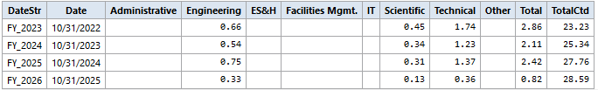
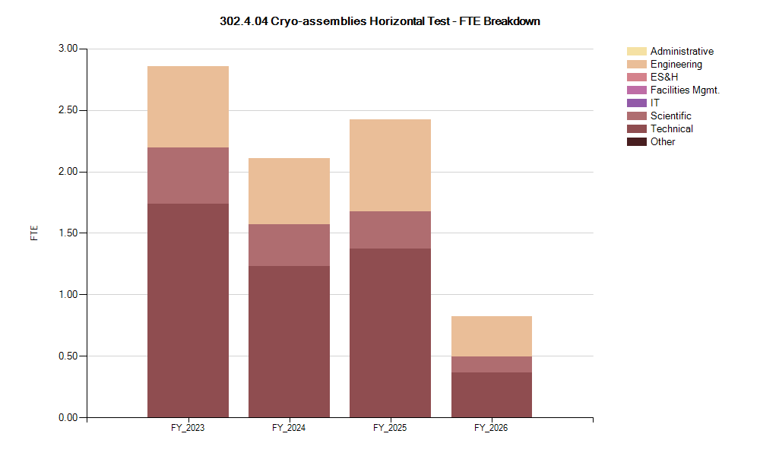
302.4.04: FTE Breakdown
Charge #4
Testing ~3-3.5 units per FY

Slide 30

302.4.04: Cost Performance Report
Charge #4
BAC = $9.974M
Schedule thresholds crossed in Current Period Cost
Cost thresholds crossed in Cumulative to Date
Cumulative SPI = 0.96, CPI = 0.74
Main Issue: Cost for Stand 4 upgrade was higher than estimated

Slide 31
WBS 302.4.04: Contingency consumption (2)
Top-10 BCRs/EAC/Manual Adjustments/CV since CD-2

Slide 32
WBS 302.4.04: COVID Impacts
Charge #1
Horizontal Test Stand installations were in progress when Stay-at-Home order was placed due to COVID-19 pandemic in 2020
  No progress was made for more than two months
  Installation work restarted around mid-June, as soon as our technicians and engineers obtained onsite access
COVID Impacts included
  Daily cleaning and disinfection of the work area
  Requirement of social distancing and face covering
  Self-isolation or quarantine of potentially exposed employees
  Difficulties in communication between different groups or organizations
  Procurement delays
COVID related efficiency drop has been evaluated as 87.5%

Slide 33
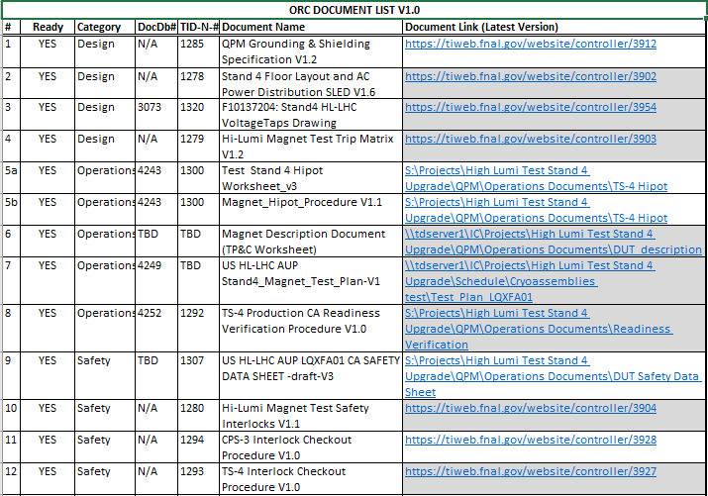
WBS 302.4.04: ES&H
Charge #10
Operational hazards at the horizontal test stand include Mechanical, Electrical, Cryogenic and Pressure hazards
Main Hazards include
  Use of overhead crane and lifting fixtures
  Use of liquid Nitrogen and Helium
  High voltage tests
Operation Readiness Clearance (ORC) for the pre-series and production magnet test was
obtained in Spring 2022
  Both the cryogenic and electrical
  work permits have been obtained
Documents prepared for
the electrical ORC

Slide 34
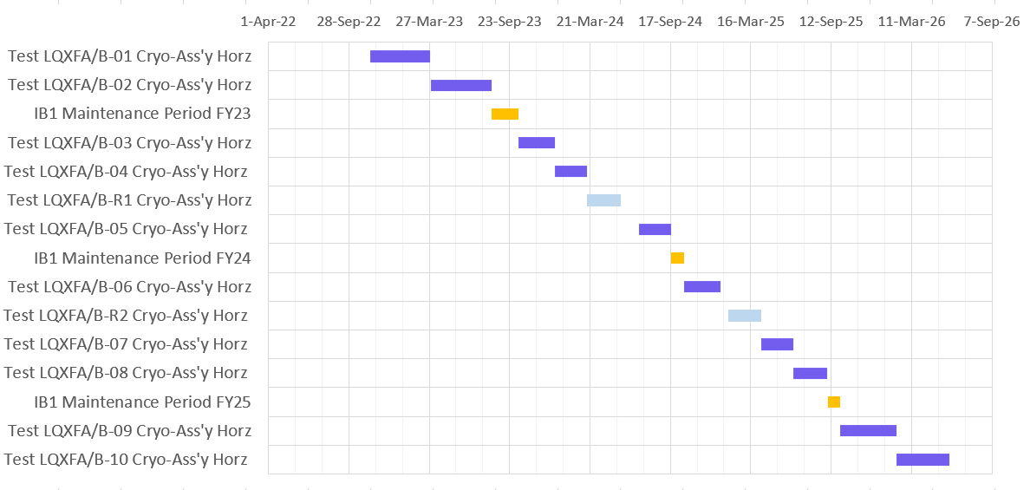
WBS 302.4.04: Schedule

Slide 35
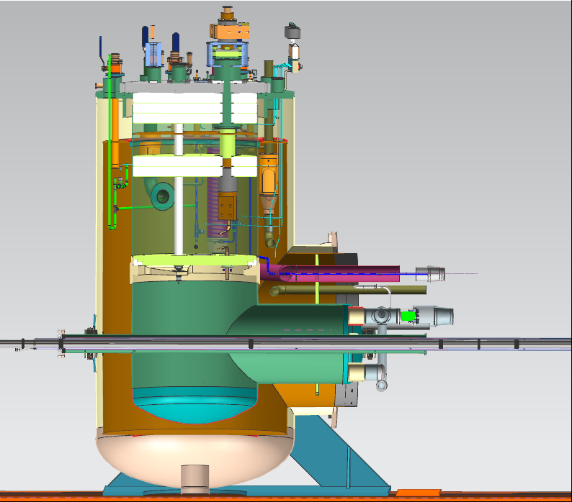
New location of the Lambda plug
Separation between the 4.5 K and 1.9 K areas moved from the Feed box to the Adapter box
We can test cryo-assemblies
at the LHC operating conditions
  High pressure
Lesson learned from testing old LHC magnets - due to limited maximum test pressure (~4.5 bar) some cryo-assembly components failed at CERN under higher pressure test
  Maximum pressure in the tunnel may reach 17 bar
Lambda plate
Lambda plug

Slide 36
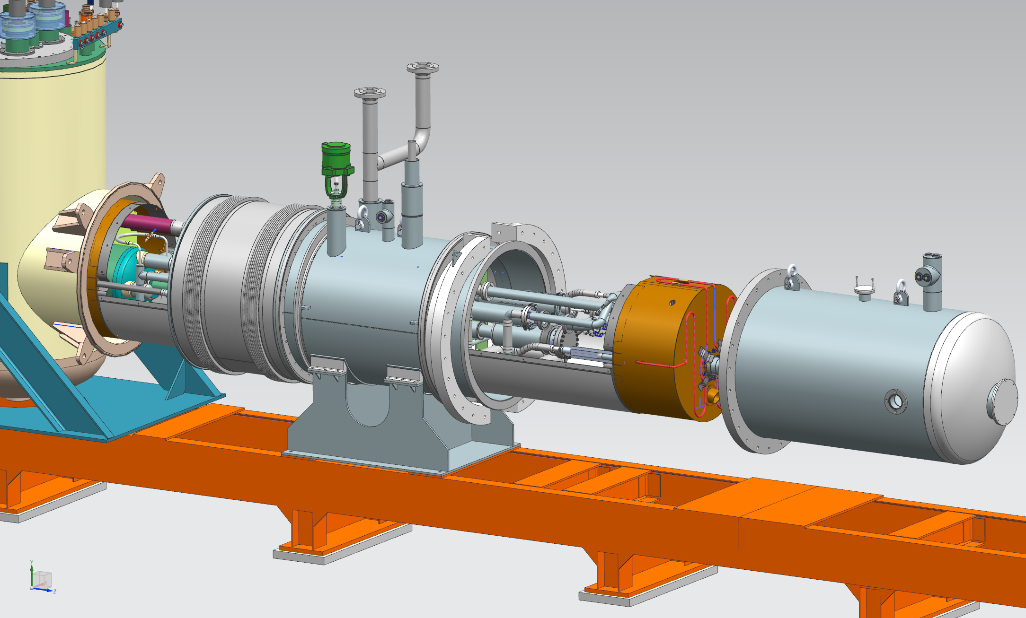
WBS 302.4.04 : Technical Status and Progress
Zero-magnet test configuration
FB-AB interconnect
Turn-around piping
Feed Box
Thermal shield
Return
end box
Adapter Box

