Slide 1
MQXFA05 SG Data during Endurance Test, by 05/31/2022
L. Garcia Fajardo, D. Cheng, P. Ferracin, G. Vallone
08/15/2022
LBNL

Slide 2
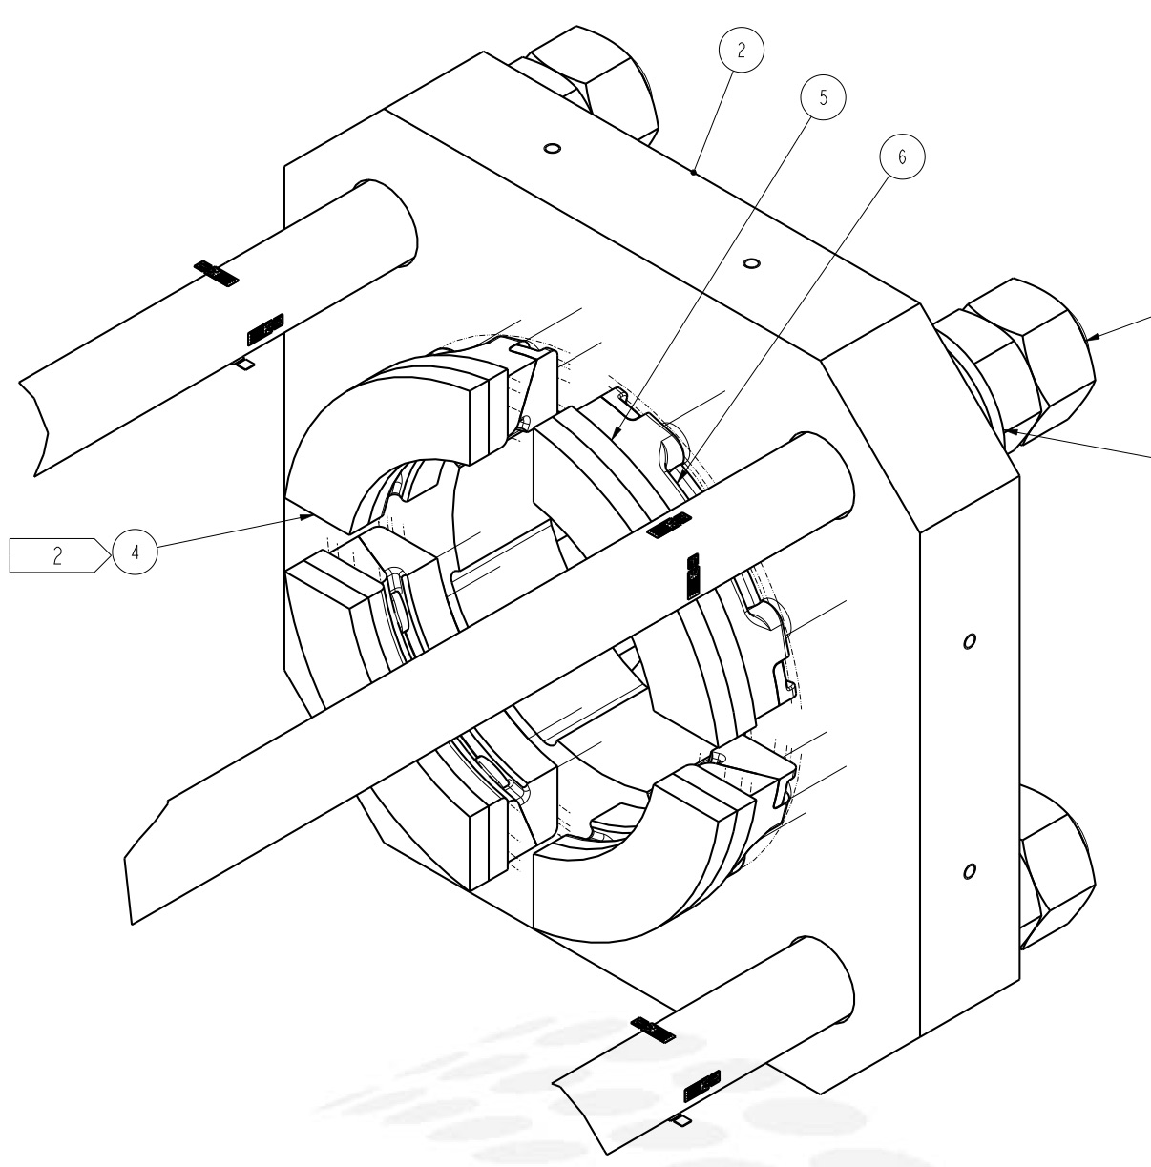
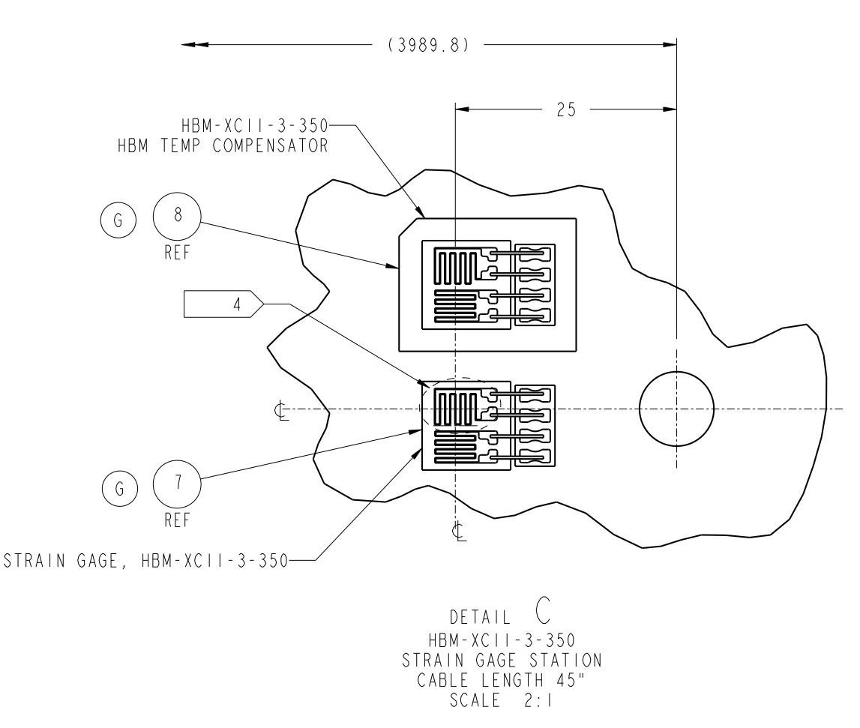
MQXFA05 SG Gauges Layout
LE
MID
RE
Shell 2
Shell 4
Shell 7
Coil Stations
Rod Stations
Only HBM gauges are installed.
Shell gauges --- three axial locations:
Shell gauges (T & Z): on shell 2, 4, & 7
Coil gauges (T & Z): on the axial location of 3989 mm (RE) from LE.
Rod stations are located on the RE
Each station is full bridge with four individual gauges.
Coil Stations
RE axial plate assembly

Slide 3
Data Processing Chronology for MQXFA05
02/17/22 ➔ First readings
03/21/22 – 03/29/22 ➔ 1st Cooldown
03/30/22 – 03/31/22 ➔ Ramp to 16230 A- Hold 30 min - ramp down to 200 A @20A/s - ramp up@20A/s to 16230 A for 5 min - ramp down to 200A@100A/s -Ramp up to 16230 A@20A/s hold for 60 min- ramp down to 0A.
03/31/22 ➔ Manual Trips 1 and 2
04/03/22 – 04/12/22 ➔ 1st Warmup
04/25/22 – 04/27/22 ➔ 2nd Cooldown
04/28/22 ➔ Spontaneous quench
04/29/22 ➔ 30 min hold at 16230A (+/- 20A/s), 5 min hold at 16230A (+30 A/s, -100 A/s), 60 min hold at 16230A (+/- 20A/s), Manual Trip 3
05/02/22 ➔ Manual Trips 4 and 5
05/03/22 ➔ Manual Trips 6 and 7
05/04/22 ➔ Manual Trips 8 and 9
05/05/22 ➔ Manual Trips 10 and 11
05/06/22 ➔ Manual Trips 12 and 13
05/09/22 ➔ Manual Trips 14 and 15
05/10/22 ➔ Manual Trips 16 and 17
05/11/22 ➔ Manual Trips 18 and 19
05/12/22 ➔ Manual Trips 20 and 21
05/13/22 ➔ Manual Trips 22 and 23
05/16/22 ➔ Manual Trips 24 and 25
05/17/22 ➔ Manual Trips 26 and 27
05/18/22 ➔ Manual Trips 28 and 29
05/19/22 ➔ Manual Trips 30 and 31
05/20/22 ➔ Manual Trips 32, 33 and 34
05/21/22 ➔ Manual Trips 35 and 36
05/23/22 ➔ Manual Trips 37, 38 and 39
05/24/22 ➔ Manual Trip 40, 60 min hold at 16230A - Manual Trip No.41
05/25/22 ➔ 30 min hold at 16230A - 4.5 K, 30 min hold at 16530A
05/26/22 to 05/31/22 ➔ 2nd Warmup

Slide 4
History plots (The magnet behavior shows repeatability during the endurance test)

Slide 5
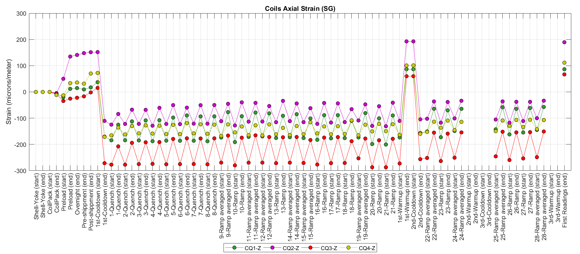
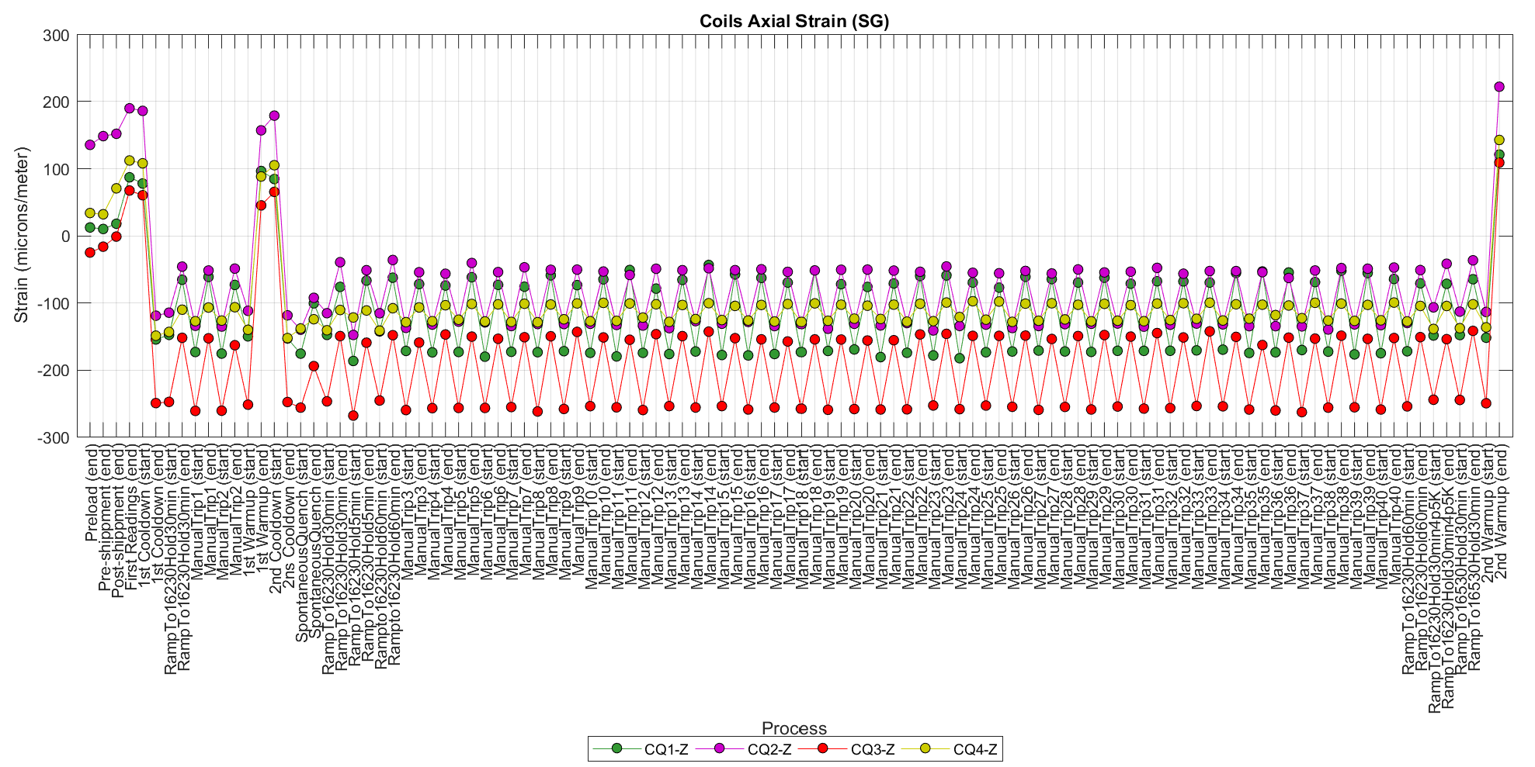
Coils’ axial strain. History plots
Magnet test
Missing temperature and SG data in the 3rd thermal cycle
Magnet endurance test

Slide 6
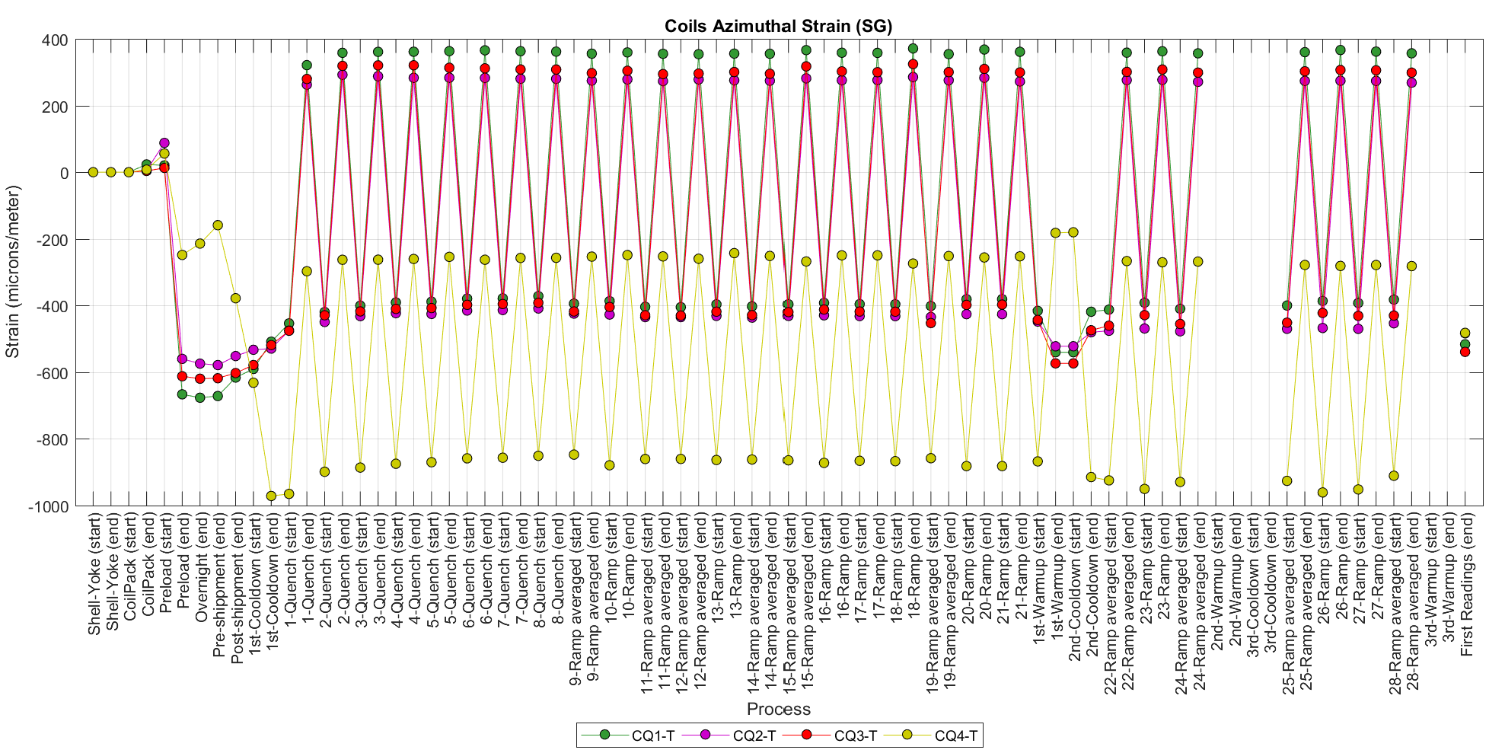
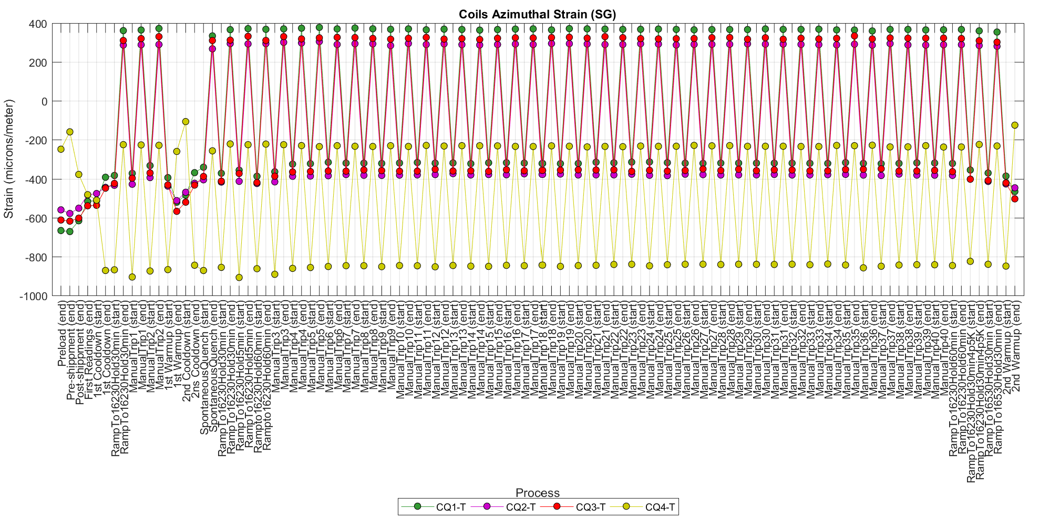
Coils’ azimuthal strain. History plots
Magnet test
Strange behavior of CQ4 during temperature changes (see individual plots)
Magnet endurance test

Slide 7
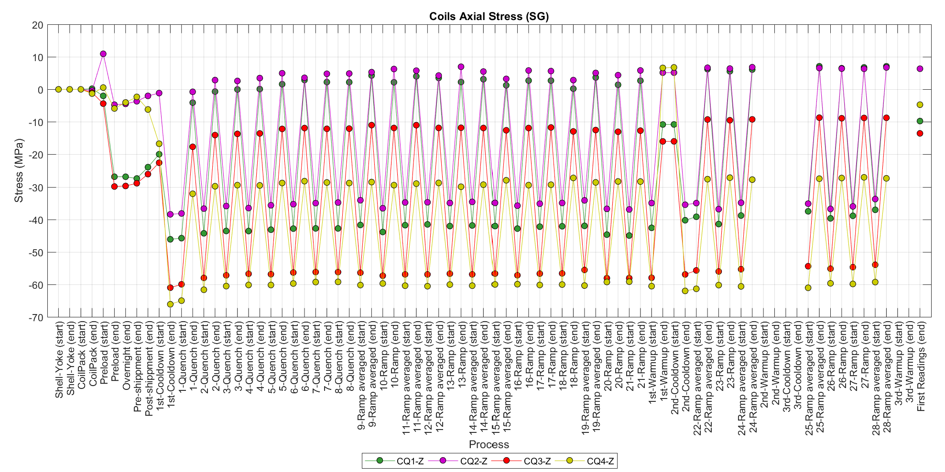
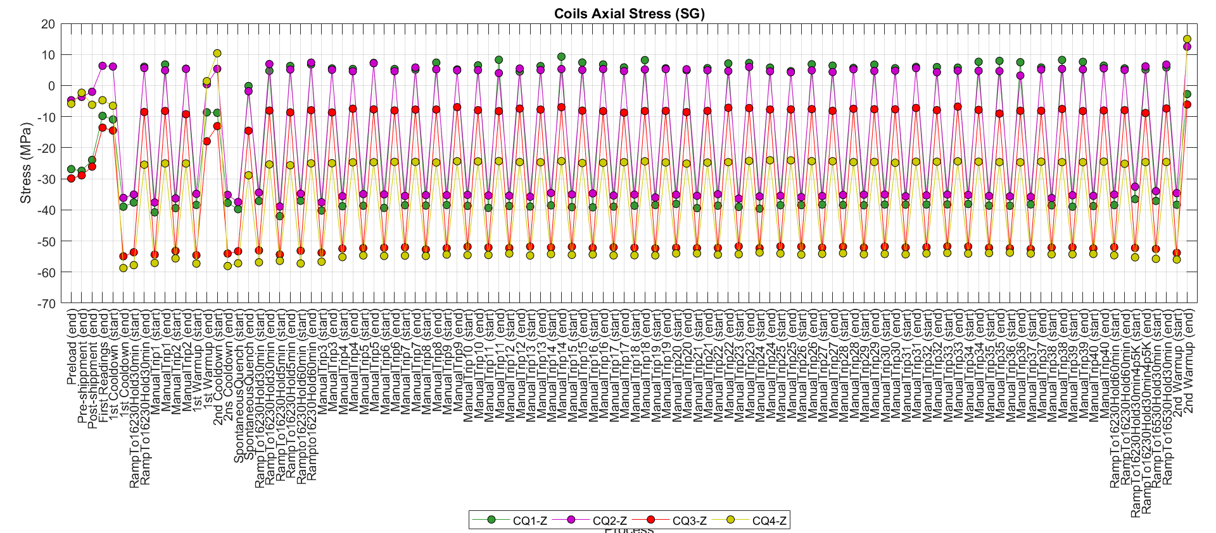
Coils’ axial stress. History plots
Magnet test
Magnet endurance test

Slide 8
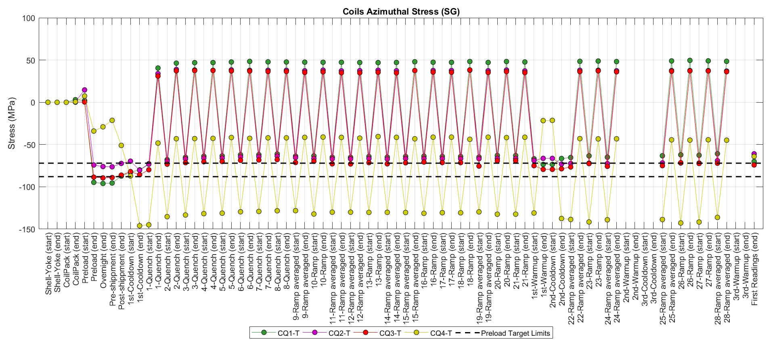
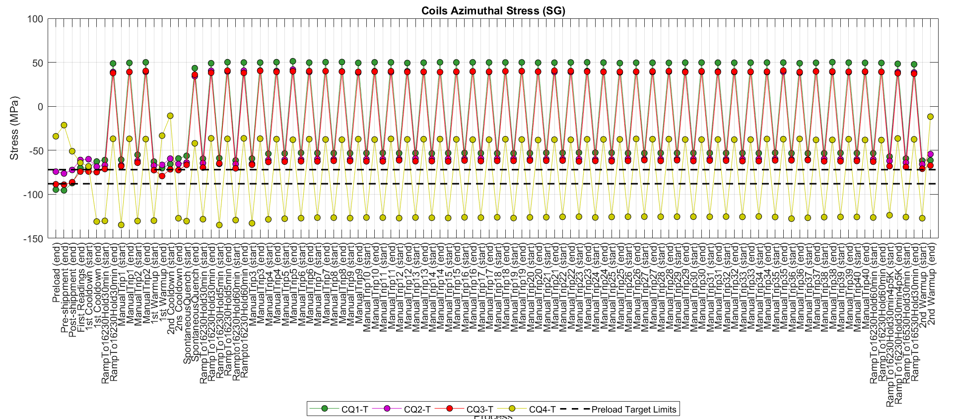
Coils’ azimuthal stress. History plots
Magnet test
CQ4 is the coil with the lowest prestress
Magnet endurance test

Slide 9
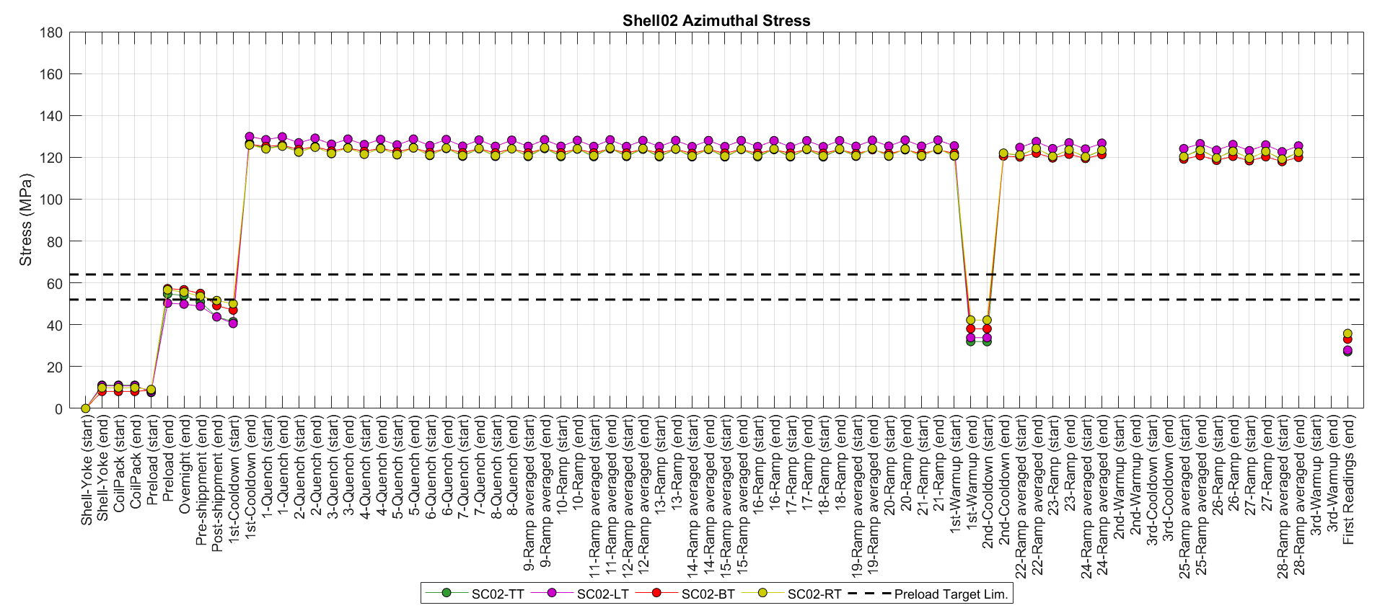
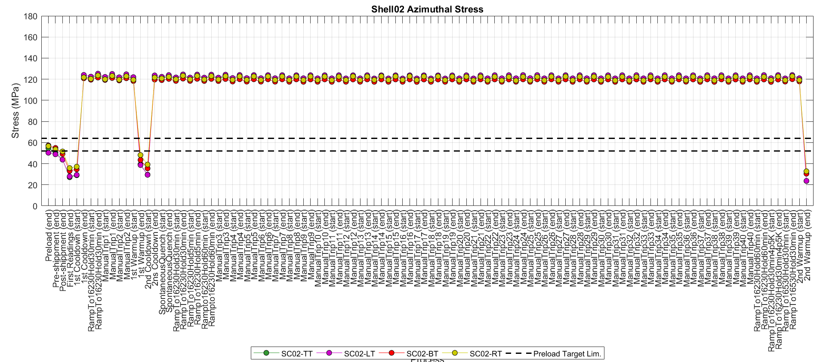
Shell02 azimuthal stress. History plots
Magnet test
Magnet endurance test
Shells don’t show signs of plastic deformation

Slide 10
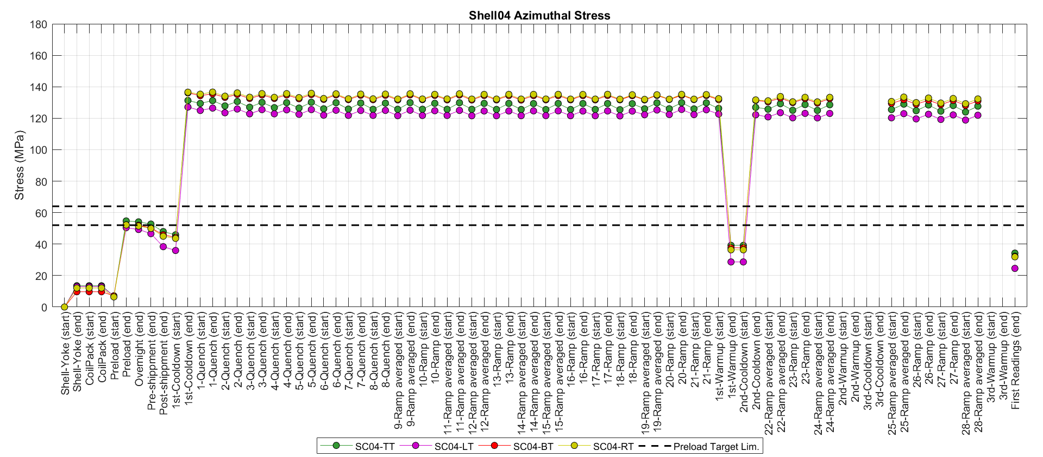
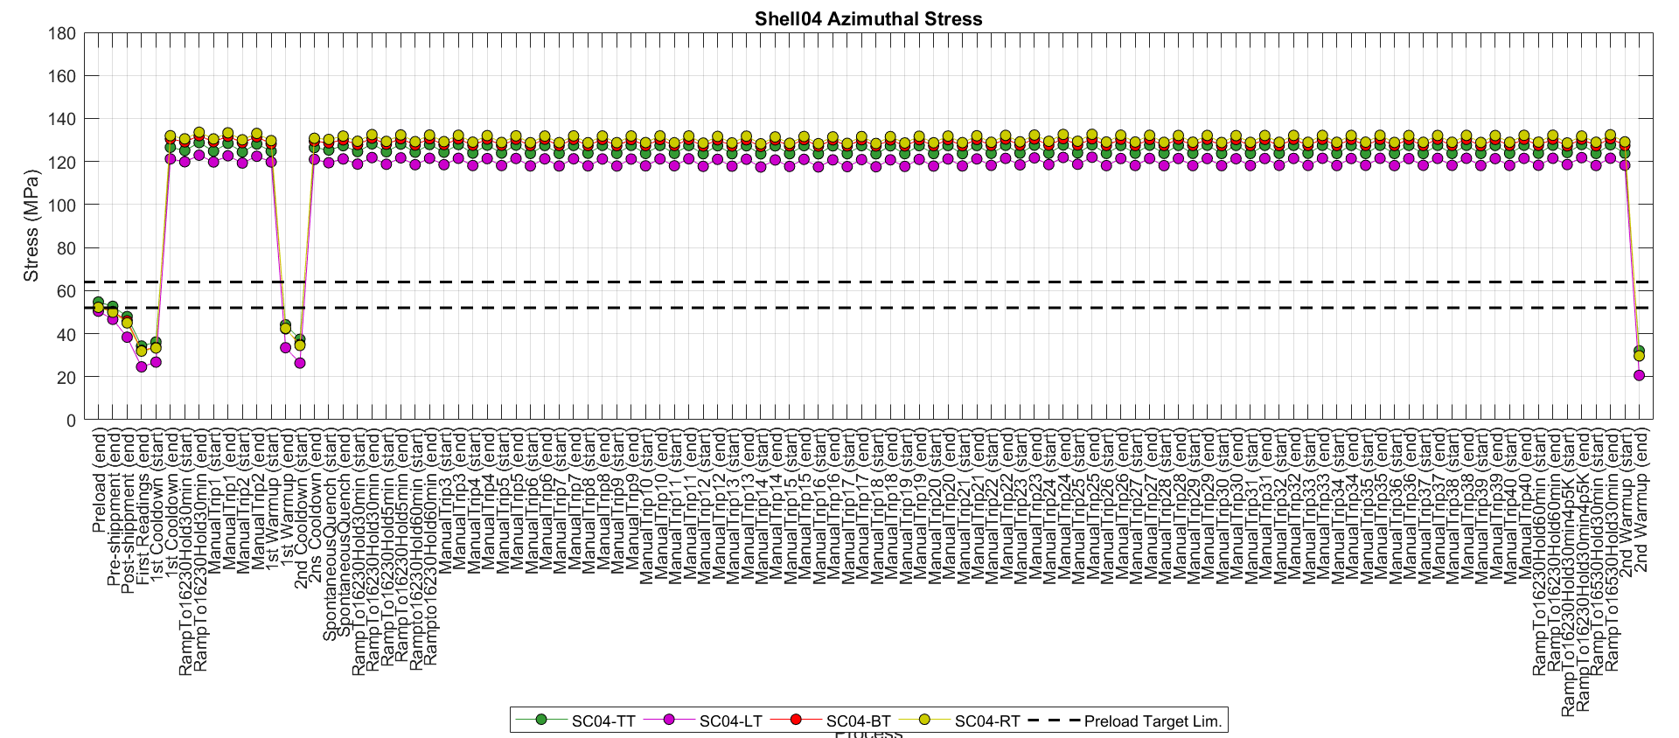
Shell04 stress. History plots
Magnet test
Magnet endurance test

Slide 11
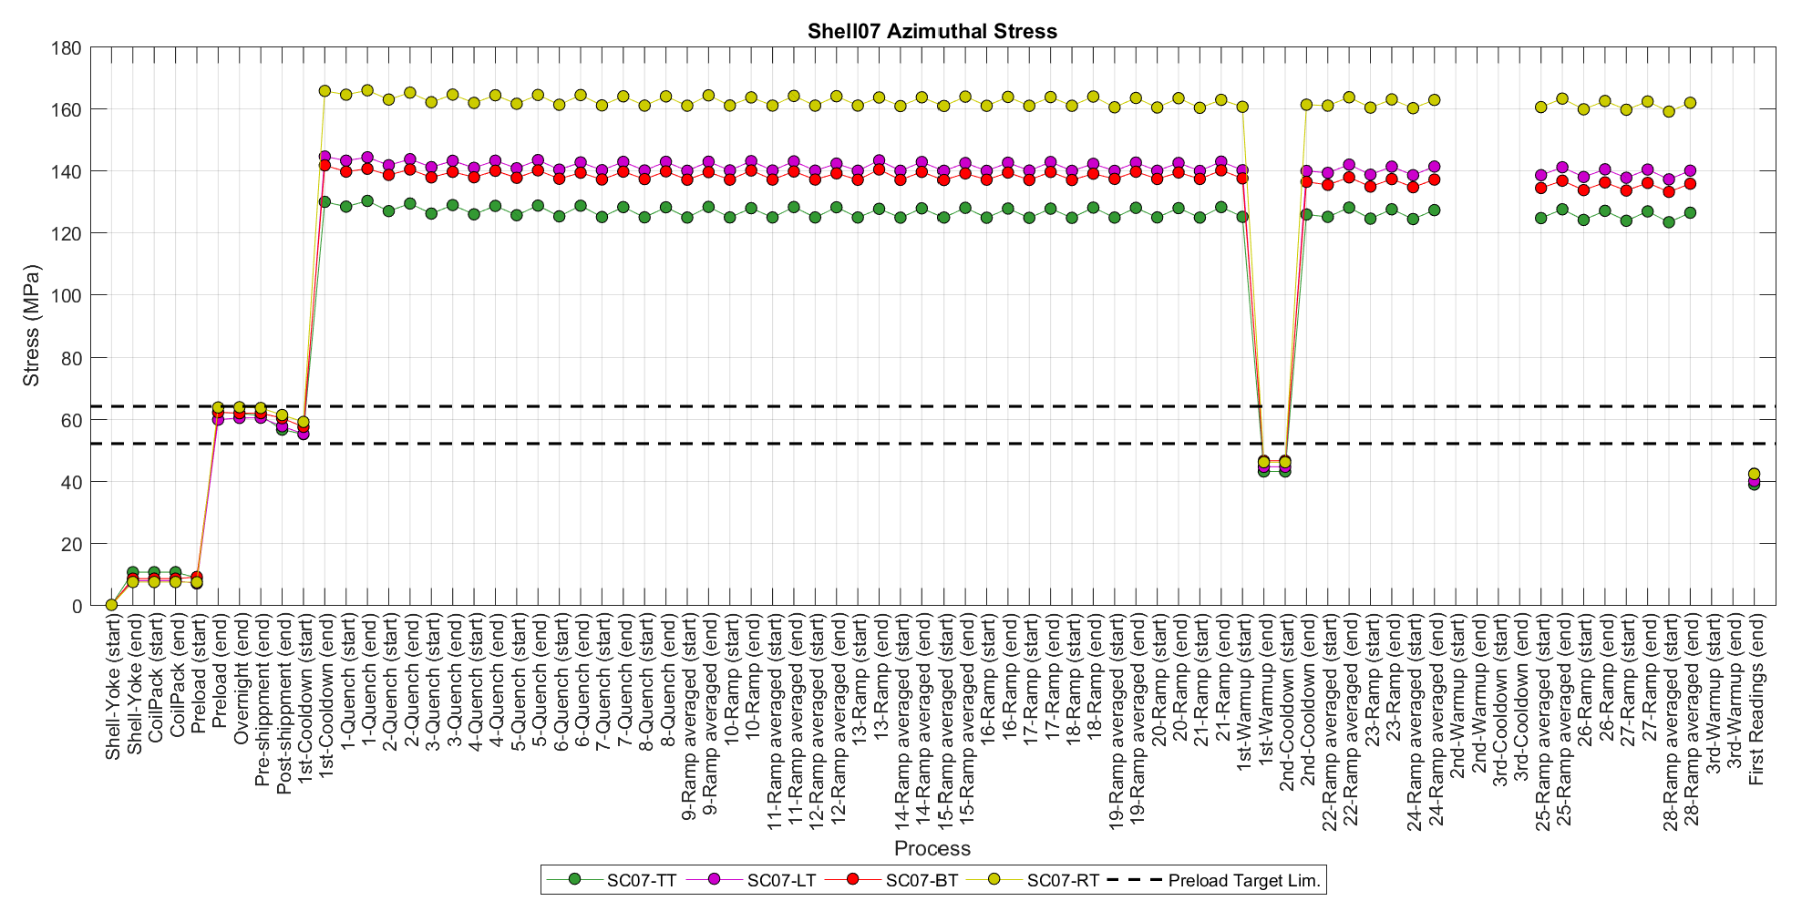
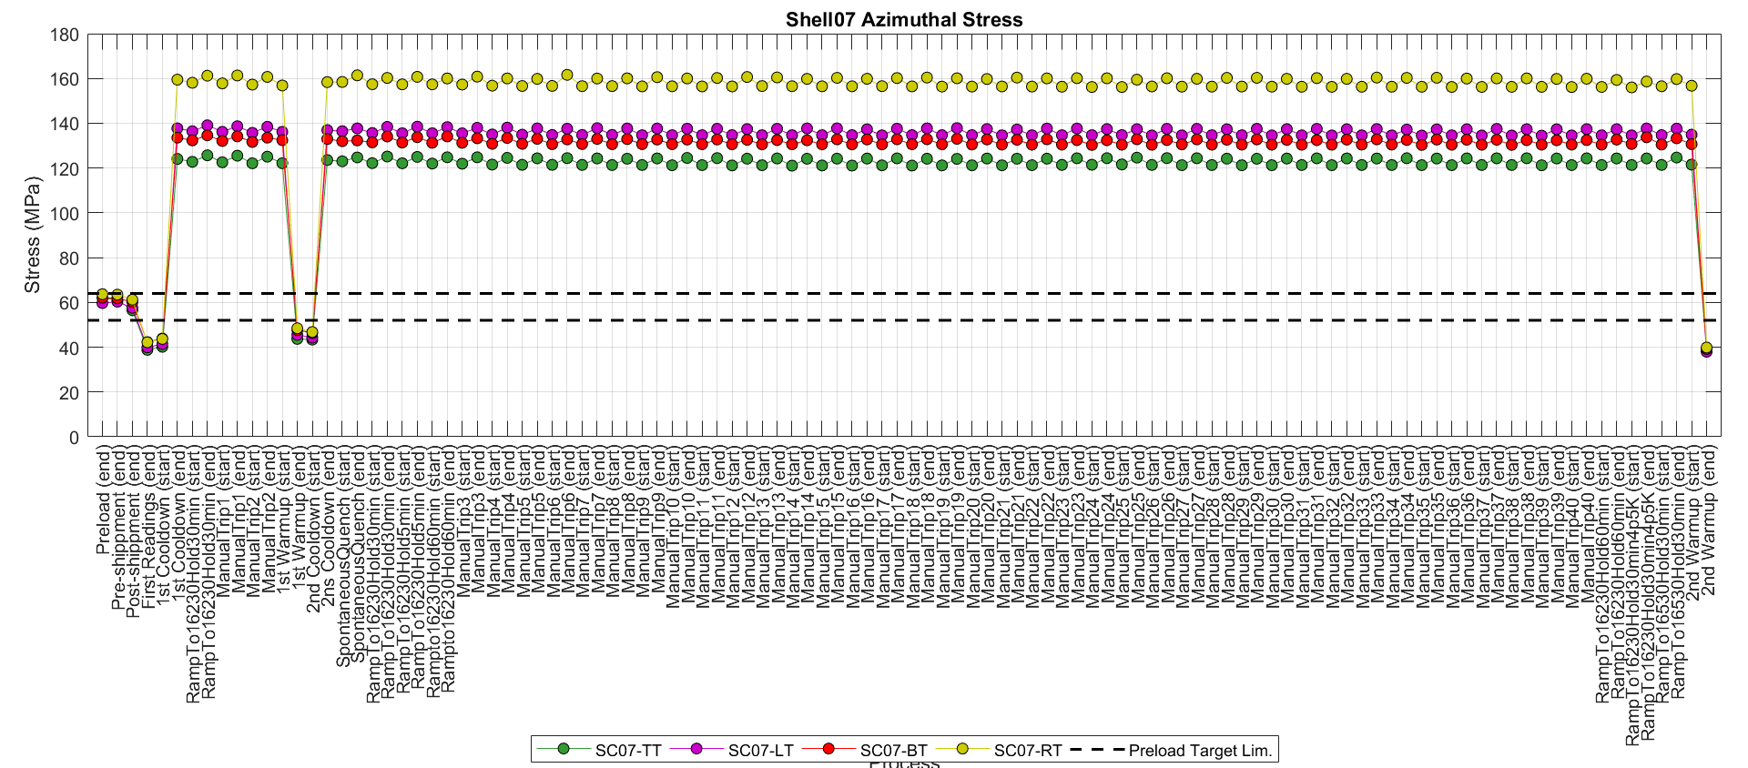
Shell07 stress. History plots
Magnet test
Magnet endurance test

Slide 12
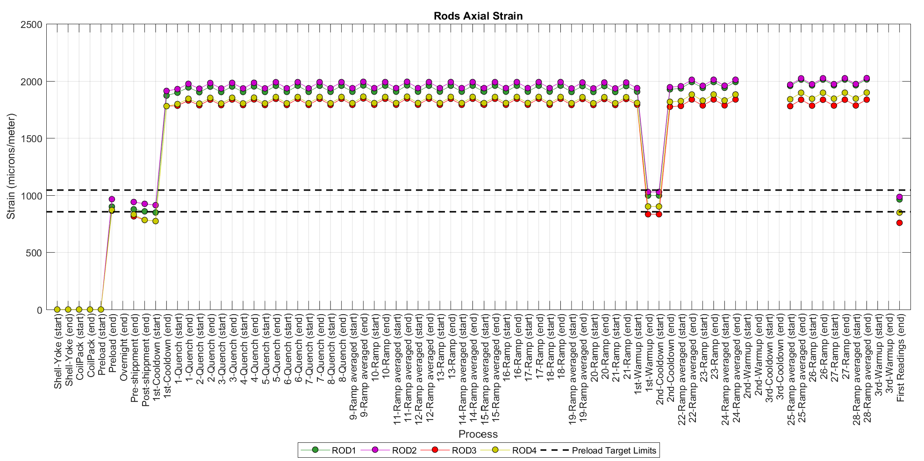
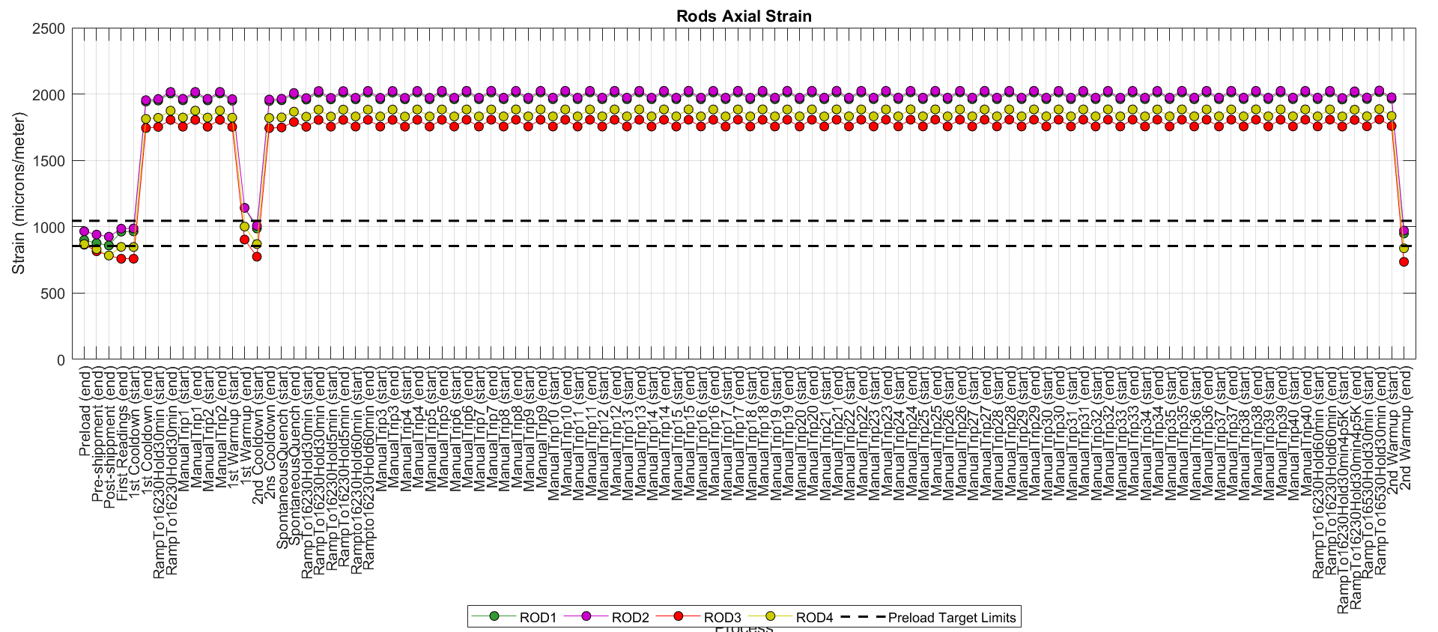
Rods’ strain. History plots
Magnet test
Magnet endurance test
The rods don’t appear to be losing preload (even though these are the rods with lower yield strength)

Slide 13
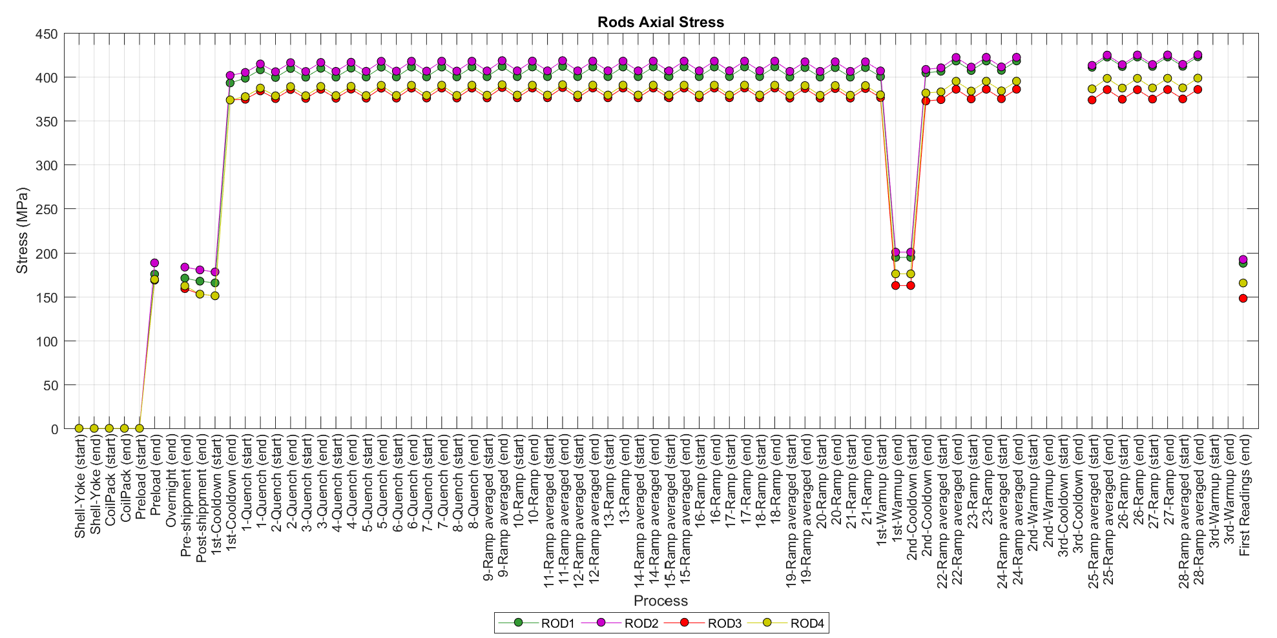
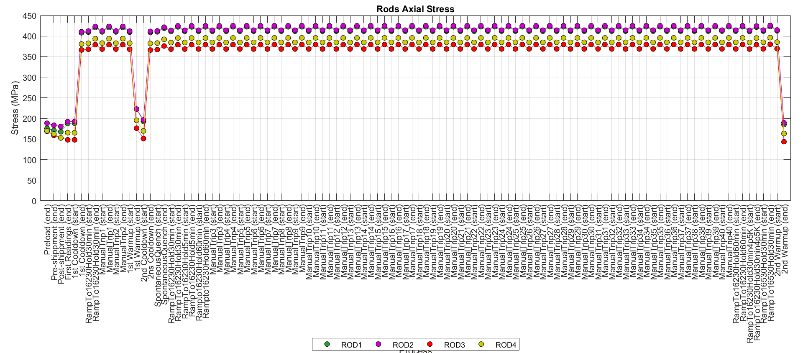
Rods’ stress. History plots
Magnet test
Magnet endurance test

Slide 14
Coil azimuthal strain during temperature changes

Slide 15
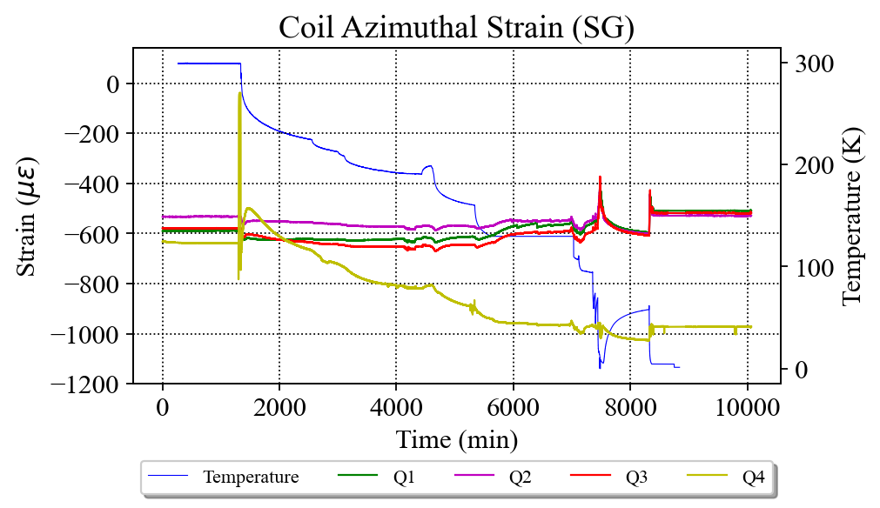
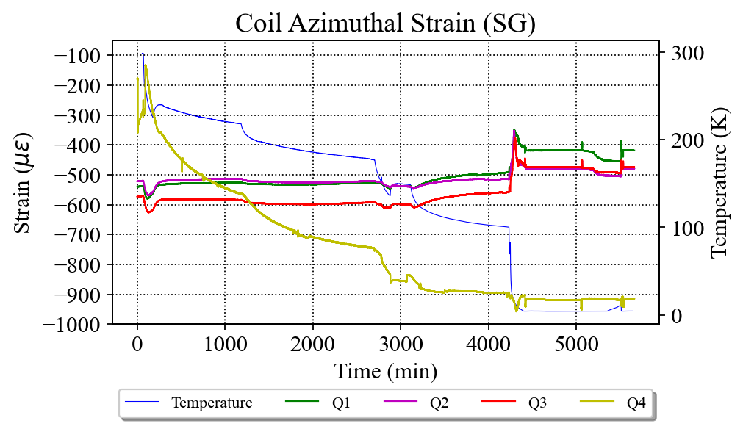
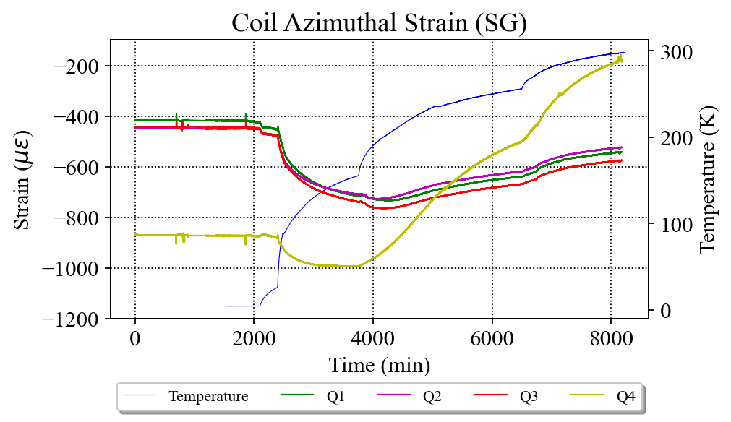
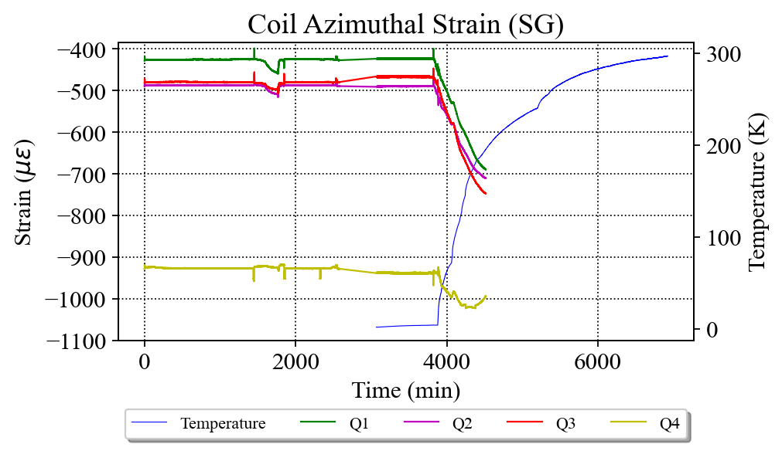
CQ4 azimuthal strain during temperature changes (test)
Missing temperature and SG data for the 3rd thermal cycle
We saw a similar issue (even worse) with CQ4 in MQXFA11
1st thermal cycle
2nd thermal cycle

Slide 16
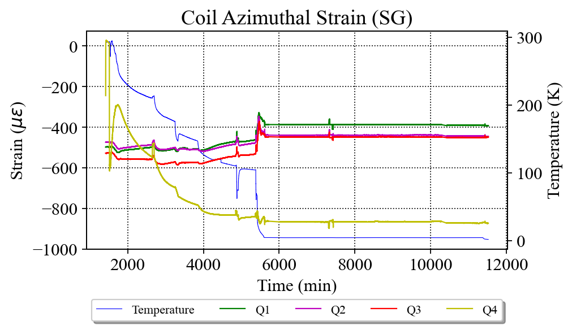
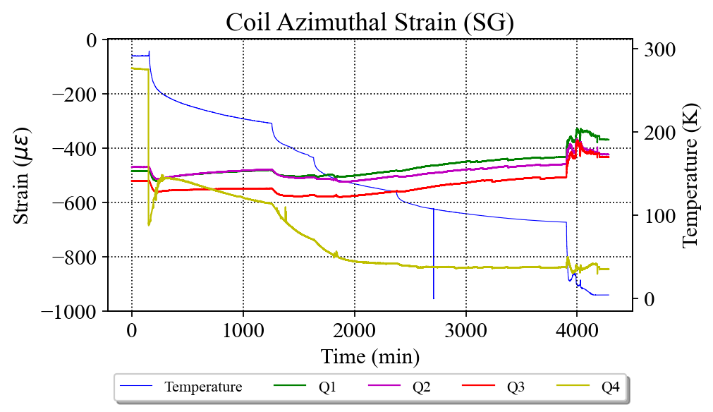
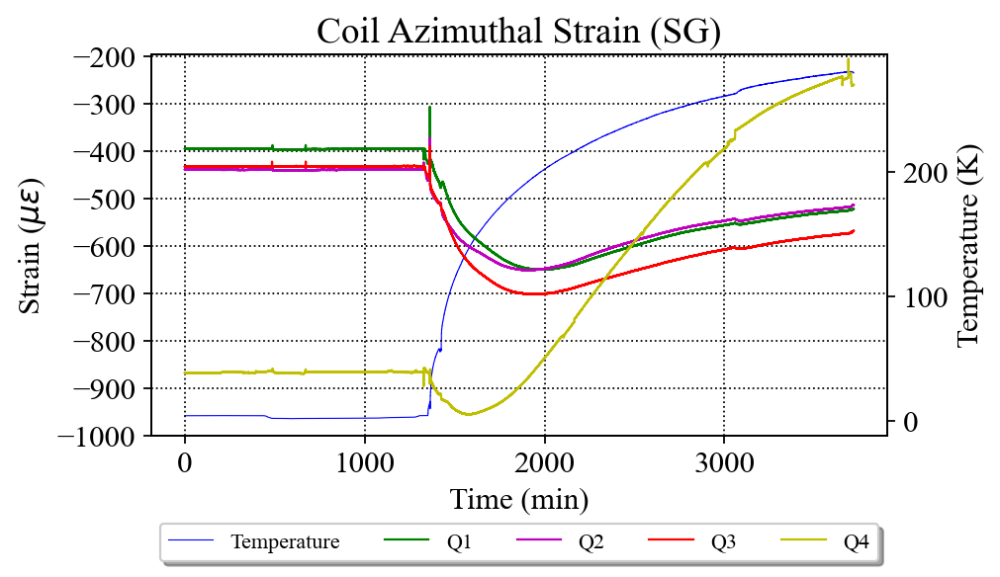
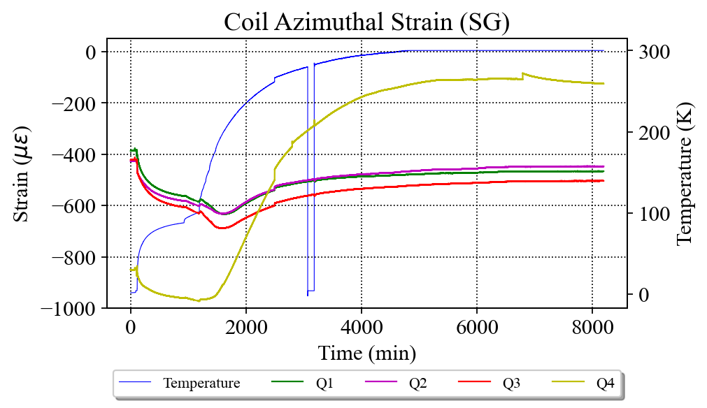
CQ4 azimuthal strain during temperature changes (endurance test)
1st thermal cycle
2nd thermal cycle

Slide 17
First ramp (no quench or manual trip) in MQXFA05 during the test and the endurance test Ramp-up and ramp-down are averaged

Slide 18
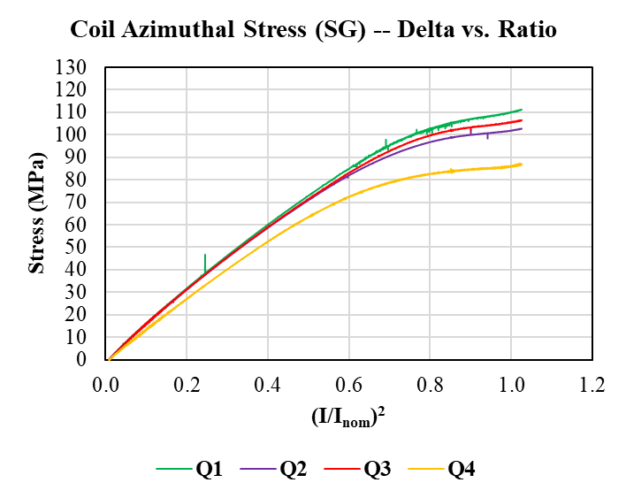
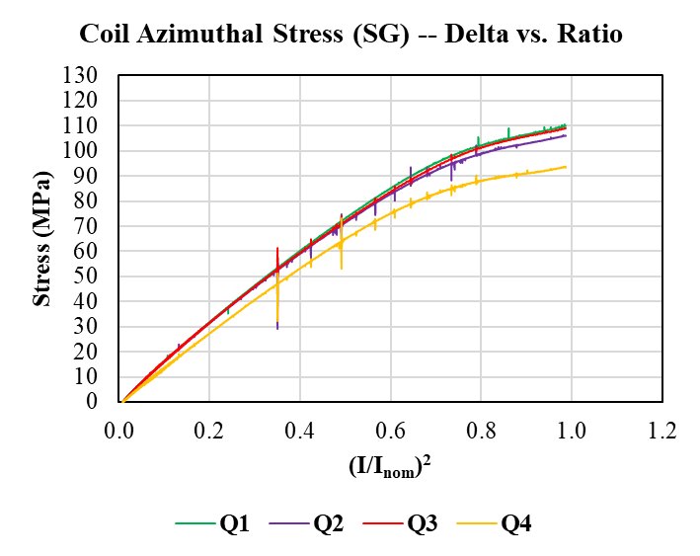
Coil stress increase during powering (ramps-up and down averaged) Comparison with previous magnets
MQXFA05 (test)
Ramp to 16.46 kA
MQXFA05 (endurance test)
Ramp to 16.14 kA
Av. delta stress: 102 MPa
Av. delta stress: 105 MPa

Slide 19
Appendix

Slide 20
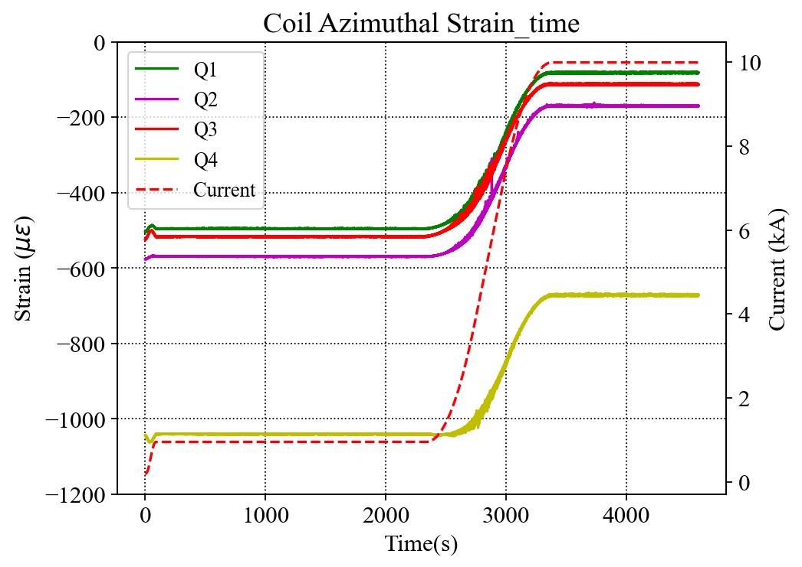
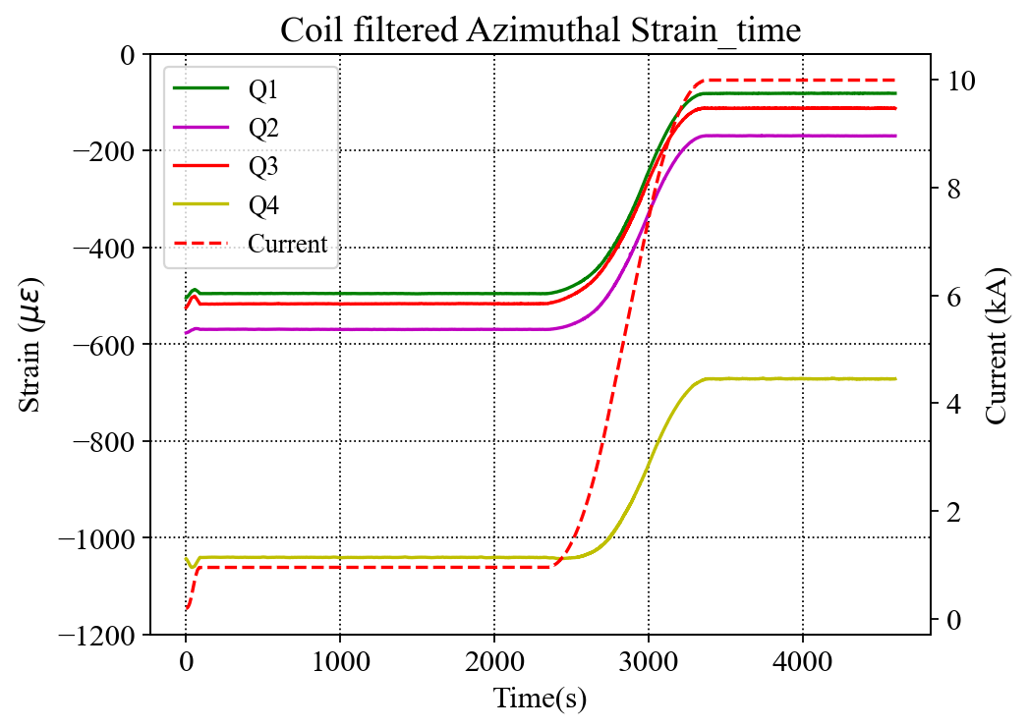
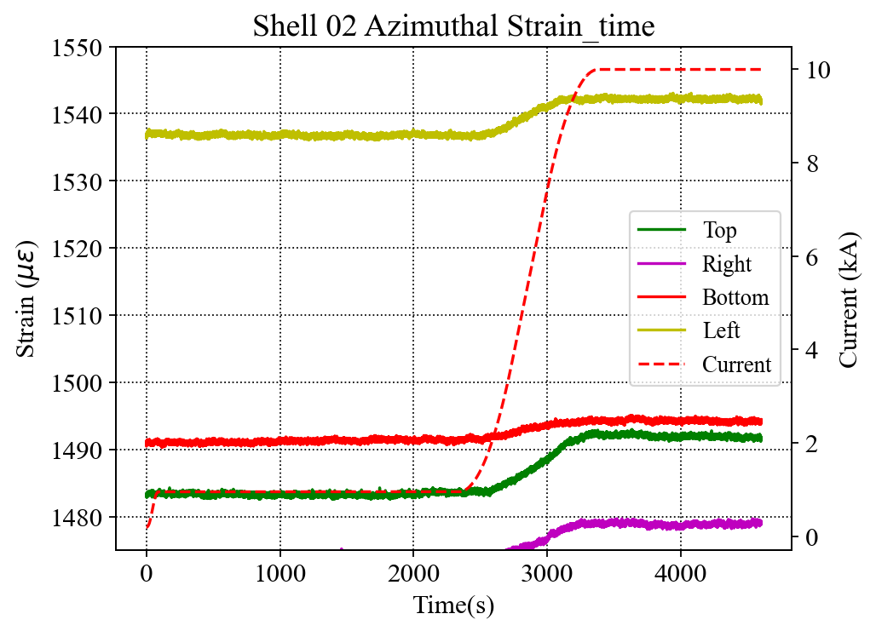
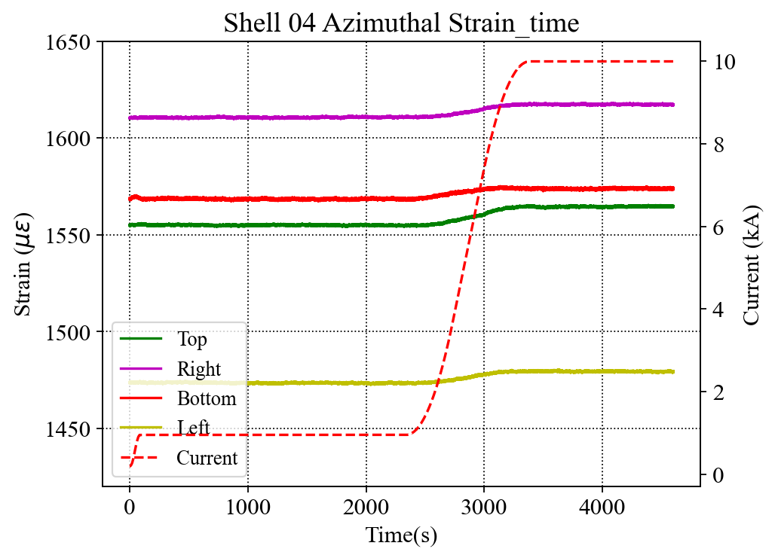
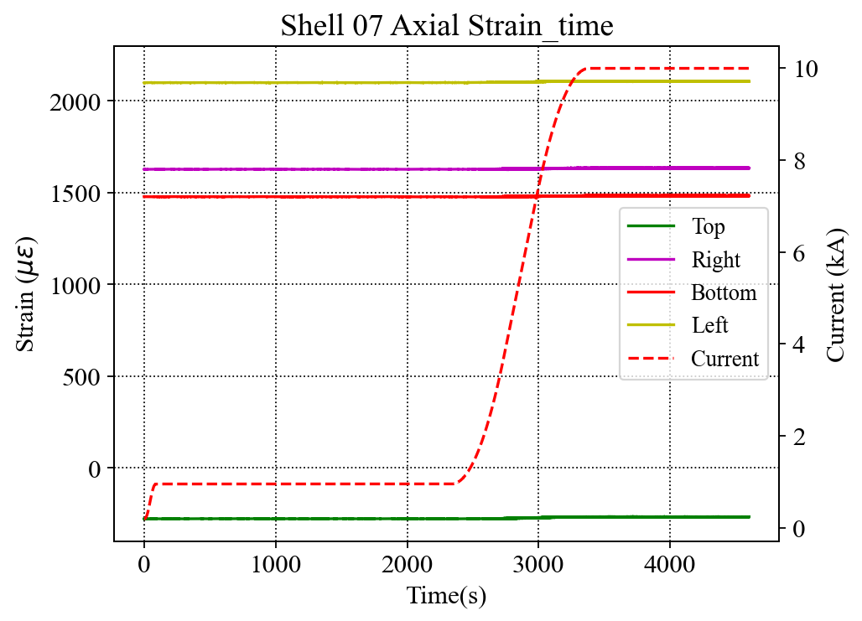
E.M. Effect is Apparent on Coils and Shell 7 (this example is for magnet 5 but applies to all)
Despite not yet fully processing the files, the gauge readings of the coils and the shell 7 appear to be noisy during current ramps
Similar effects have been observed in earlier magnets
The noise on the signals is most likely from the dI/dt.
Noisy signal
LP Filter
Cutoff frequency:0.25 Hz
Clean signal
Clean signal
Noisy signal
(note the different scale from Shells 02 and 04 plots)

Slide 21
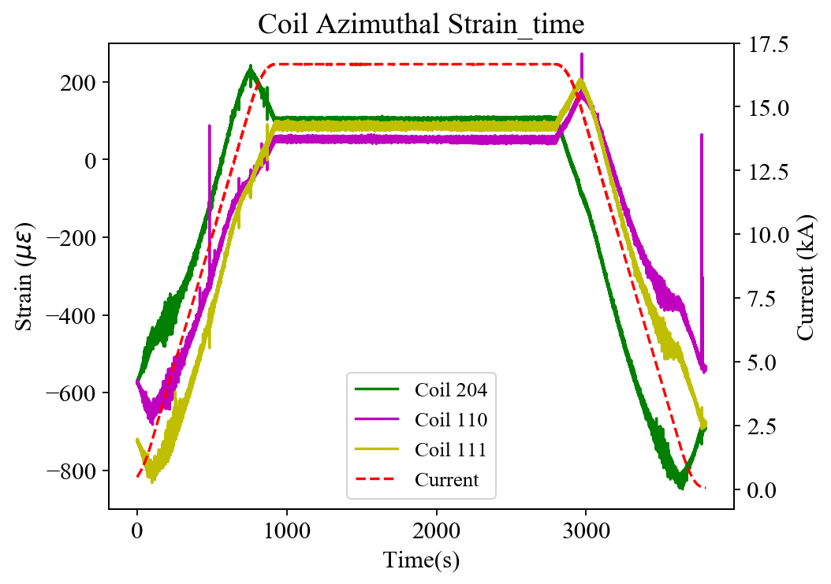
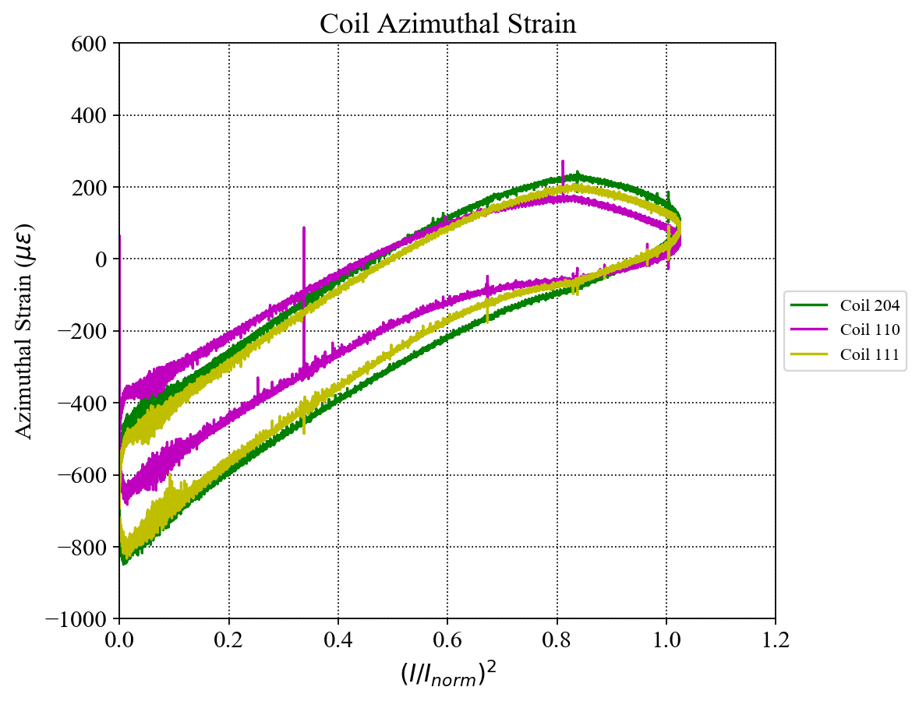
Reference: MQXFA03 Coil Azimuthal --- over I²
C204 ramp up
C204
LP Filter
Cutoff frequency:0.25 Hz
C110 & 111 ramp down
C110 & 111 ramp up
C110
Combined the ramp up and ramp down data, the three coils actually behave identically.
The readings of the “turn around” part are likely to be combined with inductive components;
The “up-warp” on the curves of C110 & 111 may be not mechanical. It is “bended” by the field.
C204 ramp down
The readings of this part may the combination of actual SG and inductive components
C111
I_{norm} = 16.47 kA

Slide 22
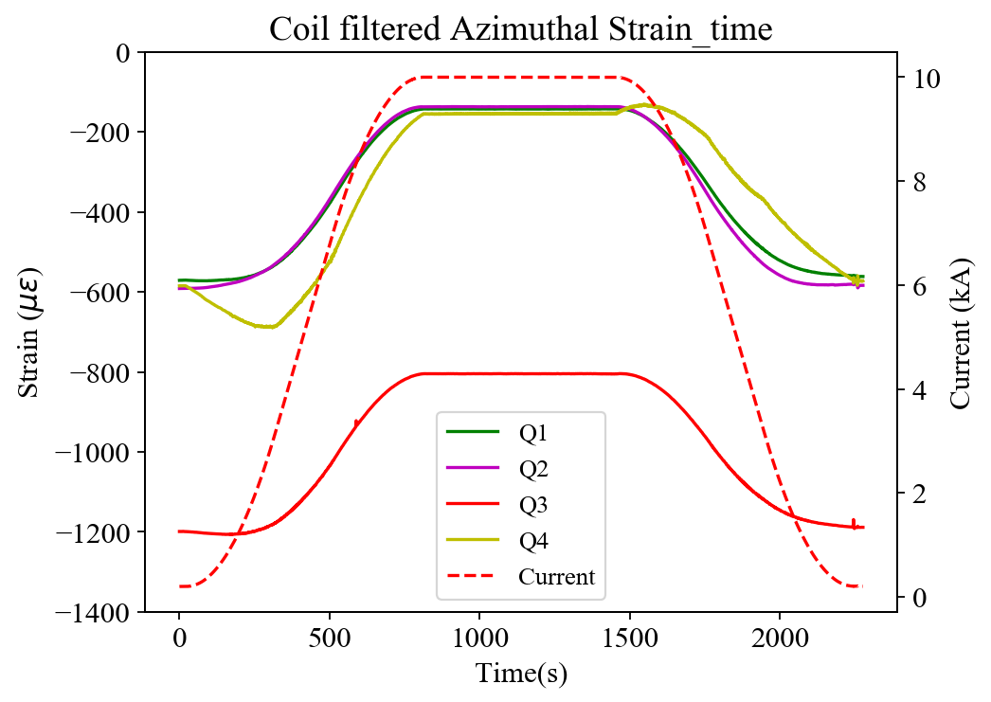
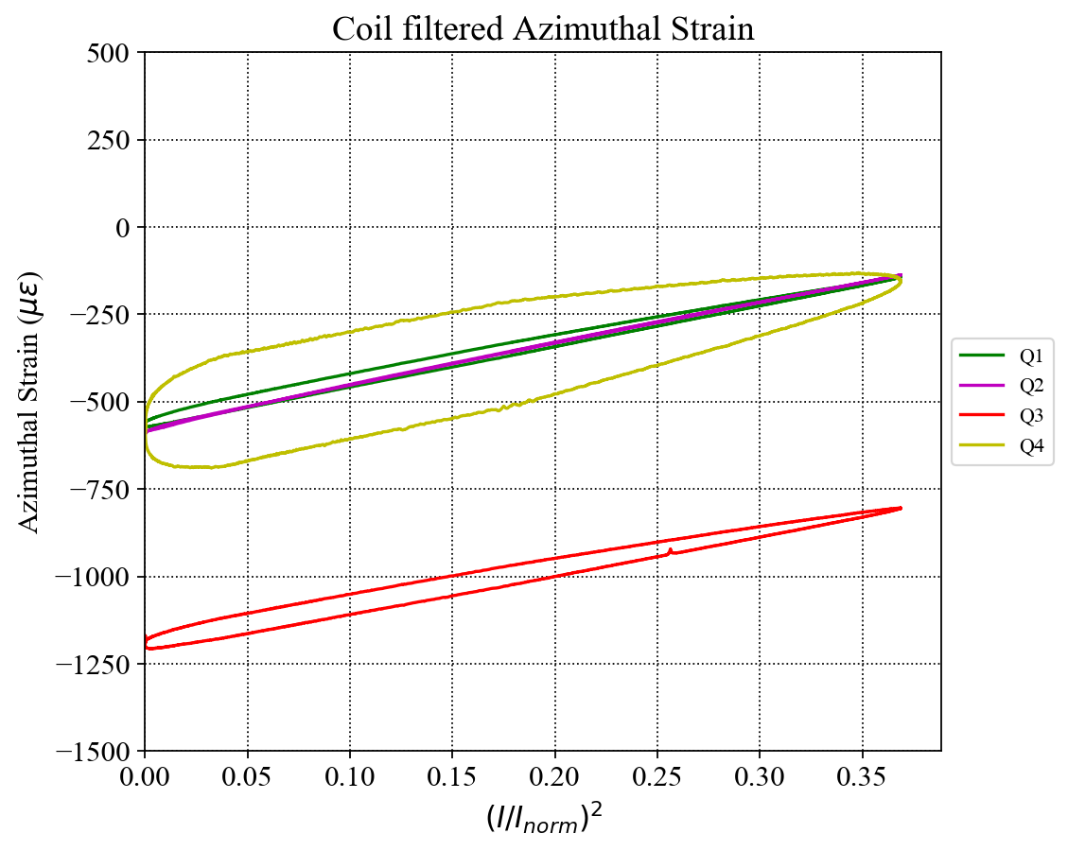
MQXFA04 Coil Strain --- over I²
The exact same behavior as seen in MQXFA03 (next slide).
From what we have learned from MQXFA03, there is no issue in the 10 kA ramp tests.
I_{norm} = 16.47 kA

