Slide 1
IJCLAB status/updates on SSR2 activities
Patricia Duchesne, Sandry Wallon, Nicolas Gandolfo, Longuevergne David
On behalf of PIP-II team at IJCLab

Slide 2
OUTLINE
Progress on SSR2 cavity
Progress on Coupler
Progress on Tuner
Other points

Slide 3
Progresses on cavity prototypes
3 cavities being built @Zanon.
First Prototype has been processed @Zanon and tested in vertical cryostat @IJCLab
Second prototype delivered @IJCLab in May, BCP treated (rotational BCP commissionning) and shipped back @Zanon for HPR, heat treatment and tank integration the 22nd of August. Will be delivered back @IJCLab for final processing beginning of December.
Third prototype under helium tank integration. To be delivered ready for vertical testing end of December.
3 additional prototypes being built to be delivered @IJCLab ready for test in spring 2023.

Slide 4
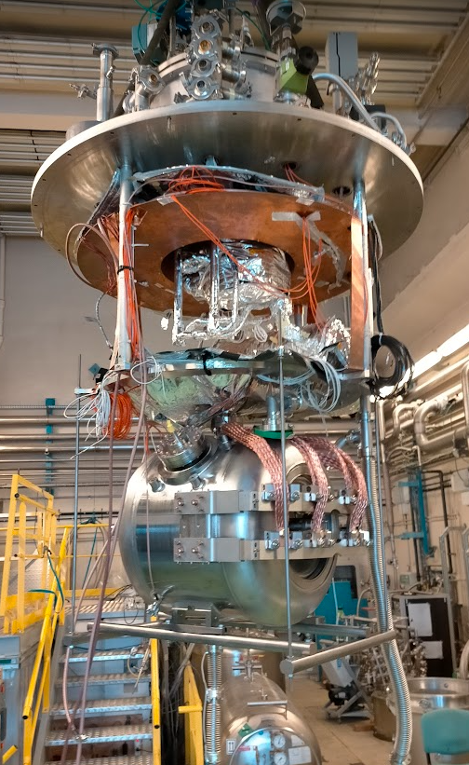
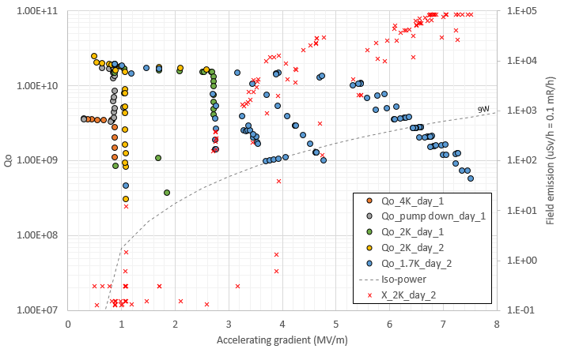
Progresses on cavity prototypes
Vertical testing of ZA01 + tuner :
Frequency of 325 MHz achieved
Tuner is fully tested and validated (stepper motor and piezo)
Reporting under final revision

Slide 5
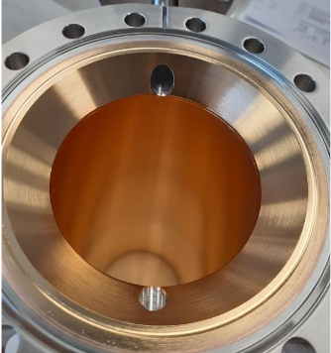
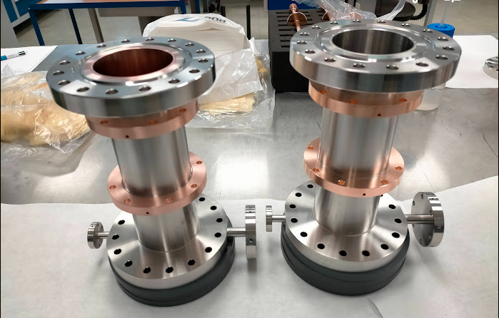
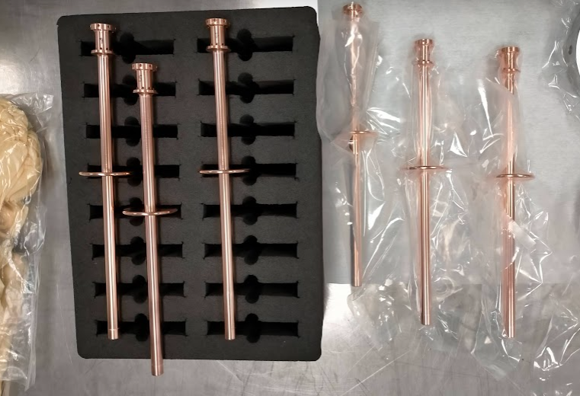
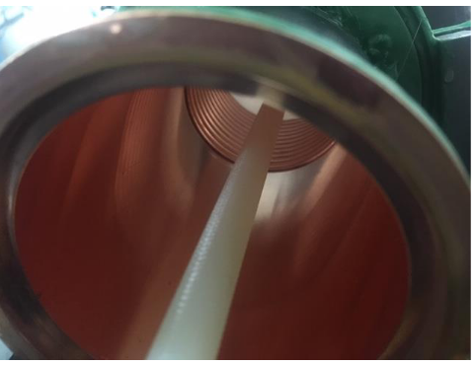
Status of proto couplers fabrication at PMB Cie
T0 : 17 Nov. 2020 (kick off meeting with PMB).
Production is slow as facing several problems (crisis, new project manager, many sub-contractors, …).
PMB is willing to deliver « high quality » parts despite the complex situation.
Status :
1st vacuum end has been cleaned and ready to be shipped to Fermilab
2nd vacuum end under cleaning and will be ready next week. Shipping forseen beginning of December
Visit of PMB planned mid of December for complete assembly and low level RF test.
3rd and 4th antenna assemblies under finalization
RRR of copper coating checked (~ average of 80)
Warm end are waiting for copper coating (subcontractor is facing delays)
T-junction will be delivered at PMB mid of November
Shipping of all parts sometime in January.

Slide 6
Other points
Schedule
Finalized. Milestones validated in PPD part2
Will need soon a general update of P6 milestones
PPD
PPD part2 finalized
PPD part1 pending
Documentation
Acceptance plan : to be drafted by Fermilab
Acceptance criteria list : preliminary list edited.
All documentation as procedures, reports, travelers are being edited and improved with prototypes parts

