Slide 1
SSR Status Update at Fermilab
SSRs team at Fermilab
November 10, 2022
ALL Partners Coordination Meeting

Slide 2
EPDM for PIP-II/SSRs scope
Engineering Process Documentation Management (EPDM) | Teamcenter No.
Prototype SSR1 | ED0001256
Production SSR1 | ED0011856
Pre-production SSR2 | ED0001257
Production SSR2 | ED0011912
The EPDMs listed contain all the references for the Design, Procurement, Fabrication, Assembly and Testing for all components and subassemblies for the cryomodule.

Slide 3
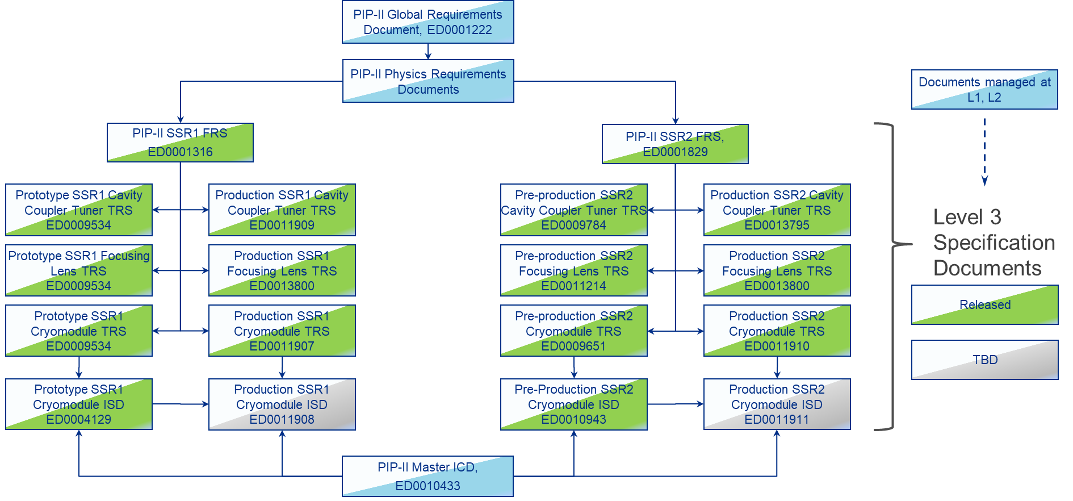
Flow-down of Requirement and Interface Specifications

Slide 4
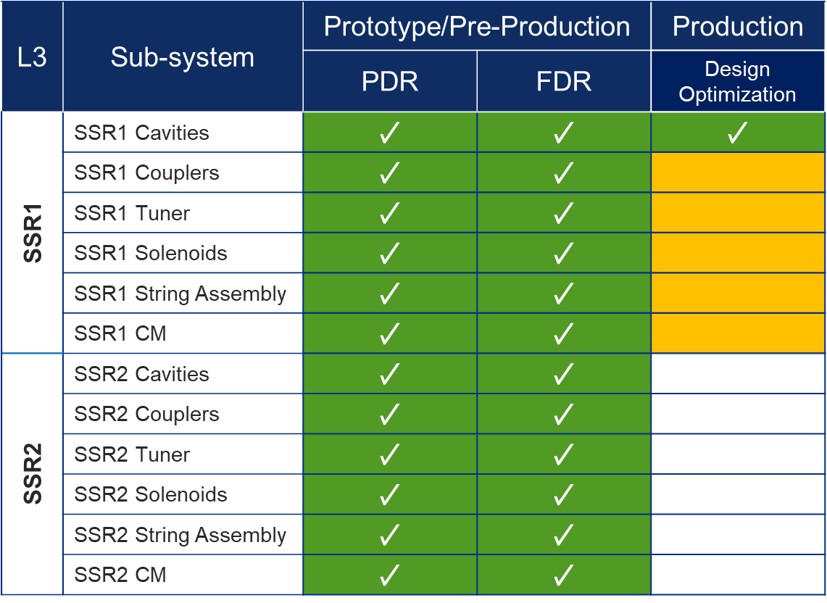
Status of Design Reviews

Slide 5
SSRs Niobium and Cavities
SPM: P. Berrutti
Presenter: M. Parise

Slide 6
Niobium
Production SSR1 Niobium​
ATI is delivering the niobium for the 1st production SSR1 CM (1-9 cavities). Next: material will be sent to Zanon for the development of welded coupons and cavities manufacturing.
Procurement of niobium for the 2nd production SSR1 CM (10-18 cavities) is ongoing: FNAL technical team is evaluating the proposals
Production SSR2 Niobium (30+ cavities)
Procurement is ongoing. RFP not issued yet.

Slide 7
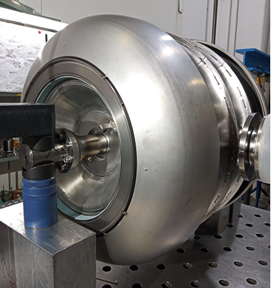
Cavities
ppSSR2 Cavities fabrication​
Fabrication at Zanon is proceeding.
1st cavity completed and first cold test attempted. See results presented by IJCLab.
2nd cavity is completed as well. Will be sent to IJCLab for the last part of the processing and preparation for cold testing by end of November
3rd is currently being jacketed. Next: processing and cleanroom assembly. Expected completion: end of December 2022.
- Fabrication of additional 3 cavities has started.
- RI has completed welding qualification and preparing documentation for the MRR.
S2-ZA-002 during He vessel Integration

Slide 8
Cavities
ppSSR2 cavities at BARC (2 cavities)
Need a date to plan MRR.

Slide 9
Cavities
Production SSR1 cavities (1-9)
FNAL contract for the fabrication was awarded to Zanon.
MRR scheduled in December 2022
Production SSR1 cavities (9-19)
FNAL is procuring Nb.
BARC should start the earliest possible preparation for the MRR (currently scheduled in Apr 2023).

Slide 10
SSRs Solenoids
SPM: Dino Karas
Presenter: Dino Karas

Slide 11
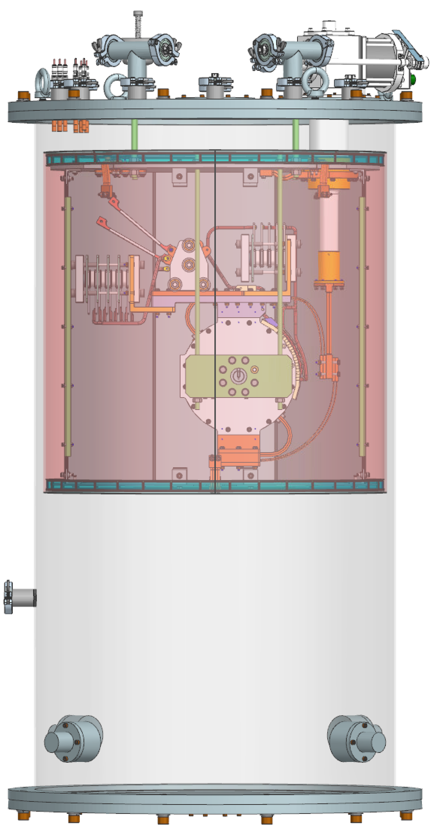
SSR solenoid status update – FNAL activities
Preparation of CoCoLoCo Test Stand
Conduction-Cooled Low-Cost test stand
All test stand equipment has been delivered and configured on the test stand
Final instrumentation walk through and documentation/safety review in progress
First cooldown and zero magnet commissioning will begin once inspections are complete
As-built 3D model from BARC received, integration into cryomodule in progress

Slide 12
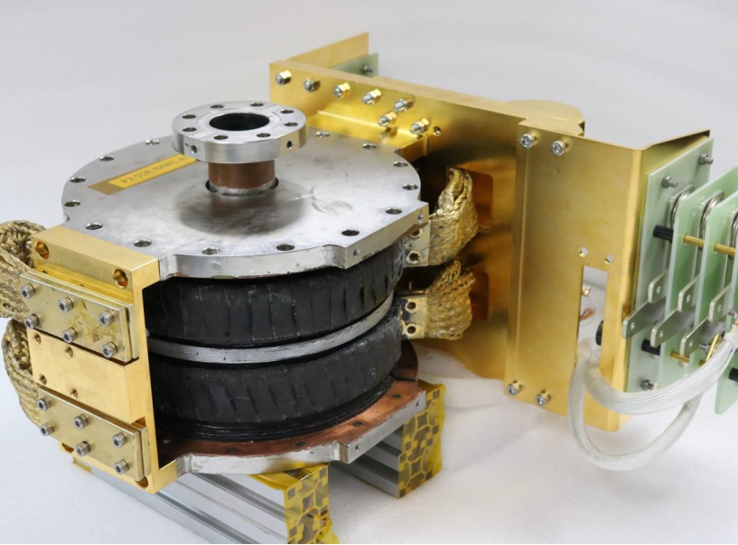
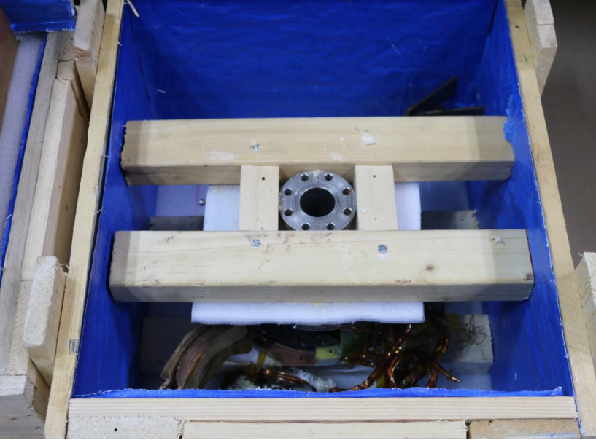
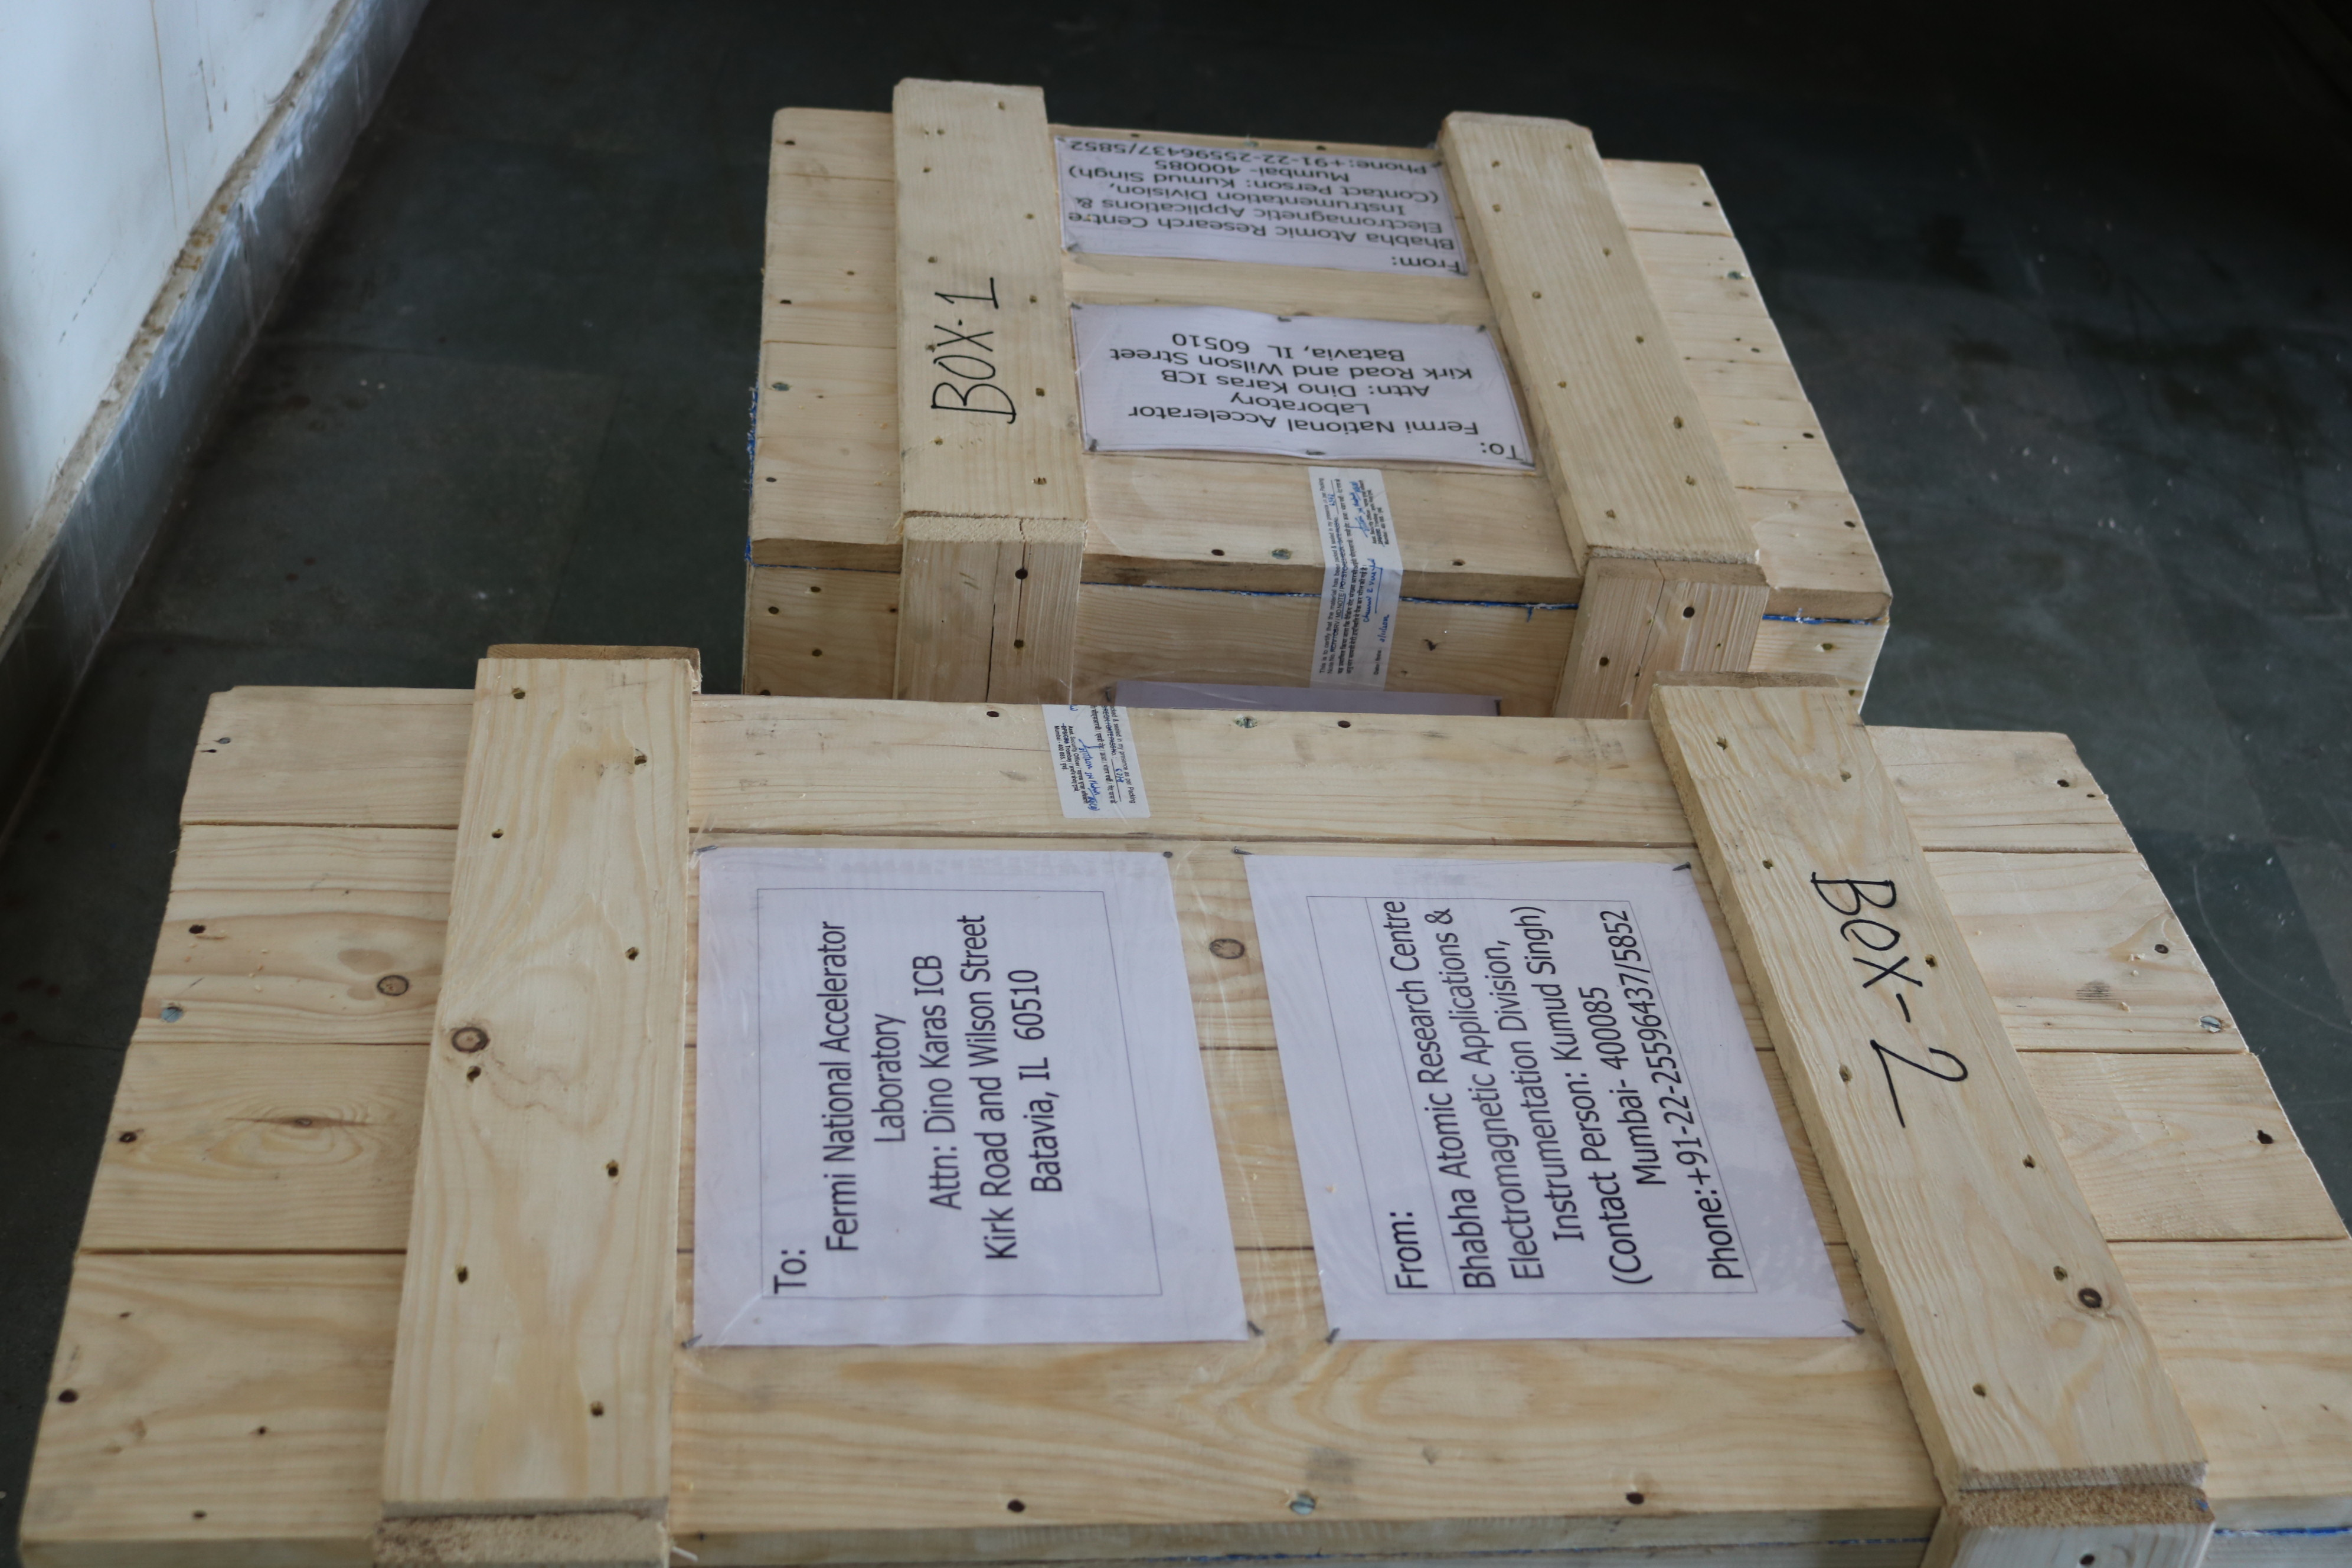
SSR solenoid status update – BARC activities
Testing of Prototype 3 has been completed and all results have been shared with FNAL
Axial Field Mapping – Kink in the field mapping due to magnetic permeability of the copper connections to the HTS leads in the test stand
Shipping of Prototype 3 magnet has been completed and magnet is currently in transit to FNAL
Testing first pre-series magnet was put on hold and is to resume in near future
BARC needed to complete required tasks related to shipping the Prototype 3 magnet
BARC needed to make updates to the test stands

Slide 13
SSRs Couplers
SPM: N. Solyak
Presenter: N. Solyak

Slide 14
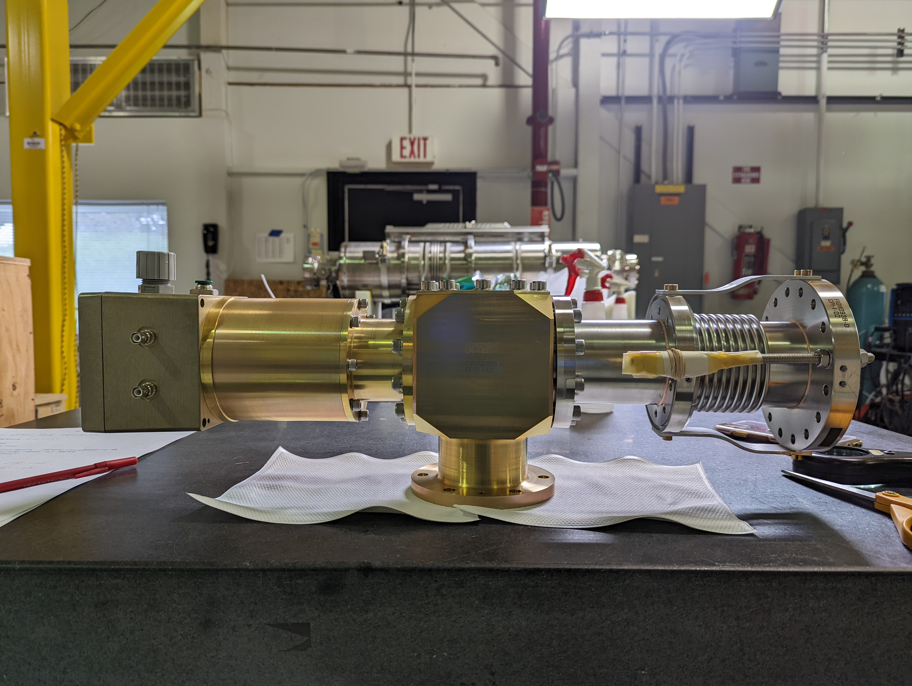
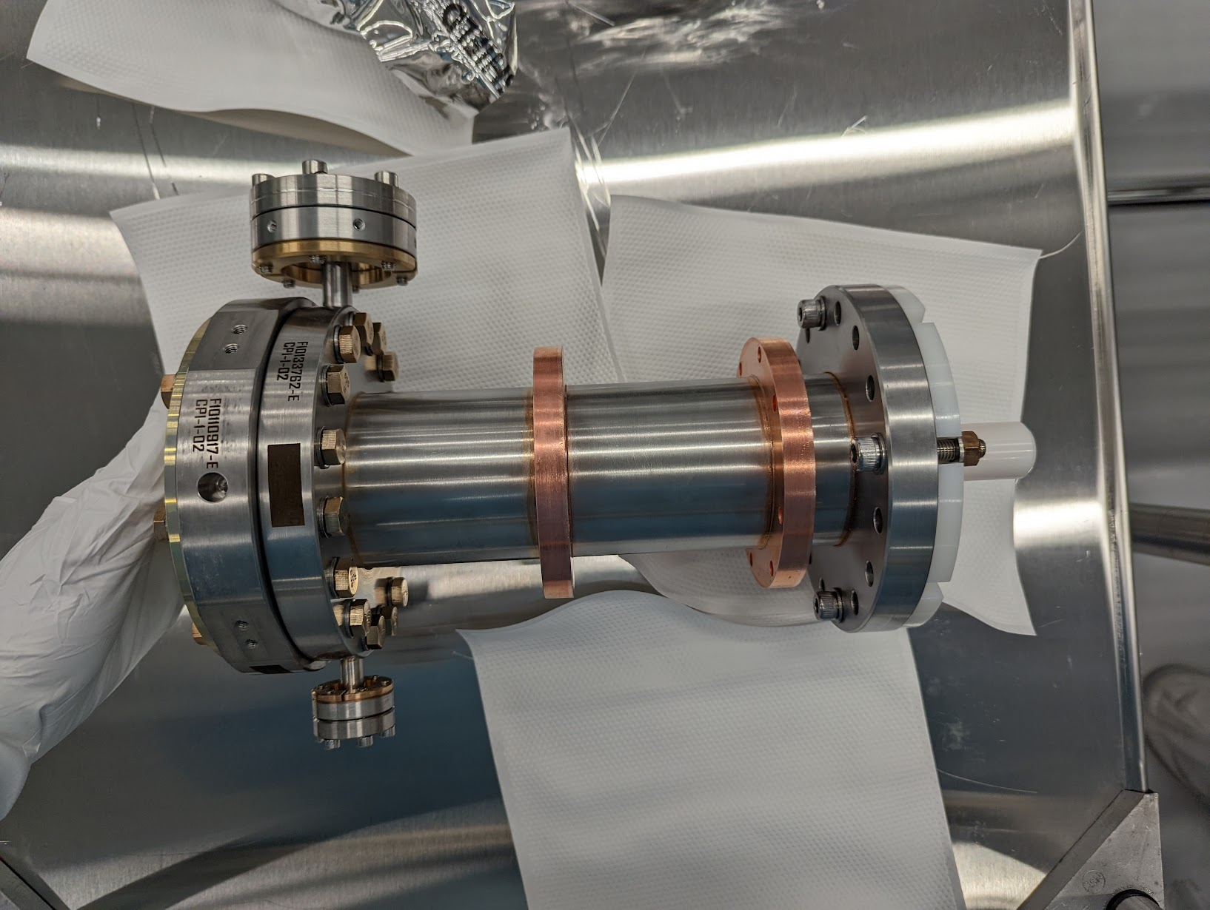
SSR2 Coupler status
ppSSR2 Coupler
4 out of 5 vacuum-end couplers received
5 out of 5 air side coupler accepted and stored at FNAL
First 2 couplers (CPI#1 & #4) were successfully tested at room temperature.

Slide 15
SSR2 coupler test stand (couplers 1 and 4)

Slide 16
Other side of the SSR2 coupler test stand

Slide 17
Testing protocol
Conditions:
Air flow rate ~3 g/s per coupler
DC bias 3.5kV – each coupler (parallel)
Cooling: radiators on window flange, 2 fans for cooling
Vacuum interlocks 2.e-6 Torr for both vacuum gauges
Window temperature interlock ~140 F (check?)
RF processing for each reflection phase (0, 90, 180, 270 deg)
Pulse mode (1 Hz): 10; 100; 300; 500 ms, power ramp up to 25kW; stay few min per short pulses, ~5min for 500ms at maximum power, if no MP
CW mode: ramp up power to 12kW. Stay >1.5 hours to reach equilibrium temperature
Diagnostics
Vacuum: 2 vacuum gauges on couplers and vacuum in pump line
Temperature: window flanges (2), chamber (1), DC blocks (2);
DC bias: voltage (1) and pick-up probes (2)

Slide 18
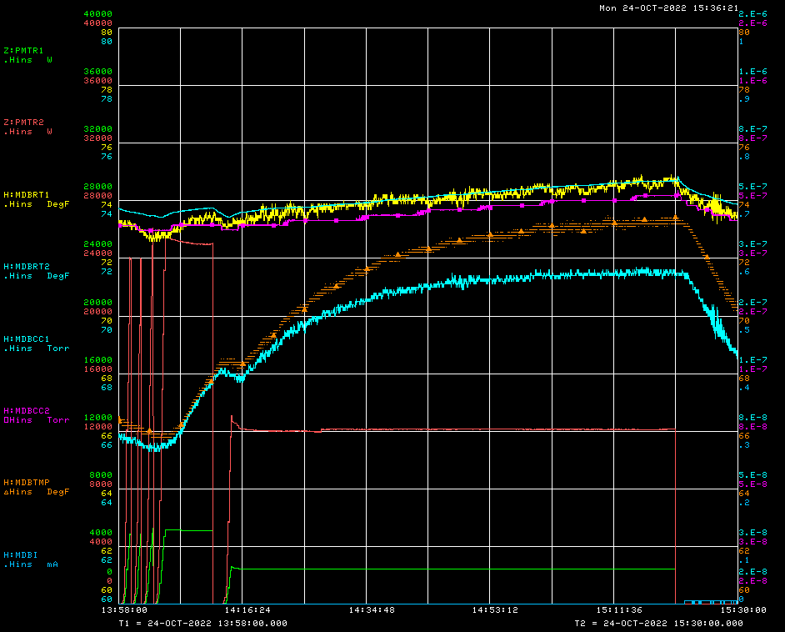
SSR2 couplers #1 #4
Phase = 90°
Bias ON; 3.5kV
Air flow=3 g/s (ea)
Pulse mode: 10, 100; 300; 500ms, P_{max} =24kW
CW mode (~1.5hrs) P_{max} =12kW
No MP
T _{window#1}
Vacuum#1
Vacuum#2
T _{chamber}
T _{window#2}
RF power

Slide 19
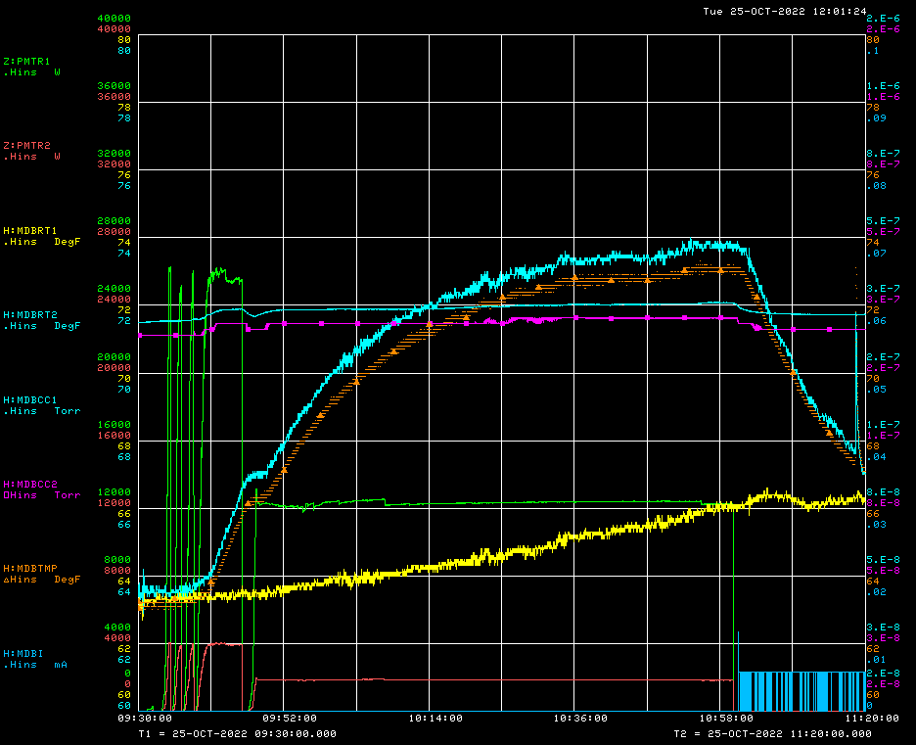
SSR2 couplers #1 #4
Phase = 0°
Bias ON; 3.5kV
Air flow=3 g/s (ea)
Pulse mode: 10, 100; 300; 500ms, P_{max} =24kW
CW mode (~1.5hrs) P_{max} =12kW
No MP
T _{window#2}
Vacuum#1
Vacuum#2
T _{chamber}
RF power
T _{window#1}

Slide 20
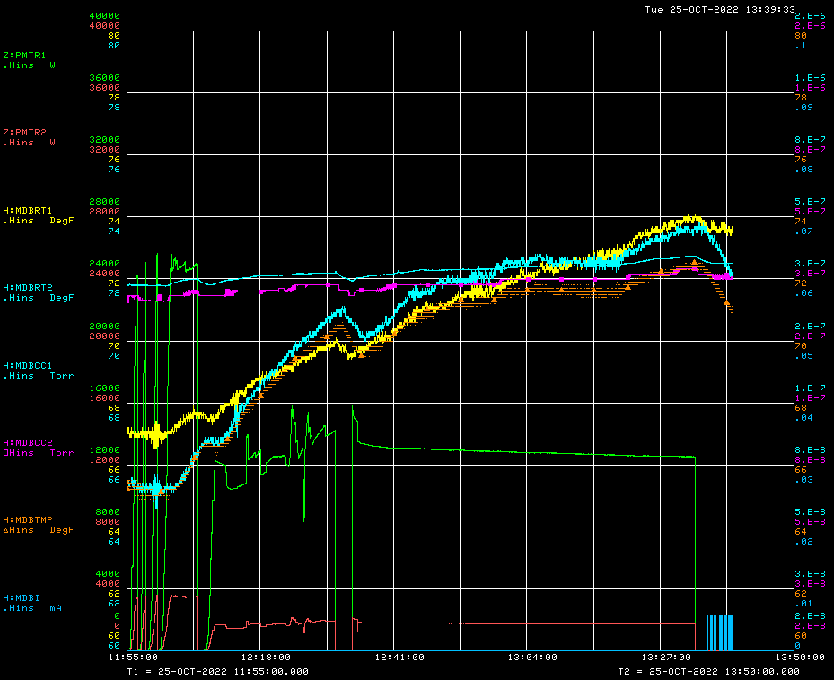
SSR2 couplers #1 #4
Phase = 180°
Bias ON; 3.5kV
Air flow=3 g/s (ea)
Pulse mode: 10, 100; 300; 500ms, P_{max} =24kW
CW mode (~1.5hrs) P_{max} =12kW
No MP
Vacuum#2
Vacuum#1
T _{window#1}
T _{window#2}
T _{chamber}
RF power

Slide 21
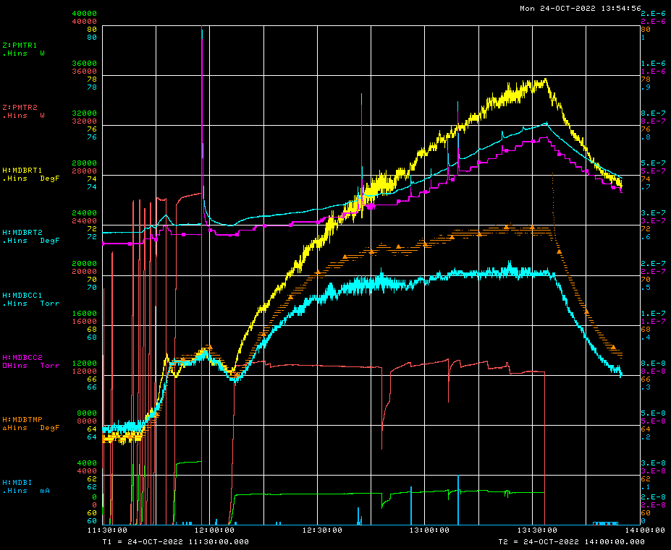
SSR2 couplers #1 #4
Phase = 270°
Bias ON; 3.5kV
Air flow=3 g/s (ea)
Pulse mode: 10, 100; 300; 500ms, P_{max} =24kW
CW mode (~1.5hrs) P_{max} =12kW
No MP
T _{window#1}
Vacuum#1
Vacuum#2
T _{chamber}
T _{window#2}
RF power

Slide 22
SSR2 couplers #1 #4
Summary
SSR2 pre-production couplers #1 and #4 were tested at RT stand in standing wave mode for 4 reflection phases: 0, 90, 180, 270 degrees. DC bias 3.5kV was applied for both couplers. Cooling provided by air flow through antennas, outside windows were cooled by 2 fans. Test done for pulse mode (10,100,300,500ms) with RF power up to 25kW and in CW mode for maximum power 12 kW (TRS). We stay at maximum power at least 1.5 hours to reach temperature equilibrium.
Test results:
No MP for all tested regimes. Vacuum increase follows the temperature rise
Maximum window flange temperature is < 80F (30C)

Slide 23
SSRs CM design
SPM: M. Parise Presenter: M. Parise

Slide 24
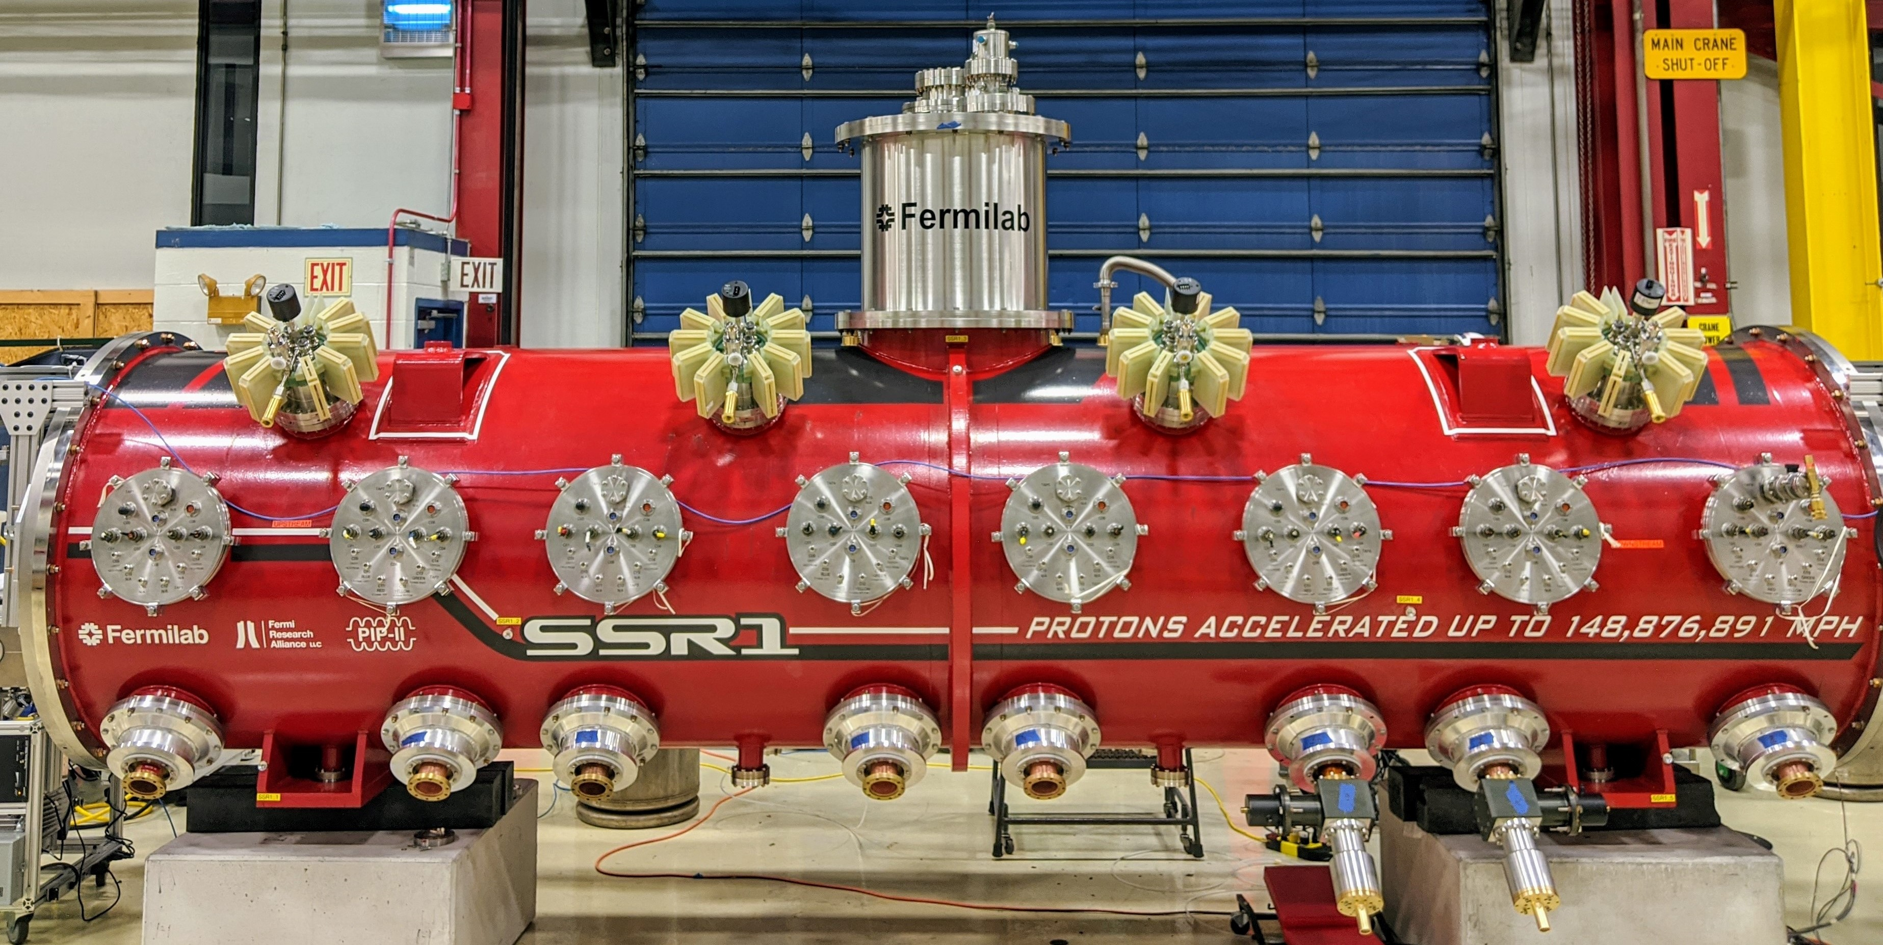
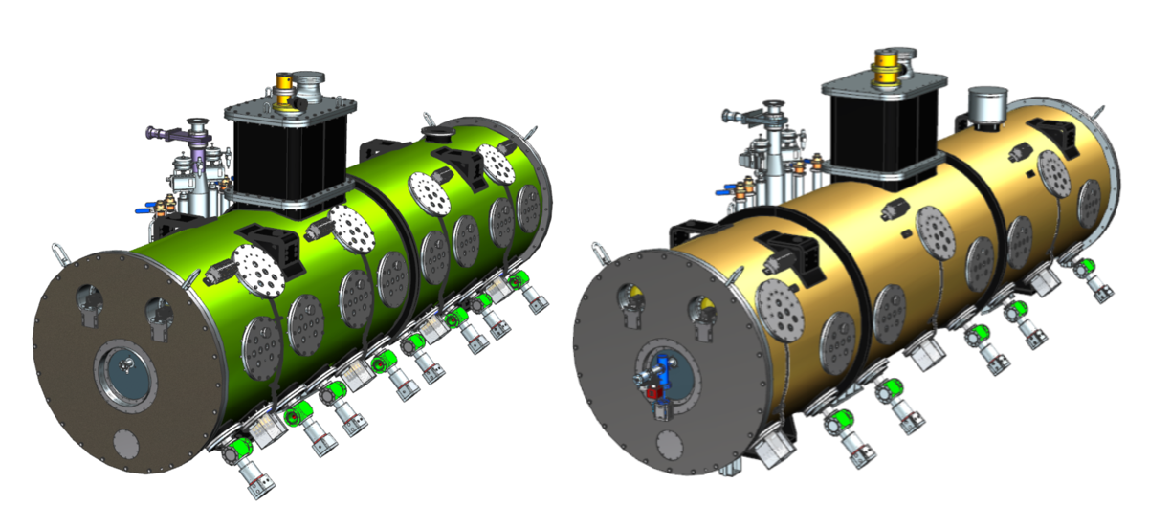
Pre-productionSSR2 CM: F10138829
Production SSR1 CM: F10142933

Slide 25
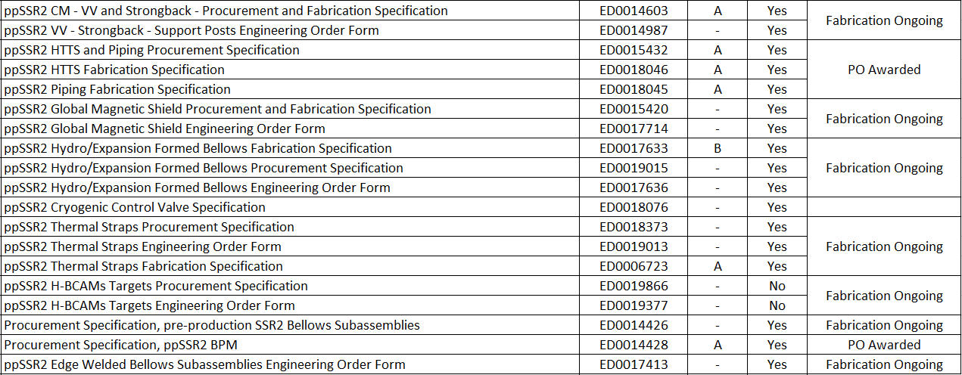
pp SSR2 CM
90+% of the procurement for the ppSSR2 CM was initiated.
Most of procurement and fabrication specification are completed and used to initiate the procurements. Check EPDM, Tab "Cryomodule"
Pre-production SSR2​ | ED0001257​

Slide 26
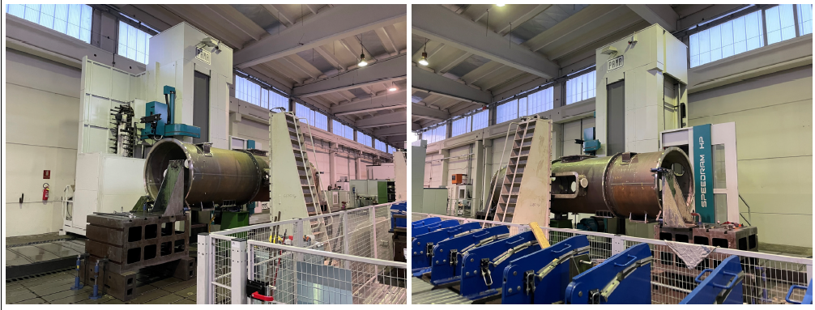
pp SSR2 CM: Vacuum Vessel Strongback Tray
Final machining of vacuum vessel is ongoing

Slide 27
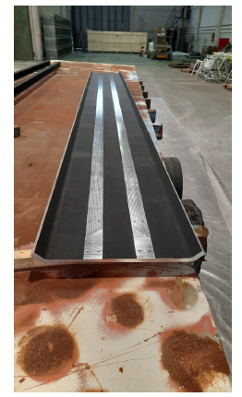
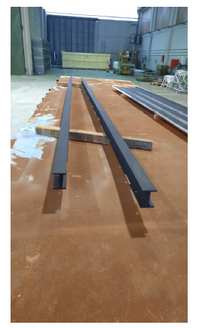
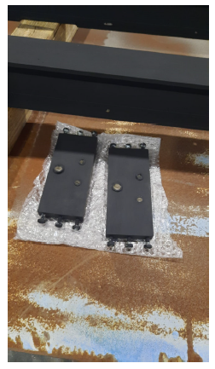
pp SSR2 CM: Vacuum Vessel Strongback Tray
Fabrication of strongback is ongoing

Slide 28
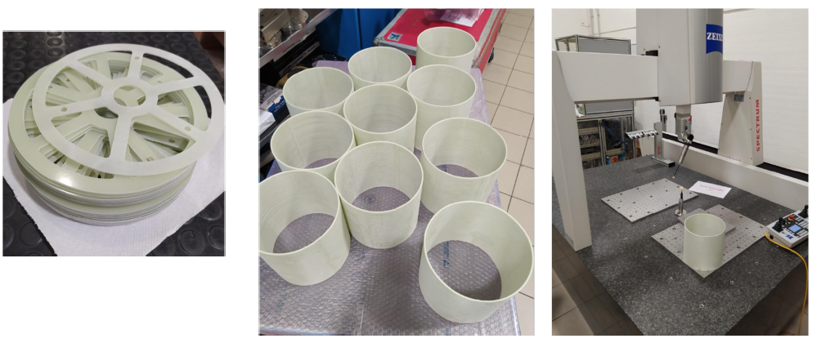
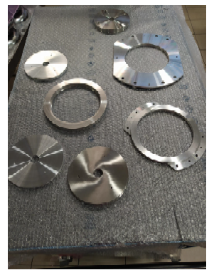
pp SSR2 CM: Vacuum Vessel Strongback Tray
Fabrication of support posts is ongoing

Slide 29
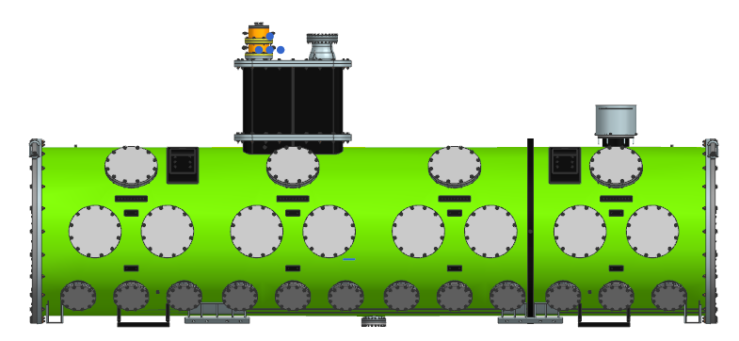
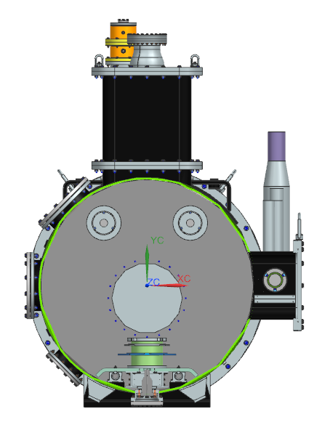
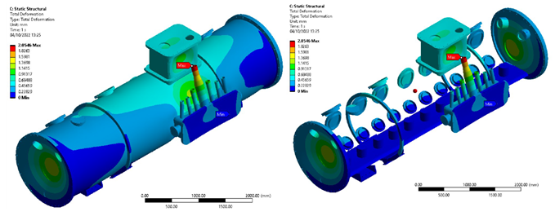
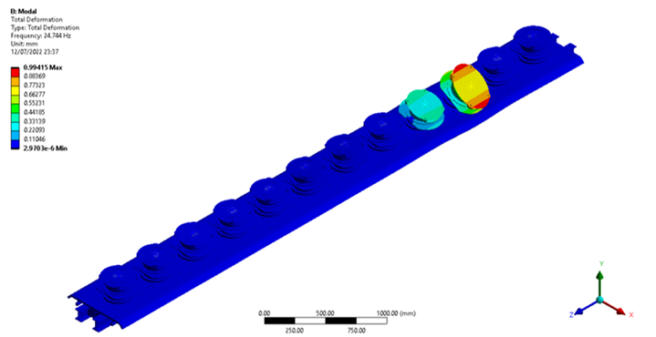
Production SSR1 CM
Analyses on production SSR1 vacuum vessel and strongback tray are complete, completion of drawings package is ongoing.
Thermal shield analyses are ongoing.

Slide 30
Action items from previous meetings
BARC: cavities tooling Technical discussion ongoing
BARC: Plan tuner Manufacturing Readiness Review Discussion in progress
Release TRS/ISD for the SSR2 cryomodule Released!!!

Slide 31
Action Items

