Slide 1
SAR 1 and SAR 2 Slides
Technical Integration Group
Chris Becker
Friday, Nov 11, 2022

Slide 2
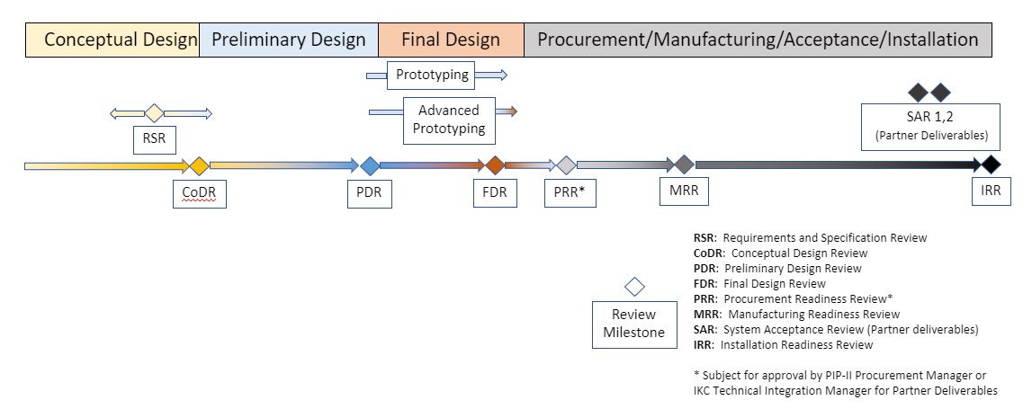
Review Milestone Flowchart
SAR (System Acceptance Review) 1 and 2 are towards the end of the Review Cycle
“Enable the transfer of ownership and technical risk associated with Partner deliverables from Partners to FNAL” (ED0008163)
Partners conduct SAR 1 to review deliverable and verifications
Acceptance is completed by FNAL with SAR 2
SAR 1 conducted pre-shipment to FNAL
SAR 2 conducted post-shipment and final FNAL verifications

Slide 3
Necessity of Acceptance Criteria for SAR 1 & 2
Sample Acceptance Criteria and Checklist sheet shown below
Acceptance Criteria needs to be defined for SAR 1 and 2 completion (prior to PRR) to ensure
- Proper verifications are identified
- Associated procedures are agreed upon by both parties
- Necessary verifications are included within procurement contracts as required
At a minimum, performance & critical interface verifications that are repeated for each serialized component are identified
Usually defined in TRS & ISD
Other critical repeated inspections can be identified (i.e. shipping criteria)
Example SAR Verification Table

